Slide 1
104 JOBBANK:
Towards Smart AI-Based Job Matching
Rick Lu
Chief Data Officer, 104 CORP.

Slide 2
Agenda
1. JOB BANK: Status, Challenges and Dreams
2. Why Open-Data? Why Hackathon?

Slide 3
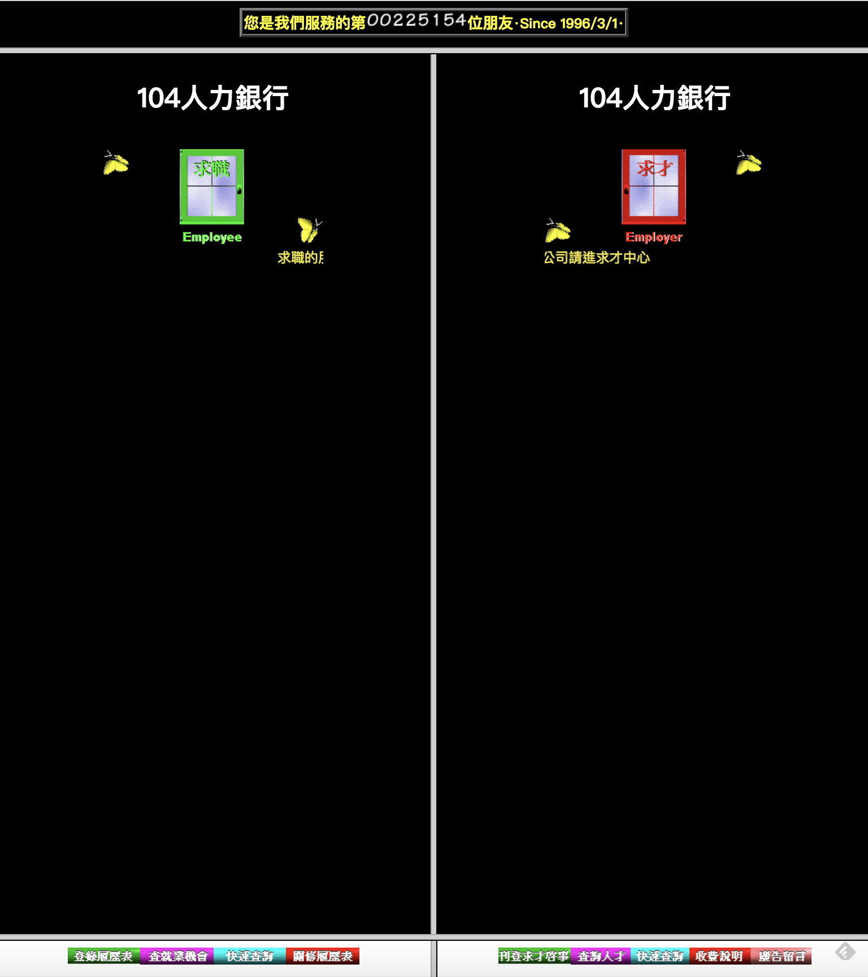
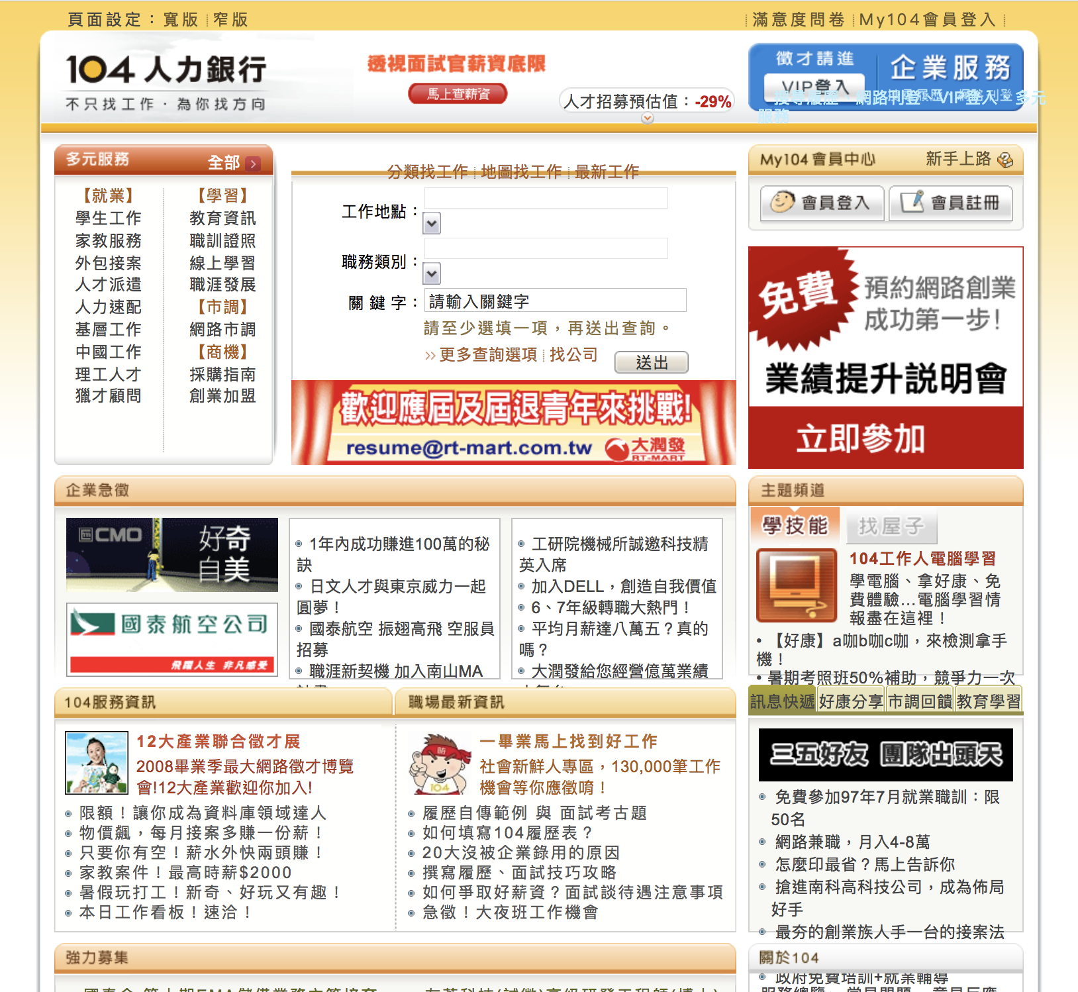
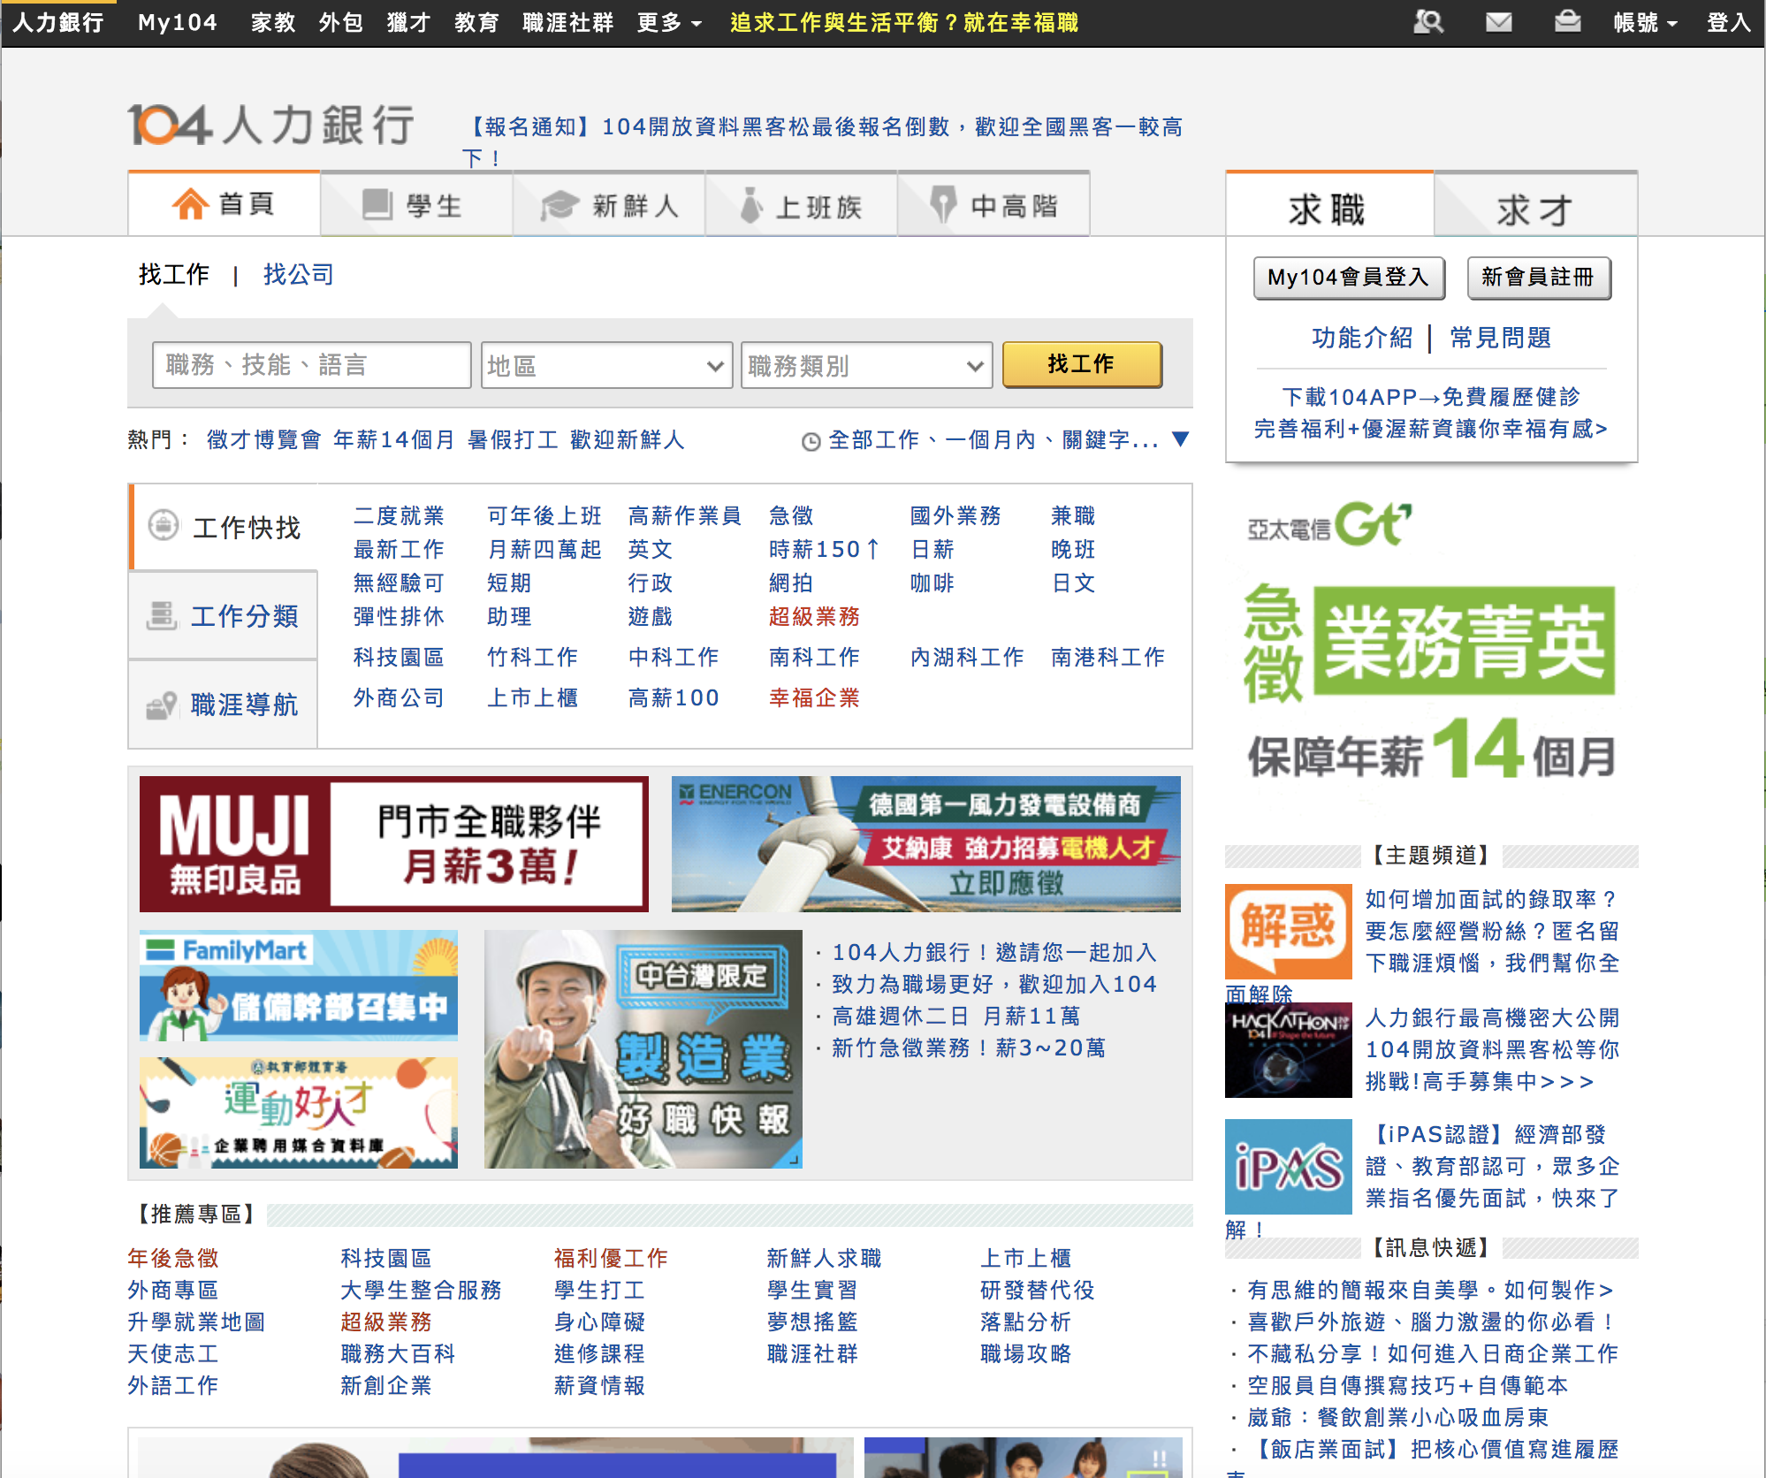
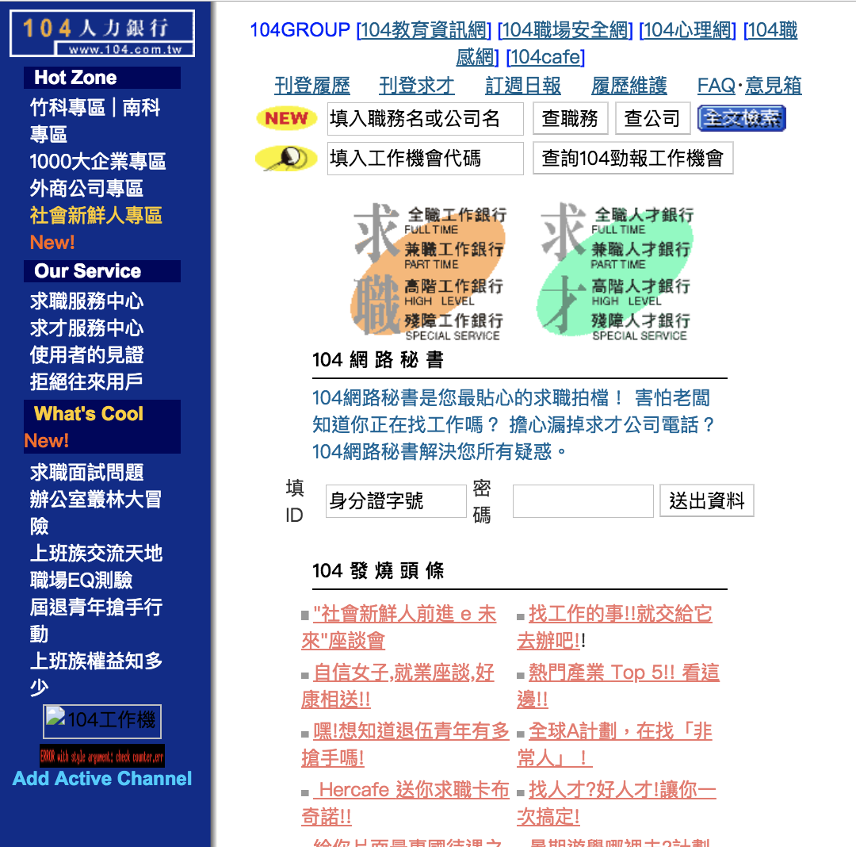
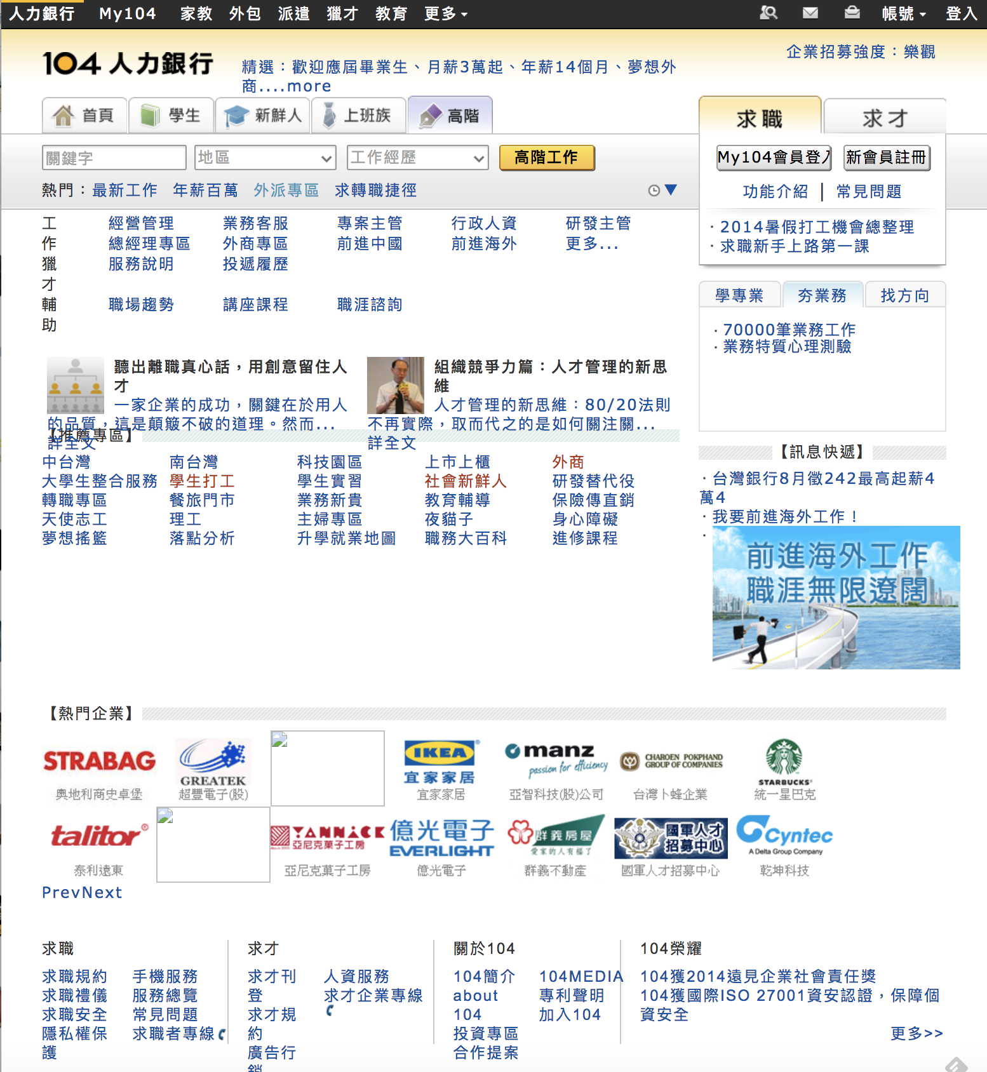
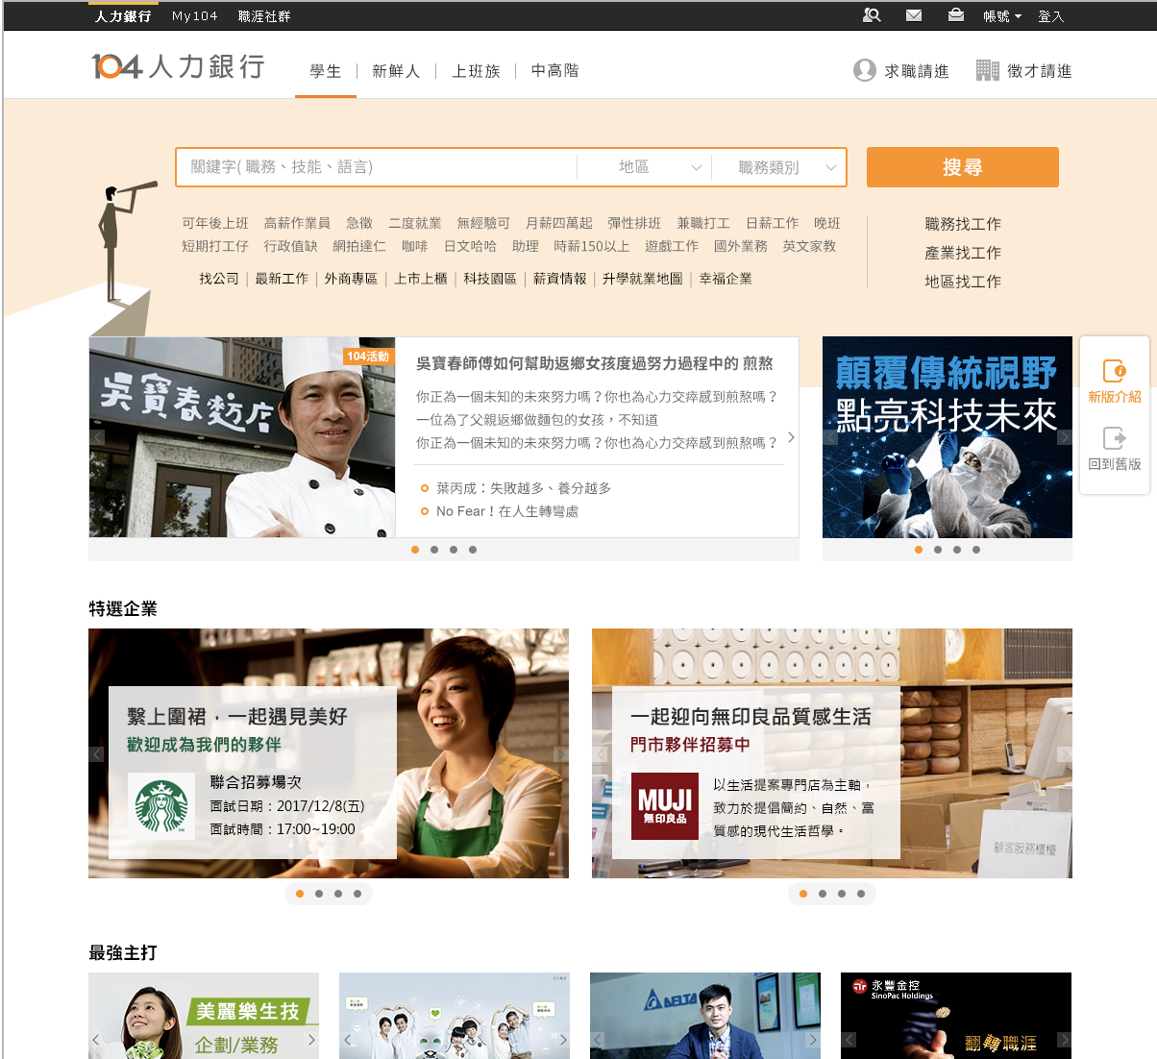
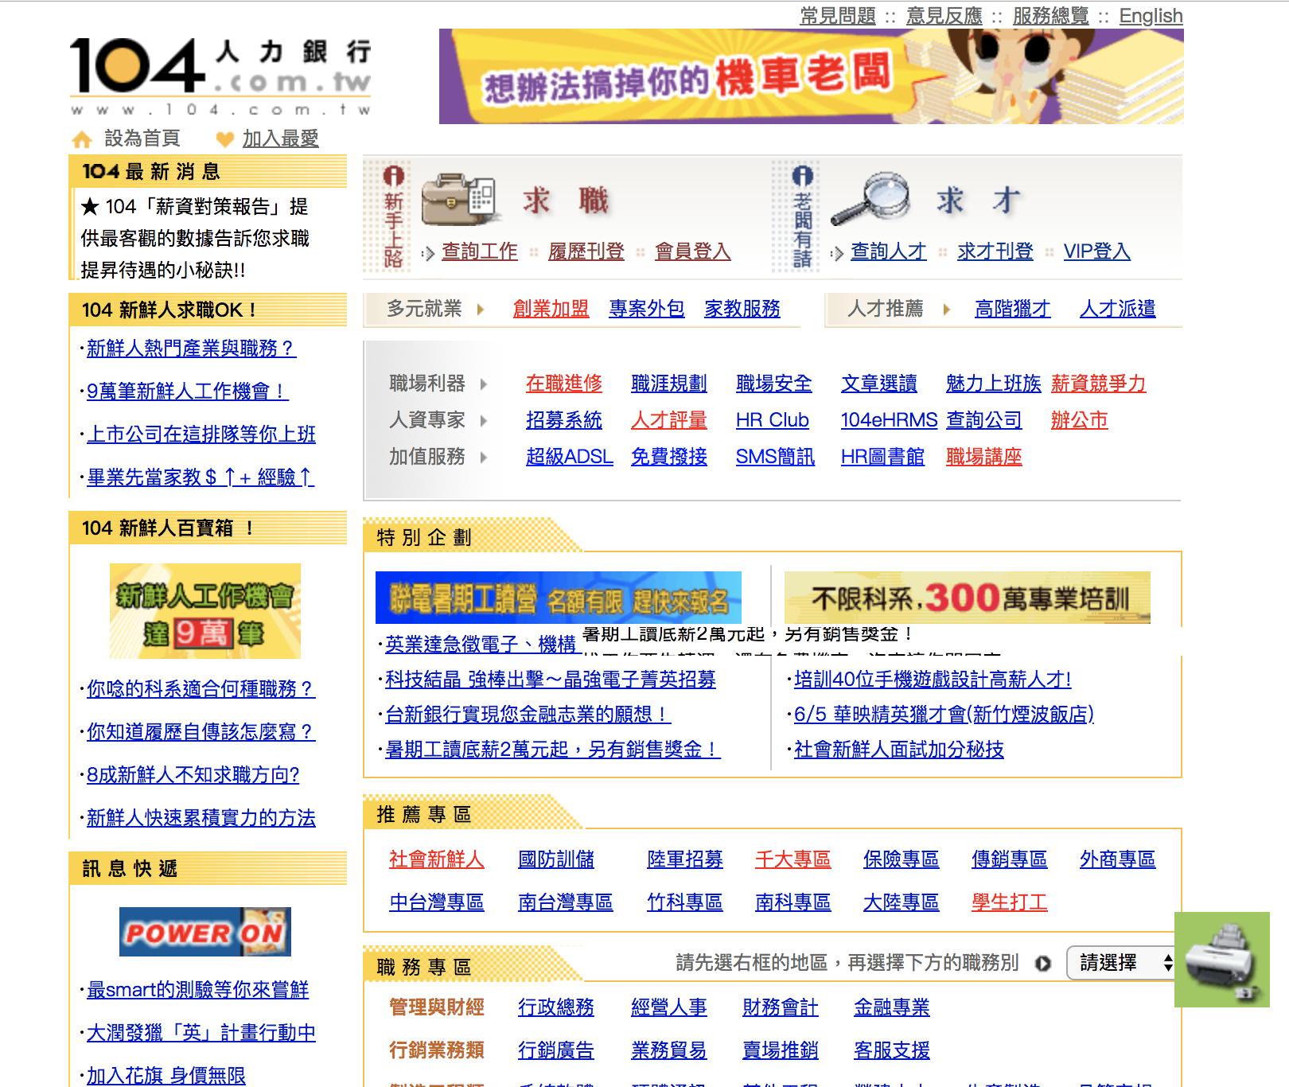
20 years: 104 dominates the job market in Taiwan
1996
2008
2016
2000
2014
2018
2004

Slide 4
What data in 104?
7.5
RESUMES
50
JOBS
300
BEHAVIORS
Millions
Millions
Billions
Resumes, majority of Taiwanese. ➔ Millions
Jobs, high coverage of Taiwan market. ➔ Billions
Behaviors, HR vs Candidate ➔ Trillions⁺
Notes:
The difficulties of alg. Inventory-limits and temporal-window-candidate.

Slide 5
Data in 104
From a RESUME
From a JOB
PROFILE: Gender, Age, Location
SKILL
SCHOOL: high school, BS, MS, PhD.
FAMILY
COLLEAGUE
INTEREST
PERSONALITY
  SOCIAL-OPINION*
  ……
INDUSTRY: Key company, title, salary
COMPANY GRAPH: division, department
SKILL GRAPH
CREDIT RATING*: default records, Labor-check,
SOCIAL-OPINION
…..

Slide 6
Challenges and Dreams
Analysis of content and user-behavior and ML Model
  ➔unlimited storage for long-term job matching issue
User-friendly Interface and User-experience
Lack of social-opinion Data ➔applying state of art models, e.g., NN, LSMC, Logistic Reg.
Notes:
The difficulties of alg. Inventory-limits and temporal-window-candidate.
Economics billing and

Slide 7
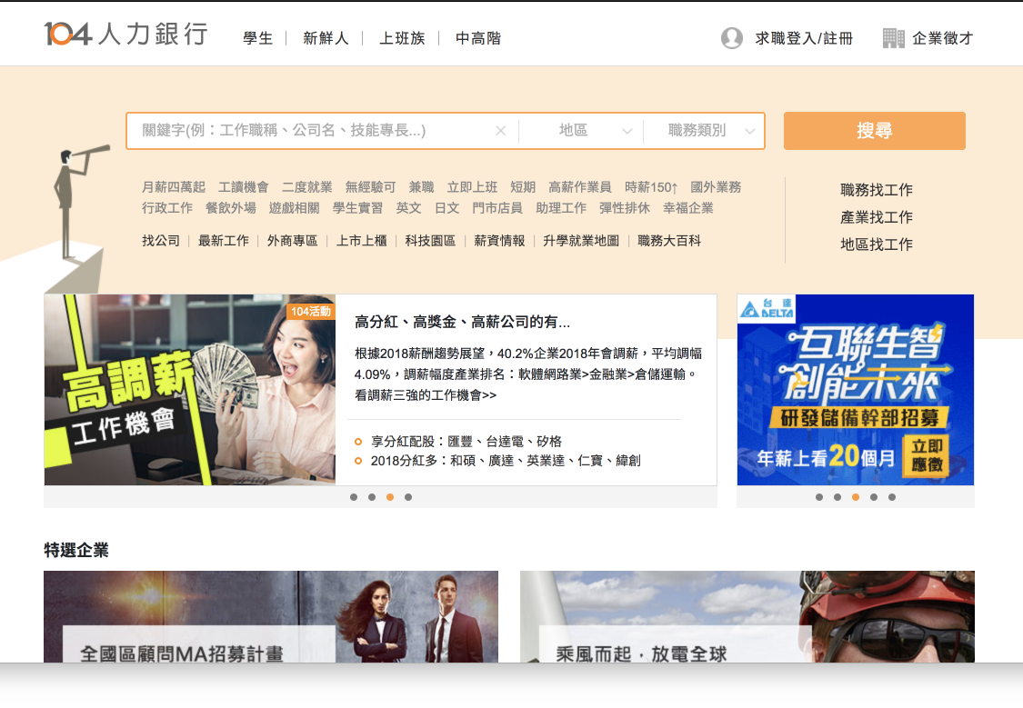

Slide 8
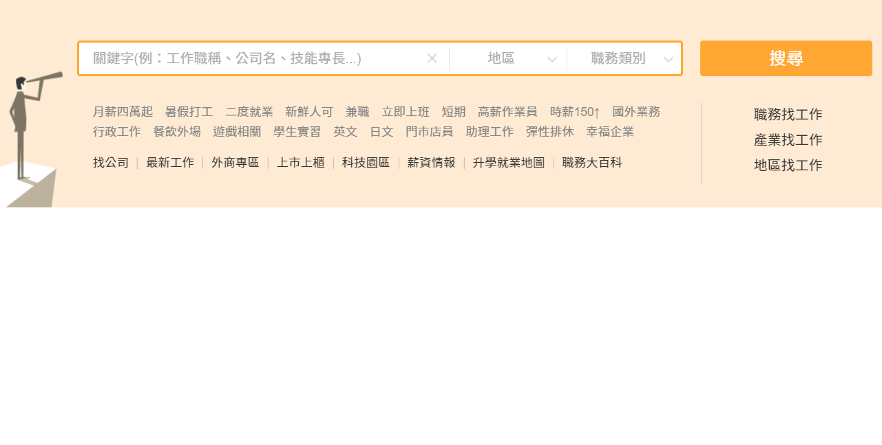
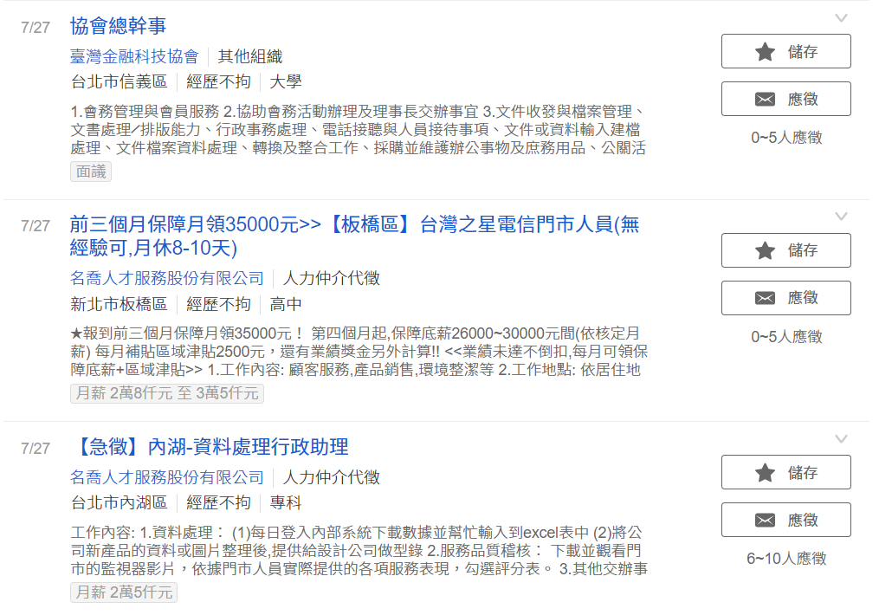
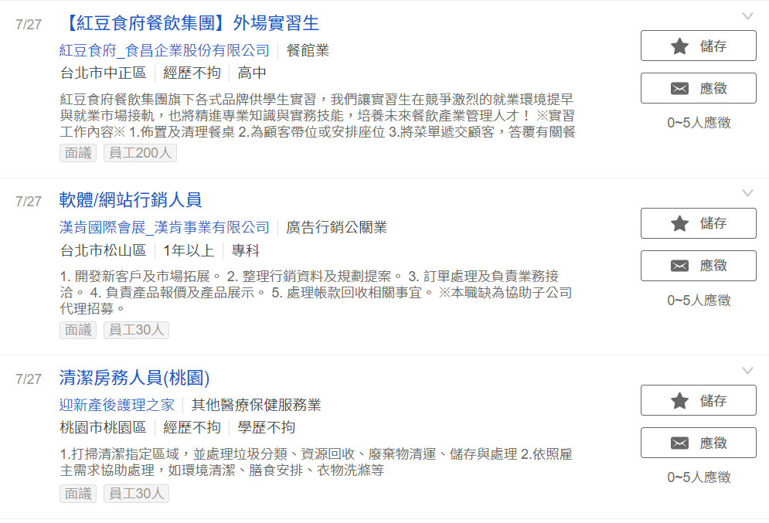
Experiement. 7/19~7/24
舊排序 5%
新排序 5%

Slide 9
媒合數增加 45%

Slide 10
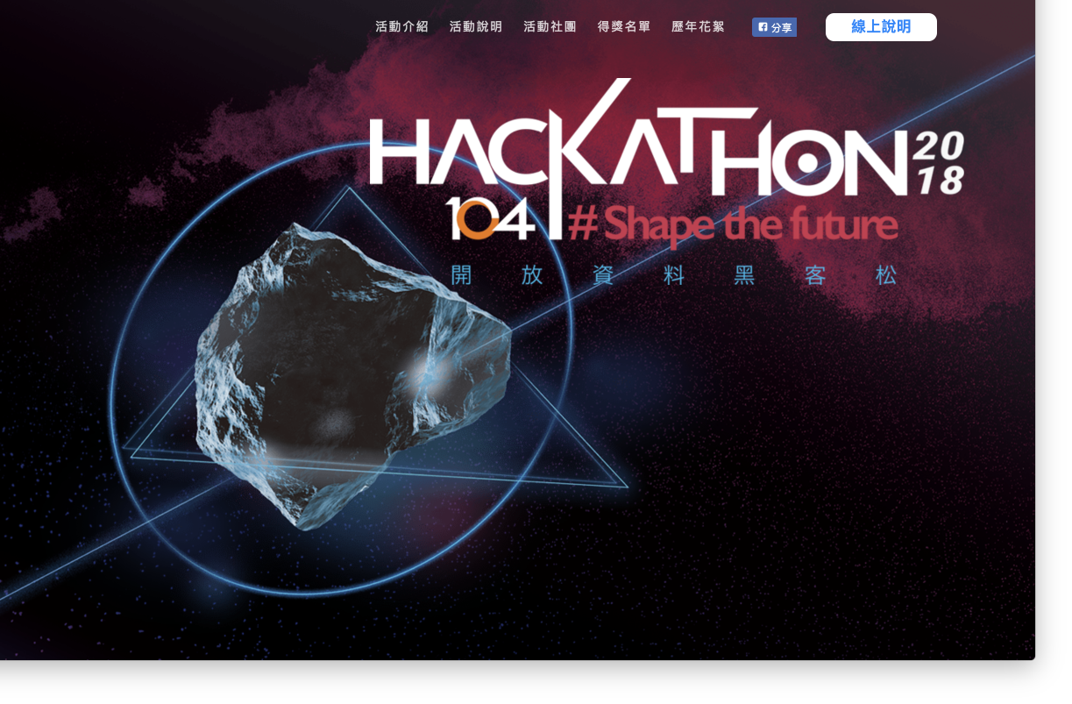
104’s Open Data

Slide 11
 | 瀏覽頁數 | 人數
日期排序 | 1468692 (67%) | 28648
相關性排序 | 689812 (31%) | 27018
其他排序 | 33997 (2%) | 1227

Slide 12
主動應徵增加 20%

Slide 13
Thank you!

