Slide 1

Bloodborne Pathogens
Hospital X Safety and
Compliance Training
Notes:
Pre-presentation prep:
*Log into the Zoom session 10 minutes before training session start time.
*Ensure Producer is logged in and is given cohost privileges.
*Participants should be assigned to the waiting room until they are let in by the Producer no earlier than five minutes before training start time.
*Check your sound output and video camera settings to ensure connectivity and access.
*Review Facilitator Guide completely before class begins, noting areas that need clarification with the Producer.
*Check expected attendance records and contact emails for participants who have signed up in the event of connection/attendance issues.
*Ensure subtitles have been selected from PPT tools and follow any prompts to ensure microphone access.
*Note within each slide there are areas that say (click) before the verbiage to be read. *DO NOT SAY CLICK. That is an indication for you to click to reveal the information on the slide that aligns with the verbiage to be read by you. You might use your mouse to click, or the space bar on your keyboard.
*Time has been built into the overall presentation time to allow for additional questions that may arise throughout the course and at the end. Please refer back to slide information as needed to reiterate concepts that need clarification.
Say:
As we wait for all participants to be let into the room, take a moment to please silence outside distractions such as cell phones. While we are waiting please make sure you have your participant guide for this training.
Wait:
3 minutes post scheduled start time to begin next part.
Say:
Welcome to the Hospital X Bloodborne Pathogens Safety and Compliance Training. I am __(your name and role in company)___, and I will be your facilitator today. Behind the scenes we have __(Producer name and role in company)_, who will be acting as our tech assistant as well as the chat moderator. Please put any questions or technical needs in the chat. In the same fashion, please keep the chat free from side chatter unrelated to the training to ensure we are able to address your questions and needs as soon as reasonably possible.
This will be a 60 minute training with a final quiz to be taken after. The final quiz should not take more than 15-20 minutes, but you will be given more time if needed. You can expect to be finished with the training and quiz within 90 minutes.
During the training you will be asked to fill in sections in your participant guide. Again, please make sure you have that handy with a pen or pencil to complete your tasks.
We value your time and want to ensure you get the most out of this training. Please note it is company policy to have your video camera on during the length of the presentation. Your time today will be documented and added to your weekly pay for hours worked. Let’s get started.
Do:
Advance to next slide.

Slide 2
Agenda
Course Goals and Objectives
Bloodborne Diseases Overview
Bloodborne Pathogens
Exposure and Transmission
Preventing Exposure
Post Exposure Procedures
Notes:
Say:
Let’s begin by going over the agenda for today’s training.
Do:
Click to reveal each section of the course as you read each section title that appears.
Do:
Advance slide when agenda introduction is complete.

Slide 3
Course Goals
Increase Employee Safety
There is always some risk of infection through exposure.
Proper Identification and Handling Procedures
Knowing these will help you apply safe practices in the workplace.
Exposure Control Plan
Know it. Use it.
Notes:
Say:
Let’s begin with the goals of this course. Essentially, why are you taking this training?
Do:
Click to display each section below reading the description with each section as indicated before each verbal cue in parenthesis. (Click)
Say:
(Click) Working in medical environments can be an extremely rewarding career. As an individual working in these environments, the position carries some risks of infection through exposure. The goal of this course is to help you function safely within our healthcare facilities.
(Click) The best way to keep our employees safe from exposure is through proper identification and handling procedures if you are exposed to a contamination. As you learn how to apply safe workplace practices in tasks potentially involving bloodborne pathogens and biohazardous materials, you will control your exposure and stay healthy on the job.
(Click) Hospital X has an Exposure Control Plan, which identifies the jobs and tasks where potential exposure can occur. It is essential to know and understand these safety procedures, but it is equally important that you follow the protocols in the Exposure Control Plan to ensure the best possible outcome of a potential exposure.
Do:
Advance to next slide.

Slide 4
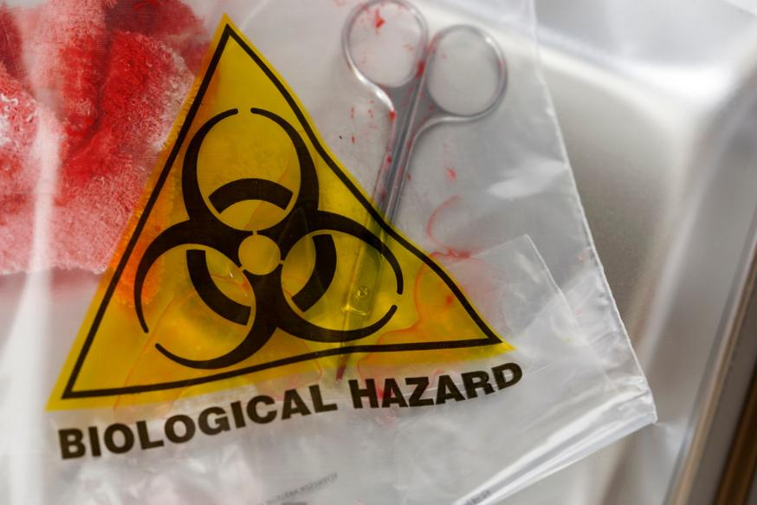
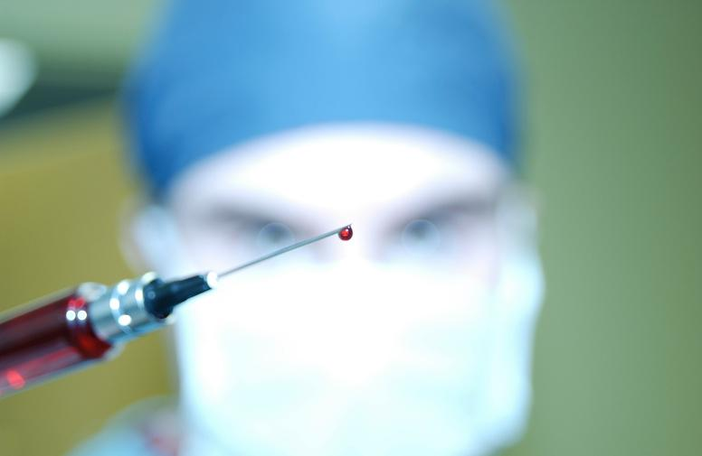
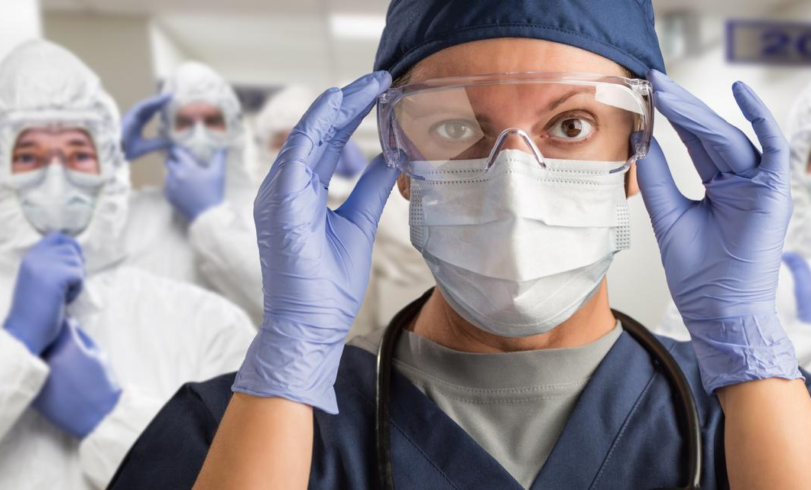
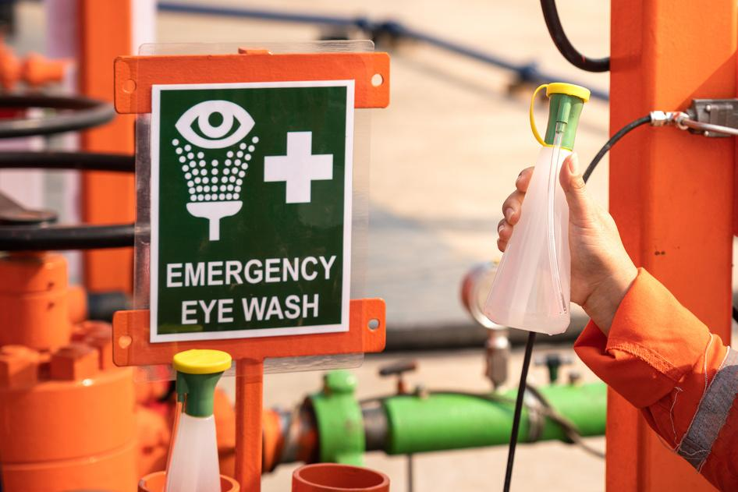
Course Objectives
Recognize hazardous contaminated items in the workplace.
Identify methods of exposure to avoid contamination.
Demonstrate how to control exposure to hazardous items.
Conduct post exposure procedures in the event of an exposure incident.
Notes:
Say:
By the end of this course, you will be able to
(Click) Recognize hazardous contaminated items in the workplace.
(Click) Identify methods of exposure to avoid contamination.
(Click) Demonstrate how to control exposure to hazardous contaminated items.
(Click) Conduct post exposure procedures in the event of an exposure incident.
Do:
Advance to next slide.

Slide 5
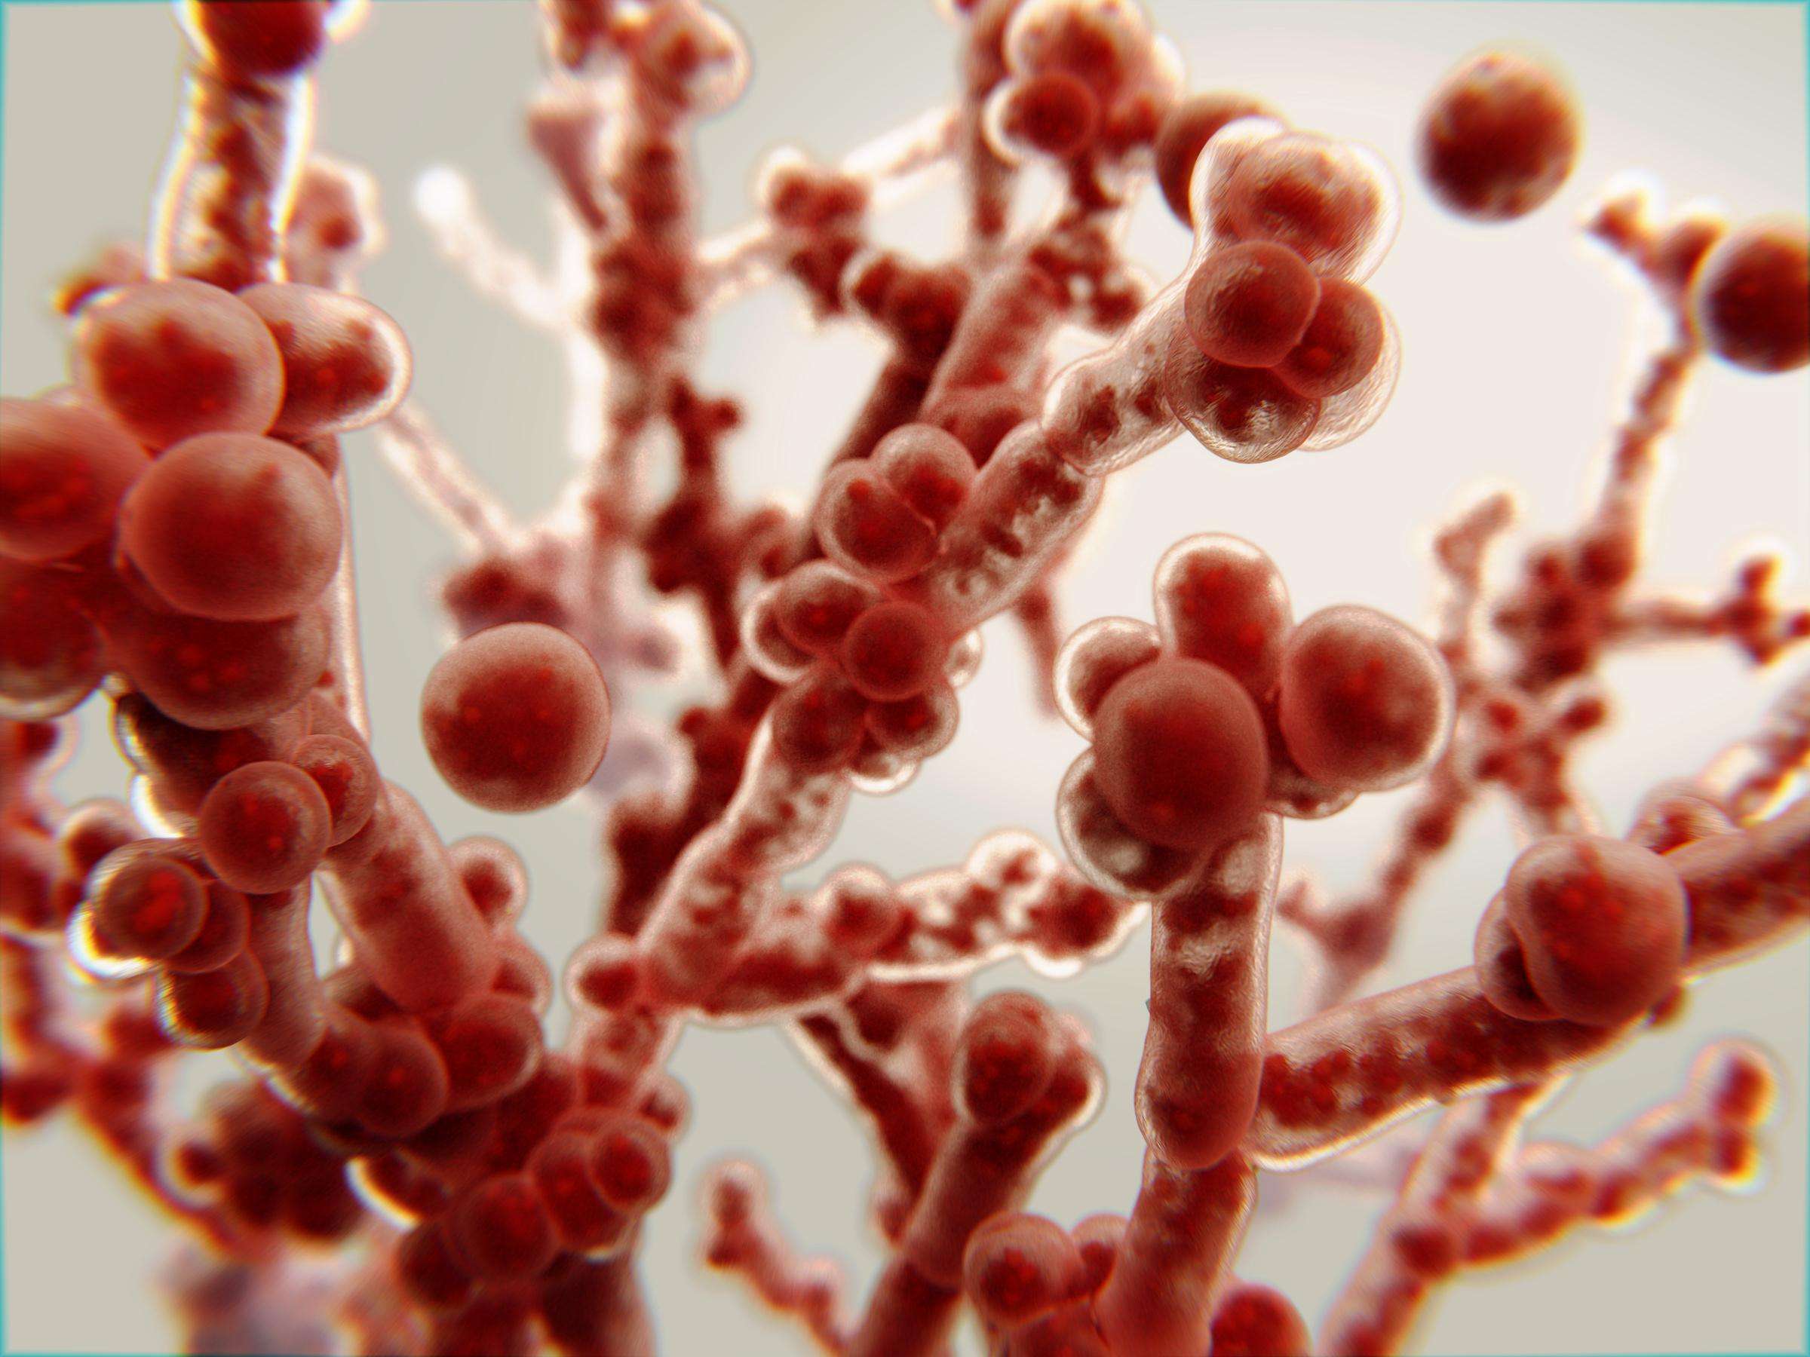
Bloodborne Diseases
Pathogens of Concern
Risks of Pathogen Exposure
Notes:
Say:
The first section we will dive into is Bloodborne Diseases. Many bloodborne diseases still exist today, despite the prevalence of vaccinations against viruses and improved access to medical care and treatment for bacterial infections. In this section we will cover two concepts:
(Click) Pathogens of concern. Though there are many more pathogens that healthcare workers and hospital staff could potentially be exposed to, we will cover a select few that data indicates are of highest concern.
(Click) Risks of Pathogen Exposure.
Do:
Advance to next slide

Slide 6
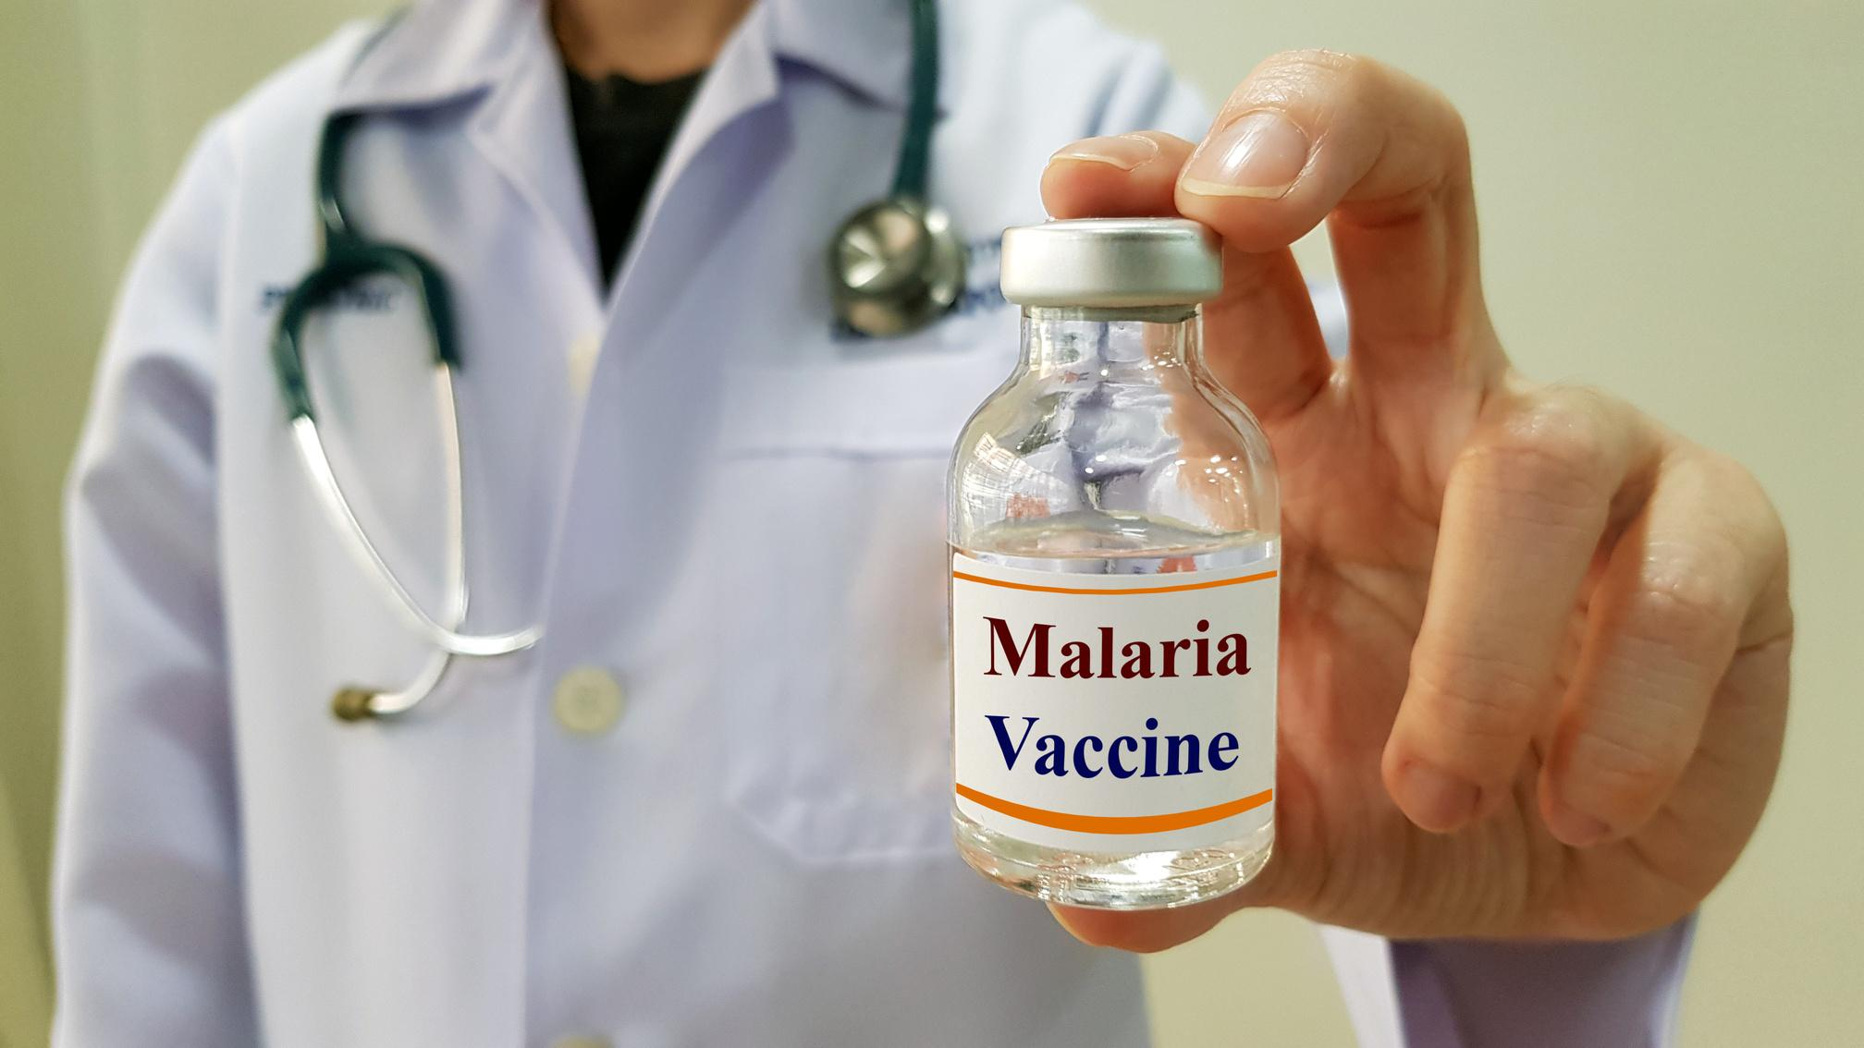
Bloodborne Diseases Overview
  Present serious risk
  Preventable
Examples:
  Zika
  Ebola
  Malaria
  Syphilis
Notes:
Say:
(Click) Bloodborne diseases can present a serious risk to infected individuals, (Click) yet they can be prevented with proper precautions.
(Click) You might have seen some of these bloodborne diseases in the news in recent decades, such as (Click) Zika or (Click) Ebola viruses.
Other bloodborne diseases you may have heard of are (Click) malaria and (Click) syphilis.
Do:
Advance to next slide

Slide 7
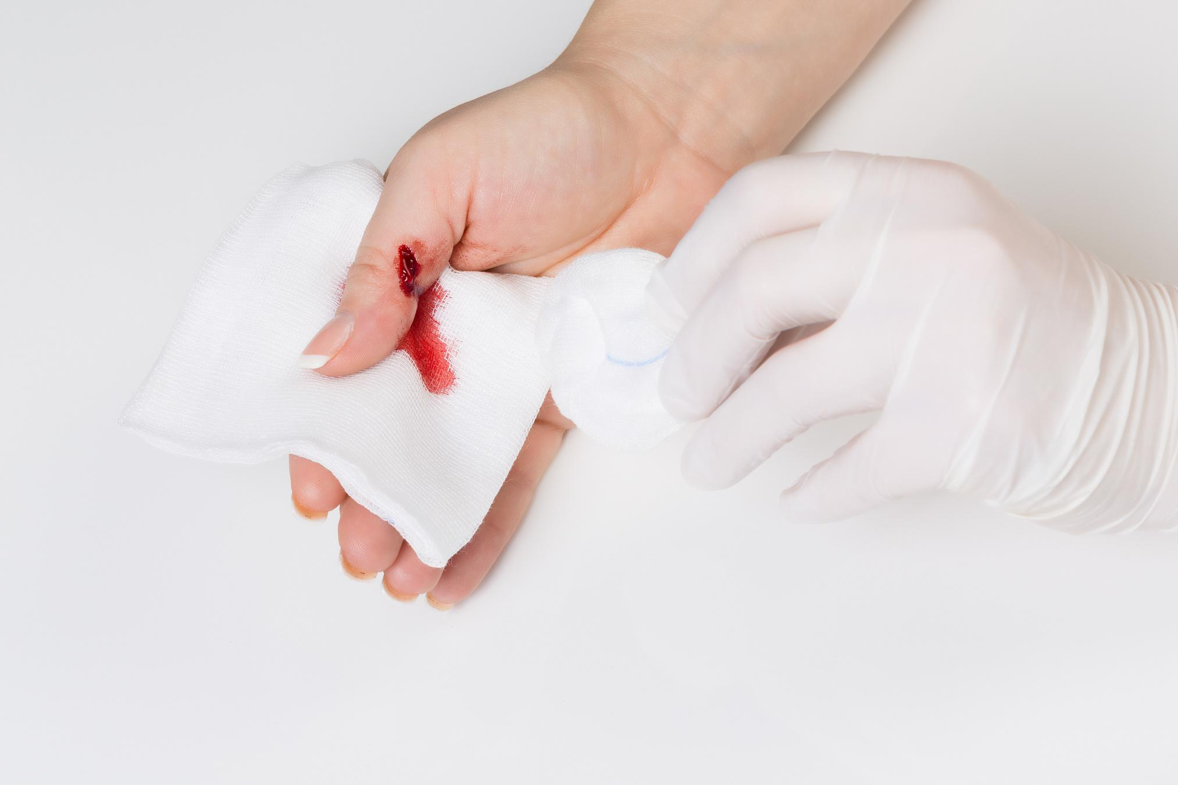
Specific Routes of Infection
  Direct contact
  Needles or other sharp objects
  Sexually transmitted infections (STI's)
  Mother to child
  Bodily fluids
Notes:
Say:
Bloodborne diseases often have specific routes of infection.
(Click) Infection with bloodborne pathogens occurs through direct contact with contaminated blood or blood products.
(Click)These include contact with blood through needles or other sharp objects, (Click) sexually transmitted infections, or STI’s (Click) and transmission from mother to child during pregnancy or at birth.
(Click) Bloodborne pathogens can also be transmitted through contact with other bodily fluids.
Ask:
What do you think are the most common bloodborne pathogens you might be exposed to in a workplace or everyday situation? Take a minute to think about this. Feel free to answer with your guesses in the chat, but hold off on hitting enter until I call time. I will give you two minutes. (give two minutes for participants to complete this task)
Do:
Start a 2 minute timer. When time is up, ask participants to hit enter. Review the chat and point out the answers that are most common in the chat.
Do:
Advance to next slide.

Slide 8
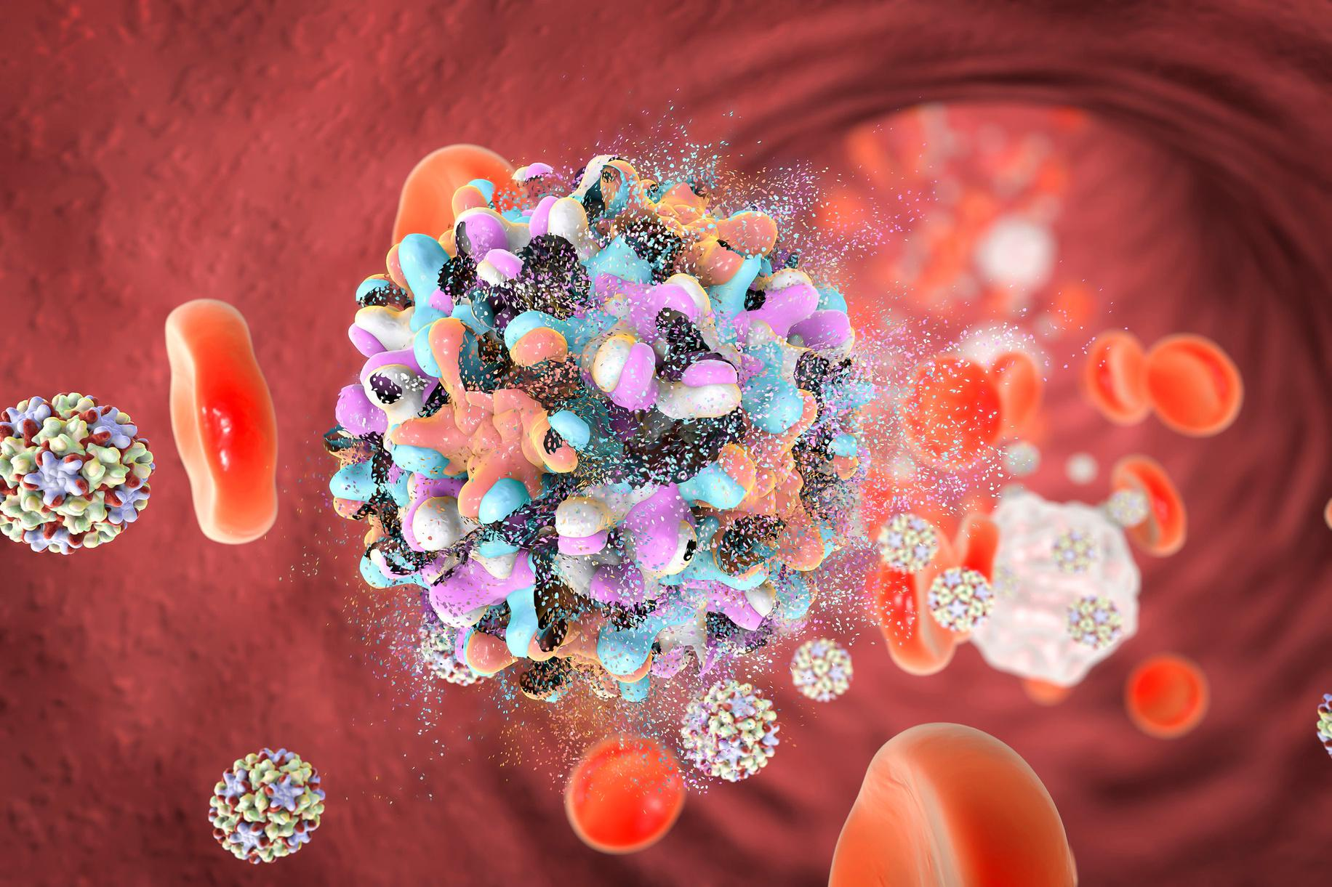
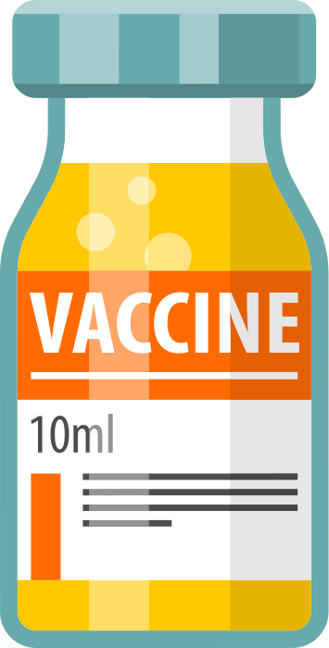
Pathogens of Concern
Hepatitis (HBV)
  Liver infection
  Fatigue, poor appetite, nausea, stomach pain
  Jaundice
Risks
  Can become chronic
  Cancer
  Cirrhosis
Vaccine Available
Notes:
Say:
The most common bloodborne pathogens you may be exposed to in a workplace or everyday situation are Hepatitis B, Hepatitis C, and HIV. The Occupational Health and Safety Administration, or OSHA, considers these pathogens to be the most common pathogens of concern, and are the primary focus of this course. All three of these viruses can infect people through various methods and can cause serious illness.
(Click) Let’s start with Hepatitis B. Hepatitis B is a (Click) liver infection caused by the Hepatitis B virus, or HBV as indicated in parenthesis above.
(Click) Symptoms can include fatigue, poor appetite, nausea, and stomach pain.
(Click) Jaundice is another common symptom of Hepatitis as the liver function is compromised.
(Click) What are the risks of Hepatitis B? For most people it is a short-term illness. However, (Click) it can turn into a long-term, chronic infection with life-threatening issues (Click) like cancer or (Click) cirrhosis of the liver.
(Click) Fortunately, HBV is preventable with a vaccine, which is the essential prevention measure against this disease.
Do:
Advance to next slide

Slide 9

Pathogens of Concern
Hepatitis C (HCV)
  Liver infection
  No symptoms until advanced liver disease presents
Risks
  Advanced liver disease
  Other life threatening health problems
NO Vaccine Available
Notes:
Say:
(Click) Similarly, Hepatitis C is another type of (Click) liver infection, but this one by the Hepatitis C virus, or HBC.
(Click) However, people infected with HCV often have no symptoms and do not feel sick. Symptoms that do appear are often the result of advanced liver disease.
(Click) And one of the risks of Hepatitis C is (Click) advanced liver disease.
(Click) As the liver malfunctions this could lead to other life threatening health problems.
(Click) Unfortunately, there is currently NO vaccine available to prevent the virus from infecting you. The best prevention is to avoid risky behavior like injecting drugs.
Do:
Advance to next slide

Slide 10
Pathogens of Concern
AIDS
  Caused by human immunodeficiency virus (HIV)
  Flu-like symptoms
  May be asymptomatic
  Immunocompromised
Risks
  Compromised immune system can lead to
additional health issues
NO Vaccine Available
Notes:
Say:
The third of the three most prevalent pathogens of concern is AIDS. (Click)
Aids is the disease (Click) caused by the human immunodeficiency virus, or HIV. HIV attacks the body’s immune system and can lead to the development of AIDS if left untreated. Prior to the development of AIDS, HIV-positive individuals may have acute and/or chronic HIV infections.
(Click) Signs of infections include (Click) flu-like symptoms, (Click) but some people may not feel sick at all. Acute and chronic infections may progress slowly, taking up to a decade.
(Click) With the development of full-blown AIDS, people may be immunocompromised and subject to several illnesses.
(Click) Additional risks of AIDS are a compromised immune system (Click) which can lead to (Click) additional health issues and life threatening illness.
(Click) While there are some treatment options available to reduce the severity of symptoms and transmission, there is currently NO vaccine available to prevent HIV infection.
Before moving into the next section, let’s test your understanding.
Do:
Advance to the next slide.

Slide 11
Knowledge Check
Mentimeter
Click on the link in the chat and follow the directions you see on the screen.
6947-0533
Use this code to access the poll.
Notes:
Say:
(Click) In just a moment, our Producer will post a link in the chat for a single question hosted in Mentimeter.
(Click) You should not need the access code listed on the right of the screen, but it is there in the event of a tech malfunction with the link. If the link does not work, please post a note in the chat and our Producer will help you out. The answers are anonymous. This does not affect your grade in the course. It is just a quick check of your understanding. Once you have answered the question, go ahead and return to the slide show and I will post the results.
Do:
As participants are answering, have the producer access the Mentimeter poll. Assess completion of the task by the number of participants who have answered. Once all participants have answered, the producer will share it with the audience.
Say:
As most (or all) of you know, Hepatitis B is the only one of the three main pathogens of concern that has a vaccine available as a preventative measure. For all bloodborne pathogens, avoiding risky behaviors where bodily fluids can be transferred, or the sharing or reuse of needles occurs, is best prevention.
Do:
Advance to next screen.

Slide 12
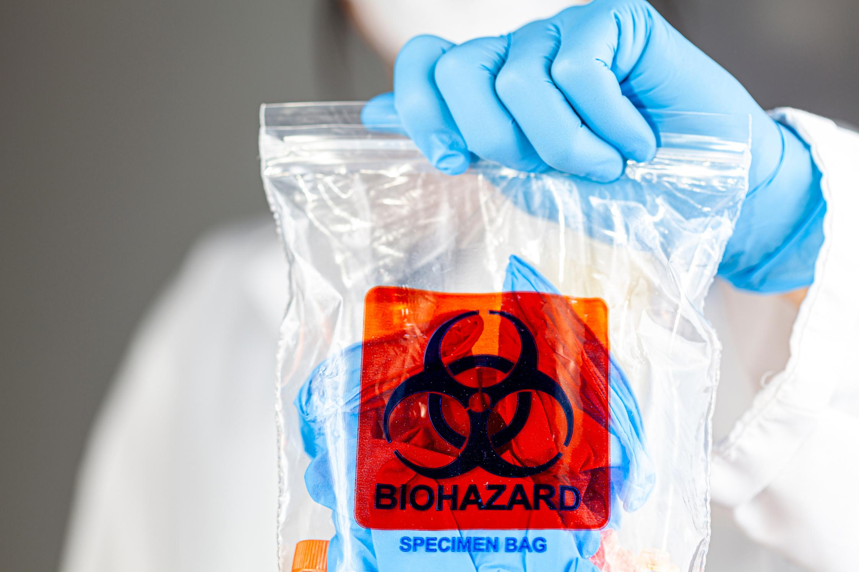
Bloodborne Pathogens
Definition
Sources of Contamination
What's Contaminated
Notes:
Say:
From the previous section, you became familiar with some of the diseases and risks caused by bloodborne pathogens. But what exactly is a bloodborne pathogen?
In this section we will discuss (Click) the definition of bloodborne pathogens, (Click) the sources of bloodborne pathogen contamination, (Click) and discuss items that are most likely contaminated along with the measures of contamination for those items.
Do:
Advance to next slide.

Slide 13
Definition of Bloodborne Pathogens
Infectious microorganisms such as viruses or bacteria that are carried by human blood and can cause disease in humans.
— Occupational Safety and Health Administration (OSHA)
Notes:
Say:
(Click) (Click) The Occupational Safety and Health Administration, or OSHA, defines bloodborne pathogens as infectious microorganisms such as viruses or bacteria that are carried by human blood and can cause disease in humans.
I will give you a minute to fill in the blanks on your participant guide before moving on. This is found on page_____. Give a thumbs up using the reactions carrot at the bottom of your Zoom screen when you are ready to move on.
Do:
Advance to next slide when appropriate.

Slide 14
Ask
Yourself
True or False?
Bloodborne pathogens are only found in blood or dried blood.
Zoom Poll
Check the chat for the link to the poll. Give a thumbs up when you have answered.
Notes:
Say:
(Click) On the previous screen, we learned that OSHA defines bloodborne pathogens as viruses or bacteria that are carried by human blood.
(Click) The question becomes are these pathogens only found in blood or dried blood?
(Click) Click on the link in the chat to mark your answer via a Zoom Poll. (give one minute before responding)
DO:
(Producer will post the results)
Say:
From the results we can see that the majority of you said (indicate which result was highest from the poll).
Bloodborne pathogens can indeed be found in other places.
Do:
Advance to next slide.

Slide 15

Sources of Bloodborne Pathogen Contamination
  Bodily fluids
  Surfaces contaminated with bodily fluids
Notes:
Say:
You might have been surprised to learn that bloodborne pathogens are not only found in blood. And many may assume that they are safe from the presence of bloodborne pathogens if there is no visible blood. But bloodborne pathogens are found (Click) in other body fluids, (Click) and they can live on surfaces contaminated with those body fluids.
Do:
Advance to next slide.

Slide 16
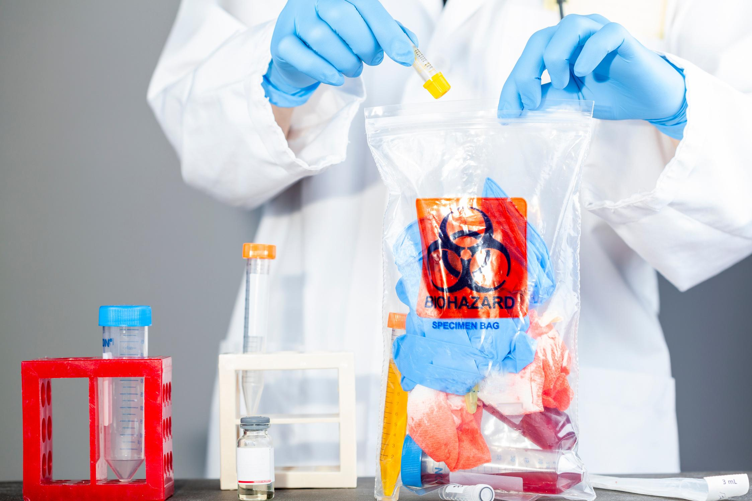
Sources of Bloodborne Pathogen Contamination
Body Fluids
  Cerebrospinal fluid
  Saliva
  Synovial fluid
  Pleural fluid
  Semen
  Vaginal secretions
  Amniotic fluid
  Pericardial fluid
  Peritoneal fluid
Notes:
Say:
Let’s discuss the possible sources of Bloodborne Pathogen contamination.
(Click) There are many body fluids that become sources for this contamination, including (Click and read each through peritoneal fluid).
I will give you a few minutes to enter these into your notes on the corresponding page in your participant guide. (provide 2-3 minutes)
You will want to note that any body fluid which contains blood becomes a source of bloodborne pathogen contamination, including any fluid where it is difficult to differentiate between body fluids.
These body fluids are often referred to as “other potentially infectious material”, or OPIM. Go ahead and add in that acronym in the space provided at the bottom of your notes.
Do:
Advance to the next slide.

Slide 17
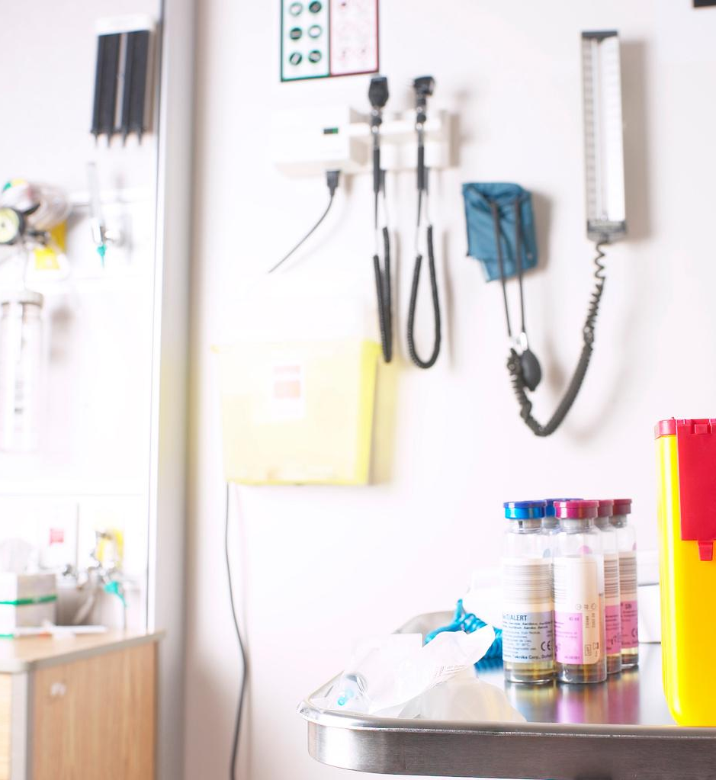
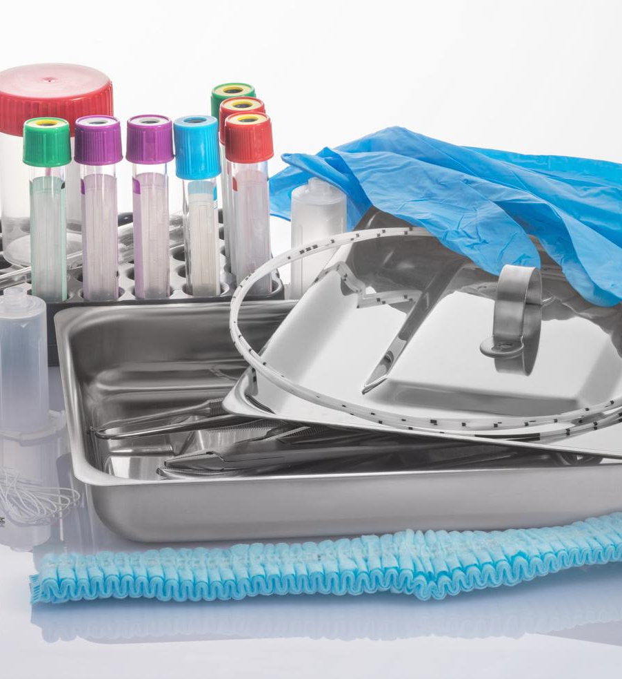
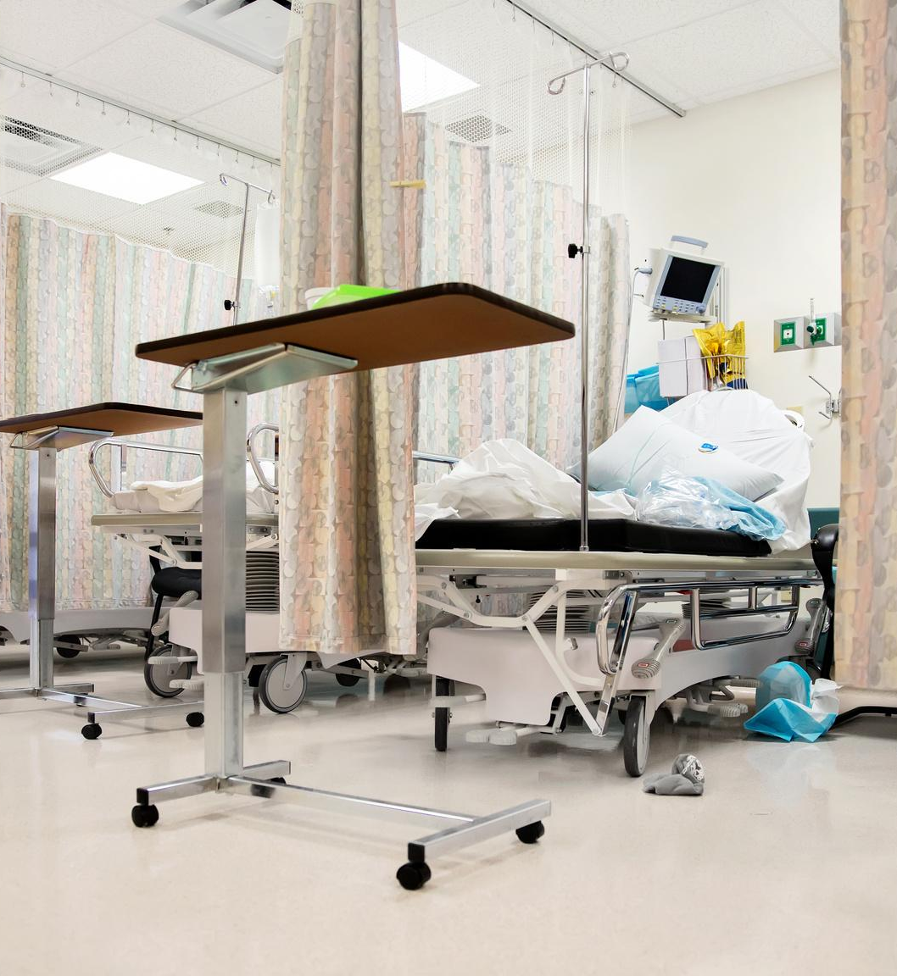
What's Contaminated?
Surfaces
Materials
Environments
Notes:
Say:
Take a moment to think on this question, “What’s contaminated?” If you would like to type in some ideas into the chat, please go ahead and do that now. (Allow one minute for participants to type answers into the chat).
Do:
Review the answers in the chat as they come in noting similarities and general categories of answers. (1 minute max)
Say:
All great answers. We have three basic categories that these fall into.
(Click) Surfaces. (Click) Materials (Click) and Environments.
Contamination for bloodborne pathogens is measured simply by the presence of blood and other bodily fluids on the surface. If you can visibly see or are reasonably sure that there is body fluid on a machine or other surface, it is best to prevent your exposure by taking precautions with the appropriate measures or, by calling the hospital’s environmental services team. You can see this noted on the next page of your participant guide.
Do:
Advance to next slide.

Slide 18

What's Contaminated?
Bacteria
Levels of Contamination
  Highly contaminated surfaces
  Contaminated surfaces
  Clean and disinfected surfaces
  Microbe free
Notes:
Say:
(Click) Contamination by other infectious bacteria is measured in microbes per inch.
With bodily fluids, contamination was determined by the mere presence of certain body fluids on a surface. With bacteria, we see 4 levels of contamination. (Click)
These are (Click) highly contaminated surfaces. Examples would be toilet seats, the floor, and the bottom of your shoes.
(Click) Contaminated surfaces. These would be any surface not cleaned within the past 24 hours within a healthcare setting and any surface that contains, or comes into contact with, highly contaminated items or body fluids.
(Click) Clean and disinfected surfaces. These are surfaces that use chemical disinfectants to cleanse them, and washed hands and linen are considered to meet this standard.
(Click) Finally, we have microbe free, which is the highest level of clean. These are items that go through a chemical sterilization process or an autoclave.
Do:
Advance to next slide

Slide 19
Knowledge Check
Kahoot Quiz
This quiz will help you check your understanding on contamination in the medical workplace.
Link
Check the chat for the link to the quiz. Give a thumbs up when finished.
Notes:
Say:
(Click) And now we have another opportunity to check your understanding of the information we have covered.
(Click) Our producer has put the link for the Kahoot quiz in the chat. (Click)
This quiz will not be accounted for in your final quiz. When you have completed the quiz, come back to the Zoom session and give a thumbs up indicating you have completed the quiz. (Quiz will take no more than 3 minutes).
I will post the results of the top three when everyone has completed the knowledge check. Good luck!
Do:
Wait until all members have given their thumbs up indicating completion.
(Producer will share Kahoot results) Regain share screen after congratulating the top 3.
Advance to the next slide.

Slide 20
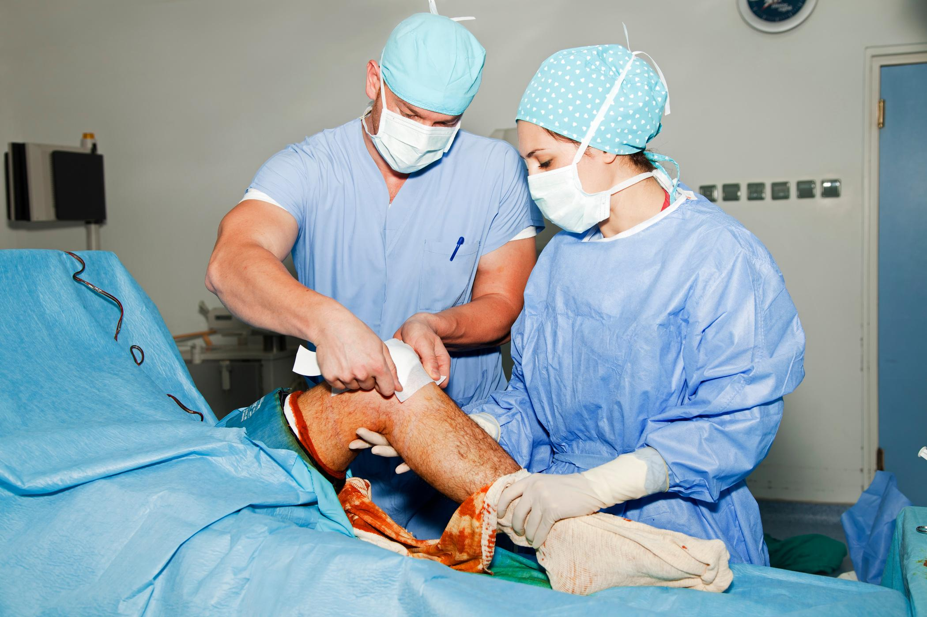
Exposure and Transmission of Bloodborne Pathogens
Occupational Exposure
Tasks with Exposure Risk
Notes:
Say:
So far, we have covered the top 3 bloodborne pathogens of concern for you in the Hospital X workplace including the risks of each type of infection, and we have discussed sources for these types of contamination as well as the levels of possible contamination.
Now, let’s move on to Exposure and Transmission of Bloodborne Pathogens.
In this section we will discuss (Click) occupational exposure and (Click) tasks with exposure risk.
Do:
Advance to next slide.

Slide 21
Think About It:
Scenario
Your patient appears healthy. You have no reason to believe they have any infectious diseases, so there is no risk of contamination from bloodborne pathogens.
True or False?
Type your answer and reasoning into the chat.
Notes:
Say:
(Click) Before we dive into this section, I want you to consider this scenario.
(Click) You are working in your role at Hospital X. Your patient appears healthy. You have no reason to believe they have any infectious diseases, so there is no risk of contamination from bloodborne pathogens.
(Click) Is this true or false? Go ahead and type your answer with a short reasoning of your choice into the chat.
Do:
Give participants one minute to enter their answers and reasoning into the chat. Read out two of the answers with their reasons.
Say:
Nice work on your answers and reasoning. If you answered false, you are correct. Theoretically if a person is healthy, then there is no risk of exposure and contamination. However, it is impossible to know this unless you have tested a person’s blood. An individual can appear healthy and without symptoms yet still carry a harmful virus. That is why it is important to be aware of the ways in which pathogens can be transmitted so that you can reduce your risk.
Do:
Advance to next slide.

Slide 22
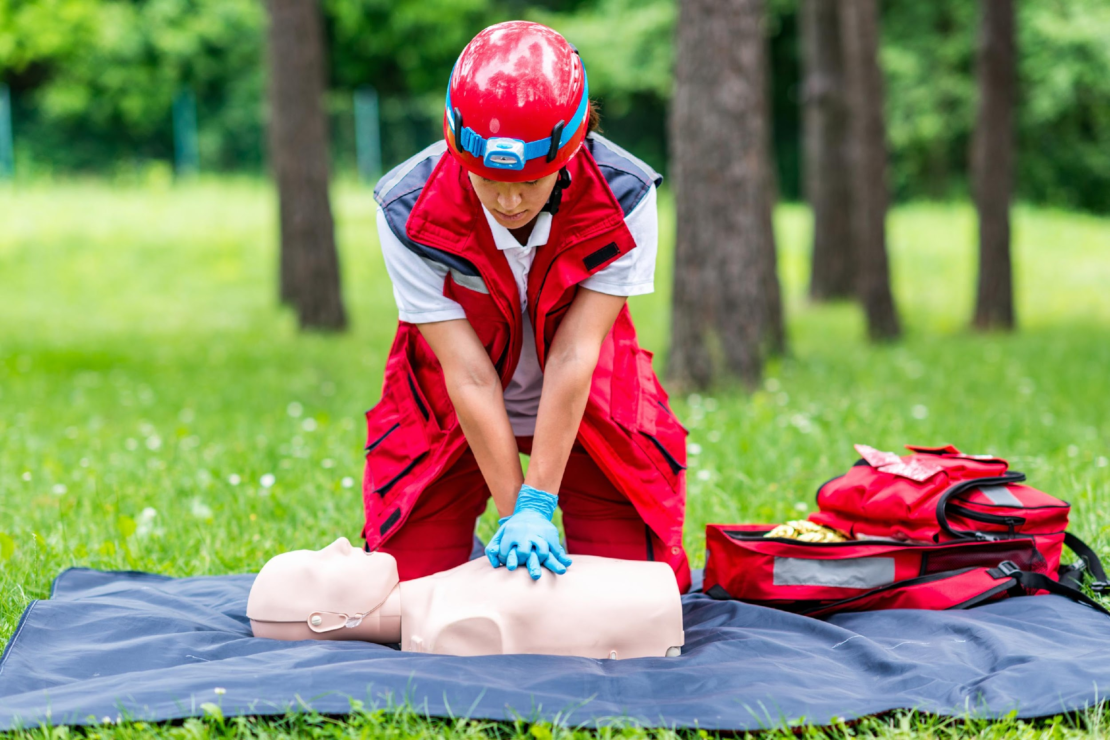
Occupational Exposure
Who is at risk?
Not just traditional healthcare workers.
  Hospital staff
  First responders
  Childcare workers
  Environmental service technicians
Notes:
Say:
Occupational exposure is just what it sounds like. It is the exposure to something dangerous within the workplace.
(Click) But who is at risk? In the Hospital X workplace, the first group of employees that come to mind is, of course, the traditional healthcare workers. This could be the doctors or nurses in attendance.
(Click) But other employees are also at risk. This could be:
(Click and read each category through Environmental Service Technicians.) Go ahead and write down the missing elements in your participant guide.
Essentially any employee that works in a healthcare or laboratory setting where body fluids and blood are present is at risk for exposure to bloodborne pathogens.
Do:
Advance to next slide.

Slide 23
Definition of Occupational Exposure
Any "reasonably anticipated skin, eye, mucous membrane, or parenteral contact with blood or other potentially infectious materials that may result from the performance of an employee's duties."
— OSHA Bloodborne Pathogen Standard
Notes:
Say:
The definition of occupational exposure is:
(Click) Any “reasonably anticipated skin, eye, mucous membrane, or parenteral contact with blood or other potentially infectious materials that may result from the performance of an employee's duties.” The CDC estimates that 5.6 million workers in the healthcare industry and related occupations are at risk of occupational exposure to bloodborne pathogens.
(Click) This is called the OSHA Bloodborne Pathogen Standard
You can fill that in on your participant guide before we move on.
Do:
Give one minute for participants to fill in that section in their guides.
Advance to next slide.

Slide 24
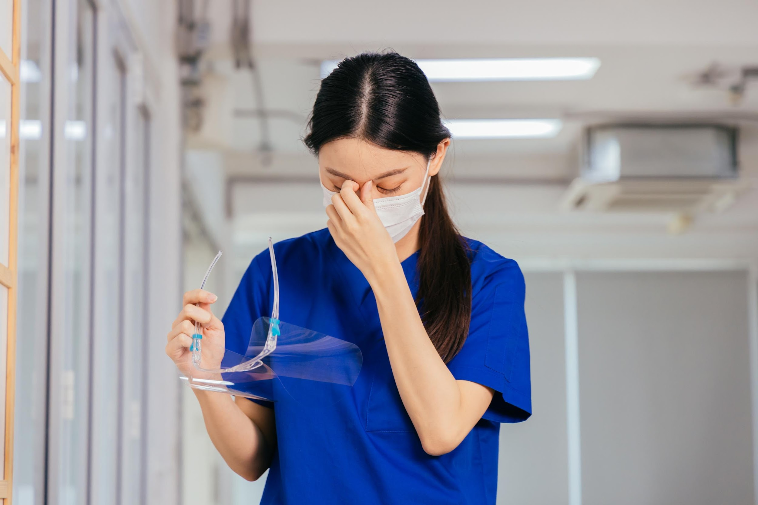
Tasks with Exposure Risk
High Risk
  Needle sticks
  Contaminated sharps
  Spattering/spraying bodily fluids (aerosols)
Cross Contamination
  Eyes, nose, mouth, genital or anus
  Touching one contaminated body part to another
Notes:
Say:
In your daily work at Hospital X, you may encounter various tasks in which you will need to be aware of the potential exposure to bloodborne pathogens. OSHA has defined some situations in which exposure risk is high. (Click)
These situations include:
(Click and read each section through Spattering/spraying bodily fluids)
Another term for this would be aerosols. All three situations puts potentially infected blood or body fluids directly in contact with your blood.
(Click) Additionally, cross contamination of body fluids can be sources of exposure to bloodborne pathogens.
(Click) Touching your eyes, mouth, nose, genital, or anal areas with contaminated blood or body fluids or (Click) touching them with a part of your body that has been in contact with these fluids is another way that you may be exposed.
Examples of specific areas of exposure in your work environments might include:
Blood or other body fluids on surfaces.
Sharp or broken equipment that may have blood or body fluids on it.
Splatter or spray from dental or oral procedures
Do:
Advance to next slide

Slide 25
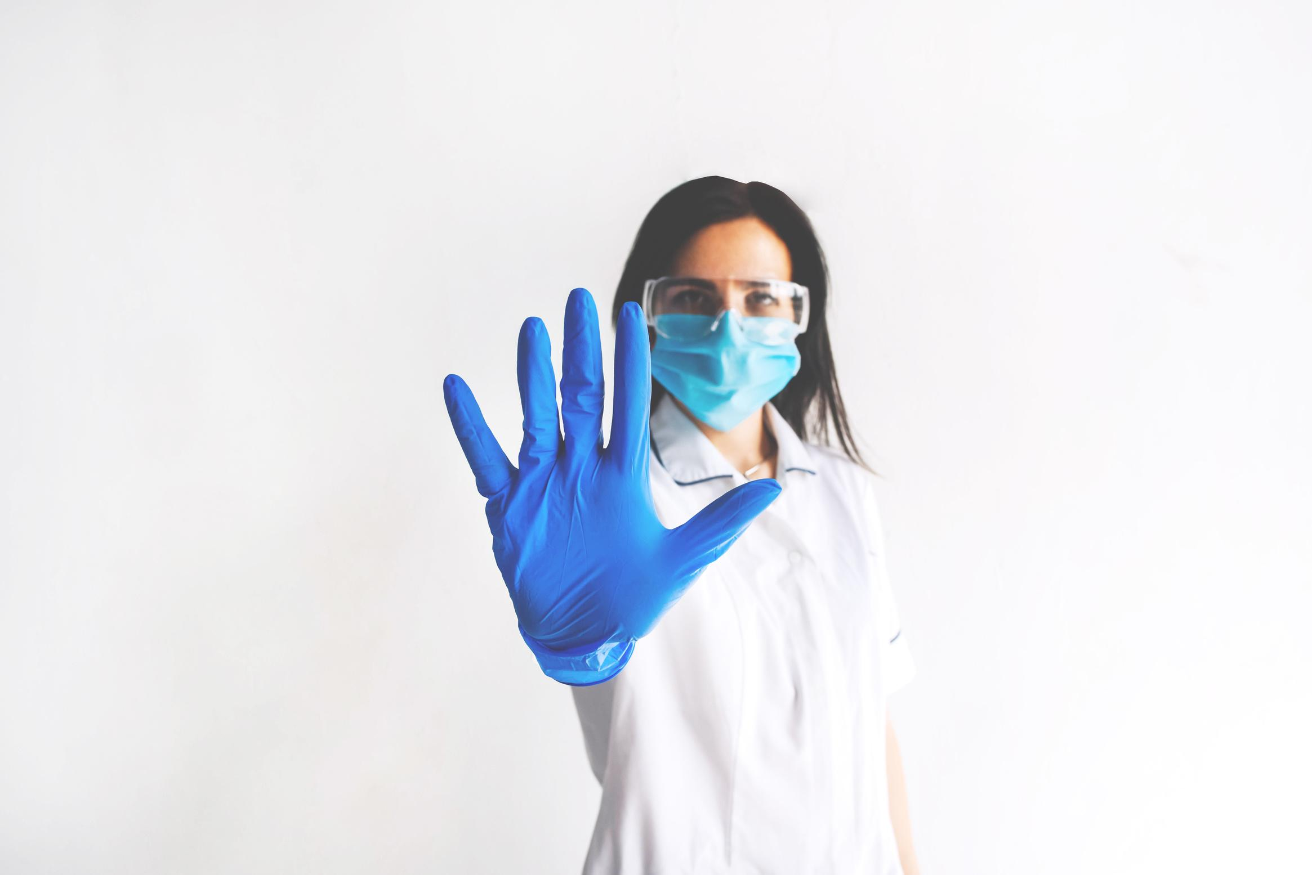
Preventing Exposures
Bloodborne Pathogen Standard
Universal Precautions
Engineering Controls
Work Practices
Personal Protective Equiptment
Exposure Control Plan
Notes:
Say:
In this section we will discuss the first defense against bloodborne pathogen transmission: Prevention.
Topics in this section include (Click and read each topic through Exposure Control Plan)
Do:
Advance to next slide.

Slide 26

Universal Precautions
OSHA Bloodborne Pathogen Standard
  Laws and procedures to protect workers
  Required exposure and control plan
  Identify and ensure preventative measures
  Education
  Procedures for exposure
  Employee rights to medical evaluation and follow up
Notes:
Say:
(Click) OSHA has developed what they call the Bloodborne Pathogen Standard. Go ahead and fill that in on your participant guide.
It is there to (Click) protect workers and prevent exposure through laws and procedures for organizations that employ workers with an occupational risk for bloodborne pathogen exposure.
(Click) The standard requires employers to create and maintain an exposure control plan, (Click) as well as identify and ensure the use of preventative measures among employees.
(Click) Part of prevention is educating employees and personnel about risks and preventative measures.
(Click) Finally, organizations adhering to OSHA’s Bloodborne Pathogen Standard must have procedures in place in the event of an exposure incident.
(Click) All employees have the right to medical evaluation and follow up in the event of exposure.
Do:
Give participants a moment to fill in the blanks on their participant guide before moving on.
Advance to next slide when ready.

Slide 27

OSHA Bloodborne Pathogen Standard
Universal Precaution
All blood or other potentially infectious material (OPIM) must ALWAYS be treated as infectious regardless of the health status or appearance of an individual.
Notes:
Say:
(Click) Universal Precaution. What is this?
(Click) It’s an understanding that all blood or OPIM always be treated as infectious regardless of the health status or appearance of the individual. Treating exposures in this way is considered universal precaution, and OSHA’s Bloodborne Pathogen standard requires it. Remember many bloodborne infections show no symptoms early on, so there is no affirmative way to determine the potential for infection based on outward appearance or lack of symptoms.
Do:
Advance to next slide.

Slide 28
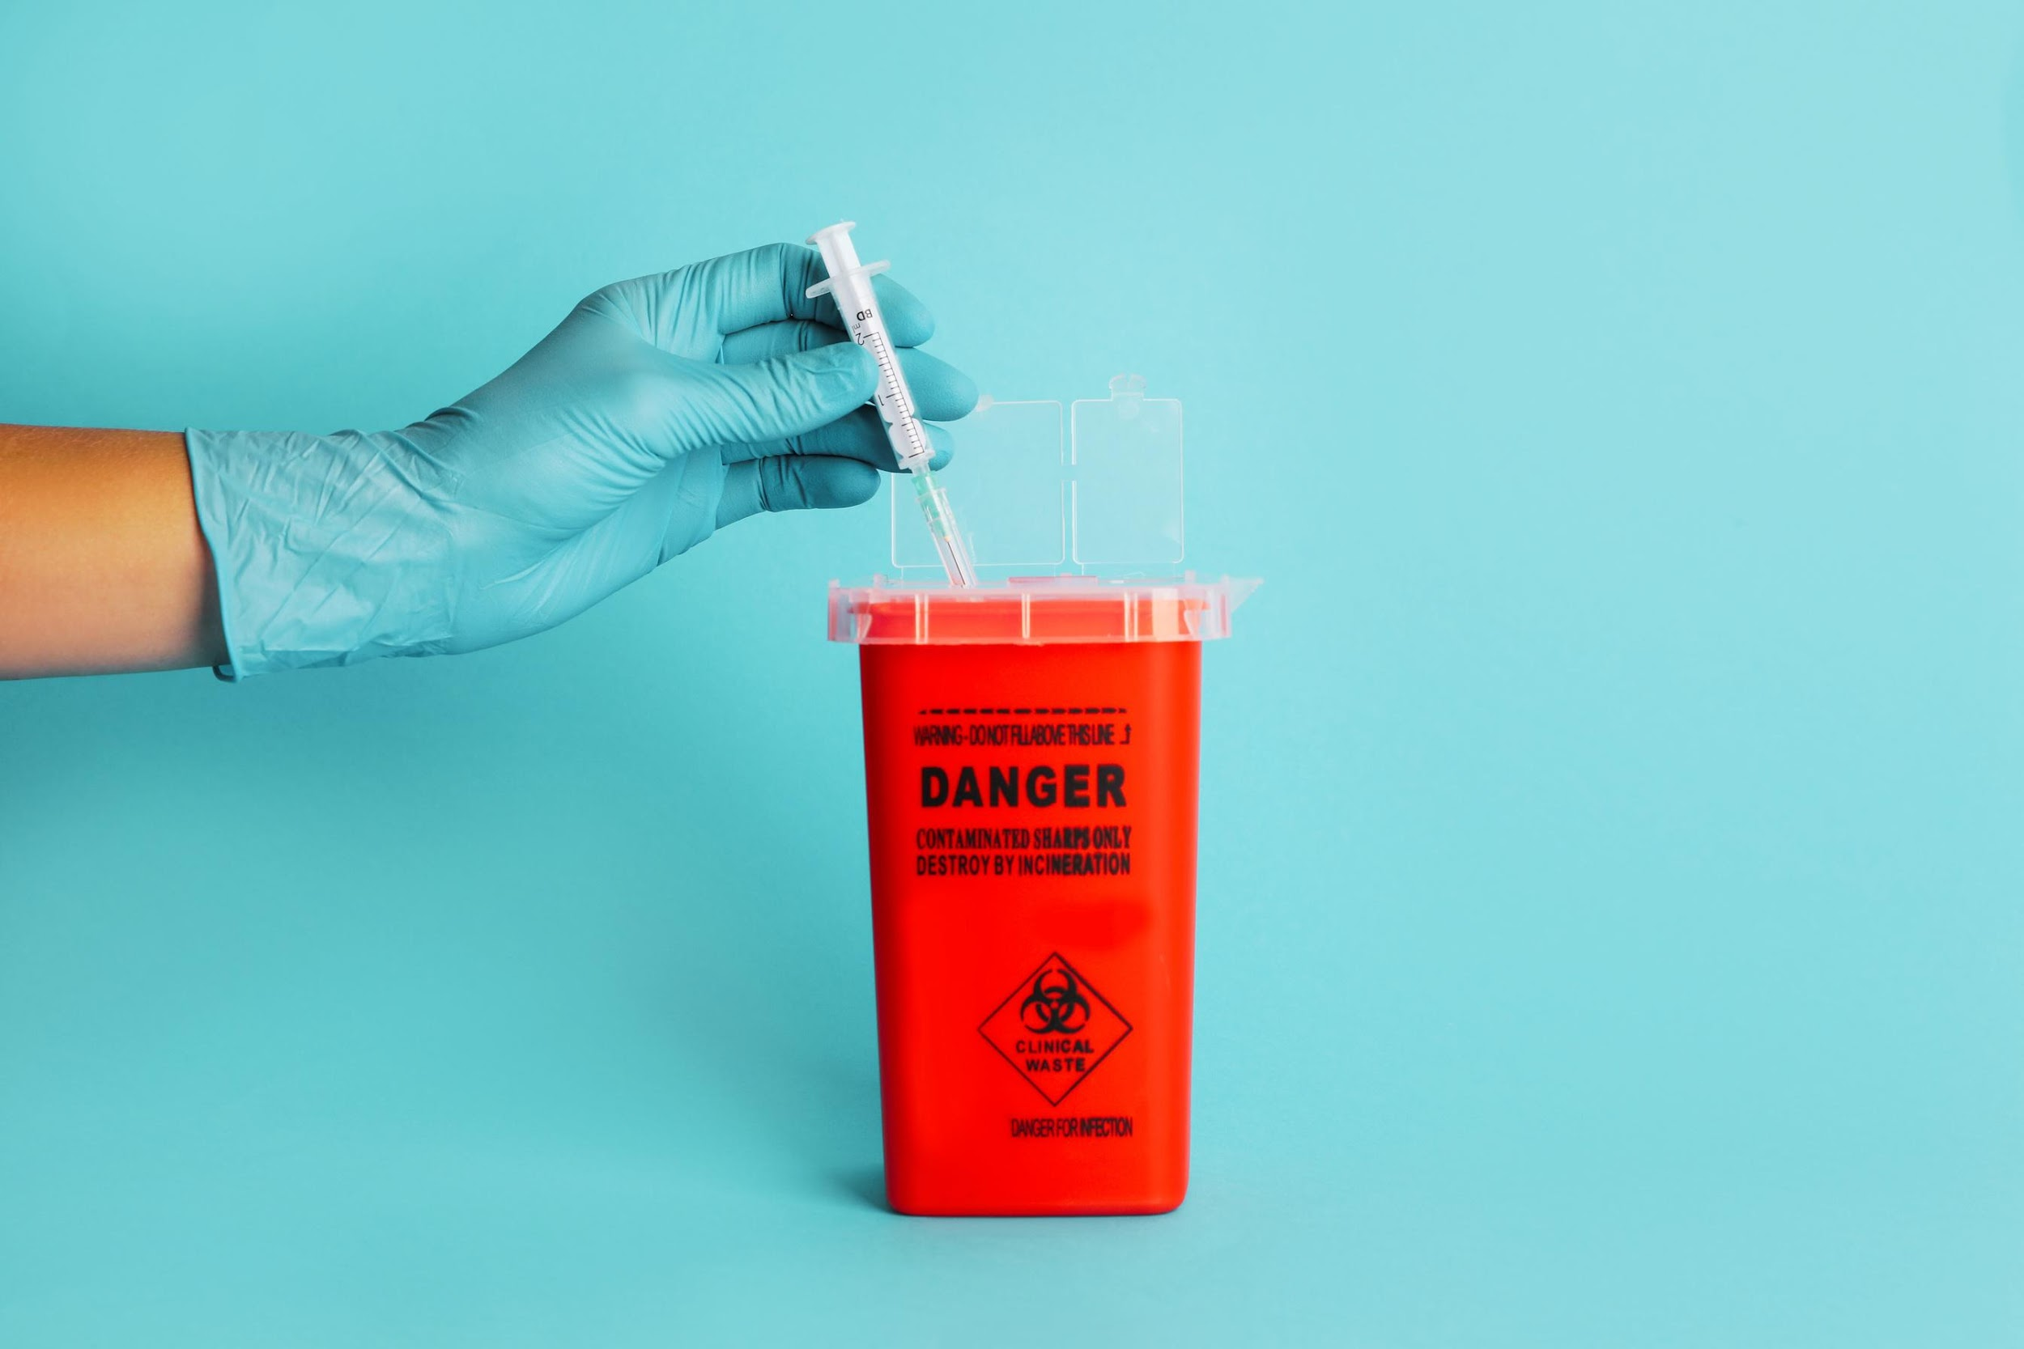
Engineering Controls
Devices that isolate or remove bloodborne pathogens from the workplace.
  Sharps disposal containers
  Safer medical devices -
    ex: needleless systems, or blunt tip surgical suture needles
  Barriers -
    ex: splashguards, CPR masks, trash grabbers
  Handwashing devices and facilities
Notes:
Say:
In addition to using universal precaution, we will examine the three ways Hospital X seeks to limit your exposure to bloodborne pathogens. The first of which is engineering controls.
(Click) Engineering controls are the devices that isolate or remove bloodborne pathogen hazards from the workplace.
One of the most common examples would be as seen here (click). Sharps disposal containers. Needlesticks account for a majority of bloodborne pathogen exposures.
(Click) Safer medical devices, such as (Click) needleless systems or needles with sharps injury protection systems, are some examples of engineering control to prevent exposure to bloodborne pathogens. Another example of engineering include blunt-tip surgical suture needles.
(Click) Equipment that creates a barrier against spraying or splashing of body fluids such as a splashguard is a common engineering control.
(Click) Simple safeguards like resuscitation masks create a barrier to the exchange of body fluids in the event of Cardiopulmonary Resuscitation (CPR). In cleanup situations, brooms and dust pans, and grabbers for picking up contaminated items are engineering controls that separate you from potential contamination. Mops used for wet cleanup methods can also be considered engineering controls.
The most common and most often used engineering control available at your disposal is (Click) handwashing equipment. Handwashing facilities and devices are present in every healthcare setting and are part of the first line of defense against bloodborne pathogen exposure. Write that down in your participant guide at the bottom.
Do:
Provide time for participants to make notes of examples in the corresponding portion of their participant guides, then
Advance to next slide.

Slide 29
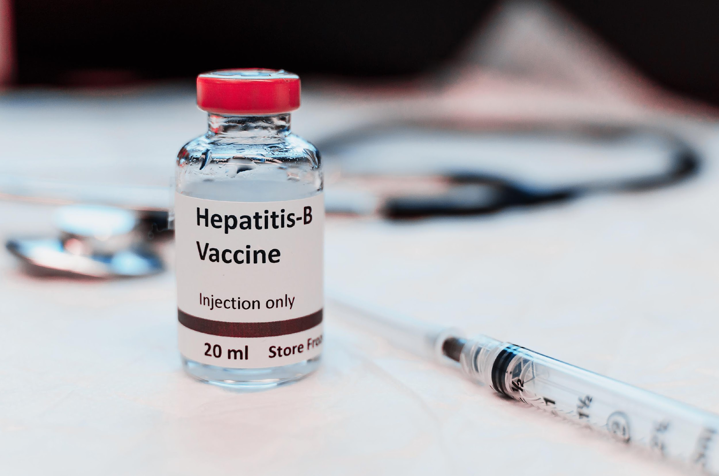
Work Practices
Prevent Exposure and Infection
  Hepatitis B vaccination
  Wash hands and exposed skin
    after removing gloves or PPE
    after contact with blood
    after contact with OPIM
  Avoid
    eating or drinking in contaminated areas
    applying makeup
    inserting contact lenses
Notes:
Say:
(Click) The next mode of protection from bloodborne pathogens involves the practices you engage in and out of the healthcare environment.
(Click) You should work with your supervisor at Hospital X to obtain a Hepatitis B vaccination if you have not already received one. Remember, this vaccination is the most effective prevention tool against infection if you have been exposed to the Hepatitis B virus.
Once you are on the job, a few common-sense rules apply in environments where exposure to bloodborne pathogens may be possible.
(Click) The most important work practice is to wash your hands and exposed skin (Click) after removing gloves or other PPE, (Click) after any contact, or suspected contact with blood or (Click) OPIM.
(Click) Lastly, In environments where bloodborne pathogens may be present, it is essential that you (Click) avoid eating or drinking in an area where these potentially contaminated blood or fluids may be stored or on surfaces.
(Click) In addition, avoid applying makeup or (Click) inserting contact lenses in these environments.
These are all ways cross contamination frequently occurs both inside and outside of your work environment.
Take a moment to ensure you have copied down the items that are missing in your guides. (Give one minute)
Let’s move on to the third category of prevention.
Do:
Advance to next slide.

Slide 30
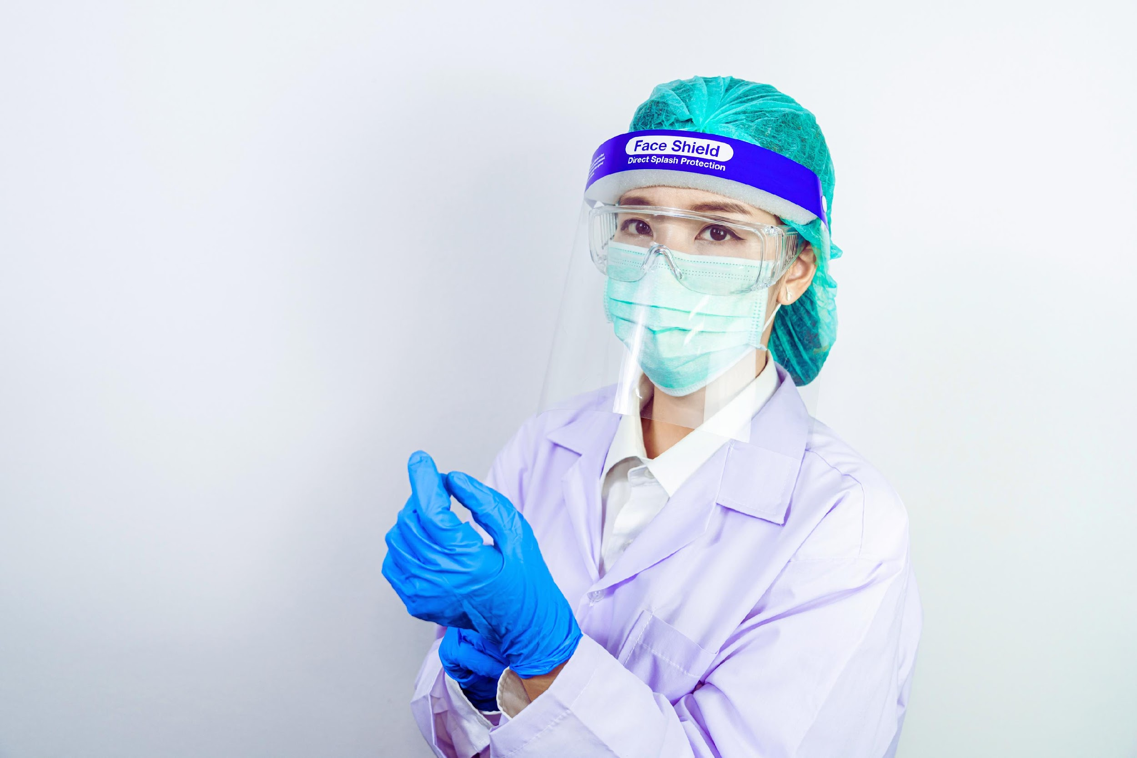

Personal Protective Equipment (PPE)
Any protective equipment deemed appropriate and necessary to complete your job safely in a healthcare setting.
Ask your supervisor what types of PPE are required or recommended for your position.
Notes:
Say:
Remember, prevention is the best defense for exposure to bloodborne pathogens, and PPE is considered one of the lines of defense in situations where bloodborne pathogens are present.
(Click) PPE includes any protective equipment that is deemed appropriate and necessary to complete your job safely in a healthcare setting. For many healthcare professionals, this includes layers to protect their body, particularly those areas where mucus membranes are present, such as your eyes, nose, and mouth. For staff at Hospital X, it is important to protect yourself against transmission of pathogens and bacteria.
(Click) Ask your supervisor what types of PPE are required or recommended for your position.
Do:
Advance to next slide.

Slide 31
True or False?
PPE
Considered the first line of protection for workers with occupational exposure risk in healthcare settings.
Zoom Chat
Type your answer and reasoning into the chat.
Notes:
Say:
Another chance to check your understanding. This one is a true or false question. (Click)
(Click) PPE is considered the first line of protection for workers with occupational exposure risk in healthcare settings.
(Click) Go ahead and type your answer in the chat along with any additional reasoning other than because the slide said so! (Give a minute to allow participants to enter their answers before providing feedback.)
Actually, the engineering controls in place in healthcare environments and the work safety practices that you use while working are considered the first and second lines of defense in the prevention of exposure to bloodborne pathogens. PPE is the final layer between you and exposure.
Do:
Advance to next slide.

Slide 32
Hospital X's Responsibilities
Maintain and update an Exposure Control Plan (ECP)
Ensure employee access to the ECP
Provide appropriate protection
Access to HBV
Notes:
Say:
Hospital X understands that we hold a vital role in protecting our employees.
(Click) It is our responsibility at Hospital X to maintain and update an Exposure Control Plan and (Click) share it with our employees. Each year, this plan is reviewed and updated as we perform an assessment of hazards and risks in your work environment, including the evaluation of the types of PPE needed for safety on the job.
(Click) Additionally, it is our job to provide you with the appropriate protections for your work environment at no cost to you. This provision includes maintaining any reusable PPE, such as lab coats, by disinfecting, cleaning, or sterilizing them as needed. Ask your supervisor for the locations of required and recommended disposable PPE such as gloves, masks, protective eyewear, and other items.
(Click) If you have not received information about access to a hepatitis B vaccination within 10 days of your offer of employment, contact your supervisor, unless you have already received the vaccine. Remember, this vaccine is your best prevention tool against contracting HBV.
Give me a thumbs up when you have finished filling in the blanks in your participant guide and we will move on.
Do:
Advance to next slide when the participants have indicated they are finished.

Slide 33

Post Exposure Procedures
First Steps
Post Exposure Medical Follow Up
Notes:
Say:
Unfortunately, due to the nature of the Hospital X workplace, exposures will sometimes occur. It’s important to remember what to do if you are exposed to potentially infected blood. In this section we will cover:
(Click) The first steps to take after exposure and (Click) the details of the post exposure medical follow up.
Do:
Advance to next slide.

Slide 34
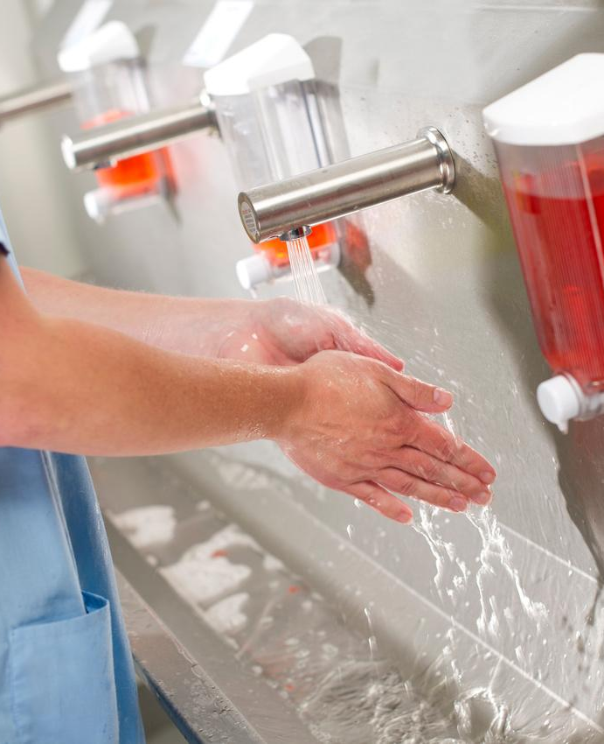

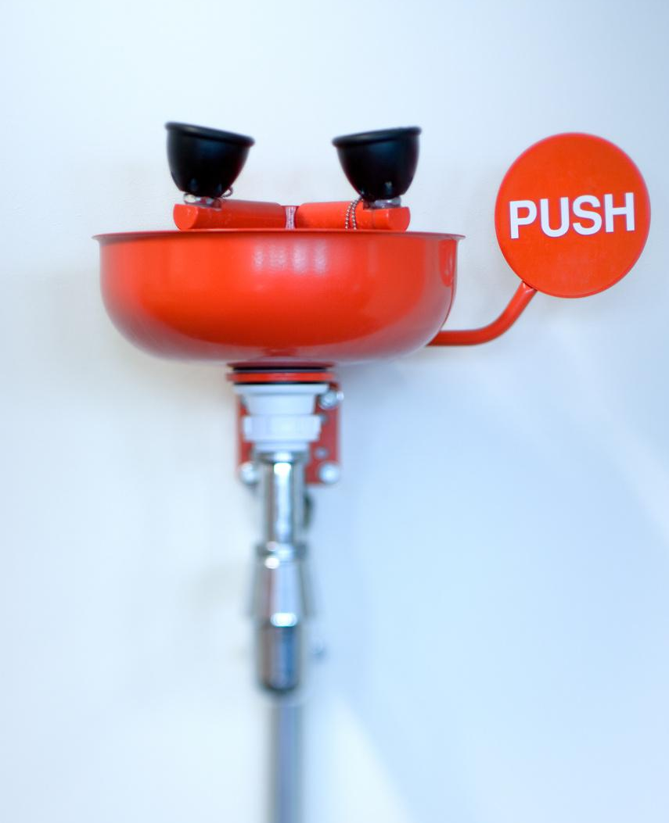

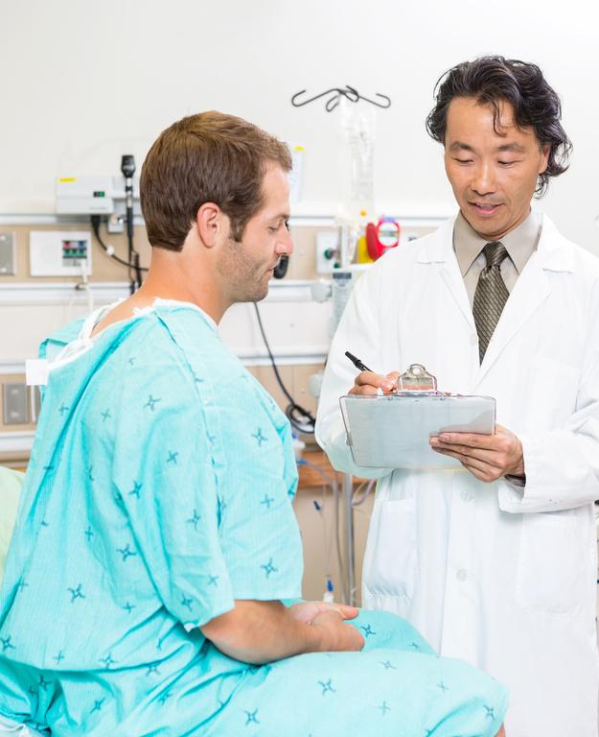
First Steps After Exposure
Wash all exposed areas with soap and water.
Flush
Irrigate
Report
Follow Up
splashes to nose, mouth, or skin with water.
eyes with water or saline if applicable.
the exposure to your employer.
using the directions from your employer.
Notes:
Say:
In the event that you have been exposed to blood or other OPIM, it’s essential that you follow the post exposure procedures outlined by Hospital X. These align with the Exposure Control Plan outlined in the last section.
Take a look at these 5 images. (Click to reveal the 5 images with a few seconds between each click to allow participants to process what they are seeing.)
(Click) This first step is to wash all exposed areas fully with soap and water. Remember that aerosols or splatters can travel a bit, and so ensuring you are washing all exposed areas is crucial to preventing cross contamination later.
(Click) Step two is to flush splashes to your nose, mouth, and surrounding skin areas with water.
(Click) Exposure to the eyes does occur, and using an eye station or sterile saline solution to wash the potential fluids from the eyes is the third step. If you are unsure that the exposure extended to the eyes, it’s better to be safe and irrigate than to assume otherwise.
(Click) Report the incident immediately to your employer. You will have to fill out an incident report and will be given a copy for your files. Any necessary testing and medical care will then be assigned.
(Click) Last, but not least, follow up using the directions from your employer. Even if you feel fine, and feel the risk of future effects is low, it is important to follow all post exposure treatment plans to ensure the best outcome for your health.
These steps are vital components of the Exposure Control Plan, so I will give you a minute or so to add these notes to your participant guide.
Do:
Advance to next slide when all participants are ready.

Slide 35

Post Exposure Medical
Follow Up
Free Confidential Medical Care
  Record injury and incident information
  Get testing
  Get support
Notes:
Say:
Remember, Hospital X wants you to know you have access to free, confidential medical care in the event of an exposure. (Click)
There are three aspects to expect for the medical follow up:
(Click) Documentation of the injury and incident.
(Click) Testing
(Click) and Support.
Do:
Advance to next slide.

Slide 36
Post Exposure Medical
Follow Up
Record the Injury and Information
  Employer should document:
    routes of exposure
    how incident occured
Notes:
Say:
(Click) When recording the injury and information about the incident, your employer should document (Click) (Click) the routes of exposure and (Click) how the incident occurred. Record any sharps injuries in the sharps injury log.
Do:
Advance to next slide.

Slide 37
Post Exposure Medical
Follow Up
Get Testing
  If blood or OPIM came from a known source:
    Employer - gain consent from source for testing and document test results.
    You will be provided with results of tests.
  No testing needed if infection is known.
  Unknown source:
    Provide blood samples for testing.
  Results are confidential.
Notes:
Say:
(Click) Get testing. Free testing will be provided to you if needed.
(Click) If the blood or OPIM came from a known source, (Click) your employer through a medical professional should get consent from source individual for testing of source individual’s blood (Click) and document test results.
(Click) No testing is needed if there is a known infection.
(Click) If the source of the infection is unknown, you should have access to testing. (Click) Your blood should be collected as soon as possible after the exposure incident.
(Click) You should be provided with the confidential test results of the infected individual.
Ask:
Are there any questions about this step? (follow up answers as needed based on protocol)
Do:
Advance to next slide.

Slide 38
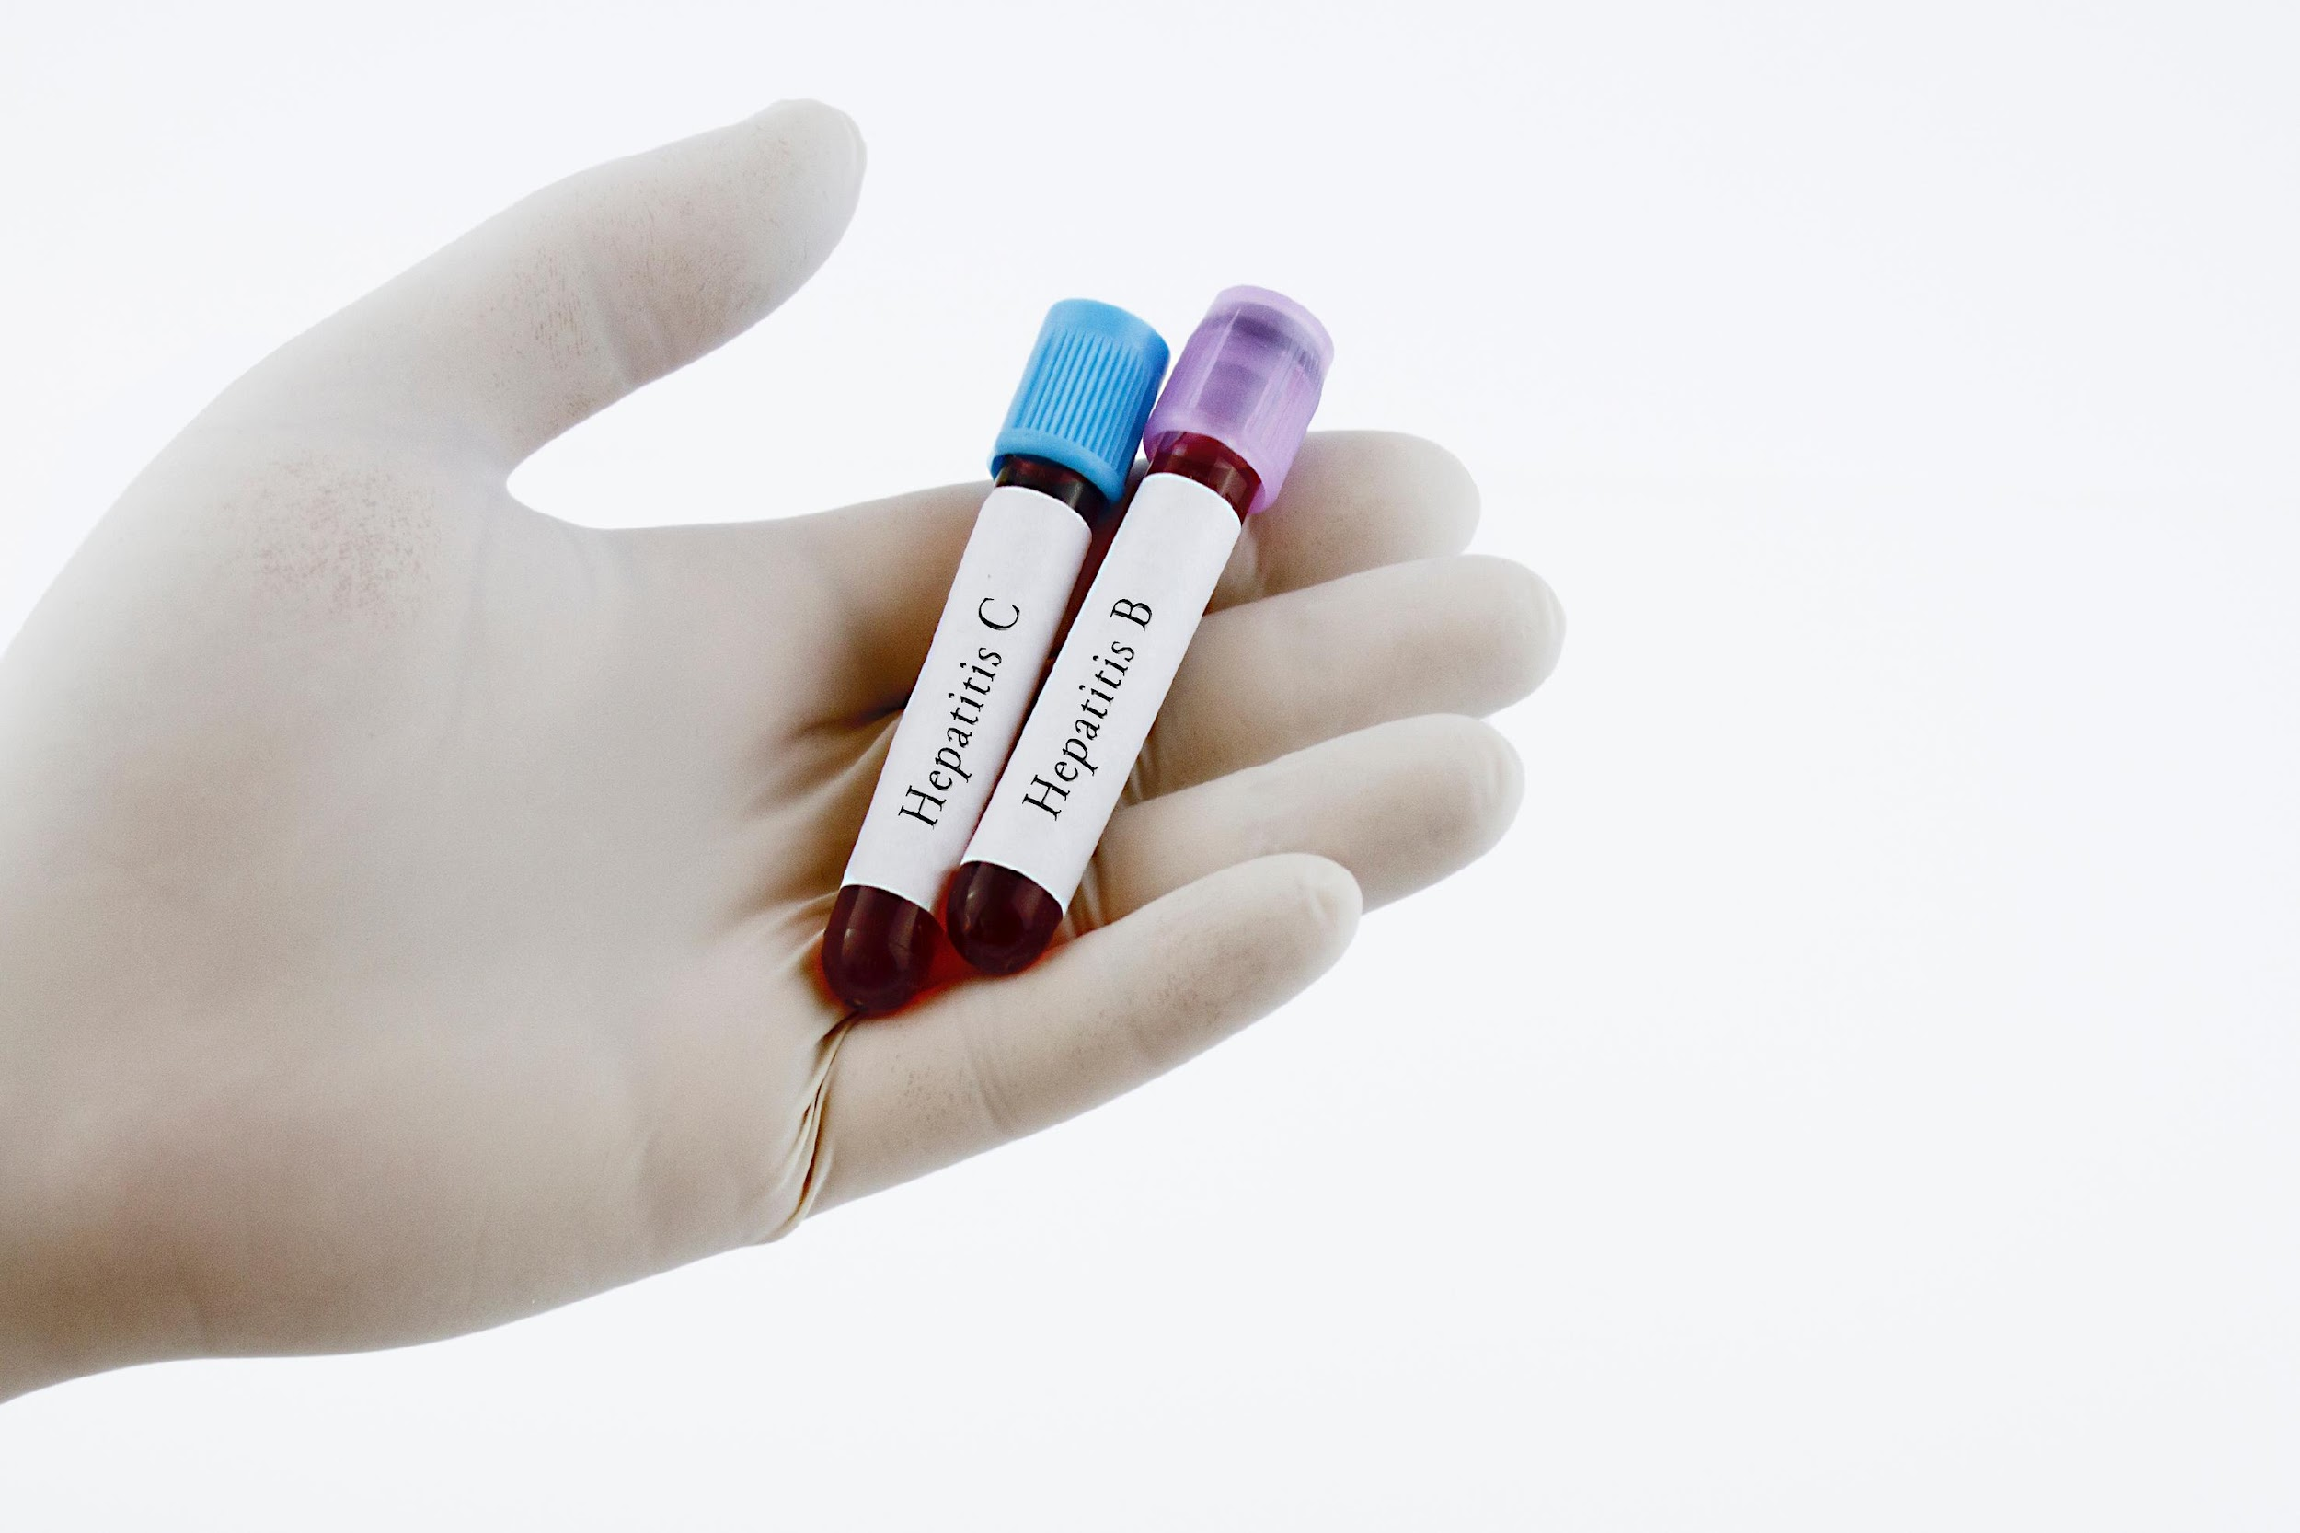
Post Exposure Medical
Follow Up
Get Support
  Hospital X will provide you with:
    Post exposure testing
    Post exposure counseling
    Protective treatment against disease
    Medical professional follow up
  No cost to you.
Notes:
Say:
(Click) Get support.
(Click)
It is the responsibility of Hospital X to provide you with (Click) Post exposure testing, (Click) post exposure counseling, (Click) and protective treatment against disease if possible.
(Click) A medical professional follow up after exposure will be made available to you at no cost. (click)
Ask:
Do we have any questions regarding this slide? (answer questions as needed using protocol)
Do:
Advance to next slide.

Slide 39
Knowledge Check
True or False?
Thumbs Up/Down
You must follow up with medical care if you have been exposed to potentially infectious blood on the job.
Use the thumbs up if you believe it is true, thumbs down if you believe it is false.
Notes:
Say:
Let’s do a quick knowledge check on this section.
(Click) True or false?
(Click) You need to follow up with medical care if you have been exposed to potentially infectious blood on the job.
(Click) Give a thumbs up if you feel that you do need to follow up with medical care if you have been exposed to potentially infectious blood on the job, or a thumbs down if you feel it is not necessary.
(After the majority of the participants have responded) This is true. It is better for your health and safety, as well as the health and safety of those around you to be tested. This is an expectation of Hospital X’s post exposure plan.
Do:
Advance to next slide.

Slide 40
Summary
Bloodborne Diseases Overview
Bloodborne Pathogens
Exposure and Transmission
Preventing Exposure
Post Exposure Procedures
Notes:
Say:
In summary, today we have discussed (Click) what bloodborne diseases are and the risks of the three pathogens of concern in the Hospital X workplace: Hepatitis B and C as well as HIV/AIDS.
(Click) We covered the sources of bloodborne pathogens as well as levels of contamination along with the surfaces, materials and environments that may be contaminated in the healthcare setting.
(Click) You learned the OSHA Bloodborne Pathogen Standard and tasks that are considered high risk for exposure and transmission.
(Click) You are aware of the ways to prevent exposure through Universal Precautions, engineering controls and PPE as well as the Hepatitis B vaccine.
(Click) Finally, we covered post exposure procedures that are part of the Hospital X Exposure Control Plan which is updated annually.
Do:
Advance slide when summary is complete.

Slide 41

Final Quiz
  Use the link provided in the chat to access the final quiz.
  If you have any questions during the quiz, please notify me through the chat.
  Once complete you will be given permission to leave the Zoom training.
Notes:
Say:
Before we head into the final quiz, are there any lingering questions that need clarification? (follow up as needed referring back to previous slides as necessary)
(Click) A link to the final quiz will be posted in the chat. Use that link to complete your final assessment. You may use your participant guide as needed. This emulates the workplace as there are visual procedure aids posted in the staff quarters at your worksite. The post exposure procedures are also available from HR at any time you need them. Please keep your participant guide after this course in the event that you need to refer back to the material while employed with Hospital X.
(Click) If you have any questions during the quiz, please send a private message to me through the chat. While I cannot help with the answers, I may be able to provide clarification on questions or tech support as needed.
(Click) Once complete, please return to the Zoom session tab and notify me through the private chat. I will check for completion on my end and once verified, you will be given permission to leave the training.
Good luck!
Do:
(Producer will add link to the chat).
Keep this slide up while monitoring the chat for questions and assertations of completion.
When a participant notifies you of completion, notify the producer who will check the LMS for completion. If completion is noted, the producer will notify the participant of their ability to leave the training session by leaving the Zoom meeting.
Once all participants have exited, you may close out the Zoom training session.
Notify HR of the completion of the training along with which participants have taken today’s training.

