Slide 1
Contracting Risks
Farshad Ghodoosi
Assistant Professor
David Nazarian College of Business & Economics
California State University, Northridge

Slide 2
Structure
I. Overview
II. Three Inquires
III. Computational Analysis
IV. Results
V. Normative Suggestions

Slide 3
The Problem
Incongruent Decisions
Lack of systemic approach (ex ante v. ex post)
Lack of clarity about the protective risk

Slide 4
Three Inquiries
I. Why do parties include force majeure clauses given common law doctrines?
II. What are the predictors and their respective weights in courts’ force majeure analysis?
III. What is the most efficient and equitable approach?

Slide 5
Inquiry I
Why do parties include force majeure clauses given common law doctrines?

Slide 6
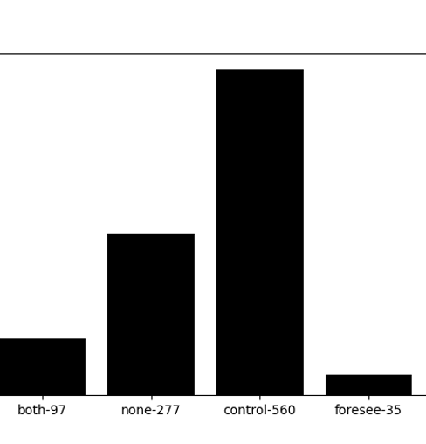
Raison D'etre
Common Denominator: Parties' Basic Assumption
Empirical approach
1,000 clauses (from SEC filings and Google searches – various sectors)
Most frequent word after force, party, shall, event => control
No mention of the word assumption & basic.
Notes:
Both the Restatement (Second) of Contracts § 265, § 261 and UCC § 2-615 emphasize that the supervening event must be an event the “non-occurrence of which was a basic assumption on which the contract was made.”

Slide 7
Two Explanations
I. Law & Economics
Basic assumption as a penalty default rule due to the cost of judicial discovery
II. Behavioral Economics
Default rules are sticky
=> Preferred approach
Removal of hindsigh bias
Move from perceived risk to actual risk

Slide 8
Inquiry II
What are the predictors and their respective weights in courts’ force majeure analysis?

Slide 9
Predictors
Foreseeability
Control
Contractual Language
=> Relationship between control & foreseeability: rejections are based on foreseeability and acceptance are based on control.
=> Courts tend to emphasize on the strict construction in the context of market-related incidents.

Slide 10
Theoretical Framework
Types of Event
Acts of God
Accident (Major)
Accident (Minor)
Disruption
Governmental Acts
Economic hardship
Reasoning (Predictors)
1) Contract Language
2) Foreseeability
3) Control
Case Outcome
1) Accept
2) Reject

Slide 11
Dictionary
Variables | Dictionary
Acts of God | "wildfire", "hurricane", "tornado", "drought", "flood","blizzard", "storm", "tsunami", "famine", "lightening","earthquake","volcano","epidemic","epidemics","pandemics","pandemic","endemic","endemics", "disease", "weather"
Accident (Major) | "terrorism", "terrorist", "revolution", "riot", "rebel", "war", "hostility"
Accident (Minor) | "crash", "accident", "explode", "explosive", "explosion", "fire"
Disruption | "disturbance", "strike", "labor", "worker", "workers"
Governmental Acts | "regulations", "government", "governmental", "shutdown", "permit", "closure"
Economic Hardship | "economic", "market", "prices", "crisis", "downturn", "recession", "hardship"
Contract Language | "Dictionary", "dictionarium", "meaning", "meanings", "interpret", "interpretation", "interpretations", "construct", "construction", "ambiguity", "ambiguous", "unambiguous", "vague", "vagueness", "narrow", "narrowly", "language", "plain", "ordinary", "ejusdem", "express"
Foreseeability | "foresee", "foreseeable", "foreseeability"
Control | "control"
Intent | "intent", "intention", "intentions"

Slide 12
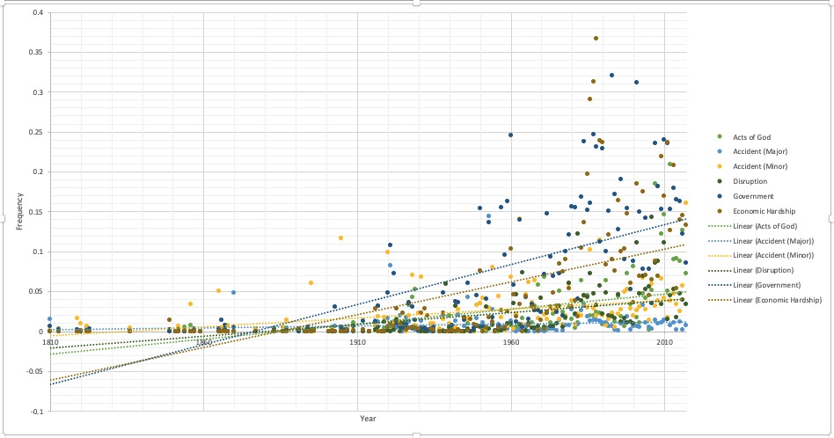
Events
Increasingly cases relate to economic hardship and governmental actions.

Slide 13
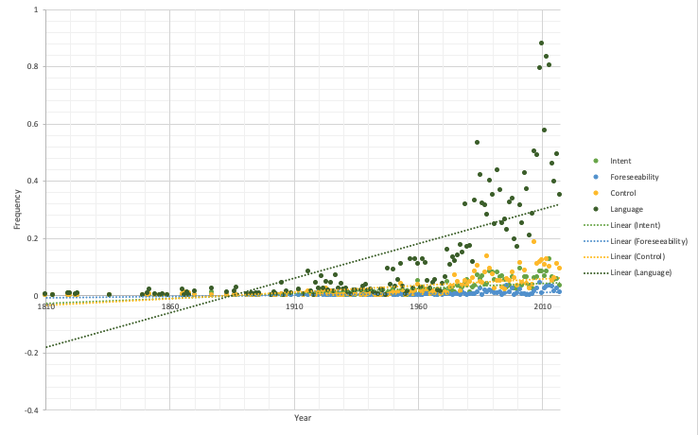
Reason
Use of intent & contractual language increasingly play a bigger role.

Slide 14
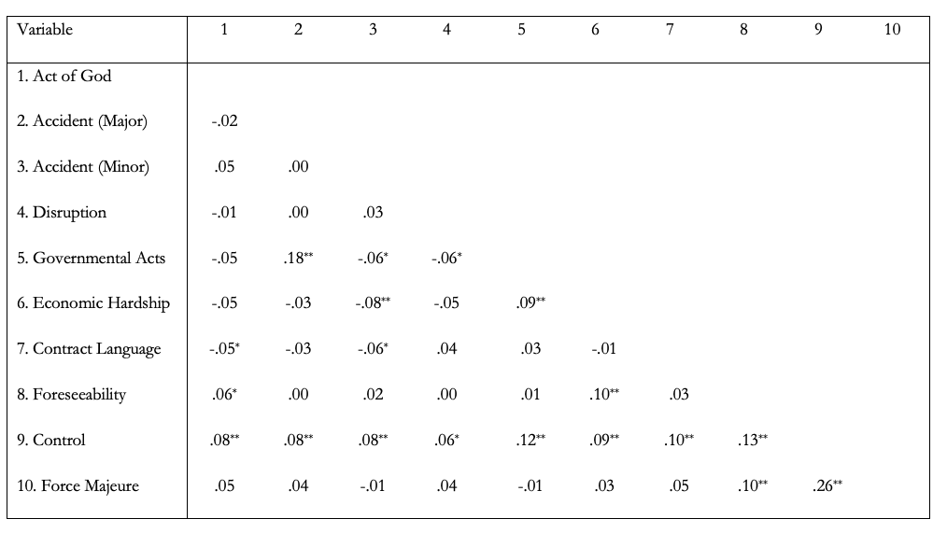
Correlation Analysis
As the table shows the factor control is positively related to all other variables whereas foreseeability and language are only positively related to two of the events.
Therefore, as courts engage more with the force majeure issue, they are more likely to deploy the control analysis and less so analysis related to foreseeability and contractual interpretation.

Slide 15
Direct Effect
Results show that there is no direct effect between the types of event and the courts’ weighted score for force majeure.

Slide 16
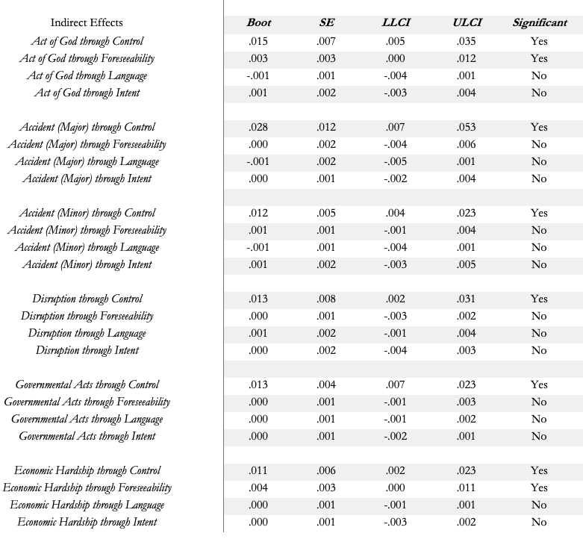
Interaction Effects
As to the indirect effect, the results show that the control variable always mediates the relationship between the event type and the weighted score of force majeure. In other words, the discussion about control explains why there is a relationship between the event and the weighted score for force majeure.
The language variable (along with intent) however never mediates the relationship. The foreseeability predictor only mediates in events related to act of God and economic hardship.

Slide 17
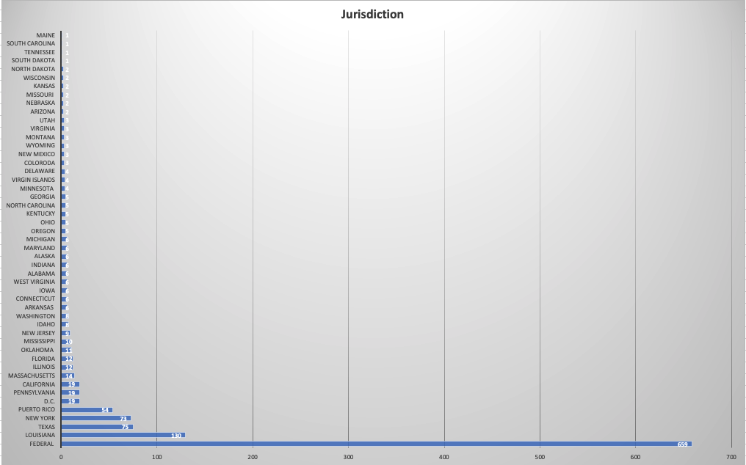
Jurisdiction

Slide 18
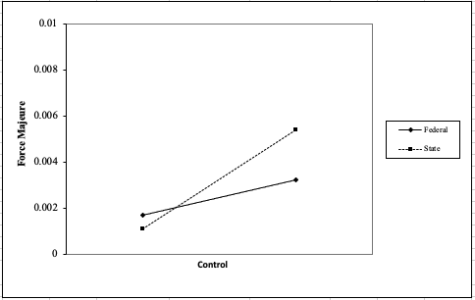
Impact of Jurisdiction
The result suggest that jurisdiction only plays a major moderating effect for the control variable. This means that the relationship between control and force majeure is strengthen at the state level.

Slide 19
Robustness Check (Cosine Similarity)
Phrase | Force | Majeure | Similarity
Control | 0.49 | 0.50 | Relatively High
Foresee | 0.17 | 0.11 | Low
Intent | 0.25 | 0.24 | Relatively Low
Language | 0.37 | 0.35 | Relatively Low
Interpret | 0.25 | 0.24 | Relatively Low
TF-IDF vectorizer technique suggests a strong connection between the word control and force majeure.

Slide 20
Hand Coding
Dummy code (reject, accept, not sure).
Cases that have accepted force majeure argument are positively related (marginally siginificant – P value of 0.6) to the number of times the term force majeure appeared in those case.
Cases that have rejected force majeure arguments are negatively related to the number of times the term force majeure appeared in those cases.
It is reasonable to conclude that the more courts discuss force majeure (hence for frequency score for force majeure) the more likely they are to accept the force majeure argument.

Slide 21
Results Summary
Ex post analysis (beyond-parties-control standard) based on control plays a determinative role in cases related to force majeure clauses.
Types of event does not tend to predict the outcome.
State courts tend to engage more with the standard of control.

Slide 22
Inquiry III
What is the most efficient and equitable approach?

Slide 23
Promisee's Position
The missing piece => promisee's position
Normatively, the courts should expand their standards for force majeure analysis.
Courts need to shift the focus on the degree to which promise
(a) has detrimentally relied on the promise,
(b) change his/her position,
(c) justice so requires,
Consequently, damages should go beyond restitution and cover reliance damages if performance is excused.

Slide 24
Second Restatement § 90
A promise which the promisor should reasonably expect to induce action or forbearance on the part of the promisee or a third person and which does induce such action or forbearance is binding if injustice can be avoided only by enforcement of the promise. The remedy granted for breach may be limited as justice require

