Slide 1

Managing Change

Slide 2

WELCOME
Be present
Be courteous
Be engaged

Slide 3

AGENDA
1. Introductions & Objectives
2. Change: Importance & Ubiquity
3. A VUCA World: Critical Leadership Behaviors.
4. Change Model: 3 Phases.
5. Wrap-up

Slide 4
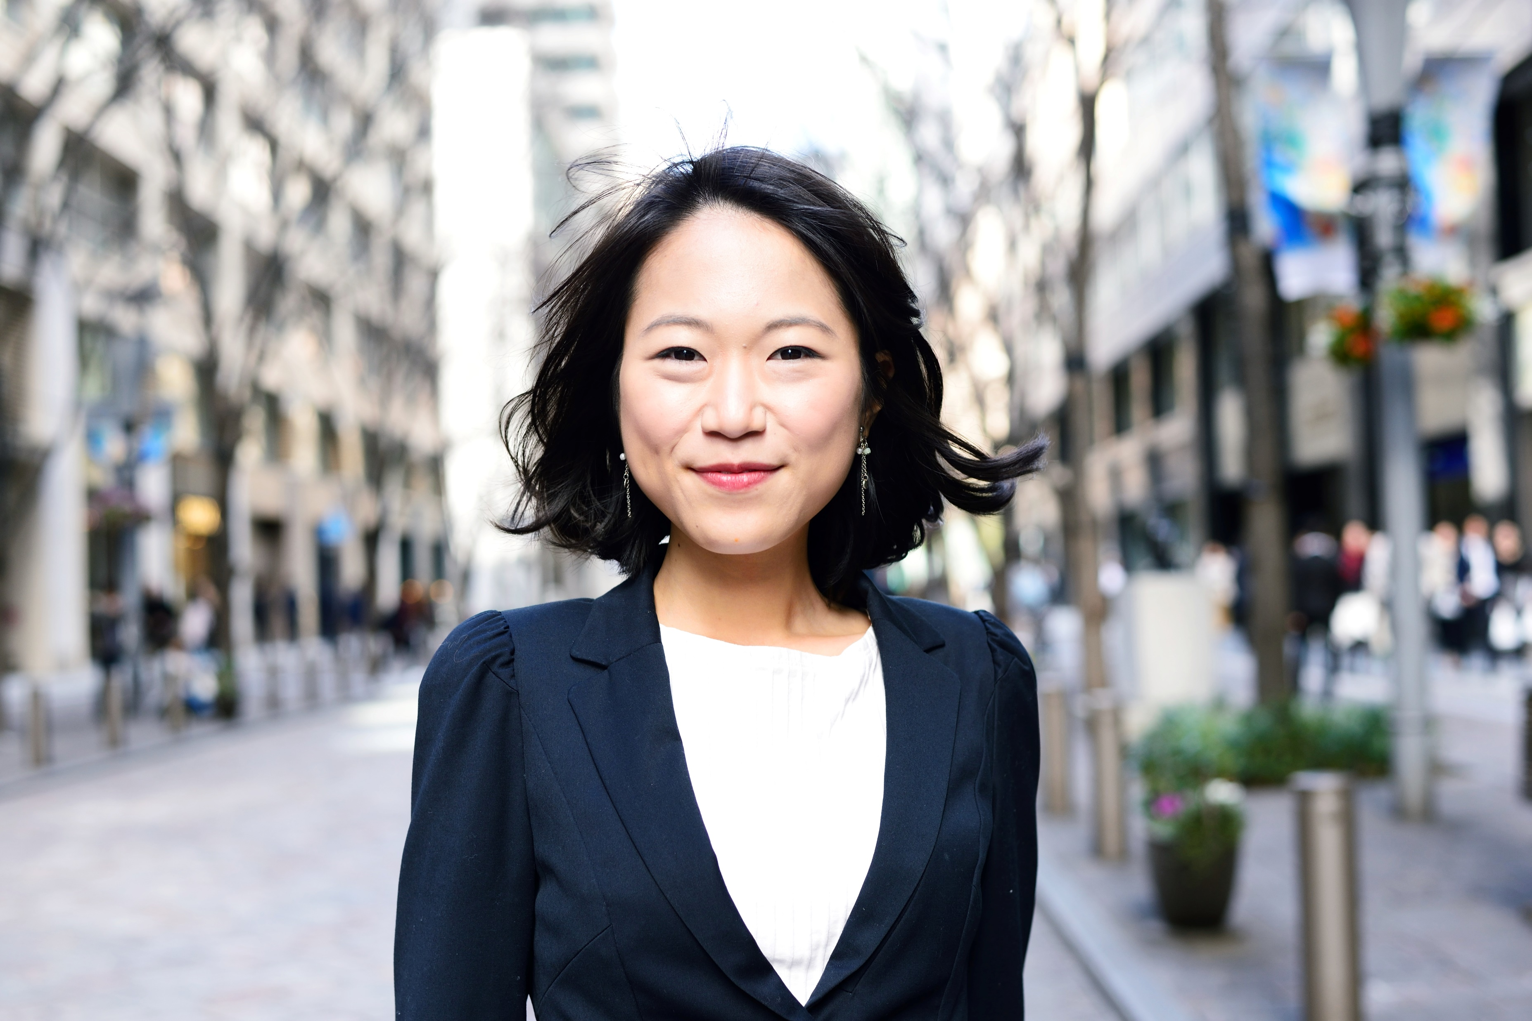

Introduction – Meet Us
FACILITATOR NAME
PRODUCER NAME

Slide 5

A FEW NOTES…
Need pen & paper for journaling and reflection.
Message [producer] in chat with questions / tech issues.
PPT. will be sent out after the training.
Keep your camera on if possible.
Mute when not speaking.
Keep background noise to a minimum.

Slide 6

Learning Objectives
Explain the concept of a VUCA world.
Articulate critical leadership behaviors that drive changes.
Examine three phases of the change model.

Slide 7
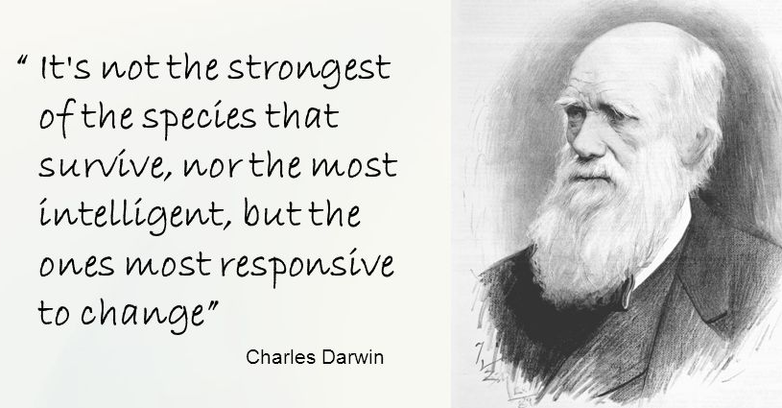
CHANGE
"Change is inevitable. Growth is optional." — John Maxwell
"All is flux, nothing stays still." ― Plato

Slide 8


Activity: Journal
Which quote about change resonates with you the most? Why?

Slide 9


Navigating a VUCA World
Volatile
Uncertain
Complex
Ambiguous

Slide 10
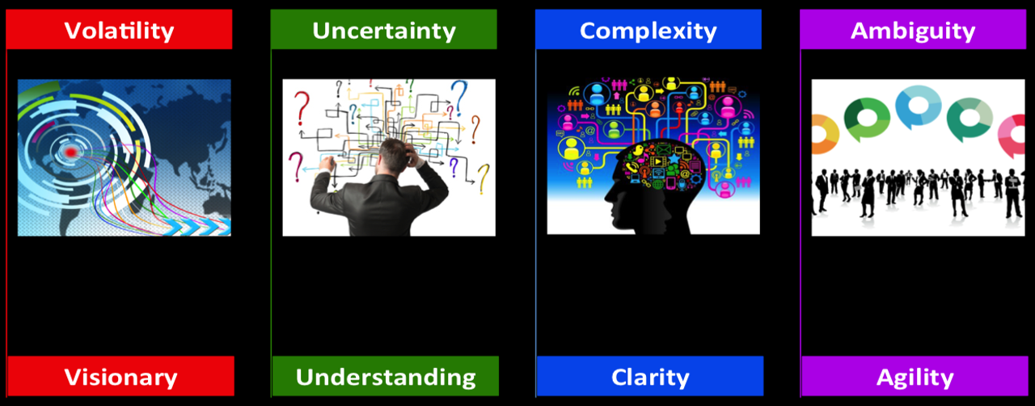
Where have you delt with volatility before?
How might acting with vision mitigate volatility?
Critical Leadership Behavior: VISION

Slide 11
How does your team function with uncertainty?
What understanding is needed to counteract uncertainty?
Critical Leadership Behavior: UNDERSTANDING

Slide 12
What factors make change complex?
How does clarity counteract complexity?
Critical Leadership Behavior: CLARITY

Slide 13
How has ambiguity impacted a recent project?
How might being agile mitigate ambiguity?
Critical Leadership Behaviors: AGILITY

Slide 14

During
Leader Response
Engages
Is Authentic
Thinks Critically
Communicates
Critical Leadership Behaviors: A Summary

Slide 15

Activity: Scenarios

Slide 16

BREAK OUT DISCUSSION
GOAL
Apply leadership behaviors to address a VUCA challenge.
PROMPTS
Complexity: Organizational Restructuring
Volatility: Market Disruption

Slide 17




Complexity: Organizational Restructuring
Context: You are the HR director of a large conglomerate with diverse business units. The company wants to streamline operations and improve efficiency.
Scenario: The board decides to restructure the organization, merging departments, eliminating redundant roles, and introducing matrix reporting structures. Employees are confused about their new responsibilities.
Discuss:
How do you ensure clear communication about the changes and their rationale?
What training and support can you provide to help employees adapt to the new structure?
How do you address resistance from middle managers who fear losing power?

Slide 18

Volatility: Market Disruption
Context: You are the CEO of a traditional retail company that has been in business for decades. Your industry is facing rapid technological advancements and changing consumer preferences.
Scenario: A new e-commerce giant enters the market, offering same-day delivery, personalized recommendations, and competitive prices. Within a year, your company’s sales plummet, and you risk bankruptcy.
Discuss:
How do you adapt your business model to compete with the new entrant?
What strategies can you implement to regain customer trust and loyalty?
How do you manage the emotional impact on your employees during this volatile period?

Slide 19
Create Climate for Change
Engage and Enable the Organization
Implement and Sustain Change
Change Management Model:
3 PHASES

Slide 20
Activity: Journal
Which phase do you feel most comfortable leading and why?

Slide 21

1. ESTABLISH
a sense of urgency
Change Management Model:
8 Elements
A Look Forward
Creating a
Climate for Change
2. BUILD
a guiding coalition
3. DEVELOP
vision and strategy
4. COMMUNICATE
change vision
Engaging and Enabling the Organization
5. EMPOWER
broad-based action
6. GENERATE
short-term wins
7. CONSOLIDATE
gains, produce more change
Implementing and Sustaining Change
8. ANCHOR
new approaches in culture

Slide 22
BREAK OUT DISCUSSION
GOAL
Consider how you might apply today’s knowledge to a current business endeavor.
PROMPTS
Identify a change you are in the process of leading.
Which phase are you in? What is going well?
What supports do you need?

Slide 23

WRAP-UP

Slide 24

What we covered…
We defined how a VUCA world impacts our company.
We discussed critical leadership behaviors to respond to changes in a VUCA world.
We looked at the 3 phases of our change model and where our strengths as leaders lie.

Slide 25

FINAL RELECTION
What are your next steps toward leading a particular change?

Slide 26

Thank you

