Slide 1

Expecting the Unexpected: Coping with surprises in Probabilistic and Scenario Forecasting
Max Henrion
Chief Executive Officer
Lumina Decision Systems, Inc.
Los Gatos, California
henrion@Lumina.com
Presentation at INFORMS Analytics Conference April 2011
Bringing clarity to green decisions

Slide 2
Overview
The challenges of forecasting: Black Swans – are they inherently unpredictable?
Expert elicitation of probabilistic forecasts
Brainstorming to expect the unexpected
Using past errors to estimate future uncertainty

Slide 3
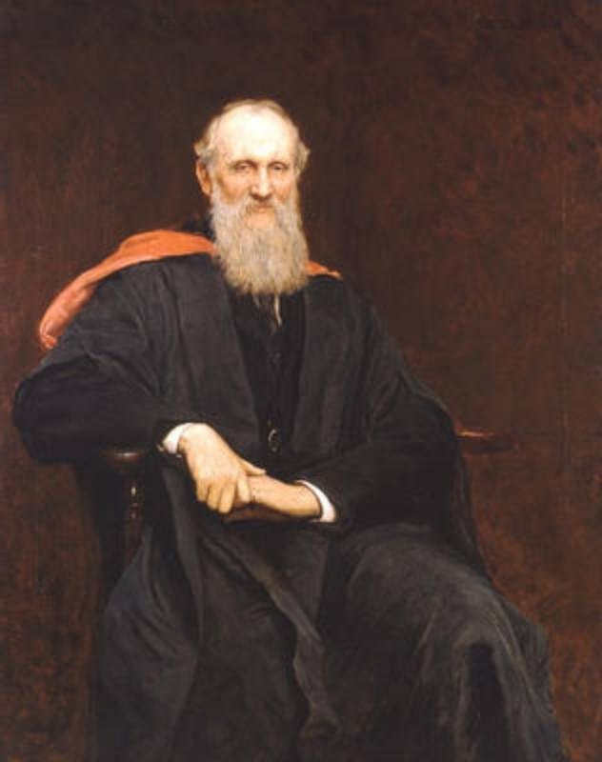
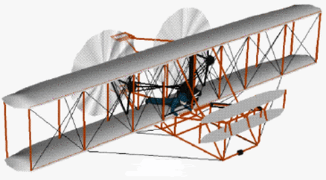
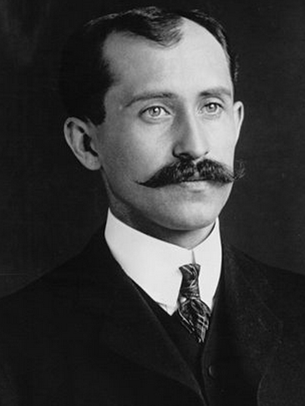
Lord Kelvin
There is nothing new to be discovered in physics now. All that remains is more precise measurement.
1900
1903
Heavier-than-air flying machines are impossible.
Wilbur
Wright
“I confess that in 1901, I said to my brother …that man would not fly for 50 years. Ever since I have distrusted myself and avoided all predictions.”
Sir William Thompson,
Lord Kelvin 1824-1907

Slide 4
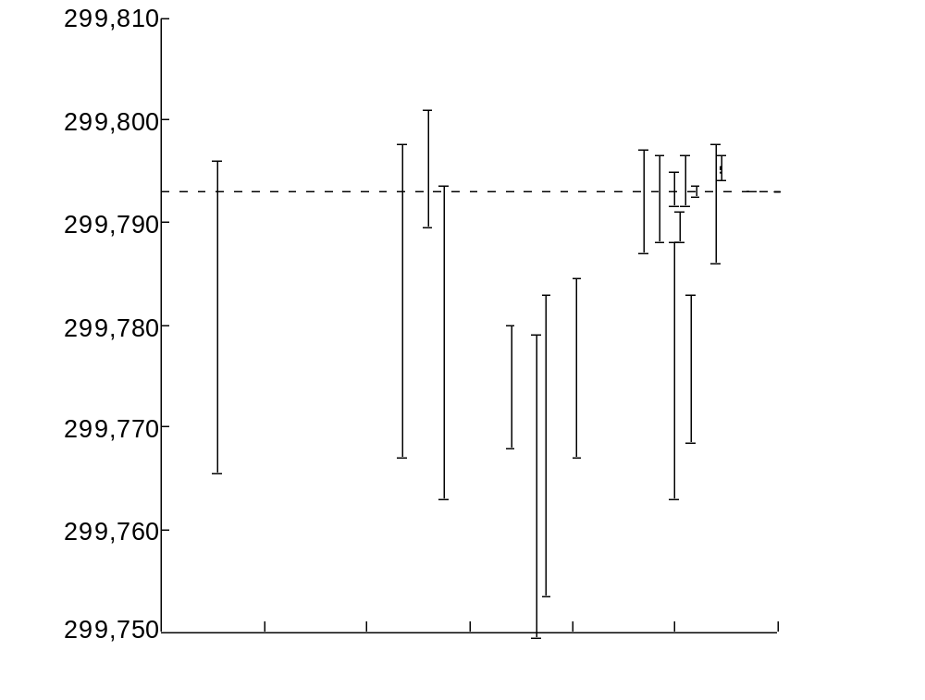
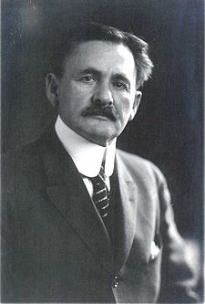
Reported uncertainty in measurements of c, the speed of light
Km/sec
Michelson 1926
Value now accepted
Rosa & Dorsey 1906
Albert Abraham Michelson 1852-1931
Henrion, M & Fischhoff, B, “Assessing uncertainty
in physical constants”,
American J. Physics,
54 (9), 1986
Michelson, Pease & Pearson, 1935
1900
1910
1920
1930
1940
1950
1960

Slide 5
Calibration of uncertainty in measurements of physical constants
Quantity | Date | N | Birge ratio | Surprise index
c, speed of light | 1875 - 1964 | 27 | 1.42 | 11%
G, gravitational const. | 1798-1983 | 14 | 1.38 | 29%
μ’_{p}/μ_{n} magnetic moment | 1949-1967 | 7 | 1.44 | 14%
α⁻¹, inv. fine structure |  | 24 |  | 38%
Ω_{ABS}/Ω_{NBS} | 1938-1968 | 7 | 0.40 | 0%
Particle lives |  | 92 | 1.26 | 9%
Particle masses |  |  |  | 6%
Recommended values | 1928 - 1973 | 40 | 7.42 | 57%
Gaussian distribution |  |  | 1.00 | 2%
Henrion, M & Fischhoff, B, Assessing Uncertainty in Physical Constants, American J. Physics, 54 (9), 1986

Slide 6
Why do precision metrologists underestimate extremes?
They trim outlier observations
They keep refining the apparatus and eliminating biases until the results seem as expected
Unexpected results are harder to publish

Slide 7


The Black Swan
Nassim Taleb
A Black Swan event
Is an outlier - rare and unexpected
Has extreme impact
Is explainable and predictable – only in retrospect

Slide 8
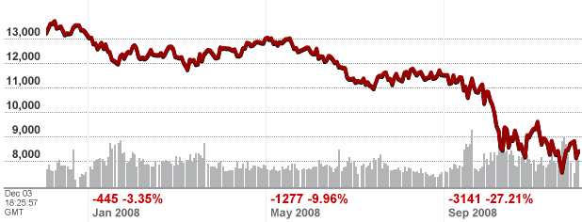
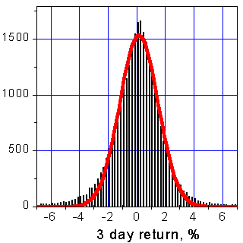
Market prices are not normal
Market price distributions are thick-tailed, not Gaussian
But conventional financial models – e.g. Markovitz CAP and Merton-Black-Scholes for pricing options – assume Gaussian volatility, part of the problem
In October 2008, Taleb’s Hedge Fund, Universa Investments was up by 115%, using put options on long tail.
So maybe we can bet on “surprises”!

Slide 9
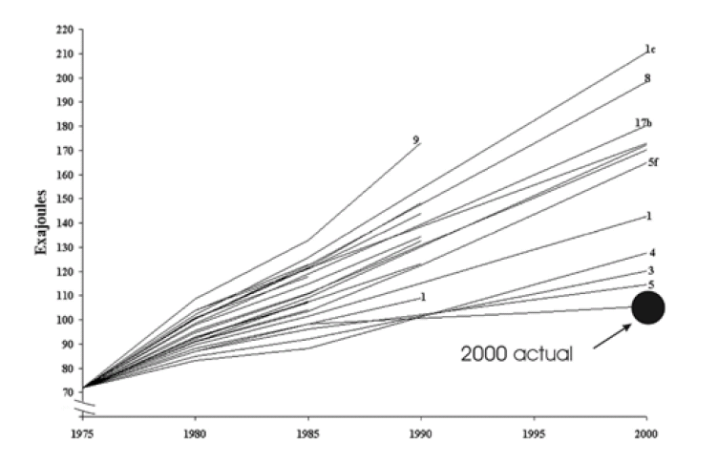
US Primary energy use in 2000 from 1970s
Actual in 2000
Projections of total US primary energy use from the 1970s
From “What can history teach us? A Retrospective from Examination of Long-Term Energy Forecasts for the United States” PP Craig, A Gadgil, and JG Koomey, Ann. Review Energy Environ. 2002. 27.
Redrawn from US Dep. Energy. 1979. Energy Demands 1972 to 2000. Rep. HCP/R4024-01. Washington, DC: DOE.

Slide 10
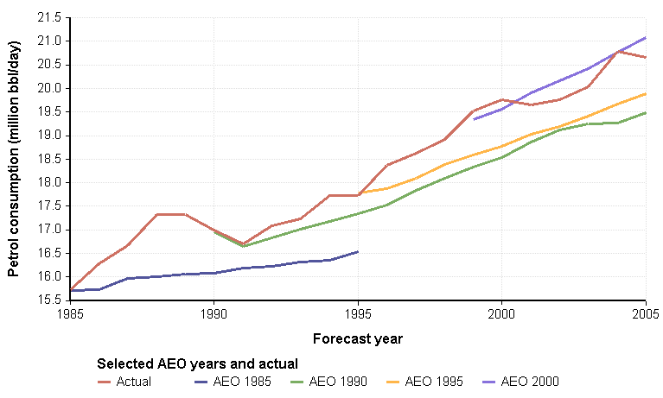

Retrospective review of AEO forecasts:
US Petrol consumption (million bbl/day)
AEO 2000
Actual
AEO 1995
Actual
AEO 1990
AEO 1985
Data from Annual Energy Outlook
Retrospective Review 2006

Slide 11
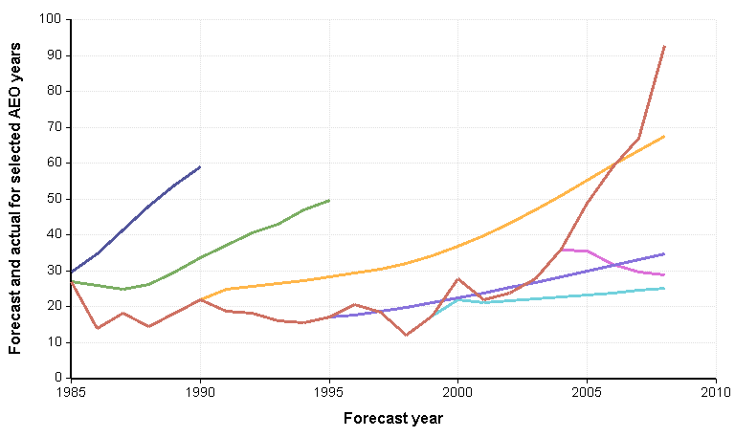
Retrospective review of AEO forecasts:
World oil price ($/barrel)
Actual
AEO 1982
AEO 1985
AEO 1990
AEO 1995
AEO 2005
AEO 2000
Actual
Data from Annual Energy Outlook: Retrospective Review 2009.

Slide 12

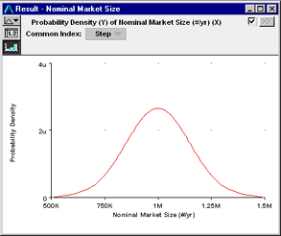

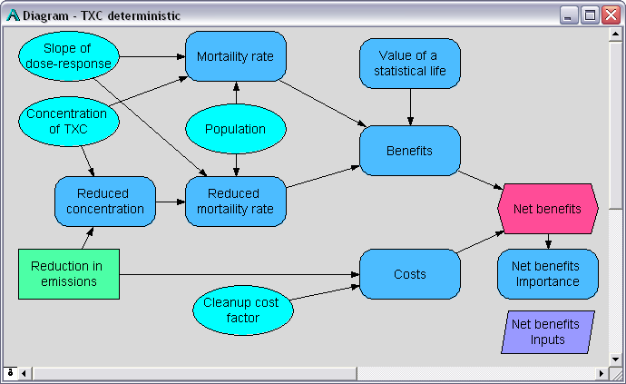
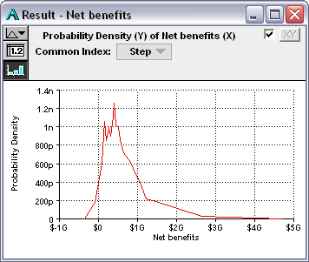
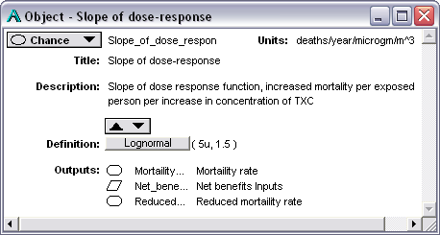
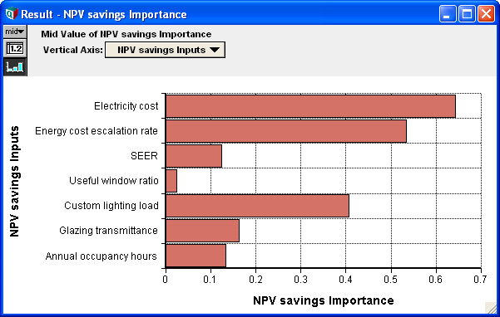

Probabilistic simulation for forecasting and decision making
1. Express uncertainty by eliciting probability distributions from experts
3. View uncertainty on key results
5. Make a decision
2. Use Monte Carlo simulation to propagate probability distributions through the model.
4. Use sensitivity analysis to compare effects of uncertain assumptions on results

Slide 13
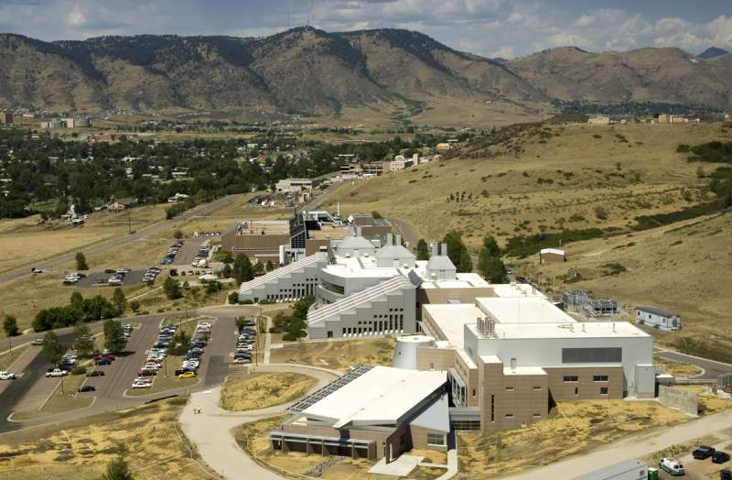

SEDS: Stochastic Energy Deployment System
Energy resources
Converted Energy
Converted energy
Demand
SEDS provides projections of US energy markets to 2050, and effects on GHG emissions, energy costs, and oil imports
Its evaluates the effects of DoE’s R&D programs on energy efficiency and renewable energy
It assesses the uncertain effects of R&D on future improvements in technology performance.
It treats uncertainties explicitly using probability and Monte Carlo
It is agile for rapid analysis and modification
It provides transparency, using hierarchical influence diagrams
It is developed by NREL and six other national labs plus Lumina
Built in
Biomass
Biofuels
Buildings
Coal
Electricity
Industry
Macro-
economics
Natural
Gas
Hydrogen
Light
Vehicles
Oil
Liquid
Fuels
Heavy Vehicles

Slide 14









SEDS: A Nationwide Collaboration
Collaboration led by NREL with five national labs plus Lumina

Slide 15
Representative energy efficiency and renewable energy technologies
Wind: Onshore and offshore
Solar
  Photovoltaics
    Crystalline silicon
    Thin film
    Concentrating PV
    At residential, commercial, and utility scale
  Concentrating solar power
    Parabolic trough
    Power tower with 6 hrs thermal storage
Biomass:
  Ethanol: From corn and cellulosic
  Electricity generation from biomass
Enhanced geothermal
  Exploration
  Wells/pumps/tools
  Reservoir engineering
  Power Conversion
Industrial energy efficiency
  12 technologies aimed at reducing energy use and GHG emissions from a wide variety of industries
Hydrogen
  Hydrogen production
    Central natural gas
    Distributed natural gas reformation
    Central biomass gasification
    Central wind electrolysis
    Distributed ethanol reformation
    Compression, storage, & dispensing
  Hydrogen storage
    350 bar or 70 bar compression
    Liquid
    Cryogenic
    Adsorbents
    Metal hydrides
    Chemical hydrides
  Hydrogen fuel cell: PEM
Buildings
  Windows: Dynamic or highly insulating
  LED lighting
  Photovoltaics for residential and commercial use
Vehicles: including spark ignition, diesel, flex fuel, hybrid, plug-in hybrid, battery, hydrogen fuel cell

Slide 16
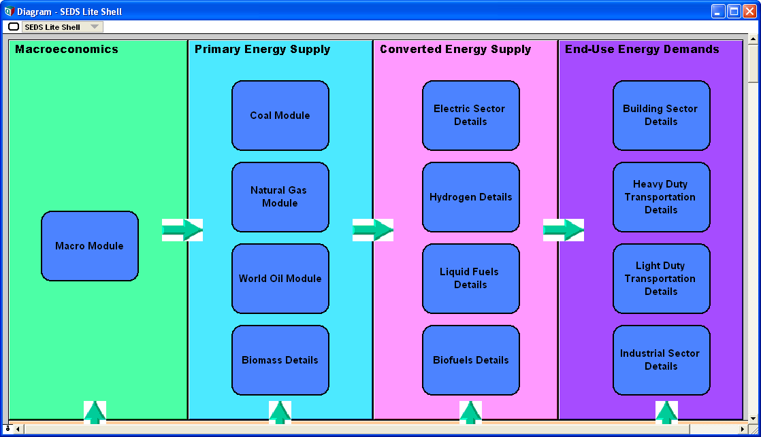
SEDS: Stochastic Energy Deployment System.
Main Modules
Energy resources
Converted Energy
Converted energy
Demand
Biomass
Biofuels
Buildings
Coal
Electricity
Industry
Macro-
economics
Natural
Gas
Hydrogen
Light
Vehicles
Oil
Liquid
Fuels
Heavy Vehicles

Slide 17
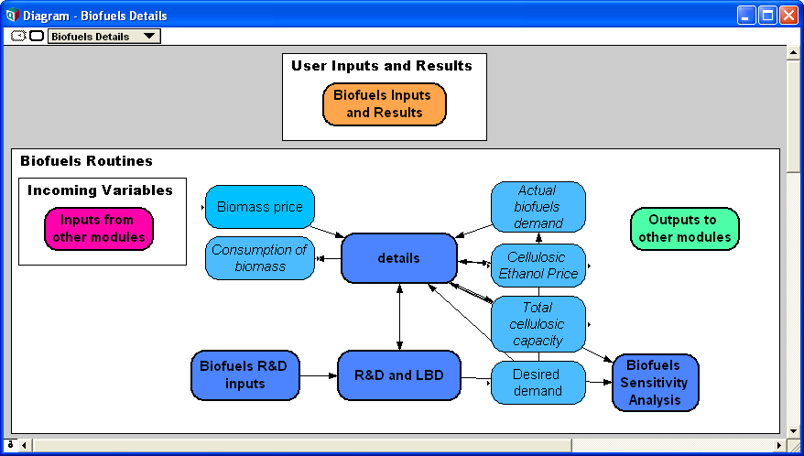
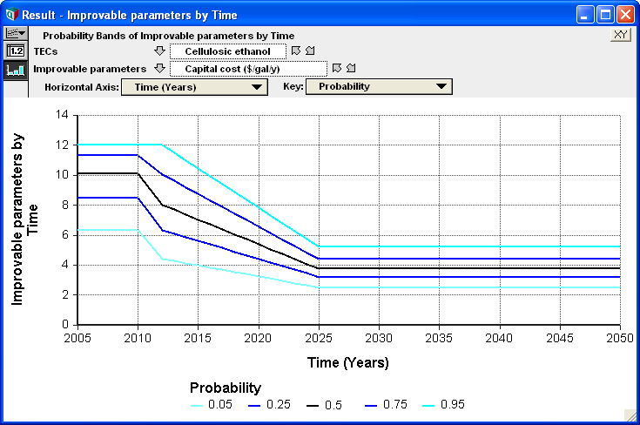
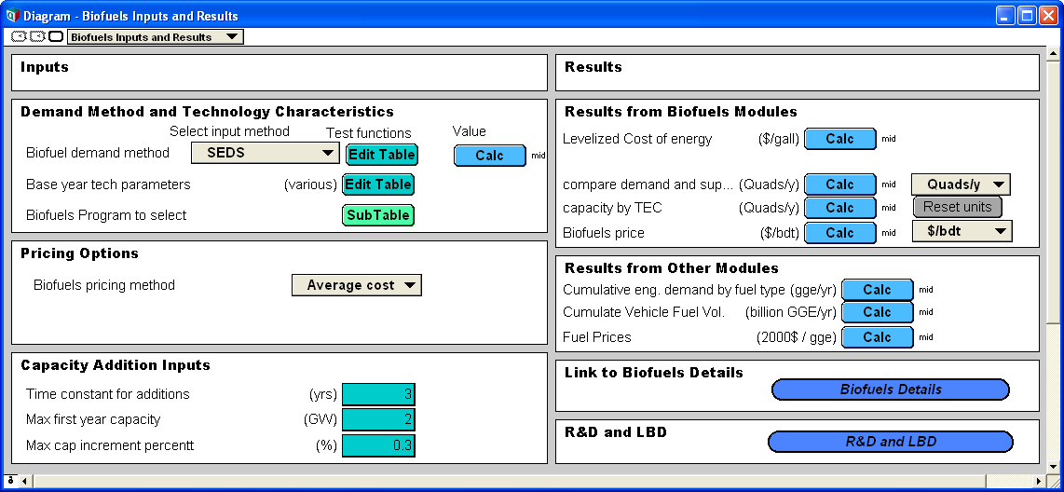
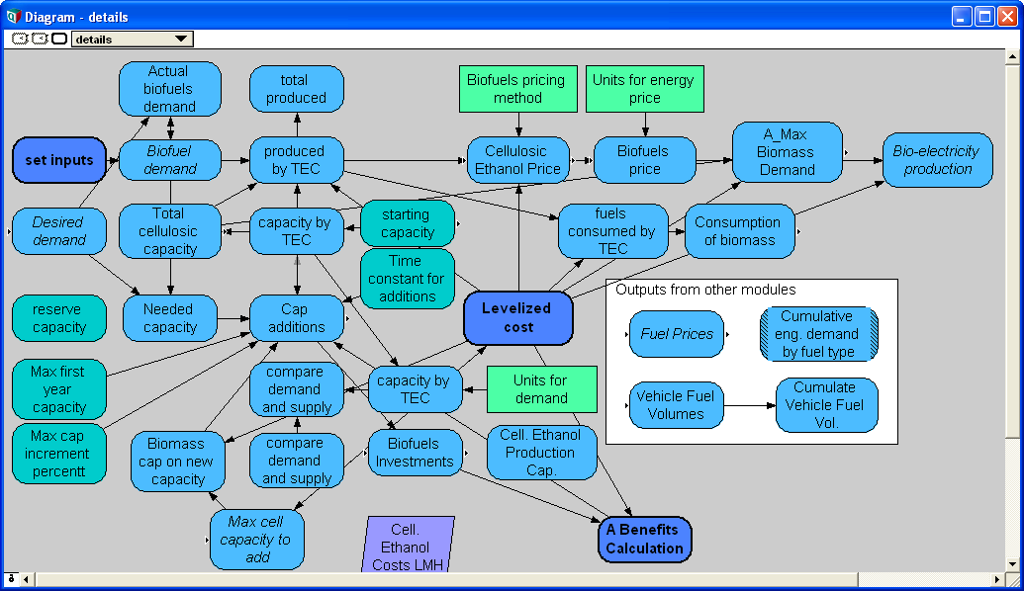
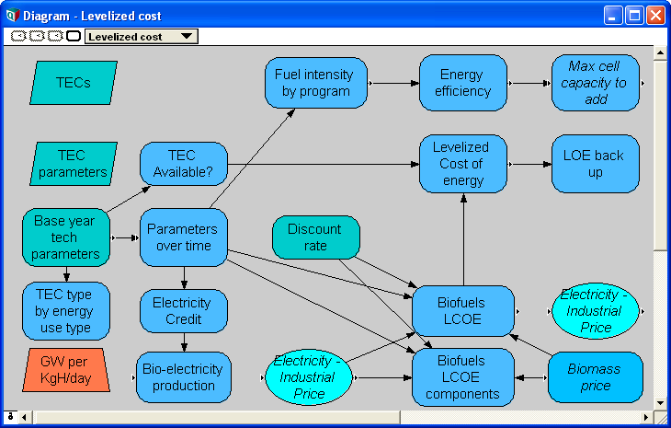
Diving into SEDS
Energy resources
Converted Energy
Converted energy
Demand
Biomass
Biofuels
Biofuels
Buildings
Coal
Electricity
Industry
Macro-
economics
Natural
Gas
Hydrogen
Light
Vehicles
Oil
Liquid
Fuels
Heavy Vehicles
Top level view of main modules.
Let’s open up Biofuels details….

Slide 18
Assessing uncertainty about the effect of R&D
Expert elicitations to assess uncertainty about the future performance of each technology as probability distributions
  Selected technology performance metrics (TPMs):
    E.g. efficiency (%), unit capital cost ($/KW), operating cost ($/Kw/y), and capacity factor
  For selected goal years -- e.g. 2015 and 2025
  Conditional on R&D funding levels:
    Zero: No R&D funding by DoE.
    Target: Current R&D funding plan
    Double: 2 x Target funding
Probability elicitations with over 180 experts on 40 technologies

Slide 19
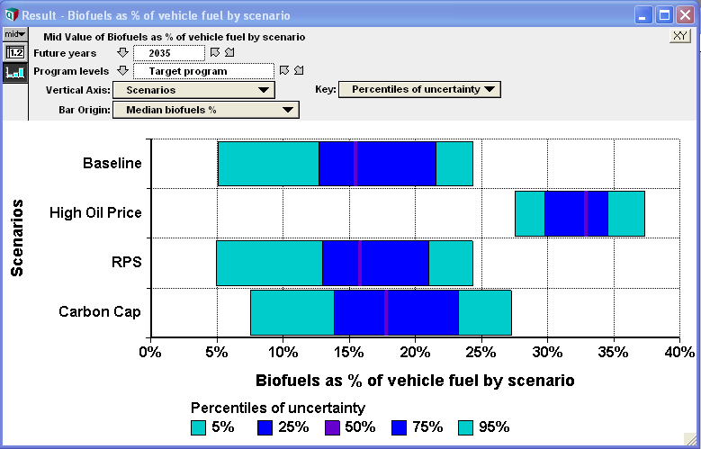
Biofuels as % of light vehicle fuel by scenario for 2035: : Stochastic
Numbers and graphs are purely illustrative

Slide 20
How to express uncertainty as probability distributions
Judgment is unavoidable in extrapolating from what we know to what we need to make decisions about. Let’s be explicit about it
Probability is the clearest, most widely used language for expressing uncertainty.
Obtaining probability distributions from a range of experts is the best way to quantify the current state of knowledge (and lack thereof)
There are well-developed methods for obtaining expert judgment as probability distributions
Careful elicitation methods can minimize cognitive biases
Uncertainty: A Guide to Dealing with Uncertainty in Risk and Policy Analysis. M Granger Morgan & Max Henrion, Cambridge UP, 1990

Slide 21
A little exercise: Please assess your subjective probability intervals
1st percentile: x₁ is a value such that you assess a 1% probability that the true value is smaller than x₁.
99th percentile: x₉₉ is a value such that you assess a 1% probability that the true value is larger than x₉₉.
Please assess a 1st and 99th percentile to express the uncertainty in your knowledge in the following quantities:
The length of the Golden Gate Bridge, including approaches and central span? 1%ile: 99%ile: 9
What is the maximum capacity in Megawatts of the Moss Landing Power Plant? 1%ile: 99%ile: ________
What was the total budget for NOAA in FY2008 (President’s request)?
1%ile: 99%ile: _________

Slide 22
A little exercise: Please assess your subjective probability intervals
1st percentile: x₁ is a value such that you assess a 1% probability that the true value is smaller than x₁.
99th percentile: x₉₉ is a value such that you assess a 1% probability that the true value is larger than x₉₉.
Please assess a 1st and 99th percentile to express the uncertainty in your knowledge in the following quantities:
The length of the Golden Gate Bridge, including approaches and central span? 1.7 miles (8,981 feet or 2,737 m)
What is the maximum capacity in Megawatts of the Moss Landing Power Plant? 2560 Megawatts
What was the total budget for NOAA in FY2008 (President’s request)? $3,815 million

Slide 23
Overconfidence in subjective probability ranges
Well calibrated = 2%
Redrawn from M. Granger Morgan and Max Henrion, Uncertainty: A Guide to Dealing with Uncertainty in Quantitative Risk and Policy Analysis, Cambridge Univ Press: New York, 1990

Slide 24
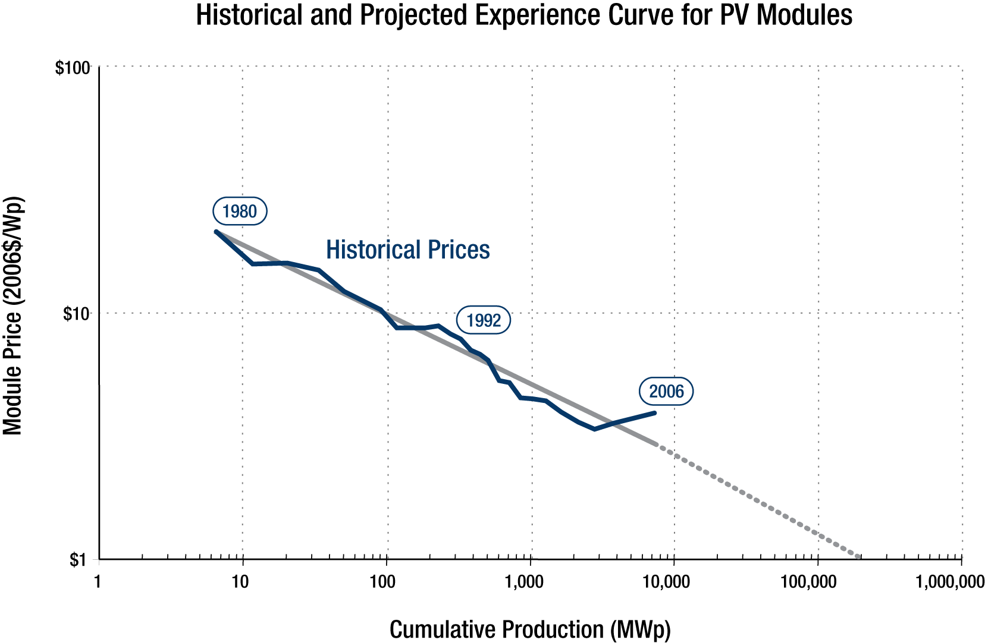

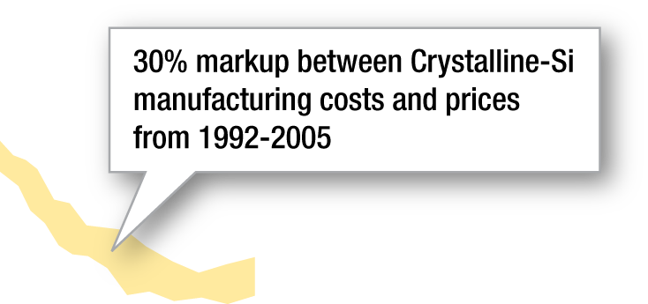

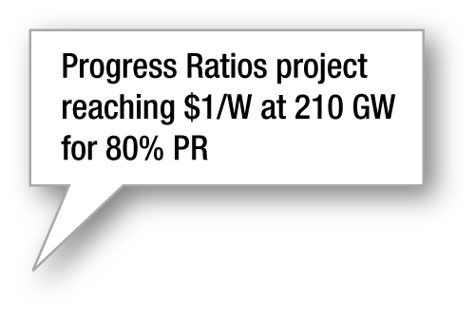

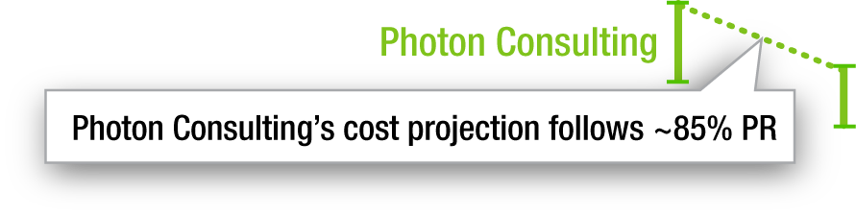
Learning curves for photovoltaic power:
Past and projected as a function of experience
Notes:
24

Slide 25


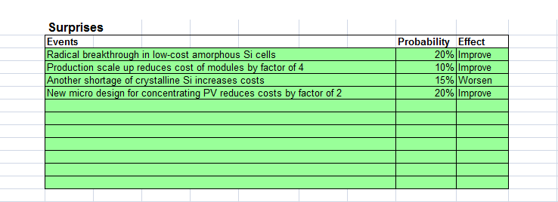
How to expect the unexpected:
Brainstorming for surprises
Assemble a collection of experts, with a wide set of views.
Remind us of examples of past surprises in the domain of interest
Set a light, relaxed, creative tone. Ask for suggestions, without criticism
Ask for extremes & surprises:
Black Swans and Gold Swans
Record on a whiteboard or wall of bright post-its.
Build on each others ideas: Think through consequences, and interactions.
Finally, ask experts to rate probabilities
in photovoltaics

Slide 26
Sample Black Swans in energy
(and some Gold Swans)
Past
1950’s nuclear power would be “too cheap to meter”, but in 1970s, the high cost in US stopped building.
Oil prices: 1978, 2004, 2008, 2011
Low cost of sulfur controls on power plants to meet US Clean Air Act 1990 SOx emissions
Natural gas price dropped due to abundance from shale 2008-10
Future
Oil price>$300/bbl in 2012
Grid-parity for photovoltaics in 2014: $1/Watt -> $0.06/kWh
Genetically engineered organisms to convert cellulosic biomass to drop-in fuels
“Artificial leaf” catalytic photosynthesis of hydrogen for storable electricity
Americans embrace small, light vehicles

Slide 27
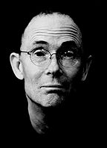
How can we imagine the future?
“The future is already here —
it’s just not very evenly distributed.”
William Gibson

Slide 28
Retrospection on past AEO forecasts:
World oil price ($/barrel)
Actual
AEO 1982
AEO 1985
AEO 1990
AEO 1995
AEO 2005
AEO 2000
Actual
Data from Annual Energy Outlook: Retrospective Review 2009.

Slide 29
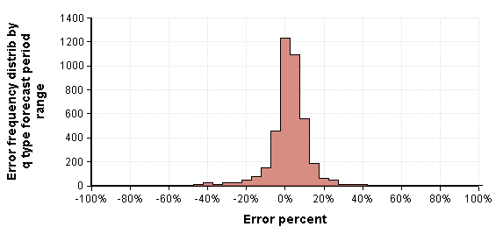
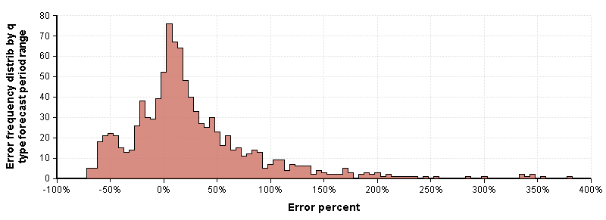
Distributions for percent error in AEO Forecasts 1980 to 2008
Energy production and consumption (12 quantities)
Energy prices (4 quantities)
Data from Annual Energy Outlook: Retrospective Review 2009.

Slide 30
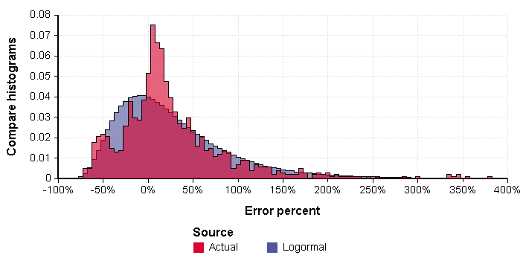
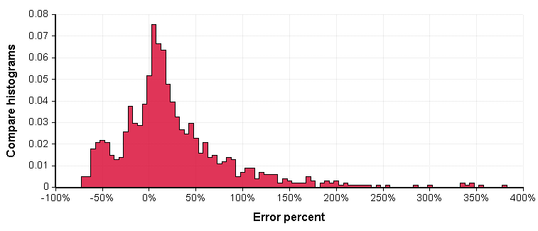

Fitting the empirical error distribution for AEO energy price forecasts
Lognormal

Slide 31
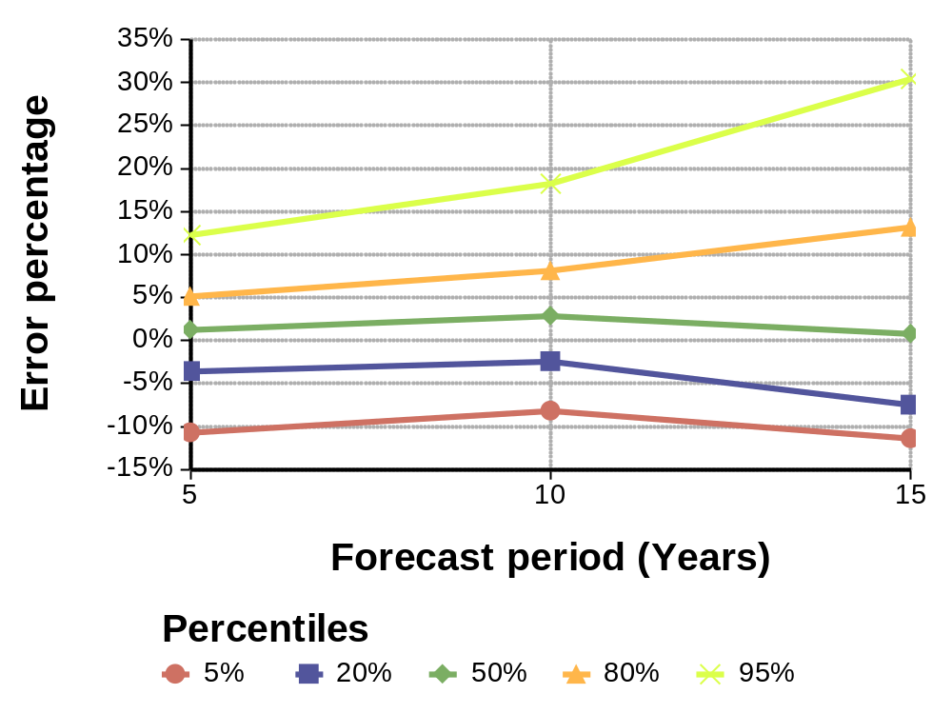
Error widths for12 energy quantities:
They increase over time, but not as much as you might expect
95%ile
80%ile
50%ile
20%ile
5%ile
1 to 5
6 to 10
11 to 15
Forecast period (years)
Data from Annual Energy Outlook: Retrospective Review 2007.

Slide 32
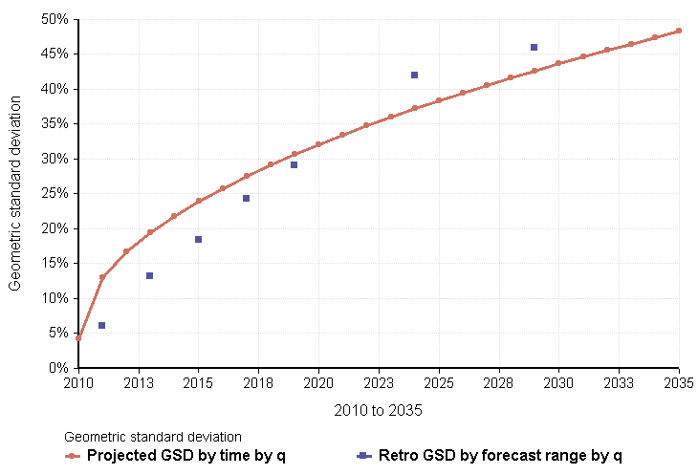
Error by forecast range:
(geometric standard deviation)
Total energy intensity (quads/$billion GDP)
Projected GSD = Base_GSD
+ GSD/inc x (Time-Base_year)^0.5

Slide 33
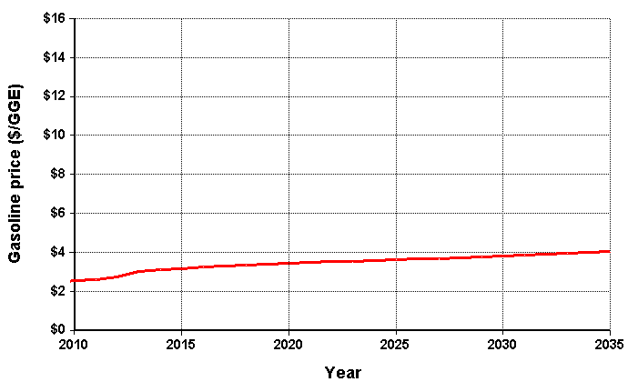
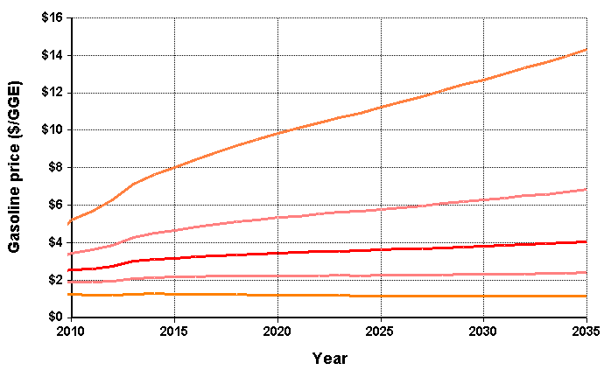
Apply retrospective error distribution to estimate uncertainty in forecast price of gasoline
95%ile
75%ile
50%ile
25%ile
5%ile
The median (50%ile) is the AEO 2009 Reference case
Uncertainty using lognormal fitted to oil price errors by forecast range (1 to 25 years)

Slide 34
Apply retrospective error distribution to estimate uncertainty in forecast price of gasoline
95%ile
75%ile
50%ile
25%ile
5%ile
The median (50%ile) is the AEO 2009 Reference case
Uncertainty using lognormal fitted to oil price errors by forecast range (1 to 25 years)

Slide 35
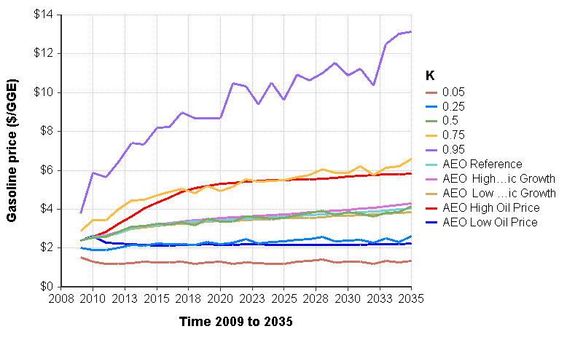
Compare AEO 2009 forecast scenarios with uncertainty from past error
Percentiles from uncertainty fitted to AEO oil price errors over forecast range applied to median from AEO 2009 Reference case
Compare to five AEO cases, High and Low Economic Growth, High and Low Oil prices.

Slide 36
Retrospective uncertainty assessment:
Some observations
Some types of quantity (prices) are less predictable than others (energy flows).
You need a long history for useful calibration.
Large errors are often due to Black Swan events, outside and beyond the model.
So, error distributions have long tails — not Gaussian.
Expect gold swans as well as black swans

Slide 37
Summary: Quantifying forecast uncertainty
Forecasts are inevitably uncertain:
We might as well embrace uncertainty explicitly
Elicitation of expert assessments as probability distributions
  Find the best experts
  Use a careful elicitation protocol
  Highlight extremes and brainstorm “surprises” to counter overconfidence
Retrospective error analysis of past forecasts
  Shows you how well we did in the past
  Long-tailed distributions capture past Black Swans
  Probabilistic forecasts on key quantities are becoming available
Expert elicitation and retrospective error analysis are complementary
The future might be yet more unpredictable:
Results will be lower bounds on uncertainty

Slide 38
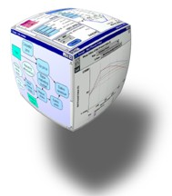
Bringing clarity to green decisions

Slide 39
References
Expecting the Unexpected: Coping with surprises in Probabilistic Forecasting
M. Henrion & B. Fischhoff, "Assessing Uncertainty in Physical Constants", American Journal of Physics, 54, (9), September, 1986, pp. 791-798.
M. Granger Morgan and Max Henrion, Uncertainty: A Guide to Dealing with Uncertainty in Quantitative Risk and Policy Analysis, Cambridge University Press: New York, 1990.
Alexander I. Shlyakhter, Daniel M. Kammen, Claire L. Broido and Richard Wilson : The credibility of energy projections from trends in past data: The US energy sector, Energy Policy, Feb 1994
Laura Lee, Bad Predictions, Elsewhere Press, 2000.
PP Craig, A Gadgil, and JG Koomey, “What can history teach us? A Retrospective from Examination of Long-Term Energy Forecasts for the United States”, Ann. Review Energy Environ. 2002. 27.
Thomas Gilovich, Dale W Griffin, Daniel Kahneman, Heuristics and Biases: The Psychology of Intuitive Judgment, Edited by Cambridge UP, 2006.
Nassim N. Taleb, The Black Swan: The impact of the Highly Improbable, Random House: NY, 2007
www.lumina.com
Max Henrion
INFORMS Analytics Conference
Chicago, April 2011

