Slide 1
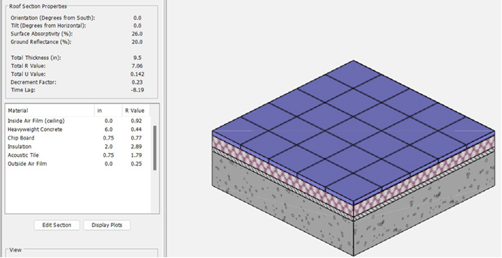
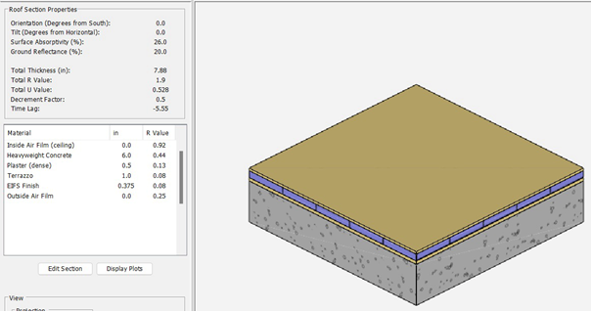
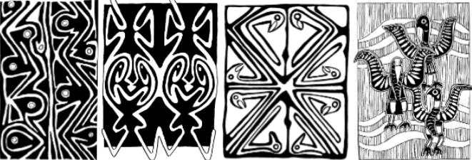
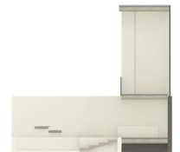
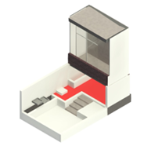
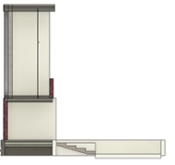
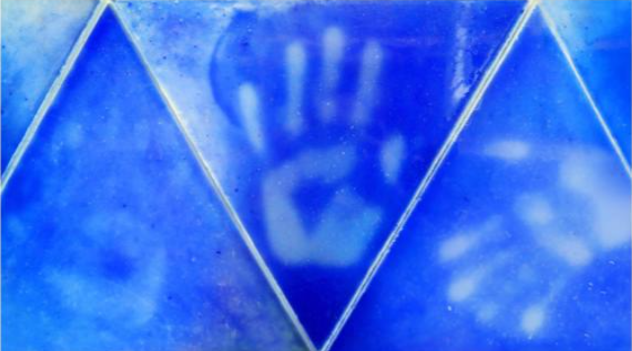
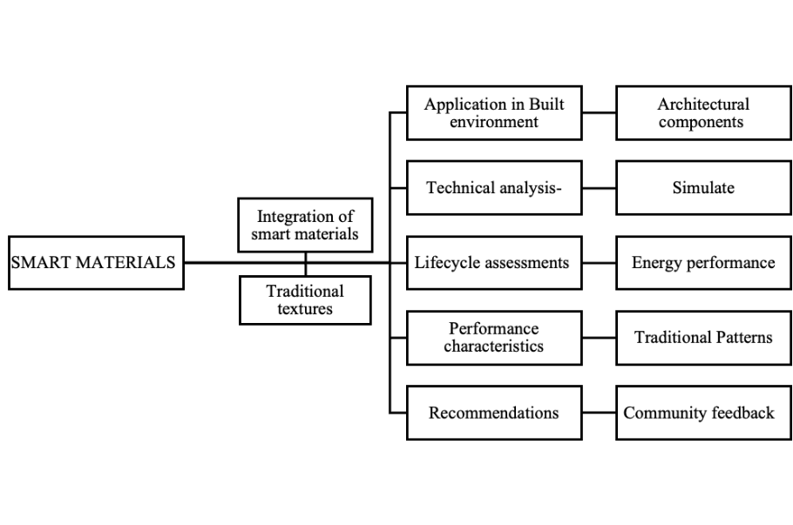
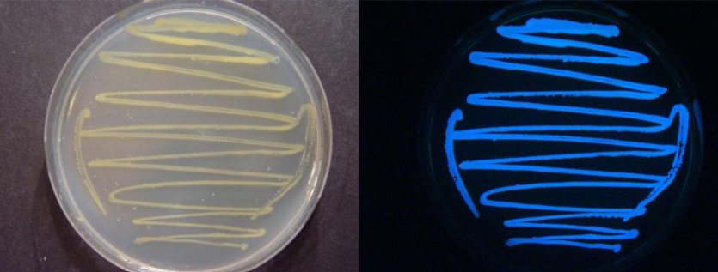
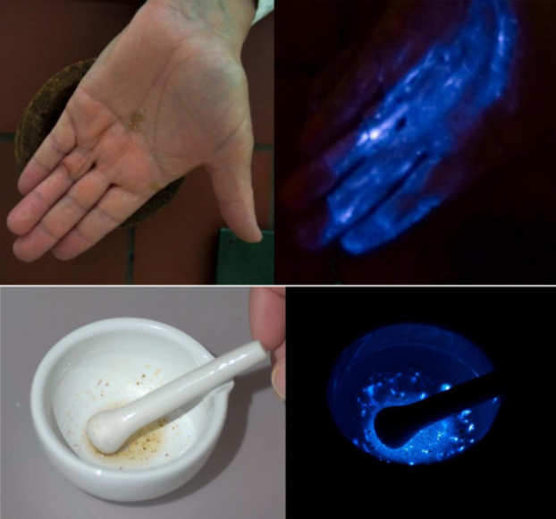
Integration of smart materials with traditional aesthetic
ABSTRACT
Introduction
Case study Analysis
Simulations
This research explores the integration of responsive and adaptive smart materials in modern architecture for a balance of sustainability and cultural heritage. Advanced materials such as Thermochromic glass, Shape memory polymers, and Phase change materials (PCMs), Bioluminescent paint, benefits energy efficiency and adaptability. The research will provide practical guidelines for designers to link innovation to traditional practices through literature reviews, advanced simulations, and community feedback.
Exploring the potential of energy conservation through successful case studies where smart materials blend modern functionality with traditional design elements. The aim is to achieve Digital models demonstrating significant energy savings, while physical prototypes replicating the application of traditional textures using modern materials that remain adaptable and culturally relevant.
The research emphasizes community involvement, with local focus groups evaluating prototypes for cultural and aesthetic relevance. Surveys and data analysis focused on performance criteria such as aesthetic satisfaction. The results suggest that preserving cultural heritage is central to customizing smart materials to enhance their applicability. The study concludes with general guidelines recommending collaboration between architects and material scientists to develop smart responsive materials that integrate innovation with tradition, fostering sustainable, culturally resonant architectural designs.
Keywords:
Responsive materials, thermochromic glass, shape memory polymers, sustainability, cultural heritage, energy efficiency, modern architecture, material adaptability, architectural innovation.
The paper discusses the growing demand for sustainability in building design, emphasizing the integration of smart materials to enhance energy efficiency while preserving cultural heritage. Innovative materials such as thermochromic glass, shape-memory polymers, phase change materials (PCMs), terracotta, water-based paints, and bio-luminescent materials are highlighted for their potential to improve building performance. The research emphasizes the importance of balancing technical efficiency with the aesthetic and cultural values of traditional architecture. Strategies include advanced simulations, literature reviews, community engagement, and case studies that demonstrate the coexistence of innovation and heritage. Exploring the collaboration between architects and materials scientists to develop designs that respect cultural identities while meeting contemporary sustainability needs, aiming for a future where adaptive buildings harmoniously integrate tradition and innovation.
AIM: The project aims to explore the integration of smart materials in architectural design, focusing on enhancing energy efficiency, environmental sustainability, and occupant well-being while preserving cultural and aesthetic integrity.
OBJECTIVES:
1. Studying the performance and applications of smart materials like phase change materials, thermochromic glass, and bioluminescent paint for energy management.
2. Analyzing traditional architectural components made from materials like wood, terracotta, and stone to find harmony between traditional aesthetics and innovative smart technologies.
3. Conducting lifecycle assessments to evaluate the environmental and energy performance impacts of these materials in architectural designs.
4. Highlighting strategies that combine modern solutions with the preservation of cultural heritage.
RESEARCH HYPOTHESIS:
How can the integration of smart materials that mimic traditional textures in modern architecture enhance sustainability and energy efficiency while preserving cultural heritage and promoting community acceptance?
RESEARCH QUESTION:
Designing smart materials that resemble traditional textures and improve energy efficiency.
Enhancing the sustainability of traditional designs without losing cultural value.
Utilizing technical analysis and community feedback for better integration of these materials.
Identifying challenges and opportunities in using smart materials for climate-responsive architecture.
Evaluating the long-term sustainability impacts through lifecycle assessments.
MFC technology provides a sustainable method for wastewater treatment while generating clean electrical energy through microbial processes. It addresses environmental and energy challenges but faces commercialization hurdles, mainly due to low power output. Air-Cathode MFC Innovations uses oxygen from the air, simplifying design and reducing costs achieved significant power densities a study reported 4.38 W/m³, and another demonstrated a current of 22 mA at 0.56 V using low-cost terracotta materials. Introduced by Jana et al., this design enhances wastewater treatment efficacy, achieving a COD removal efficiency of 92% to 95.5% by improving organic matter utilization. Continued research is necessary to enhance power output, reduce costs, and optimize designs for broader applications, positioning MFC technology as a key player in sustainable wastewater treatment and energy generation.
This framework will enhance architectural resilience against climate change a future in which advanced materials are seamlessly integrated into,traditional designs, cultivating a sustainable and culturally inclusive built environment.
Thermochromic tiles- ΔTsol solar-modulation efficiency and Tlum light transmission in visible range, Reducing solar heat gain by altering transparency.
Phase-Changing Materials (PCM): Absorbs and releases heat for temperature regulation.
Insulative, Self-sustaining light source makes bioluminescent paint an energy-efficient solution-Inorganic Pigment Paints.
Effective "healing" self-repair function of the material and prolonging the lifetime of its functionality rehydration Micro capsule containing Glue
effective for self-shaping applications due to their compact and lightweight movement with minimum energy input.
Self-healing Composites - These materials can automatically repair minor damages, extending their lifespan and lowering maintenance costs. They utilize encapsulated healing agents released upon damage, primarily researched in polymers, coatings, and concrete.
Shape Memory Alloys (SMAs) - SMAs can change shape in response to external stimuli like heat and return to their original form when the stimulus is removed. This property enables efficient applications, such as smart windows for adaptive comfort and energy management, making SMAs highly effective due to their superior mechanical properties and durability.
The building geometry and material specifications with respect to the evaluation of building energy analysis in Opaque software.
U VALUE R VALUE SHGC, EUI, INDOOR THERMAL COMFORT METRICS
Lattice screens or jaalis for passive cooling
Clay or terracotta roofs with PCM integration
Decorative façades with thermal insulative coatings
Natural ventilation designs using SMA-enabled shading systems
Figure 1. : CASE STUDY 1 Traditional paint from Papua New Guinea.
The Case study explains traditional paints in Papua New Guinea, focusing on their cultural context, materials, and conservation challenges. It highlights the use of plant saps and oils as binding agents in paints, revealing that they are not just powdered substances. Key preparation techniques for wood include felling, shaping, and smoothing, with natural materials used for priming to enhance paint adhesion. It also discusses inorganic pigments, particularly valuable red ochres and other colors sourced from local flora, emphasizing their historical and cultural significance. The importance of scientific analysis for informed preservation of significant artifacts, like spirit masks and ceremonial objects, is emphasized throughout.
Figure 2. : CASE STUDY 2
Iceberg diving platform by bulot+collins
.
DISCUSSIONS & CONCLUSIONS
"Iceberg," an installation by bulot+Collins for Beam Camp in New Hampshire, was built collaboratively by 104 campers. Made from locally sourced timber, barrels, and 1,400 thermochromic tiles from recycled HDPE, the structure serves as a jumping platform in the camp's ponds. The tiles change color with temperature, These tiles change color from icy blue in cold conditions to polar white when warm, symbolizing polar ice melt and enhancing the visual experience. Spanning 63 m² (700 sq ft), the design includes stairs for jumping and a sunbathing area. This project allowed campers to gain practical skills and take ownership of their creation while integrating them into the design process.
This research emphasizes the integration of smart materials with traditional architectural aesthetics to enhance energy efficiency, environmental sustainability, and cultural heritage in modern architecture. It highlights materials like thermochromic glass, shape memory polymers, and phase change materials (PCMs) that adapt to climate changes, reducing reliance on mechanical heating and cooling systems, improving thermal performance, and increasing occupant comfort. The study advocates for customizing these smart materials to reflect traditional patterns, fostering community acceptance and ensuring the alignment of innovative solutions with heritage values. It underscores the importance of community feedback and interdisciplinary collaboration among architects, material scientists, and designers to address both functional and cultural requirements. Despite challenges such as high initial costs and regulatory hurdles, raising awareness and supportive regulations can encourage the adoption of smart materials in construction. The research also discusses the lifecycle impacts of smart windows, which contribute to significant energy savings and reduced carbon footprints. In summary, it calls for a balance between modern innovation and cultural authenticity to develop sustainable, adaptive buildings that align with environmental and community values, promoting a resilient urban environment amidst climate change challenges.
METHODS
Figure 3:. Experimental demonstration of Cypridinabioluminescence. Top Left: a dry hand with some dried specimens of Cypridina, Right: the same handafter grinding Cypridina and moisturization. Bottom Left: dried Cypridina specimens placed in a mortar together with few milliliters of water, Bottom Right:the same mortar after grinding the Cypridina
REFERENCES
CONTACT
[1] Y. Ke et al., "Smart Windows: Electro-, Thermo-, Mechano-, Photochromics, and Beyond," Oct. 01, 2019, Wiley-VCH Verlag. doi: 10.1002/aenm.201902066.
[2] Hill, R. (2001). Traditional paint from Papua New Guinea: Context, materials and techniques, and their implications for conservation. The conservator, 25(1), 49-61.
[3] Bulot+Collins. (2020, March 18). thermochromic tiles of recycled HDPE clad the 'iceberg' diving platform by bulot+collins. Designboom | Architecture & Design Magazine.
[4] Yi, H., & Kim, Y. (2021). Self-shaping building skin: Comparative environmental performance investigation of shape-memory-alloy (SMA) response and artificial-intelligence (AI) kinetic control. Journal of Building Engineering, 35, 102113.
[5] Zhuang, B., Dai, Z., Pang, S., Xu, H., Sun, L., & Ma, F. (2019). 3D ordered macroporous VO2 thin films with an efficient thermochromic modulation capability for advanced smart windows. Advanced Optical Materials, 7(22), 1900600.
[6] T. C. Chang, X. Cao, S. H. Bao, S. D. Ji, H. J. Luo, and P. Jin, "Review on thermochromic vanadium dioxide based smart coatings: from lab to commercial application," Adv Manuf, vol. 6, no. 1, pp. 1–19, Mar. 2018, doi: 10.1007/s40436-017-0209-2.
[7] V. P. Prasadam et al., "Atomic layer deposition of vanadium oxides: process and application review," Jun. 01, 2019, Elsevier Ltd. doi: 10.1016/j.mtchem.2019.03.004.
[8] B. Zhuang, Z. Dai, S. Pang, H. Xu, L. Sun, and F. Ma, "3D Ordered Macroporous VO2 Thin Films with an Efficient Thermochromic Modulation Capability for Advanced Smart Windows," Adv Opt Mater, vol. 7, no. 22, Nov. 2019, doi: 10.1002/adom.201900600.
[9] Y. Ji, A. Mattsson, G. A. Niklasson, C. G. Granqvist, and L. Österlund, "Synergistic TiO2/VO2 Window Coating with Thermochromism, Enhanced Luminous Transmittance, and Photocatalytic Activity," Joule, vol. 3, no. 10, pp. 2457–2471, Oct. 2019, doi: 10.1016/j.joule.2019.06.024.
[10] R. Tällberg, B. P. Jelle, R. Loonen, T. Gao, and M. Hamdy, "Comparison of the energy saving potential of adaptive and controllable smart windows: A state-of-the-art review and simulation studies of thermochromic, photochromic and electrochromic technologies," Solar Energy Materials and Solar Cells, vol. 200, Sep. 2019, doi: 10.1016/j.solmat.2019.02.041.
[11] H. Yi and Y. Kim, "Self-shaping building skin: Comparative environmental performance investigation of shape-memory-alloy (SMA) response and artificial-intelligence (AI) kinetic control," Journal of Building Engineering, vol. 35, Mar. 2021, doi: 10.1016/j.jobe.2020.102113.
[12] C. G. Granqvist, M. A. Arvizu, Bayrak Pehlivan, H. Y. Qu, R. T. Wen, and G. A. Niklasson, "Electrochromic materials and devices for energy efficiency and human comfort in buildings: A critical review," Electrochim Acta, vol. 259, pp. 1170–1182, Jan. 2018, doi: 10.1016/j.electacta.2017.11.169.
[13] H. Ye, L. Long, H. Zhang, and R. Zou, "The performance evaluation of shape-stabilized phase change materials in building applications using energy saving index," Appl Energy, vol. 113, pp. 1118–1126, 2014, doi: 10.1016/j.apenergy.2013.08.067.
[14] C. P. K. Yeung et al., "Phase separation of VO2 and SiO2 on SiO2-Coated float glass yields robust thermochromic coating with unrivalled optical properties," Solar Energy Materials and Solar Cells, vol. 230, Sep. 2021, doi: 10.1016/j.solmat.2021.111238.
[15] F. Fiorito et al., "Shape morphing solar shadings: A review," Mar. 01, 2016, Elsevier Ltd. doi: 10.1016/j.rser.2015.10.086.
[16] D. Mann et al., "Comparative building energy simulation study of static and thermochromically adaptive energy-efficient glazing in various climate regions," Energies (Basel), vol. 13, no. 11, Jun. 2020, doi: 10.3390/en13112842.
[17] Y. Cui et al., "Thermochromic VO2 for Energy-Efficient Smart Windows," Sep. 19, 2018, Cell Press. doi: 10.1016/j.joule.2018.06.018.
[18] F. Z. Shu et al., "Dynamic Plasmonic Color Generation Based on Phase Transition of Vanadium Dioxide," Adv Opt Mater, vol. 6, no. 7, Apr. 2018, doi: 10.1002/adom.201700939.
[19] L. Aditya et al., "A review on insulation materials for energy conservation in buildings," 2017, Elsevier Ltd. doi: 10.1016/j.rser.2017.02.034.
[20] A. Kirimtat, B. K. Koyunbaba, I. Chatzikonstantinou, and S. Sariyildiz, "Review of simulation modeling for shading devices in buildings," Jan. 05, 2016, Elsevier Ltd. doi: 10.1016/j.rser.2015.08.020.
Ar. Thrishna .M
Ar. Kiruthika Selvi K J
Aniruddha Maram
REVA University
Email: thrishna.m@reva.edu.in
Phone: 8971549194
Website: www.reva.edu.in
SMART MATERIALS IN ARCHITECTURE
The paper discusses about the benefits of smart materials in architecture, including strength, durability, and responsiveness to environmental changes. Smart materials are categorized into three types: property-altering, energy-exchanging, and material-changing. They can either change their properties based on external stimuli (Type 1) or transform energy without changing their structure (Type 2). Additionally, it discusses healing mechanisms: autonomic healing involves the release of resins for self-repair, while autogenic healing refers to a material’s inherent ability to self-repair, exemplified by certain types of cement..
Bioluminescent paint is an innovative smart material inspired by natural light-producing organisms like fireflies and jellyfish. It generates light through biochemical reactions without needing external energy sources, making it an energy-efficient alternative to traditional lighting, particularly in areas where electricity is limited or costly. This paint not only offers significant environmental benefits by reducing carbon footprints and being biodegradable, but it also eliminates harmful chemicals, making it safer for frequent human contact. Additionally, bioluminescent paint can mitigate light pollution by providing a softer glow, making it suitable for sensitive environments. Its potential uses include passive emergency lighting, marking boundaries, and enhancing safety in various settings, including urban areas and disaster preparedness scenarios.

