Slide 1
Date fields in Marketcheck history feed

Slide 2
Short Description
scraped_at - The date of introduction of a car in database with a specific price on a dealers inventory
status_date - The last update date of a listing with unchanged price or miles on that dealers inventory
first_scraped_at - The oldest scraped_at for a VIN in the history database, irrespective of its dealer.
The next slides explain how the above dates are updated in database based on price changes in online listing. The same logic applies when miles change over the course of a listings online presence.

Slide 3
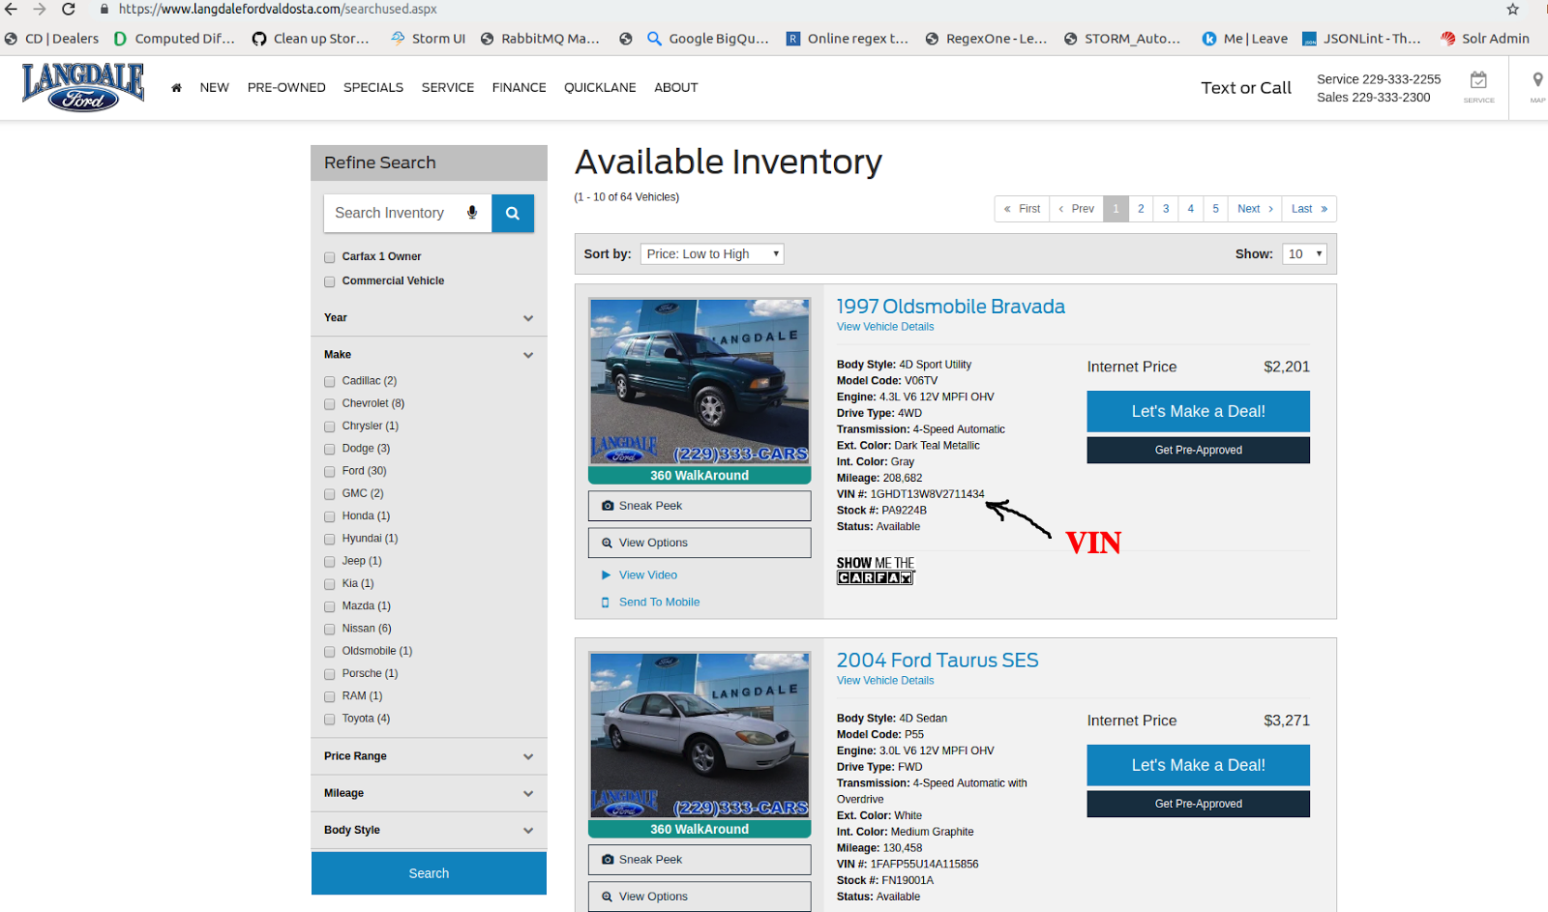
Day 1: 03-Feb-2019
Scenario:
Lets assume that on 03-Feb-2019 we saw a car for the very first time, i.e. we did not have VIN 1GHDT13W8V2711434 in the Marketcheck history database before.

Slide 4
Day 1: 03-Feb-2019
Action on History database:
As this is an unknown car w.r.t. the history database, we created a new record in the history database, using a new listing ("id": "07507373-67d3-4ac0-bab1-73540ae7798c"), which looks like this (for the sake of clarity we are considering only the relevant fields required in this example)
New listing insert
{
"id": "07507373-67d3-4ac0-bab1-73540ae7798c", ⇐ New listing id
"vin": "1GHDT13W8V2711434",
"first_scraped_at": "2019-02-03", ⇐ Current date
"scraped_at": "2019-02-03", ⇐ Current date
"status_date": "2019-02-03", ⇐ Current date
"price": 2201, ⇐ Note the price
"miles": 30000,
"seller_name": "Langdale Ford Valdosta"
}

Slide 5
Day 2: 04-Feb-2019
Scenario:
On 04-Feb-2019, we crawled all search result pages of the dealer and found that the car was still listed with the same price as compared with the last crawl price.

Slide 6
Day 2: 04-Feb-2019
Action on History database:
Now on 04-Feb, the car is a known car w.r.t. the history database, with an unchanged price, so now we update the status_date of the same record ("id": "07507373-67d3-4ac0-bab1-73540ae7798c") in the history database. After the database update the record looks like this:
Updated listing
{
"id": "07507373-67d3-4ac0-bab1-73540ae7798c", ⇐ last record id
"vin": "1GHDT13W8V2711434",
"first_scraped_at": "2019-02-03", ⇐ Unchanged date
"scraped_at": "2019-02-03", ⇐ Unchanged date
"status_date": "2019-02-04", ⇐ Updated date
"price": 2201, ⇐ Unchanged price
"miles": 30000,
"seller_name": "Langdale Ford Valdosta"
}

Slide 7
Day 3: 05-Feb-2019
Scenario:
On 05-Feb-2019, we crawled all search result pages of the dealer and found that the car was still listed with the same price as compared with the last crawl price.

Slide 8
Day 3: 05-Feb-2019
Action on History database:
The car is a known car w.r.t. the history database, with unchanged price, so now we updated the status_date of the last record ("id": "07507373-67d3-4ac0-bab1-73540ae7798c") in history database. After the database update the record looks like this:
Updated listing
{
"id": "07507373-67d3-4ac0-bab1-73540ae7798c",
"vin": "1GHDT13W8V2711434",
"first_scraped_at": "2019-02-03", ⇐ Unchanged date
"scraped_at": "2019-02-03", ⇐ Unchanged date
"status_date": "2019-02-05", ⇐ Updated date
"price": 2201, ⇐ Unchanged price
"miles": 30000,
"seller_name": "Langdale Ford Valdosta"
}

Slide 9
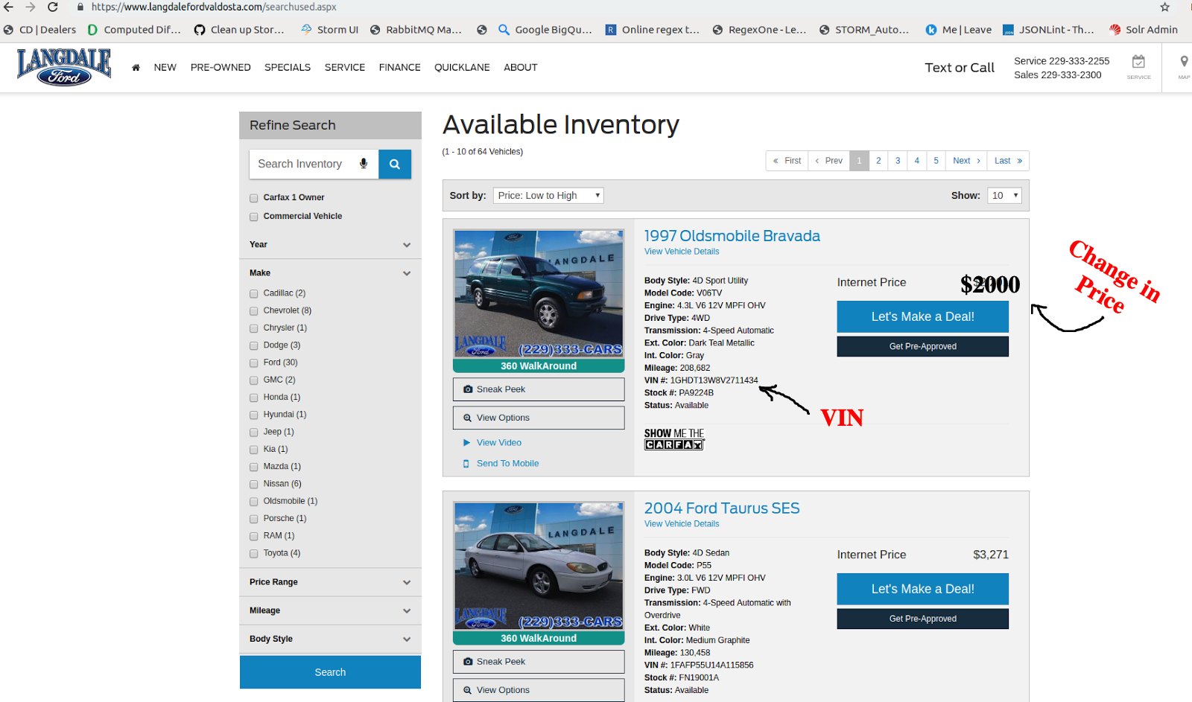
Day 4: 06-Feb-2019
Scenario:
On 06-Feb-2019, we crawled all search result pages of the dealer and found that the car price has been reduced by the dealer as compared with the last crawl price.

Slide 10
Day 4: 06-Feb-2019
Action on History database:
The car is a known car w.r.t. history database, however now with a changed price and the change is more than 10% of the earlier price, so we created a new record in history database, using a new ("id": "1faf9bc2-bb91-44fd-a32a-a2dd5854ff9b"). After an insert we have two listings in the database, previous listing as it is and a new one with a changed price. Notice that the first_scraped_at in both New and Previous listing is just the same.
New listing
{
"id": "1faf9bc2-bb91-44fd-a32a-a2dd5854ff9b", ⇐ New listing id
"vin": "1GHDT13W8V2711434",
"first_scraped_at": "2019-02-03", ⇐ Same for all listings for this VIN
"scraped_at": "2019-02-06", ⇐ Current date
"status_date": "2019-02-06", ⇐ Current date
"price": 2000, ⇐ Note the price
"miles": 30000,
"seller_name": "Langdale Ford Valdosta"
}
Previous listing in history database
{
"id": "07507373-67d3-4ac0-bab1-73540ae7798c",
"vin": "1GHDT13W8V2711434",
"first_scraped_at": "2019-02-03", ⇐ Same for all listings for this VIN
"scraped_at": "2019-02-03",
"status_date": "2019-02-05",
"price": 2201,
"miles": 30000,
"seller_name": "Langdale Ford Valdosta"
}

Slide 11
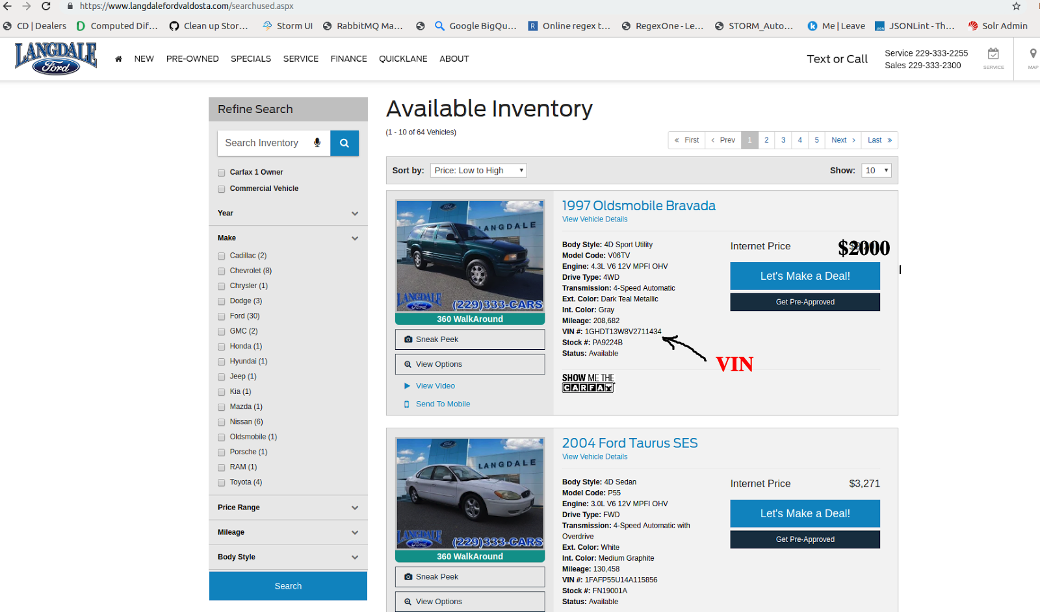
Day 5: 07-Feb-2019
Scenario:
On 07-Feb-2019, we crawled all search result pages of the dealer and found that the car price is same as compared with the last crawl price.

Slide 12
Day 5: 07-Feb-2019
Action on History database:
The car is a known car w.r.t. the history database, with unchanged price, so now we updated the status_date of the last record ("id": "1faf9bc2-bb91-44fd-a32a-a2dd5854ff9b") in the history database. After the database update the records look like this:
Updated listing
{
"id": "1faf9bc2-bb91-44fd-a32a-a2dd5854ff9b",
"vin": "1GHDT13W8V2711434",
"first_scraped_at": "2019-02-03", ⇐ Same for all listings for this VIN
"scraped_at": "2019-02-06", ⇐ Current date
"status_date": "2019-02-07", ⇐ Updated date
"price": 2000, ⇐ Note the price
"miles": 30000,
"seller_name": "Langdale Ford Valdosta"
}
Previous listing in history database
{
"id": "07507373-67d3-4ac0-bab1-73540ae7798c",
"vin": "1GHDT13W8V2711434",
"first_scraped_at": "2019-02-03", ⇐ Same for all listings for this VIN
"scraped_at": "2019-02-03",
"status_date": "2019-02-05",
"price": 2201,
"miles": 30000,
"seller_name": "Langdale Ford Valdosta"
}

Slide 13
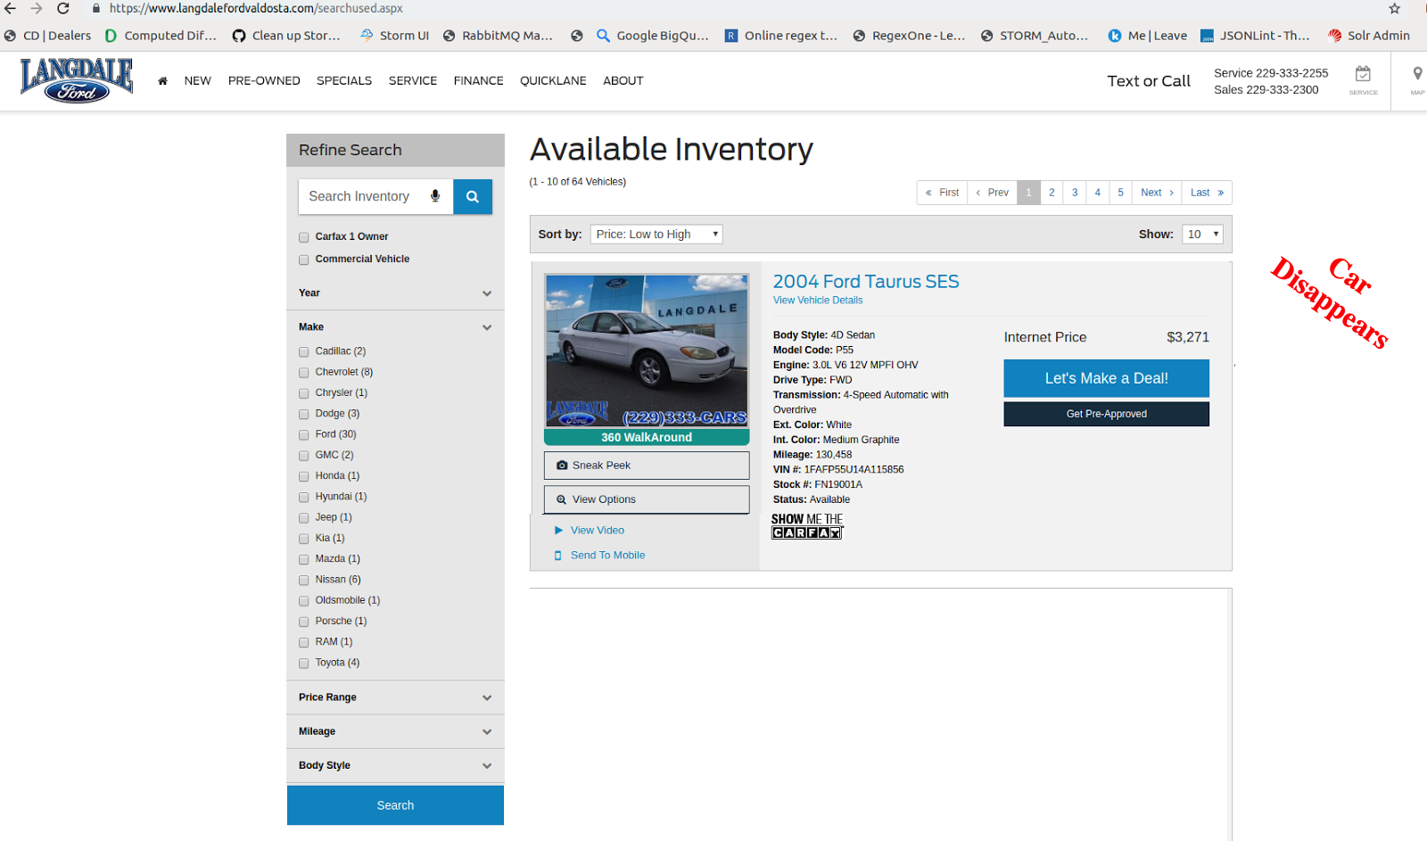
Day 6: 08-Feb-2019
Scenario:
On 08-Feb-2019, we crawled all search result pages of the dealer and could not find the car in dealers inventory.

Slide 14
Day 6: 08-Feb-2019
Action on History database:
As the car is not seen, there is no action on database. The history database continues to retain the last two listings for the car.
{
"id": "1faf9bc2-bb91-44fd-a32a-a2dd5854ff9b",
"vin": "1GHDT13W8V2711434",
"first_scraped_at": "2019-02-03",
"scraped_at": "2019-02-06",
"status_date": "2019-02-07",
"price": 2000,
"miles": 30000,
"seller_name": "Langdale Ford Valdosta"
}
{
"id": "07507373-67d3-4ac0-bab1-73540ae7798c",
"vin": "1GHDT13W8V2711434",
"first_scraped_at": "2019-02-03",
"scraped_at": "2019-02-03",
"status_date": "2019-02-05",
"price": 2201,
"miles": 30000,
"seller_name": "Langdale Ford Valdosta"
}

Slide 15
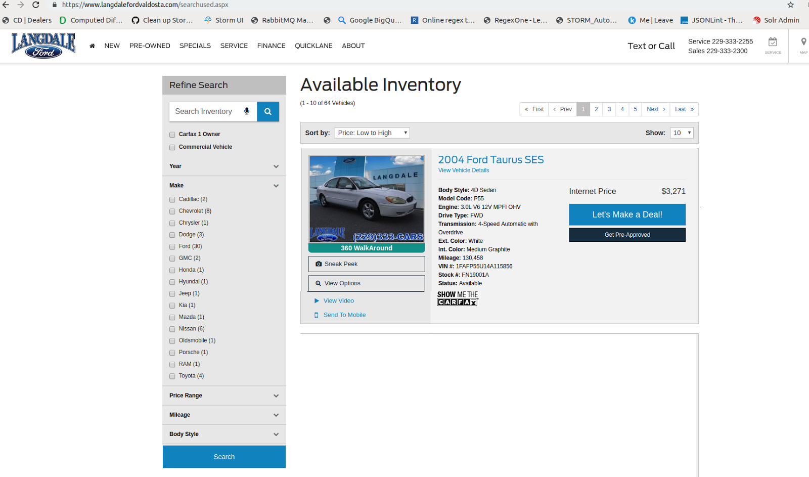
Day 7: 09-Feb-2019
Scenario:
On 09-Feb-2019 we crawled all search result pages of the dealer and could not find the car in dealers inventory.

Slide 16
Day 7: 09-Feb-2019
Action on History database:
As the car is not seen, there is no action on database. The history database continues to retain the last two listings for the car.
{
"id": "1faf9bc2-bb91-44fd-a32a-a2dd5854ff9b",
"vin": "1GHDT13W8V2711434",
"first_scraped_at": "2019-02-03",
"scraped_at": "2019-02-06",
"status_date": "2019-02-07",
"price": 2000,
"miles": 30000,
"seller_name": "Langdale Ford Valdosta"
}
{
"id": "07507373-67d3-4ac0-bab1-73540ae7798c",
"vin": "1GHDT13W8V2711434",
"first_scraped_at": "2019-02-03",
"scraped_at": "2019-02-03",
"status_date": "2019-02-05",
"price": 2201,
"miles": 30000,
"seller_name": "Langdale Ford Valdosta"
}

Slide 17

Day 8: 10-Feb-2019
Scenario:
On 10-Feb-2019 we crawled all search result pages of the dealer and found the car in dealers inventory, after a gap of 2 days.

Slide 18
Day 8: 10-Feb-2019
Action on History database:
As the car reappeared in less than or equal to 3 days with no change in price, we update the last listing's status_date, and use the fresh scraped values of price, miles and other scraped attributes.
{
"id": "1faf9bc2-bb91-44fd-a32a-a2dd5854ff9b",
"vin": "1GHDT13W8V2711434",
"first_scraped_at": "2019-02-03", ⇐ Unchanged date
"scraped_at": "2019-02-06", ⇐ Unchanged date
"status_date": "2019-02-10", ⇐ Updated date
"price": 2000,
"miles": 30000,
"seller_name": "Langdale Ford Valdosta"
}
{
"id": "07507373-67d3-4ac0-bab1-73540ae7798c",
"vin": "1GHDT13W8V2711434",
"first_scraped_at": "2019-02-03",
"scraped_at": "2019-02-03",
"status_date": "2019-02-05",
"price": 2201,
"miles": 30000,
"seller_name": "Langdale Ford Valdosta"
}

Slide 19

Day 9: 11-Feb-2019
Scenario:
On 11-Feb-2019, we crawled all search result pages of the dealer and found that the car was still listed with the same price as compared with the last crawl price.

Slide 20
Day 9: 11-Feb-2019
Action on History database:
Again, the car is a known car w.r.t. history database, with unchanged price, so now we updated the status_date of the last record ("id": "1faf9bc2-bb91-44fd-a32a-a2dd5854ff9b") in history database. After the record update listings in database looks like this:
{
"id": "1faf9bc2-bb91-44fd-a32a-a2dd5854ff9b",
"vin": "1GHDT13W8V2711434",
"first_scraped_at": "2019-02-03", ⇐ Unchanged date
"scraped_at": "2019-02-06", ⇐ Unchanged date
"status_date": "2019-02-11", ⇐ Updated date
"price": 2000,
"miles": 30000,
"seller_name": "Langdale Ford Valdosta"
}
{
"id": "07507373-67d3-4ac0-bab1-73540ae7798c",
"vin": "1GHDT13W8V2711434",
"first_scraped_at": "2019-02-03",
"scraped_at": "2019-02-03",
"status_date": "2019-02-05",
"price": 2201,
"miles": 30000,
"seller_name": "Langdale Ford Valdosta"
}

Slide 21
Day 10: 12-Feb-2019
Scenario:
On 12-Feb-2019, Car disappears again from inventory

Slide 22
Day 10: 12-Feb-2019
Action on History database:
As the car is not seen, there is no action on database. The history database continues to retain the last two listings for the car.
{
"id": "1faf9bc2-bb91-44fd-a32a-a2dd5854ff9b",
"vin": "1GHDT13W8V2711434",
"first_scraped_at": "2019-02-03",
"scraped_at": "2019-02-06",
"status_date": "2019-02-11",
"price": 2000,
"miles": 30000,
"seller_name": "Langdale Ford Valdosta"
}
{
"id": "07507373-67d3-4ac0-bab1-73540ae7798c",
"vin": "1GHDT13W8V2711434",
"first_scraped_at": "2019-02-03",
"scraped_at": "2019-02-03",
"status_date": "2019-02-05",
"price": 2201,
"miles": 30000,
"seller_name": "Langdale Ford Valdosta"
}

Slide 23
Day 11 to 20: 13-Feb-2019 to 22-Feb-2019
Scenario:
The car still not available in inventory between 13-Feb-2019 and 22-Feb-2019

Slide 24
Day 11 to 20: 13-Feb-2019 to 22-Feb-2019
Action on History database:
As the car is not seen, there is no action on database. The history database continues to retain the last two listings for the car.
{
"id": "1faf9bc2-bb91-44fd-a32a-a2dd5854ff9b",
"vin": "1GHDT13W8V2711434",
"first_scraped_at": "2019-02-03",
"scraped_at": "2019-02-06",
"status_date": "2019-02-11", ⇐ Status date remained unchanged, like all other fields
"price": 2000,
"miles": 30000,
"seller_name": "Langdale Ford Valdosta"
}
{
"id": "07507373-67d3-4ac0-bab1-73540ae7798c",
"vin": "1GHDT13W8V2711434",
"first_scraped_at": "2019-02-03",
"scraped_at": "2019-02-03",
"status_date": "2019-02-05",
"price": 2201,
"miles": 30000,
"seller_name": "Langdale Ford Valdosta"
}

Slide 25
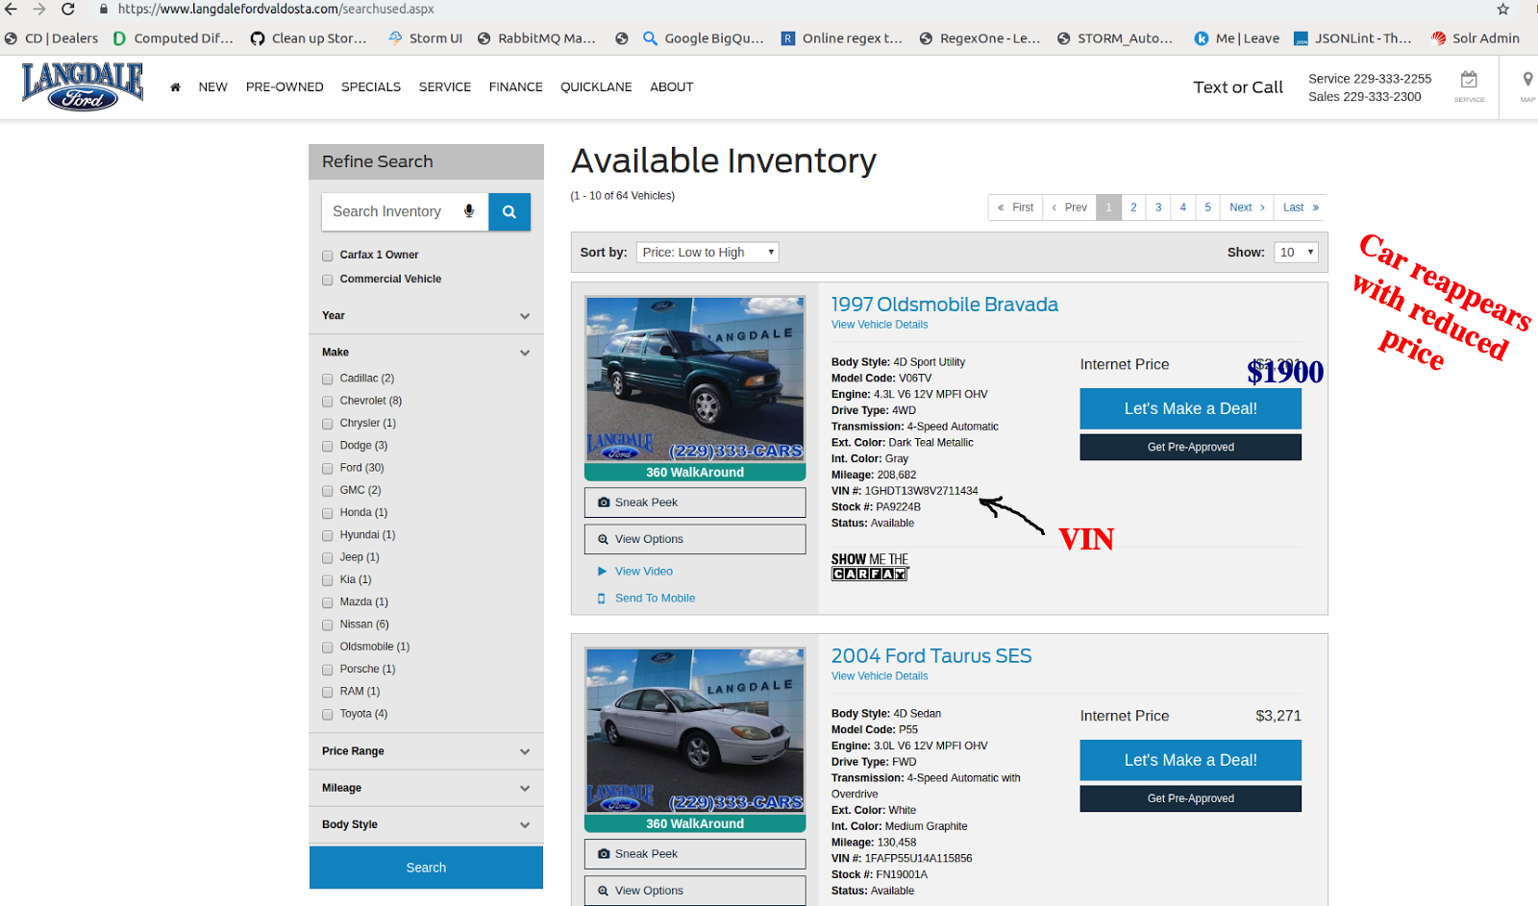
Day 21: 23-Feb-2019
Scenario:
On 23-Feb-2019 we crawled all search result pages of the dealer and found the car in dealers inventory, after a gap of 10 days.

Slide 26
Day 21: 23-Feb-2019
Action on History database:
As the car reappeared after more than 3 days, we created a new record in history database, using a new ("id": "d3670db5-e108-41fd-b59d-70af266a9eda"), which looked like this.
{
"id": "d3670db5-e108-41fd-b59d-70af266a9eda",
"vin": "1GHDT13W8V2711434",
"first_scraped_at": "2019-02-03", ⇐ Unchanged date
"scraped_at": "2019-02-23", ⇐ Current date
"status_date": "2019-02-23", ⇐ Current date
"price": 1900,
"miles": 31000,
"seller_name": "Langdale Ford Valdosta"
}
{
"id": "1faf9bc2-bb91-44fd-a32a-a2dd5854ff9b",
"vin": "1GHDT13W8V2711434",
"first_scraped_at": "2019-02-03",
"scraped_at": "2019-02-06",
"status_date": "2019-02-11",
"price": 2000,
"miles": 30000,
"seller_name": "Langdale Ford Valdosta"
}
{
"id": "07507373-67d3-4ac0-bab1-73540ae7798c",
"vin": "1GHDT13W8V2711434",
"first_scraped_at": "2019-02-03",
"scraped_at": "2019-02-03",
"status_date": "2019-02-05",
"price": 2201,
"miles": 30000,
"seller_name": "Langdale Ford Valdosta"
}

Slide 27
Day 22: 24-Feb-2019
Scenario:
The car removed from inventory and never reappeared.

Slide 28
Day 22: 24-Feb-2019
Action on History database:
Following 3 listings continue to remain in history database with no changes after 23-Feb-2019.
{
"id": "d3670db5-e108-41fd-b59d-70af266a9eda",
"vin": "1GHDT13W8V2711434",
"first_scraped_at": "2019-02-03",
"scraped_at": "2019-02-23",
"status_date": "2019-02-23",
"price": 1900,
"miles": 31000,
"seller_name": "Langdale Ford Valdosta"
}
{
"id": "1faf9bc2-bb91-44fd-a32a-a2dd5854ff9b",
"vin": "1GHDT13W8V2711434",
"first_scraped_at": "2019-02-03",
"scraped_at": "2019-02-06",
"status_date": "2019-02-11",
"price": 2000,
"miles": 30000,
"seller_name": "Langdale Ford Valdosta"
}
{
"id": "07507373-67d3-4ac0-bab1-73540ae7798c",
"vin": "1GHDT13W8V2711434",
"first_scraped_at": "2019-02-03",
"scraped_at": "2019-02-03",
"status_date": "2019-02-05",
"price": 2201,
"miles": 30000,
"seller_name": "Langdale Ford Valdosta"
}

Slide 29
Possible interpretations or usages of date fields
Assuming that the car (1GHDT13W8V2711434) never came back online after 23-Feb-2019 (the last status_date):
The car was sold on 24-Feb-2019 at $1900 by "Langdale Ford Valdosta"
The Car listing will feature in the daily exports of all durations listed below when the car was seen on the dealer’s inventory:
1. from 03-Feb-2019 to 07-Feb-2019 (for 5 days)
2. from 06-Feb-2019 to 11-Feb-2019 (for 6 days)
3. from 23-Feb-2019 to 23-Feb-2019 (for 1 day)

Slide 30
End

