Slide 1
Advertising Intelligence

Slide 2
We believe businesses have the right to...
Advertising Intelligence
Businesses should have the ability to...
Easily track their digital ads campaigns
See what’s making them money
Get data for ad campaigns in real-time
from one location.
Notes:
Advertising Intelligence is a digital ads reporting tool for Facebook Ads and Google Ads. It brings ad campaigns from these platforms under one roof so you and your client can see what’s working and what isn’t. See which ads are performing best, at what times, and on which platforms. Uncover the recipes behind top performing campaigns and become the expert in digital ads.
Small businesses who run digital ads should have the ability to easily track their digital ads campaigns, see what’s making them money, and get data for their ad campaigns in real-time - all from one location.

Slide 3
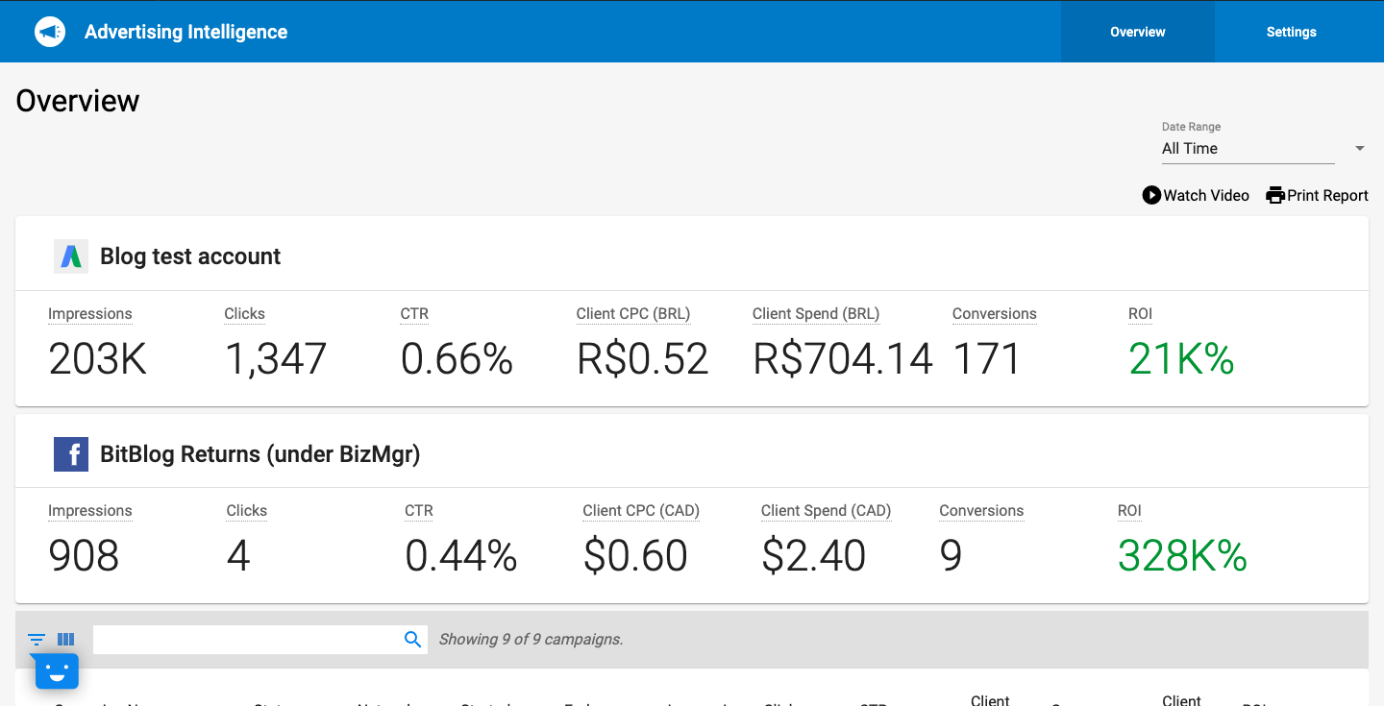
Two ways to request feedback
Advertising Intelligence
What is Advertising Intelligence?
A digital ads management tool that allows you to:
Compare Google Ads and Facebook Ads side-by-side
See where ad campaigns are making your clients money
Spot trends behind campaigns, making you the expert in digital ads
Automated reporting
Supports multi-location
Notes:
Advertising Intelligence allows you too…
Automated reporting - save time and money from manual reports and switch to automated. Plus, your clients can view the product at any time and get real-time metrics.
For mutli-location clients, they have access to a multi-location view through their Business Center account.
As you can see from the screenshot, Advertising Intelligence shows the Impressions, clicks, CTR, client CPC, Client Spend, conversions, and ROI for Google and Facebook Ads.

Slide 4
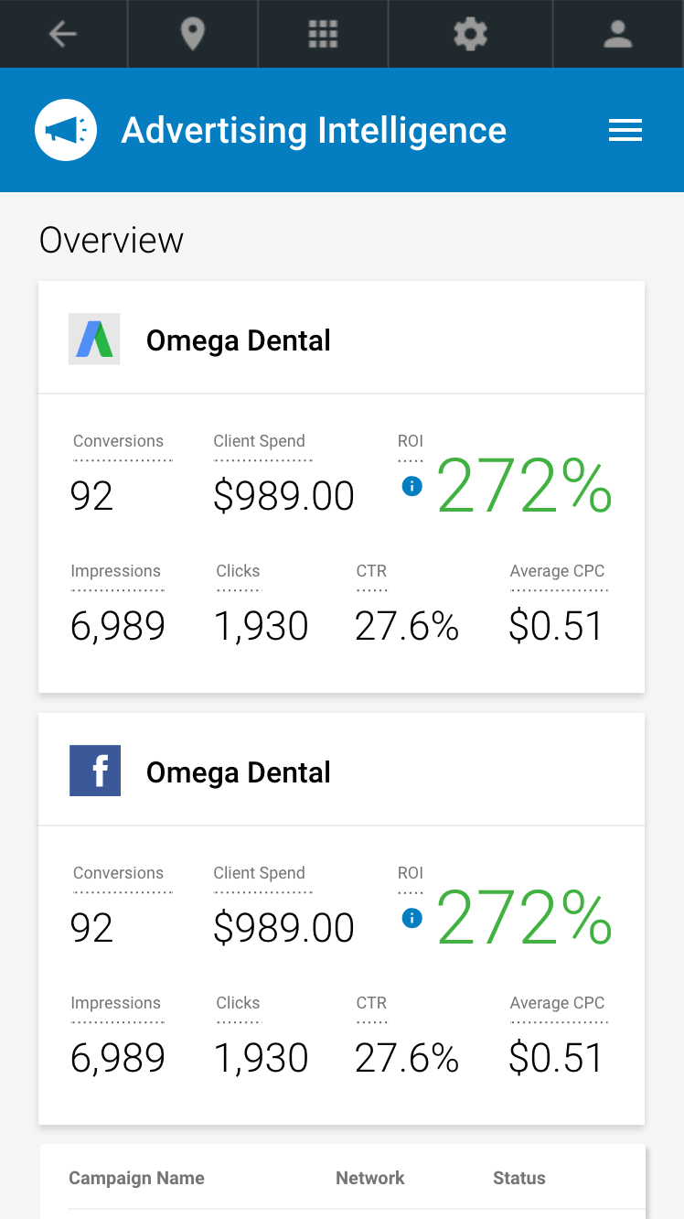
Two ways to request feedback
Advertising Intelligence
Supported advertising platforms
What ad platforms does Advertising Intelligence support?
Google Search Ads
Google Display Ads
Google Analytics
YouTube Ads
Google Shopping Ads
Gmail Ads
Facebook Ads
Instagram Ads
Messenger Ads
Audience Network Ads
Notes:
As mentioned earlier, Advertising Intelligence supports Facebook Ads and Google Ads, which includes...

Slide 5
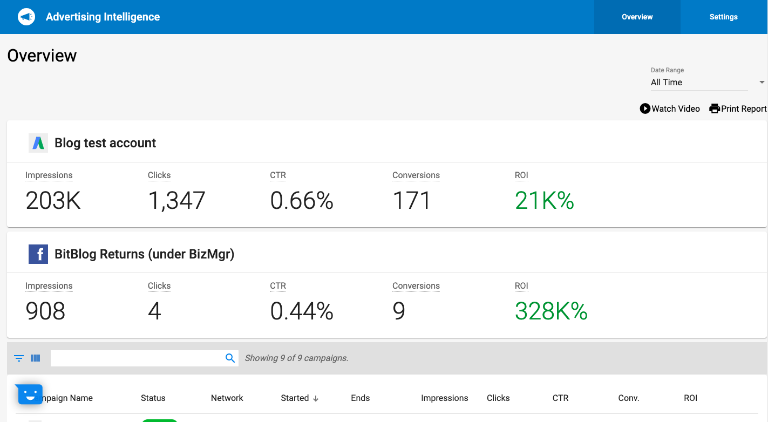
Two ways to request feedback
Advertising Intelligence
Freemium Product
Product Overview
Advertising Intelligence is a freemium product that allows your clients to kick-start their digital advertising analysis
Compare Google Ads and Facebooks Ads campaigns side-by-side
Single login for convenience
Customizable features
Automated reporting
Notes:
Customizable features - the option to ride ROI and the client spend metrics.

Slide 6
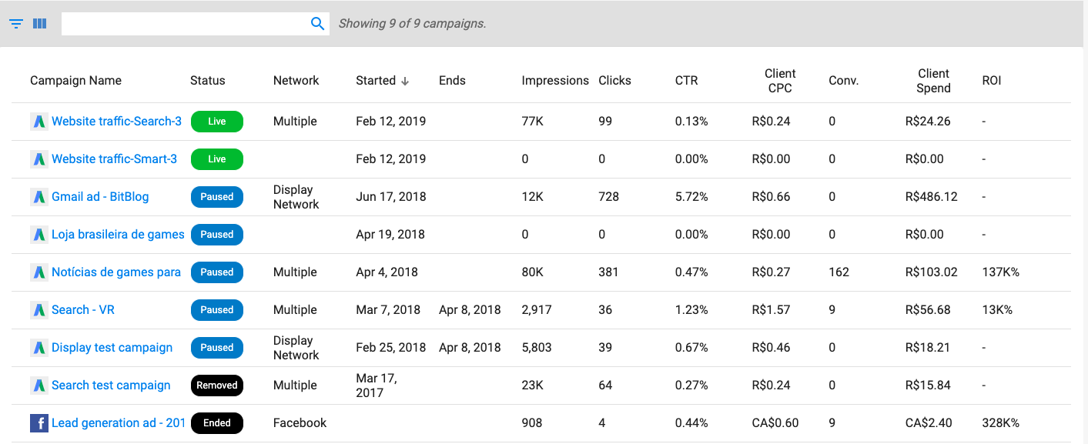
Two ways to request feedback
Advertising Intelligence
Add-on: Advanced Reporting
Add-on Overview
The Advanced Reporting add-on unlocks a ton of features for you and your clients to become the experts in digital ad campaigns.
Customizable date ranges for analyzing
Individual campaign metrics
Campaign details page
Set campaign objective and see campaign funnel
Keyword and ad analysis
Customizable features
Notes:
In addition to Advertising Intelligence, we also offer an add-on, called Advanced Reporting. This add-on unlocks a ton of features, with the benefit of digging into individual campaigns, customizing date ranges so you can see how ads are performing at certain times, and seeing metrics such as keyword analysis.
As we can see in the screenshots, each campaign from Google Ads and Facebook Ads is broken down. For each campaign, we can see the campaign name, status, network, when the campaign starts and end, the impressions, clicks, CTR, CPC, client spend, conversions, and ROI.

Slide 7
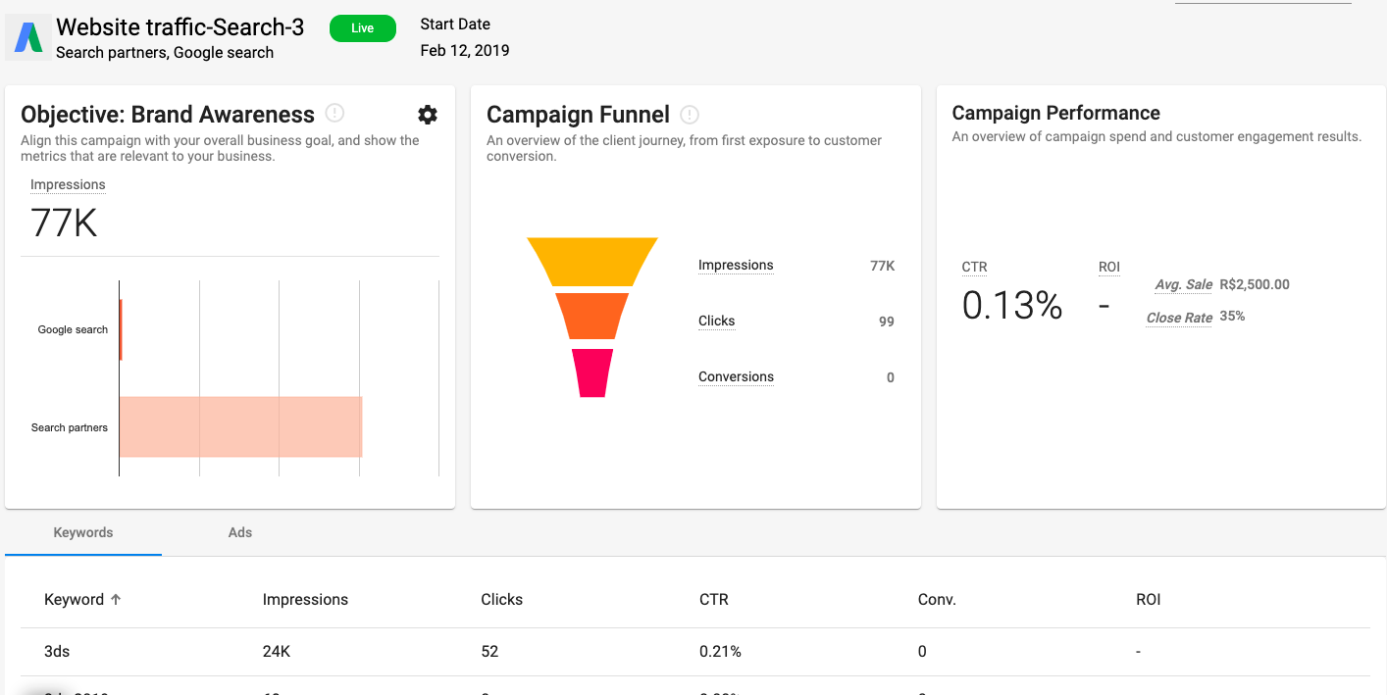
Two ways to request feedback
Advertising Intelligence
Advanced Reporting: Campaign Details
Overview
The campaign details page allows you to set a campaign objective, see the campaign funnel and performance, and a keyword and ad analysis.
Customizable date range
Relevant metrics to match your campaign objective
Breakdown of keywords and ads
Notes:
One feature page included in the Advanced Reporting add-on is the Campaign Details page. On this page we also have the ability to customize the date range.
On the screenshot, the first card is the Objective Card. You have the ability to choose from a large list of objectives depending on what you are trying to achieve with the digital ads campaign. Once you chose an objective, the relevant measurement will appear.
The second card is the campaign funnel, where you can see the customer journey from impressions, to clicks, to conversions.
The third card is the campaign performance card, giving you an overview of the most important performance metrics.
Though we can’t see it in the screenshot, by scrolling down there is a keyword analysis and an ad analysis.

Slide 8
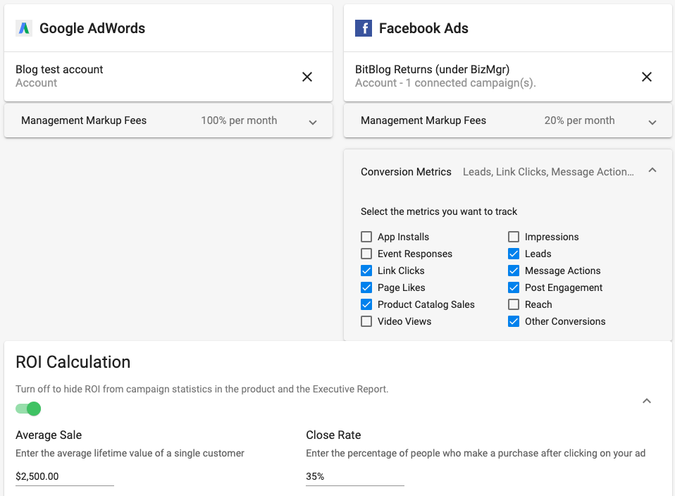
Two ways to request feedback
Advertising Intelligence
Tab: Settings
Settings Overview
The ability to manage
Your account connections
Management mark-up fees (add-on only)
Conversion metrics
Customizable features
Hide ROI
Hide client cost metrics

Slide 9
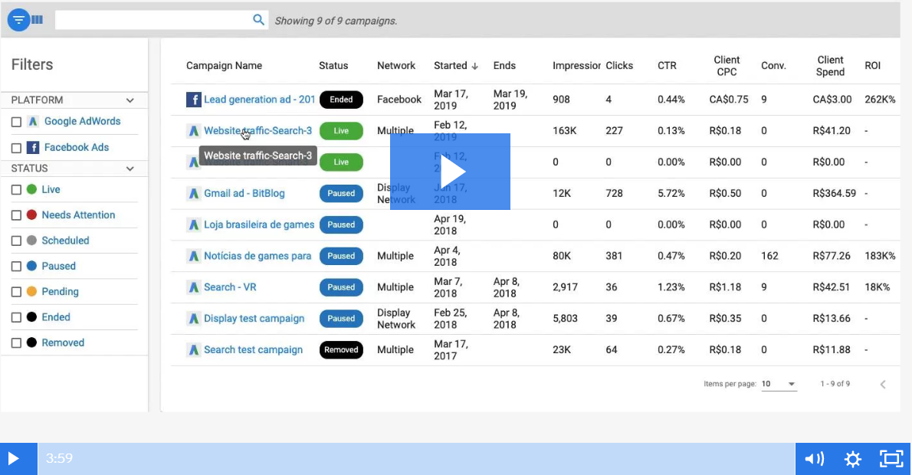
Two ways to request feedback
Advertising Intelligence
Demo

