Slide 1
Website

Slide 2
We believe businesses have the right to...
Website
Businesses should have...
World-class security
Advanced reporting
Lightning-fast speed
built into their website.
Notes:
SMB FACING:
Website Hosting can seem like a lot of work. You need to find the perfect host that offers world-class security, advanced reporting, and lighting-fast speed. We believe that website hosting should be effortless and dependable while hosting sites that are also fast, secure and backed up automatically.
Wouldn’t it be nice if there was a dependable solution?

Slide 3
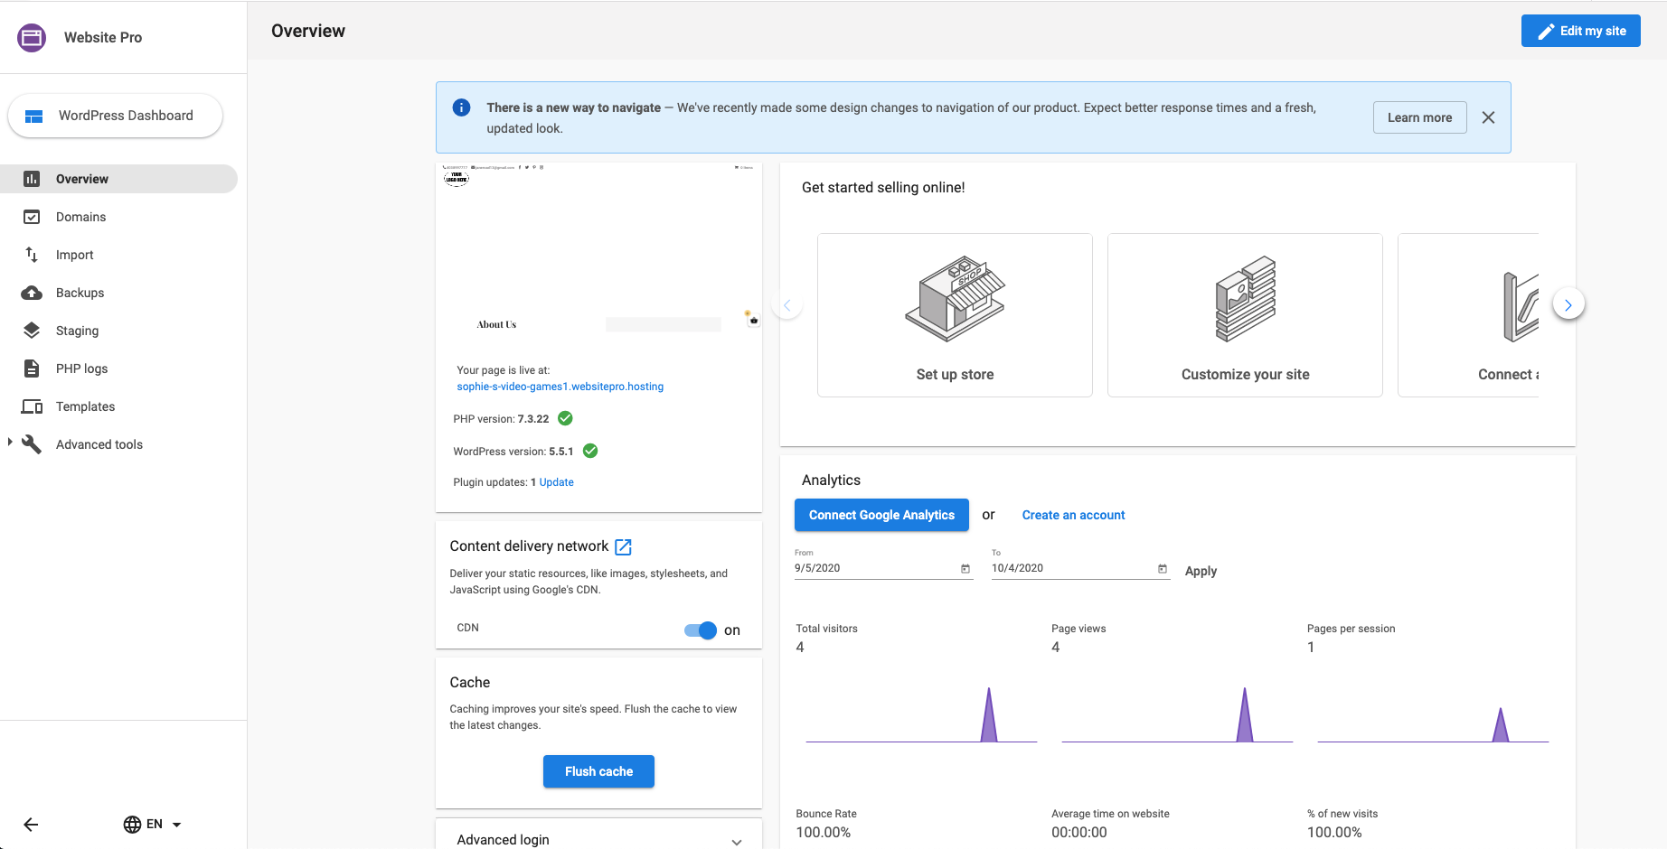
Two ways to request feedback
Website Pro
What is Website Pro?
A web hosting solution that allows you to:
Design and develop beautiful Wordpress websites
Access the Google Cloud Platform
Access an easy to understand reporting dashboard
Migrate sites for free
Push sites to production with one click
Have one login for all clients
Notes:
SMB FACING:
Website Pro is a web hosting solution that is backed by two of the most trusted and reliable platforms on the web: WordPress and the Google Cloud Platform. Website Pro allows you to design and develop beautiful WordPress websites and have access to an easy to understand reporting dashboard.
Key Selling Features:
World-class security with the Google Cloud platform
Website creation in minutes with custom templates
Free SSL certificates
Free CDN
No extra charge for daily backups
Help with migrating existing WordPress sites
One-click website setup
Free subdomain
Built in reporting
Technical Aspects
NGINX
PHP 7
Google Cloud SQL
HTTP/2
Redis cache
We take the stress out of websites.

Slide 4
Website
One Click Set-Up
Fill out Form
Watch website be created
Access Website
Notes:
SMB FACING: With Website Pro you can have a beautiful website in seconds! Simply choose to create your website from a custom template, or start from scratch. All you need to do is fill out your business name in the form and watch the site be created.

Slide 5
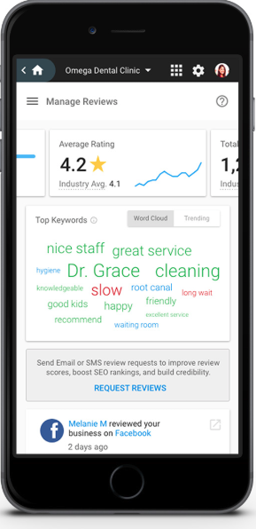
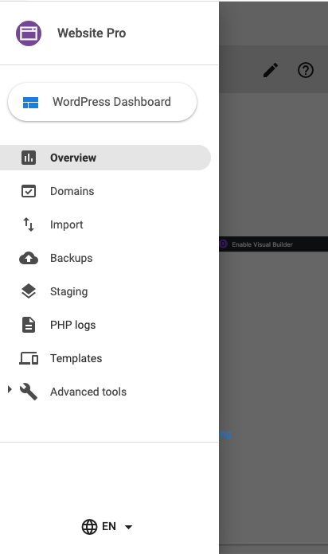
Two ways to request feedback
Website
Tab: Overview Easily access the important details of your site
Overview
Connect your Google analytic account for more detailed reporting
Access your Wordpress Dashboard to edit your site
Increase site speed with cache flushing
Access technical aspects of your site with phpMyAdmin and SFTP through the ADVANCED TOOLS tab
Notes:
SMB FACING:
The Website Pro overview page provides you with everything you need to jump into website creation, reporting, or more in-depth developer tools. Access the WordPress dashboard with the click of a button or view the analytics for your site.

Slide 6
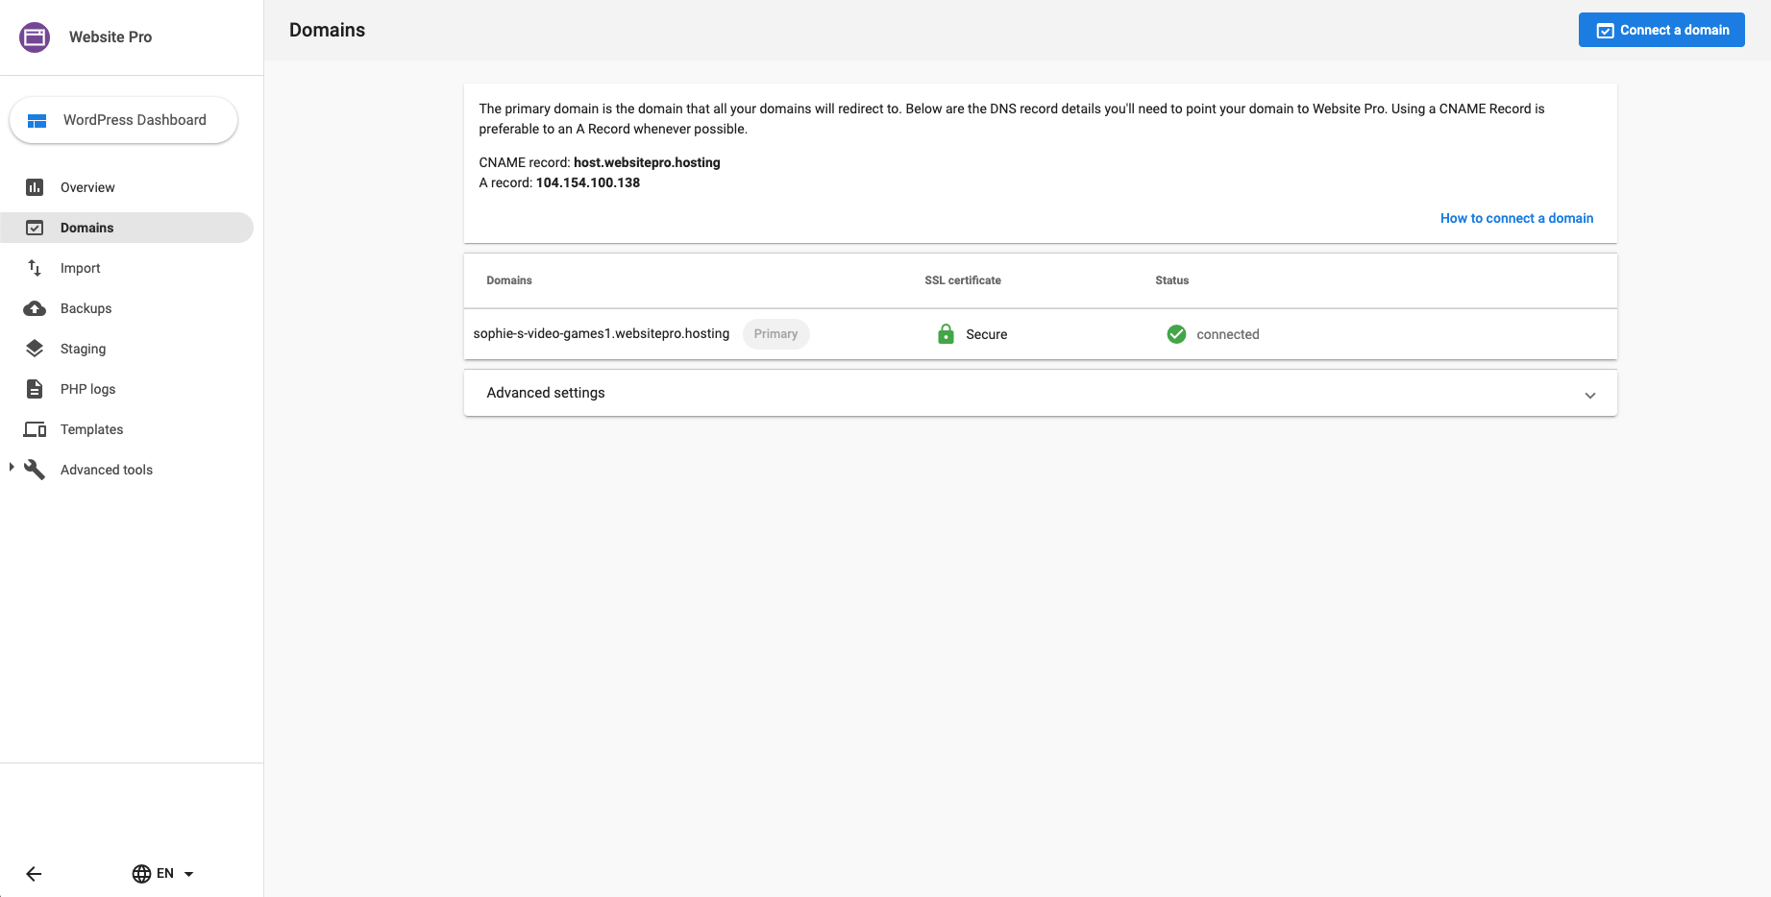
Two ways to request feedback
Website
Tab: Domains Connect to your space online
Domains
Easily connect your domain in just a few steps
Notes:
SMB FACING:
Website Pro lets you connect your domain easily. Simply click ‘Connect a Domain’ and paste or type the domain into the required space. This domain will become ‘pending’ and take anywhere between 5 minutes to 24 to properly connect. Once it has successfully been connected you will see a green checkmark next to the domain.

Slide 7
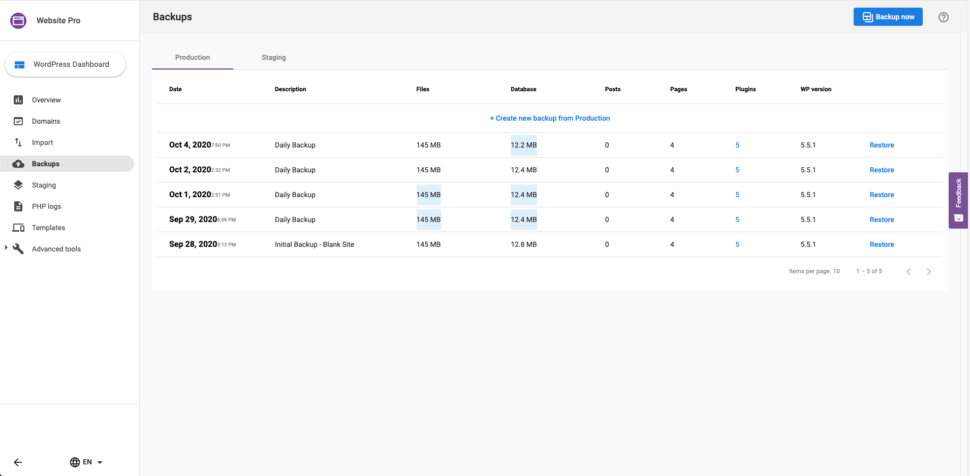
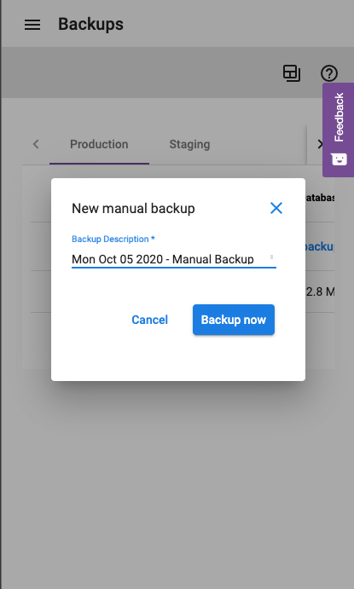
Two ways to request feedback
Website
Tab: Backups Never lose a site again
Backups
Automatic daily backups
Restore sites with the click of a button
Thinking of making big changes? Make a manual backup at any time
Notes:
SMB FACING:
On the Backups tab you are able to access any of your site’s previous backups and easily restore it. Website Pro performs an automatic backup everyday. However, if you’re planning on making some big changes, you can also backup your site at any time by clicking “Backup Now” in the top right corner. It’s important to note that as you are restoring your site you will be unable to make any edits or visit your site until the restore is complete. Depending on the size of site, this could take anywhere from a couple of minutes to a little longer.

Slide 8
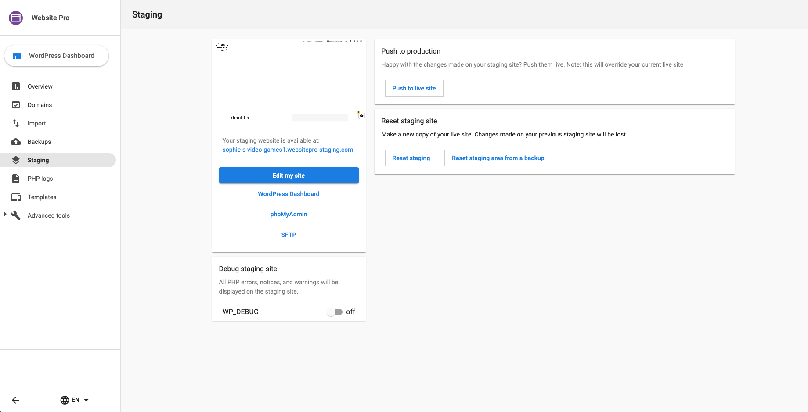
Two ways to request feedback
Website
Tab: Staging Test changes and updates without disruption
Staging
Play in a safe environment
Test design changes and updates without making changes to your live website
Once your done working on your staging site, push to live site with a single click
Preserve the staging files for making changes at a later date
Easily load a staging site from one of your backups
Notes:
SMB FACING:
An important aspect of any web developers workflow is staging. In the Website Pro staging tab you are able to test design changes and updates without making changes to your live site. Happy with what you’ve created in the staging environment, easily push the staging site live with the click of a button!

Slide 9
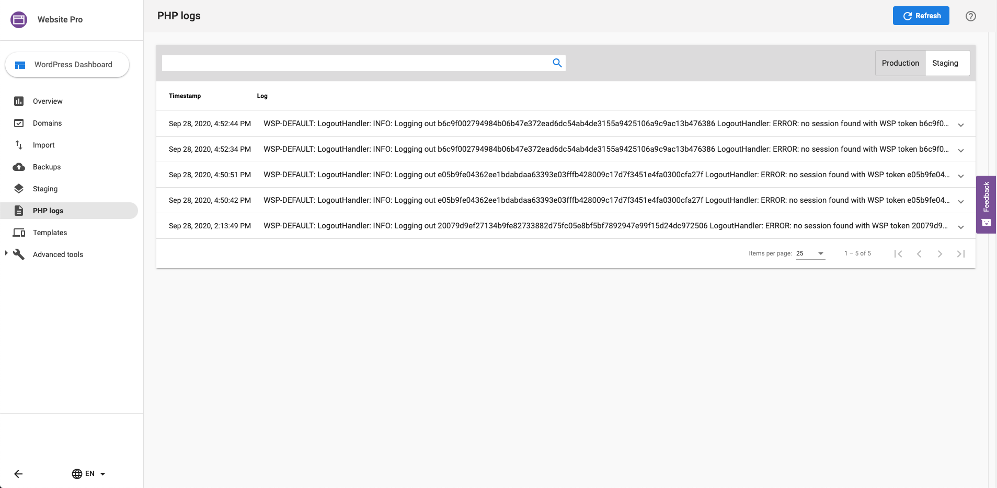
Two ways to request feedback
Website
Tab: PHP Logs Easily search and discover recent errors
PHP Logs
View and search PHP logs for both production and staging environments
Identify easy-to-fix errors
Notes:
SMB FACING:
The next tab in Website Pro is PHP Logs. This tab allows you to search and view PHP logs for both staging and production environments! This can help you or your developer identify easy-to-fix errors.

Slide 10
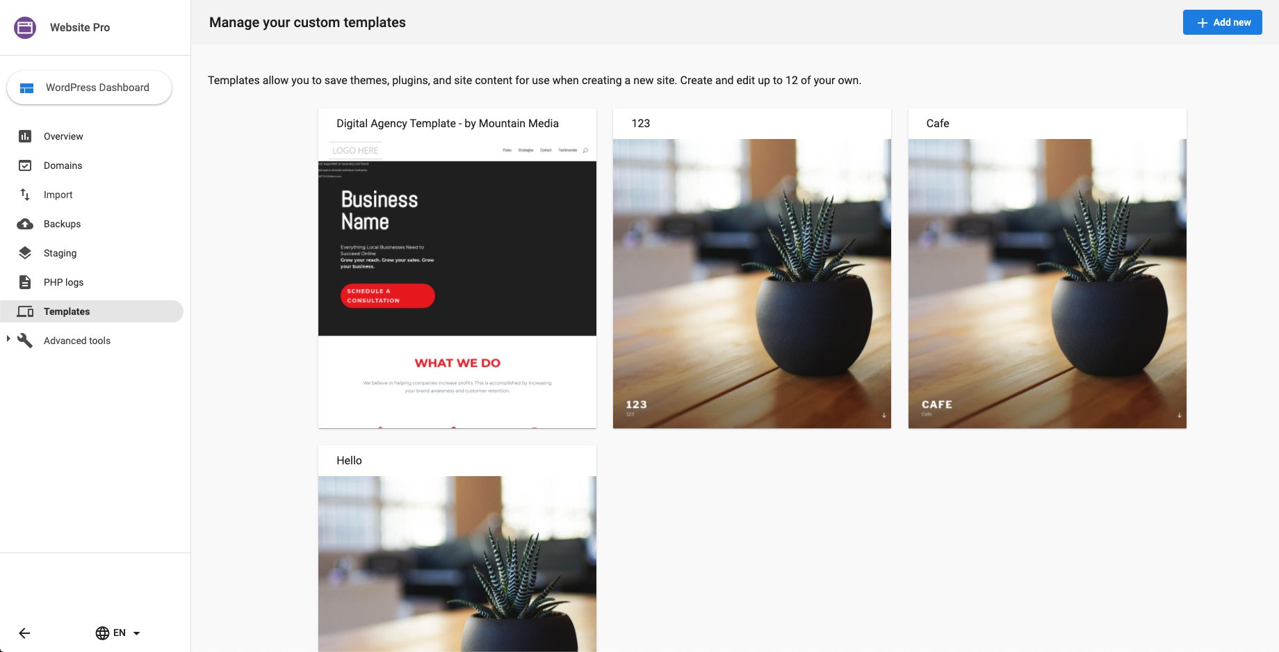
Two ways to request feedback
Website
Tab: Custom Templates Website creation in seconds
Custom Templates
2 preset templates; light & dark
Create your own template and re-use it over & over
Can have up to 12 templates
Notes:
SMB FACING:
The final tab in Website Pro, but arguably one of the most exciting, is the Templates tab. This tab is only visible to ?. Here you can create up to 5 templates to help you take the time

Slide 11
Website
EXPRESS VS PRO

Slide 12
Two ways to request feedback
Features | Website Express | Website Pro
Backups | 2 | Unlimited
Access to the WordPress dashboard | ✔ | ✔
Access to phpMyAdmin | ✔ | ✔
Access to STP | ✔ | ✔
Free SSL certificate | ✔ | ✔
PHP Logs | ✔ | ✔
Connect Google Analytics | ✔ | ✔
Staging Environment |  | ✔
Custom Domains |  | ✔
Notes:
SMB FACING:
The final tab in Website Pro, but arguably one of the most exciting, is the Templates tab. This tab is only visible to ?. Here you can create up to 5 templates to help you take the time

Slide 13
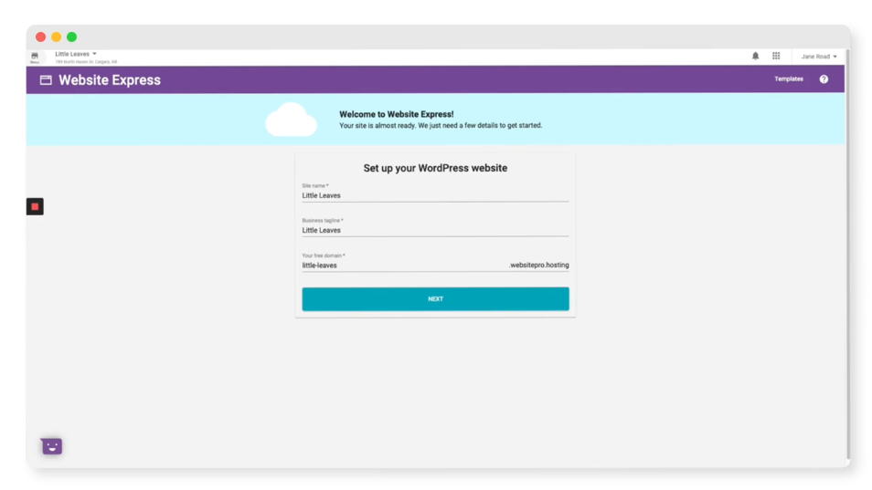
Two ways to request feedback
Website Express Demo

Slide 14
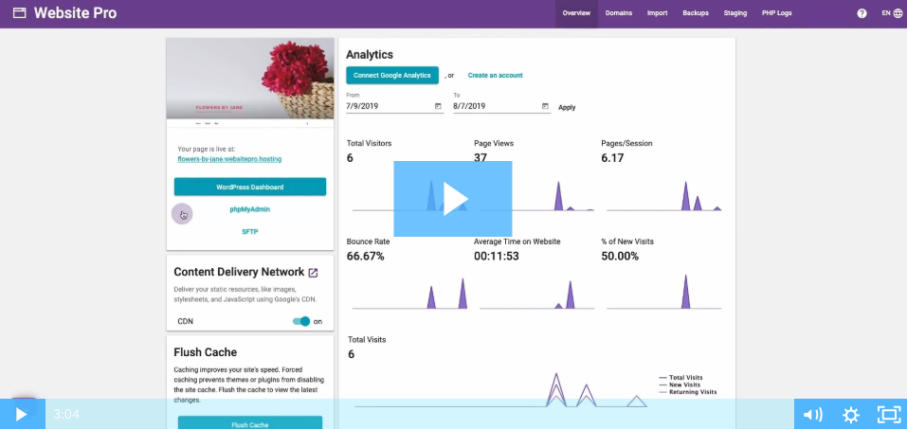
Two ways to request feedback
Website Pro Demo

