Slide 1



Customer Voice
Notes:
Customer Voice is a powerful tool to get your clients more customer reviews and boost their star rating! We all know how important it is nowadays to collect customer reviews, in order to establish trust with potential customers. Customer Voice makes it easy to collect customer reviews after they’ve visited the business and when they’re most likely to leave a review..

Slide 2



We believe businesses have the right to...
Customer Voice
Businesses should have the ability to...
Request
feedback from
their customers
Participate
in online conversations about their
business
Ask customers for reviews online, and address negative feedback offline
Notes:
We believe that businesses should have the ability to request feedback from their customers, participate in online conversations, and ask for reviews online, while addressing negative feedback offline.

Slide 3



Customer Voice
How does Customer Voice work?
Customer visits business
Upload customer information
Send SMS or Email review request
Customer leaves review
Business shines in local search!
Collect phone number or email
One at a time
or in bulk
Follow up email is sent if no review is left
Watch review volume and star rating grow!
Notes:
The workflow for achieving feedback is simple! Consider this customer’s journey at your client’s business.
First, the customer visits the business and a phone number or email address is collected from the business.
Within Customer Voice, simply upload that customer information and quickly and conveniently send an email or SMS message to that customer asking for a review.
The customer then leaves their review on the business’s chosen review site! As a result, the business shines in local search, resulting in even more customers through the door to start the workflow all over again.

Slide 4

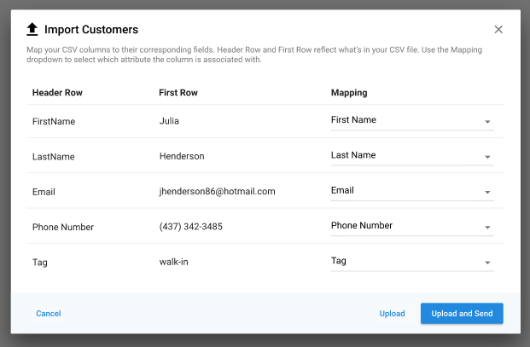
Two ways to request feedback
Customer Voice
Tab: Customers Add customers in bulk to save time
Manage Customers
Import a bulk csv file or add customers one at a time
Include phone number or email address
Add a tag to help classify the customer
Keep on top of the status of the review request
Notes:
In the Customers tab, import customer information one at a time or in bulk. You must include a phone number or an email address so that the request can be sent. From this page, you can also see at a glance the status of your most recent sent requests, so you know who to target next!

Slide 5
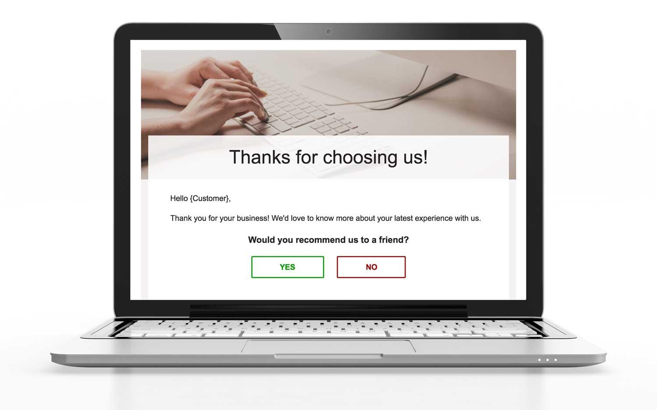
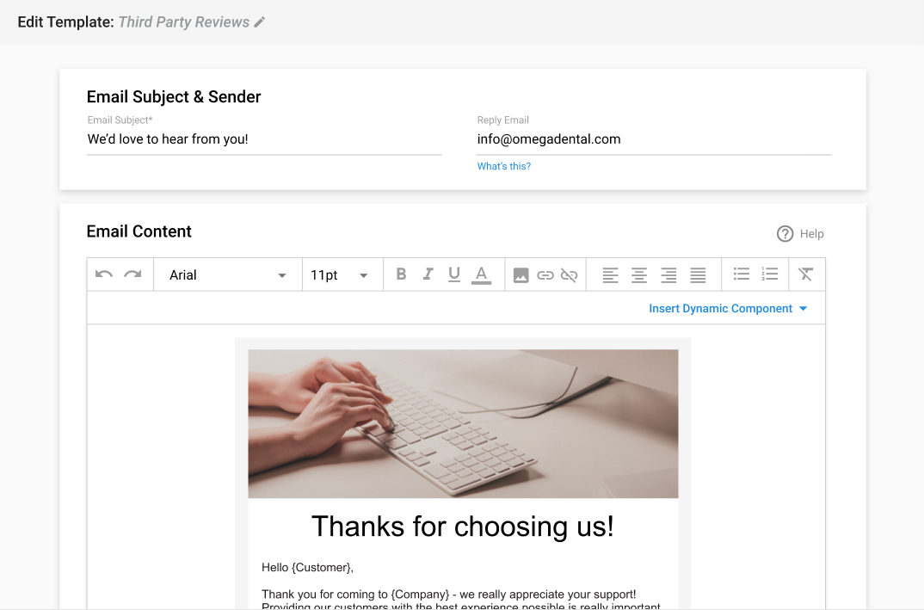
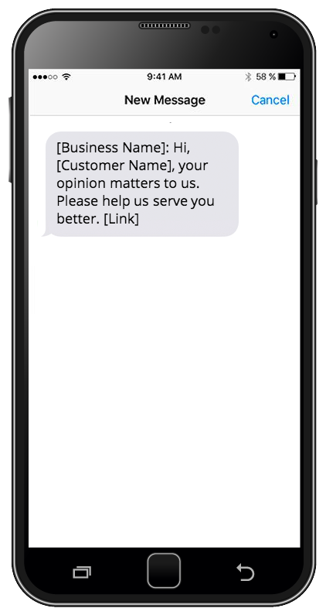
Two ways to request feedback
Customer Voice
Tab: Templates Send email or SMS review requests
Manage Templates
Create unlimited email or SMS templates
Include a link to preferred review site
Customize templates to suit your brand messaging
Edit follow up email to re-engage customers
Notes:
With Customer Voice your clients have the power to generate more reviews and increase their review ratings. With a couple clicks, your clients can reach their customers via email or text and collect reviews on the sites that are most important to their business. These SMS and email templates are customizable, so you can alter them to fit whatever branding you need.

Slide 6
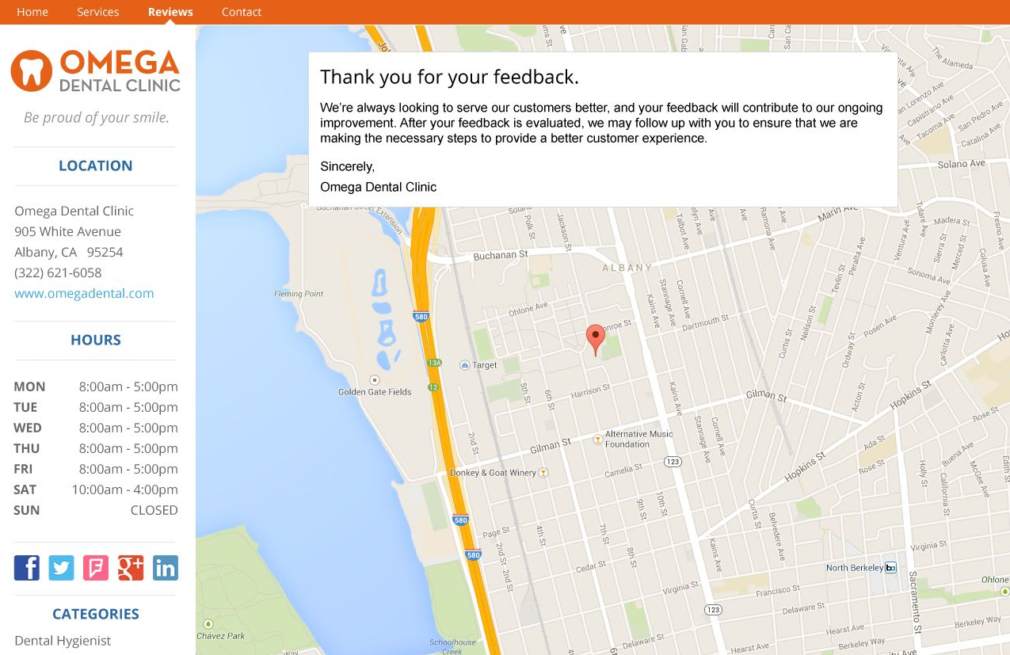
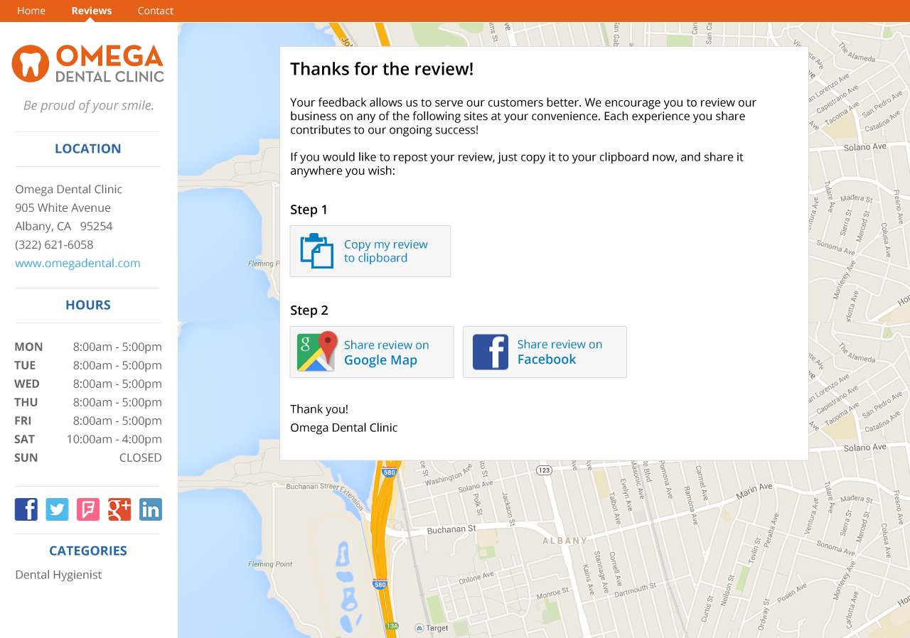


Review workflows
Customer Voice
On what sites can I request reviews?
First party reviews
My Listing page
Third party reviews
Review sites like Google and Facebook
Notes:
Customer Voice allows your clients to choose between collecting first party reviews on their My Listing page, or third party reviews on sites like Google and Facebook.
Customer Voice also gives your clients the ability to manage negative feedback in a timely way—so they can address the situation before it harms their online reputation.
Plus, with the customizable Review Generation widget installed on your client’s website, harvesting the positive reviews your clients need is easier than ever!

Slide 7
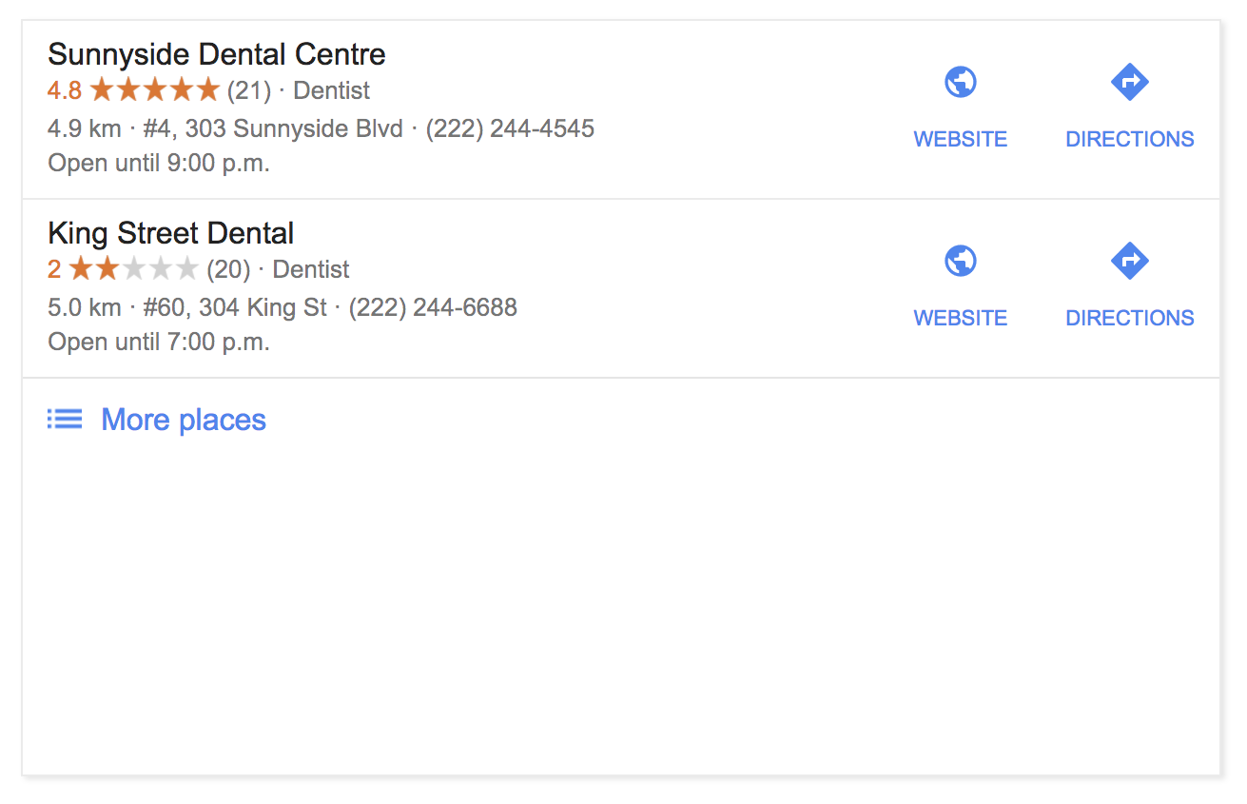

Why new reviews matter
Customer Voice
Online reviews are the first thing a consumer sees when searching for a business online.
87%
will only consider using a business if they have an average rating of 3-5 stars
Notes:
Today, online reviews are crucial to the success and revenue of a local business. In fact, 87% of consumers say they will only consider using a business if they have an average rating of 3-5 stars.¹
If you search online for a dentist, and two in your neighbourhood show up: one with 5 stars, and one with 2, which are you more likely to choose?
Your clients know building their online star rating is important, but they need your help doing it.

Slide 8
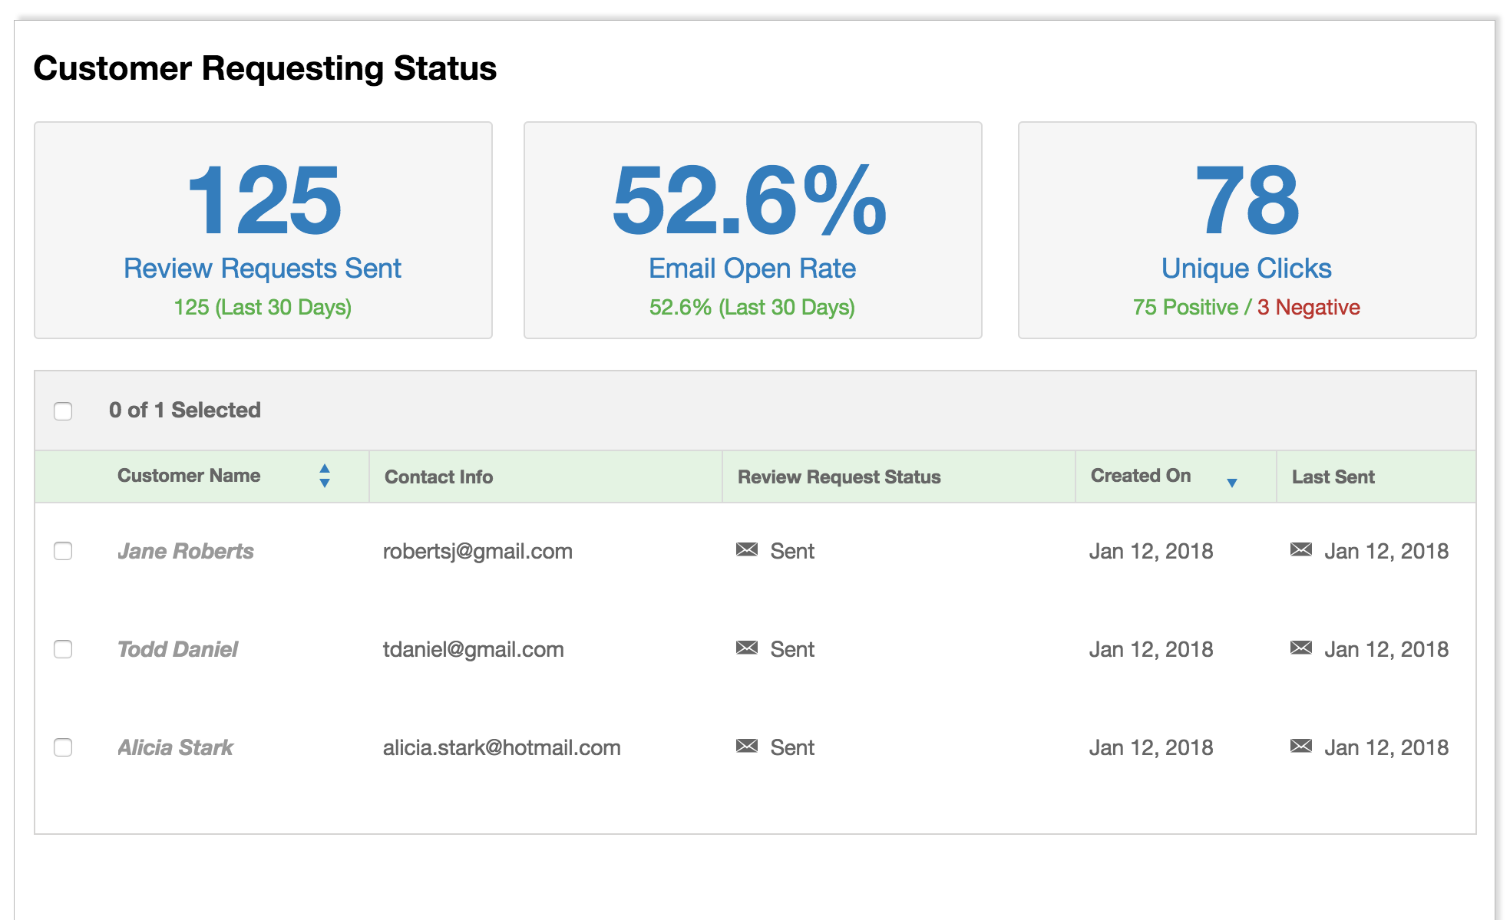
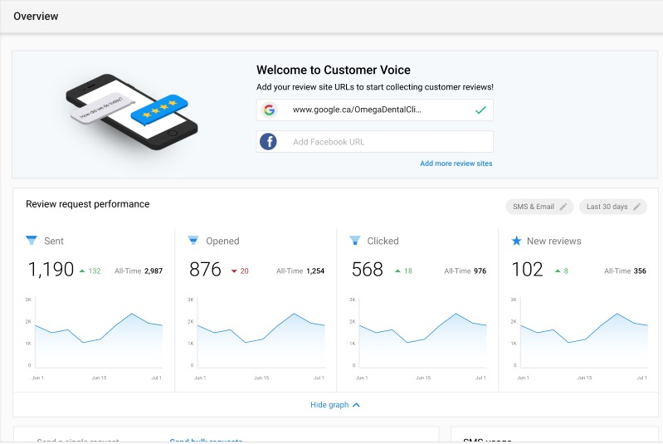
Review request insights
Customer Voice
Tab: Overview Get stats on your sent review requests
View Insights
See how your requests are performing for both email and SMS. Track:
  Number of review requests sent
  Click through rates
  Request status in real time
Notes:
On the Customer Voice dashboard your clients can see immediate ROI. It allows them to keep track of their review requests; see info like how many requests have been sent, click through rates, and request status, all in realtime.

Slide 9
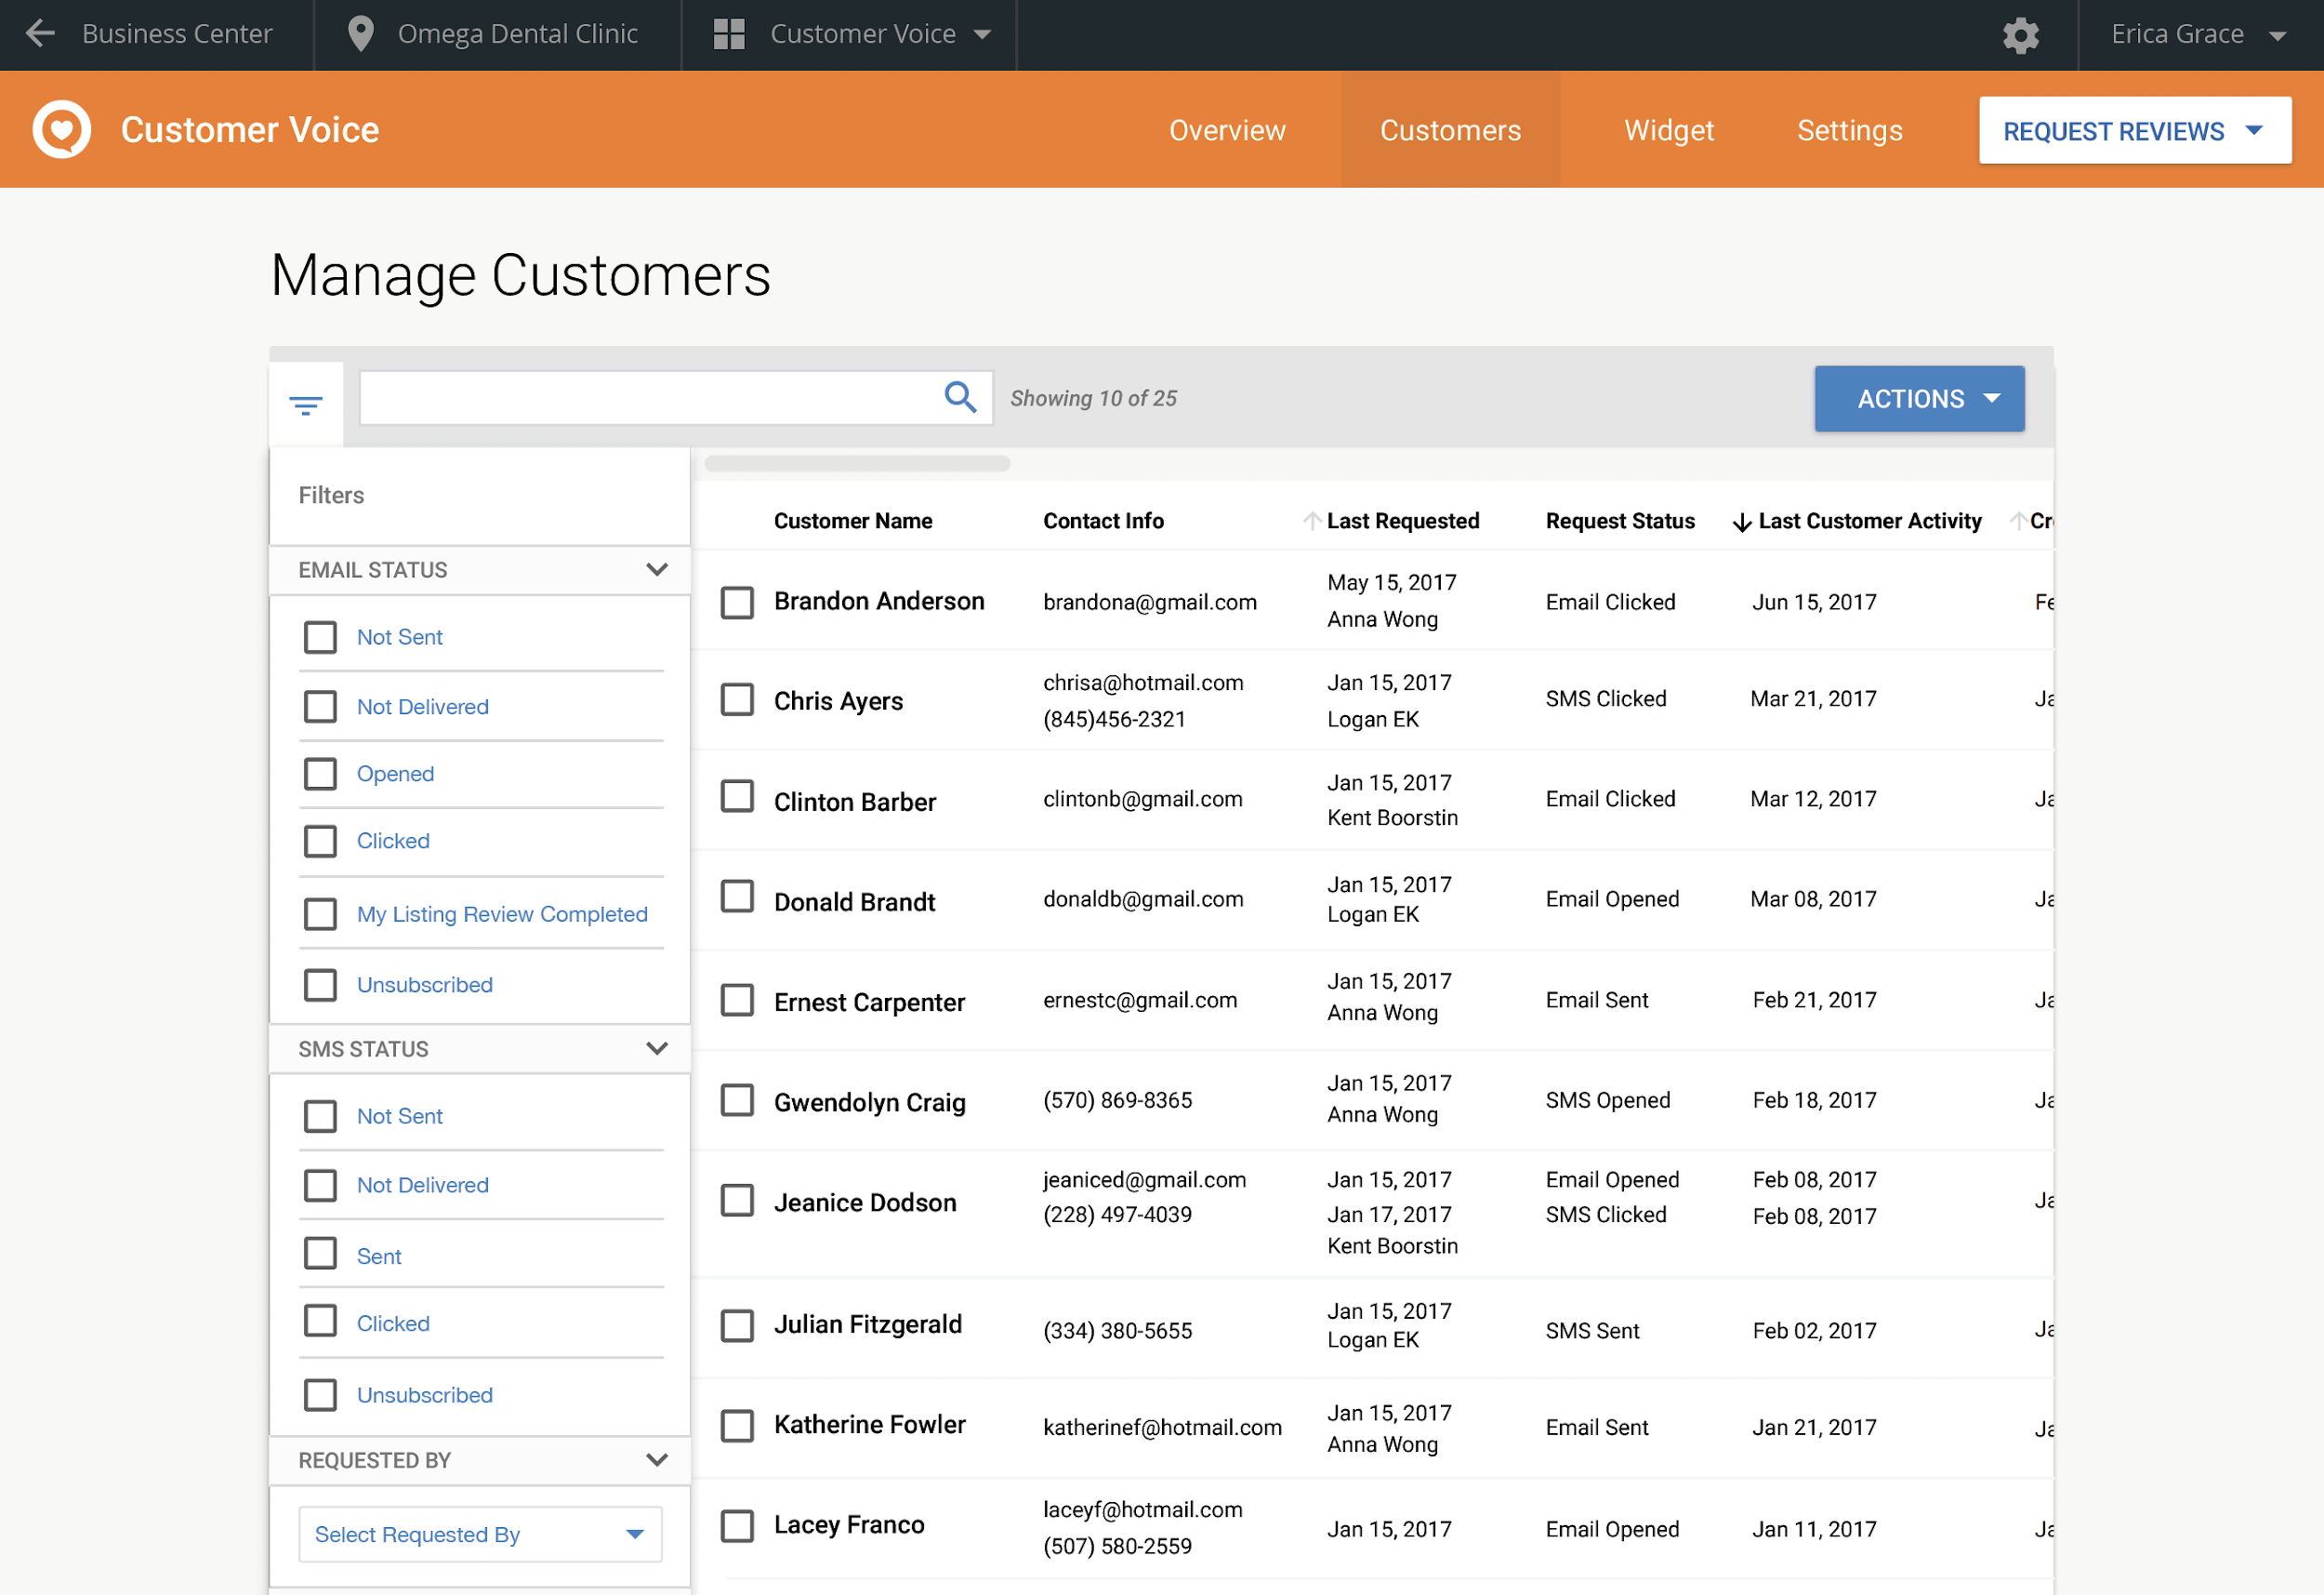
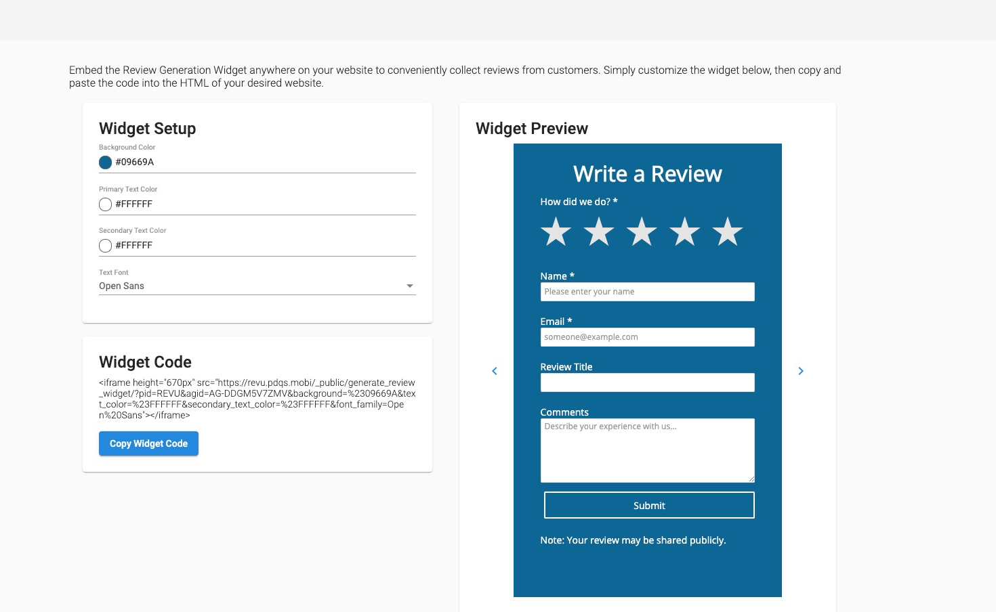
Customer Voice
Tab: Tools Collect reviews conveniently on your website
Widget Setup & Preview
Customize the widget to suit your branding
Embed on your website using HTML code
Notes:
But sending email or SMS reviews isn’t where Customer Voice’s capabilities stop! Your clients can also collect reviews conveniently on their website as well. Customize the widget to suit the website and quickly embed—it’s that simple to get even more reviews.

Slide 10
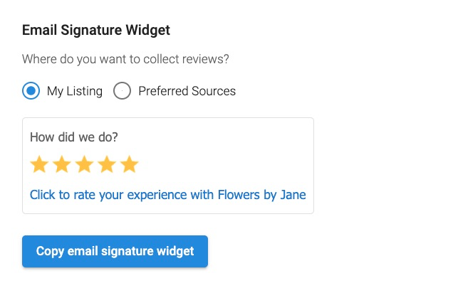
Customer Voice
Tab: Tools Collect reviews with every outbound email
Email Signature Widget
Customize the email signature widget
Paste the widget into your email signature to collect reviews with every email sent
Notes:
The email signature widget allows you to passively and proactively ask for reviews in every one of your outbound business emails. Any one you’re corresponding with can easily click the link and leave your business an online review on the site of your choice.

Slide 11
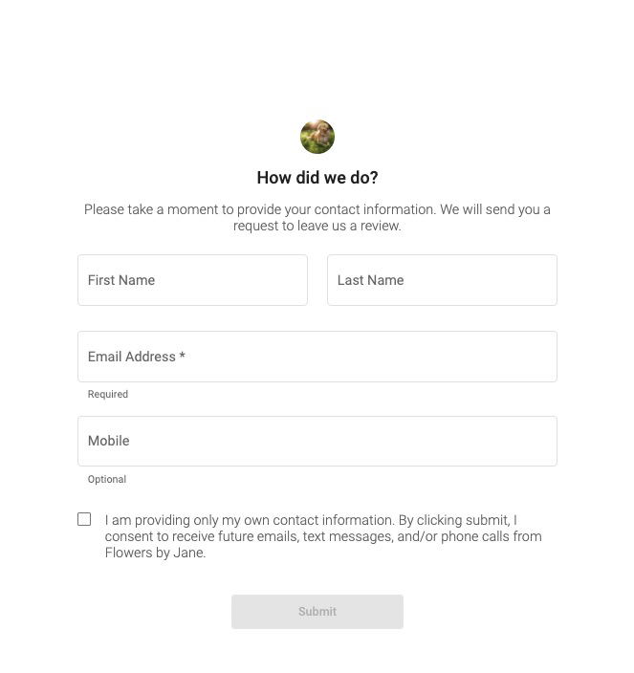
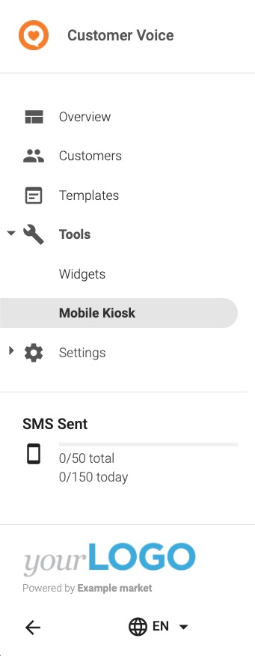
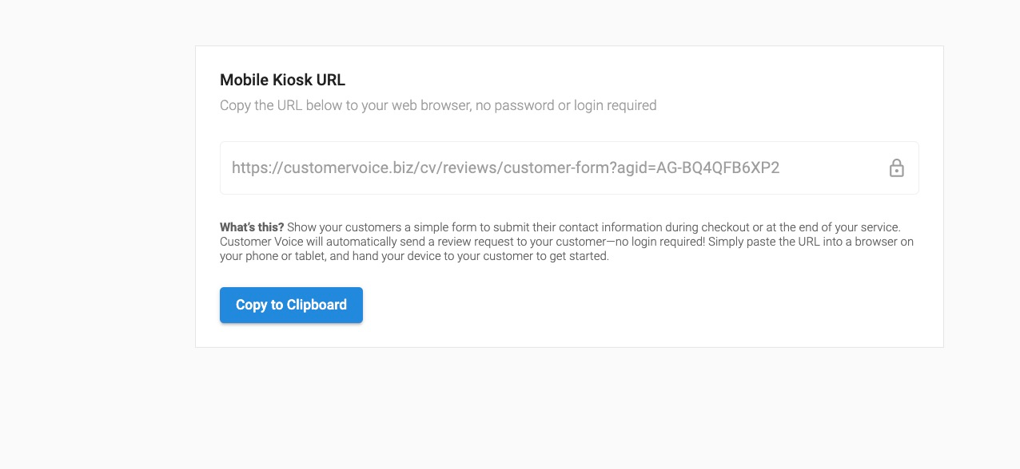

Customer Voice
Tab: Tools Collect reviews from customers on-site
Mobile Kiosk
Gather customer information at the point of sale or service
  Maximize chance of receiving a review
Use on phone or tablet—ideal for salespeople or at checkout
Notes:
Mobile Kiosk helps capture happy customer reviews at the point of sale or point of service, when they’re most likely to leave a review. Simply bring up the form on a mobile device, such as a salesperson’s phone or a tablet at checkout, to have the customer submit their information and automatically receive a link to review the business.

Slide 12
Customer Voice
EXPRESS
Notes:
Customer Voice is a powerful tool to get your clients more customer reviews and boost their star rating! We all know how important it is nowadays to collect customer reviews, in order to establish trust with potential customers. Customer Voice makes it easy to collect customer reviews after they’ve visited the business and when they’re most likely to leave a review..

Slide 13
Two ways to request feedback
Customer Voice
EXPRESS
Tab: Customers Add customers in bulk to save time
Manage Customers
Import a bulk csv file or add customers one at a time
Include phone number or email address
Add a tag to help classify the customer
Keep on top of the status of the review request
Notes:
In the Customers tab, import customer information one at a time or in bulk. You must include a phone number or an email address so that the request can be sent. From this page, you can also see at a glance the status of your most recent sent requests, so you know who to target next!

Slide 14
Two ways to request feedback
Customer Voice
EXPRESS
Tab: Templates Send email or SMS review requests
Manage Templates
Create 1 email templates
Include a link to preferred review site
Customize templates to suit your brand messaging
Notes:
With Customer Voice your clients have the power to generate more reviews and increase their review ratings. With a couple clicks, your clients can reach their customers via email or text and collect reviews on the sites that are most important to their business. These SMS and email templates are customizable, so you can alter them to fit whatever branding you need.

Slide 15
Review workflows
Customer Voice
EXPRESS
On what sites can I request reviews?
First party reviews
My Listing page
Third party reviews
Review sites like Google and Facebook
Notes:
Customer Voice allows your clients to choose between collecting first party reviews on their My Listing page, or third party reviews on sites like Google and Facebook.
Customer Voice also gives your clients the ability to manage negative feedback in a timely way—so they can address the situation before it harms their online reputation.
Plus, with the customizable Review Generation widget installed on your client’s website, harvesting the positive reviews your clients need is easier than ever!

Slide 16
Why new reviews matter
Customer Voice
EXPRESS
Online reviews are the first thing a consumer sees when searching for a business online.
87%
will only consider using a business if they have an average rating of 3-5 stars
Notes:
Today, online reviews are crucial to the success and revenue of a local business. In fact, 87% of consumers say they will only consider using a business if they have an average rating of 3-5 stars.¹
If you search online for a dentist, and two in your neighbourhood show up: one with 5 stars, and one with 2, which are you more likely to choose?
Your clients know building their online star rating is important, but they need your help doing it.

Slide 17
Review request insights
Customer Voice
EXPRESS
Tab: Overview Get stats on your sent review requests
View Insights
See how your requests are performing. Track:
  Number of review requests sent
  Click through rates
  Request status in real time
Notes:
On the Customer Voice dashboard your clients can see immediate ROI. It allows them to keep track of their review requests; see info like how many requests have been sent, click through rates, and request status, all in realtime.

Slide 18
Customer Voice
EXPRESS
Tab: Widget Collect reviews conveniently on your website
Widget Setup & Preview
Customize the widget to suit your branding
Embed on your website using HTML code
Notes:
But sending email or SMS reviews isn’t where Customer Voice’s capabilities stop! Your clients can also collect reviews conveniently on their website as well. Customize the widget to suit the website and quickly embed—it’s that simple to get even more reviews.

Slide 19
Customer Voice
EXPRESS VS PRO
Notes:
Customer Voice is a powerful tool to get your clients more customer reviews and boost their star rating! We all know how important it is nowadays to collect customer reviews, in order to establish trust with potential customers. Customer Voice makes it easy to collect customer reviews after they’ve visited the business and when they’re most likely to leave a review..

Slide 20
Features | Customer Voice Express | Customer Voice Pro
Ability to create customers | Unlimited | Unlimited
Ability to send email review requests | 15 per month | Unlimited
Ability to bulk send review requests | ✔ | ✔
Sync Customer List in Business Center with Customer Voice | ✔ | ✔
Customize and display the Review Widget and Email Signature Widget | ✔ | ✔
Sources synced with Reputation Management Express and Pro | Google, Facebook, MyListing | ✔
Customize and save review request templates | 1 | 40
Access to purchasing SMS add-ons |  | ✔
Send automated follow-up email to customers who haven’t reviewed |  | ✔
Send from a customized email domain |  | ✔
Daily Digest emails + Executive Report | ✔ | ✔

Slide 21
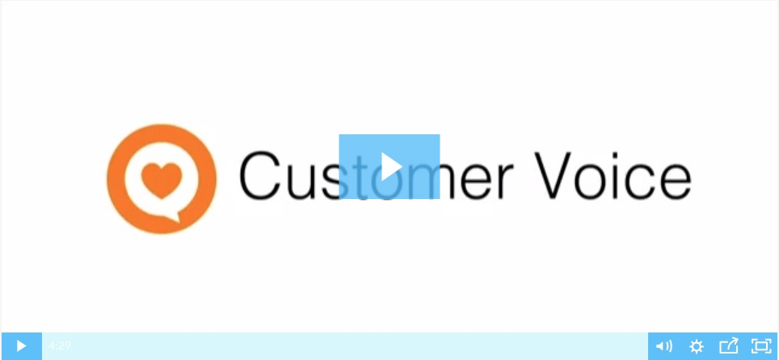

Customer Voice
DEMO
Customer Voice Pro
Customer Voice Express
Notes:
Customer Voice Pro:
https://vendasta-1.wistia.com/medias/anh7b0lejg
https://support.vendasta.com/hc/en-us/articles/360034289693?flash_digest=9793bec980e358e94e8072a2b0e0fe31929249cc
Customer Voice Express
https://vendasta-1.wistia.com/medias/rokkonv5vd

