Slide 1
Hyper-local Marketing Experts

Slide 2
New customers
They’re the life-blood of your business.
But finding them is hard. Especially when you’re busy running a business.
That’s where we come in.

Slide 3
ABOUT US
The vital stats
12 years of experience
30,000+ clients
45,000+ campaigns
1,200,000+ customers

Slide 4
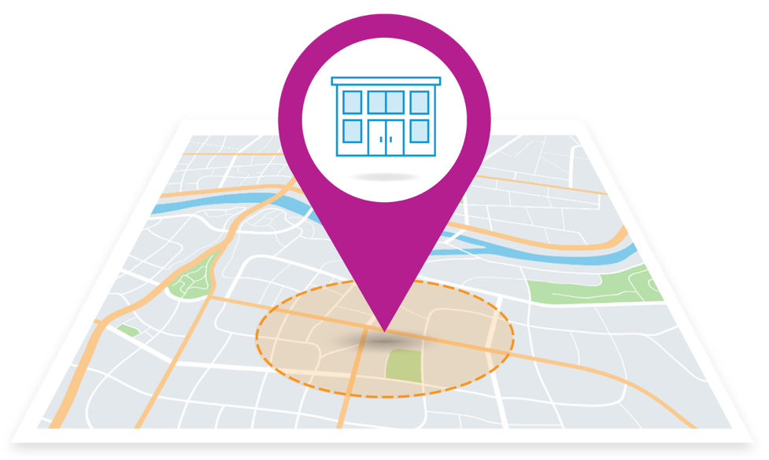
FOCUSED EXPERTISE
Our specialty is bringing in new business from your local community, regionally or nationally
How do you define your “market area”?
Neighborhoods
Towns
Zip codes
Counties
Cities
States

Slide 5
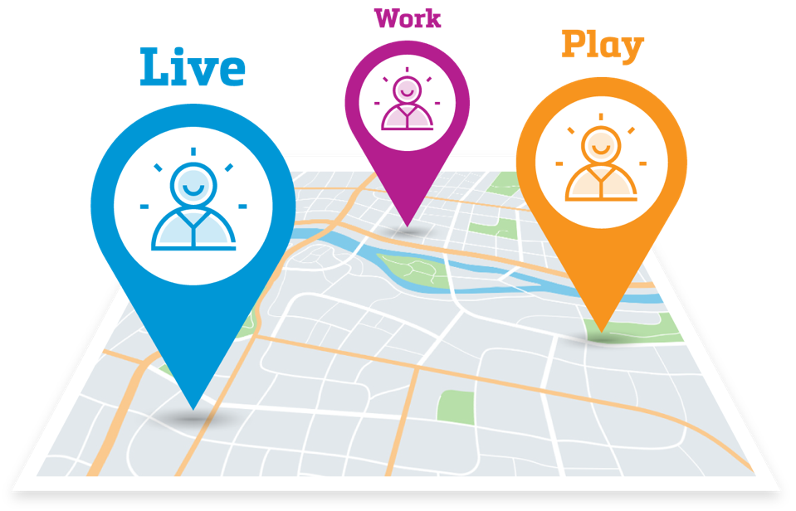
NEW CUSTOMERS
We know how to find them where they live, work and play
Dominate your market:
Live – focus on the households around your business
Work – focus on the offices within proximity to your business
Play – focus on high-traffic areas around your business (shopping, sports, dining)

Slide 6
DEEP INDUSTRY EXPERTISE
Our experience runs deep in many industries
– Partial list –
Auto repair shops
Fitness & health
Dental
Medical
Home services
Landscaping
Real estate
Financial
Chiropractic
HVAC
Landscaping
Retail
Beauty & Wellness
Restaurants
Insurance
Nonprofit

Slide 7
LIFE-STAGE EXPERIENCE
Our experience spans every life-stage of your business
Stage 1:
Launch and Early Stage
Stage 2:
Growth or Expansion
Stage 3:
Stagnant or Decline
Little brand awareness
Intensive operational time demands on business owner
Limited time and budget
Growing marketplace
Lower competition
Increasing brand awareness
Gaining market share
Mature business
New/aggressive competition
Flat/shrinking marketplace
Losing or flat market share
Which life-stage are you?

Slide 8
PROVEN PROCESS
Our approach gets you in market and generating results – fast!
Step 1
Assess
20-point assessment
Goals, customers, existing marketing and sales efforts, competition
Uncover your growth opportunity
Step 2
Create
Create your plan
Industry-leading creative talent and experts
Create materials that stand-out and generate action
Step 3
Implement
Driven by best-practices and proven methods
Set-up and launch marketing activities
Start getting you more members
Step 4
Optimize
Robust data analytics
Call tracking and KPI tracking
Advanced dashboard and reporting tools
Optimize results

Slide 9
PRINT CAPABILITIES
Postcards
What it is and why it matters:
A time-tested tool to connect with potential customers to earn their business
Our industry-leading creative builds your brand within your local community
Hyper targeted – yields you the highest ROI possible
What we can do:
Countless sizes and formats
The most thorough demographic analysis in the nation
Identifies the very best specific neighborhoods for you
The highest quality lists that are continually updated
The fastest turnaround times in the industry
Complementary access to our data warehouse for insights and analytics
We’ve mailed over one billion postcards!

Slide 10
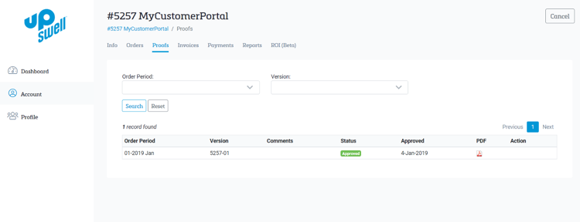
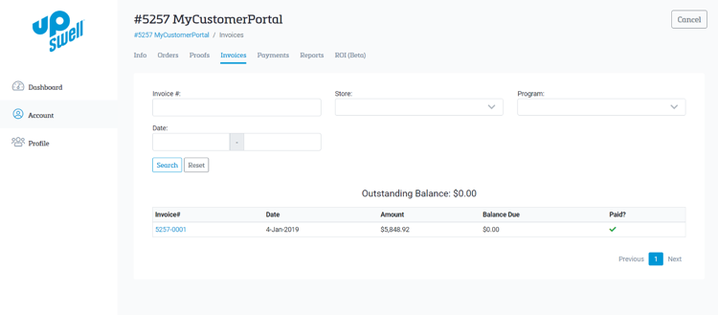
DATA AND ANALYTICS
Analytics and reporting
FREE monthly campaign analytics and reporting
A dedicated marketing consultant assigned to you
Analytics begin immediately, no lengthy set up or waiting
Conducted throughout the life of your marketing
Includes: Penetration rates, spend allocations, key marketing metrics, competitive activity and much more
Understand your ROI - customers and revenue acquired

Slide 11
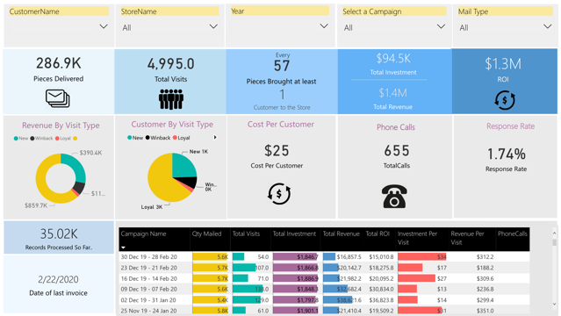
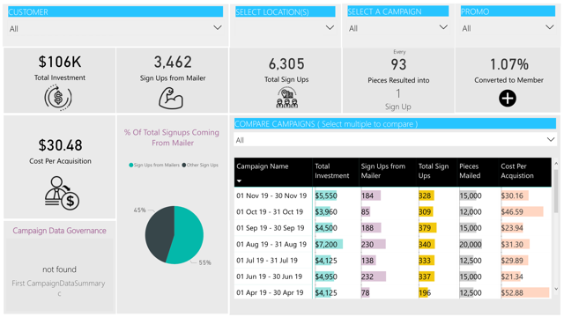
DATA AND ANALYTICS
My UpSwell
No charge
We don’t charge for set up or access to your dashboard, unlike many agencies
Real-time
Daily and weekly reviews
We don’t wait 4-6 weeks, until the end of your campaign
Improvements can be made faster
Integrated
See across every marketing channel
Make better decisions and optimization
Ability to dive deep with custom-reporting
Secure
HTTP connected server
We never share or sell your data

Slide 12
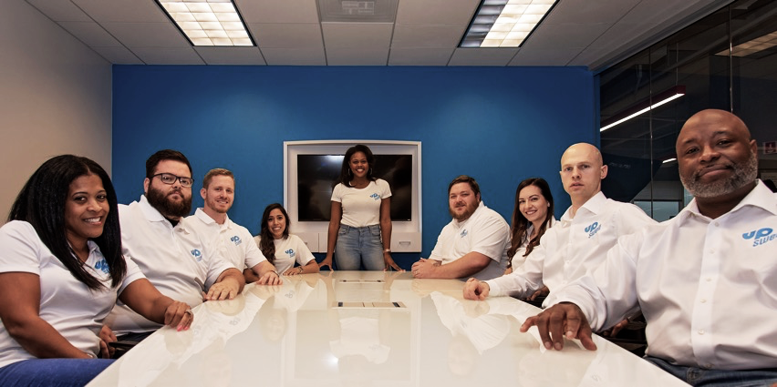
RECOMMENDATIONS
We’re the partner you need to start getting you more customers
One less thing to worry about
Proven team, proven performance
Deep industry expertise
Easy to work with – no hassle
We’ll get you to market – fast!

Slide 13
Let us start helping you grow your business today !!

