Slide 1
AN INTRODUCTION ABOUT FOLDSCOPE
DR.A.M.RAMACHANDRAN
ASST PROFESSOR,
DEPT OF MICROBIOLOGY,
DR.N.G.P.ARTS AND SCIENCE COLLEGE,
COIMBATORE- 641 048

Slide 2
Introduction
The foldscope is an unique invention by an Indian scientist, Dr.Manu prakash, professor at Stanford University developed to foster deep interest in science at an early stage by providing “ microscope for every child”.
The foldscope is an ultra affordable paper microscope inspired by origami.
It is a portable, sturdy and versatile microscope made mostly out of paper (water proof) that magnifies the wonders of the microscopic world, without the bulk and expense of a conventional research microscope.
Foldscope is designed to bring microscopy out of science labs and in to the hands of people around the world.
foldscope is a real microscope, with a magnification and resolution sufficient for imaging live individual cells, cellular organelles, embryos, swimming bacteria and much more. It is affordable and can be used anywhere. It brings science to daily life.

Slide 3
MoU
The Foldscope has been brought to India by DBT-GOVT. OF INDIA & Prakash lab , USA in the presence of the Honorable prime minister of India Shri.Narendra Modi during his visit to USA for the India –US Start up connect event at Silicon Valley on 27th September, 2015.

Slide 4
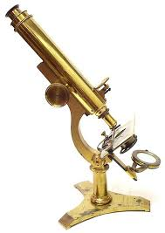
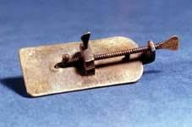
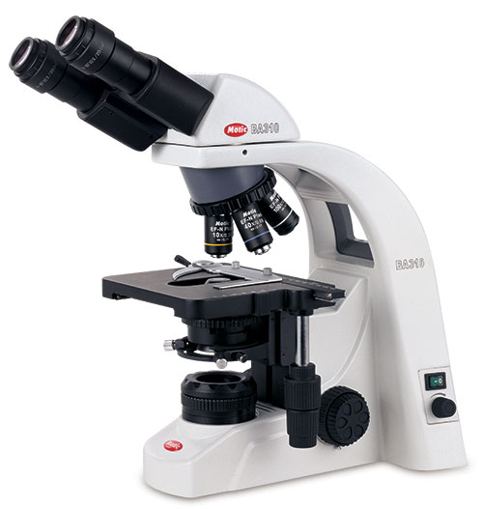
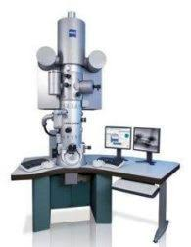
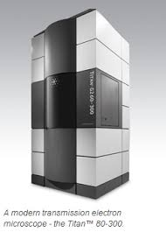
Progeny of Microscopes
1 ^{ST} GENERATION LIGHT MICROSCOPES
2nd GENERATION ELECTRON MICROSCOPES

Slide 5
Pioneers in microscopy
Senior
Junior

Slide 6
Antony von leewenhock & Manu prakash
MICROSCOPE
FOLDSCOPE

Slide 7
Definition & Difference
MICROSCOPE | FOLDSCOPE
1. A microscope is a high precision optical instrument that uses a lens or a combination of lenses to produce highly magnified images of small specimens . 2. A light source is used (either by mirrors or lamps) to make it easier to see the subject matter. | The Foldscope is an origami-based optical microscope that can be assembled from a flat sheet of paper. Sun light or LED light can be used as light source

Slide 8
How to assemble a foldscope?

Slide 9
Foldscope operation
The Foldscope is operated by following steps
1. Sample mounted on a microscope slide,
2. Turning on the LED - light soure
3. Viewing the sample while panning and focusing with one’s thumbs.
The sample is viewed by holding the Foldscope with both hands and placing one’s eye close enough to the micro-lens so one’s eyebrow is touching the paper

Slide 10
ADVANTAGES BY USING FOLDSCOPE
1. It is less expensive, price is less than a dollar.
2. High magnification (2,000x).
3. Weighs less (8.8 g)
4. It is small enough to fit in a pocket (70x20x2 mm³ )
5. It requires no external power
6. It can survive being dropped from a 3-story building or stepped on by a person.
7. Its minimalistic, scalable design is inherently application-specific instead of general-purpose.

Slide 11
Slide fixing in foldscope

Slide 12
LED Illumination

Slide 13
Foldscope viewing with mobile camera

Slide 14
What is my task in foldscope?

Slide 15
To Extend the foldscope application in water analysis

Slide 16
objectives
-Sample Collection
-Observation Of Samples by foldscope
-Bacterial Endo Toxin estimation in the Samples
-Enumeration and Characterization Of Bacteria in the Samples

Slide 17
1. Drinking water sample collection: The samples will be collected by aseptic procedure in the pre sterilized screw cap bottles. It shall be processed immediately or if delay stored in refrigerated condition at 4º C . 2. Observation of sample by Foldscope: Place a drop of water sample on the clean glass slide and shall be observed for dust and other particles
Materials and Methodology

Slide 18
3. Endotoxin detection
The endotoxin combine with a lysate form an agglomerate which can be detected by UV spectrophotometer.
but It is replaced by foldscope and the rate of time consuming also reduced

Slide 19
4. Identification and characterization of Bacteria
It encompass, a.foldscopic observation- staining techniques b. Biochemical analysis-IMViC, TSI test, sugar utilization c. Media analysis

