Slide 1
Foldscopes
Microbiology Class of 2015

Slide 2
Introduction to Foldscopes
What happens to the world if every single kid carries a microscope in his/her pocket? What can be found?
New organisms
Reasoning for good hygiene
Pathways to cures
Endless amounts of information!

Slide 3
Introduction to Foldscopes Continued
Why are Foldscopes great?
Cost less than $1 to make
Take less than 15 minutes to assemble
Do not break if you drop them or step on them
Slides are simple and easy to make

Slide 4
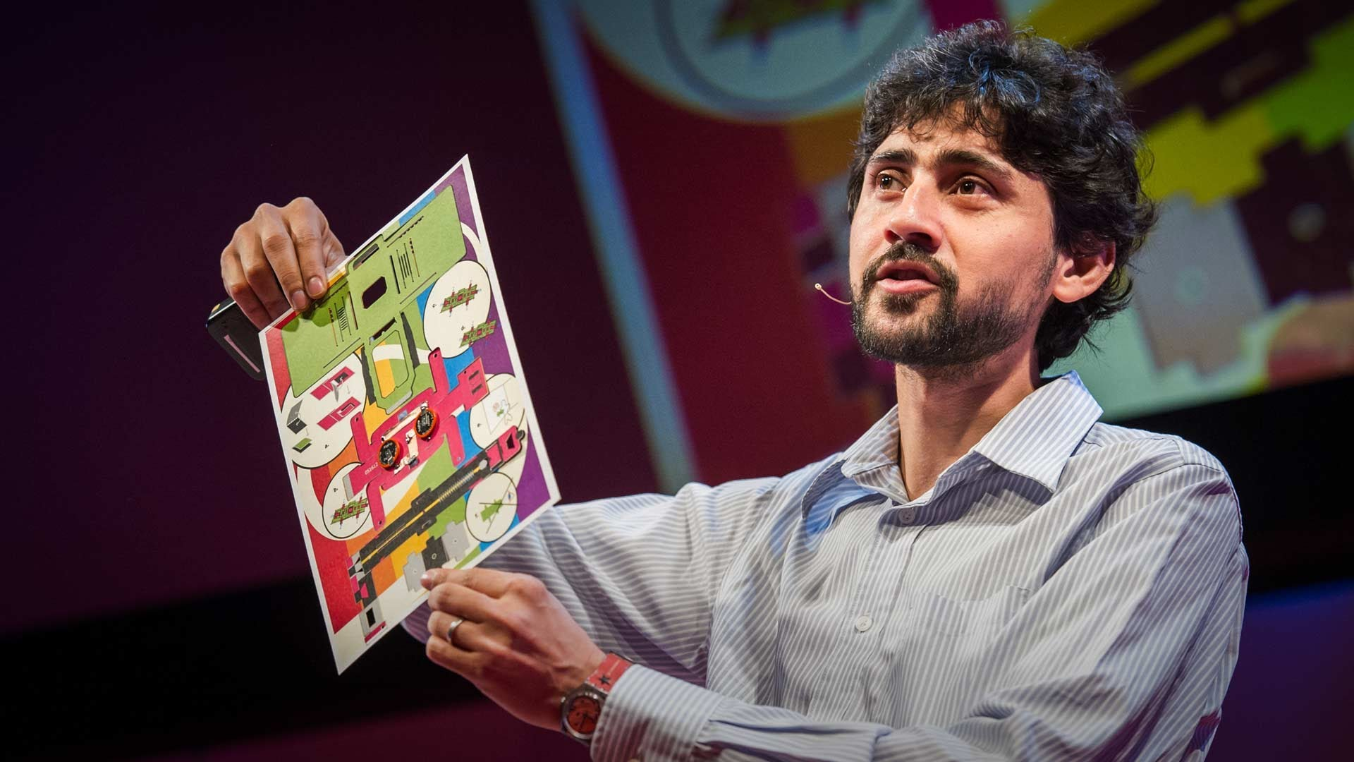
The Man Behind Foldscopes
Manu Prakash
Assistant Professor of Bioengineering at Stanford University

Slide 5
Features of the Foldscope
A spherical lens in middle of the mounting platform provides over 2000x magnification with sub-micron resolution (800nm)
It is focused by sliding the paper platform around with thumbs
Projector attachment
Can accommodate standard glass slides or paper slides that come with the Foldscope kit

Slide 6
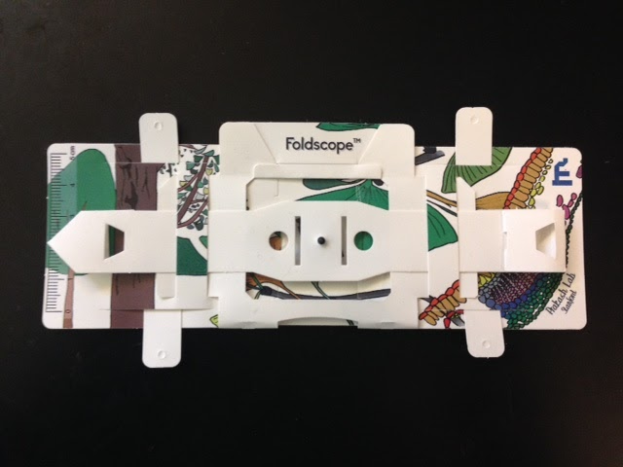
A Foldscope

Slide 7
Procedure: Constructing the Foldscope
In order to make Foldscopes, it is necessary to have the 8” by 11” pieces of paper that contain the pop-outs for the scope itself and the very small lenses that accompany them.
Pop out the biggest section with the title “Foldscope” on top (pop out all parts that can).
Fold the bottom portion up on the dotted lines.
Take the top part of the folded portion and insert the flap into the slot behind, right underneath the title.
Pop out the portion with four legs.
Turn the Foldscope over.
Insert the flap between the legs into the slot on the back of the Foldscope and insert the stem into the the slot on the other side.
Turn the Foldscope over again.
Fold the stem along the dotted lines and weave it across the front of the Foldscope.
Fold the excess stem on the right in along the dotted lines and tuck it into the slot.
Insert the lense under the center.
Turn the Foldscope over.
Put the legs in the slots above them.
Put the unique sticker on the back.

Slide 8
Procedure: Isolating Specimens and Growing Colonies
Collect a sample of dirt from the environment in a tube.
Add water to to the tube.
Gather three separate tubes of 10ml of sterile water (“sterile saline”).
Label three tubes 1/10, 1/1,000, and 1/10,000.
Take 100ml of the dirt sample and add it into tube 1/10.
Take 100ml of the 1/10 dilution and add it into tube 1/1,000.
Take 100ml of the 1/1,000 dilution and add it into tube 1/10,000.
Put 100µl of the 1/1,000 dilution onto a sterile agar plate. Spread thoroughly. Repeat this step two more times.
Put 100µl of the 1/10,000 dilution onto a sterile agar plate. Spread thoroughly. Repeat this step two more times.
Put the plates upside down in the incubator, but DO NOT turn the incubator on.

Slide 9
Procedure: Using the Foldscope
Following the instructions previously mentioned, construct the basic structure of the Foldscope.
Test a paper slide
  Prepare a paper slide
    Punch out a slide from the Foldscope sheet.
    Cover one side of the square with the provided cover sheet (tape).
    Place specimen on the sticky side of the cover sheet.
    Place a second cover sheet on the square to enclose the specimen.
  Place the paper slide in the designated slot.
  Adjust the slide so the specimen is over the lens.
  Look through the lens and up at the light. Push lightly on the slide to bring it into focus if necessary.
Test a glass slide
  Prepare a glass slide
    Choose a colony from the incubated plates.
    Turn the plate over and label it with a number for future reference.
    Using a sterile loop, gather a sample of the colony and spread on the glass slide.
    Add toluidine blue dye to the sample.
    Add nail polish on the end of the slide. Put a coverslip on top of the nail polish to cover the sample.
  Place the glass slide in the designated slot.
  Adjust the slide so the specimen is over the lens.
  Look through the lens and up at the light. Push lightly on the slide to bring it into focus if necessary.
Projection
  Attach one magnet to the Foldscope and one magnet to a phone.
  Line up the magnets. Turn on the phone light. Perform this in a dark room.

Slide 10
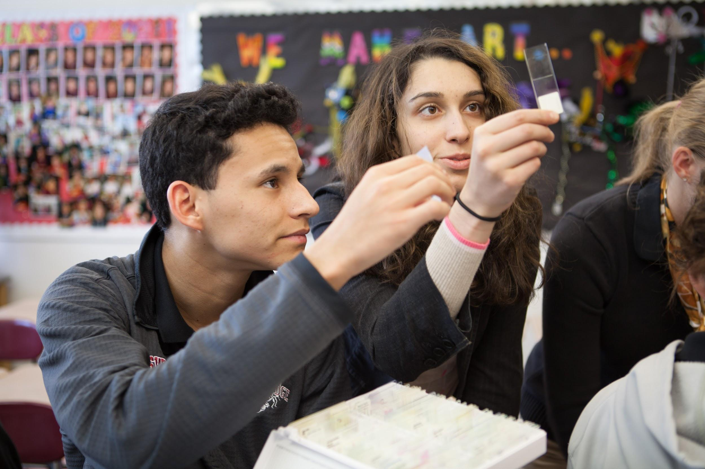
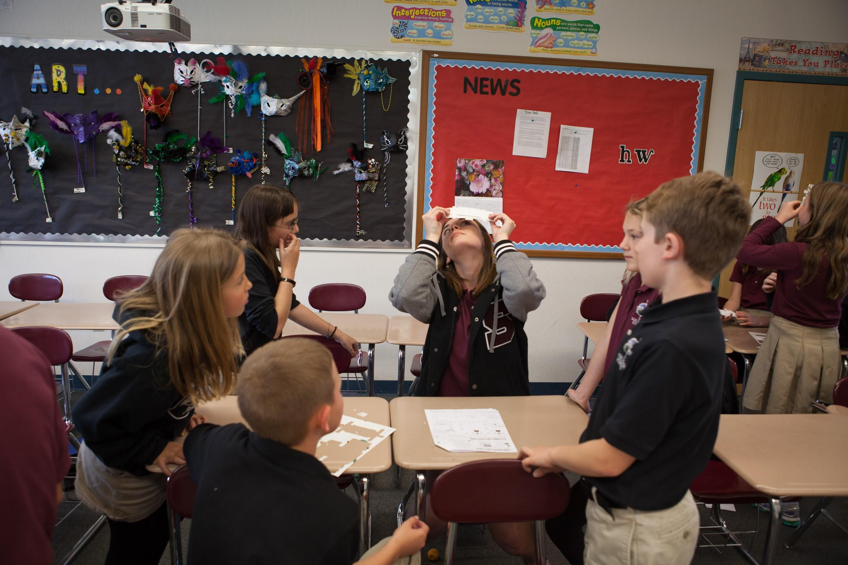
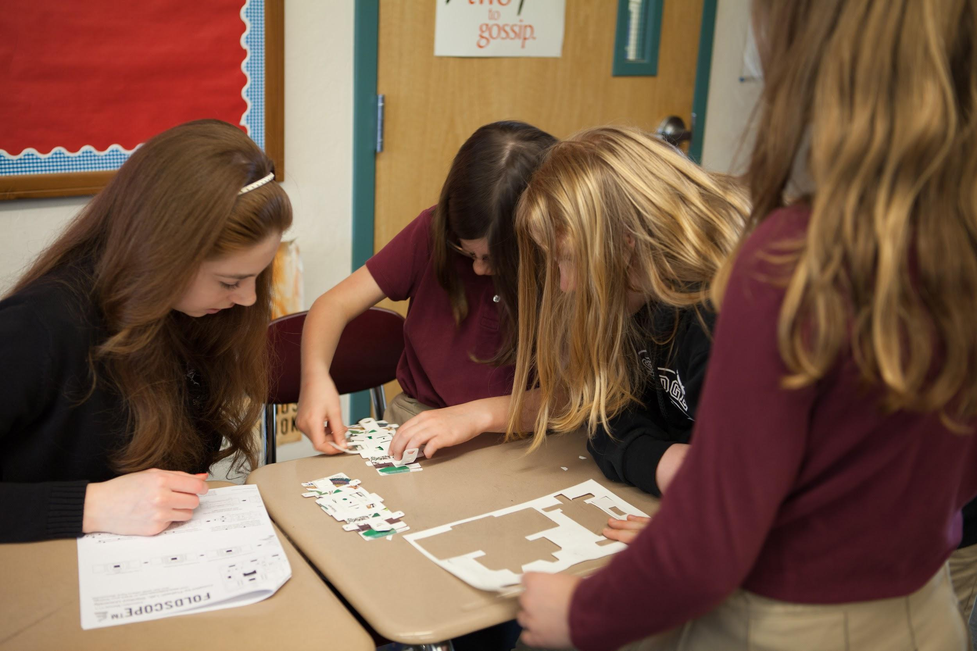
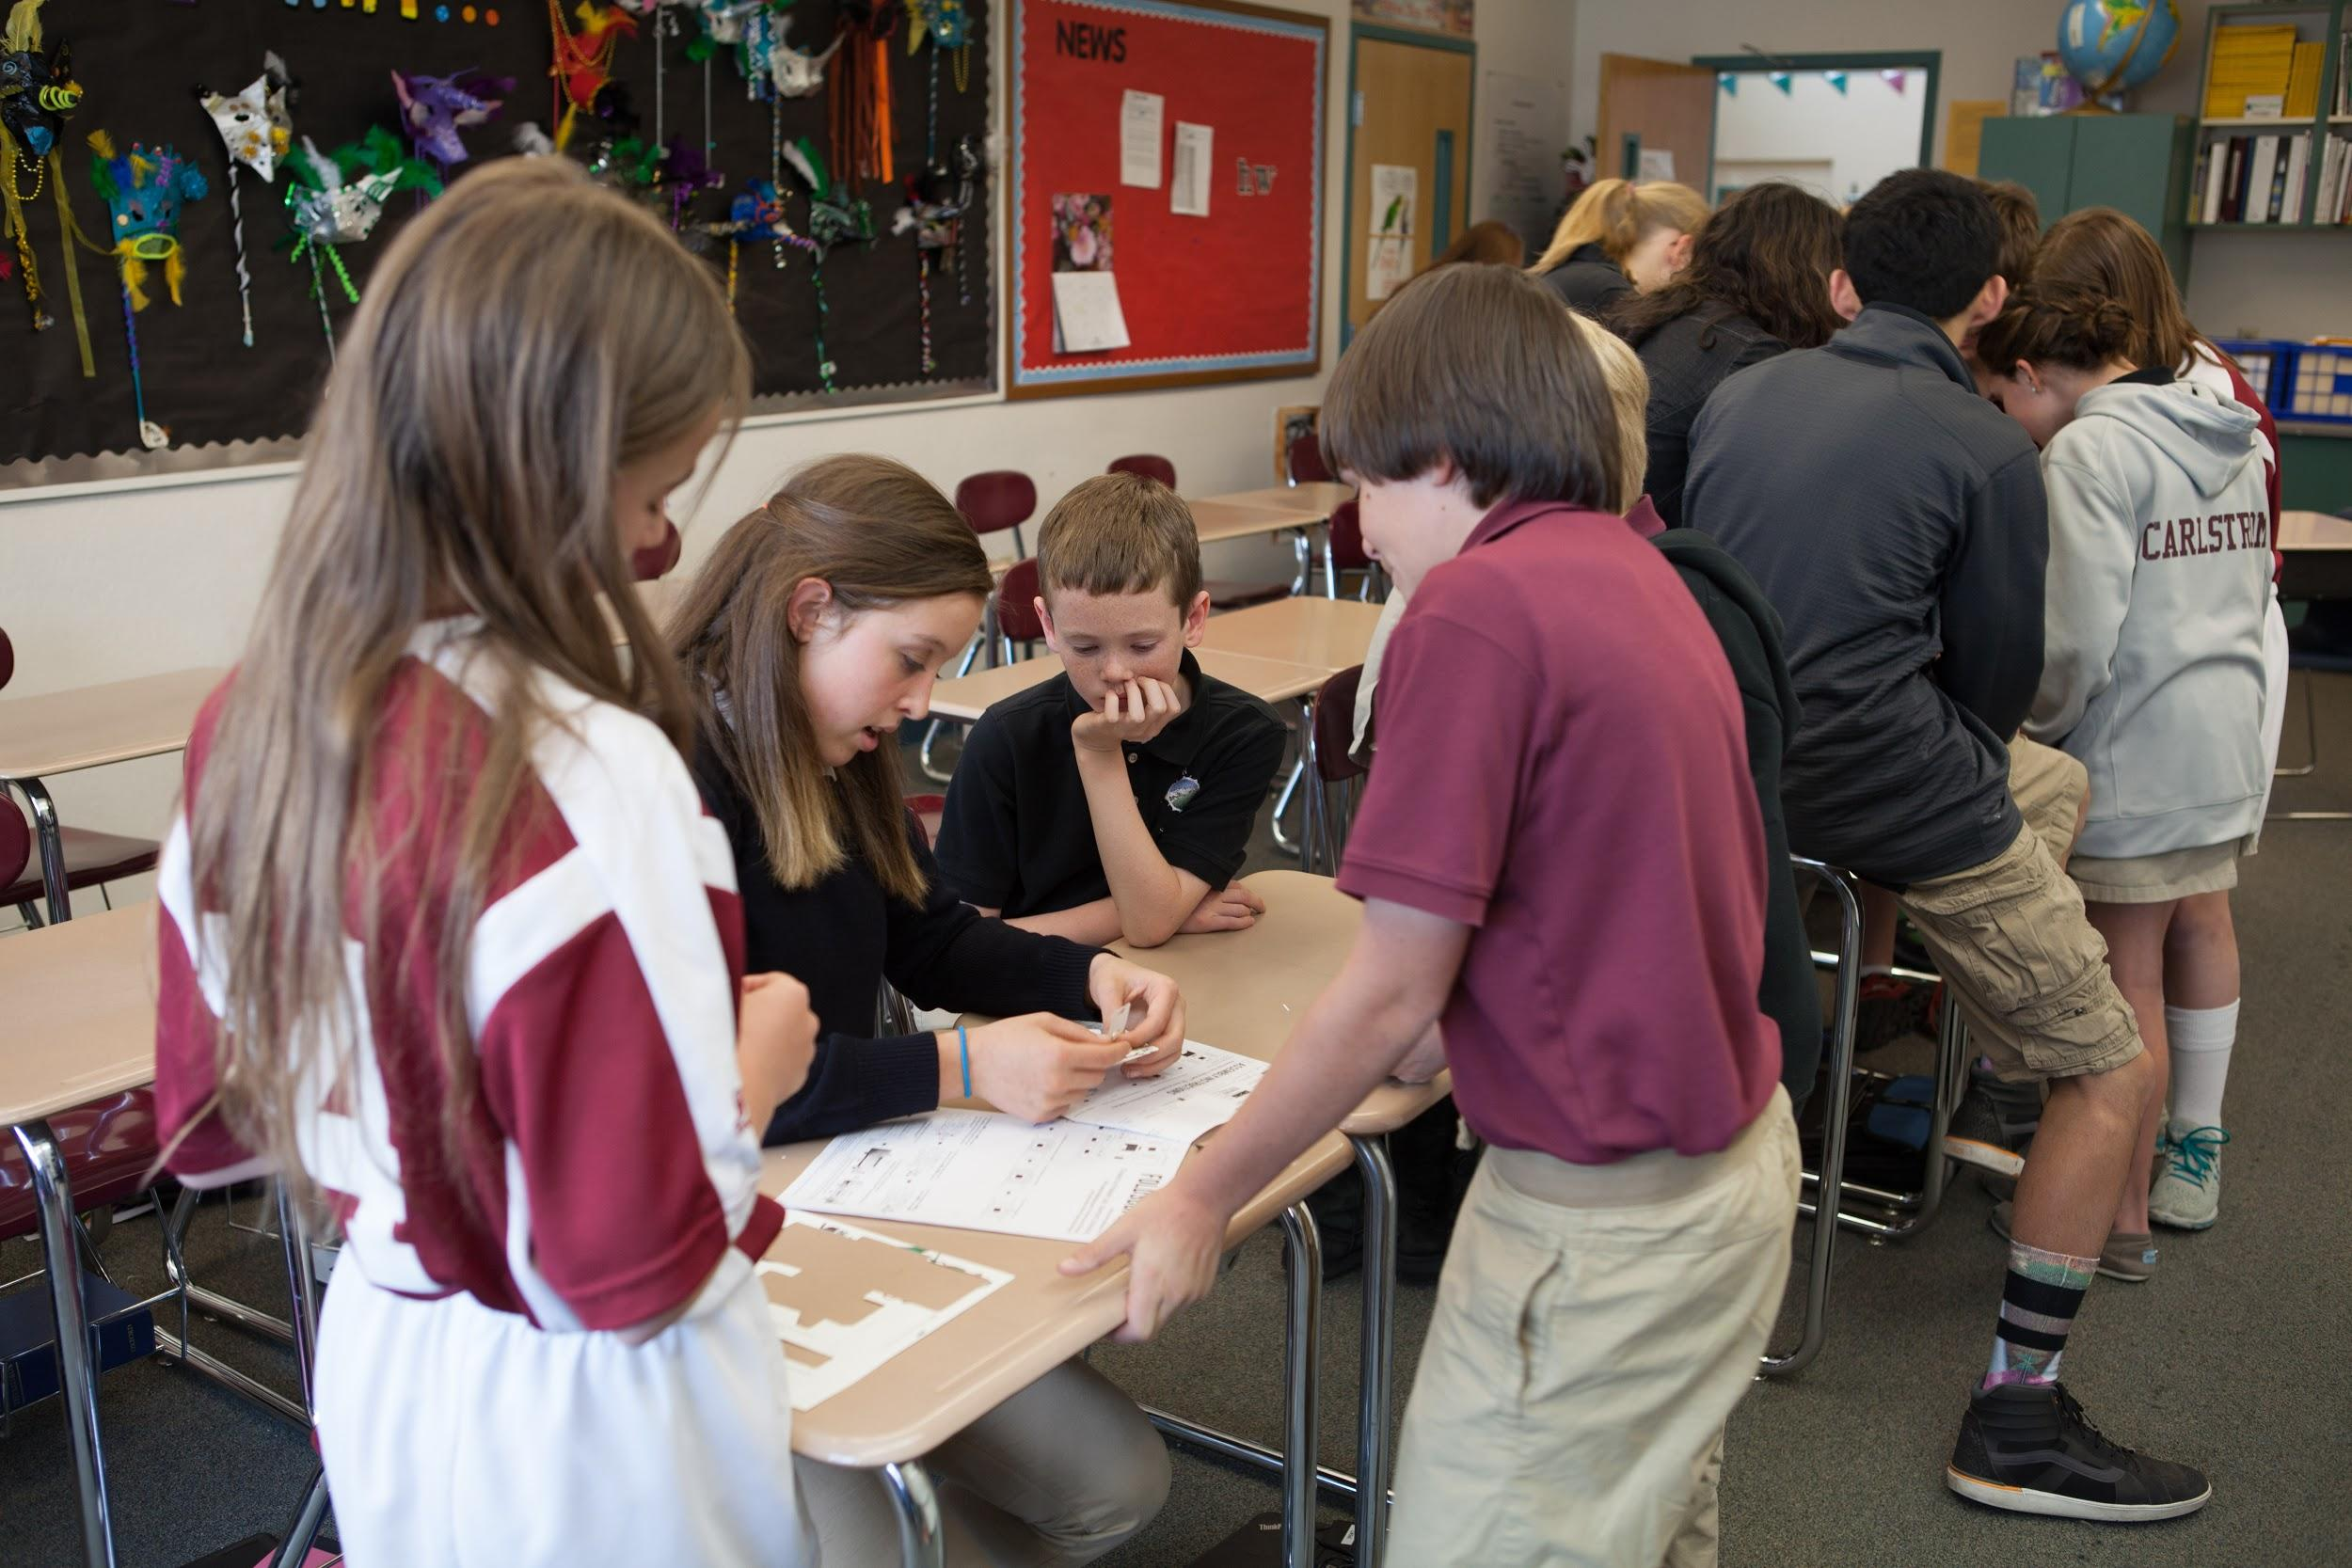
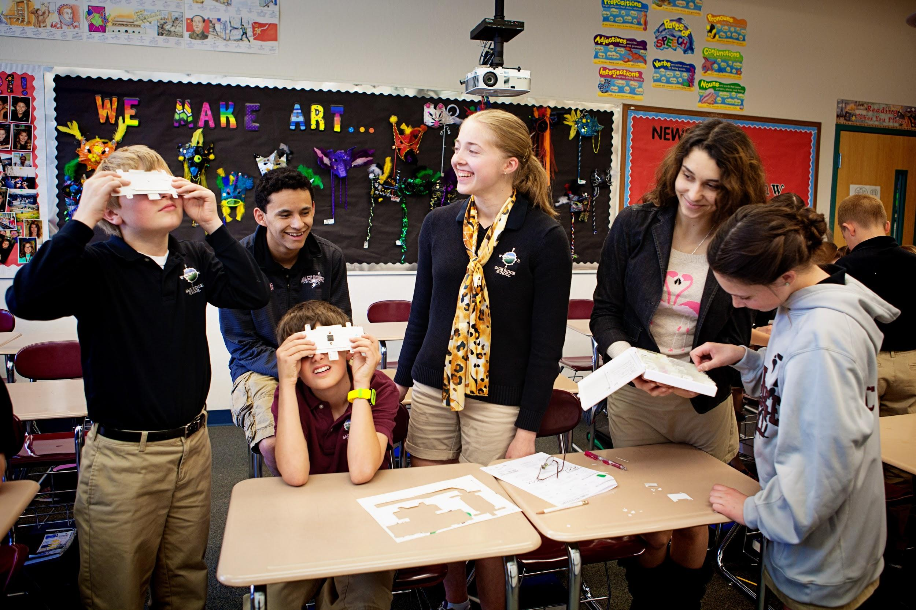
Teaching the 5th Grade

Slide 11
Works Cited
Foldscope: Microscopy for everyone. n.d. Web. 3 5 2015. <http://www.foldscope.com/>.
Manu Prakash. 21 2 2914. Cap Network. Web. 3 5 2015. <https://profiles.stanford.edu/manu-prakash>.

