Slide 1
Malaria Masters Class
Malaria Overview
Future of Diagnosis & Treatment
What attract mosquitoes

Slide 2
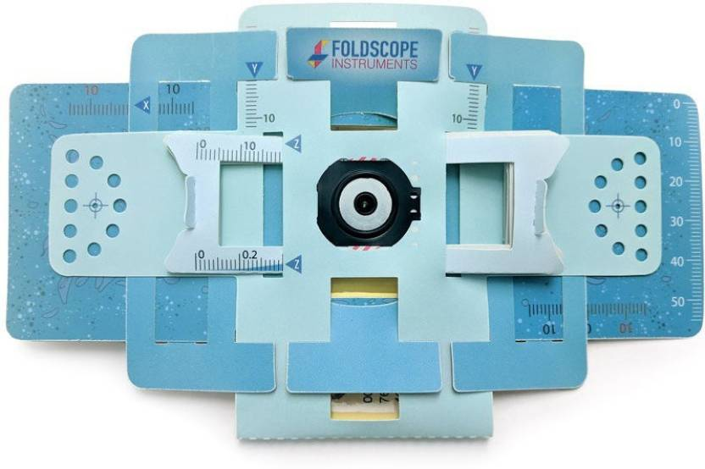
Demonstration- Foldscope

