Slide 1
Where are you with Academic Mindsets?
No idea; but I want to know
Need convincing it can be useful
I know something about it
Think it can be useful
Secure on the facts and see how I can use it or have used it
Know it is useful
Have experience of using it; looking to develop further
Can see how I can link it to other areas
#YesUCan @GLOWMath #GetontheBus
Notes:
Recommend to read the companion guide for yesUcan presentation before using this
These are headings used for participants to indicate visually where their current understanding is. Each participant is given a POST-IT note to put under appropriate heading. One aim from the session to be written on the POST-IT. Second POST-IT note to put under right hand headings. Both provide visual representation of the audience mix.

Slide 2
Maths and Mindsets
#yesUcan
Do some Maths
Try to make every number between 0 and 20 using only four 4’s and any mathematical operation with all four 4’s being used each time.
I went into a shop and purchased 3 identical slices of ham that weighed in total 1/3 lb. I got home and my wife told me she was only allowed to eat 1/4lb of ham. How many slices do I give her?
Without a calculator, work out 6.2 x 37.5 + 38 x 3.75
Notes:
These are questions for participants to work on as everybody arrives. Sheets with questions already on desks They are aimed to develop thinking skills rather than perception that maths is about memorisation

Slide 3
Notes:
This slide is up for all to see on entering room. It is aimed to set the “I can do” attitude and a first example of posters that can promote the maths and mindsets message.

Slide 4
@GLOWMaths #yesUcan
Notes:
Brief banner to introduce the Maths Hub and in particular this work group which is aimed at Maths and Mindsets. Use tag line #YesUCan

Slide 5
Mathematics
and Academic Mindsets
Welcome
Where are you?
Growth Mindset is only 25%
Available Evidence
Creating a Culture
Jo Boaler’s seven habits of success
The Power of YET
Road to Success
Posters
Verbal messages
Mathematical resources
Stanford University resources
What’s in it for you? So what now?
@GLOWMaths #yesUcan
Notes:
For further details see the companion guidancefor YesUCan presentation – separate word document

Slide 6
#YesUCan
PEOPLE
POSTERS
PROCEDURES
POLICY
You make it happen by what you do and say

Slide 7
The great teachers believe in the growth of the intellect and talent, and they are fascinated with the process of learning
Carol Dweck – Mindset 2006

Slide 8
My classroom message
We are here to learn
Do you want to learn?
Many people can help you
Don’t want to learn?
Nobody
can help you
@GLOWMaths #yesUcan

Slide 9
Comfort
Learning
Panic
Challenge
Easy
Notes:
Link to Carol Dweck “Make challenge the new comfort zone” https://www.mindsetkit.org/growth-mindset/celebrate-mistakes/make-challenge-new-comfort-zone

Slide 10
Words Count
What messages do your words convey?
Please discuss your response to the questions on the cards
@GLOWMaths #yesUcan

Slide 11
How do you respond to these situations?
When describing the groups of children you teach
When a child says “I don’t get it”
When a child says “I forgot my homework”
When a child says “It’s hard”
When a child says “I don’t know”
When an incorrect answer is given
When a correct answer is given
@GLOWMaths #yesUcan

Slide 12
How do you respond to these situations?
When a high attaining child gets 40%
When a child gets 100% consistently in homework
When a parent writes “Kesta spent 1 hour doing this but I don’t know what to do”
When a parent says “I was no good at maths”
When a teacher says “ I was no good with maths”
When a colleague says Bethan’s really clever
When parent says “my son is a natural at tennis”
@GLOWMaths #yesUcan

Slide 13
GROWTH MINDSET
Three short videos introducing Growth Mindset
Schematic
1 minute Introduction to be followed by
Descriptive
C Romero : PERTS ( 3 Minutes)
Affect on grades
C Romero : PERTS ( 2 Minutes)
@GLOWMaths #yesUcan
Notes:
This section uses videos to provide overview of a growth mindset

Slide 14
MINDSETS
GROWTH IS ONLY 25%
@GLOWMaths #yesUcan

Slide 15
ACADEMIC MINDSETS
Self Efficacy
Growth
Belonging
Purpose
Teaching Adolescents to become learners; Farrington et al 2012
@GLOWMaths #yesUcan
Notes:
Use extract from Farrington et al to discuss elements of each Mindset

Slide 16
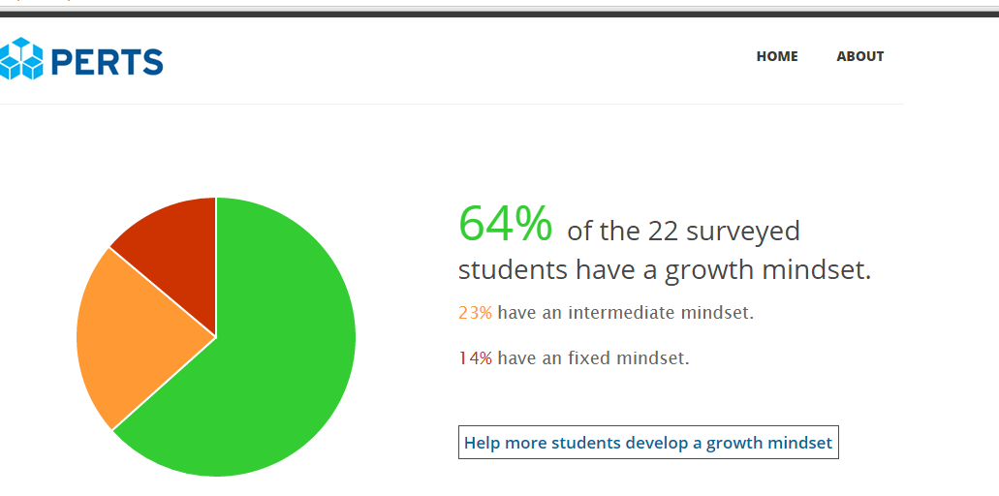

Slide 17
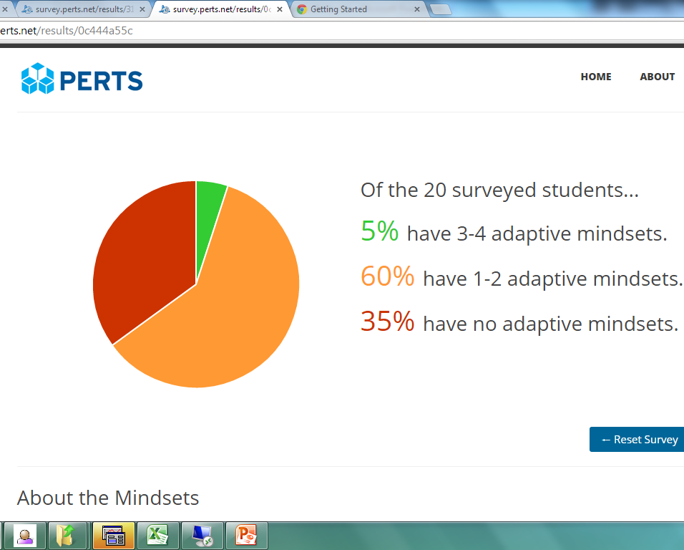

Slide 18
Staff Mindsets are important
“pedagogical practices can lock students into low achievement and deplete the math pipeline”
“It’s ok – Not everyone can be good at math” : instructors with an entity theory comfort (and demotivate) students.
Rattan, Good, Dweck; Journal of Experimental Social Psychology; December, 2011
@GLOWMaths #yesUcan
Notes:
Verbal messages from parents and teachers important. Students must not be comforted with it being ok if they don’t do well.

Slide 19
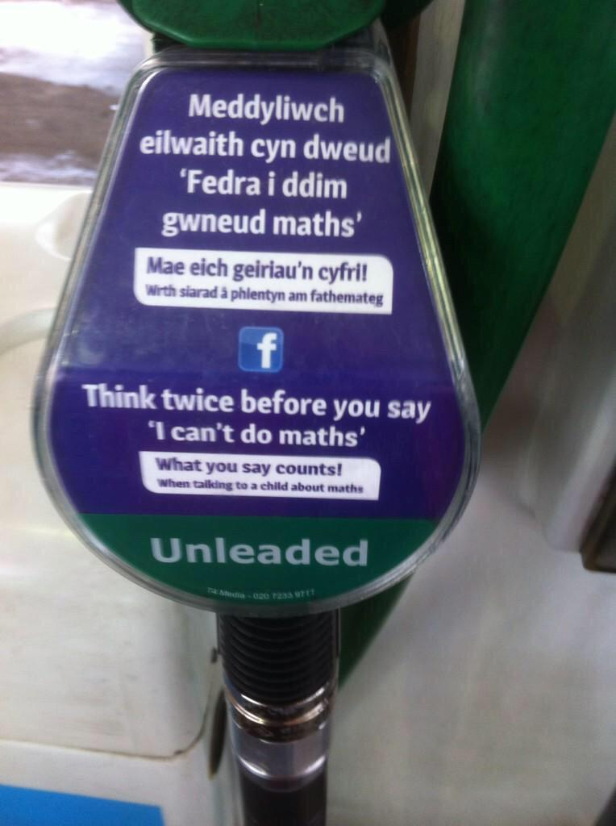
Notes:
Campaign run in Wales, UK. This message was on petrol pumps throughout the country.

Slide 20
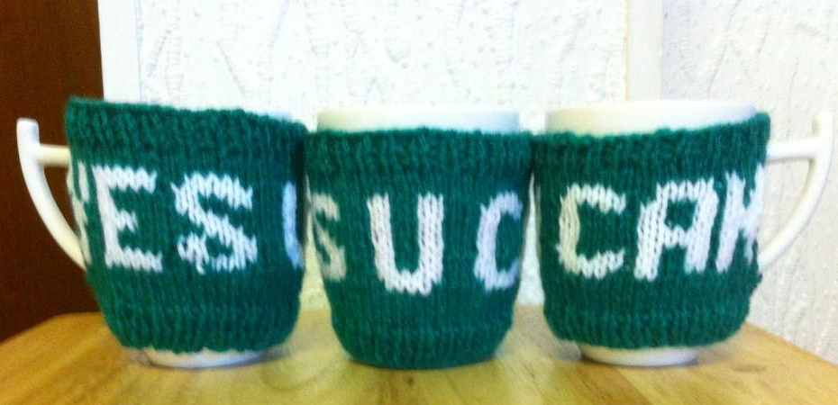
Notes:
#yesUcan is message for everyone. These are “mug hugs” that help promote the message

Slide 21
Grow your brain
Video talk from Professor Jo Boaler – Mistakes and Synapse connections
@GLOWMaths #yesUcan

Slide 22
Students Mindsets The power of yet or NOT YET
@GLOWMaths #yesUcan
Notes:
Carol Dweck talking

Slide 23
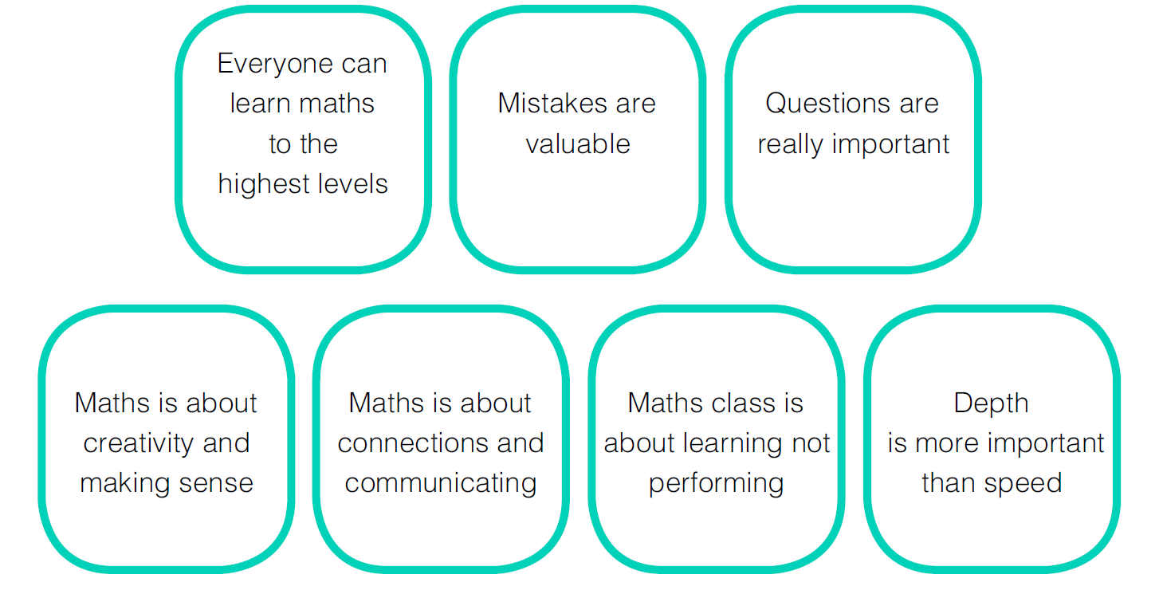
Positive Classroom Norms
@GLOWMaths #yesUcan

Slide 24
Where are you on your road to
success ?
E
F
F
O
R
T
I did
100%
I am
90%
I can
80%
I think I can
70%
I might
60%
I think I might
50%
I want to
40%
I wish I could
30%
I don’t know how to
20%
I can’t
10%
I won’t
0%

Slide 26
Celebrate Mistakes
Great ideas here
Notes:
Pertslab mindsetkit links to videos

Slide 27
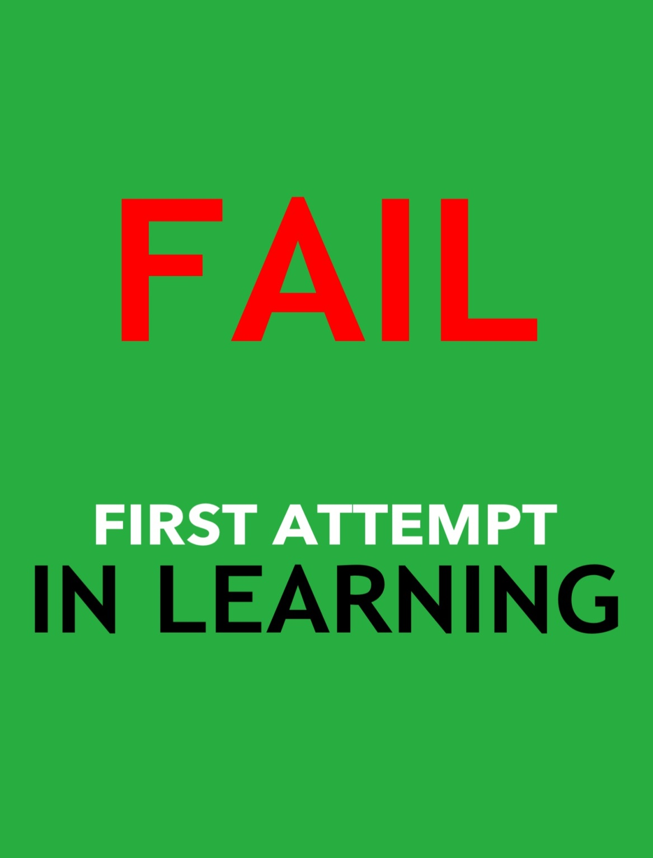

Slide 28
Other Ideas and Resources
Nrich.org.uk
Youcubed.org
Kangaroomaths.com
nnparenttoolkit.org.uk
nationalnumeracy.org.uk
https://www.mindsetkit.org/
http://hwb.wales.gov.uk/Resources
@GLOWMaths #yesUcan

Slide 29
A Good Read
The Elephant in the Classroom Jo Boaler
Mindset Carol Dweck
Bounce Matthew Syed
The Expert Learner Gordon Stobart
Mathematical Habits of Mind Cuoco et Al
@GLOWMaths #yesUcan
Notes:
Recommended reading as well as the web sites referenced

Slide 30
So What Now? What’s in it for you?
Practical phrases used, posters, teachers and students attitude to mistakes
Research
@GLOWMaths #yesUcan
Notes:
Need to make sure something is taken back into the classroom. Previous session “so what now” can be found here http://tinyurl.com/qbnq8rl

Slide 31
#GetontheBus
HEARTS
AND
MINDS
#yesUcan
#Believe2Achieve
Notes:
This only works if you get people’s hearts and minds behind the initiative. This complements the opening slides that stress it is people that make things happen. Ideally have a picture of teachers, students or inspirational leaders super imposed over this slide.

Slide 32
Thank you #yesUcan make a difference
@GLOWMaths #yesUcan
Notes:
Light hearted message of the POWER of YET from Seasame Street video. Let audience go out singing it !

Slide 33
@GLOWMaths #yesUcan
Notes:
Brief banner to introduce the Maths Hub and in particular this work group which is aimed at Maths and Mindsets. Use tag line #YesUCan

