Slide 1
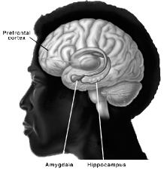
Lesson 10:
How Your Brain Thinks Thoughts
Giuseppe Arcimboldo (1593, Italy)

Slide 2
We need your help!
Notes:
We know of some incredible new science about the brain that can really help young people be successful.
Sometimes, young people don’t believe advice if it comes from adults.
They are more likely to believe it if it comes from other young people like yourself.
We need your help to learn this stuff so that you can spread this message to other young people.

Slide 3
Everybody has challenges in school. What are some setbacks or problems that you have experienced in your classes in school?
Warm Up
Notes:
Please take out a piece of paper, pencil or pen, and answer this question.
The purpose of this exercise is for you to start thinking about how what I am about to share in brain research, will help you face some setbacks or problems in school.
Maybe one time you wanted to learn something well, but you didn’t know it as well as you desired.

Slide 4
Keisha
“I’m usually good at classes like PE or social studies, but I get nervous before a math or science test. It’s like I try to memorize everything, but when I sit down to take the test, I can’t remember anything and my heart starts beating really fast.”
- Keisha, 9th grade student in San Jose, CA
Notes:
Here’s what some young people had to say…
Can someone read this for us?

Slide 5
Alan
“I’m not the best at English or Social Studies class. It’s mostly because English isn’t my first language. Everybody else seems to know so much more than me. They can new learn things so much faster.”
- Alan, 10th grade student in San Jose, CA
Notes:
Who can read this one?
So we can see that these are common problems.
Fortunately, lots of scientific research shows that these problems can be overcome by learning about the brain.
We’re going to start with a little movie clip that highlights two ways of looking at the world…

Slide 6
Star Wars Clip
Notes:
What Happened?
What did Yoda want Luke to do?
Why wasn’t Luke successful? (answers). Yes, he had an attitude that he couldn’t do it.
What was Yoda’s attitude or belief?

Slide 7
The Growth Mindset
Yoda had a Growth Mindset which is a belief that people can learn, change and become better at things with effort, strategies and help.
Notes:
Movie Debrief (continued):
Scientists would call Yoda’s attitude or belief a Growth Mindset. It is a belief that individuals can learn, change and become better at things with effort, strategies and help.
So What?
Obviously this movie is a fantasy, but does it remind you at all of real life? How?
Who can tell me about a time in your life when you had an attitude like Yoda, and showed a growth mindset about a challenge?
How did your growth mindset help you?
Now What?
What advice would you give to someone who just says things like:
“Well, I’m just no good at math.” OR
“I could never become a good athlete.” OR
“I’m just an angry person, so I’m not going to change…”

Slide 8
The Growth Mindset
The brain has an amazing ability to grow and develop like a muscle.
With a growth mindset, you know that people can learn, change and develop.
You know that people aren’t just “dumb” at Math or English; everybody can improve.
Notes:
(read slide and explain)
Next we’re going to do a ball toss game show you how your brain learns.

Slide 9
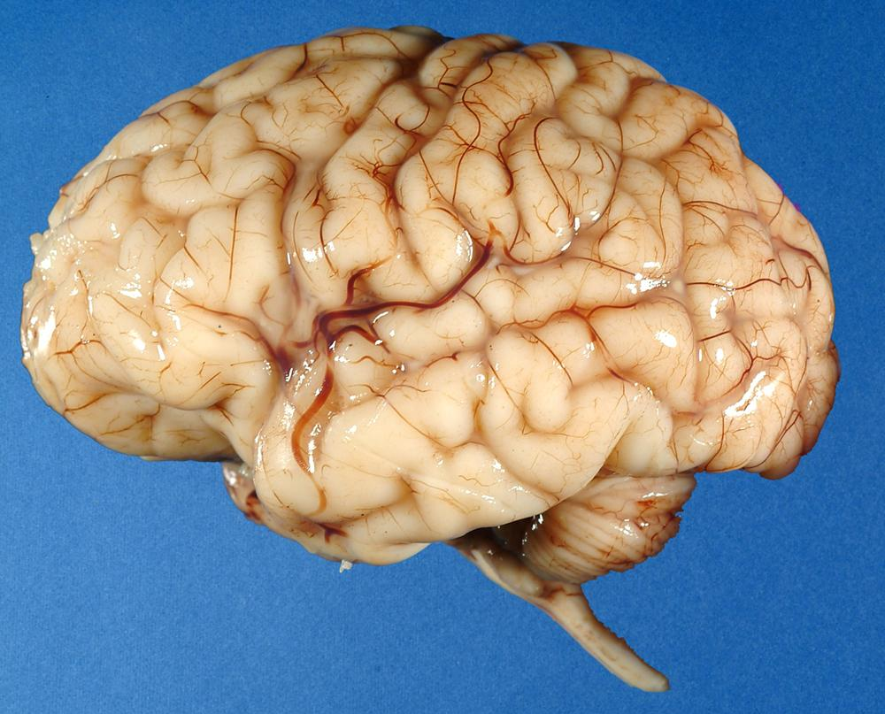
The Brain
Notes:
Here’s that brain muscle. Yes, it’s a pretty gross looking picture.
But today, we’ll use pictures like this next one to learn more about it.

Slide 10
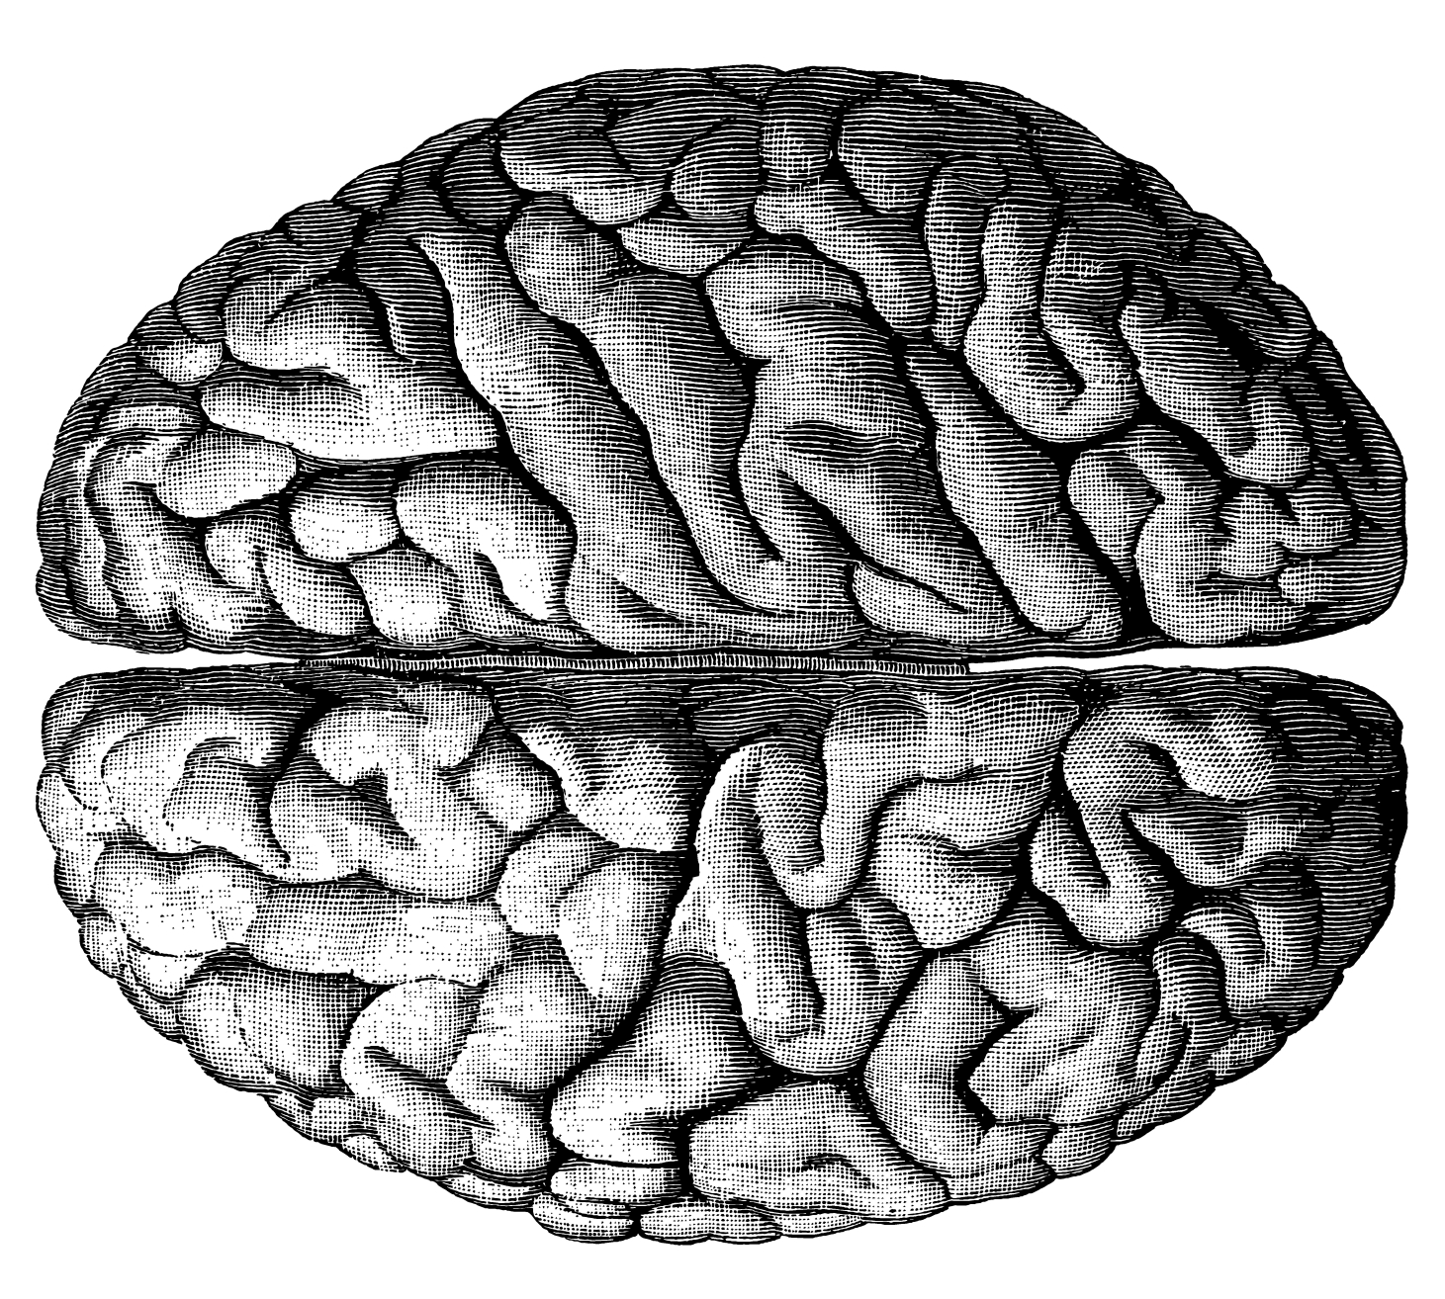
The Brain
Notes:
So here’s a diagram of a brain that’s easier to look at.
Now let’s drill down deeper and take a peek.

Slide 11
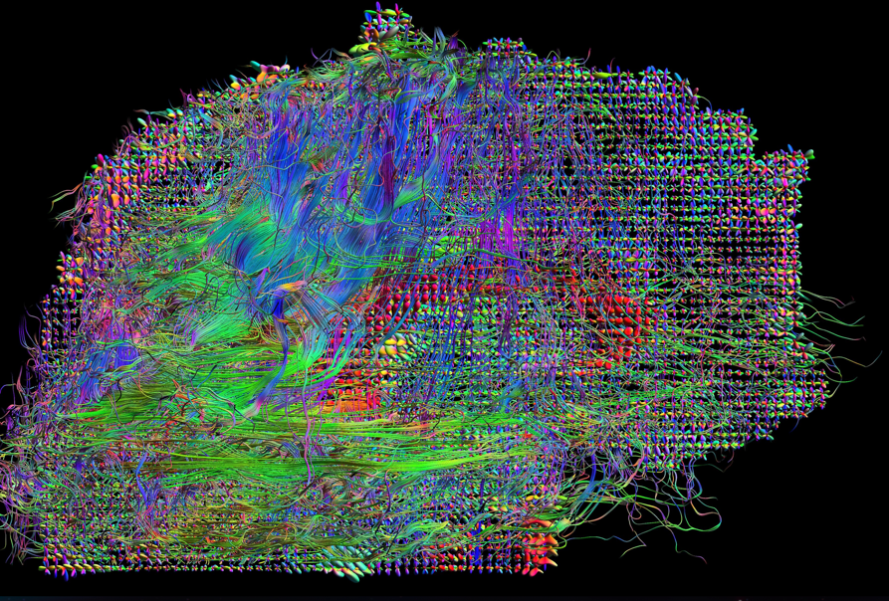
A Dense Network of Neurons
Notes:
The brain, when you drill down deeper, is actually a dense network of neurons, or brain cells, that are connected.
Now let’s drill down even further to look at just one brain cell, or neuron.

Slide 12
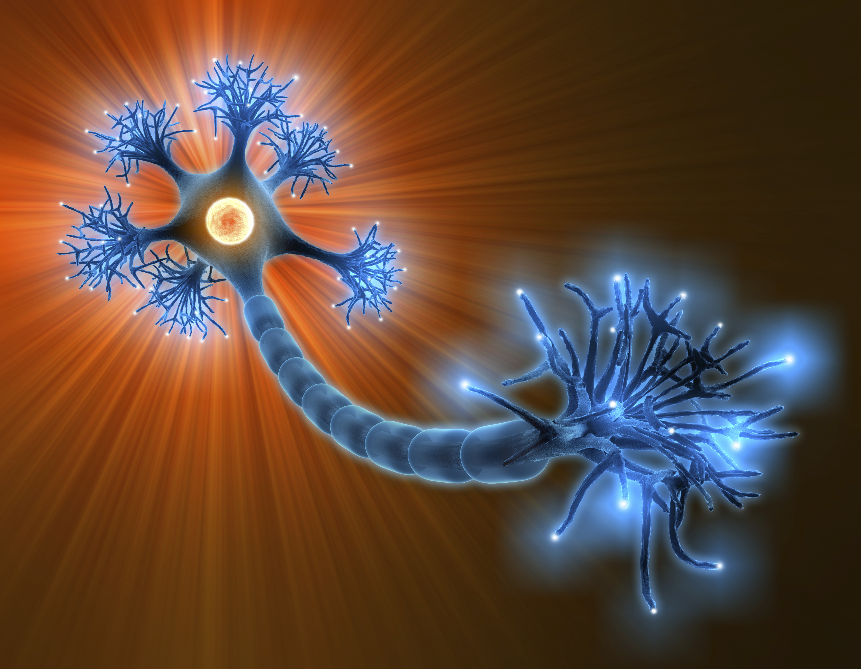
Parts of a Neuron
dendrites
cell body
axon
axon transmitters
Notes:
In the diagram below, we’re just looking at one cell. There are several parts that are important.
First, you can see the cell body. That’s the center of the cell that houses the genetic material. This material can be altered by
the environmental signals the cell receives.
The cell receives messages through the dendrites. These cell ends splay out from the cell body to receive information
from other nerve cells. Dendrites send information to the cell body, which then puts out its own signal along it’s long cable.
We call this long cable the axon. It carries an electrical message out to its transmitters.
Putting this all together, the axon transmitter changes this signal to a chemical that crosses a space to the next cell, and that cell picks the signal up with its dendrites, changes it to an electrical message and sends the message back to its own cell body.
Now that you can see that the neuron cell has different parts, you may be wondering how the brain thinks thoughts and learns.
thoughts. Let’s play a ball tossing game, to show how cells make connections with each other for thinking and learning.

Slide 13
String Ball Toss
How does your brain think?

Slide 14
How Thoughts Are Transmitted
Notes:
The brain thinks thoughts by sending messages.
The neurons in your brain are connected in a dense network, like a web. These cells communicate with each other.
Each neuron is connected to between one and one million other cells. Overall in your brain, there are over a trillion connections.
When you have a thought, it sends a signal from one set of neurons to another.
Also, messages can travel as fast as 1000 feet per second, or 680 miles an hour, the speed of a fast jet plane. Then the brain turns the signals into thoughts or actions.
In fact, your brain is the most complex 3-pound mass in the known universe!
Here’s a video of a leading brain researcher explaining how neurons work.

Slide 15
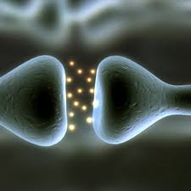
Neuron & Synapses Video
Synapse = connecting space between neurons
Chemicals carry the signal across the space.
Notes:
Now we are going to watch a video about how thinking takes place.
You will hear an additional vocabulary word called Synapse.
A Synapse is the scientific name for the space between neurons. As an electrical signal reaches the ends of the axon, it changes to a chemical signal that flows across this synaptic space to the next cell.
You will hear how your brain cells connect with electrical and then chemical signals, and then electrical and then chemical signals from one cell to another.

Slide 16
“What part of the neuron receives messages from other cells?”
“Dendrites”
Notes:
“What part of the nerve cell receives messages from other cells?” Who knows the answer to this question?
But, let’s imagine what just happened in your brain to get this response.
Your eyes read the words of the question and your ears heard: “What part of the neuron receives messages from other cells?”
Your neurons had to retrieve this information from your brain, through connections to other neurons with this answer. [CLICK ON ARROW]
Your neurons go through a connection to get this word “Dendrites” and then you said this aloud. You might also send signals to type this out [Click for typing hand]
We have told you that the brain sends signals from one neuron to the next, through electrical impulses going along the cell and chemicals flowing the signal across the space between cells. (The space is a to think thoughts and send messages through connections….
How much energy do you think this takes up?

Slide 17
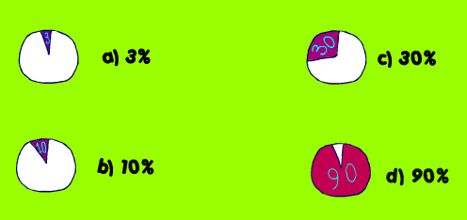
Take a Guess!
How much of the energy in your body is taken up by your brain?
Notes:
The brain is the biggest energy eater in your body, burning about 30% of the fuel your body uses.

Slide 18
Your Brain Needs…
Fuel
Sleep
Exercise
Challenge!
Notes:
With all that energy being used, your brain needs certain things to function well.
Fuel: Your brain needs healthy foods with Omega-3’s such as Eggs, Nuts and Fish
Sleep: Your brain needs to recharge for at least 1/3 of the time (8-9 hours of sleep). If not you forget things more easily.
Exercise: Movement and exercise increase breathing and heart rate so that more blood flows to the brain. A recent study found that walking actually improves memory.
Challenge: If you don’t use brain cells, you’ll lose them. Research shows that the more you challenge your brain, the more connections you grow between cells.

Slide 19
When you work hard at something,
the active neuronal pathways
thicken with connections and
they get faster at thought.
Notes:
This is why many people say “practice makes perfect”

Slide 20
What does this mean for successful learning?
Your brain forgets when it doesn’t have enough energy or rest.
The more your brain muscle practices, the easier it is for the brain to find information.
If you tie a new fact to other knowledge that your brain already has, it’s easier for the brain to “get it”.
Notes:
Read slide. Ask question:
#2: If you just cram for a test, and don’t study the material except at the last minute, why would your brain be likely to forget the knowledge when the test is over? (Answer: Didn’t practice and space the practice.)
Excellent, now we’re going to have a quiz show so you can show off what you learned today.

Slide 21
Brain Quiz Show!
Break up into two teams, and come up with a team name.
Like Family Feud™, one player/team comes up to answer question.
If you know the answer, tap the table first.
You then have 30 seconds to ask your team for help.
If you answer incorrectly, the other team gets a chance.

Slide 22
Brain Quiz Show!
What is a growth mindset?
Notes:
ANSWER: The belief that your basic qualities and abilities are things that you can change and grow.

Slide 23
Brain Quiz Show!
How does your brain think thoughts?
Notes:
ANSWER: By sending messages across neurons.

Slide 24
Brain Quiz Show!
Name four parts
of a neuron.
Notes:
ANSWER: cell body, axon, dendrites, axon transmitters.

Slide 25
Brain Quiz Show!
What are dendrites?
Notes:
ANSWER: the branching process of a nerve cell (neuron) that conducts impulses from other cells into its cell body. OR
.
The part of the neuron that receives messages from other cells.

Slide 26
Brain Quiz Show!
How are messages transmitted in your brain?
Notes:
ANSWER: From an electrical signal along the cell’s axon to a chemical signal in the synaptic space, that is picked up by the next cell’s dendrites and transferred to the nerve body electrically. (Electrical to chemical pathway)

Slide 27
Brain Quiz Show!
Name four things that your brain needs to function well.
Notes:
ANSWER: fuel, sleep, exercise, challenge

Slide 28
Brain Quiz Show!
How does challenge help your brain?
Notes:
ANSWER: The more you challenge your brain, and practice at getting better at something, the easier and faster it is for the brain to find that information and do well at the challenge.

Slide 29
Brain Quiz Show!
Name three things that you would tell your little brother or sister about their brain.
Notes:
ANSWER: (many answers are possible)

