Slide 1

Making It Happen: Managing Staff Strains
Monica Manny Ralston
Archival Processing Manager
Cheri Thies
Archival Collections Cataloger

Slide 2
Project Scenario
Goals
Eliminate a backlog of 4700 cubic feet
Increase collections access
Sustain a processing backlog of less than 1 year’s work at existing staff levels
Notes:
In 2010 the Minnesota Historical Society embarked on a half million dollars project to eliminate a backlog of 4700 cubic feet of unprocessed government records and manuscript acquisitions. Corollary goals were to increase access to these hidden collections through web accessible inventories and to sustain a processing backlog of less than 1 year’s work at the conclusion of the project.

Slide 3
Project Scenario
How did we get here?
Redundant steps and procedures
No common ground
Time-insensitive, one-size-fits-all, perfectionism
10+ years of processing staff cut backs and curatorial vacancies
Notes:
How did we get here? There are many causes that contributed to our backlog – some that had become evident as we worked through a self study in 2007. Our workflow included many redundant steps and procedures. We had no common ground regarding what constituted acceptable, good enough practice and, because we had no common ground, processing actions were time-insensitive. Staff followed an inflexible, one-size-fits-all approach that aimed at perfection rather than a basic level that prioritized access. And for more than a decade, we had experienced about a 75% cut in archival staff with lengthy periods when the positions responsible for manuscript acquisitions were vacant.
Knowing that we faced a growing backlog and inefficient workflows, we began looking for ways to streamline and had already made some improvements in inter-departmental hand-offs, step reduction, and data interoperability but none that could tame a backlog that large.

Slide 4

Project Scenario
Staff Funding
$500,000
40% ($193,357) = National Historical Publications and Records Commission, Basic Project Grant
60% ($306,643) = Minnesota Historical Society staff match
Timeline: 18 months (21 months actual)
Notes:
Staff resources were strained, so we sought funding that could help us attract resources to add more staff. What we found was the perfect fit in a basic project grant from the National Historical Publications and Records Commission. 40% of that budget was granted by the NHPRC; the remainder was a 60% match of Minnesota Historical Society staff time. Expected to run 18 months, the project actually started 3 months later than expected and ran an additional 3 months longer than intended.

Slide 5
Project Scenario
Processing Benchmarks
Arrangement
4,700 cubic feet ÷ 18 months = 262 per month
535 accessions ÷ 18 months = 30 per month
Notes:
Setting the benchmarks for this project was fairly simple: divide 4700 cubic feet by the 18 month duration of the project and we knew we needed to arrange and describe 262 cubic feet per month. Divide the total number of accessions by 18 and we needed to complete roughly 30 accessions a month.

Slide 6
Project Scenario
Processing Benchmarks
Arrangement
4,700 cubic feet ÷ 18 months = 262 per month
535 accessions ÷ 18 months = 30 per month
Discovery and Access
Increase box retrieval by 10% at project end
Increase pageviews by 10% at project end
Notes:
To measure user impact, we hypothesized that we could increase both the number of finding aid pageviews on our web server and the number of boxes retrieved in the library by 10% at the end of the project.

Slide 7
Project Scenario
Project Plan
Timed task analyses
Backlog survey
Size
Record series and collection types
Relationship to existing series or collections
Housing conditions
Minimal arrangement and description
Notes:
Since concluding our self study, we had continued to track time spent in processing and cataloging tasks. With this data we could estimate that any small acquisition that resulted only in a MARC record typically required 1 hour. For any acquisition that needed an inventory, at least another hour to physically process and list box contents was required. For acquisitions that were additions to existing collections, cataloging time could easily be reduced by half, but the size and condition of legacy inventories could magnify encoding time by four-fold or more.
To plan how the backlogged accessions would be staged, we had spreadsheets that listed their size, content, relationships, and housing conditions. This survey helped us determine what physical steps and descriptive products were necessary and how staff could be flexibly deployed to make the most effective use of team strengths for each accession.
To prevent scope creep, we planned to apply minimal arrangement and description techniques – to appraise and arrange at series levels, to catalog materials following DACS minimal requirements, and to produce searchable, keyword rich container lists.

Slide 8
Project Scenario
Staffing Pattern
Grant-funded Staff
2 Processing Assistants (100% each)
Assistant Cataloger (100%)
Rostered Staff
Project Director (20%)
Project Manager (50%)
3 Archival Catalogers (2 at 75% each; 1 at 15%)
Clerical support (15%)
Government Records Specialist (10%)
Manuscripts Curator (10%)
Notes:
Time tracking had evidenced that 60% or more of our time was spent on basic physical processing tasks. With the grant funds we hired two processing assistants and an assistant cataloger who could focus on the more time-consuming tasks of sorting, boxing, labeling, and container listing while freeing up the more experienced staff to focus on appraisal, arrangement, and description. The grant’s staffing pattern doubled the size of the existing processing staff and gave us a more appropriate balance between basic and advanced skill sets.
For the grant-funded staff this meant a quick immersion in local procedures. For existing staff, this meant a shift from work they had previously performed on an individual basis to work that was team-based and that required them to plan and delegate tasks they had once performed themselves.

Slide 9
Greatest Challenge: Staffing
Integrate existing and grant staff into one fluid team
Training
Large learning curve
Short time frame
Notes:
Only one of the grant staff had worked for MHS before and we had changed several procedures since that time so there was a large learning curve and a short 3 ½ week training time. During that time we had to not only introduce the grant staff to the nitty-gritty of daily life—supplies, email, calendar, IT, emergency routes out of the building, key card access, etc.- but also our archival procedures—two cataloging programs (our local OPAC and OCLC), shelflist cards (yes, we still have them), detailed description guidelines, excel spreadsheets for EAD encoding, printed finding aids (yes, we still have them), procedures for scanning and updating legacy finding aids, locator assignment, box and folder labeling, etc., etc.

Slide 10
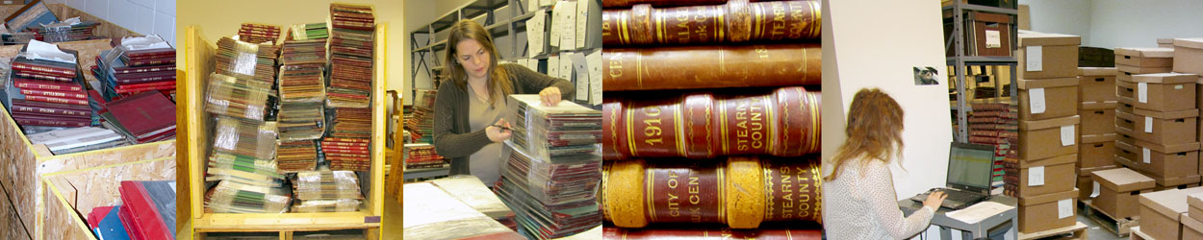
Greatest Challenge: Staffing
Issues
The big WHY
Let the computers do it
Staying ahead of them
Resistance to change by some existing staff
Involvement of non-departmental staff
Poaching of some grant staff for other projects
Notes:
The big WHY
As Monica stated, we had done workflow improvement during our self study and thought we were ready with procedures and practice as the grant work started. But the questions of “why” (why do we do this? why is this done this way? etc.) from the grant staff made us really rethink a number of things—we had to retrace our brain pathways to try to really remember why we did some things the way we did and give serious consideration to suggestions from the grant staff for ways to update and streamline our work.
Let the computers do it
The grant staff were often more computer savvy than the existing staff and taught us a number of “new tricks” in various programs.
Staying ahead of the grant-funded staff
Keeping ahead of the grant staff was often very hard for the existing staff. With 75% of our time going to the grant and 25% to our regular duties it was hard to do all that needed to be done in both areas. Staying ahead of the grant staff (planning their projects, proofing their work, answering questions, trouble shooting, etc.) while trying to rein in our regular duties to those things that were absolutely necessary was often quite stressful.
This included keeping a close eye on what the grant staff were doing and how they were doing it. A few times, in their enthusiasm for the collections, they worked ahead of where we had talked and it led to redoing portions of finding aids and physical rearrangement of a few collections.
Resistance to change by some existing staff
As previously stated, we had been implementing work flow changes several years and some staff were finding that hard, especially with procedural changes: “but we’ve always done it this way, why change now.” This was exacerbated by the grant’s transition to team processing (with a processing assistant doing the preliminary processing and listing, passing it to the assistant or archival cataloger to proof and then do the catalog record and finished finding aid).
Involvement of non-departmental staff
Some of these staff embraced the grant, working with us to enhance and streamline the flow of work done to records from the moment they are acquired to their use in the reading room or online; others were hesitant and sometimes even recalcitrant in the process (again, the resistance to change)
Poaching of some grant staff for other projects
The use of some grant staff for other projects, as determined by those higher in the organization, harmed the integration of the entire staff in working to complete the project. It happened several times and required frequent on the fly changes to staffing task assignments.
It also added to the time extension of the grant which led to confusion for the project staff (when will I run out of money) and aggravation for the processing staff (when will we get back to normal work).

Slide 11
Solution: Staff Management
Orientation and Training
Project kick-off meeting
Calendar
Procedural documentation and templates
Software
Notes:
Project kickoff meeting
A kickoff meeting with all project staff that laid out the project goals, benchmarks, staff roles and responsibilities, and project guidelines was held the first week.
Calendar
To build trust and confidence among the team members, we set up a training calendar for the first month. Each cataloger trained the grant staff in one or more of the challenges Cheri identified. Our assistant cataloger, who had been with us before, was included and trained staff in our EAD encoding procedures. While he was developing his training, we started the two new processing assistants on a very large but simple acquisition. By starting with this accession, the assistants learned the routine steps involved with sorting, boxing, assigning shelf numbers, labeling, and listing. Putting the two of them together on their first assignment allowed them to learn the same steps at the same time, helped us reinforce uniformity in their tasks, and gave us all a sense of accomplishment during those first few weeks.
Procedural documentation and templates
Before the project started, we concentrated on revising our documentation to give more explicit definitions and instructions and revamped our templates to meet the project’s minimum requirements.
When the project started, grant staff were introduced to the documentation one piece at a time. Whenever they found themselves at a crossroads where they were uncertain what to do, they learned to remind each other to stop and look it up. In this way, they learned to answer their own questions and became more proficient as they became more familiar with routine steps and procedures.
Software
To develop familiarity with our software, staff were encouraged to learn by doing and were afforded playtime.

Slide 12
Solution: Staff Management
Scheduling and assignments
Backlog survey
White board
Processing checklist
Notes:
Backlog survey
Given some of the unplanned contingencies that occurred with this project – a three-week state shut-down and staff reassignments that resulted in a project extension -- scheduling and team assignments sometimes felt more like juggling. Benchmarks constantly needed to be adjusted and the loss of 1 processing assistant appeared to put a heavier load on the rest of us. Throughout, the backlog survey continued to serve as our primary planning tool.
White board
A white board outside my office door served two purposes: a countdown toward the 4700 cubic feet target and as an assignment roster, like swim lanes, so that we all knew who was working on what, when, and where each of us fit in the fast and fluid schedule.
Processing checklist
To guide staff through each accession, we used a standard processing checklist that outlined routine tasks and added specific processing tasks as needed. For most acquisitions, this checklist was sufficient. For a very few that evidenced more complex needs, fuller processing plans were developed.

Slide 13
Solution: Staff Management
Performance monitoring
Weekly meetings
Statistics
Coaching and motivation
Notes:
Weekly meetings
Throughout the project, the grant staff and catalogers met as a smaller team once a week. These meetings were used to check progress against the time estimates, give updates, adjust assignments and schedules, ask questions, introduce more explicit routines, and share tips.
Statistics
The same spreadsheets that were used to plan accession staging, track staff assignments and time estimates were used to record processing statistics. These included the number of cubic feet and accessions processed, and the number of resulting catalog records and inventories. Progress in these areas was measured against our benchmarks and reported monthly.
Coaching and motivation
The importance of coaching and motivating staff cannot be underestimated. Each staff member may require different methods or techniques at different times and this is where a manager must adapt to help each person perform at their best. Some of the techniques used during this project included setting firm deadlines, meeting one-on-one and making walk-by check-ins when needed, allowing staff to make mistakes and figure things out on their own, advancing skill sets by introducing new steps, featuring especially interesting or challenging assignments in our monthly what’s new blog, and recognizing achievements.
At project end we had processed 4,792 cubic feet at an average processing rate of 1.62 hours per cubic foot. Pageviews of finding aids had increased by 40%, our library was welcoming more informed users who already knew what they wanted, and the number of boxes accessed by users notably increased. Since then, our government records backlog has held at a steady 3 months averaging 60 cubic feet while our manuscripts backlog is averaging closer to 12 months of 400 cubic feet.

Slide 14
Lessons Learned
Keep it simple (access trumps perfection)
Notes:
We needed to introduce one step of the workflow at a time and build upon each step in progressive order. This wasn’t always easy, the grant staff often wanted to run ahead on a project without realizing all the issues that surrounded each step.
And we all had to remember that “access trumps perfection”. The grant staff needed guidance about what constituted good enough arrangement, housing, and descriptive actions (to be honest, this was also still a problem for some existing staff). Helping us all stay focused on the end goal of access helped when “messy” collections looked more complicated than they actually were.

Slide 15
Lessons Learned
Keep it simple (access trumps perfection)
Listen and communicate
Notes:
Remember that all staff have valid points to add and take the time to really listen. Also that questioning practice and policy can lead to greater efficiency and better quality work and product.
Scheduled meetings made sure everyone was on the same page. It’s easy to let this slide when everyone if busy and some weeks it seemed like there was nothing to say, but the consistency is important.
Emphasize to all staff that asking for input and help is a necessary part of the grant; we all can learn from each other.
Allow laughing and lightheartedness; it’s a great tension breaker and makes a good work environment.
Existing staff needed to always be cognizant of their tacit knowledge of the institution and its practices and remember to impart it to the grant staff.

Slide 16
Lessons Learned
Keep it simple (access trumps perfection)
Listen and communicate
Change affects different people in different ways
Notes:
Some embrace it, some dig in their heels. You just have to stay the course and try to bring everyone along—it’s not always easy (primal scream therapy in the stacks helps).

Slide 17
Lessons Learned
Keep it simple (access trumps perfection)
Listen and communicate
Change affects different people in different ways
Be flexible (plan for the best, deal with the worst)
Notes:
We already mentioned the poaching of staff for other projects; we also dealt with water leaks in the processing area, the complete shutdown of our state government, and a staff member’s broken arm. There were probably more but we’ve repressed them.

Slide 18
Lessons Learned
Keep it simple (access trumps perfection)
Listen and communicate
Change affects different people in different ways
Be flexible (plan for the best, deal with the worst)
Keep the talent
Notes:
We have been lucky enough to keep two of the grant staff: Meagan Kellom is now an Archival Collections Cataloger and Shelby Edwards is Assistant Curator of Manuscripts.

Slide 19
Lessons Learned
Keep it simple (access trumps perfection)
Listen and communicate
Change affects different people in different ways
Be flexible (plan for the best, deal with the worst)
Keep the talent
Take time to rejuvenate and refresh
Notes:
This is more for the existing staff. With the fast pace of the grant and the stress of trying to do your “regular” work and the grant work, it’s easy to forget that you need to breathe. You need to take your vacation time; get up and walk outside on a nice day to take a breath; whatever it takes to keep yourself ready to work.
Also, as a staff, we have an annual one day outing to a local zoo and we included the grant staff; we would have treats once in a while at meetings; we would put silly drawings on the whiteboard, etc.. Staff work better who enjoy being at work.

Slide 20
Lessons Learned
Keep it simple (access trumps perfection)
Listen and communicate
Change affects different people in different ways
Be flexible (plan for the best, deal with the worst)
Keep the talent
Take time to rejuvenate and refresh
Celebrate your accomplishments
Notes:
Let your institution know what you’ve done—we used a What’s New list and our in-house online newsletter to “toot our horn”. We let others in the profession and the general public know what we were accomplishing—we put a blurb in the MAC Newsletter, the State Library newsletter, and our institutional web staff would often mention the collections we were completing on the MNHS facebook page and twitter feed.
We also did a party near the end of the grant just for the grant staff, away from the building at a local restaurant. While it was good to tell others what we had done, it was us who had met our goals (and often exceeded them) and it was a good feeling to celebrate that with each other.

Slide 21
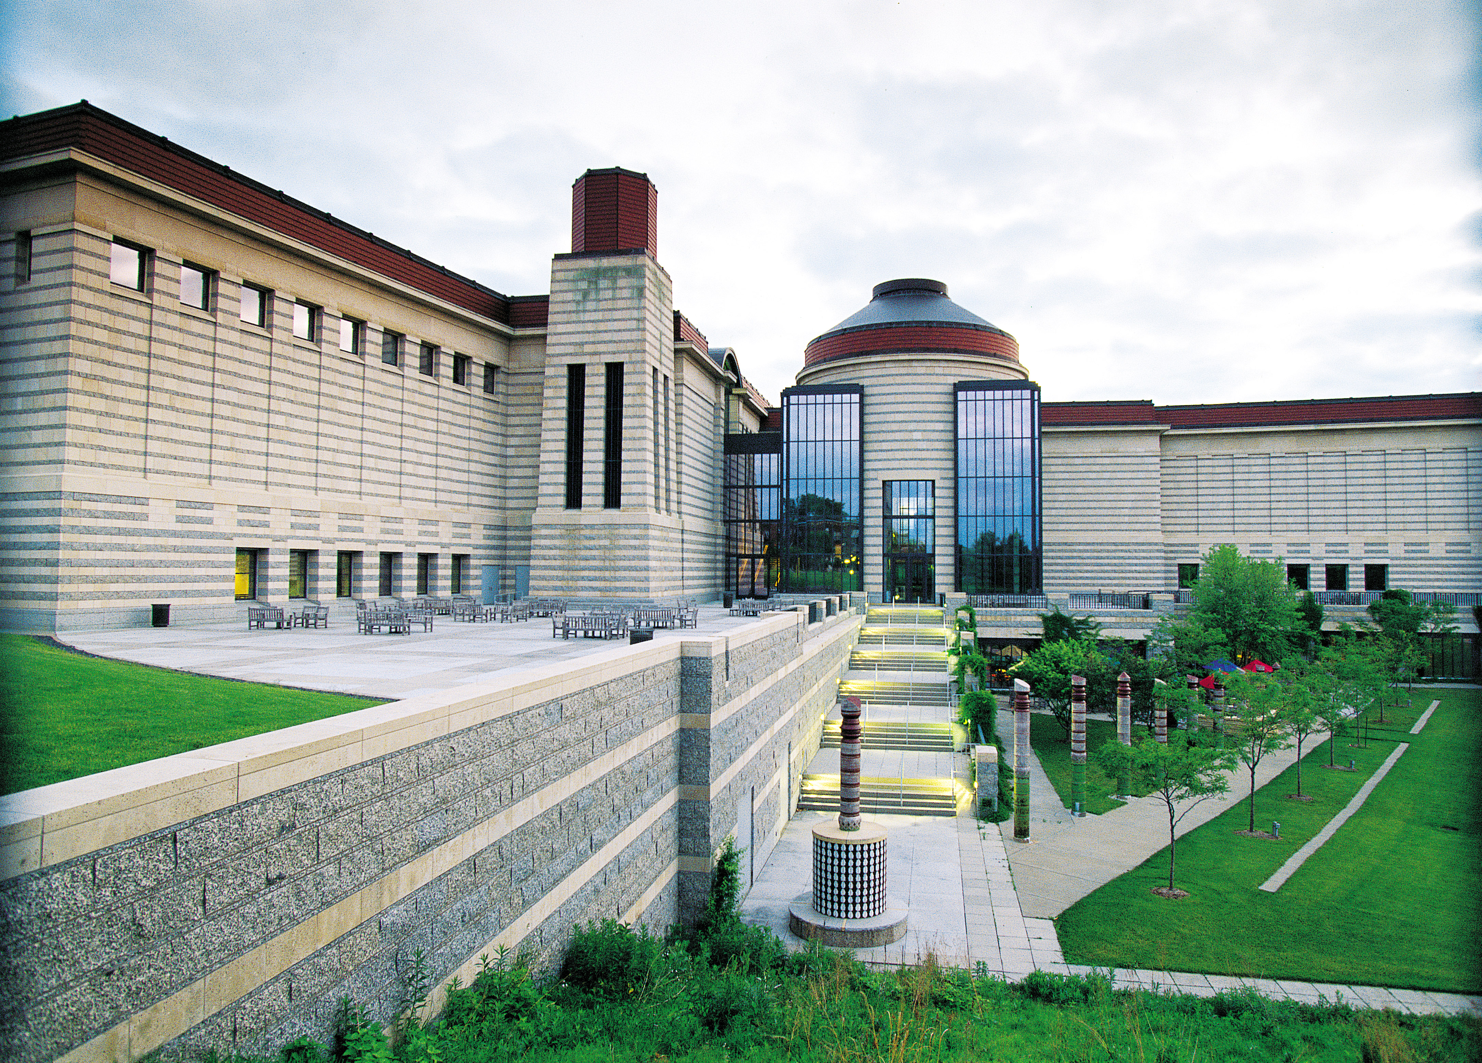
Thank you
Questions/Comments:
monica.ralston@mnhs.org
cheri.thies@mnhs.org
More information:
www.mnhs.org/library/findaids/CMToolkit/CMToolkit.htm

