Slide 1
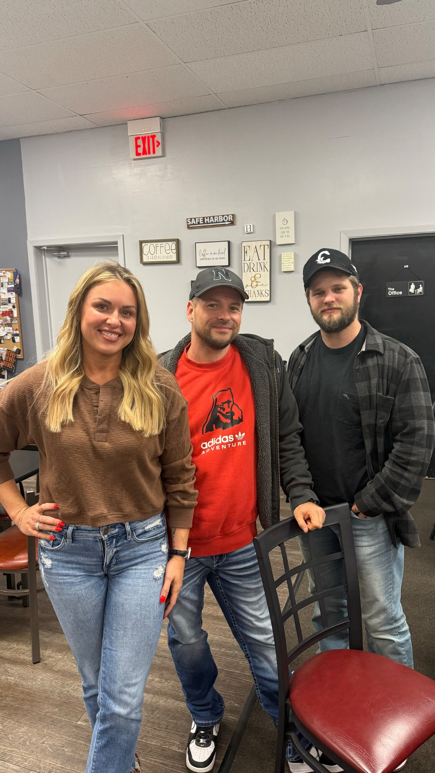
Nolan- Facebook/Instagram
Ashley- HR/Leadership
Justin- Systems/Technology
savelocalapp.com
savenebraskalocal.com

Slide 2
Save Nebraska Local
Mastermind: All Things AI
402-780-8813

Slide 3
Why are we so resistant to change?
Humans are naturally bad at thinking about change. We work hard to avoid it, yet it is one of lifes inevitable things.
We are seeing rapid change in technology.That can be scary!
What happens to the world as a result of AI? Will people be better or worse off? Will jobs be eliminated?
It’s all up to use to figure out how to use its power for GOOD.
It’s very hard, sometimes impossible even, to tell what is AI and what is real. We are now in a blended world of reality and AI.
How do we use AI to benefit our business; specifically to grow and scale in an ETHICAL way?

Slide 4
So, what the heck even is AI exactly?
The idea of AI comes from the 1950s when they were creating technology to predict the future.
1950- Alan Turing published Computer Machinery and Intelligence, which proposed a test to assess a machine’s intelligence, now known as the Turing Test.
1956- John McCarthy organized a workshop at Dartmouth College to discuss “thinking machines”, where he later coined the term Artificial Intelligence.
The Dartmouth workshop is widely considered the founding moment of AI research. Researchers investigated how to make machines perform tasks that were previously considered to require expert knowledge.

Slide 5
Common AI terms to remember
Large language model- prediction machines *think google search bars*
Prompt - series of words/sentences or statements you input into A.I. to invoke the response you are looking for.
Tokens- set of characters that are broken up and read/trained by “emergence” (which is the ability for technology to come up with ideas an structure it into a human thought). Tokens come from prompts that you give it and the AI will create keywords to form thoughts.
Theory of mind- ability that humans have to guess what humans are thinking. AI thinks in theory of mind.
Jagged Frontier- always changing/growing/expanding. Understand where AI is good/bad, how it helps and what doesn’t.
Hallucinations- AI is in a dream state. A hallucination is when AI system generates incorrect or misleading info. This can happen when AI makes a confident prediction based on insufficient or flawed data.

Slide 6
Using AI for work
People are really good at finding ways to work less hard and get paid for it. Now we have a tool that shows it is highly creative, come up with ideas and give feedback.
Using AI to increase your productivity: Leading with an AI first mindset 1. Use it as a copilot 2. Use it as a first step in the process 3. Willingness to rethink the process
Action is empowerment: keep a journal for all your repetitive annoying tasks that you hate. AI can take those off your hands!

Slide 7
Using AI for Brainstorming
Think of AI as your brainstorming Buddy!
We all had to learn to Google from scratch. Now we are all learning to use AI from scratch.
Treat AI as a person, but first tell it what kind of person it is.
Set up identity
Tell it the literal task you want it to do.
Hit enter, see what happens!
Give it additional restrictions
Score all these based on added restrictions.

Slide 8
3 C’s of AI:
Communication - back and forth talking to AI
Clarity - being clear and precise with what you are wanting from AI
Collaboration - think of it as a partner, a sidekick. It isn’t going to do the whole thing for you. You are collaborating to complete the task you start.

Slide 9
Save Nebraska Local Goals with AI
Our main goal is to help small businesses compete with big box corporations.
One of the easiest ways to achieve this is by using AI to help create automations and systems to scale and grow.
Top 10 Small businesses that struggle to keep up with large corporations:
Retail
Restaurants
Grocery Stores
Local gyms/fitness studios
Bookstores
Independent Pharmacies
Small Construction Companies
Media outlets (news/radio)
Travel Agencies
Auto Shops

Slide 10
Top 7 challenges for small business owners
Economies of Scale: Large corporations can lower costs by buying in bulk.
Technology Gaps: Big companies can afford advanced tech for operations, marketing, and customer service.
Brand Recognition: National or global brands have established trust and loyalty.
Marketing Resources: Smaller businesses struggle to compete with large-scale ad campaigns.
Convenience and Accessibility: Big corporations often provide broader services and better locations.
Pricing Wars: Small businesses can’t afford to cut prices as deeply as larger competitors.
Labor Challenges: Difficulty attracting and retaining employees due to benefits and pay disparities.

Slide 11
Beating these odds using A.I.
1. Economies of Scale - A.I. connecting small businesses to complete batch orders together. Example: Restaurants in a community use AI platforms to jointly order ingredients, reducing costs.
2. Technology Gaps - Affordable AI Tools: Modern AI platforms like Google Workspace, SaveLocalAPP, and QuickBooks offer powerful, low-cost solutions for small businesses. Example: A small law firm automates appointment scheduling and client follow-ups with AI at a fraction of the cost of enterprise systems. Example: A boutique uses no-code AI to automate online order fulfillment.
3. Brand Recognition - Customer Insights: AI analyzes customer data to identify behaviors and preferences, helping businesses create tailored experiences. Example: A bakery uses AI to send personalized offers for a customer’s favorite dessert, fostering loyalty. Also using A.I. to analyze popular brands to help match their qualities that work with your own ideas.
Reputation Management: AI tools like SaveLocalApp monitor and manage online reviews. Example: A plumber responds to feedback in real-time, building a trustworthy local reputation.

Slide 12
4. Marketing Resources
AI-Driven Ad Campaigns: Platforms like Meta Ads Manager and Google Ads use AI to create and optimize campaigns for local audiences.
Example: A yoga studio targets nearby residents with precise ad placement, maximizing ROI.
Content Creation: AI tools like Jasper or ChatGPT generate high-quality blogs, ads, and social media posts quickly and affordably.
Example: A boutique generates weekly fashion tips for Instagram using AI, driving engagement.
5. Convenience and Accessibility
24/7 Customer Support: AI chatbots provide instant answers to inquiries, improving accessibility.
Example: A car repair shop uses a chatbot to answer common questions about services, bookings, and pricing.
Enhanced Online Presence: AI tools help optimize websites for local SEO, ensuring small businesses appear prominently in local searches.
Example: A home improvement store ranks high in “hardware store near me” results.

Slide 13
6. Pricing Wars
AI Solution:
Dynamic Pricing: AI suggests price adjustments based on demand, seasonality, and competitor pricing.
Example: A florist adjusts prices for roses around Valentine’s Day to remain competitive while maintaining margins.
Cost Optimization: AI identifies areas to reduce overhead without compromising quality.
Example: A café uses AI to optimize energy usage during non-peak hours.
7. Labor Challenges
AI Solution:
Efficient Hiring Processes: AI tools like LinkedIn Recruiter or Zoho Recruit streamline hiring by identifying top talent quickly.
Example: A small gym uses AI to pre-screen trainers, saving time and finding better candidates.
Staff Management: AI schedules employees based on peak hours, reducing stress and creating fair workloads.
Example: A restaurant uses AI to adjust schedules dynamically, preventing overstaffing or understaffing.

Slide 14
Some of the Local Businesses on the SaveLocal app

Slide 15
And a few more…. But you get the point. This software works for everyone!

Slide 16
Save Local App Purpose:
To help small businesses reach their potential and compete with large corporations with a customized business in a box.
Learn more here
SAVELOCALAPP.COM

Slide 17
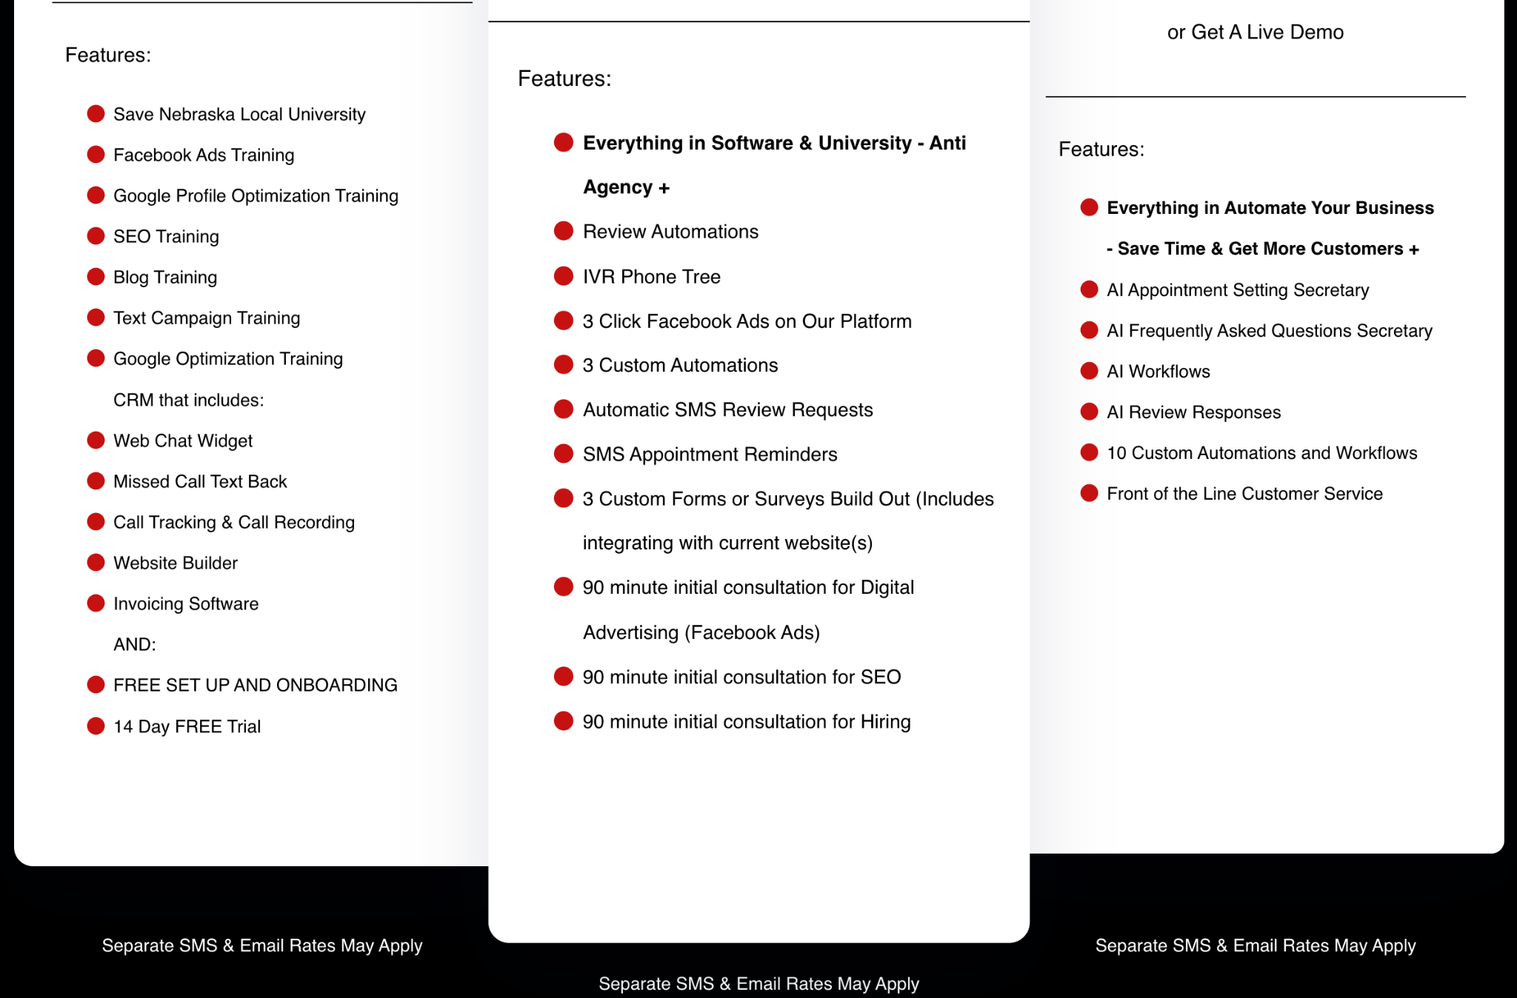
TIER 1
TIER 2
TIER 3

Slide 18
HOLIDAY SPECIAL
2ND TIER GETS A FREE 5 PAGE WEBSITE
PLUS BLOG SETUP
DECEMBER 2024 ONLY
SAVELOCALAPP.COM

