Slide 1
Identifying A,B & C Players
Who to keep and who to remove?
With Ashley Tobias of Save Nebraska Local

Slide 2
First, let’s identify what that even means…A Player
A Player- High performing employee who is considered to be in the top 10-20% of talent available in their role. A Players are often passionate about their work, think outside the box & play a pivotal role in the success of the organization. Usually they are strong leaders with ability to inspire others and have a proactive approach.
Characteristics of an A Player: strong intellectual capacity, high intrinsic motivation, good fit with company culture, desire to compete

Slide 3
B Player
B Player- employee who is consistently above average and meets or exceeds their roles expectations. Usually very competent and steady performers who are good at most aspects of their role, excel in some and can improve in others. B Players are often comfortable in their roles and dont require a lot of attention. Less likely to seek change or challenges, tend to stay put.
Characteristics of a B Player: can bring unique strengths to organizations, provide stability and integral for day to day operations. Have ability to become functional experts, colleagues may turn to them for advice. Some say B Players are valuable to a start up, while others say B Players are decent at their job but you cant rely on them to take your business to the next level.

Slide 4
C Player
C Player- employee who doesn’t perform at the expected level in organization. They struggle to meet targets, complete tasks or embody the company core values. They can be a drain on resources and morale, and they send negative signals to the rest of the team.
Characteristics of a C Player: lack of preparation, failure to meet deadlines, failure to follow up on requests, blaming others or external factors, blaming you for not giving clear instructions. Tends to be chronic underperformers who account for majority of problems on the team and require disproportionate amounts of time to correct.

Slide 5
What happens when the wrong person is hiring
When you bring on someone to hire who is not an A Player, their capacity to find the top talent is near impossible. A person can only hire as great as they have challenged themselves to become. If a B Player is doing the hiring, their capacity to find talent will almost always be limited to B & C Players because their self awareness has not reached a point to even identify top talent.
This is how an entire culture can be made toxic in a short amount of time, specifically when your management team are poor performers.

Slide 6
Let’s look at this from a Top Down approach
A CEO makes the decision to expand and grow their business, so they hire someone who is a B Player to outsource some of their duties. They are of the mindset that as long as the B Player can do 75-80% of their duties, it will still produce results. While there is some truth to this, the particularly important role to have an A Player in is with hiring or leadership of the team.

Slide 7
Biggest *or one of* KPI to pay attention to!!
Most important KPI in the Company?
-A players are the ones who consistently live the companies core values 90% of the time.
-If you look at profitability from top to bottom, the companies at the top have the highest A Player percentage.
-Average company percentage of A Players is 25%... you should want to grow that number like crazy. Goal should be to double it within a year.
-What happens when you do this? Client issues disappear, employee/relation issues go away, it literally becomes the best day of everyones life if you achieve this.

Slide 8
How do we get there?
Coach team members to get to A Player status- Each department should have a manager that is actively growing at least 1 A Player on the team at all times. Important that the manager is already an A Player.
Subtract- get rid of some employees (toxic C Players)
Add- once you get a structured interview/onboarding process, you can add new employees. Key here is the structured process.
Remember: A Players do best with systems!!

Slide 9
Scaling the CEO
-in order to scale a company, you have to free up the CEO
-CEOs goal should be to focus more on strategy and coaching than being in the day to day operations.
-CEO runs leadership team; leadership team runs the company- so the CEOs span of control is only through a handful of key people. “Solving through the lens of the leader that you are coaching”
-only way for this to work is through SYSTEMS. If you do not have a structured set of systems in place, it will fall apart.
-100% A Player status: free of politics, free of drama, they know how to be accountable, know how to coach their team members

Slide 10
What systems do we use? SaveLocal App

Slide 11
Some of the Local Businesses on the SaveLocal app

Slide 12
And a few more…. But you get the point. This software works for everyone!

Slide 13
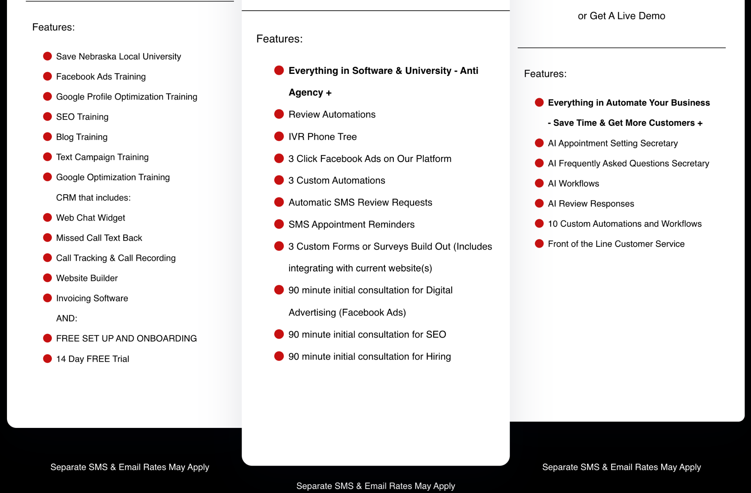
There are 3 tiers to choose from depending on your needs

