Slide 1
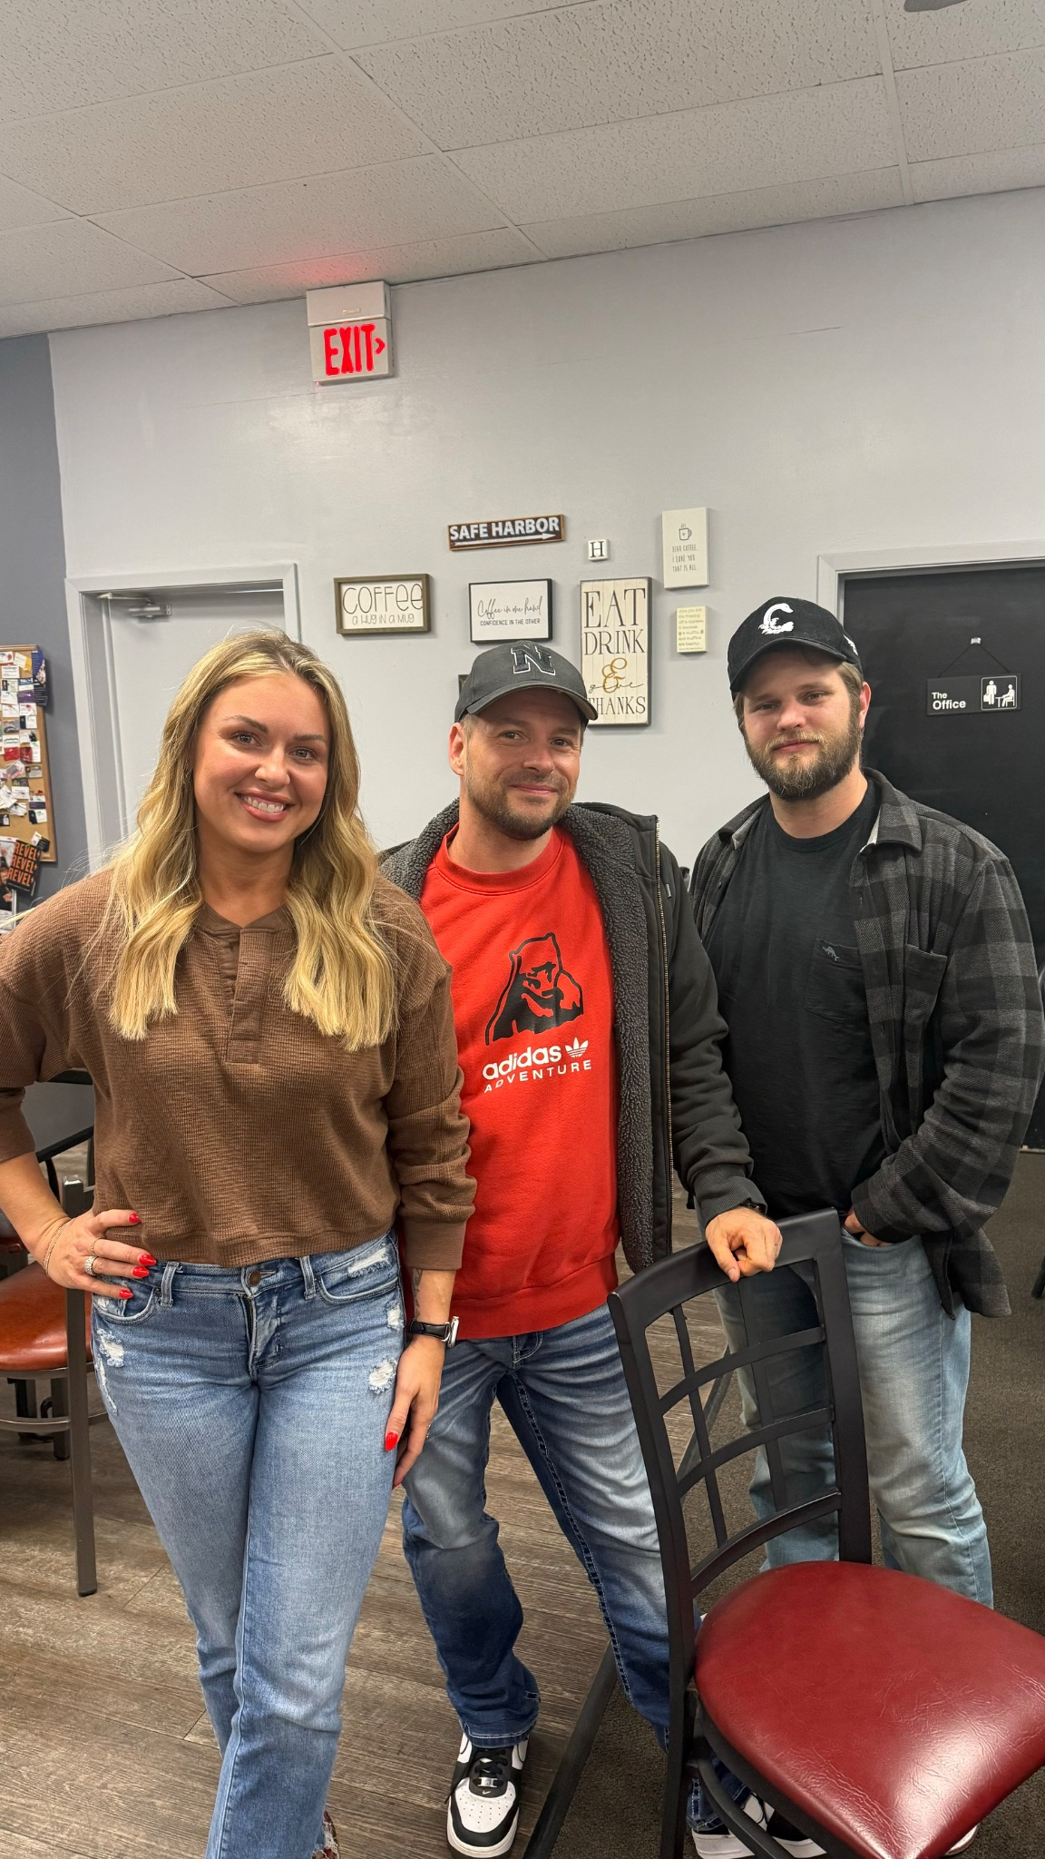
Nolan- Facebook/Instagram
Ashley- HR/Leadership
Justin- Systems/Technology
savelocalapp.com
savenebraskalocal.com

Slide 2
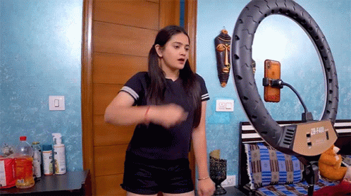
ALL THINGS REELS
with Ashley & Special Co-Host Liza

Slide 3
Special thanks to Liza Mendoza-House
LPFITNESSNE.COM
Save Nebraska Local’s Preferred Member for Gyms, Personal Training, Nutrition and Accountability.

Slide 4
Interested in co-hosting a Mastermind for Save Nebraska Local?
We are currently offering this to our preferred members and those on the SaveLocal App.
Speak to Ashley if you are interested!!
TEXT/CALL 402-780-8813

Slide 5
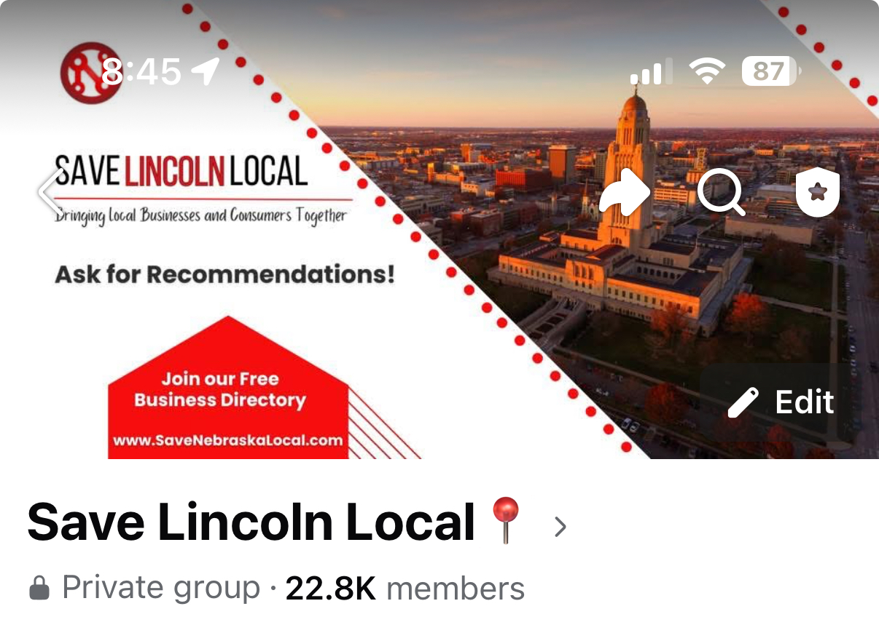
LIKE OUR FACEBOOK PAGE TO
STAY UP TO DATE ON EVENTS
JOIN OUR GROUP FOR RECOMMENDATIONS!

Slide 6
Short form video has become one of the most powerful tools for businesses to engage their audience, build brand awareness, and drive sales.
Capturing short attention spans: 15-60sec videos are best
Platform Algorithm Prioritization: Facebook, Instagram, Tiktok (each platform is unique in what it will suggest.)
Highly engaging format with a universal appeal across demographics because they are easily consumable and shareable.
Cost effective marketing: quick to produce and require minimal resources. Authentic outperforms professionally edited reels.
Trend Integration: allow businesses to capitalize on current trends quickly to go viral.
High conversion rates: create quick CTA (call to action)- Tiktok has shown that users are 167% more likely to make a purchase after seeing a product advertised in a reel.
Build brand visibility: build a loyal audience, stay top of mind
Encouraging user-generated content: inspire testimonials, create trust.

Slide 7
How to make a reel:
Choose your platform (IG/FB/Tiktok)
Planning the content: identify audience/message, keep it engaging informative/entertaining
Record content: you don’t need fancy cameras
Editing tools: features like trimming, filters, stickers, captions, trending audio.
Finishing touches: preview, add hashtags, tag relevant accounts

Slide 8
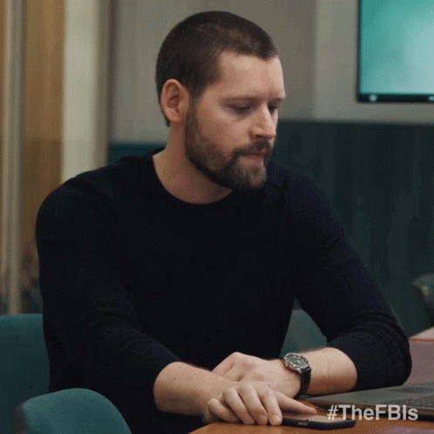
Best times to post reels:
*General Suggestions, adjust for audience analytics
Instagram reels: Tues, Thur, Fri- 9am & 6pm
Facebook reels: Weekdays between 12-3pm
Tiktok reels: Tues to Thur, 11am-2pm & 7pm-9pm
App suggestion: RealTrends
app can help with
specific analytics

Slide 9
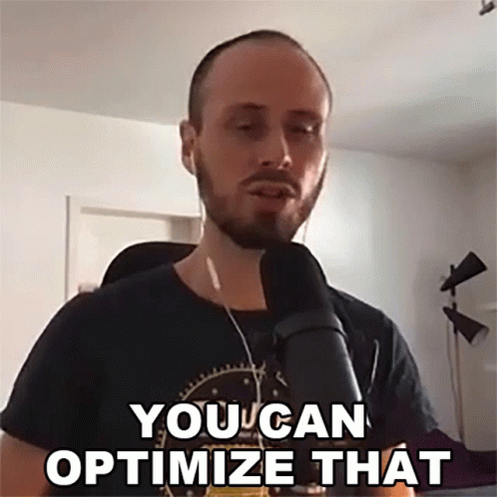
SEO Optimization for reels:
Instagram reels: use 3-5 relevant hashtags with engaging captions with keywords
Facebook reels: add keywords in captions/titles, use FB audience targeting tools, include CTA
Tiktok reels: use trending keywords as hashtags, write captions that include searchable terms, pin most engaging posts to profile

Slide 10
Video editing apps:
Capcut (great for quick AI edits, user friendly, royalty free music, green screen effects, premade templates, direct sharing across platforms and ensures reels meet each platforms specifications)
ReelTrends (hooks, hashtags, keywords, best time to post, content ideas, scripts, captions, viral forecasting)
Instagram (you can do simple edits and save the video to repost)
SaveLocal App (Social Planner to schedule out each reel for each individual platform you’re on)

Slide 11
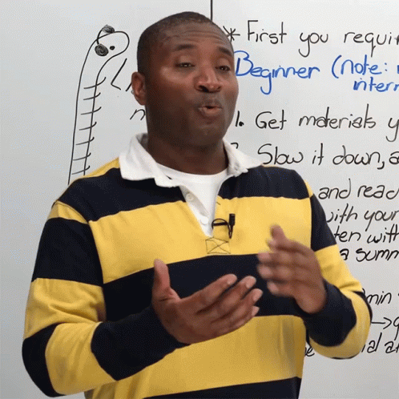

Slide 12
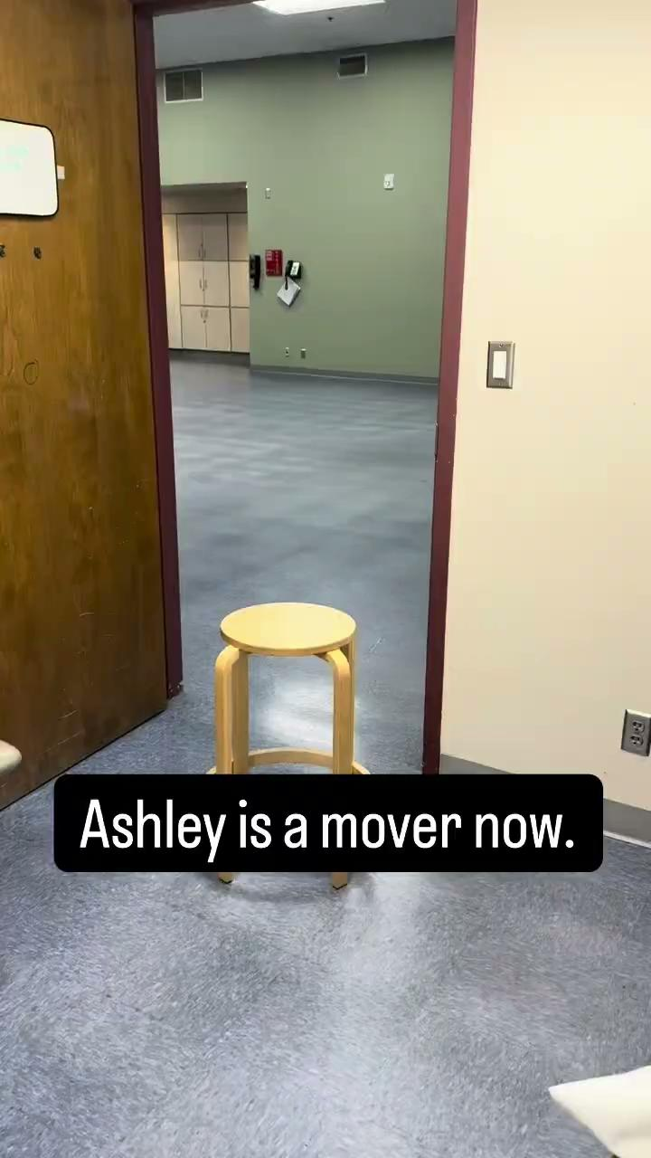
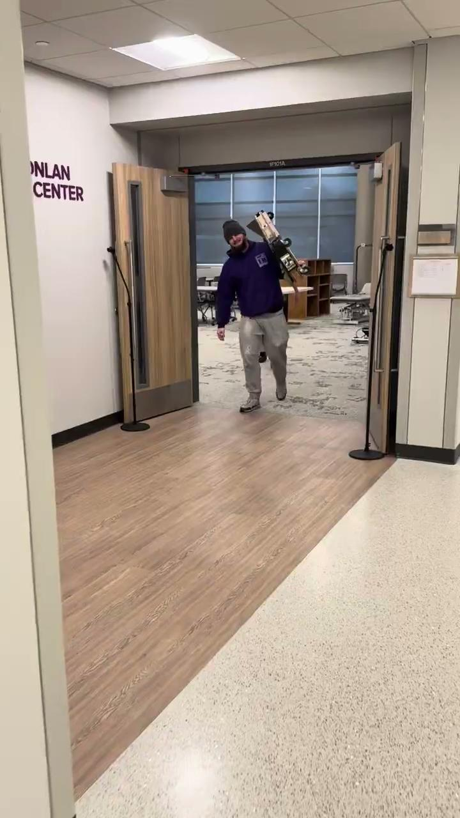
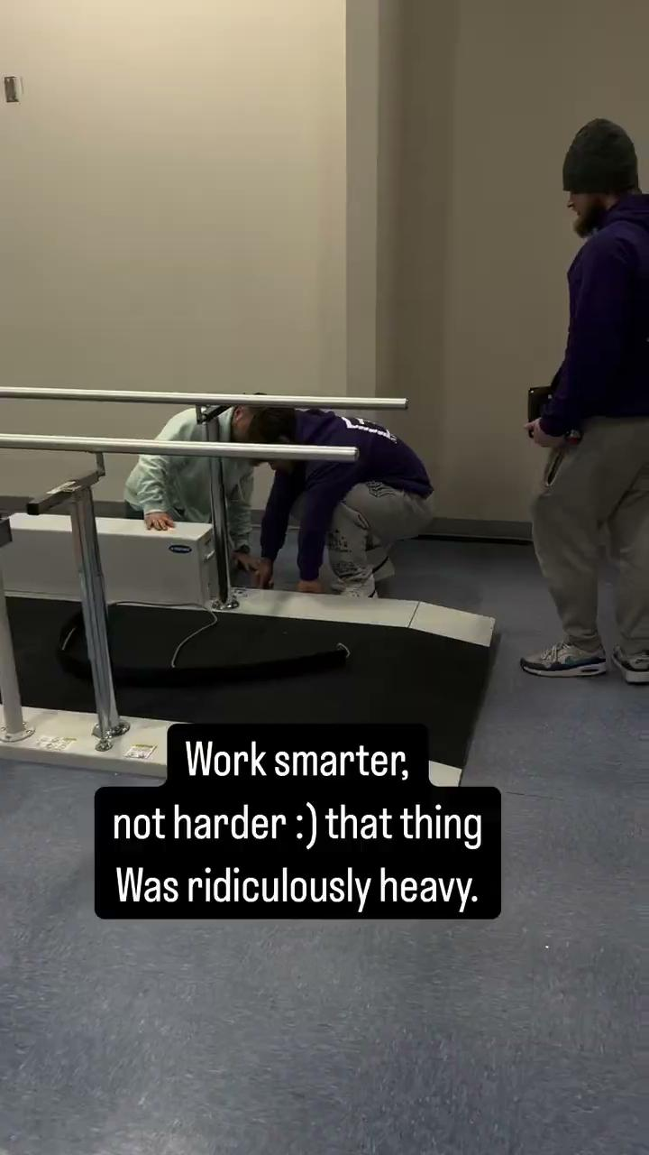
Notes:
T SQUARE MOVERS REELS

Slide 13
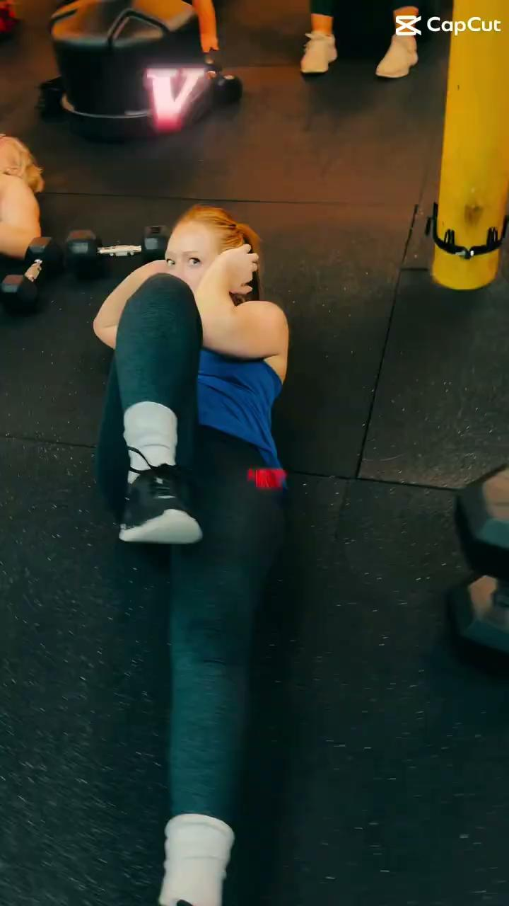
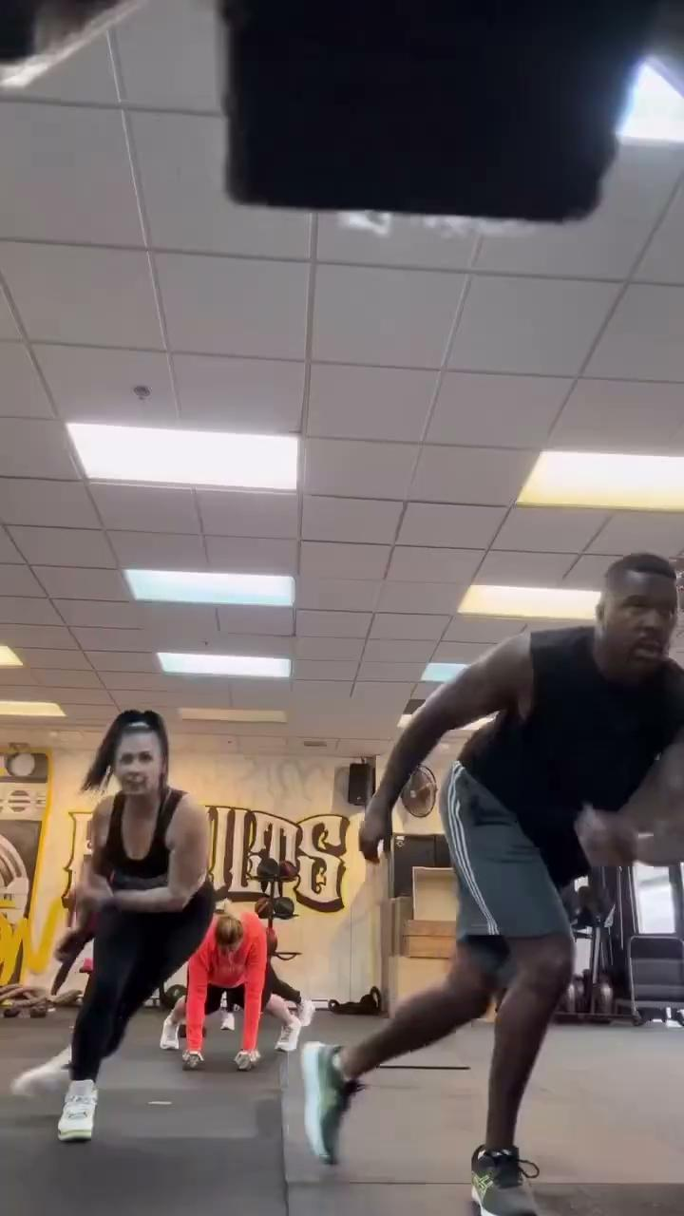
Notes:
LP FITNESS REELS

Slide 14
Some of the Local Businesses on the SaveLocal app

Slide 15
And a few more…. But you get the point. This software works for everyone!

Slide 16
Save Local App Purpose:
To help small businesses reach their potential and compete with large corporations with a customized business in a box.
Learn more here
SAVELOCALAPP.COM

Slide 17
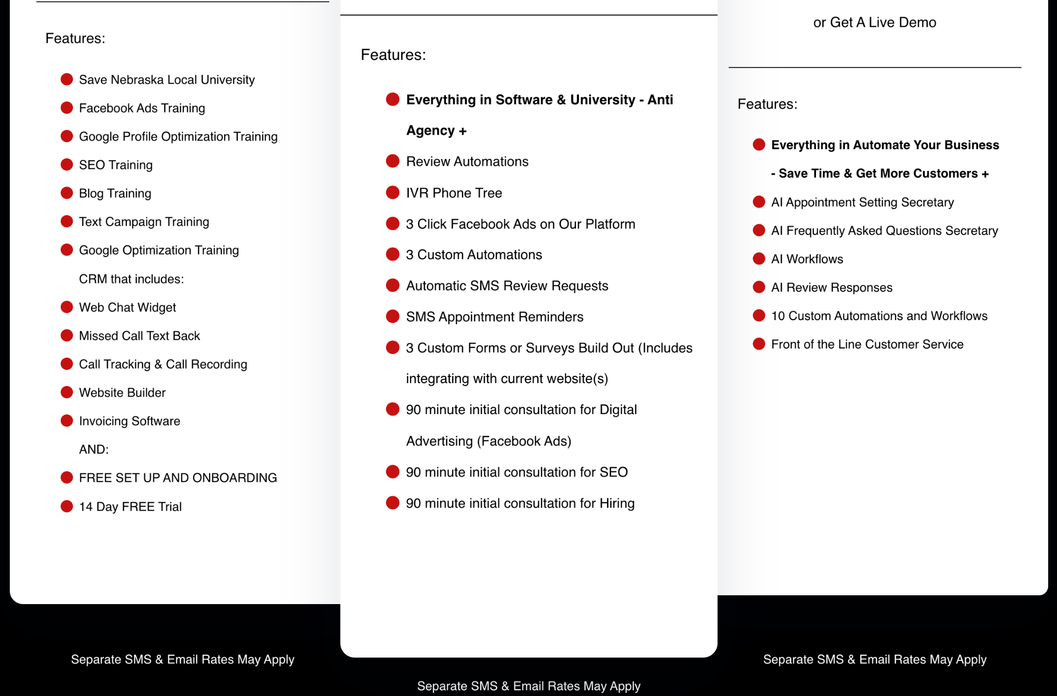
TIER 1
TIER 2
TIER 3

Slide 18
SAVELOCAL SPECIAL
TRY VOICE AI FOR 30 DAYS, ONLY $97
JANUARY 2025 ONLY
SAVELOCALAPP.COM

