Slide 1
SAVE LINCOLN LOCAL
2nd Thursday MasterMINDS!

Slide 2
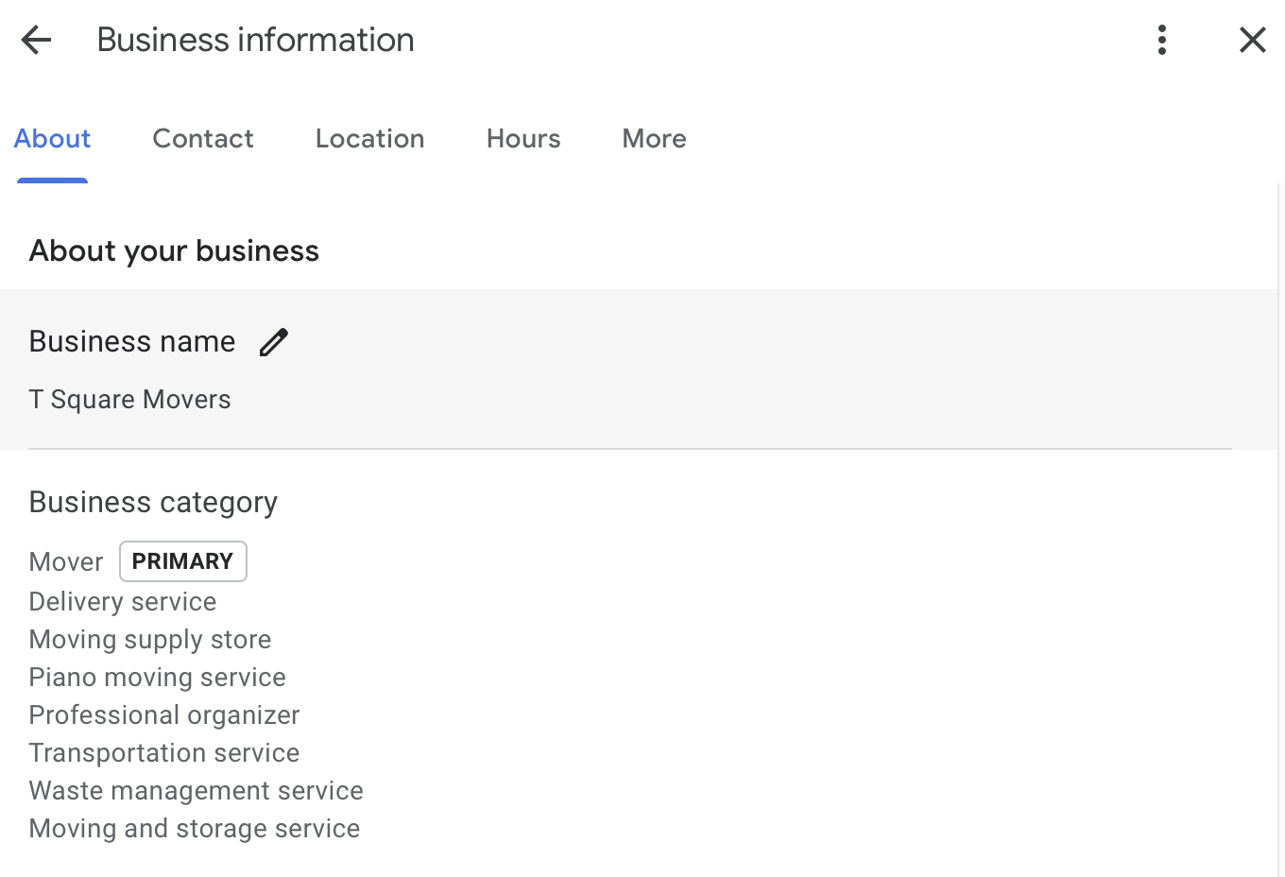
GMB Optimizations - Proper Categories!

Slide 3
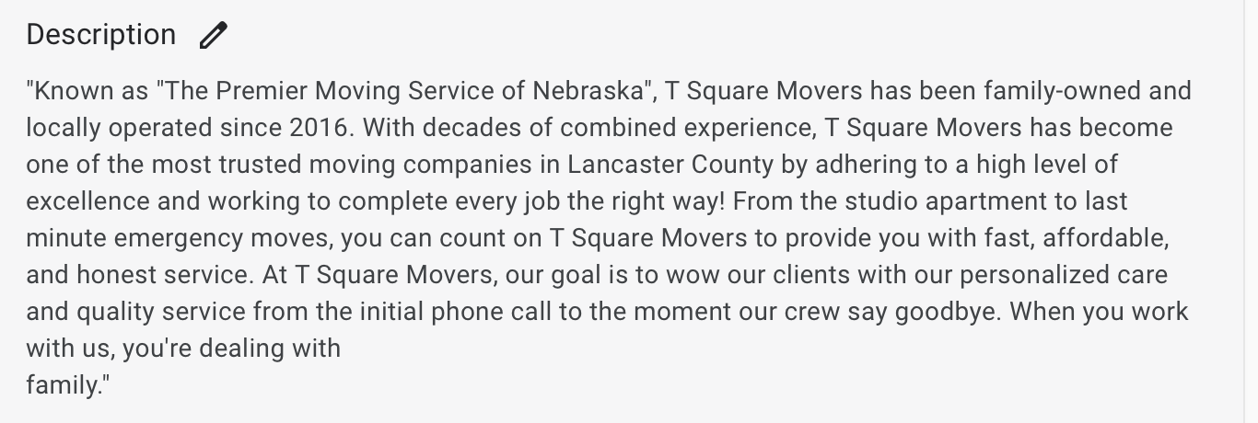
GMB Optimization - In depth Description

Slide 4
GMB Optimization - Social Profiles

Slide 5
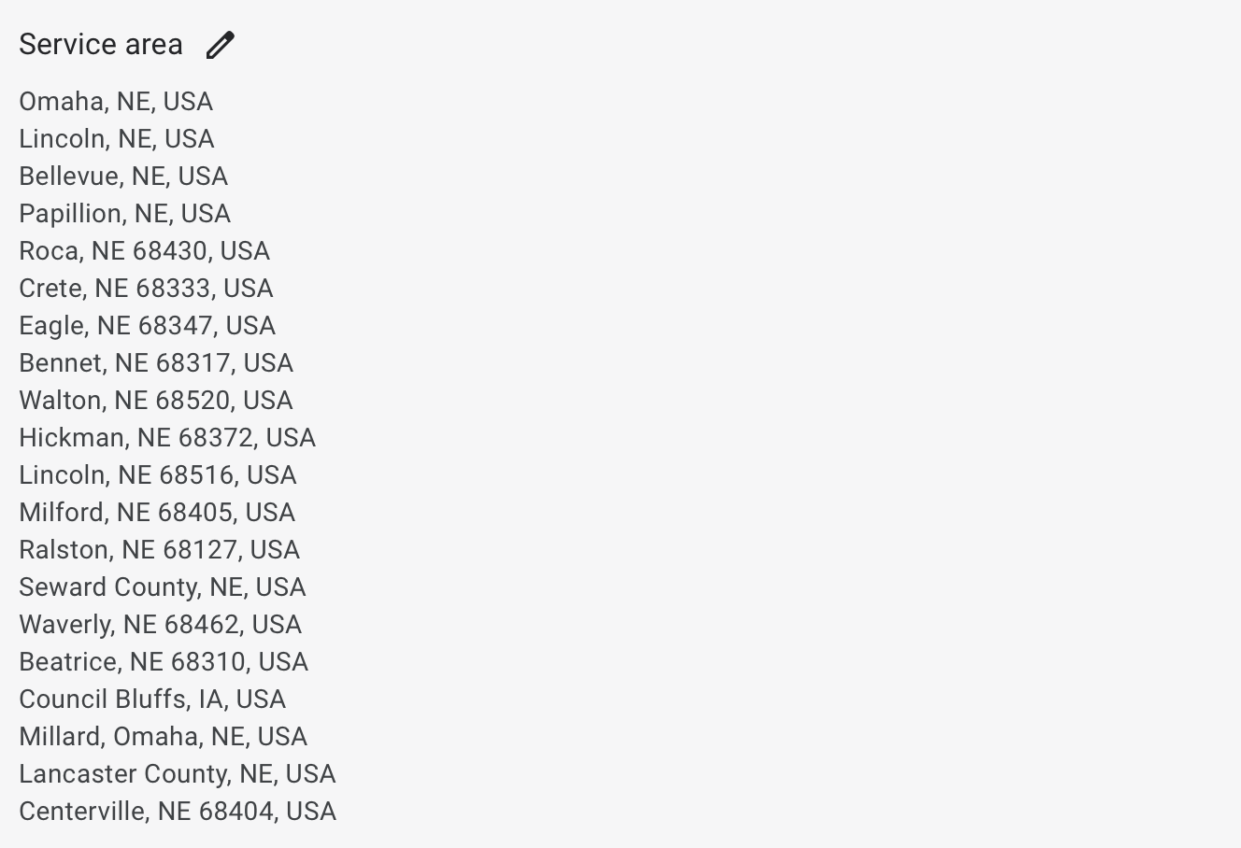
GMB Optimization - Service Areas

Slide 6
EASY SEO !!!
Blogging every 2 weeks (NO LESS THAN MONTHLY)
Swap blogs with friends, target relevant businesses in specific areas. (GPT is huge)
GMB updates weekly (NO LESS THAN EVERY 2 WEEKS)
Talk about specials, services, post pictures of your work very very easy (5 minutes of work)
ASK FOR REVIEWS & INCENTIVIZE them!
($5 refund or discount at checkout)
Use Original Images! No more stock images (those are for print not digital)
Most service businesses already take photos. Use them! If you’re not taking photos you should be ask me why!
Post on Socials! & share those posts on your personal pages.

Slide 7
BLOG LEACHING!
Know your keywords you want to rank for??
Do a google search.

Slide 8
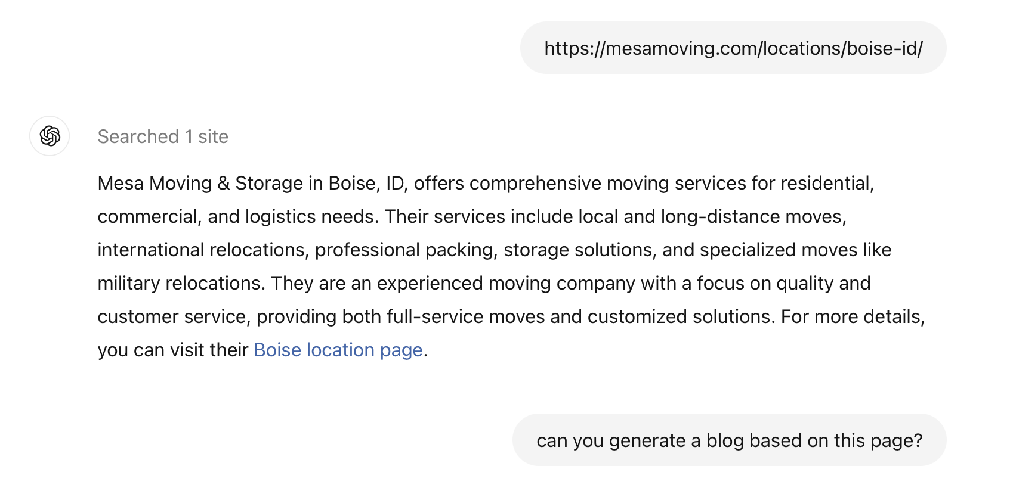
CLICK ON THE FIRST ORGANIC SEARCH RESULT AND COPY THAT URL
THEN OPEN UP CHAT-GPT

Slide 9
Prompting it to correction!
okay now can we change the business to Electric Monkey Moving of Boise
okay next lets keep the packing but lets remove the mention of storage services. also change the weblink to go to Electricmonkeymoving.com
lets replace international moves with a service talking about in home furniture arrangements. this service is usually used when doing rehab, remodels, or new flooring. Let's also talk about Senior Care location services.
CHATGPT
THE RESULTING BLOG

Slide 10
WEBSITE DESIGN STRATEGIES!
What’s your brand?
Colors
Product
Vision/Mission
Are you selling a product or service?
Multiple products? What are your best sellers or newest products?
Who is your Target Market? Kids, Middle Age, Seniors?
How do your Sales Convert the best?
What are your customers looking for when they go to your website?
What sales are most valuable to you? (quickest with least amount of work and/or most profitable/$$$

Slide 11
Examples
Product is Car wash? Brain storm
Product is Lawn Care Service? Brain Storm
Product is Senior Living Facility? Brain Storm
Product is Natural Organic Shampoo? Brain Storm

