Slide 1
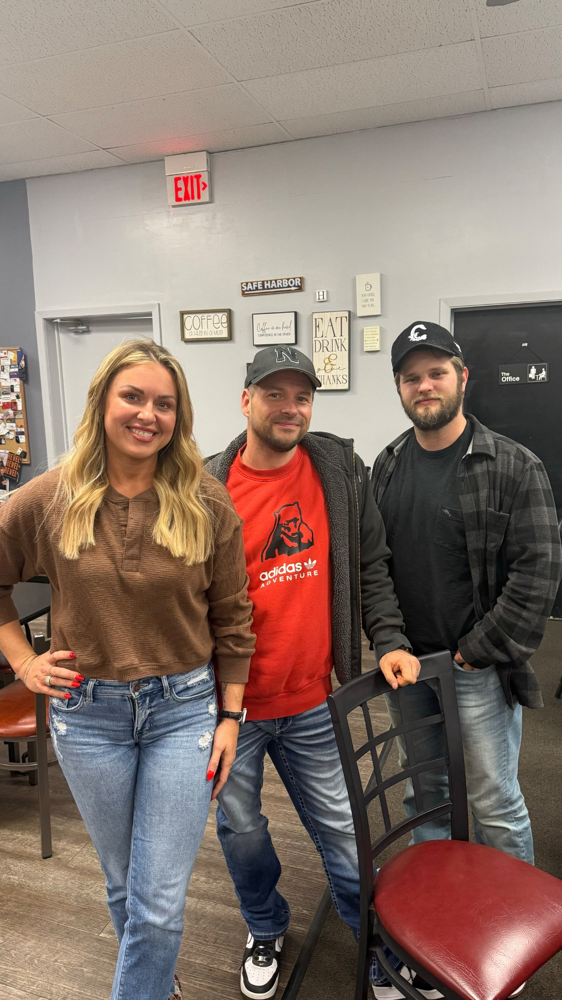
Nolan- Facebook/Instagram
Ashley- HR/Leadership
Justin- Systems/Technology
savelocalapp.com
savenebraskalocal.com

Slide 2
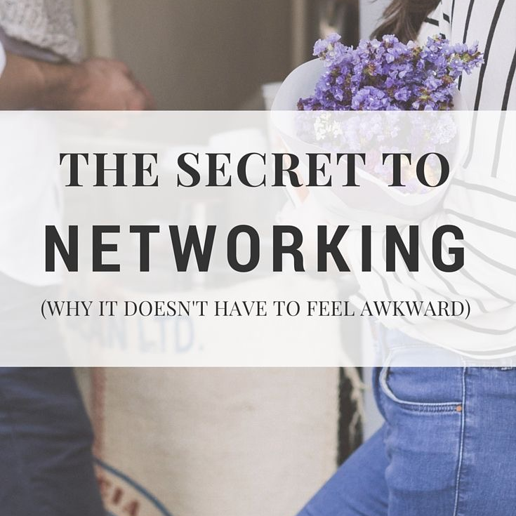
with Ashley & Special Co-Host Debbie Dugan

Slide 3
Special thanks to Debbie
via Medical Massage uses our SaveLocal software!

Slide 4
Interested in co-hosting a Mastermind for Save Nebraska Local?
We are currently offering this to our preferred members and those on the SaveLocal App.
Speak to Ashley if you are interested!!
TEXT/CALL 402-780-8813

Slide 5
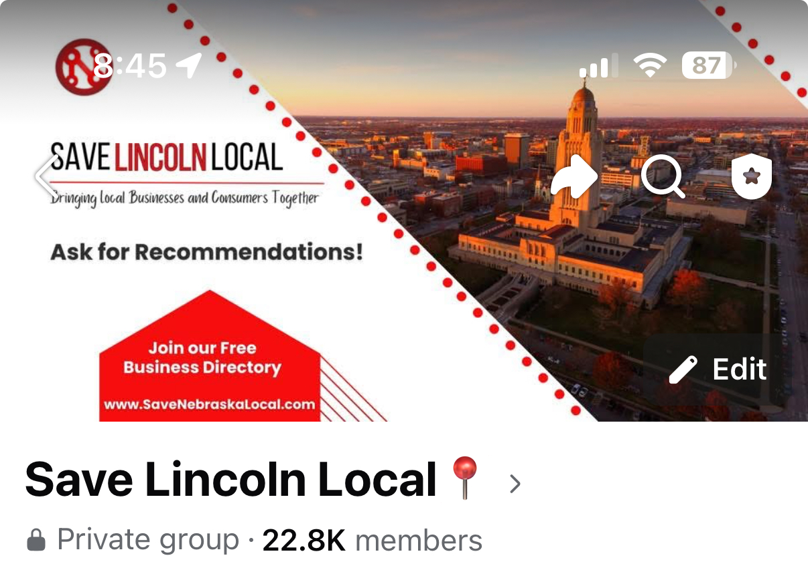
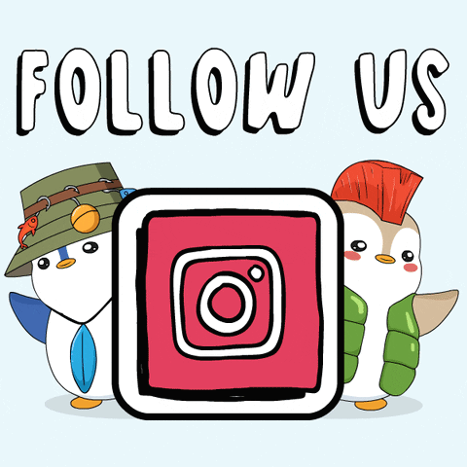
LIKE OUR FACEBOOK PAGE TO
STAY UP TO DATE ON EVENTS
JOIN OUR GROUP FOR RECOMMENDATIONS!

Slide 6
Upcoming FREE Events:
When: May 22 at 6pm
Where: Piedmont Harbor Coffee
Networking & Coffee
When: June 12 at 1:30pm
Where: Rosie’s South
Mastermind: Buy Back Your Time: Systems,
Outsourcing & AI for Summer Freedom
When: June 26 at 6pm
Where: Piedmont Harbor Coffee
Networking & Coffee
HAVE A HOT TOPIC YOU WANT US TO DISCUSS? LET ASHLEY KNOW
Justin and Nolan are hosting a Zoom Q&A every 1st and 3rd Thursday for any current Preferred Vendor and/or SaveLocal App Software customer. Text your questions ahead of time to 402-780-8813.
Next Q&A: May 15 & June 5 at 6pm

Slide 7
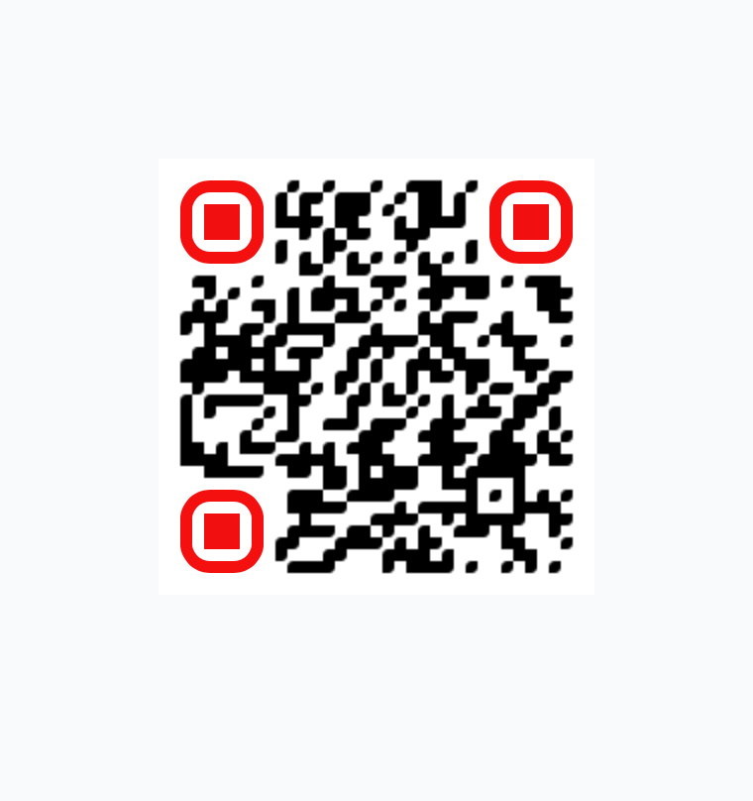
Running a business? This app does what 5 employees can’t.
Booking. Payments. Reviews. Follow-ups. (& more)
All automated. All in one place.
Save time. Save money. Save your sanity—Grow your business with the SaveLocal App.
Learn more here
SAVELOCALAPP.COM

Slide 8
Here’s what local business owners are saying:
“I cut my admin time in half thanks to the SaveLocal App.”
“It’s like hiring an assistant without the overhead.”
“I used to forget to follow up. Now the app does it for me—like clockwork.”
“This replaced four different tools I was paying for.”
“I don’t chase payments anymore. They just come in.”
“It’s like having a front desk, marketing assistant, and office manager all in one.”
“I’m finally getting reviews without asking for them!”
“Clients love how easy it is to book with me now.”
“I can actually take a day off and know things are still running.”

Slide 9
1. Missed Call Text-Back
If you miss a call, it instantly texts the customer back with a custom message—so you never lose a lead.
2. New Lead Follow-Up
Automatically sends a welcome text/email with next steps when a new lead fills out a form or messages you.
3. Review Requests
After a job or appointment, it automatically asks customers to leave a Google review—helping boost your reputation without lifting a finger.
4. Appointment Reminders
Sends text and email reminders before appointments to cut down on no-shows.
5. Abandoned Quote Follow-Up
If someone gets a quote but doesn’t book, it follows up automatically to check in and keep the conversation going.

Slide 10
6. Birthday & Holiday Texts
Sends personalized messages on birthdays or holidays to keep you top of mind.
7. Payment & Invoice Reminders
Automatically nudges clients about unpaid invoices or upcoming payments.
8. Drip Campaigns
Sends a series of texts or emails over time to nurture leads or stay connected with past customers.
9. Re-Engagement Campaigns
Haven’t heard from someone in a while? It’ll automatically reach out and invite them back.
10. Webchat to Text
When someone messages you from your website, it moves the conversation to text—so you can respond faster and keep them engaged.

Slide 11
Some of the Local Businesses on the SaveLocal app

Slide 12
And a few more…. But you get the point. This software works for everyone!

Slide 13
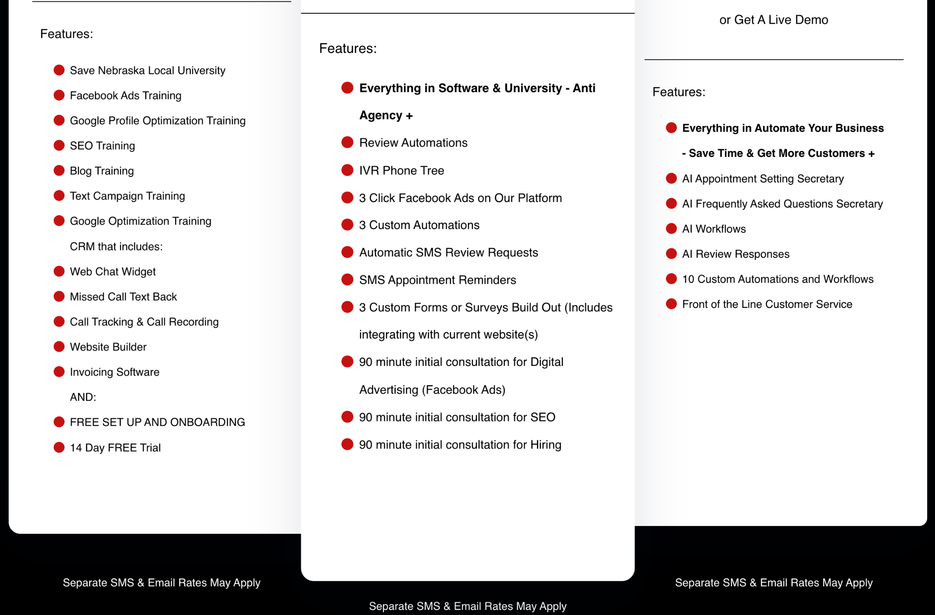
TIER 1
TIER 2
TIER 3

Slide 14
THE ART OF CONNECTION
NETWORKING
with lasting value
Moving from transactions to transformation

Slide 15
NETWORKING
journey
KNOW
LIKE
TRUST
REPEAT
FOR A LONG LONG TIME
THEN A BIT LONGER THAN THAT...
=”YOUR NETWORK IS YOUR NET WORTH”
Notes:
When I stopped focusing on "What can I get from this relationship?" and started asking "What can I bring to this relationship?", everything changed.
How many of you have found yourselves in a networking group that just didn't feel right? Raise your hand if you've ever felt like you were doing all the 'right things' but not getting results.

Slide 16
KNOW:
(Like switch/The friendship formula)=
proximity+ frequency+ relevance+intensity
Show up!
PROXIMITY
FREQUENCY
Be at the thing!
As much as possible!
RELEVANCE
INTENSITY
Be of value to others
Go deep, emotionally connect, engage
Notes:
Share a story about a networking relationship that developed through these four components. How did it transform from acquaintance to true connection?

Slide 17
The
GOLDEN RULE OF
Friendship
“If you want people to like you,
make them feel good about themselves.”
-Jack Schafer, The Like Switch
“If you want people to like you, make them feel psychologically safe”
-Debbie Dugan, the lady talking to you right now

Slide 18
LIKE
Friend Or Foe?
The expression one wears on one's face is far more important than the clothes one wears on one's back.
-Dale Carnegie
Open posture
Peacocking
Warm smile/eye crinkle
Closed and slumped
Head tilt
Resting face/disinterest
Eye contact & eyebrow flash
Personal space invasion
Notes:
Quickly demonstrate both sets of signals. Ask volunteers to identify which signals you're displaying. This creates laughter while reinforcing the point.

Slide 19
Where we go wrong
BELIEFS THAT KEEP US STUCK
How successful we are going to be
(in relationships, business, or otherwise) starts in our MINDS
ON A PERSONAL LEVEL
I suck at networking
I’m an imposter
I’m bad with names
I have nothing valuable to offer
I’m a terrible presenter
I’m better than everyone

Slide 20
Where we go wrong
BEHAVIORS THAT KEEP OUR GROUP STUCK
Are we setting our group members up for success, or making them feel pressured and unsafe
ON A GROUP LEVEL
Emphasizing only sales and referrals
Expecting immediate results from strangers
Coldness or Cliquishness
Tracking and competition
Faulty leadership
Lack of psychological safety
Notes:
Have you ever had an experience where a networking group made you feel unwelcome or pressured? How did that impact your willingness to engage?"

Slide 21
SMALL TALK
Strategies
“If you want others to like you, if you want to develop real friendships, if you want to help others at the same time as you help yourself, keep this principle in mind: Become genuinely interested in other people. -Dale Carnegie
Be observant. Be complimentary. Be genuine. Be curious
Notes:
Turn to someone next to you and practice noticing one detail about them you could use as a conversation starter. What did you observe?

Slide 22
EXTROVERTS
Both have their unique advantages!
Or introverts?
INTROVERT STRENGTHS
INTROVERT WEAKNESSES
Excellent listeners
Deep one-on-one connections
Thoughtful follow-up
Quality over quantity
In their own heads
Body language misinterpreted
Difficulty in large groups
Drained by prolonged interaction
EXTROVERT STRENGTHS
EXTROVERT WEAKNESSES
Ease of initial engagement
Energy in group settings
Quick rapport building
Comfortable initiating
Impulsive
Steals the spotlight
Dominate conversations
Energy is “too much”
Notes:
Story of when I met a new contact just recently. Extroverts do not have it all figured out.

Slide 23
CONVERSATION STARTERS
that create depth
Story-Eliciting Questions:
"How did you get the courage to leave your job and open your business?"
"Has your family been supportive of your entrepreneurial journey?"
"How did you possibly juggle working two full-time jobs?"
"Where did you train? Was this what you originally went to school for?"
Knowledge-Appreciating Questions:
"I had no idea roofing was that complicated...how did you figure that out?"
"How many franchises did you look into before you chose yours? Any regrets?"
"What's the most surprising thing you've learned in your industry?"
“The royal road to a person's heart is to talk about the things he or she treasures most.” -Dale Carnegie
Notes:
Have participants practice asking these questions in pairs for 2 minutes. The energy in the room will immediately shift

Slide 24
TRUST: EMPATHTIC LISTENING FOR THE WIN!
Hang on every word
Body language: eye contact & nodding
Empathtic vs sympathtic statements
"That must have been challenging"
"I can imagine how exciting that was for you"
"It sounds like you really put your heart
into that project"
"How did you feel when that happened?"

Slide 25
TAKER, MATCHER, GIVER
Which are you?
What’s in it for me?
Fairness focused
Rising tide raises all ships
Kiss up, kick down
Reciprocity driven
Help without expectation
Collect only “useful” contacts
Can be transactional
Values all regardless of status
Successful short term
First to call out takers
Most successful long term
Notes:
Think about the last three networking interactions you had. Which type were you operating as in each?

Slide 26
BE THE
Giver
Connect people daily
Offer to help, always
Give knowledge freely
Turn attention outward
Love on your competition
Pull others up the ladder
Notes:
Story about Jason Gayed

Slide 27
NETWORKING
reimagined
Instead of just tracking closed business...
Celebrate character and helpfulness:
"Jason spent an hour showing me how to use Google My Business"
"Liza always gives shout-outs on Facebook which makes everyone feel great"
"I admire how Cory shows up to every meeting and makes everyone feel welcome"
Ask "Who needs help?" regularly
"Who does so-and-so need to get in front of?"
"What do I need help with?"
Key Takeaways
Get out of your head and focus on others
Use techniques to reduce anxiety
Strive to be the giver, not just the matcher
Bring more value than you take
Ask for feedback and safety
Find shared values beyond business
Get real and go deep
Be curious and genuinely interested
Notes:
Make people feel good about themselves, and your network - and your life - will flourish.

Slide 28
MAKING THE MOST
of your presentations
Before Your Pitch:
Power pose (confidence)
Psychological sigh (calming)
Within Your Pitch:
Know what you actually sell (transformation, not services)
"I help [target audience] to [achieve result] so that [deeper benefit]"
Example: Not "I sell massages" but "I help professionals with chronic pain return to work pain-free so they don't miss important family moments"
Content:
Start with your "WHY" - people want something to believe in
Share your personal transformation story
Tell client transformation stories
Add emotion to "boring" industries:
Insurance: "How have you saved someone from heartache?"
Accounting: "How did you help a business owner sleep at night?"
Landscaping: "How did you transform a family celebration?"
Go deep to understand what clients truly desire

Slide 29
THANK
You
@well2dugan
619-379-6999
@ViaMedMassage
info@ViaMedMassage.com

