Slide 1
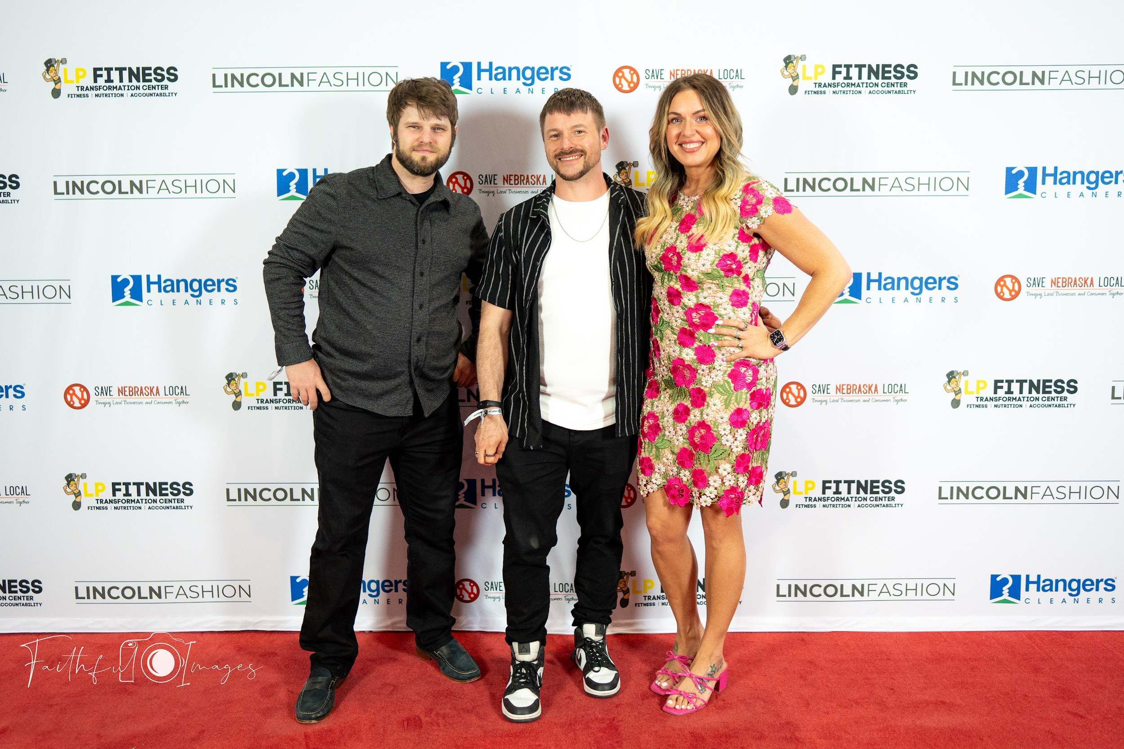
Join our FREE directory! savenebraskalocal.com
Learn about our software solutions at savelocalapp.com

Slide 2
Mastermind:
Buy Back Your Time-
Systems, Outsourcing & AI for Summer Freedom

Slide 3
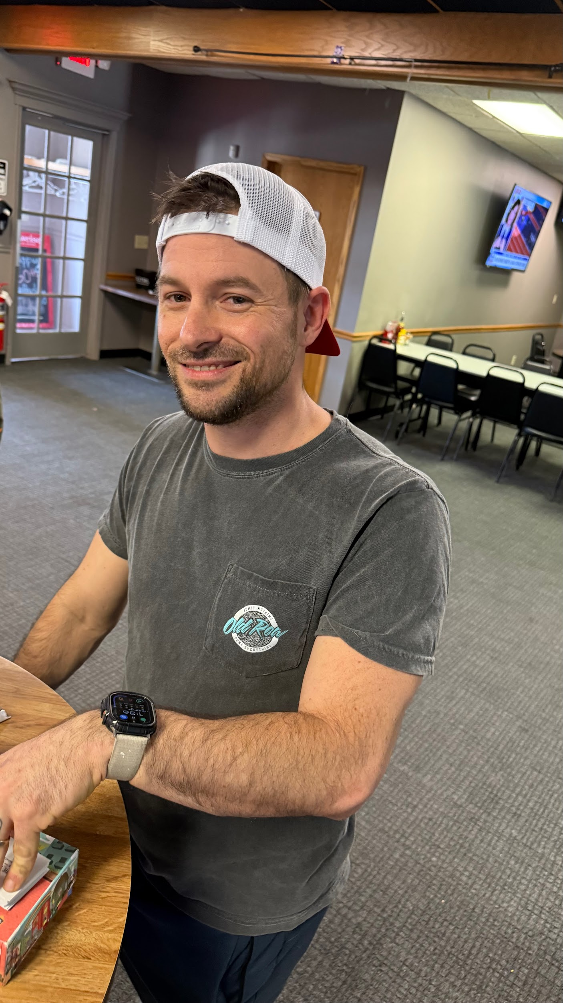
Special thanks to Justin
for showing up always and having such a strong dedication to the small business community!

Slide 4
Interested in co-hosting a Mastermind for Save Nebraska Local?
We are currently offering this to our preferred members and those on the SaveLocal App.
Speak to Ashley if you are interested!!
TEXT/CALL 402-780-8813

Slide 5
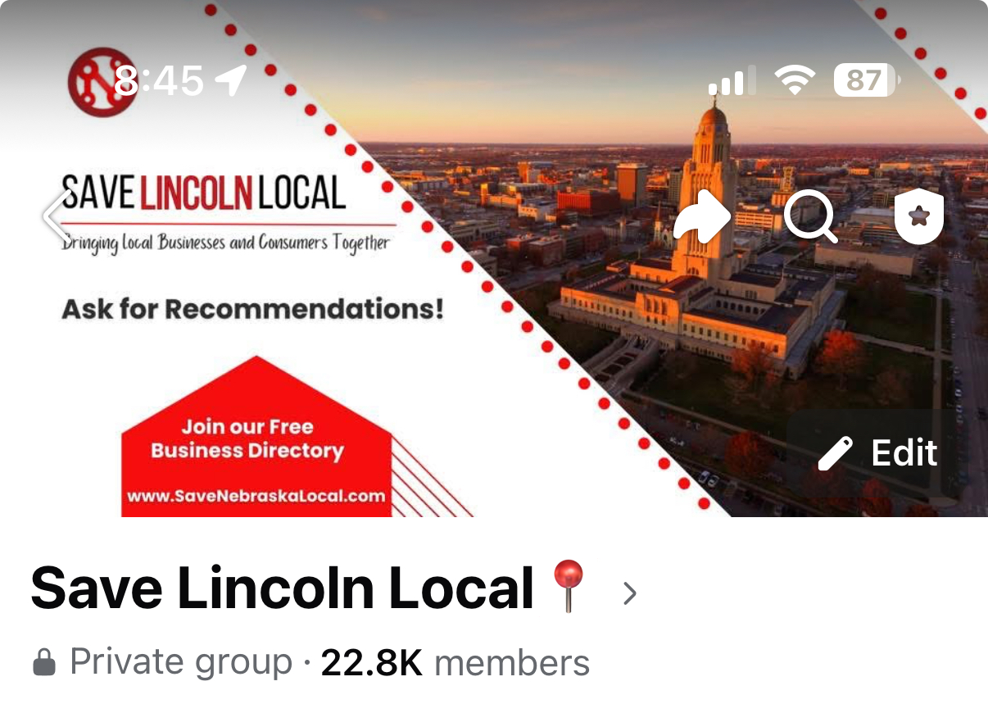
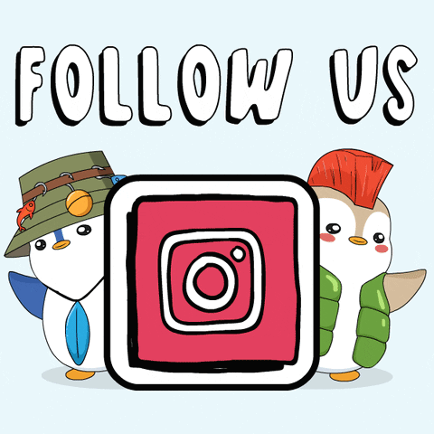
LIKE OUR FACEBOOK PAGE TO
STAY UP TO DATE ON EVENTS
JOIN OUR GROUP FOR RECOMMENDATIONS!

Slide 6
Upcoming FREE Events:
When: June 19 at 6pm
Where: Tavern on the Square
Nachos + Networking for Loaves & Fishes
When: June 26 at 6pm
Where: Piedmont Harbor Coffee House
Networking & Coffee
When: July 10 @ 1:30pm
Where: Mastermind: Amanda Swenson
Topic TBD
HAVE A HOT TOPIC YOU WANT US TO DISCUSS? LET ASHLEY KNOW
Justin and Nolan are hosting a Zoom Q&A every 1st and 3rd Thursday for any current Preferred Vendor and/or SaveLocal App Software customer. Text your questions ahead of time to 402-780-8813.
Next Q&A: July 3 & July 17

Slide 7
🎉 NACHOS & NETWORKING
Hosted by Save Nebraska Local
📍 Tavern on the Square – 816 P Street, Lincoln, NE
🗓️ Wednesday, June 19
⏰ 6:00–9:00 PM
Giveaway Drawing at 8:30 PM
🔥 JOIN US FOR THE BIGGEST SMALL BIZ NIGHT OF THE SUMMER!
Networking • Nacho Bar • Drinks • Outdoor Games • MASSIVE GIVEAWAY
This isn’t your average night out. We’re coming together to support Loaves & Fishes, a nonprofit led by Karen Lamb that feeds over 400 people every month.
🎉 NACHOS & NETWORKING
Hosted by Save Nebraska Local
📍 Tavern on the Square – 816 P Street, Lincoln, NE
🗓️ Wednesday, June 19
⏰ 6:00–9:00 PM
Giveaway Drawing at 8:30 PM
⸻
🔥 JOIN US FOR THE BIGGEST SMALL BIZ NIGHT OF THE SUMMER!
Networking • Nacho Bar • Drinks • Outdoor Games • MASSIVE GIVEAWAY
This isn’t your average night out. We’re coming together to support Loaves & Fishes, a nonprofit led by Karen Lamb that feeds over 400 people every month.
⸻
💸 HOW TO ENTER THE GIVEAWAY
Donate any amount (cash/check/Venmo @Karen-Lamb-27) from 6–8 PM to get:
✅ 1 Entry for any donation
✅ BONUS ENTRIES for every $100 donated
✅ Top Donor wins a FREE FEATURE POST in the Save Nebraska Local Facebook group (over 23K members – $250 value!)
🎟 Must be present at 8:30 PM to win.
⸻
🎁 GIVEAWAY VALUE: $6,000+
One winner takes all. No joke.
Just a few highlights:
• $2500 Website from Save Nebraska Local
• Lincoln Zoo Family Membership
• $200 Carpet Cleaning + Kit
• $200 in Holistic Wellness Products
• 1-Hour Massage
• House Cleaning
• Gift Cards & More!
💬 WHY WE’RE DOING THIS
Karen wasn’t able to participate in Give to Lincoln Day—so we’re making this her night. Let’s show up big for someone who always shows up for others.
🙌 SMALL BUSINESSES:
Want to donate to the giveaway? Message us to be featured!

Slide 8
💸 HOW TO ENTER THE GIVEAWAY
Donate any amount (cash/check/Venmo @Karen-Lamb-27) from 6–8 PM to get:
✅ 1 Entry for any donation
✅ BONUS ENTRIES for every $100 donated
✅ Top Donor wins a FREE FEATURE POST in the Save Nebraska Local Facebook group (over 23K members – $250 value!)
🎟 Must be present at 8:30 PM to win.
🎁 GIVEAWAY VALUE: $6,000+
One winner takes all. No joke.
💬 WHY WE’RE DOING THIS
Karen wasn’t able to participate in Give to Lincoln Day—so we’re making this her night. Let’s show up big for someone who always shows up for others.
🙌 SMALL BUSINESSES:
Want to donate to the giveaway? Message us to be featured!

Slide 9
Thank you to all the small businesses who donated items/services for the event!
Ravens Nest Installation & Building
T2 Movers
PureCare Dry Carpet Cleaning
Salted Root
New Start Cleaning
Via Medical Massage
K B House Nails
Makeup by Thuy
Drive Wellness & Physio Co
Larkspur Upholstery
Scissors & Scotch
Emerald Apothocary/Practicality Skin & Body
One Shot Auto
Harbor Coffee House
Too Clean Detail
Matt Taylor
Jacobsen Cosmetic
Ne Curbside
Zeng Countertops
LP Fitness Transformation Center
Kinetic Windstream

Slide 10
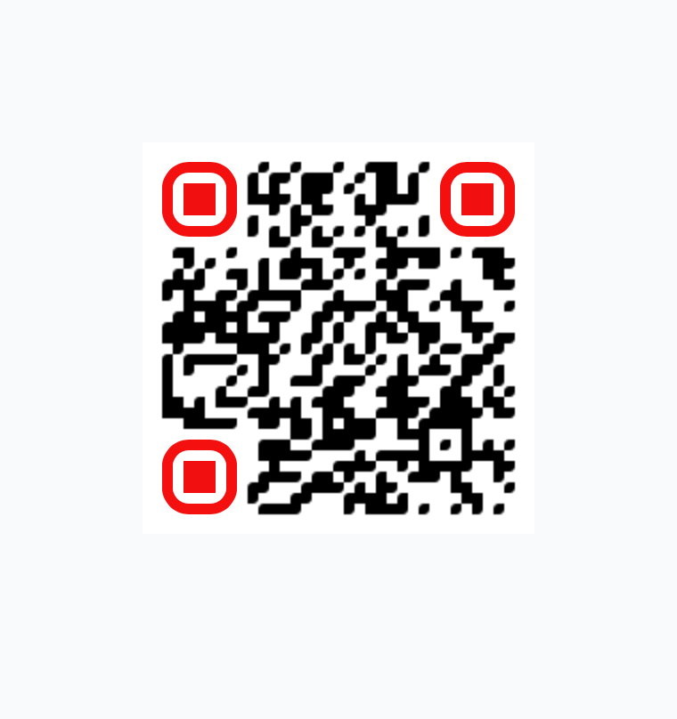
Running a business? This app does what 5 employees can’t.
Booking. Payments. Reviews. Follow-ups. (& more)
All automated. All in one place.
Save time. Save money. Save your sanity—Grow your business with the SaveLocal App.
Learn more here
SAVELOCALAPP.COM

Slide 11
Here’s what local business owners are saying:
“I cut my admin time in half thanks to the SaveLocal App.”
“It’s like hiring an assistant without the overhead.”
“I used to forget to follow up. Now the app does it for me—like clockwork.”
“This replaced four different tools I was paying for.”
“I don’t chase payments anymore. They just come in.”
“It’s like having a front desk, marketing assistant, and office manager all in one.”
“I’m finally getting reviews without asking for them!”
“Clients love how easy it is to book with me now.”
“I can actually take a day off and know things are still running.”

Slide 12
1. Missed Call Text-Back
If you miss a call, it instantly texts the customer back with a custom message—so you never lose a lead.
2. New Lead Follow-Up
Automatically sends a welcome text/email with next steps when a new lead fills out a form or messages you.
3. Review Requests
After a job or appointment, it automatically asks customers to leave a Google review—helping boost your reputation without lifting a finger.
4. Appointment Reminders
Sends text and email reminders before appointments to cut down on no-shows.
5. Abandoned Quote Follow-Up
If someone gets a quote but doesn’t book, it follows up automatically to check in and keep the conversation going.

Slide 13
6. Birthday & Holiday Texts
Sends personalized messages on birthdays or holidays to keep you top of mind.
7. Payment & Invoice Reminders
Automatically nudges clients about unpaid invoices or upcoming payments.
8. Drip Campaigns
Sends a series of texts or emails over time to nurture leads or stay connected with past customers.
9. Re-Engagement Campaigns
Haven’t heard from someone in a while? It’ll automatically reach out and invite them back.
10. Webchat to Text
When someone messages you from your website, it moves the conversation to text—so you can respond faster and keep them engaged.

Slide 14
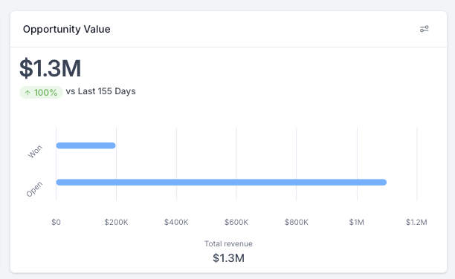
“You don’t need more time - you need better systems”
Numbers Don’t Lie

Slide 15
Short Story Time:
How and Why with Save Nebraska Local!
Saved us time
Saved us money
Increased Time to Lead
Boosted Our Quality Leads
Increased Our SEO
MORE FREE TIME!

Slide 16
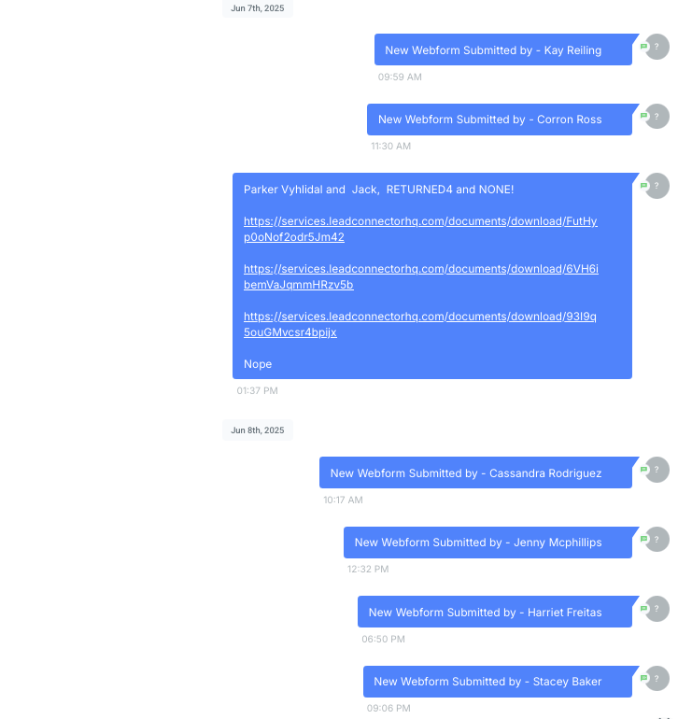
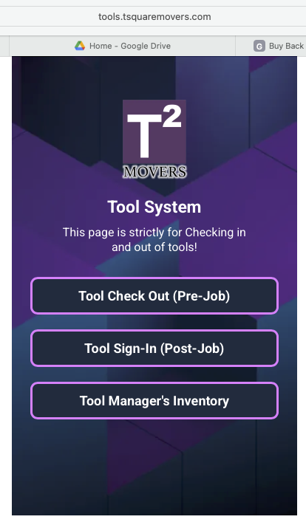
LET’S NERD OUT!
All Equipment has numbers and Airtags in the boxes.
This system makes remote
Inventory possible and
Cuts down on losses.
Saves time shopping for
Replacements or figuring out
Where something was left.

Slide 18
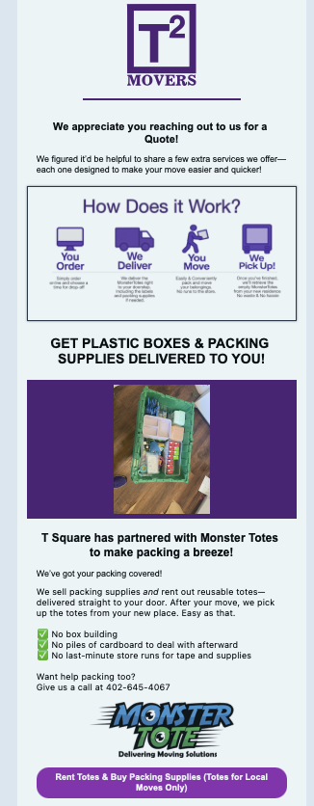
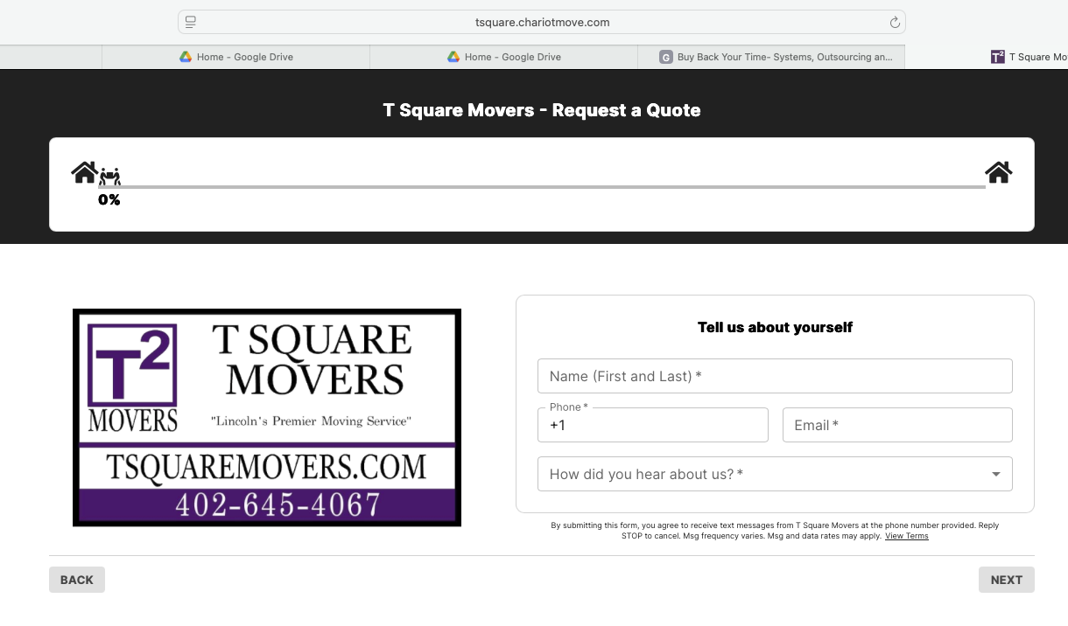
Full Encompassing Quoting System!
With UpSell

Slide 19
SAVE NEBRASKA LOCAL HOTLINE!
(402) 780-8813
She can forward calls and book appointments on Justin’s Calendar as well as attempts to collect contact information like name & email address from everyone that calls.

Slide 20
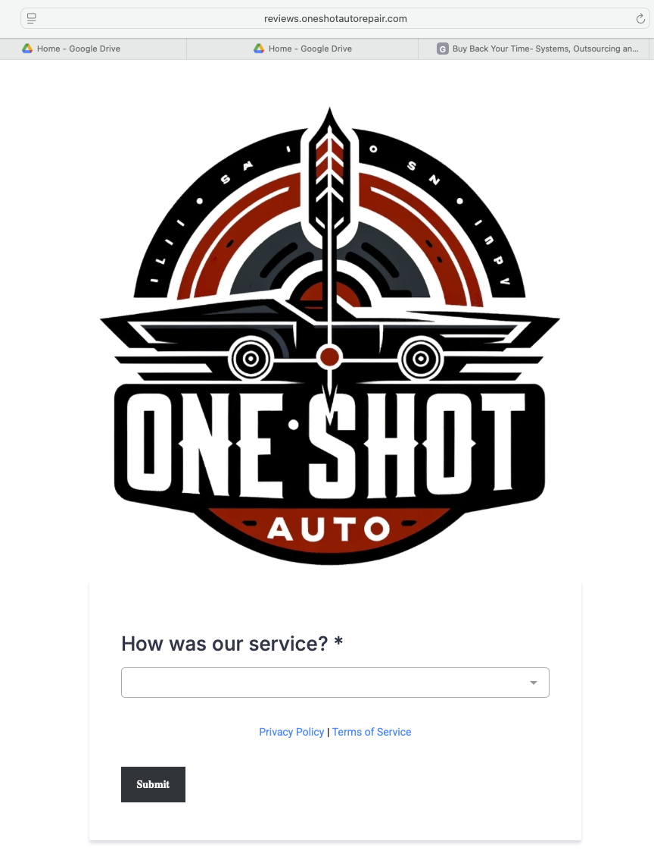
Reviews Filtering & Reply AI

Slide 21
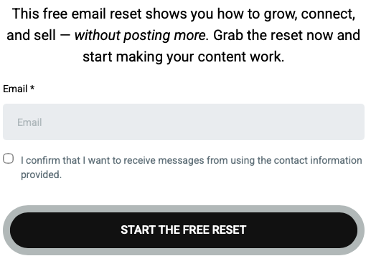
Using Simple Forms to gather information and Target for Sales

Slide 22
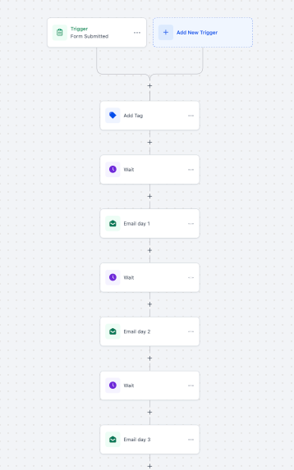
Simplest form of an automation tree
Triggered by the form.

Slide 23
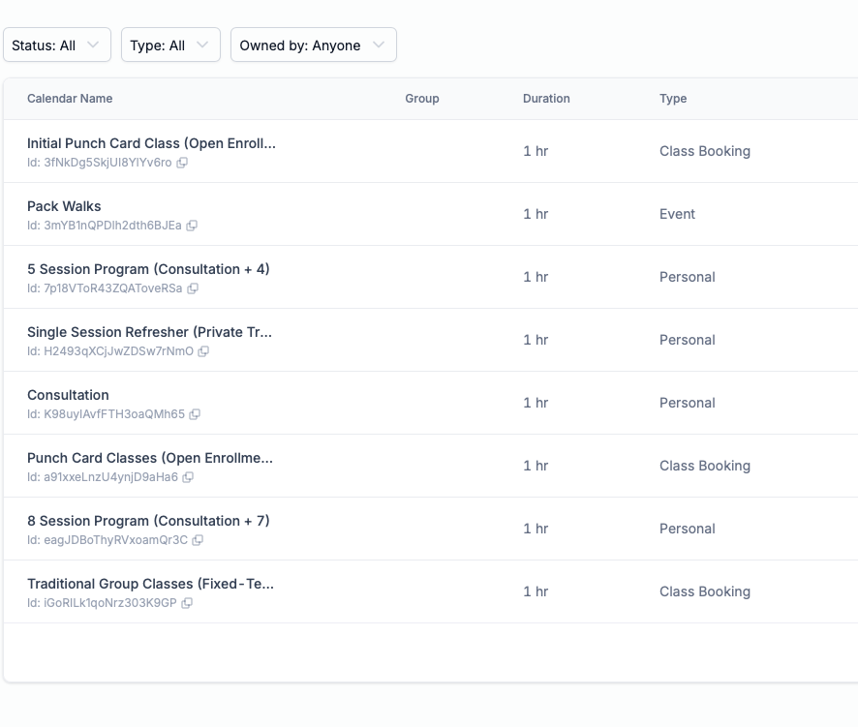
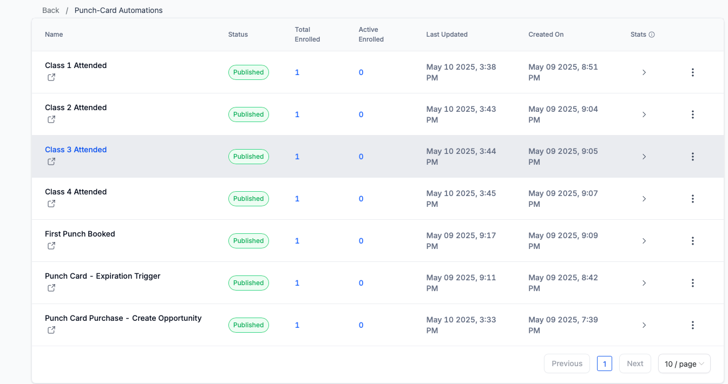
Using Automations with Calendars

Slide 24
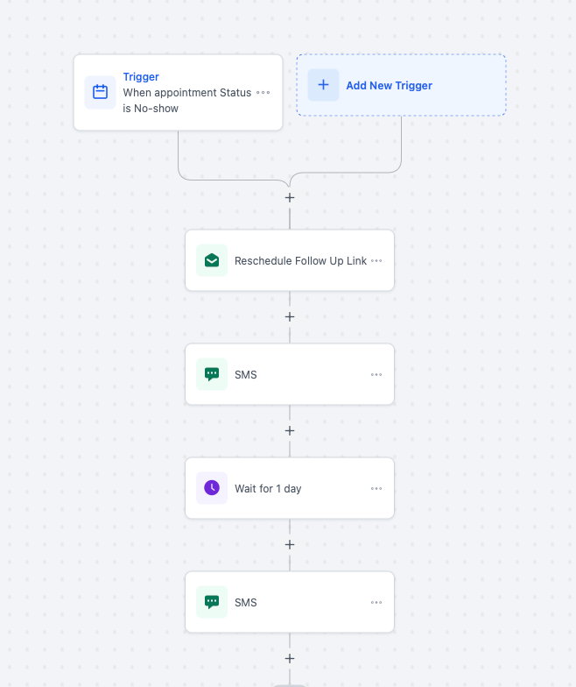
Triggering Automations to handle your scheduling.

Slide 25
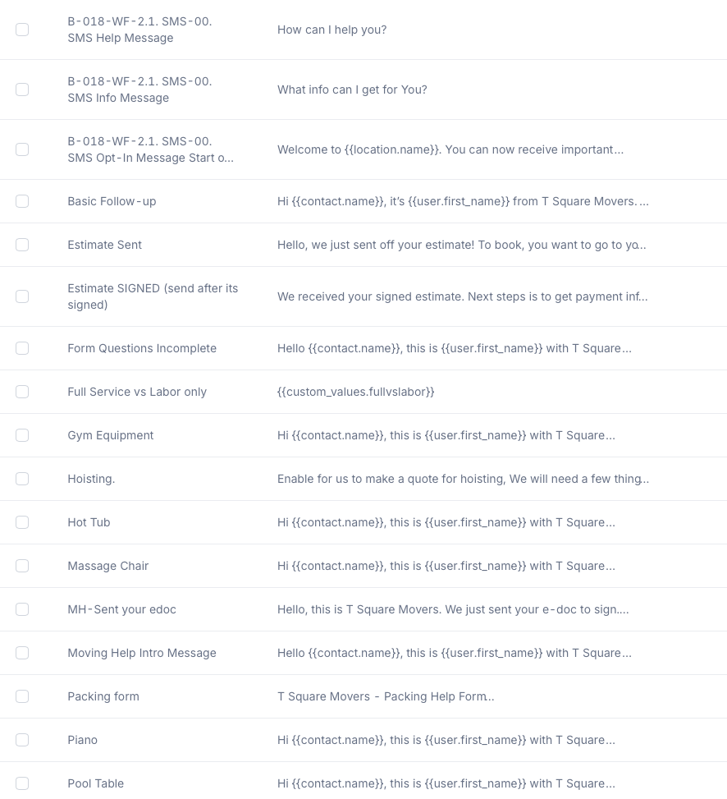
Quick scripted snippets that can be sent by sms or email.
Easy for a V.A. to utilize and easy for training.
Other useful features like phone call recording and/or transcribing.

Slide 26
Some of the Local Businesses on the SaveLocal app

Slide 27
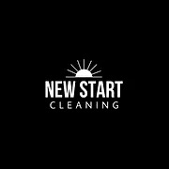
And a few more…. But you get the point. This software works for everyone!

Slide 28
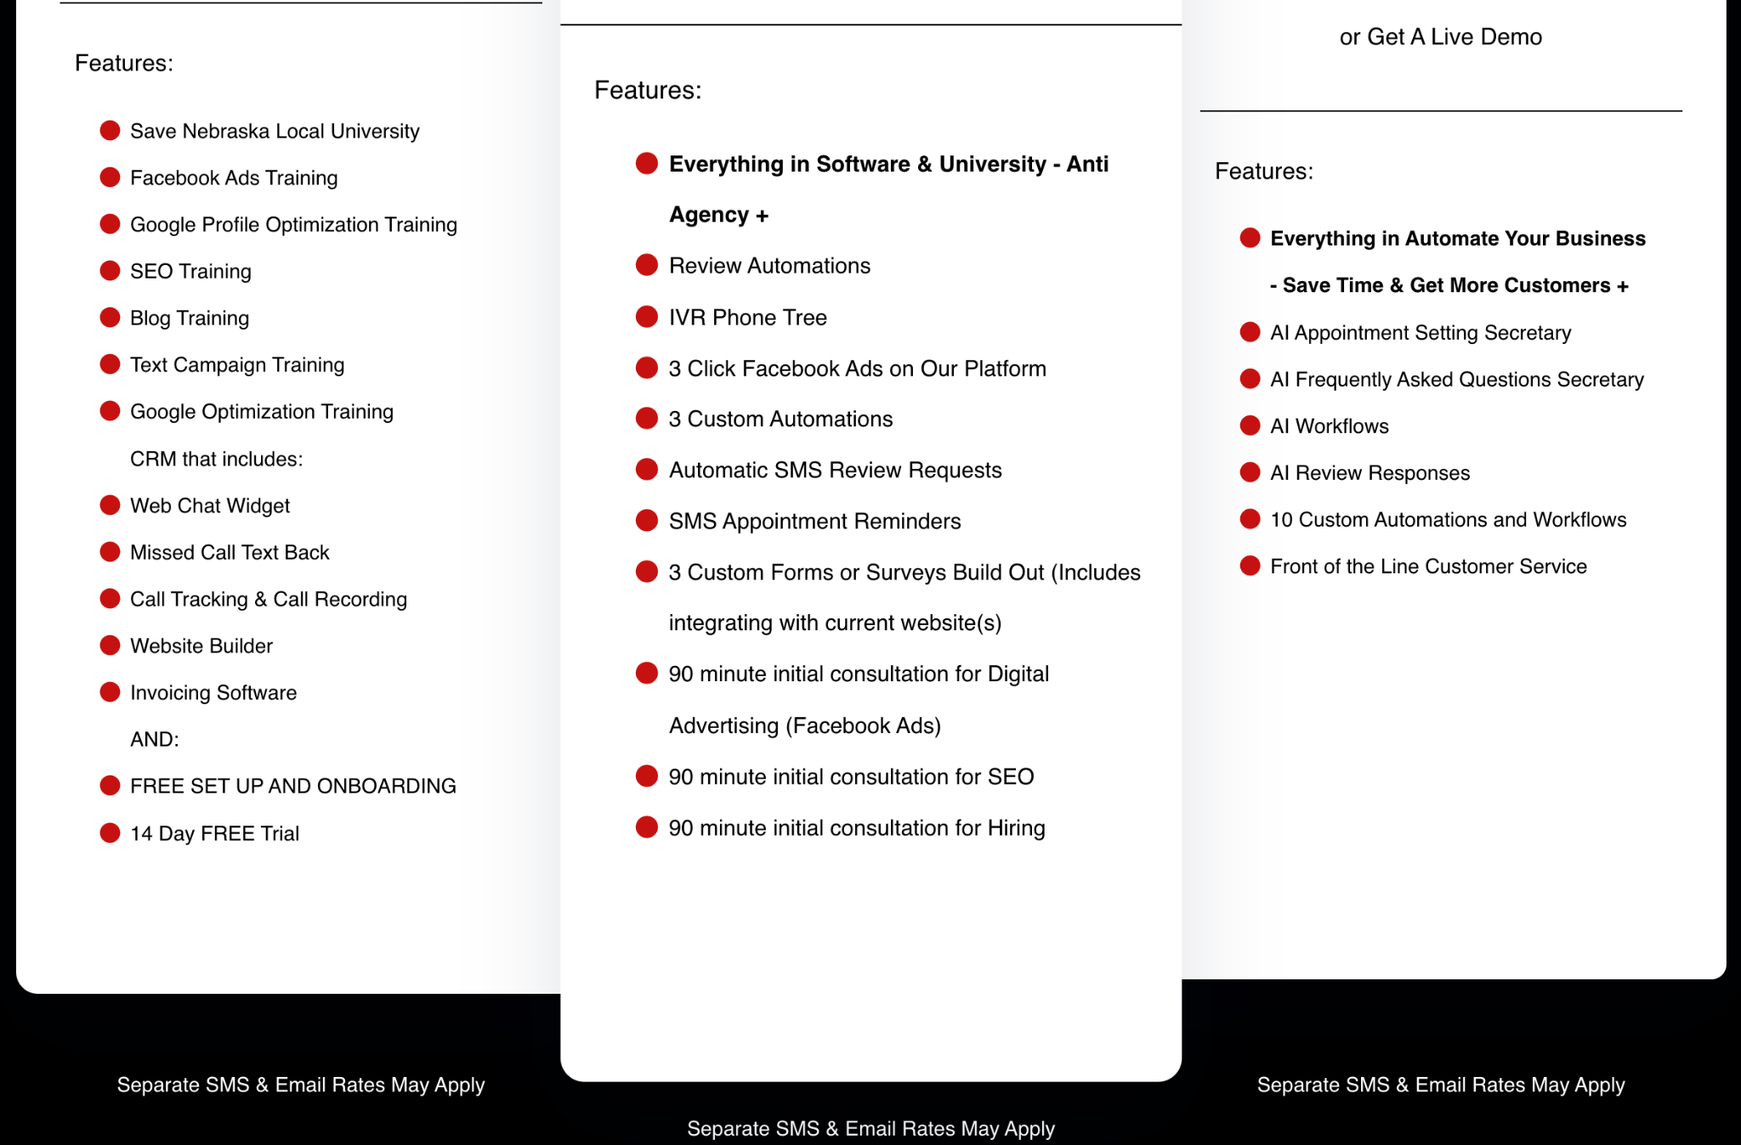
TIER 1
TIER 2
TIER 3
New low-cost option $50 p/m Webhosting w/ contact forms smtp.

