Slide 1
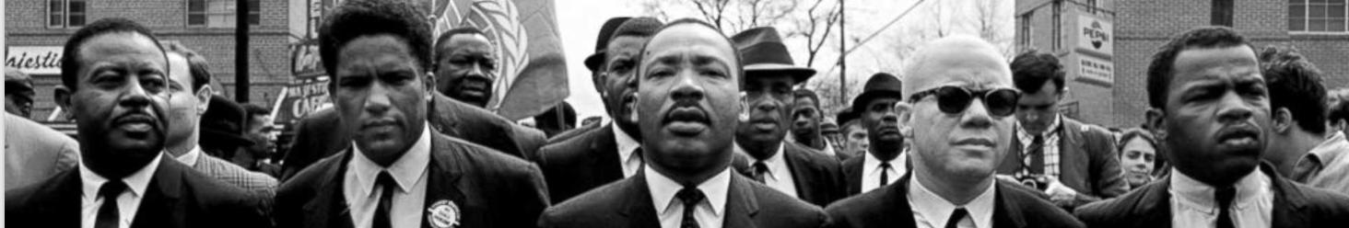

STAND IN SOLIDARITY
HOW THE PRIVATE SECTOR CAN FULFILL KING’S DREAM OF ECONOMIC JUSTICE AND EQUALITY
WHEELER SOCIAL IMPACT LLC
RODEIRCK D.S. WHEELER, MPA,MBA

Slide 2
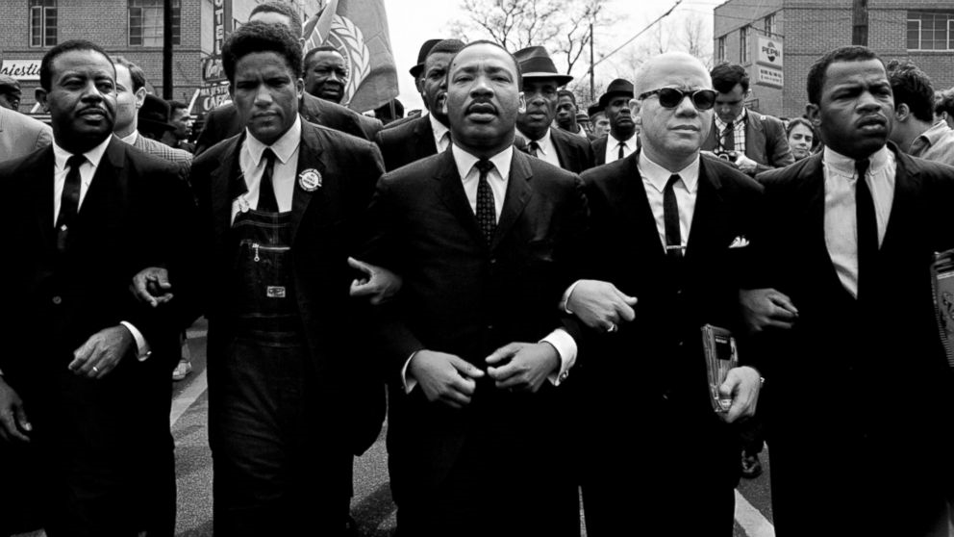
“The struggle against racial oppression in the United States has always been aligned with the struggle against economic exploitation. Separating racial equality from economic justice issues would abandon the civil rights movement’s core tenets”
— Kyle K. Moore, Economic Policy Institute

Slide 3
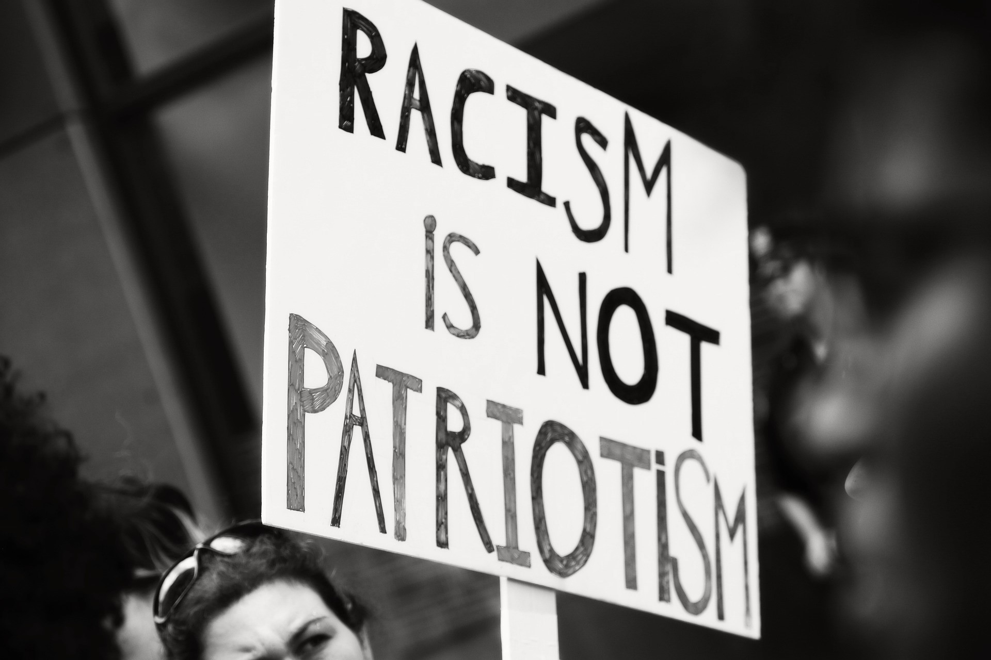
A Shift In Public Opinion & Consumer Expectations
In light of police violence and the growing visibility of global protests and systemic inequities affecting communities of color, public awareness of long-standing injustices has noticeably risen.
The senseless killings of George Floyd, 46; Ahmaud Arbery, 25; Breonna Taylor, 26; and many others is a manifestation of racism that sparked outrage in our nation and across the globe.
Since the killing of George Floyd and the global protests that ensued, public opinion has swayed dramatically in favor of racial equality, police and criminal justice reform, and effective diversity, equity, and inclusion initiatives.

Slide 4
Key Definitions
Economic Justice – A fair and just economy that provides all groups of people the equal opportunity to succeed.
Economic Equality – Eliminating sub-group disparities in income generation and wealth creation.

Slide 5
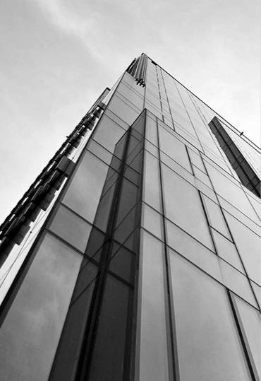
A Continuum of Corporate Responses to Racial Injustice

Slide 6
Private Sector Responses
Statements of Solidarity
A public acknowledgment of racial injustice and a call for solidarity to support systemic change in society and the workplace with the goal of eradicating racism toward African Americans.
Symbolic Actions
Quick wins acknowledging historical racist actions in America and/or racist and discriminatory practices by corporations.
Note: Symbolic actions do not impact power and authority, nor do they address racial inequalities in the labor market.

Slide 7
Private Sector Responses
Structural Changes
Actions initiated by corporations to change corporate practices needed to yield desired diversity outcomes; however, these actions are largely temporary, leadership-dependent, and do not address the root causes of economic disparities, workplace discrimination or injustice within corporate culture.
Systemic Investments
Strategic investments, rooted in antiracist practices, are long-term, sustainable, collaborative initiatives aimed at addressing root causes of social injustice and racism in America and the workplace and seek to empower people of color with the tools, resources, and assets needed to close social and economic disparities between Whites and Black Americans.

Slide 8
A Call to Action
The racial wealth gap that has been created, in large part, by the private sector, is deeply rooted in a system of economic oppression and racism.
At this point in our history, Americans are demanding change and change that is led by an antiracist private sector movement.

Slide 9
Key Definitions
Racists - any policies and practices that generate racial disparities or different outcomes by race.
A racist Economy is ambivalent toward the legacy of legal racial discrimination in America and its subsequent impact on generating disproportionate labor market outcomes and suppressing economic growth potential.

Slide 10
Key Definitions
Antiracist - the explicit purpose and intentional goal to eliminate any policies and practices that intentionally or unintentionally generate racial or ethnic disparities.
An antiracist economy provides equal opportunity for education, training, and skills development while simultaneously addressing the enduring and present effects of racial discrimination and inequality in employment (particularly hiring practices) and compensation in the private sector.
Notes:
Note: Creating an antiracist economy means proactively eradicating systemic policies and/or practices that intentionally or unintentionally perpetuate racial disparities in talent development and labor market outcomes.

Slide 11
What is an Antiracist Company?
Proactively identifies policies and practices that create racial disparities.
Eliminates policies and practices that create racial disparities.
Implements new strategies that close racial disparities.

Slide 12
“We cannot episodically wake up when a new tragedy occurs. A systemic problem requires a holistic response…Microsoft must do more and do it faster [regarding diversity and inclusion at the Company]…We must embrace the same speed and mindset we do in anticipating and building for future technological shifts.”
— Satya Nadella, CEO of Microsoft

Slide 13
Effective Antiracists Business Strategies
Assess: Measure the effectiveness of a company’s DEI initiatives to close racial disparities and create inclusive work environments.
Action: Establish short-and intermediate-term goals focused on advancing antiracist practices.
Amplify: Be a leader among peers to create enduring systems-level change and leading an economic justice and equality movement.

Slide 14
The High Cost of A Racist Economy

Slide 15
Citigroup Report
A Citigroup report, Closing the Racial Inequality Gaps, estimates that over the previous two decades, the U.S. economy lost approximately $16 trillion in total economic value due to the innate nature of racial injustice in our economic system and the continued practice of racial discrimination against people of color, particularly Black Americans, in the labor market.

Slide 16
Citigroup Report
This lost economic value includes $3 trillion from racial disparities in the labor market and approximately $13 trillion in lost economic opportunities and unrealized return on investments (ROI) due to Black businesses not receiving bank loans that would have generated over 6 million more job opportunities per year.

Slide 17
McKinsey & Company Report
McKinsey & Company estimates that racial discrimination and the widening racial wealth gap will ultimately cost the U.S. economy up to $1.5 trillion by 2028 due to racial inequalities in a labor market dominated by private-sector employment.

Slide 18
PolicyLink Report
According to PolicyLink’s findings, by eliminating racial gaps in income, our economy would gain $2.4 trillion (adjusted for inflation) in the gross domestic product (GDP) or the total value of goods produced and services provided each year.

Slide 19
What Causes the Racial Wealth Gap

Slide 20
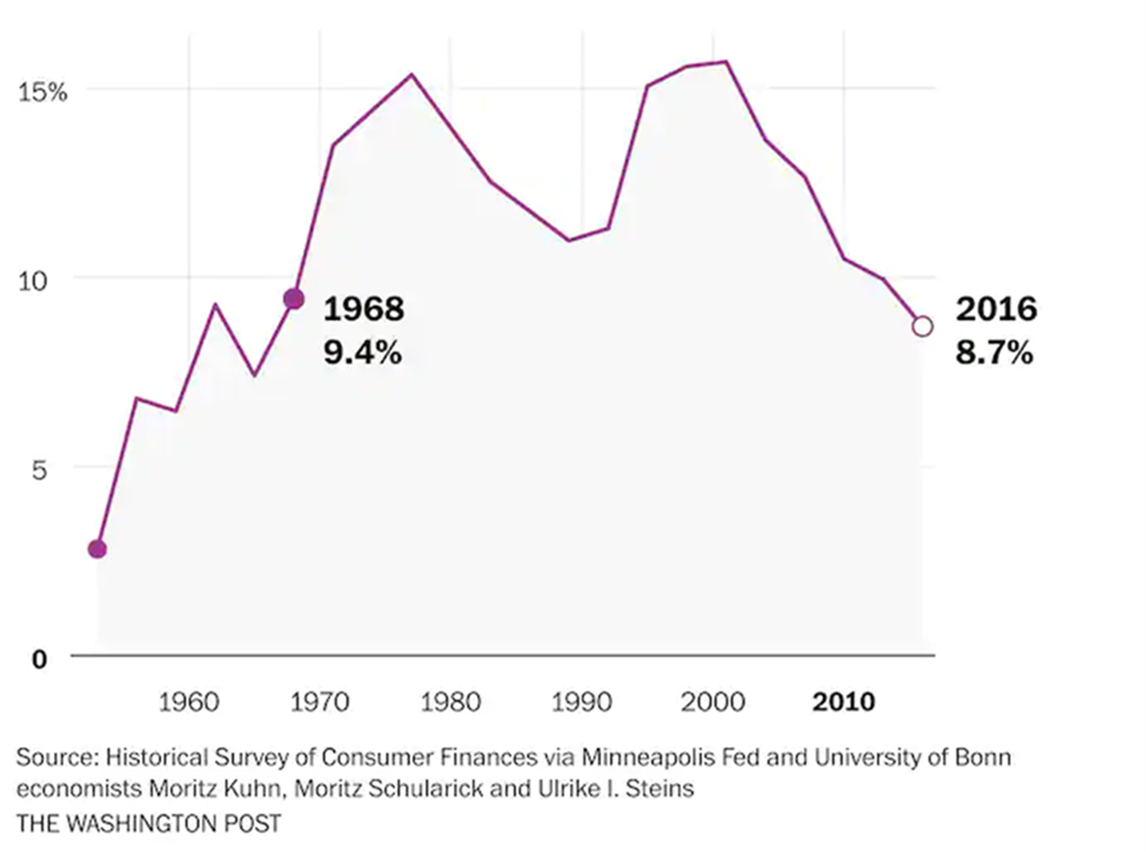
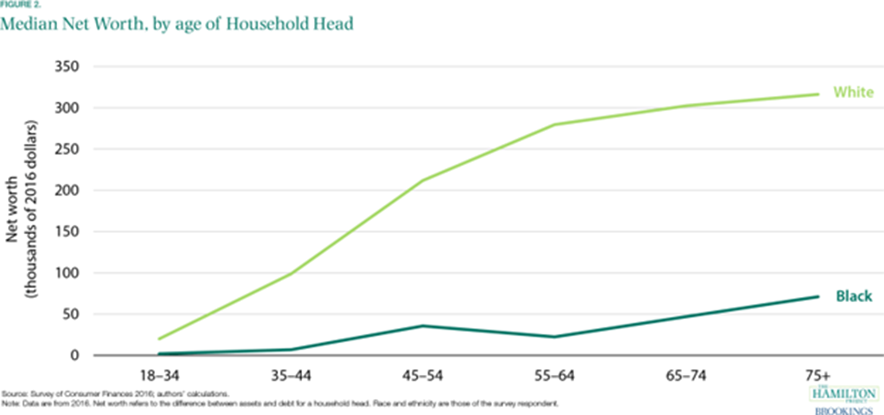
A. Median Black household wealth as a percentage of median White household wealth.
B. Median net worth by age of head of household.

Slide 21
According to the Federal Reserve Bank of Cleveland, new eco-nomic models suggest that the long-term impact of the racial income gap can almost entirely account for the widening racial wealth gap.

Slide 22
What Causes Racial Disparities in Income

Slide 23
Drivers of Income Inequality
Systemic Driver #1: Education
Systemic Driver #2: Employment
Systemic Driver #3: Compensation and Benefits

Slide 24
“Closing the racial income gap by focusing on the three systemic drivers – education, employment, and total compensation – not only benefits the economy, but research indicates that such efforts will also drive bottom-line business outcomes”

Slide 25
Bottom-Line Impact
Research has found that diverse and inclusive workplaces are more likely to achieve better financial returns and generate more cash flow per employee.
Compared to less diverse and inclusive peer companies, companies with more diverse top executives realize greater earnings before interest and taxes (EBIT).

Slide 26
Bottom-Line Impact
McKinsey found that companies in the top quartile for racial/ethnic diversity were 35% more likely to achieve financial returns above their respective national industry medians
Deloitte found that more diverse companies saw 2.3 times more cash flow per employee over three years compared to their less diverse peer companies.

Slide 27
Bottom-Line Impact
McKinsey found that companies in the top quartile for racial/ethnic diversity were 35% more likely to achieve financial returns above their respective national industry medians
Deloitte found that more diverse companies saw 2.3 times more cash flow per employee over three years compared to their less diverse peer companies.

Slide 28
Creating more diverse, inclusive, and equitable workplace cultures will drive current and future profitability and competitiveness measures at the business level.
However, if businesses fail to adopt, or are slow to adopt, antiracist practices in an increasingly diverse consumer and labor market, employers stand to lose trillions collectively, and their competitive advantage individually.

Slide 29
For more information on how the private sector can fulfill kings dream of economic justice and equality, please visit: www.standinsolidarity.com
COPYWRITE ©WHEELER SOCIAL IMPACT LLC
RODEIRCK D.S. WHEELER, MPA,MBA, PRESIDENT
PRESIDENT@WHEELERSOCIALIMPACT.COM
WWW.WHEELERSOCIALIMPACT.COM

