Slide 1
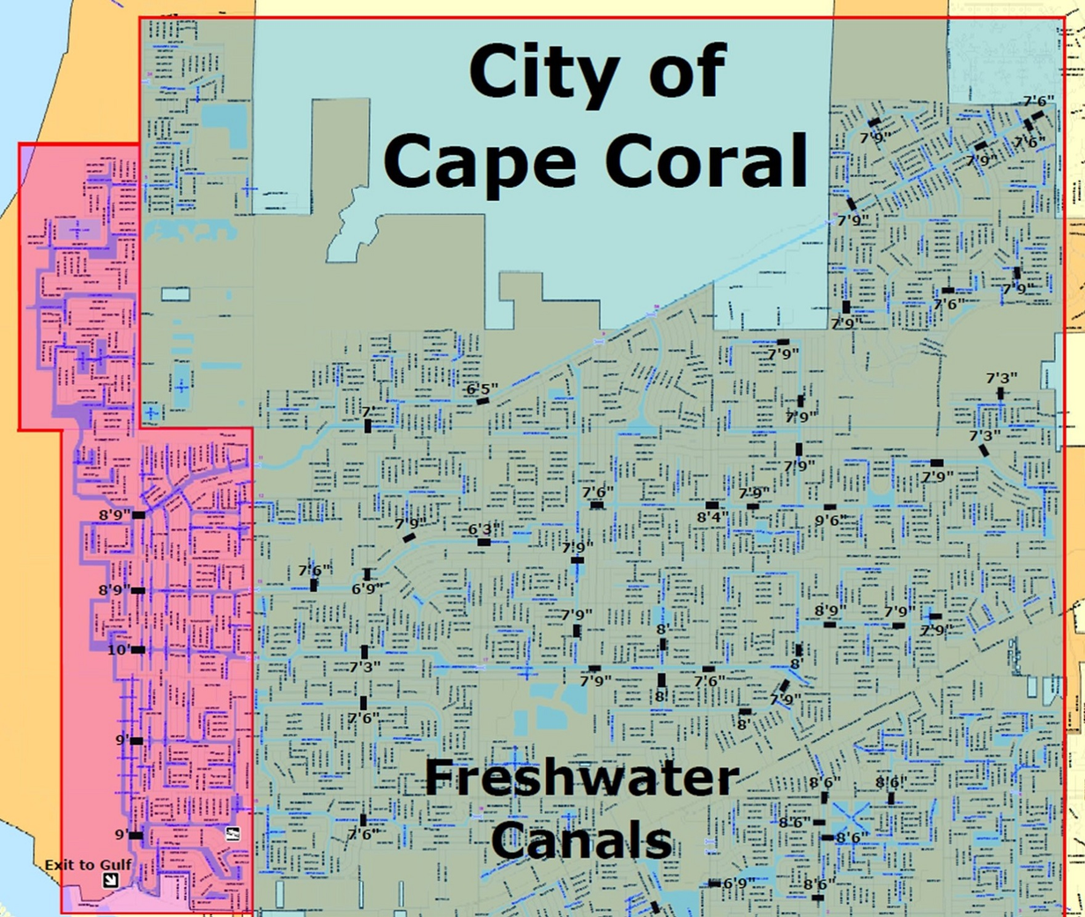
Fresh Water

Slide 2

BERGAMO
CEO: ZAKI LEV
(786) 320-5590
2020 NE 163RD STREET.SUITE 103
NORTH MIAMI BEACH
FLORIDA 33162

Slide 3
Fresh Water
BASED ON:
VERA MODEL
“BERGAMO” IS LOCATED AT:
817 NE 5TH AVE. CAPE CORAL, FLORIDA. 33909.

Slide 4
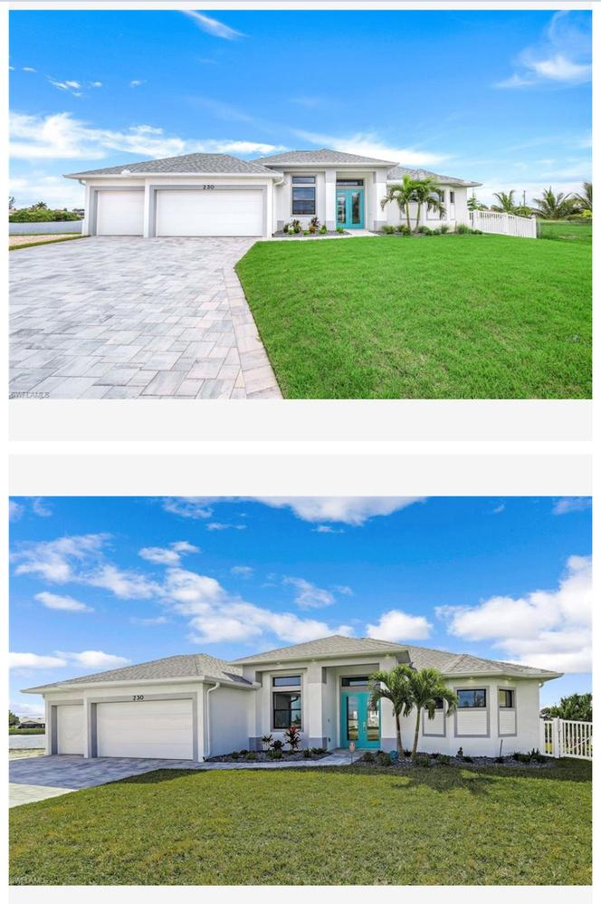
REAL STATE
COMPS OF THE AREA
SOLD
$700,000
LISTED FOR: $745,000
SINGLE FAMILY RESIDENCE
230 NE 18TH STREET
CAPE CORAL, FL 33909
3BD
2BA
2,131 SQFT

Slide 5
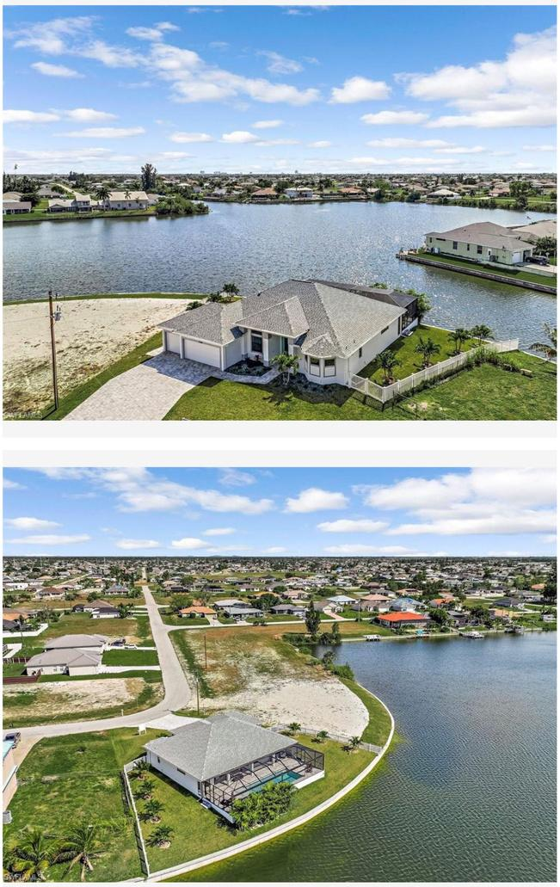
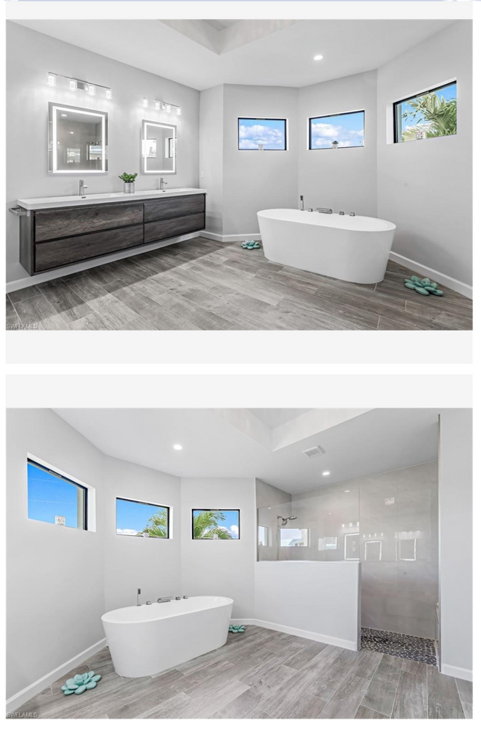
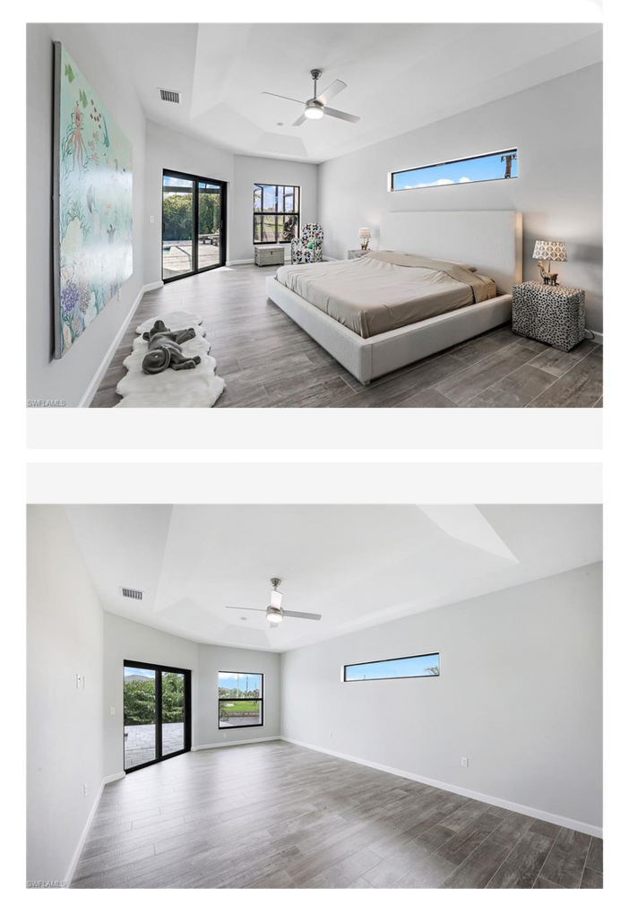

Slide 6
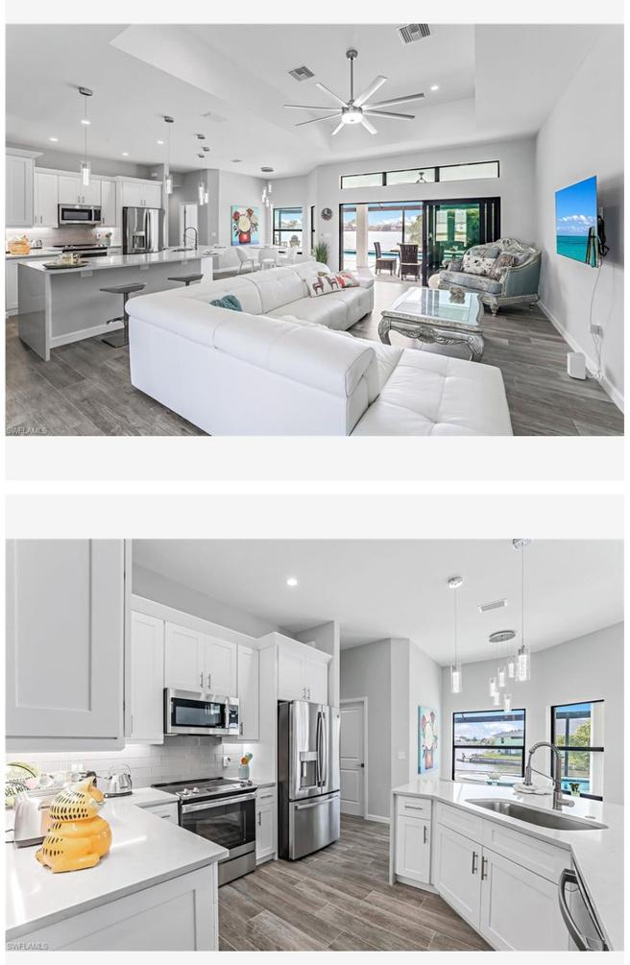
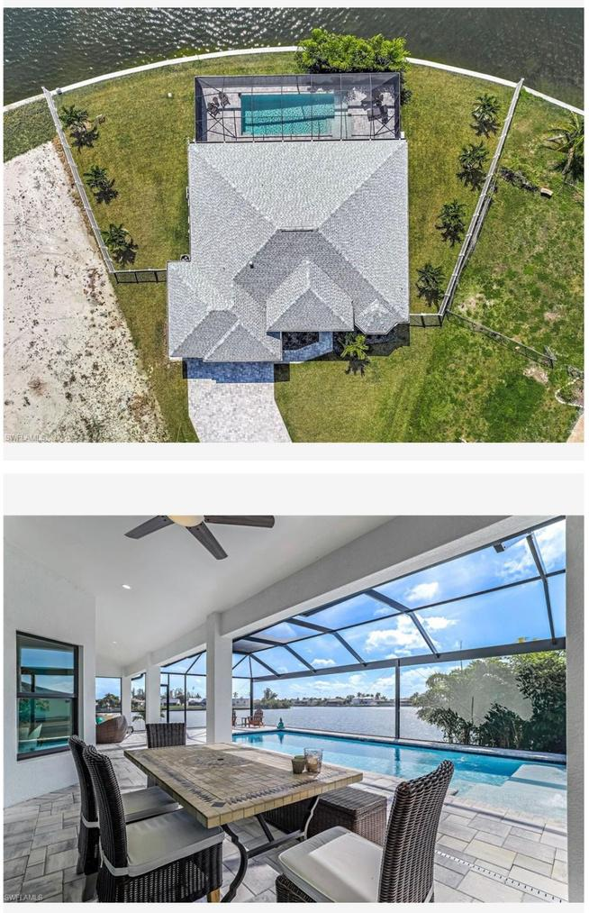

Slide 7
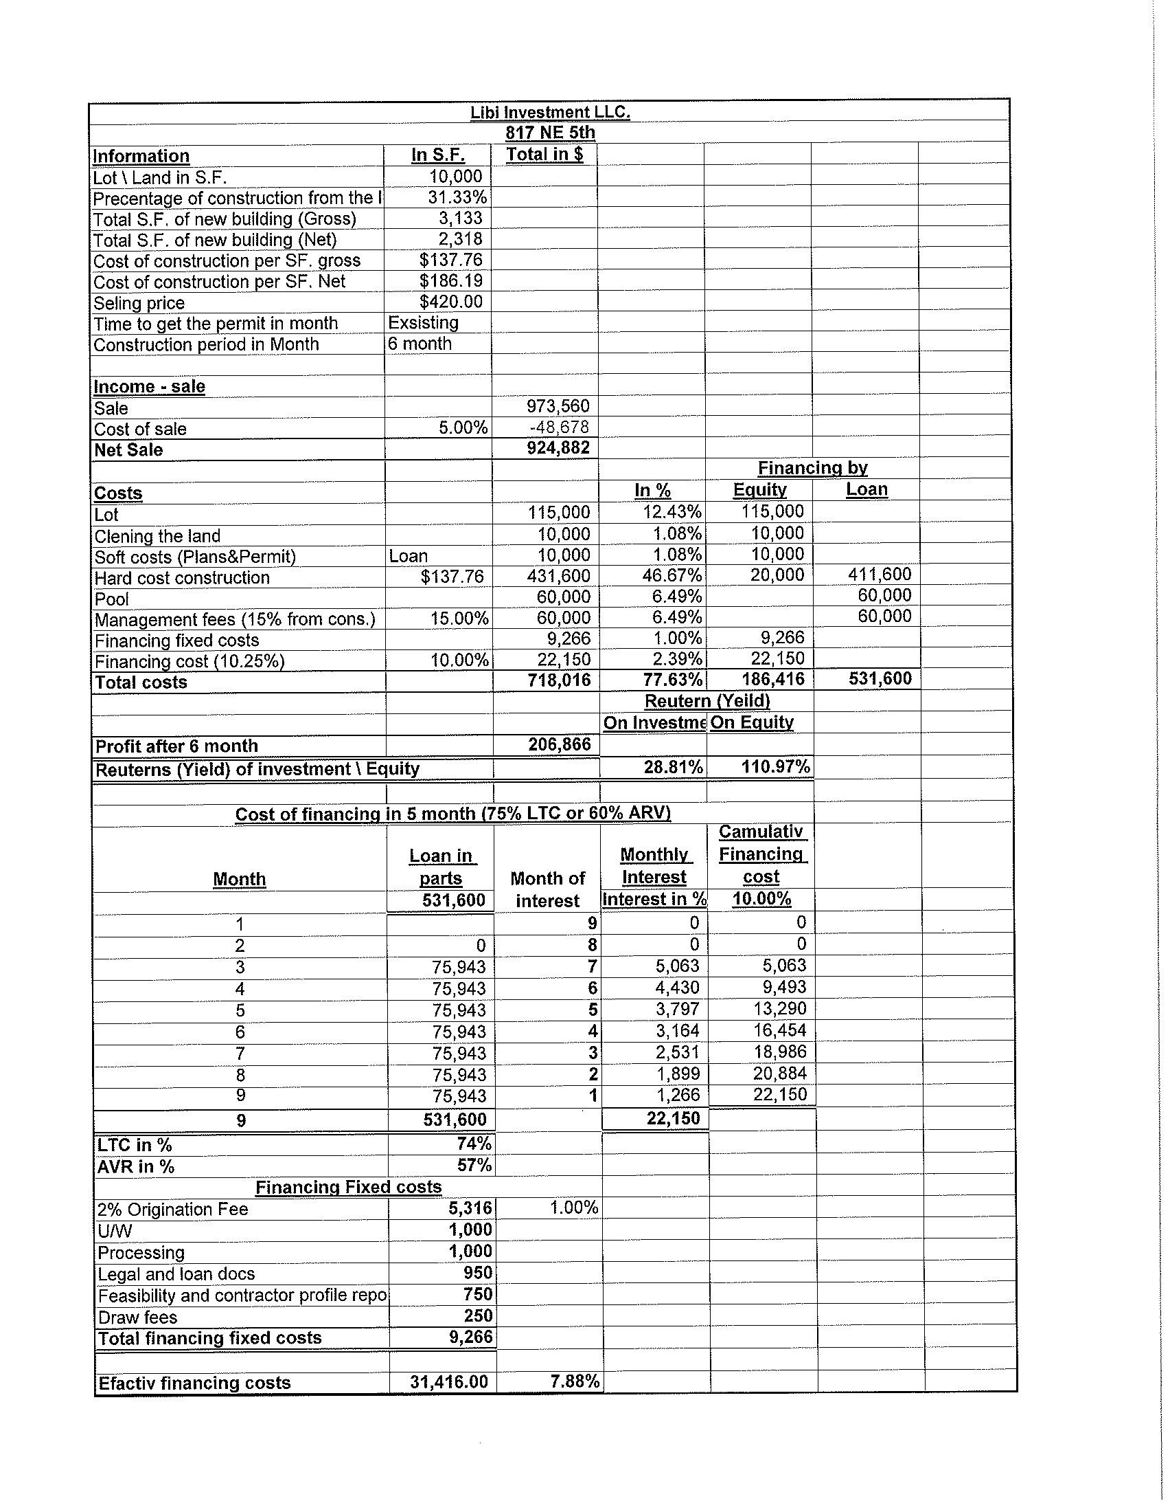

Slide 9
List of Expenses
Item | Category | Amount
Lot | Lot | $115,000.00
Toilet | Materials | $2,000.00
Trash | Materials | $5,000.00
Dirt | Materials | $15,000.00
Pest Control | Labor | $4,000.00
Grading | Labor | $12,000.00
Trusses | Materials | $14,000.00
Windows and Doors Exterior | Materials | $20,000.00
Plumbing | Labor | $20,000.00
Electric | Labor | $20,000.00
Paint | Labor | $7,000.00
Roof (Shingles) | Labor | $14,000.00
Drywall | Labor | $12,000.00
Doors and Trim (Interior) | Materials | $15,000.00
Cabinets | Materials | $12,000.00
Countertops | Materials | $5,600.00
Tile | Materials | $12,000.00
Interior Lights | Materials | $4,000.00
Pavers | Materials | $9,000.00
Plumbing (Interior) | Materials | $3,000.00
Shell | Materials | $150,000.00
Septic | Labor | $14,000.00
Well | Labor | $12,000.00
Framing | Labor | $10,000.00
Stucco | Labor | $10,000.00
Insulation and Gutters | Labor | $7,000.00
AC | Materials | $15,000.00
Appliances | Materials | $8,000.00
Pool | Materials | $45,000.00
Cage | Materials | $15,000.00
Construction Fee |  | $60,000.00
Grand Total: |  | $666,600.00

Slide 10

MILANO
CEO: ZAKI LEV
(786) 320-5590
2020 NE 163RD STREET.SUITE 103
NORTH MIAMI BEACH
FLORIDA 33162

Slide 11
Fresh Water
BASED ON:
VERA MODEL
“MILANO” IS LOCATED AT:
15 NW 19TH TERRACE CAPE CORAL, FLORIDA. 33993

Slide 12

REAL STATE
COMPS OF THE AREA
ONE HOME Portal

Slide 13
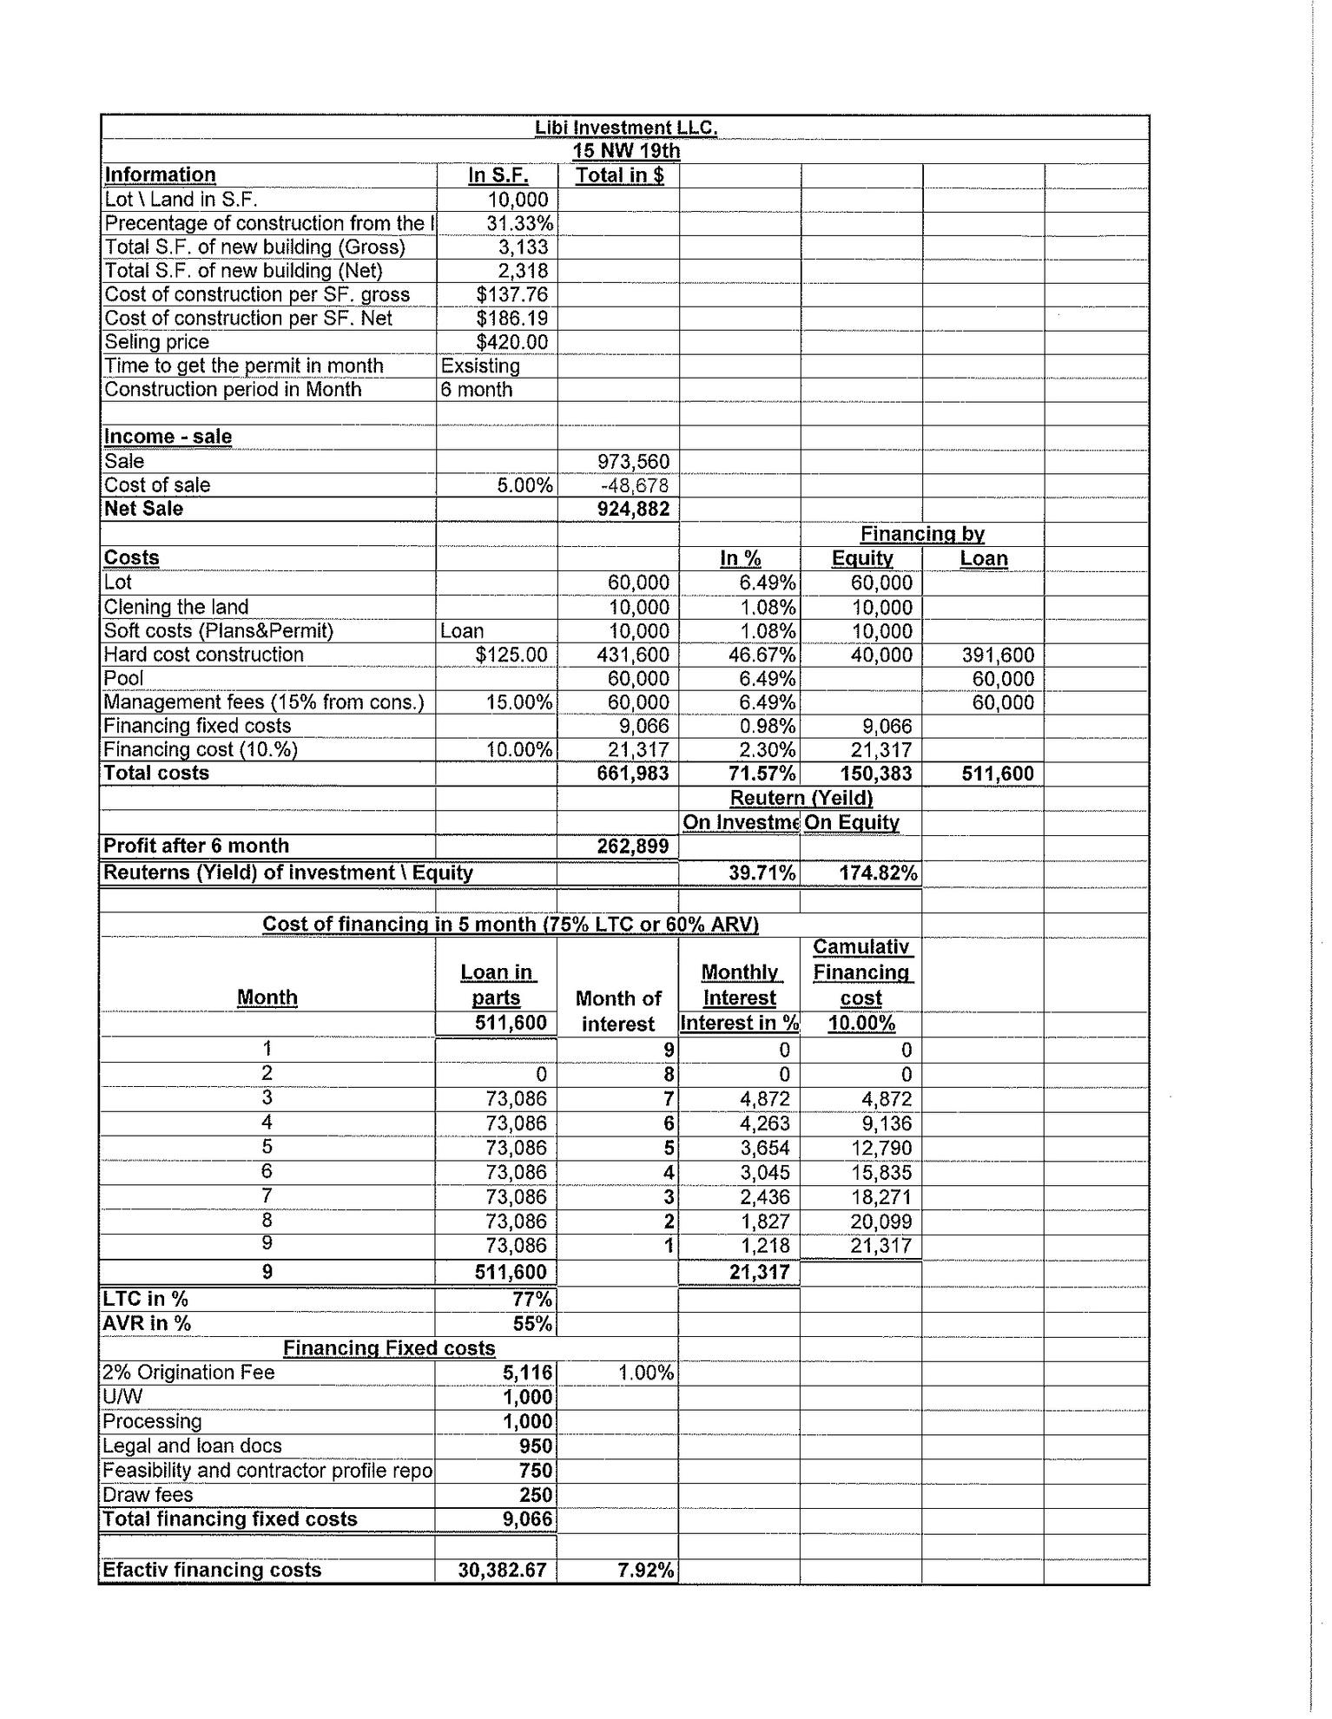

Slide 15
List of Expenses
Item | Category | Amount
Lot | Lot | $60,000.00
Toilet | Materials | $2,000.00
Trash | Materials | $5,000.00
Dirt | Materials | $15,000.00
Pest Control | Labor | $4,000.00
Grading | Labor | $12,000.00
Trusses | Materials | $14,000.00
Windows and Doors Exterior | Materials | $20,000.00
Plumbing | Labor | $20,000.00
Electric | Labor | $20,000.00
Paint | Labor | $7,000.00
Roof (Shingles) | Labor | $14,000.00
Drywall | Labor | $12,000.00
Doors and Trim (Interior) | Materials | $15,000.00
Cabinets | Materials | $12,000.00
Countertops | Materials | $5,600.00
AC | Materials | $15,000.00
Appliances | Materials | $8,000.00
List of Expenses
Item | Category | Amount
Lot | Lot | $60,000.00
Toilet | Materials | $2,000.00
Trash | Materials | $5,000.00
Dirt | Materials | $15,000.00
Pest Control | Labor | $4,000.00
Grading | Labor | $12,000.00
Pool | Materials | $45,000.00
Cage | Materials | $15,000.00
Construction Fee |  | $60,000.00
Grand Total: |  | $611,600.00

Slide 16
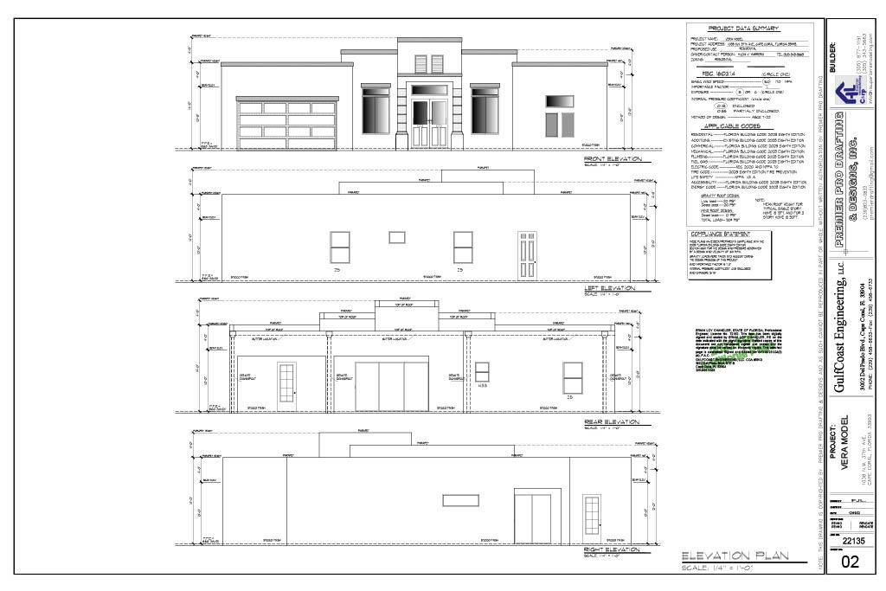

Slide 17
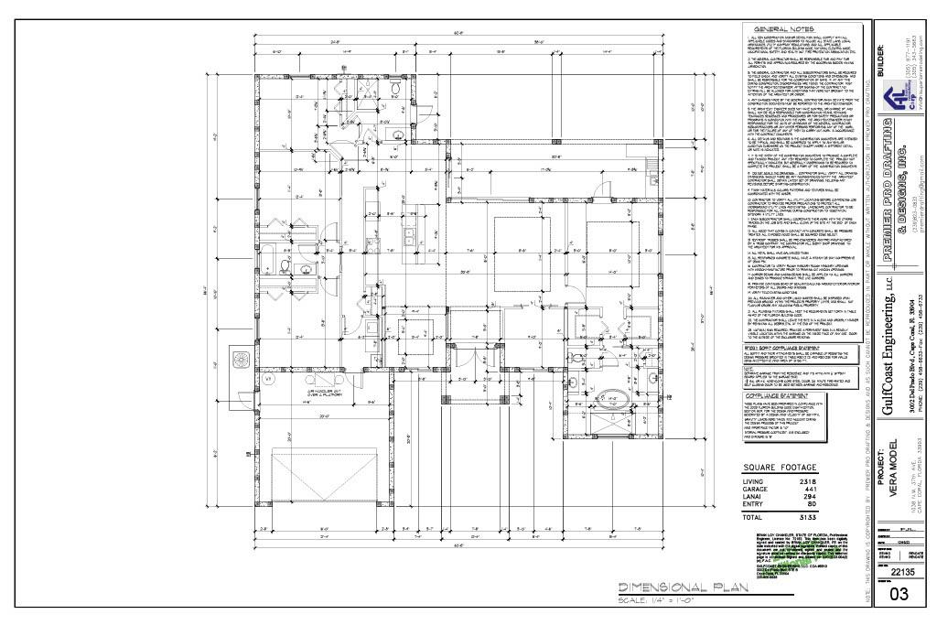

Slide 18
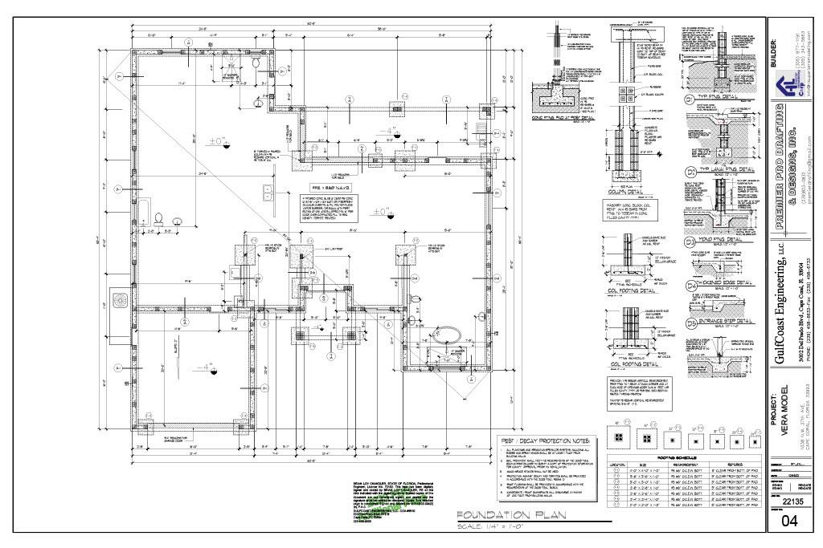

Slide 19
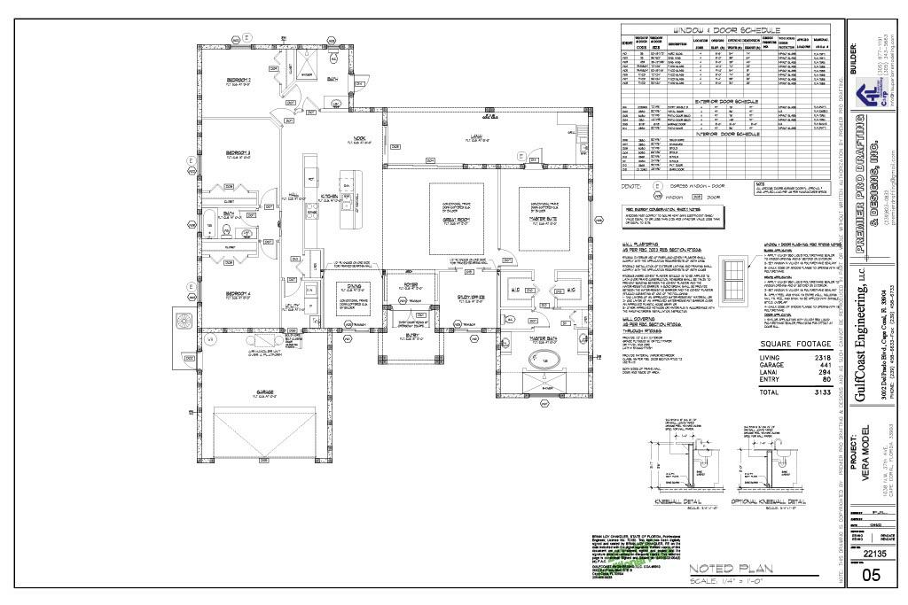

Slide 20
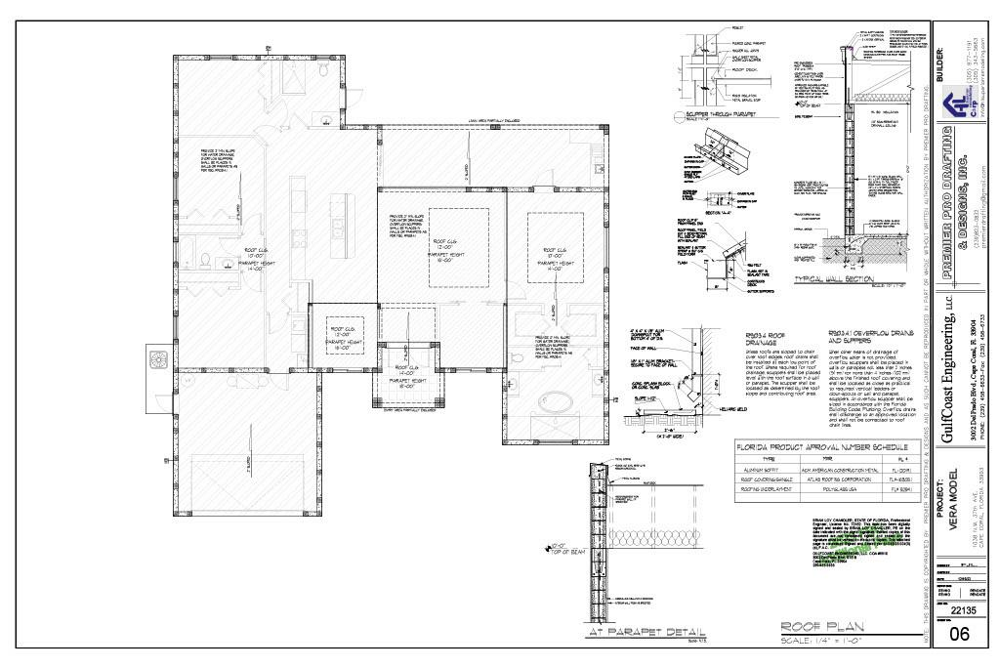

Slide 21
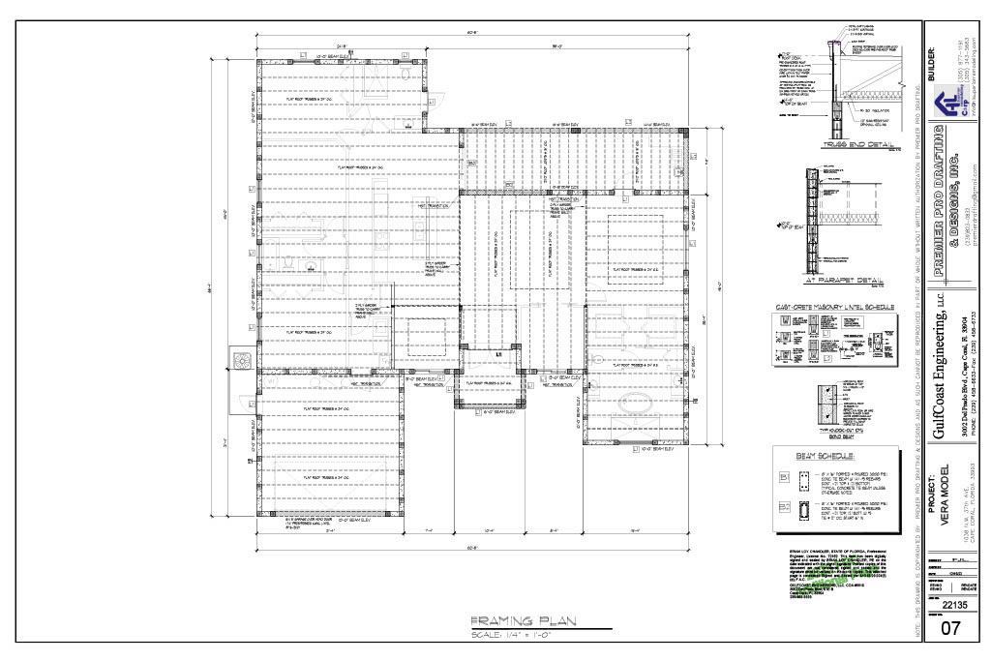

Slide 22
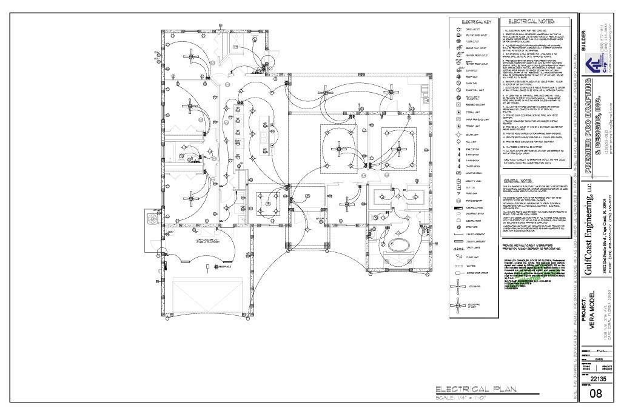

Slide 23
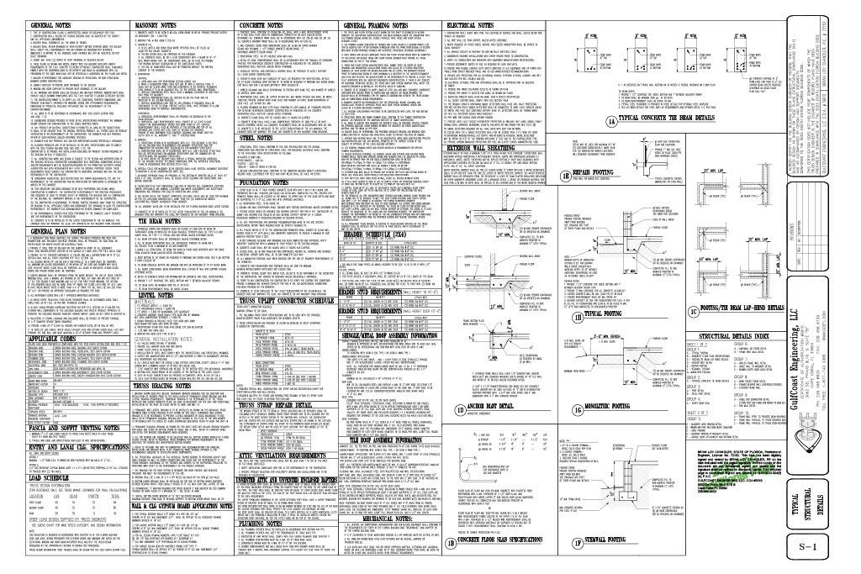

Slide 24
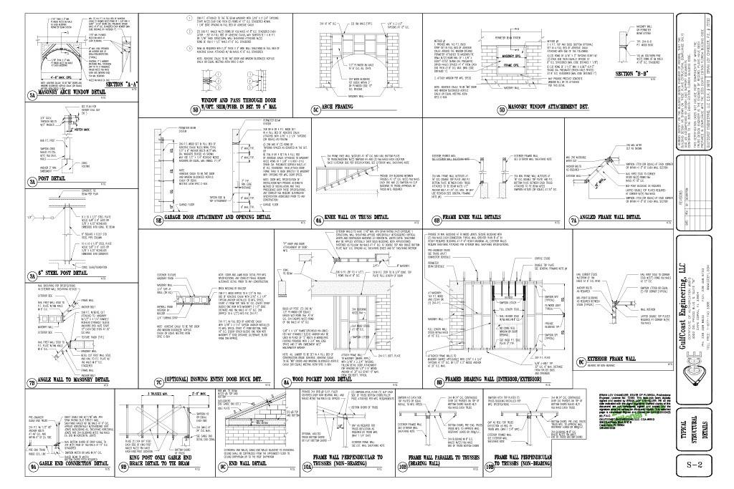

Slide 25

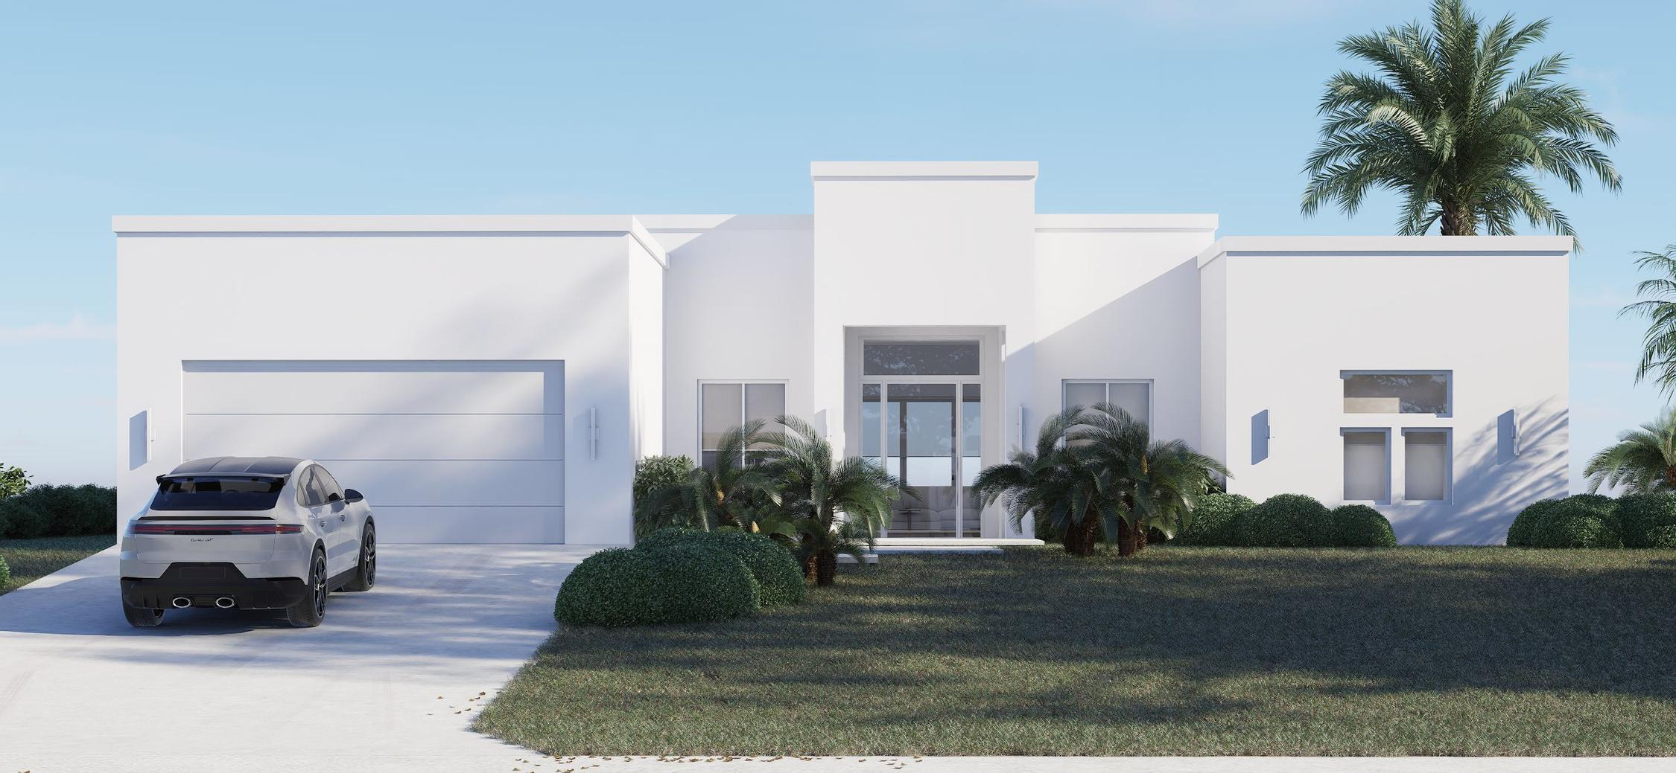

Slide 26

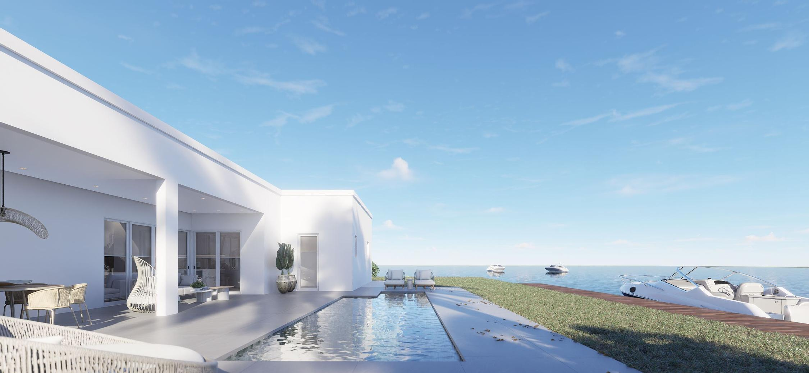

Slide 27
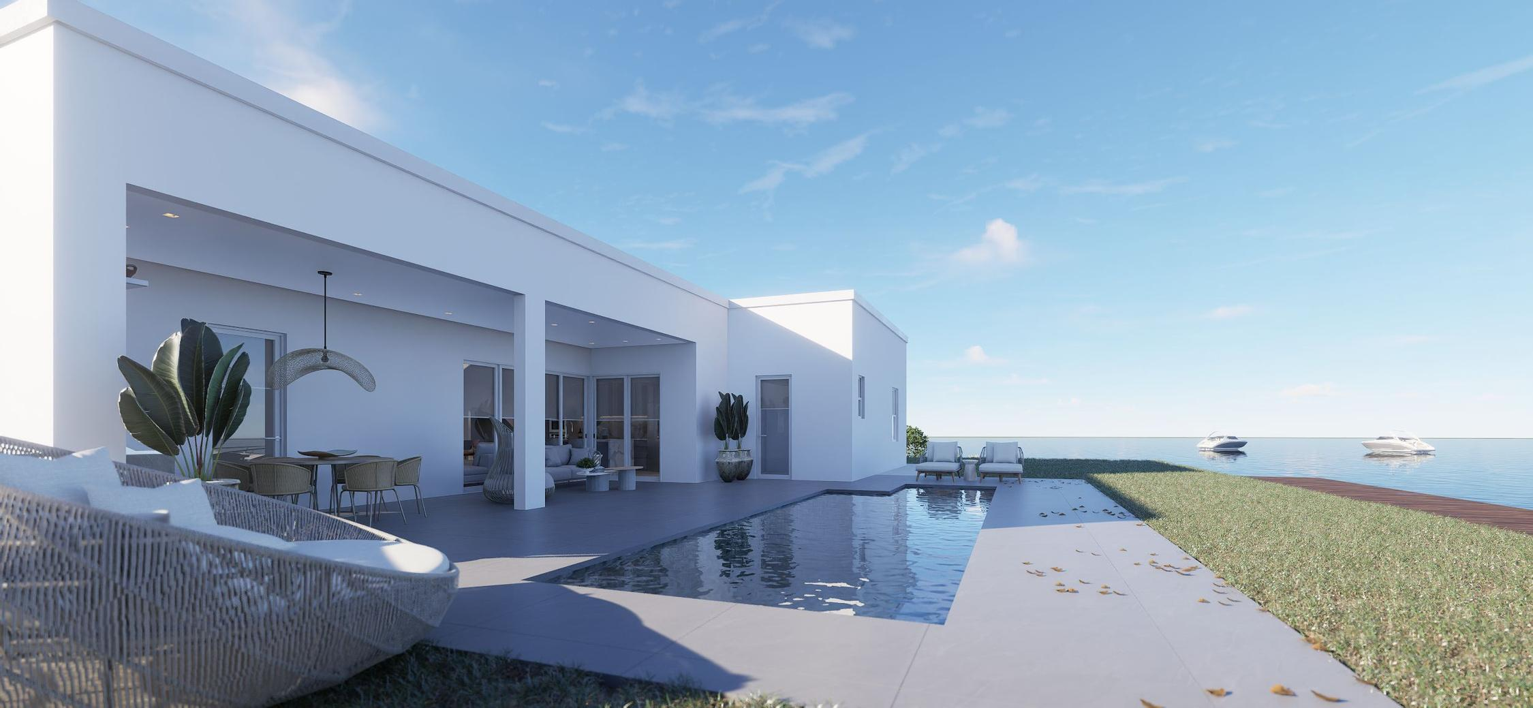

Slide 28
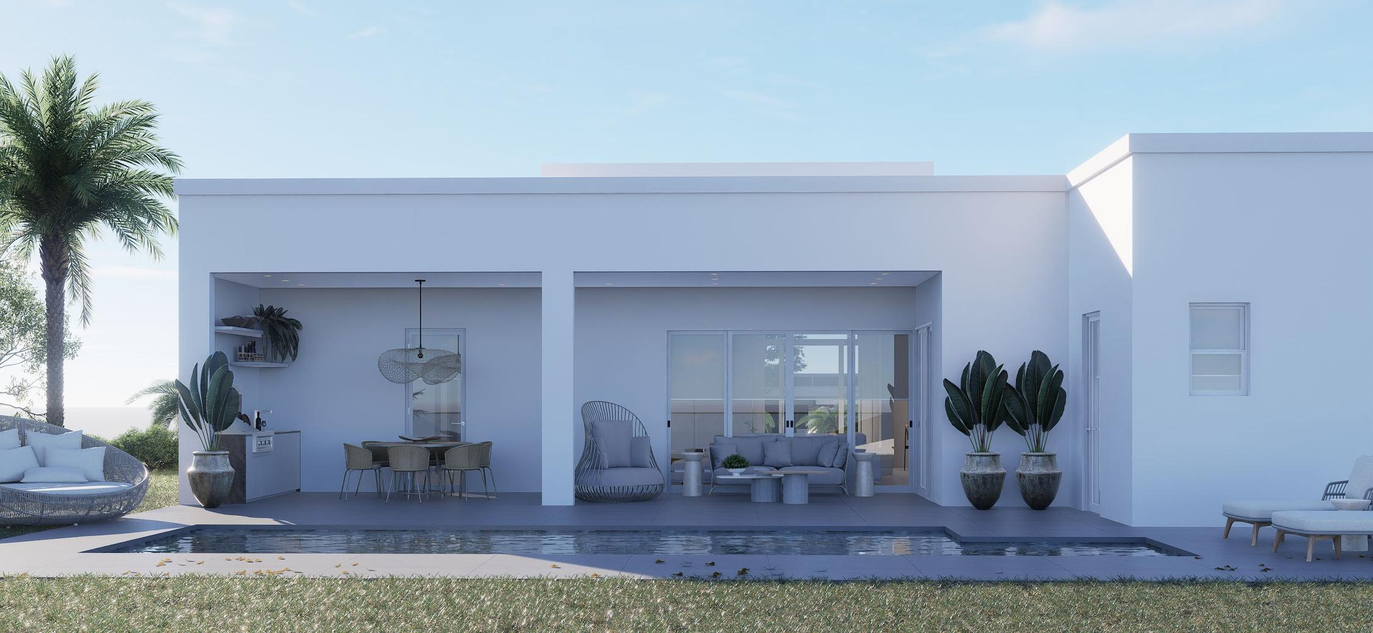

Slide 29
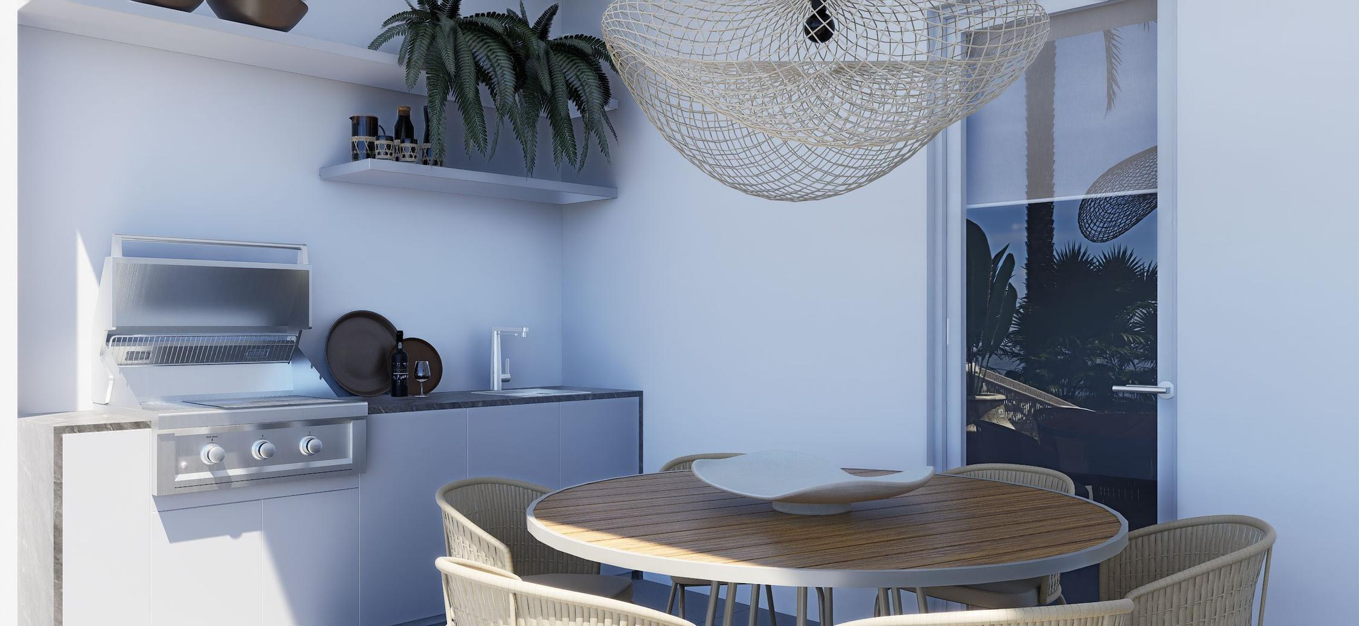

Slide 30
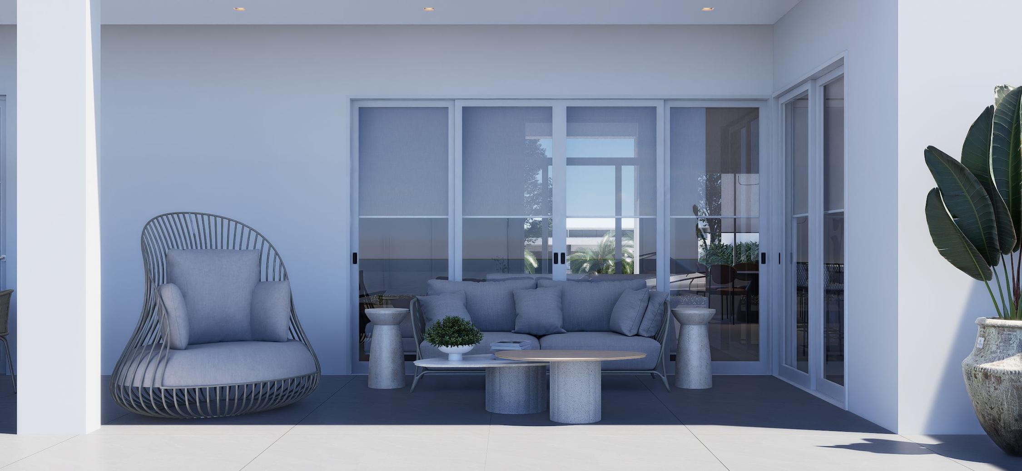

Slide 31
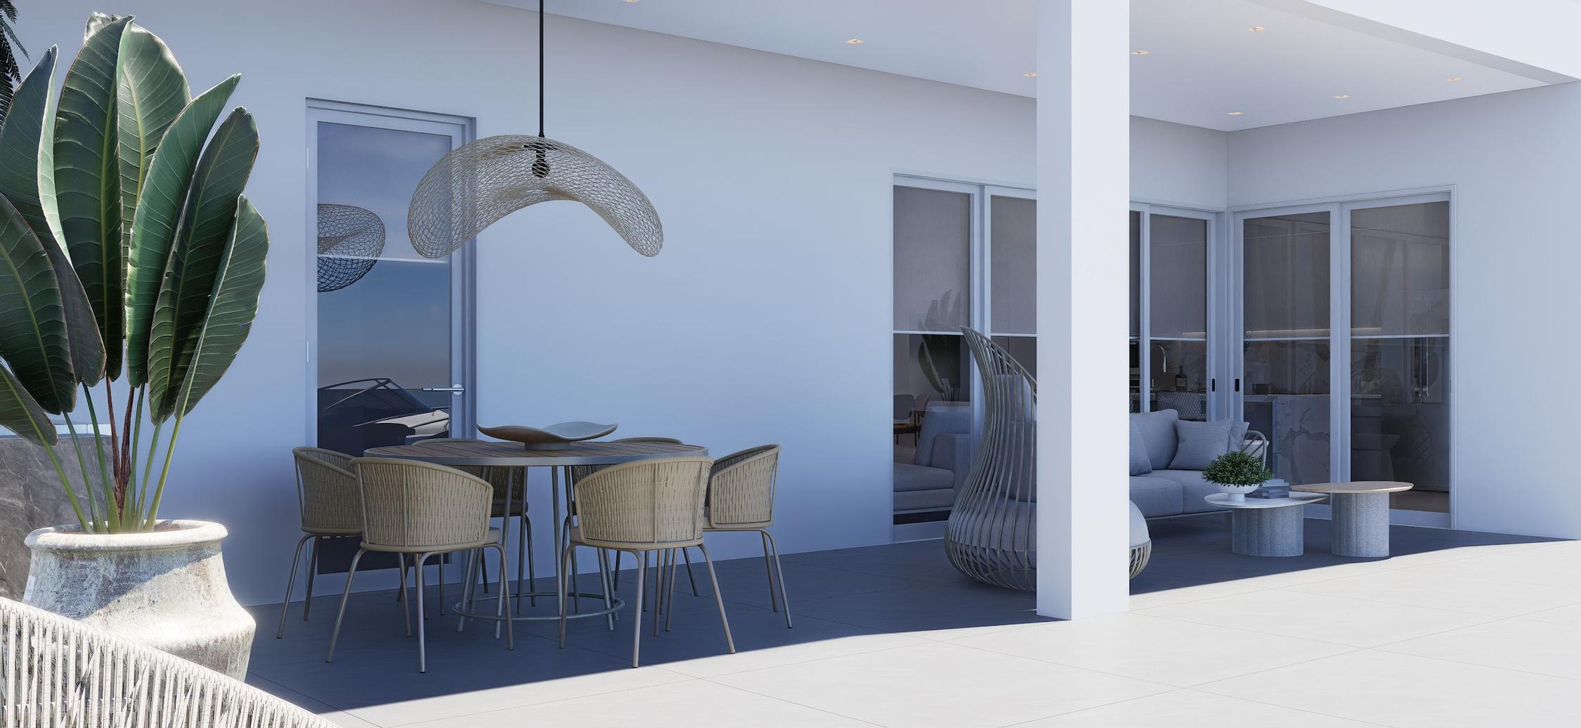

Slide 32
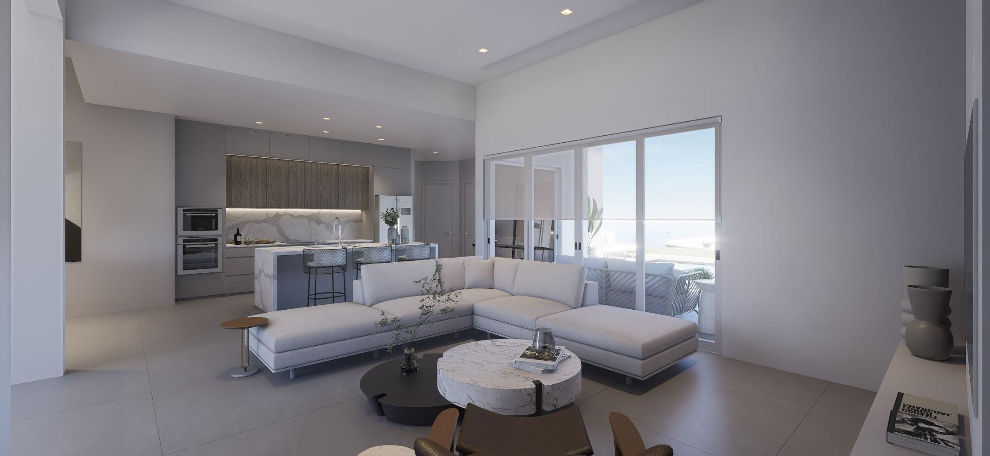

Slide 33
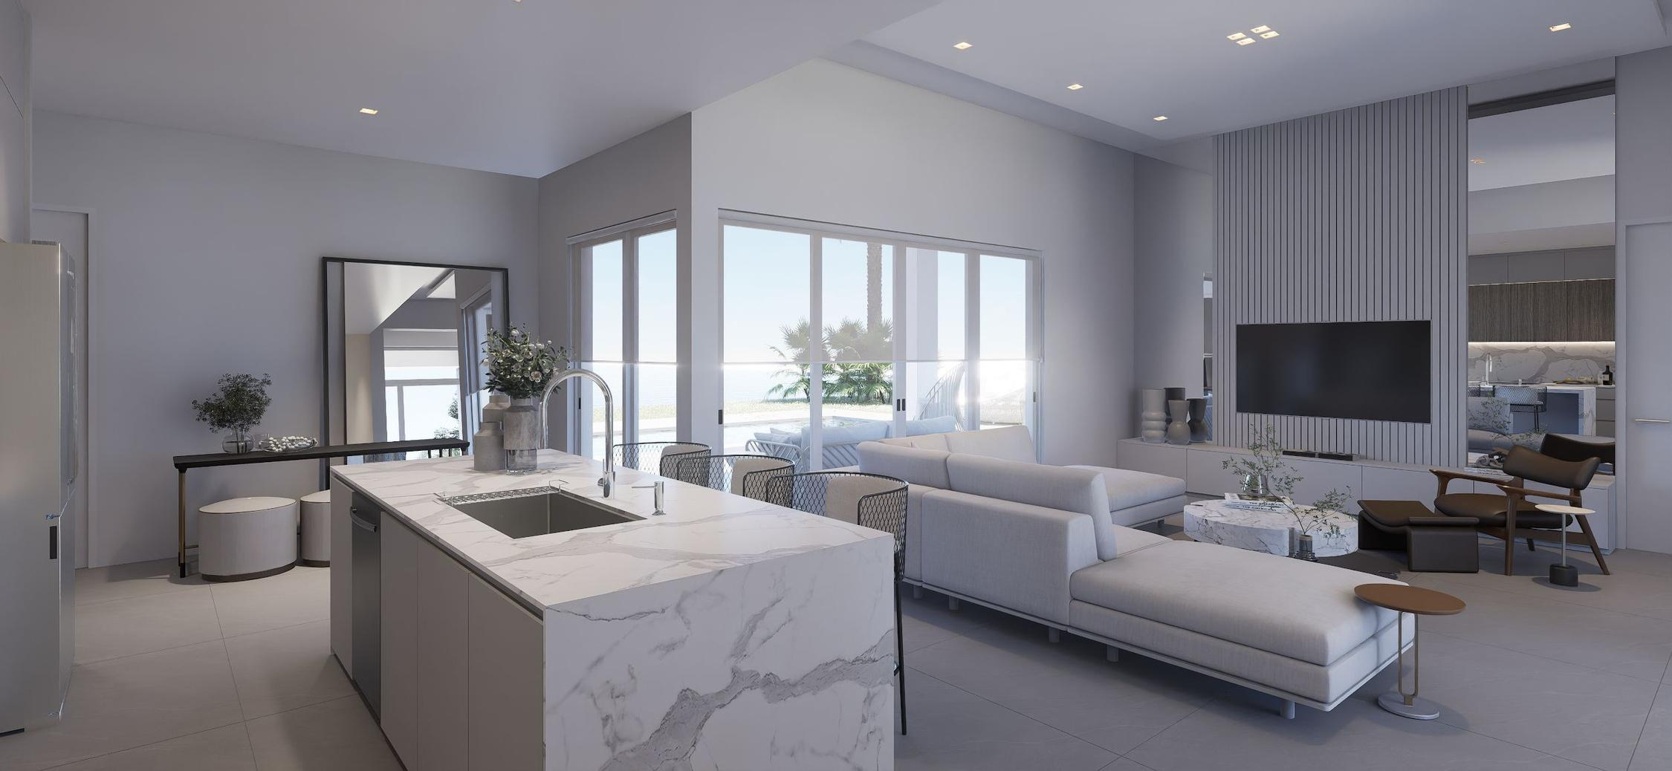

Slide 34
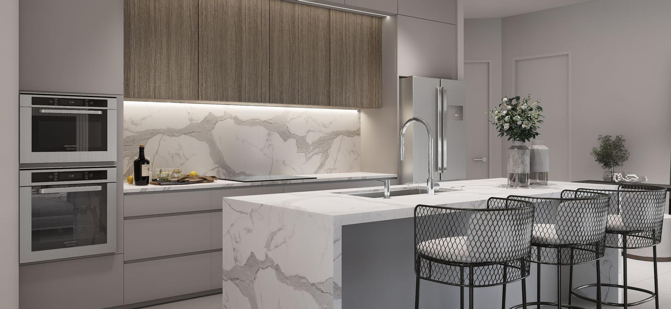

Slide 35
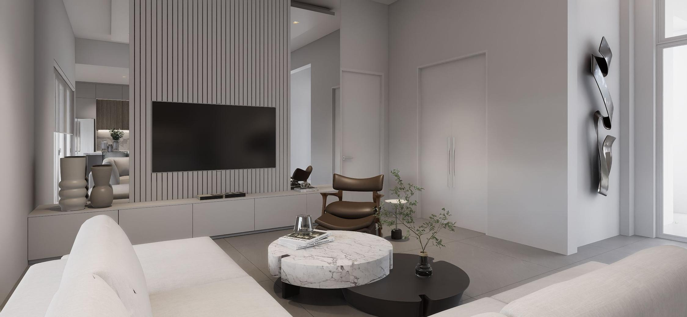

Slide 36

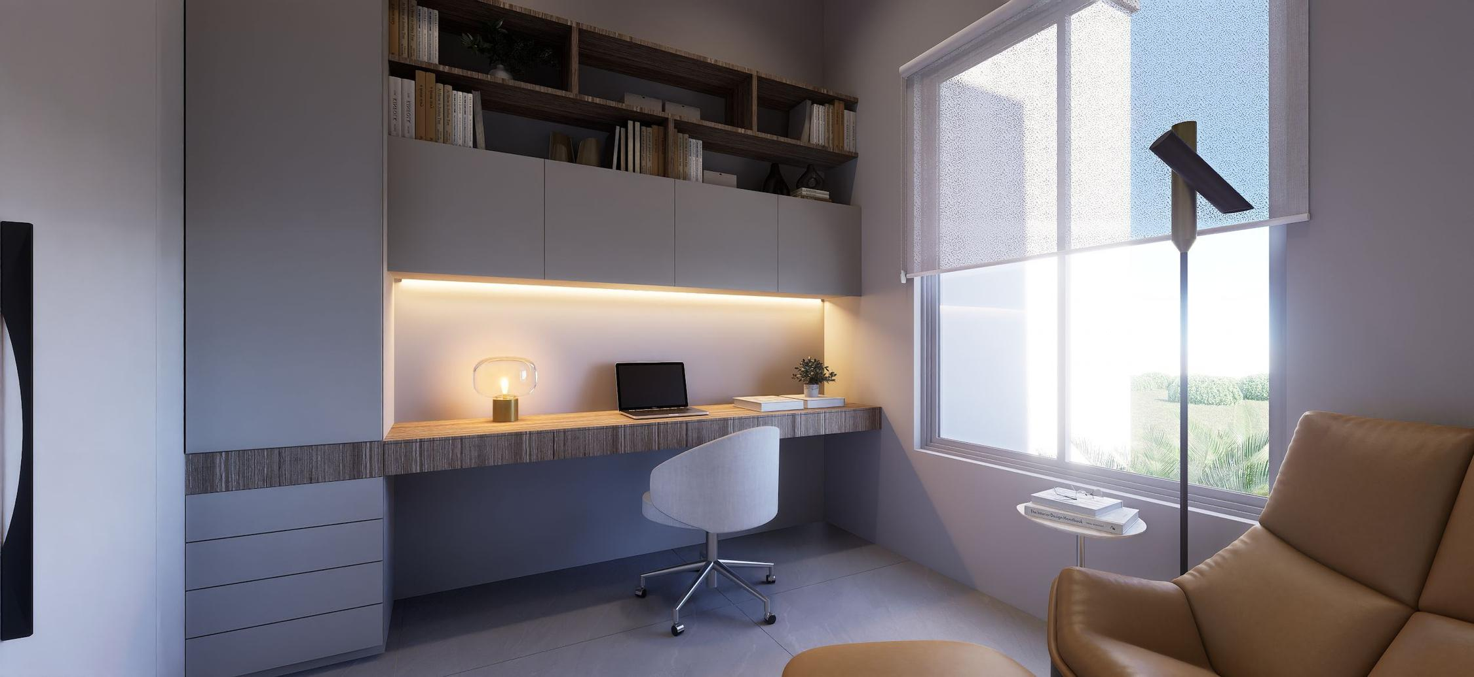

Slide 37
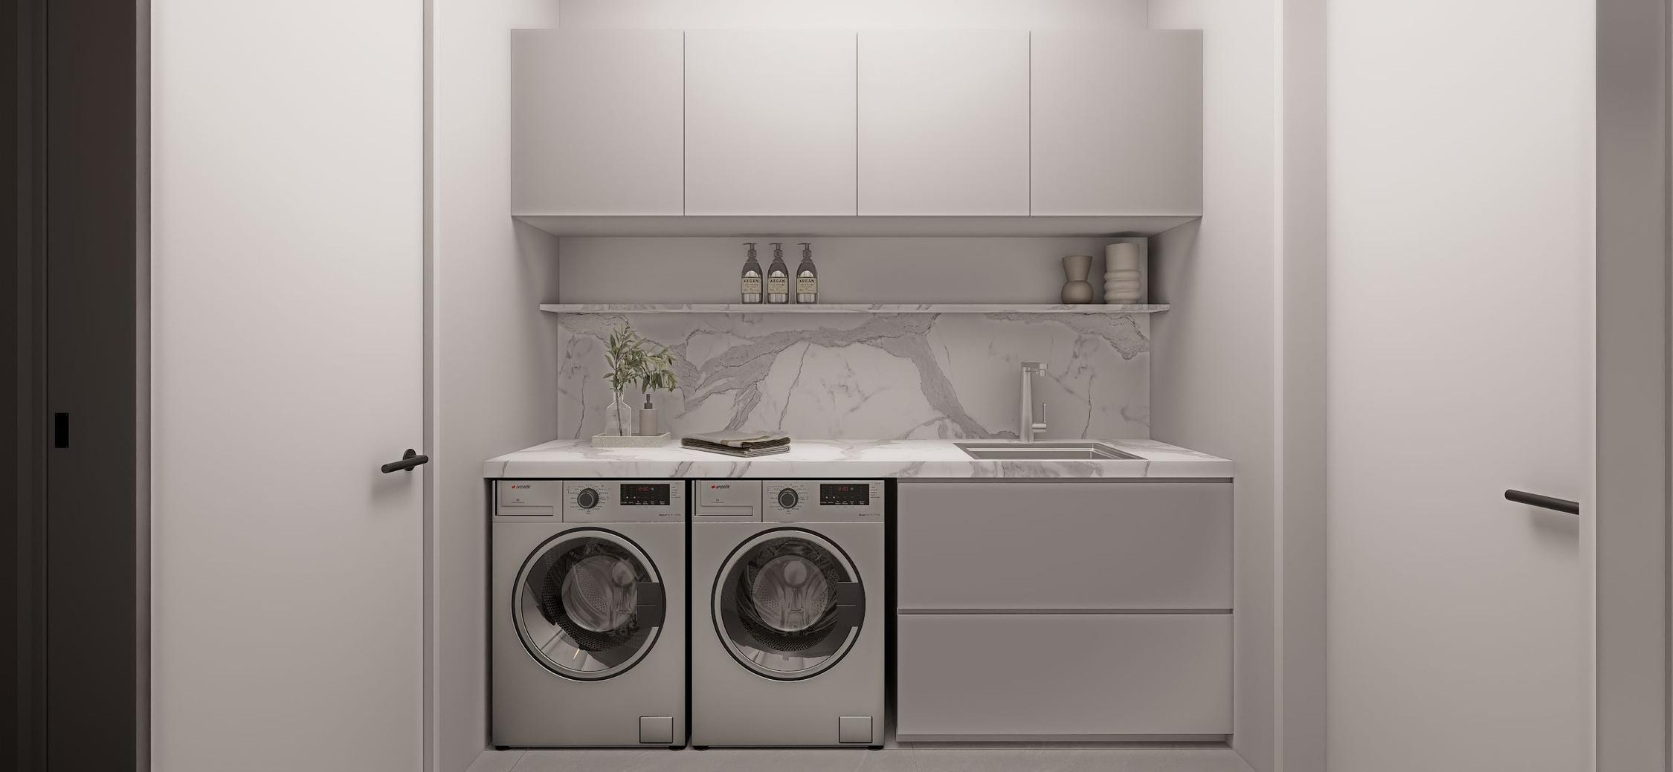

Slide 38
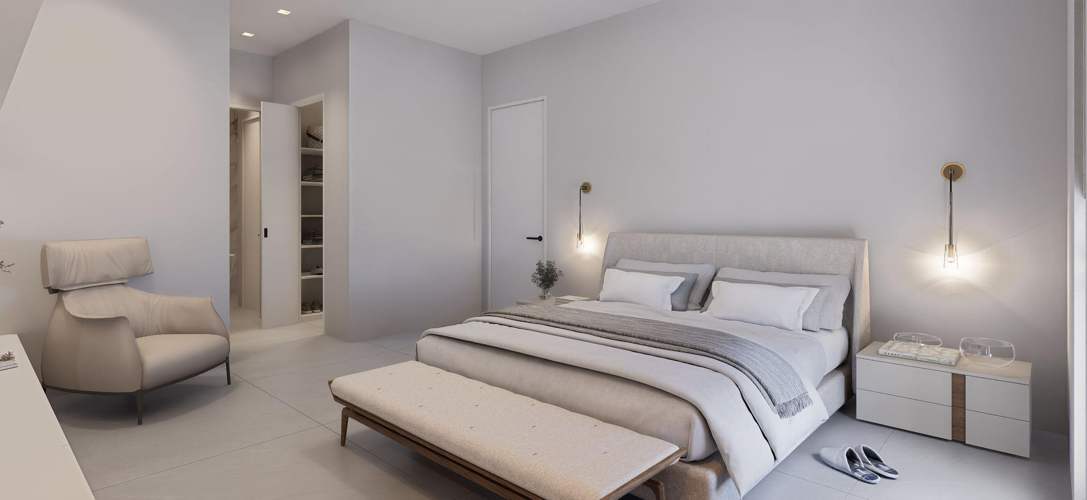

Slide 39
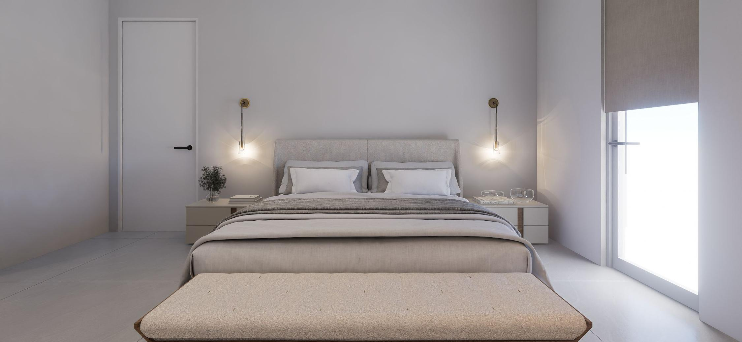

Slide 40
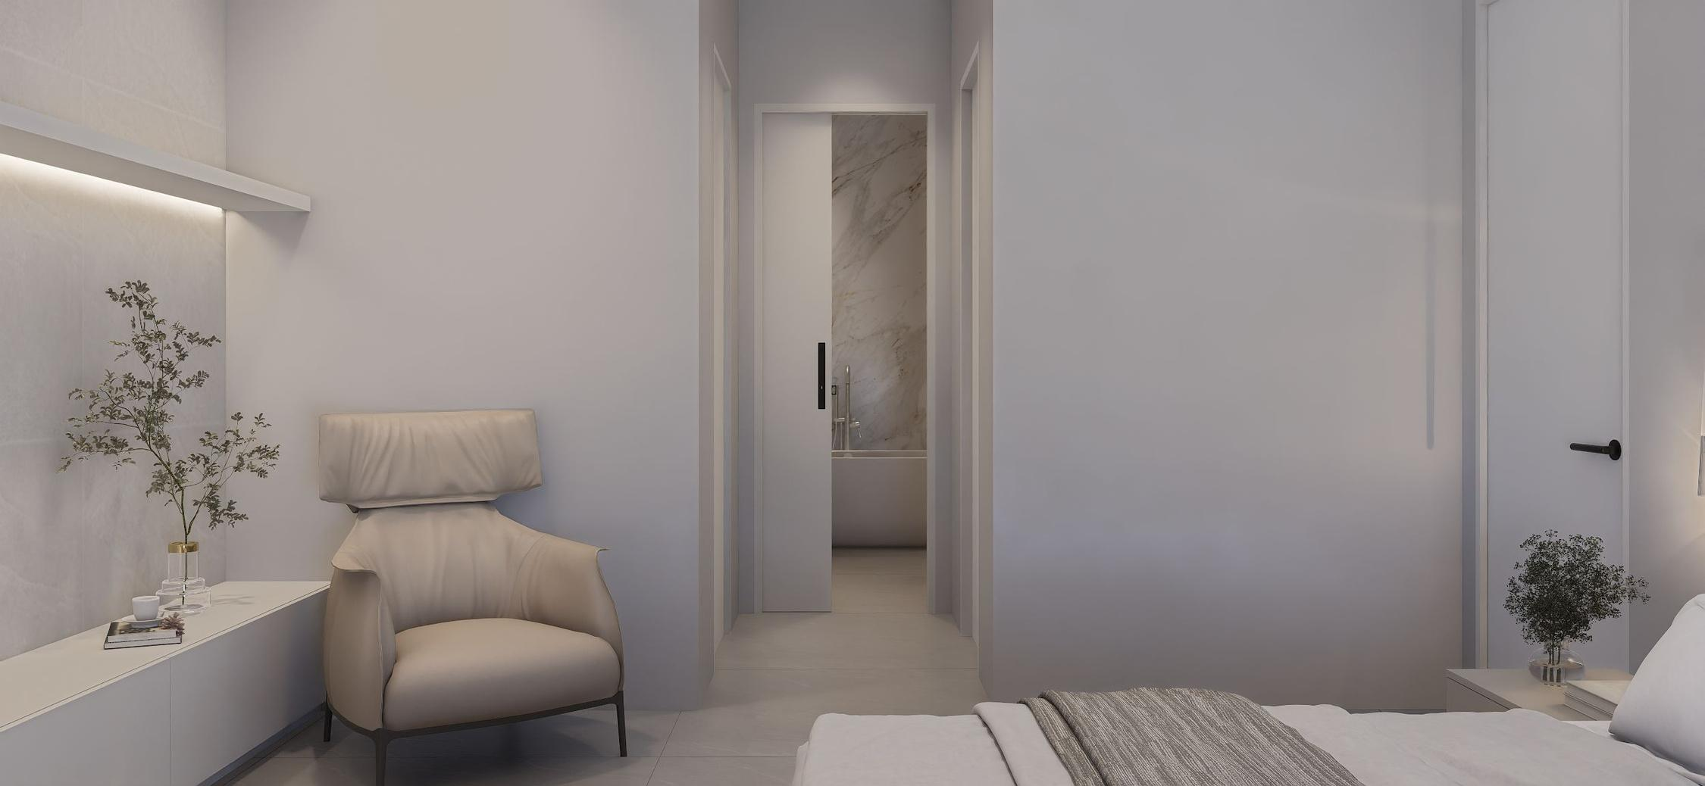

Slide 41
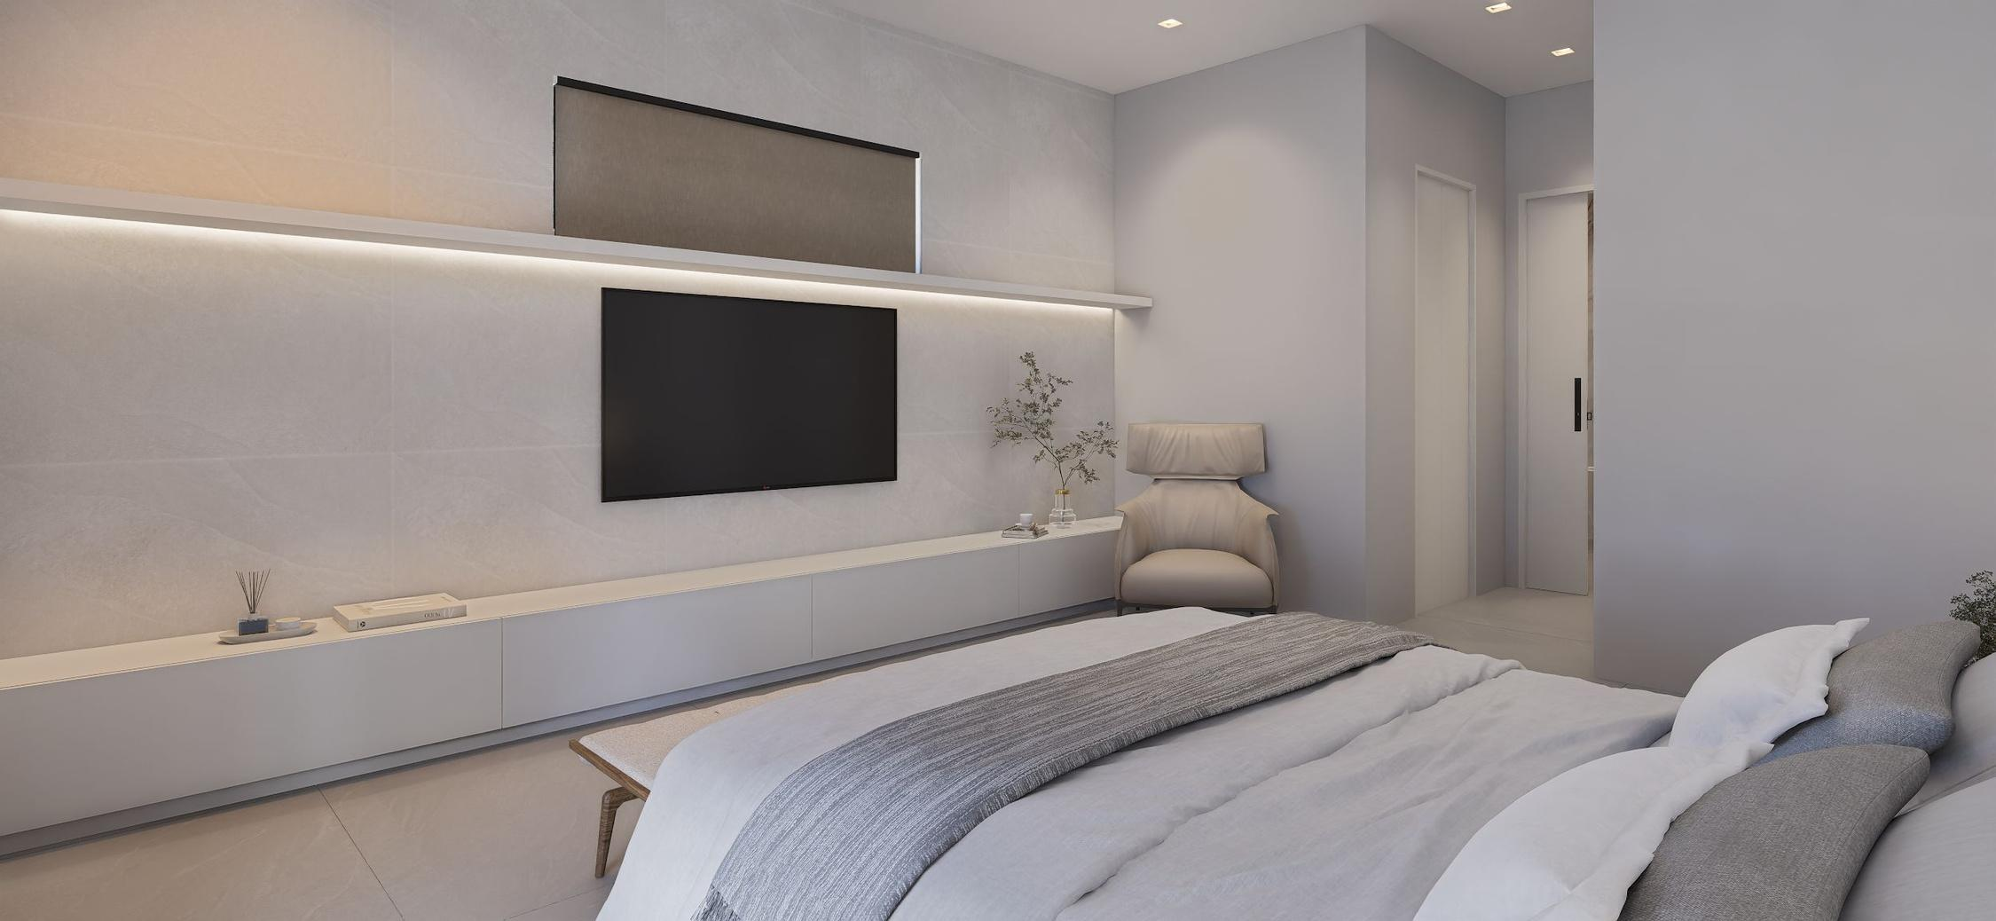

Slide 42
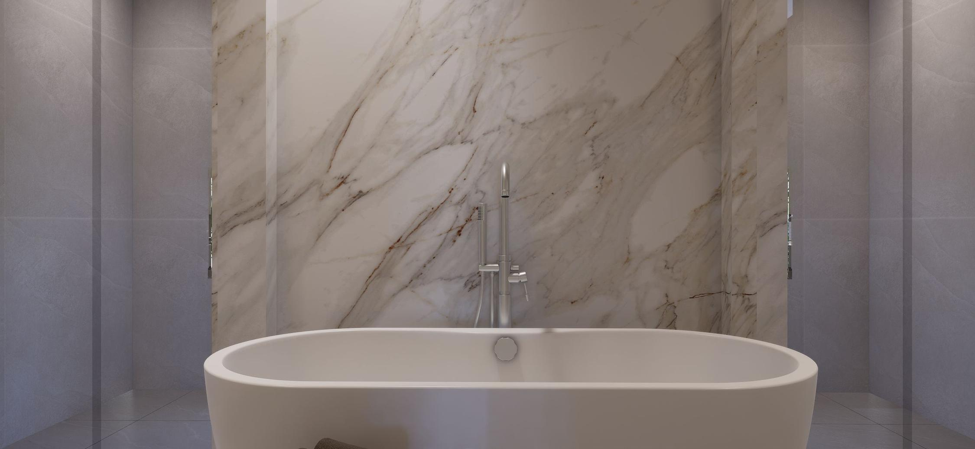

Slide 43
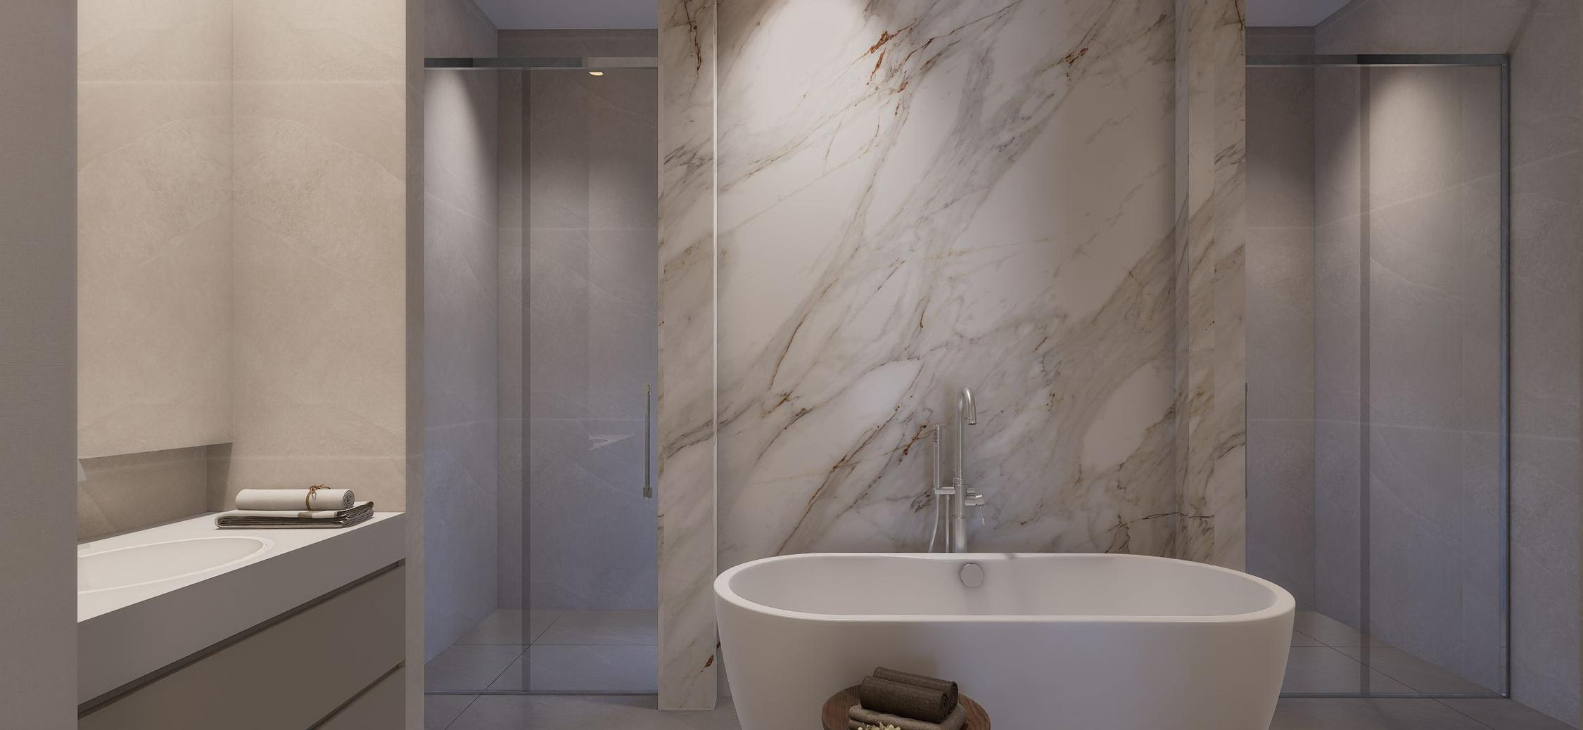

Slide 44
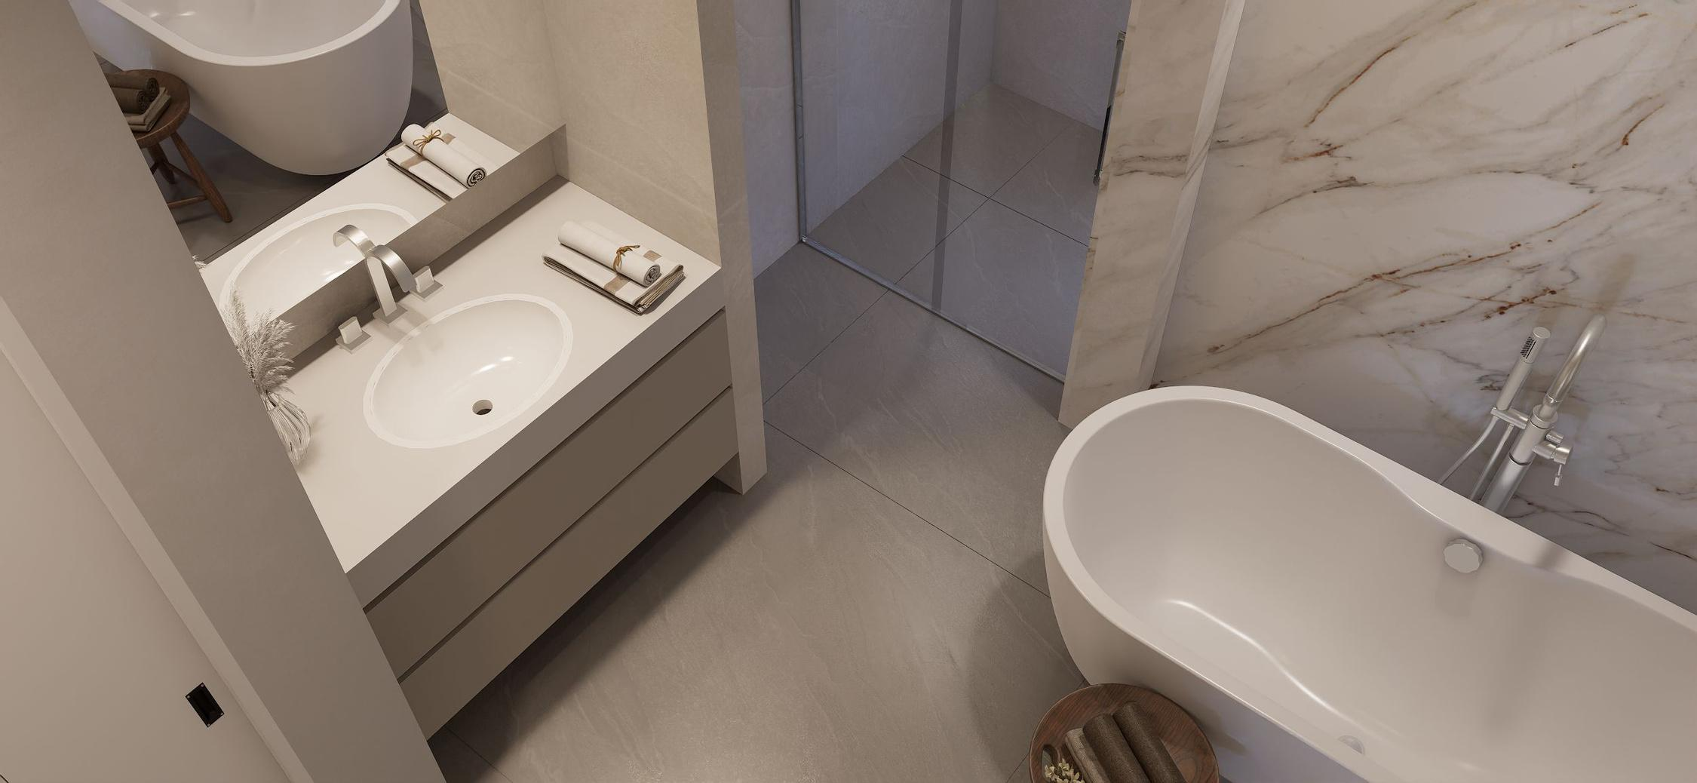

Slide 45
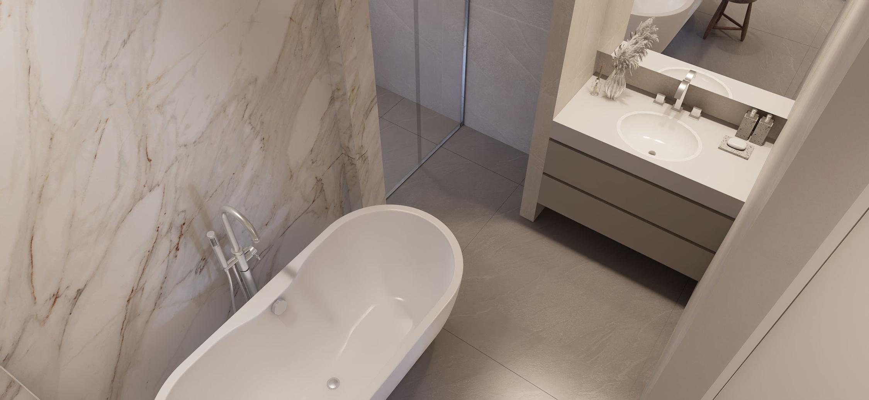

Slide 46
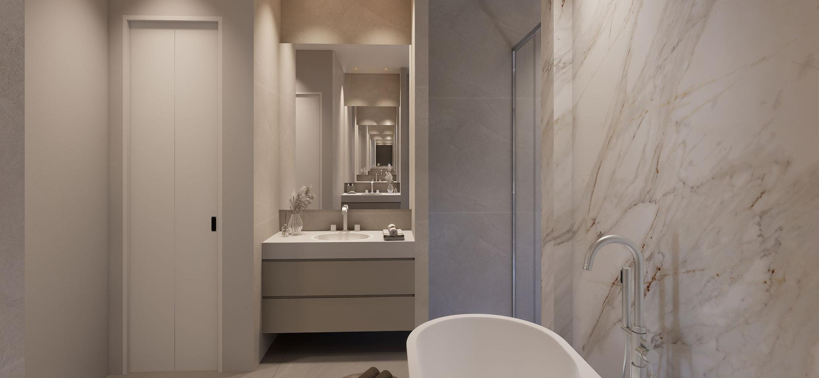

Slide 47

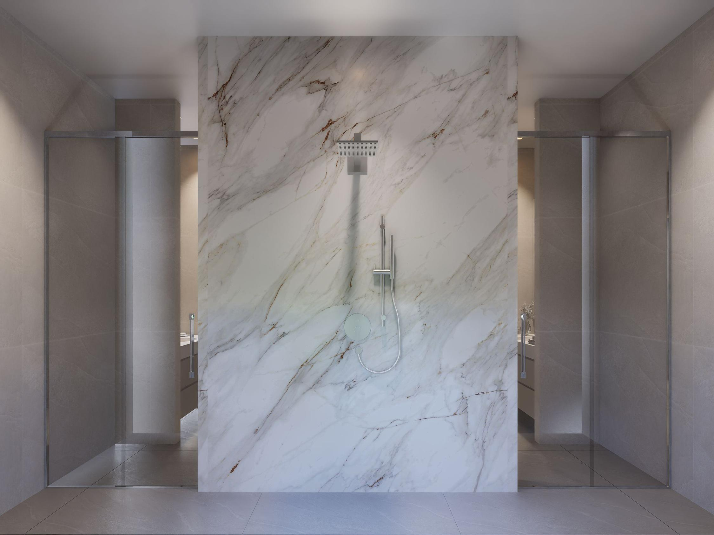

Slide 48
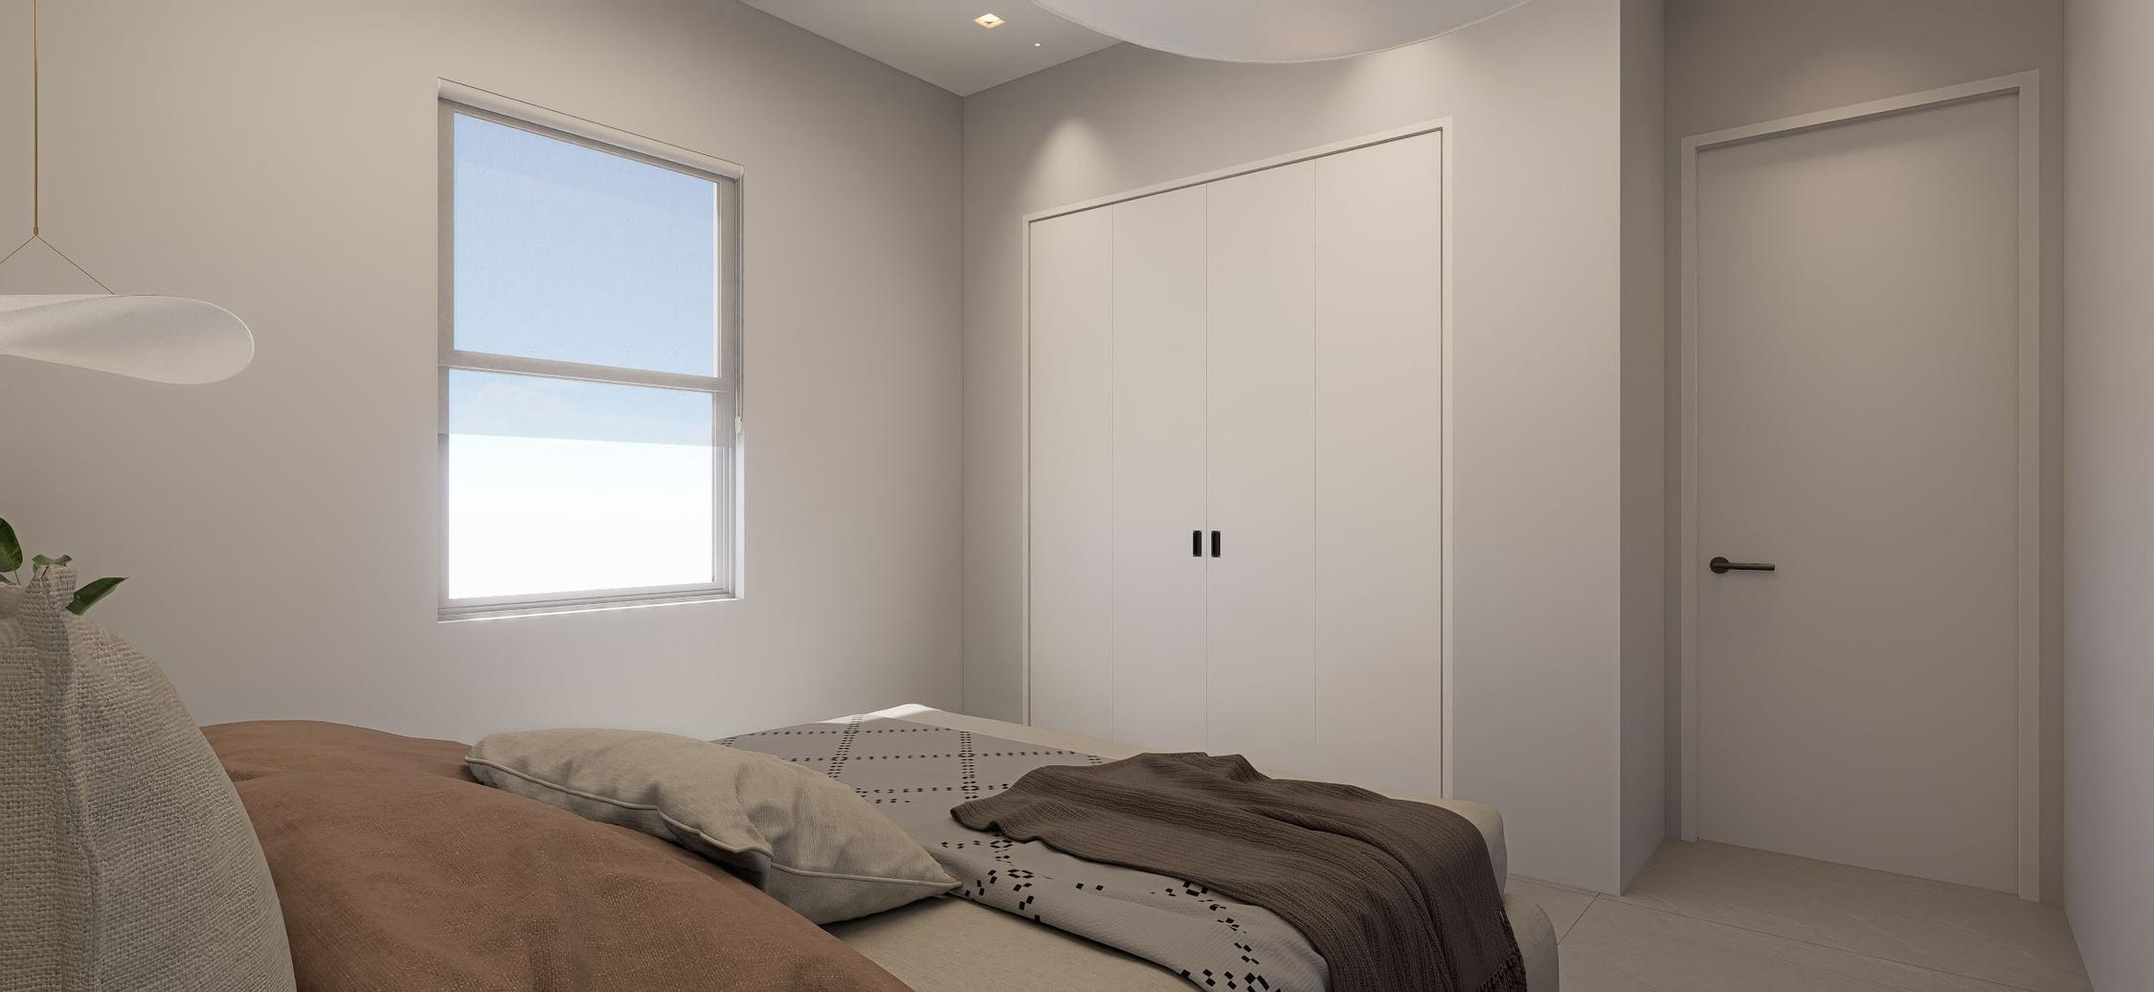

Slide 49
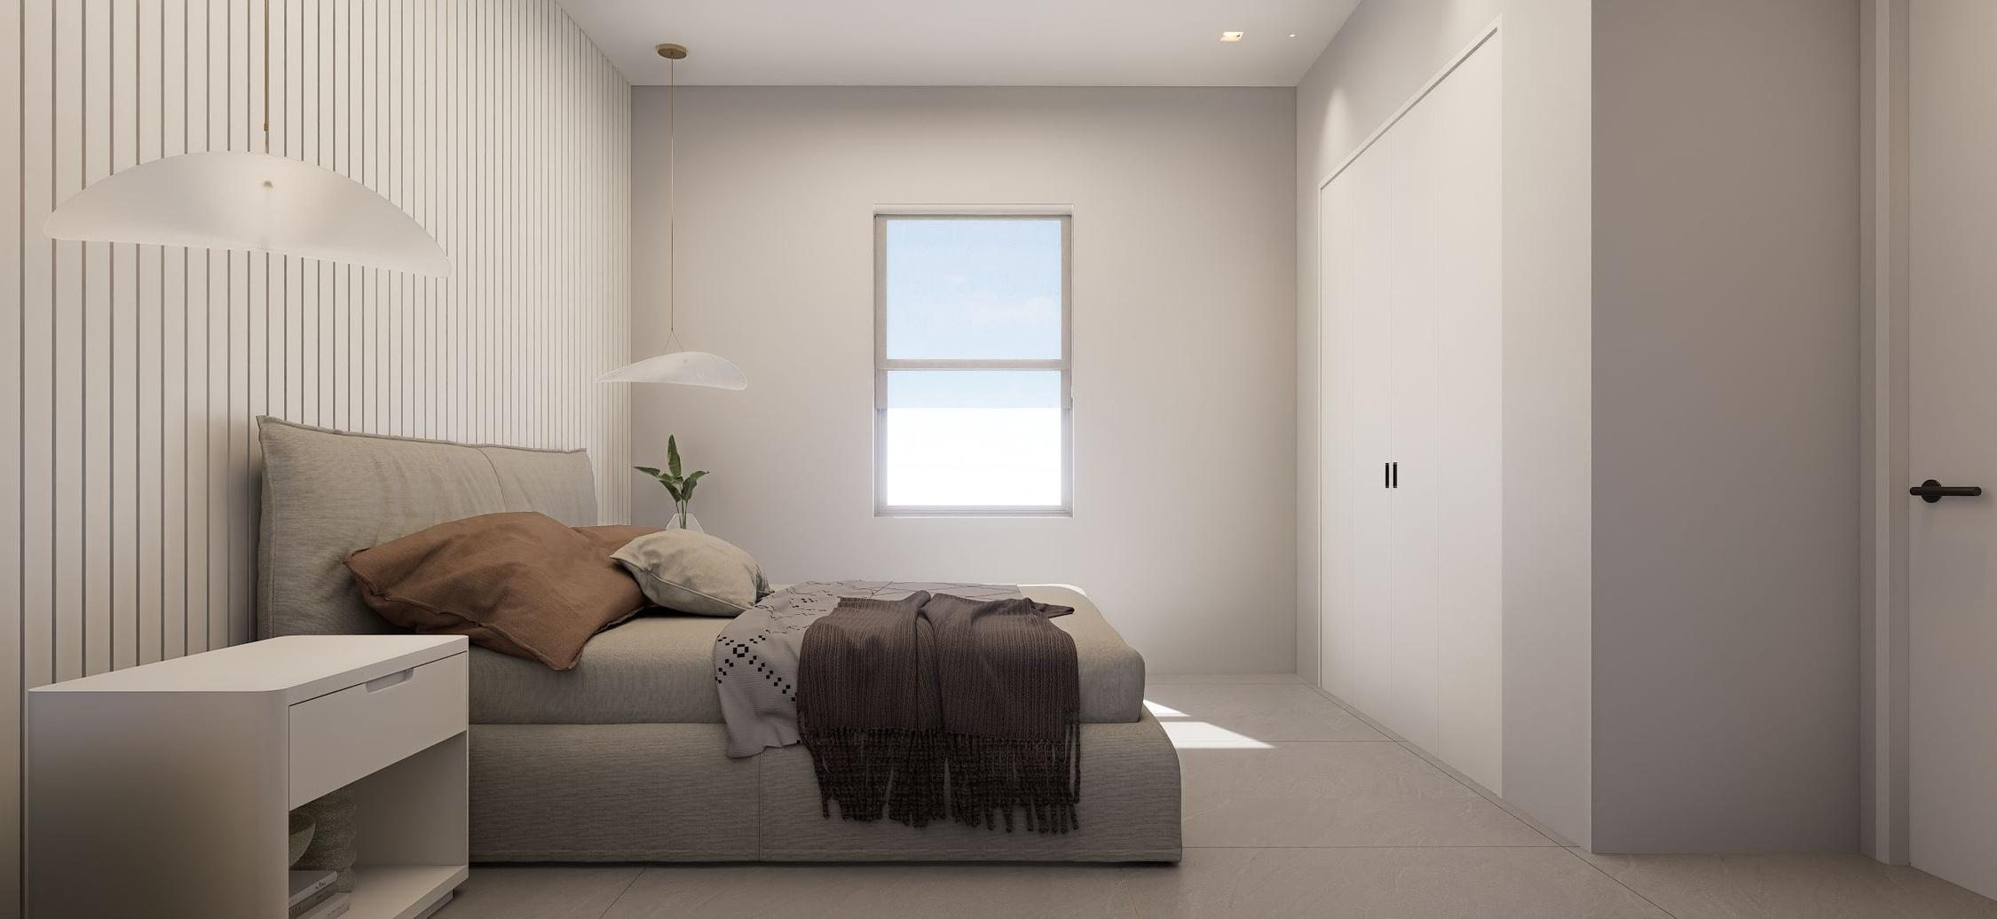

Slide 50
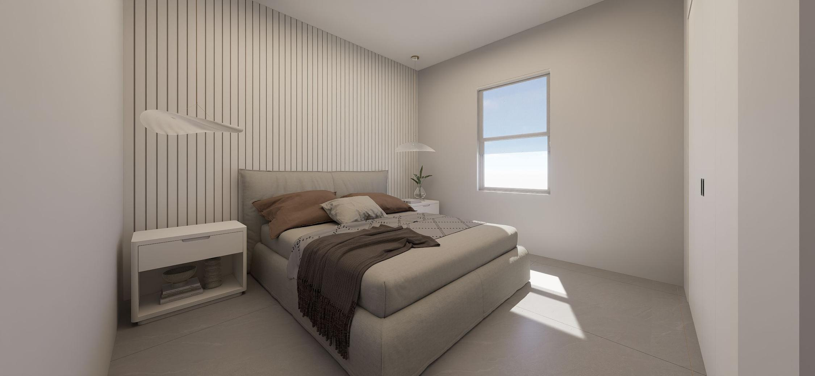

Slide 51
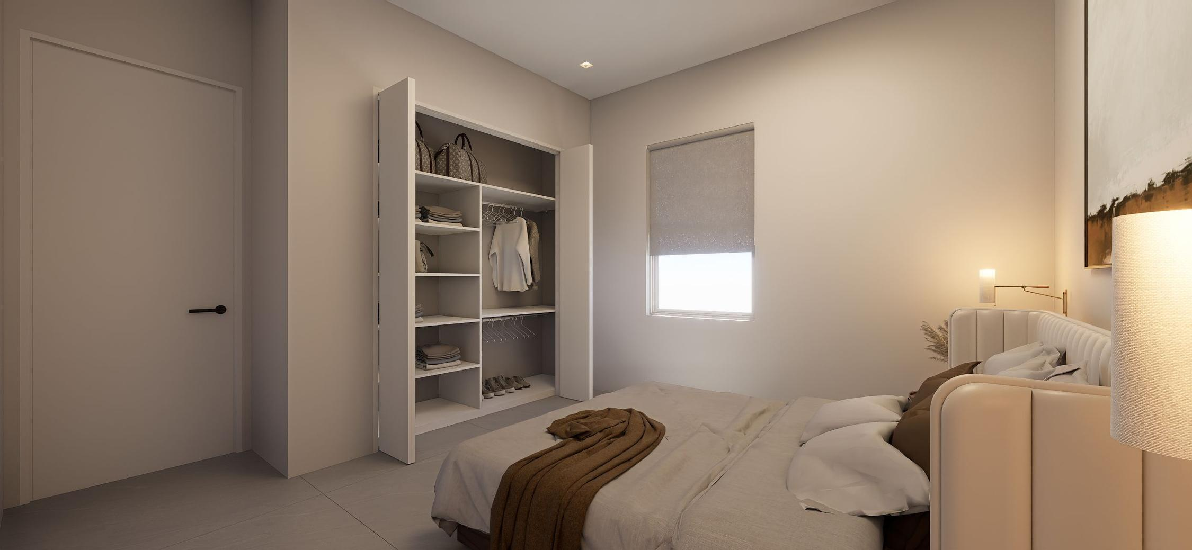

Slide 52
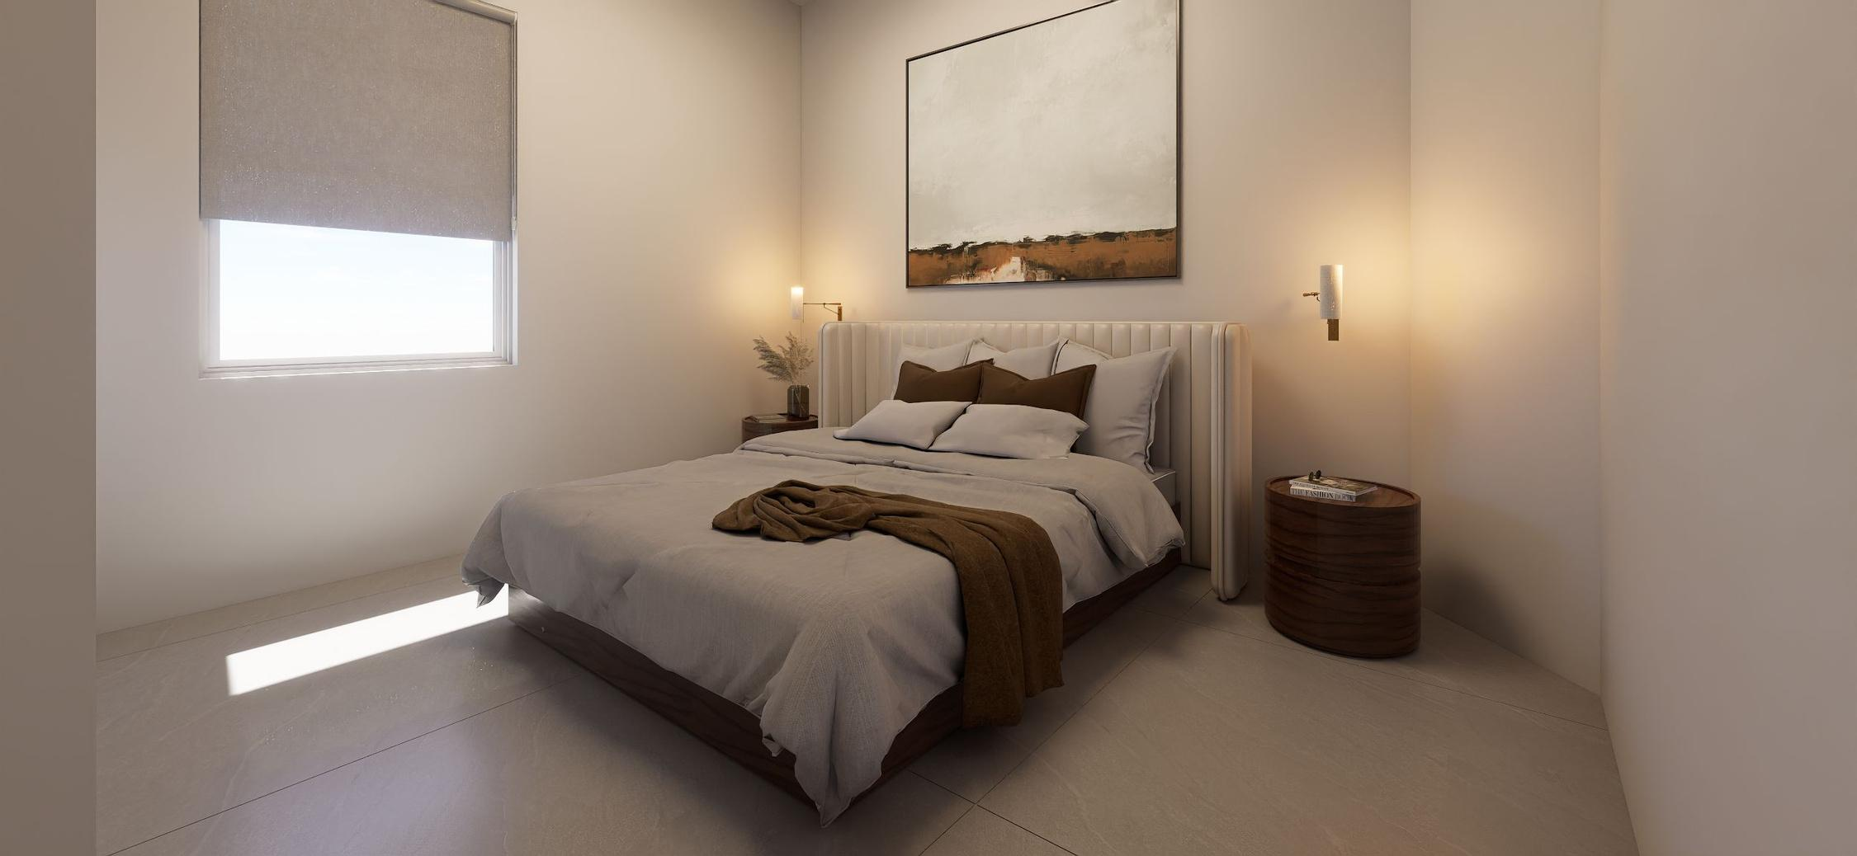

Slide 53
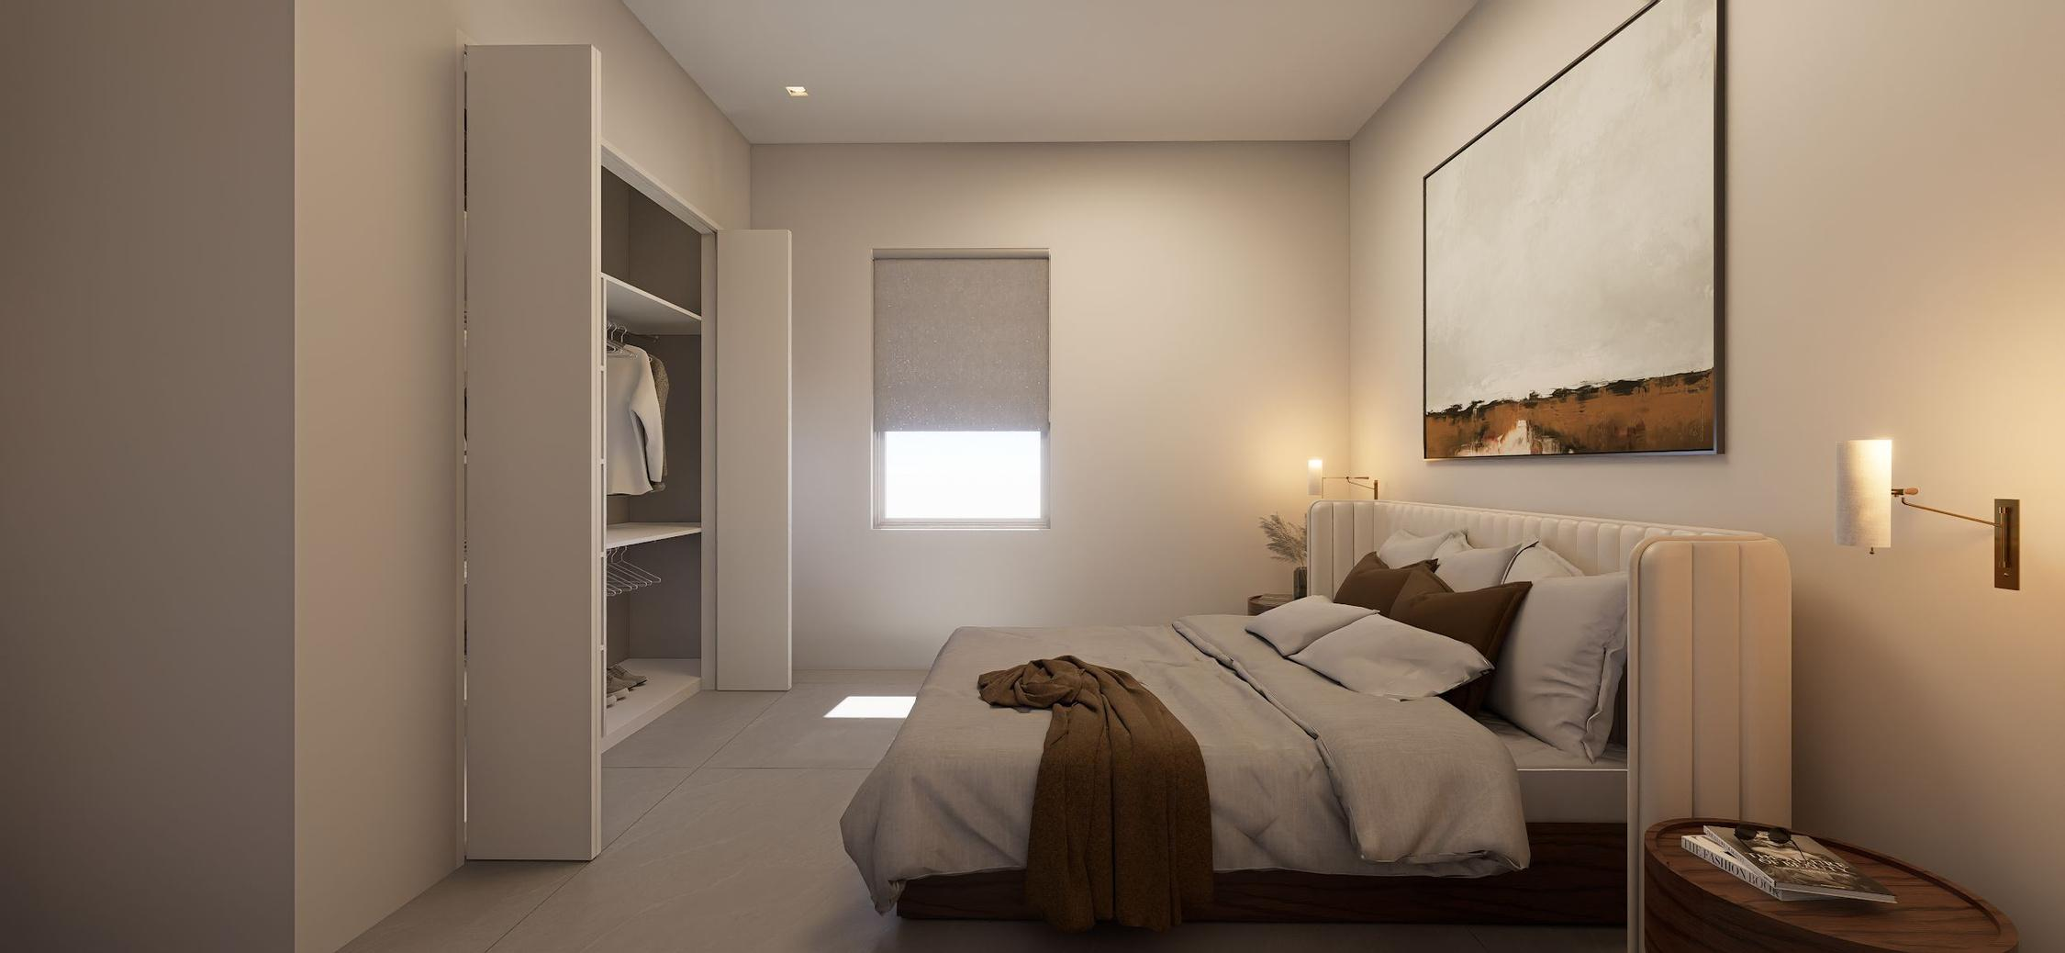

Slide 54
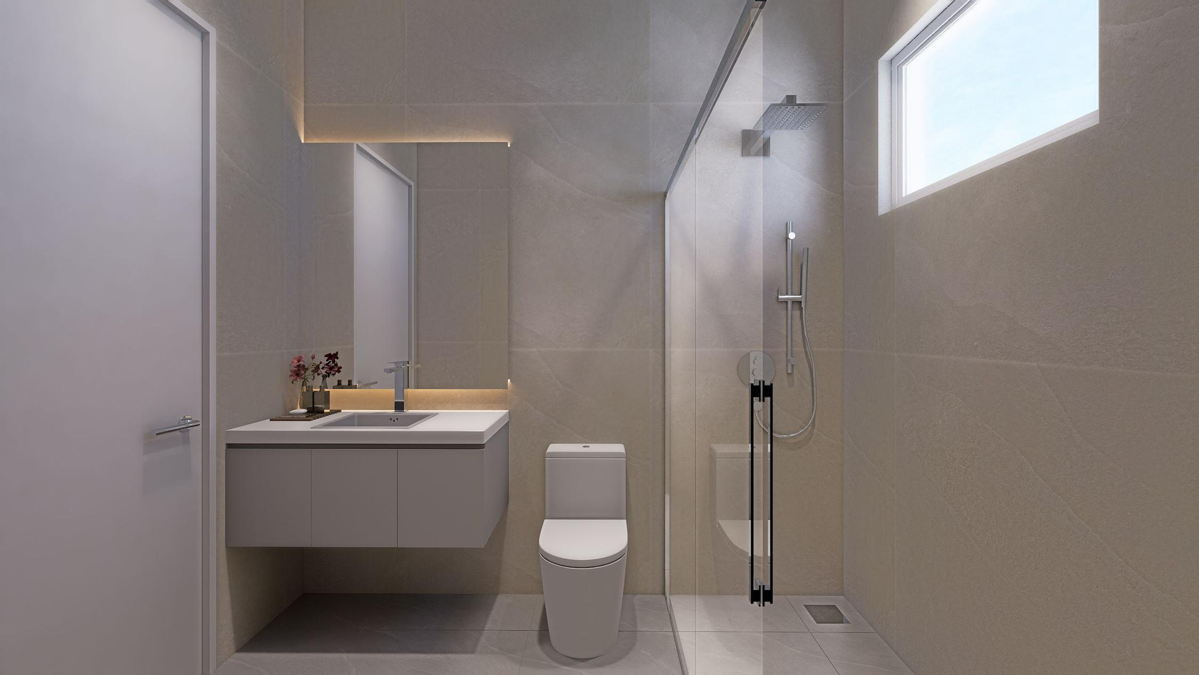

Slide 55

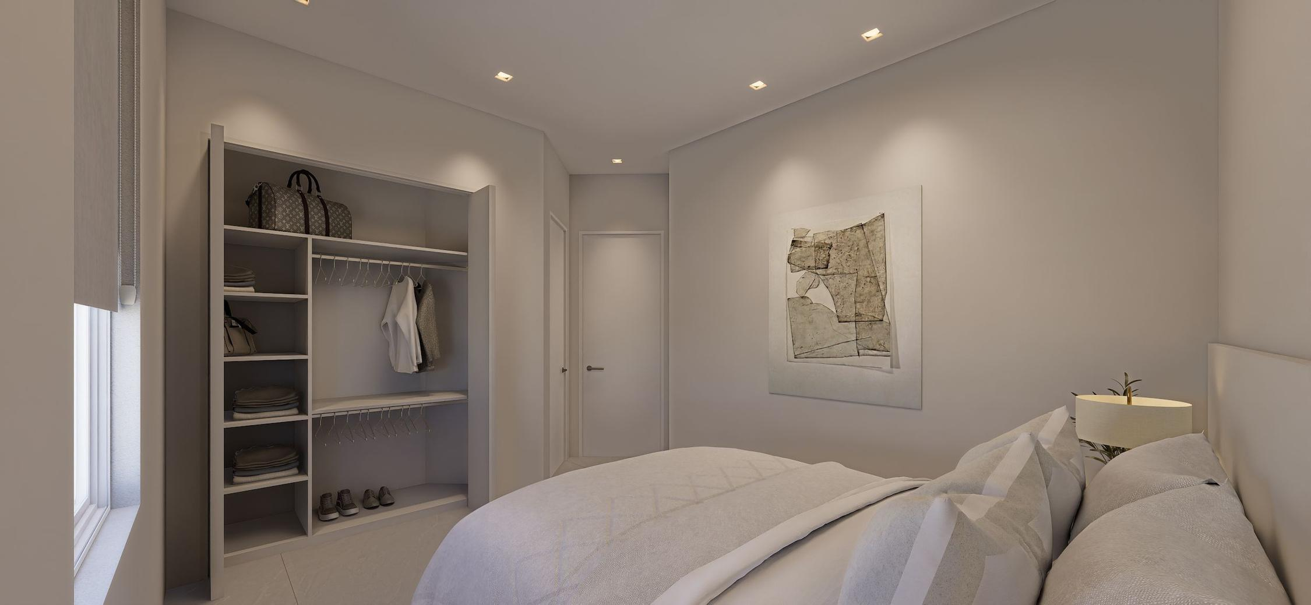

Slide 56
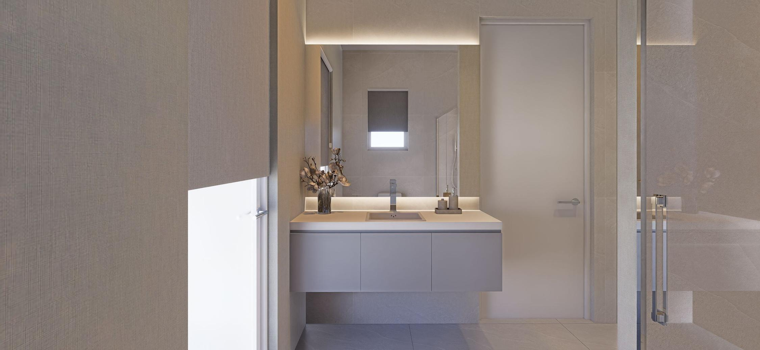

Slide 57



Slide 58


