Slide 1
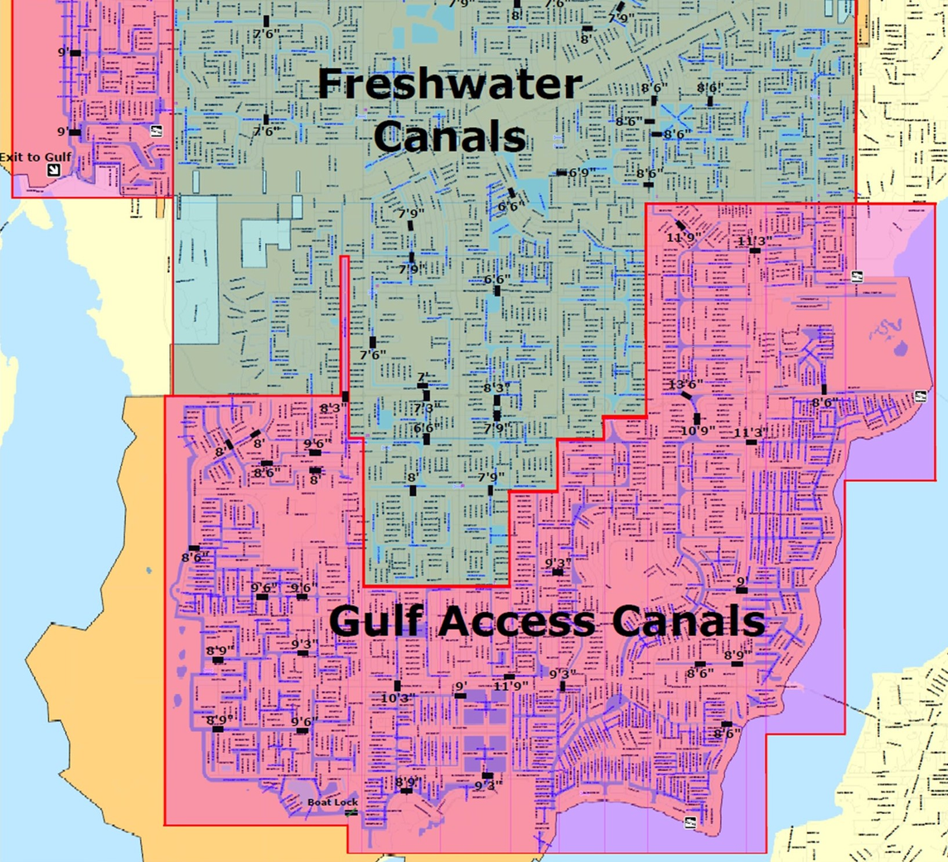
Gulf Access

Slide 2

IBIZA
CEO: ZAKI LEV
(786) 320-5590
2020 NE 163RD STREET. SUITE 103
NORTH MIAMI BEACH
FLORIDA 33162

Slide 3

Gulf Access
BASED ON:
VERA MODEL
“IBIZA” IS LOCATED AT:
3522 NW 14TH TERRACE. CAPE CORAL , FLORIDA. 33993

Slide 4
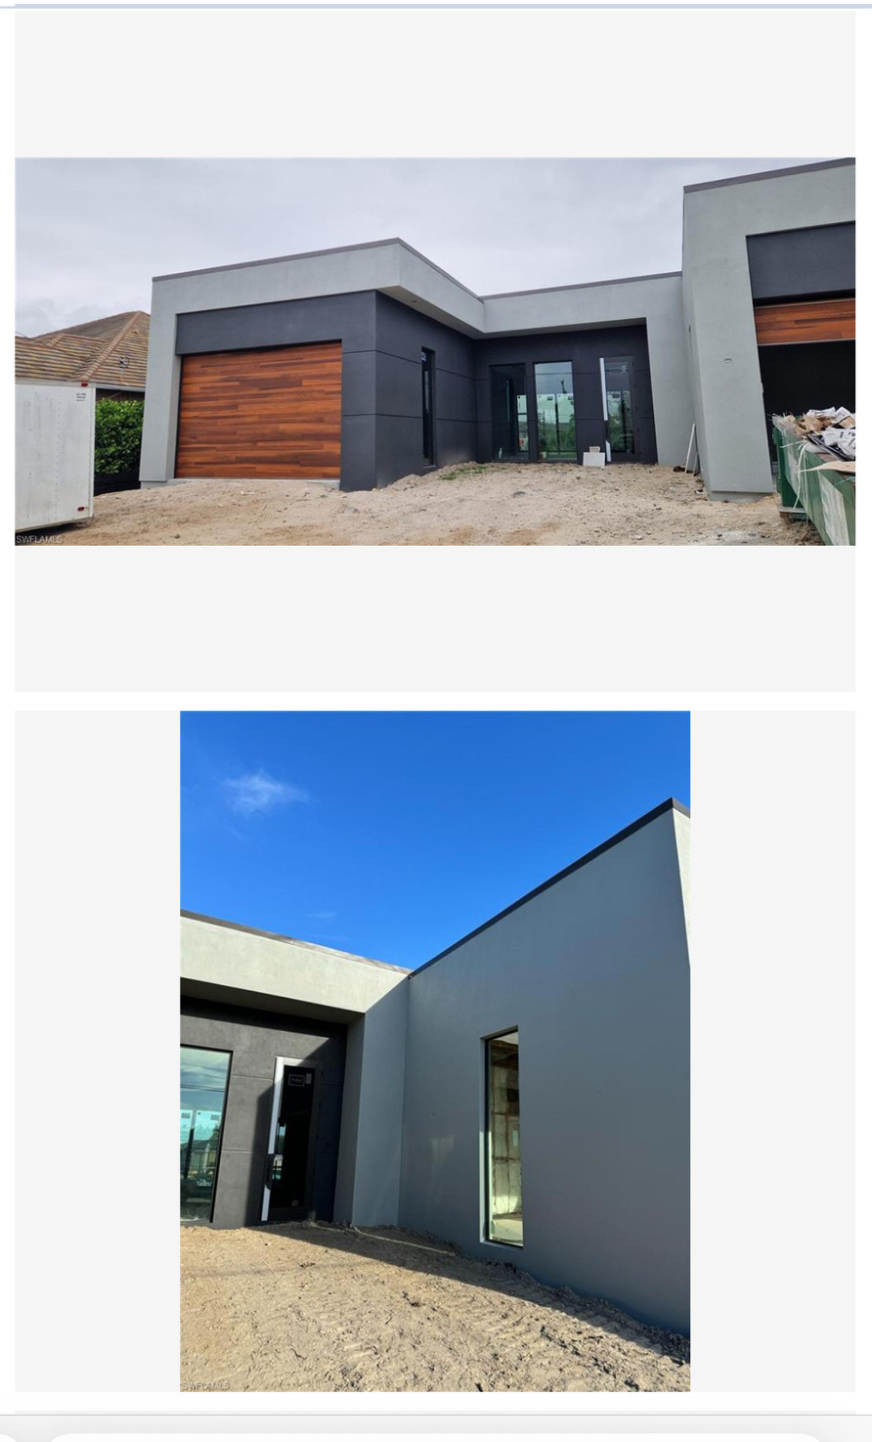
REAL STATE
COMPS OF THE AREA
SOLD
$1,475,000
LISTED FOR: $1,490,000
SINGLE FAMILY RESIDENCE
3925 SW 20TH AVENUE
CAPE CORAL, FL 33914
4BD
3BA
2,769 SQFT

Slide 5
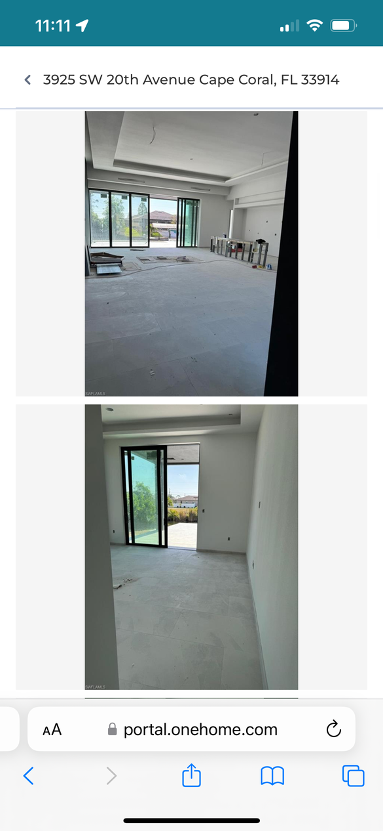
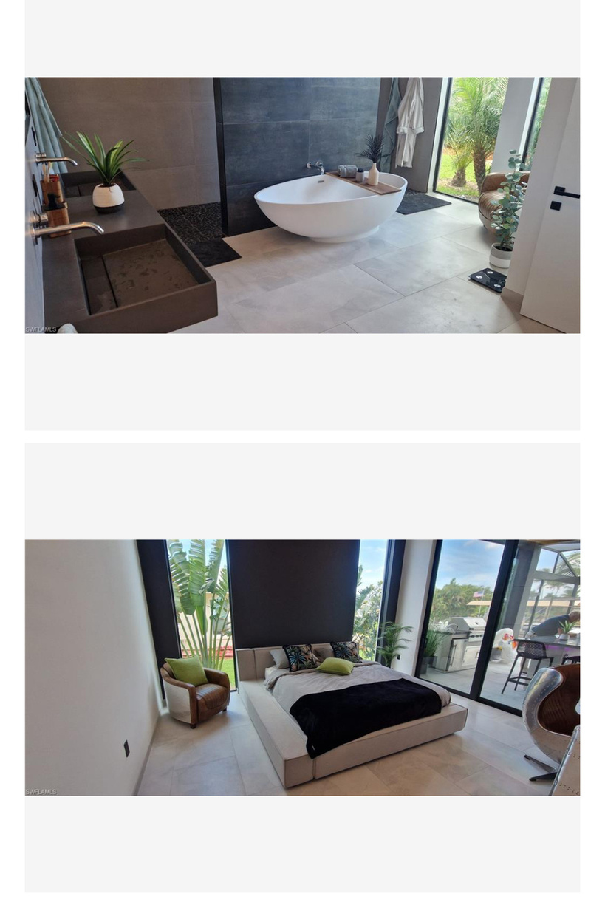
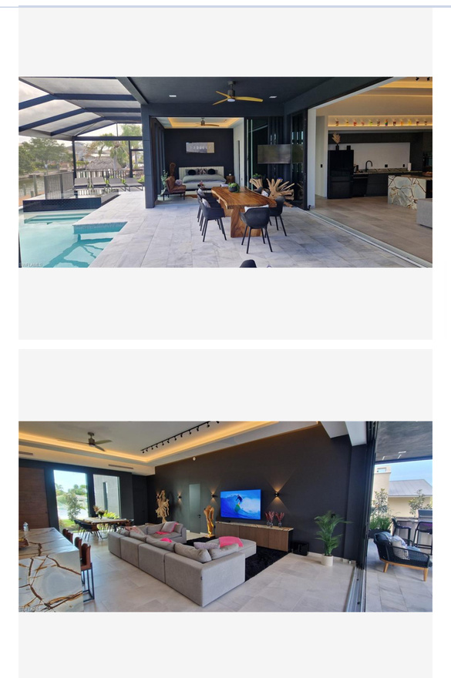
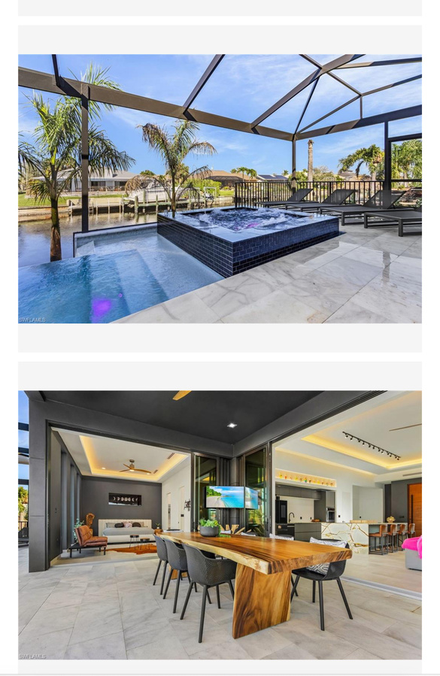
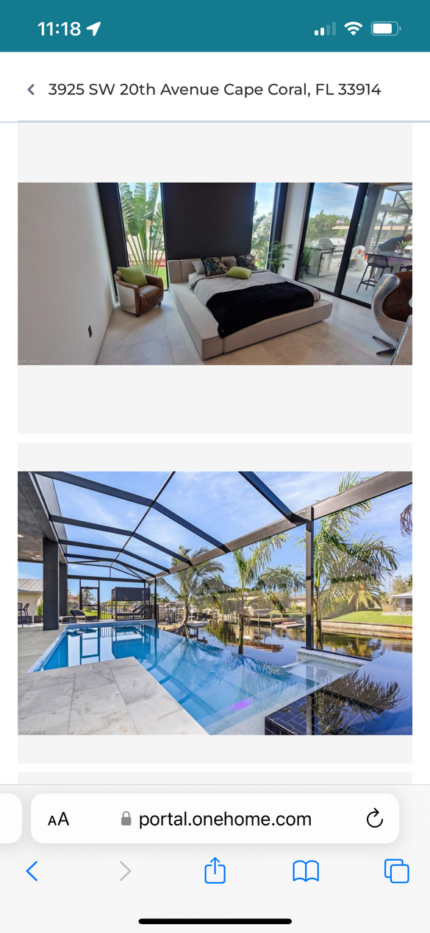

Slide 6
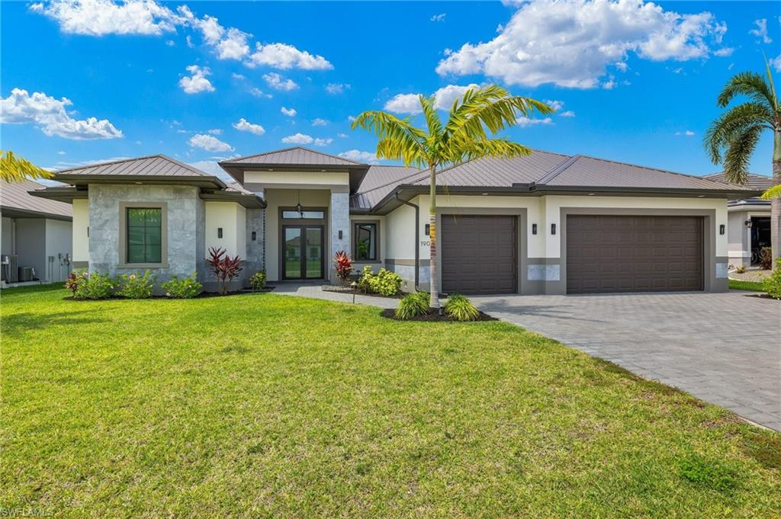
Sold
$1,295,000
Listed For: $1,295,000
Single Family Residence
1901 SW 29th Terrace
Cape Coral, FL 33914
5bd
5ba
3,045 sqft

Slide 7
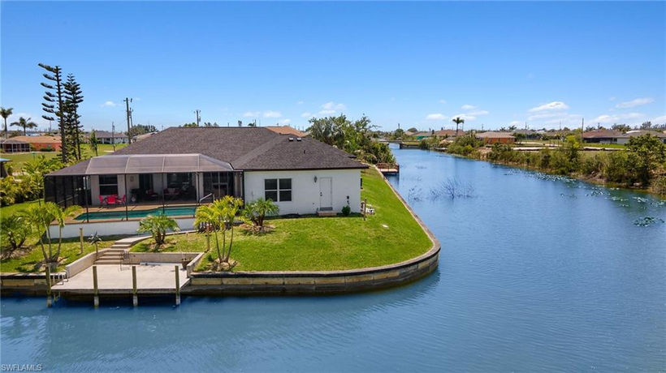
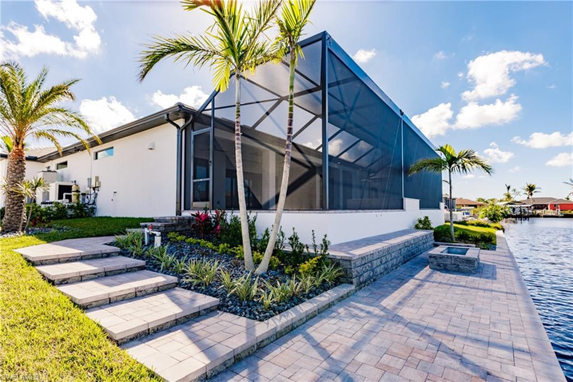
SOLD
$650,000
LISTED FOR: $674,900
SINGLE FAMILY RESIDENCE
237 NW 11TH TERRACE
CAPE CORAL, FL 33993
3BD
3BA
2,377 SQFT
SOLD
$1,180,000
LISTED FOR: $1,300,000
SINGLE FAMILY RESIDENCE
3621 EMBERS PARKWAY W
CAPE CORAL, FL 33993
3BD
3BA
2,281 SQFT

Slide 8
Libi Investment LLC. | Libi Investment LLC. | Libi Investment LLC. | Libi Investment LLC. | Libi Investment LLC. | Libi Investment LLC. | Libi Investment LLC.
3522 NW 14th | 3522 NW 14th | 3522 NW 14th | 3522 NW 14th | 3522 NW 14th | 3522 NW 14th | 3522 NW 14th
Information | In S.F. | Total in $
Lot \ Land in S.F. | 10,000
Precentage of construction from the land S.f. | 31.33%
Total S.F. of new building (Gross) | 3,133
Total S.F. of new building (Net) | 2,318
Cost of construction per SF. gross | $156.91
Cost of construction per SF. Net | $212.08
Seling price | $650.00
Time to get the permit in month | Exsisting
Construction period in Month | 6 month
Income - sale
Sale |  | 1,506,700
Cost of sale | 5.00% | -75,335
Net Sale |  | 1,431,365

Slide 9
 |  |  |  | Financing by | Financing by
Costs |  |  | In % | Equity | Loan
Lot |  | 220,000 | 15.37% | 220,000
Clening the land |  | 10,000 | 0.70% | 10,000
Soft costs (Plans&Permit) | Loan | 10,000 | 0.70% | 10,000
Hard cost construction | $156.91 | 491,600 | 34.34% | 20,000 | 471,600
Pool |  | 60,000 | 4.19% |  | 60,000
Management fees (15% from cons.) | 12.21% | 60,000 | 4.19% |  | 60,000
Financing fixed costs |  | 9,866 | 0.69% | 9,866
Financing cost (10.25%) | 10.00% | 24,650 | 1.72% | 24,650
Total costs |  | 886,116 | 61.91% | 294,516 | 591,600
 |  |  | Reutern (Yeild) | Reutern (Yeild)
 |  |  | On Investments | On Equity
Profit after 6 month |  | 545,249
Reuterns (Yield) of investment \ Equity |  |  | 61.53% | 185.13%

Slide 10
Cost of financing in 5 month (75% LTC or 60% ARV) | Cost of financing in 5 month (75% LTC or 60% ARV) | Cost of financing in 5 month (75% LTC or 60% ARV) | Cost of financing in 5 month (75% LTC or 60% ARV) | Cost of financing in 5 month (75% LTC or 60% ARV)
Month | Loan in parts | Month of interest | Monthly Interest | Camulativ Financing cost
 | 591,600 | Month of interest | Interest in % | 10.00%
1 |  | 9 | 0 | 0
2 | 0 | 8 | 0 | 0
3 | 84,514 | 7 | 5,634 | 5,634
4 | 84,514 | 6 | 4,930 | 10,564
5 | 84,514 | 5 | 4,226 | 14,790
6 | 84,514 | 4 | 3,521 | 18,311
7 | 84,514 | 3 | 2,817 | 21,129
8 | 84,514 | 2 | 2,113 | 23,241
9 | 84,514 | 1 | 1,409 | 24,650
9 | 591,600 |  | 24,650
LTC in % | 67%
AVR in % | 41%
Financing Fixed costs | Financing Fixed costs | Financing Fixed costs
2% Origination Fee | 5,916 | 1.00%
U/W | 1,000
Processing | 1,000
Legal and loan docs | 950
Feasibility and contractor profile reports | 750
Draw fees | 250
Total financing fixed costs | 9,866
Exactiv financing costs | 34,516.00 | 7.78%

Slide 11
Drywall | Labor | $12,000.00
Doors and Trim (Interior) | Materials | $15,000.00
Cabinets | Materials | $12,000.00
Countertops | Materials | $5,600.00
Tile | Materials | $12,000.00
Interior Lights | Materials | $4,000.00
Pavers | Materials | $9,000.00
Plumbing (Interior) | Materials | $3,000.00
Shell | Materials | $150,000.00
Septic | Labor | $14,000.00
Well | Labor | $12,000.00
Framing | Labor | $10,000.00
Stucco | Labor | $10,000.00
Insulation and Gutters | Labor | $7,000.00
AC | Materials | $15,000.00
Appliances | Materials | $8,000.00
Pool | Materials | $45,000.00
Cage | Materials | $15,000.00
Construction Fee |  | $60,000.00
Grand Total: |  | $771,600.00
List of Expenses | List of Expenses | List of Expenses
Item | Category | Amount
Lot | Lot | $220,000.00
Toilet | Materials | $2,000.00
Trash | Materials | $5,000.00
Dirt | Materials | $15,000.00
Pest Control | Labor | $4,000.00
Grading | Labor | $12,000.00
Trusses | Materials | $14,000.00
Windows and Doors Exterior | Materials | $20,000.00
Plumbing | Labor | $20,000.00
Electric | Labor | $20,000.00
Paint | Labor | $7,000.00
Roof (Shingles) | Labor | $14,000.00

Slide 12

TOSCANA
CEO: ZAKI LEV
(786) 320-5590
2020 NE 163RD STREET.SUITE 103
NORTH MIAMI BEACH
FLORIDA 33162

Slide 13
Gulf Access
BASED ON:
VERA MODEL
“TOSCANA” IS LOCATED AT:
3232 NW 19TH STREET. CAPE CORAL, FLORIDA. 33993.

Slide 14

REAL STATE
COMPS OF THE AREA
ONE HOME Portal

Slide 15
Libi Investment LLC. | Libi Investment LLC. | Libi Investment LLC. | Libi Investment LLC. | Libi Investment LLC. | Libi Investment LLC. | Libi Investment LLC.
3232 NW 19th | 3232 NW 19th | 3232 NW 19th | 3232 NW 19th | 3232 NW 19th | 3232 NW 19th | 3232 NW 19th
Information | In S.F. | Total in $
Lot \ Land in S.F. | 10,000
Precentage of construction from the land S.f. | 31.33%
Total S.F. of new building (Gross) | 3,133
Total S.F. of new building (Net) | 2,318
Cost of construction per SF. gross | $156.91
Cost of construction per SF. Net | $212.08
Seling price | $650.00
Time to get the permit in month | Exsisting
Construction period in Month | 6 month
Income - sale
Sale |  | 1,506,700
Cost of sale | 5.00% | -75,335
Net Sale |  | 1,431,365
 |  |  |  | Financing by | Financing by
Costs |  |  | In % | Equity | Loan
Lot |  | 80,000 | 5.59% | 80,000
Clening the land |  | 10,000 | 0.70% | 10,000
Soft costs (Plans&Permit) | Loan | 10,000 | 0.70% | 10,000
Hard cost construction | $156.91 | 491,600 | 34.34% | 20,000 | 471,600
Pool |  | 60,000 | 4.19% |  | 60,000
Management fees (15% from cons.) | 12.21% | 60,000 | 4.19% |  | 60,000
Financing fixed costs |  | 9,866 | 0.69% | 9,866
Financing cost (10.25%) | 10.00% | 24,650 | 1.72% | 24,650
Total costs |  | 746,116 | 52.13% | 154,516 | 591,600
 |  |  | Reutern (Yeild) | Reutern (Yeild)
 |  |  | On Investments | On Equity
Profit after 6 month |  | 685,249
Reuterns (Yield) of investment \ Equity |  |  | 91.84% | 443.48%

Slide 16
Cost of financing in 5 month (75% LTC or 60% ARV) | Cost of financing in 5 month (75% LTC or 60% ARV) | Cost of financing in 5 month (75% LTC or 60% ARV) | Cost of financing in 5 month (75% LTC or 60% ARV) | Cost of financing in 5 month (75% LTC or 60% ARV)
Month | Loan in parts | Month of interest | Monthly Interest | Camulativ Financing cost
 | 591,600 | Month of interest | Interest in % | 10.00%
1 |  | 9 | 0 | 0
2 | 0 | 8 | 0 | 0
3 | 84,514 | 7 | 5,634 | 5,634
4 | 84,514 | 6 | 4,930 | 10,564
5 | 84,514 | 5 | 4,226 | 14,790
6 | 84,514 | 4 | 3,521 | 18,311
7 | 84,514 | 3 | 2,817 | 21,129
8 | 84,514 | 2 | 2,113 | 23,241
9 | 84,514 | 1 | 1,409 | 24,650
9 | 591,600 |  | 24,650
LTC in % | 79%
AVR in % | 41%
Financing Fixed costs | Financing Fixed costs | Financing Fixed costs
2% Origination Fee | 5,916 | 1.00%
U/W | 1,000
Processing | 1,000
Legal and loan docs | 950
Feasibility and contractor profile reports | 750
Draw fees | 250
Total financing fixed costs | 9,866
Efactiv financing costs | 34,516.00 | 7.78%

Slide 17
List of Expenses | List of Expenses | List of Expenses
Item | Category | Amount
Lot | Lot | $80,000.00
Toilet | Materials | $2,000.00
Trash | Materials | $5,000.00
Dirt | Materials | $15,000.00
Pest Control | Labor | $4,000.00
Grading | Labor | $12,000.00
Trusses | Materials | $14,000.00
Windows and Doors Exterior | Materials | $20,000.00
Plumbing | Labor | $20,000.00
Electric | Labor | $20,000.00
Paint | Labor | $7,000.00
Roof (Shingles) | Labor | $14,000.00
Drywall | Labor | $12,000.00
Doors and Trim (Interior) | Materials | $15,000.00
Cabinets | Materials | $12,000.00
Countertops | Materials | $5,600.00
Tile | Materials | $12,000.00
Interior Lights | Materials | $4,000.00
Pavers | Materials | $9,000.00
Plumbing (Interior) | Materials | $3,000.00
Shell | Materials | $150,000.00
Septic | Labor | $14,000.00
Well | Labor | $12,000.00
Framing | Labor | $10,000.00
Stucco | Labor | $10,000.00
Insulation and Gutters | Labor | $7,000.00
AC | Materials | $15,000.00
Appliances | Materials | $8,000.00
Pool | Materials | $45,000.00
Cage | Materials | $15,000.00
Construction Fee |  | $60,000.00
Grand Total: |  | $631,600.00

Slide 18
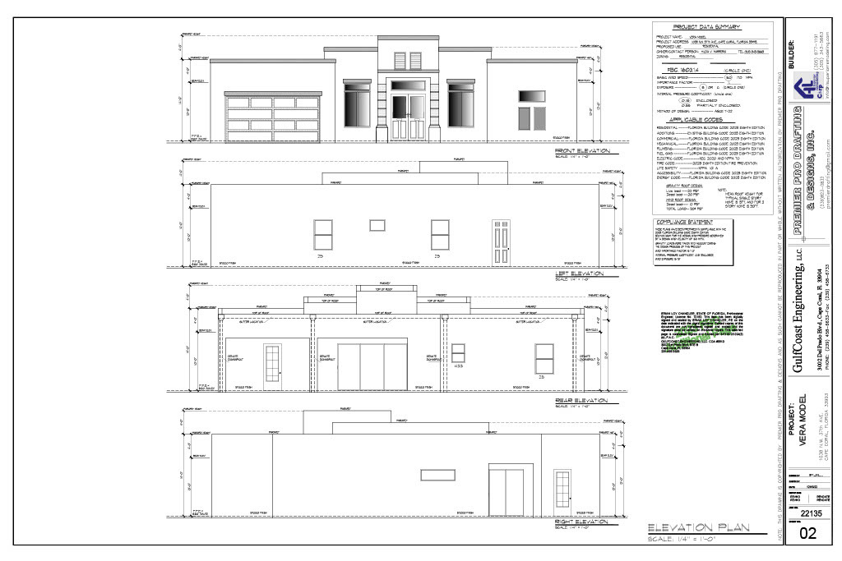

Slide 19
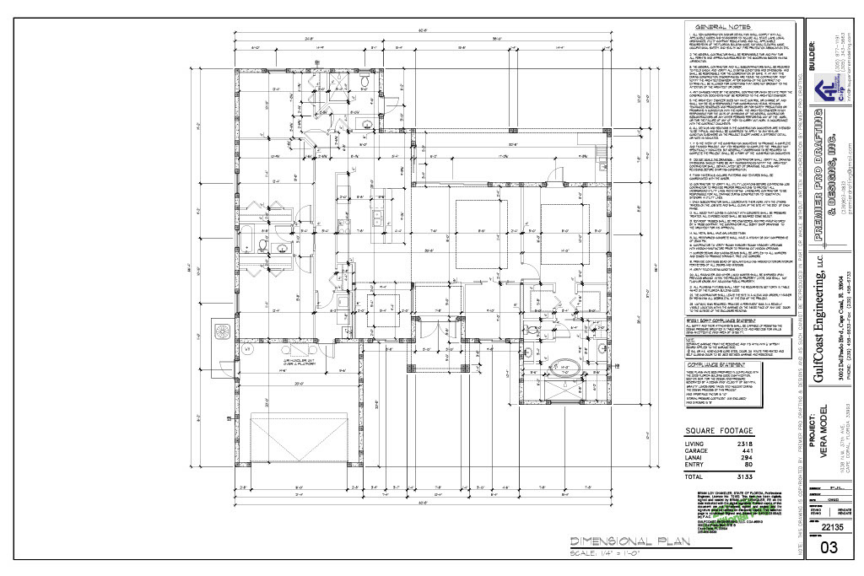

Slide 20
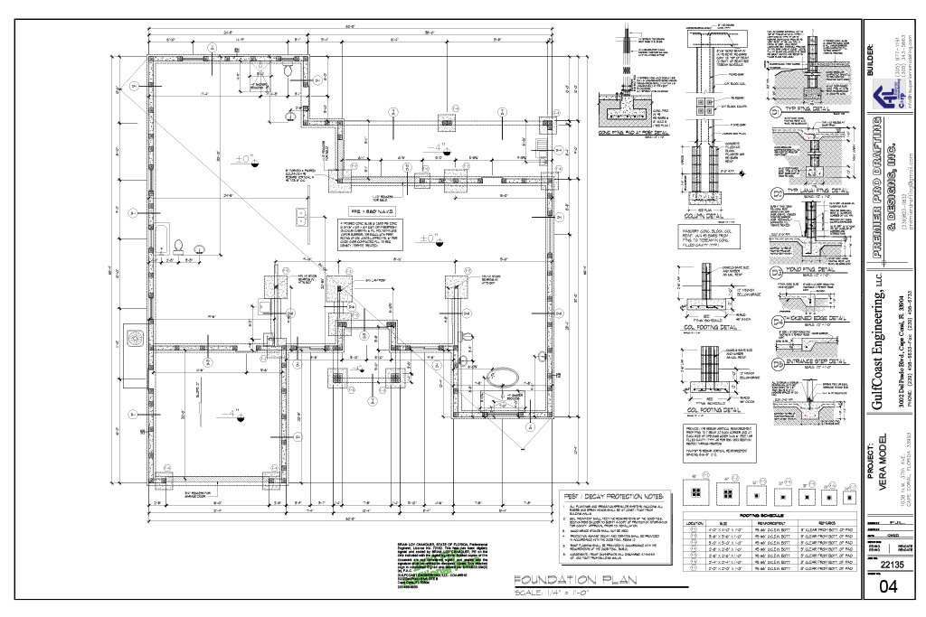

Slide 21
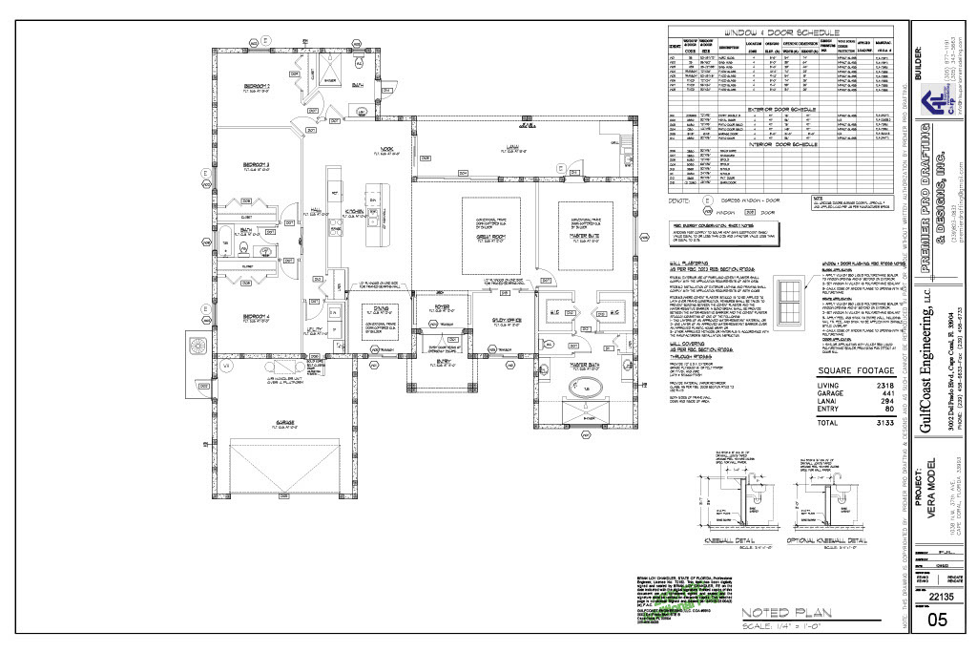

Slide 22
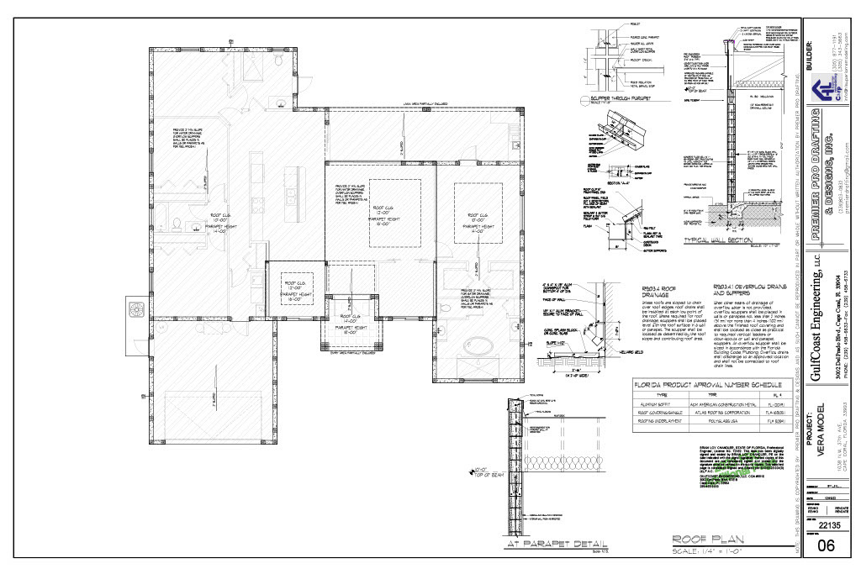

Slide 23
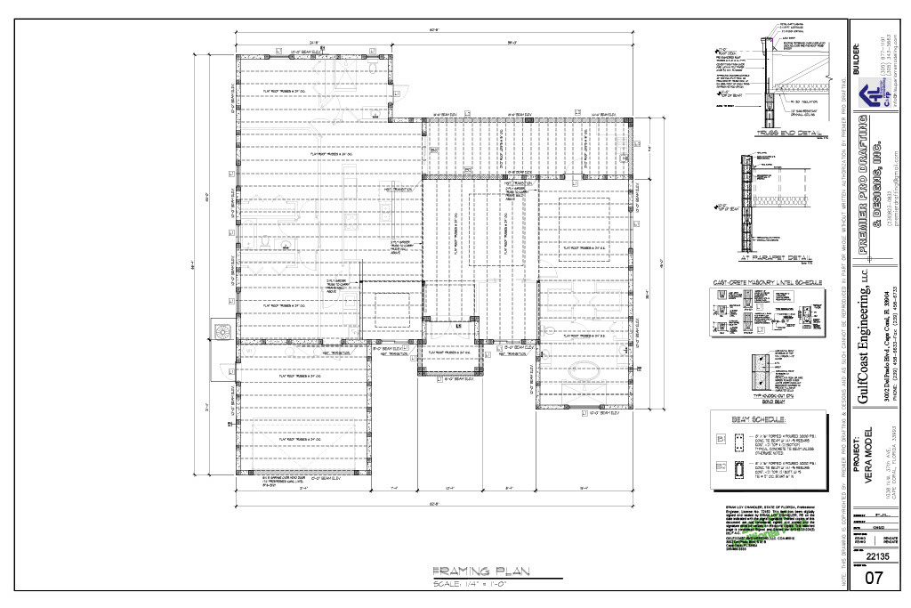

Slide 24
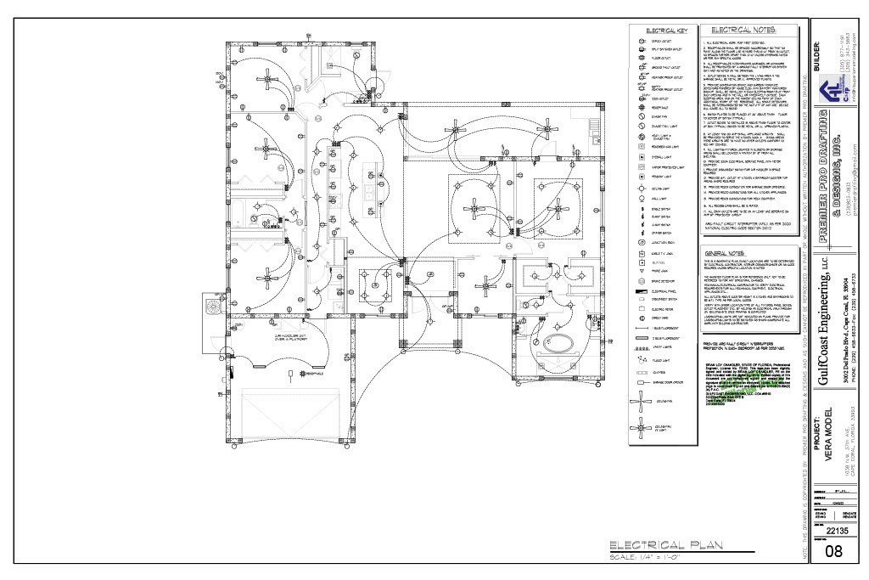

Slide 25
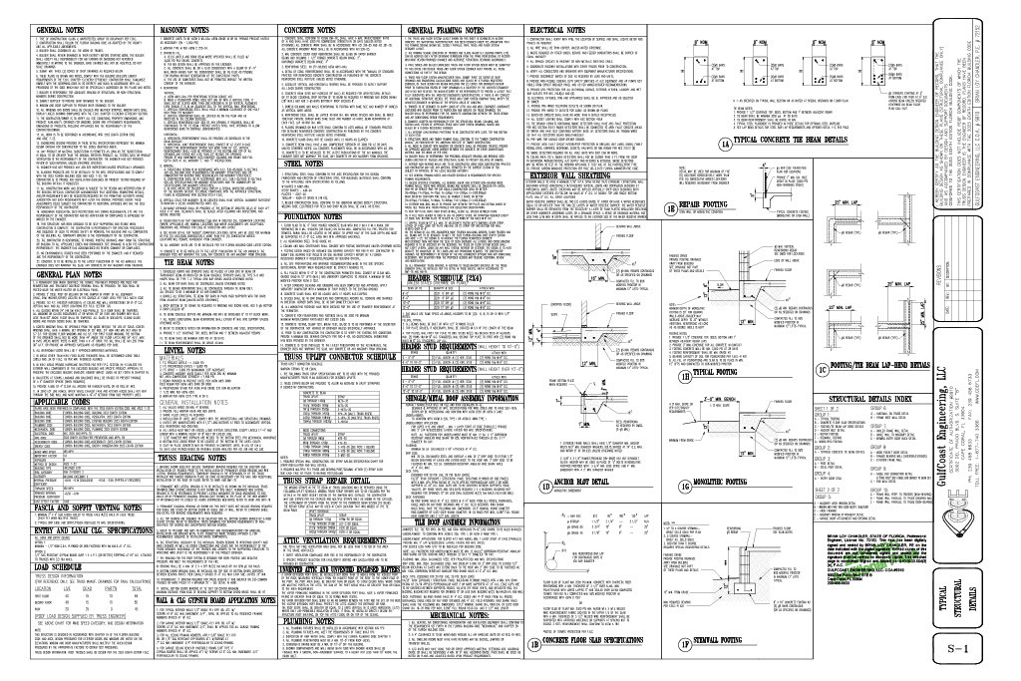

Slide 26
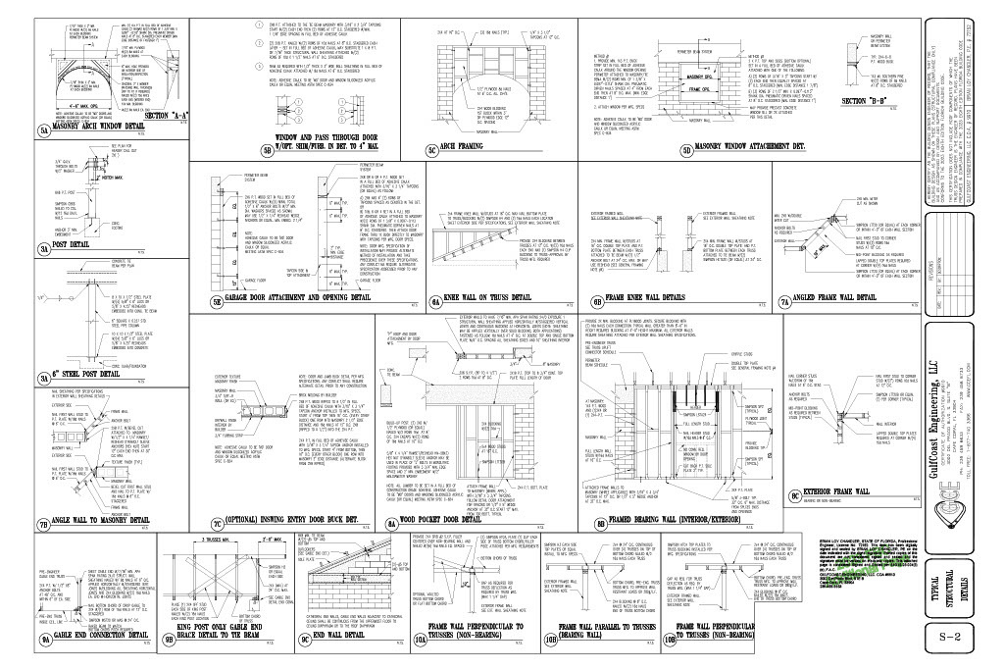

Slide 27

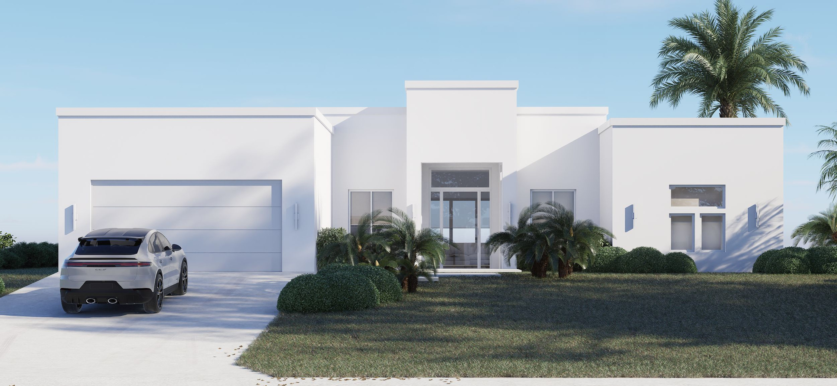

Slide 28

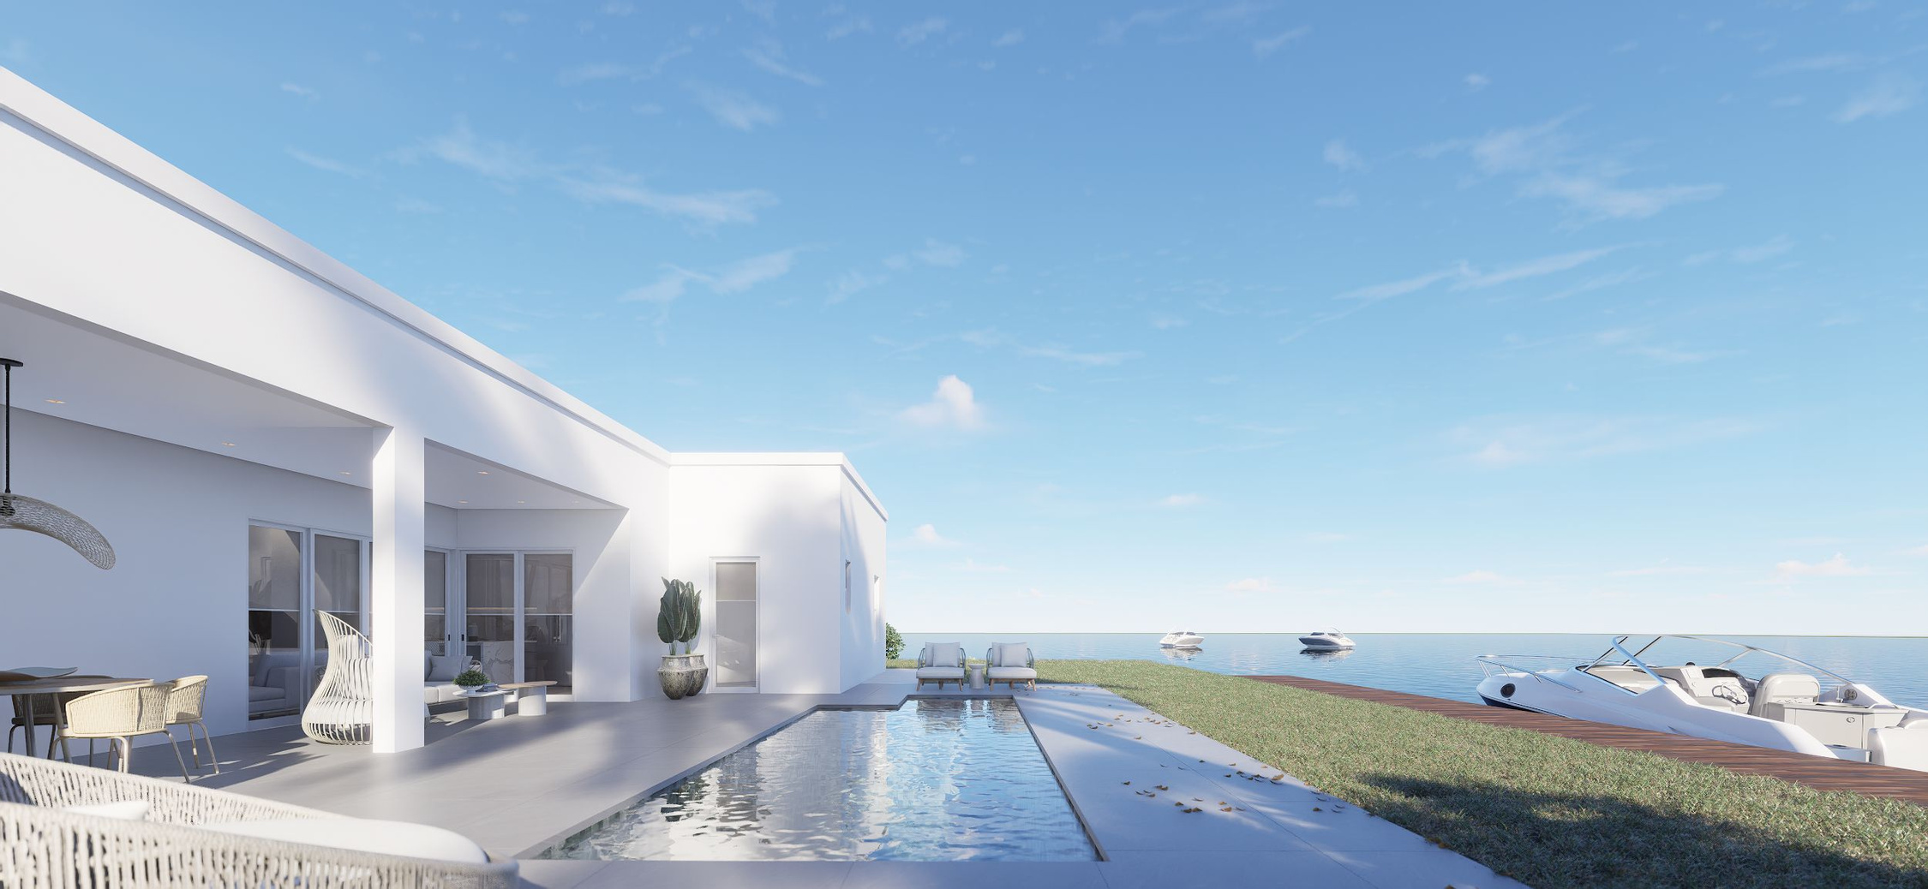

Slide 29
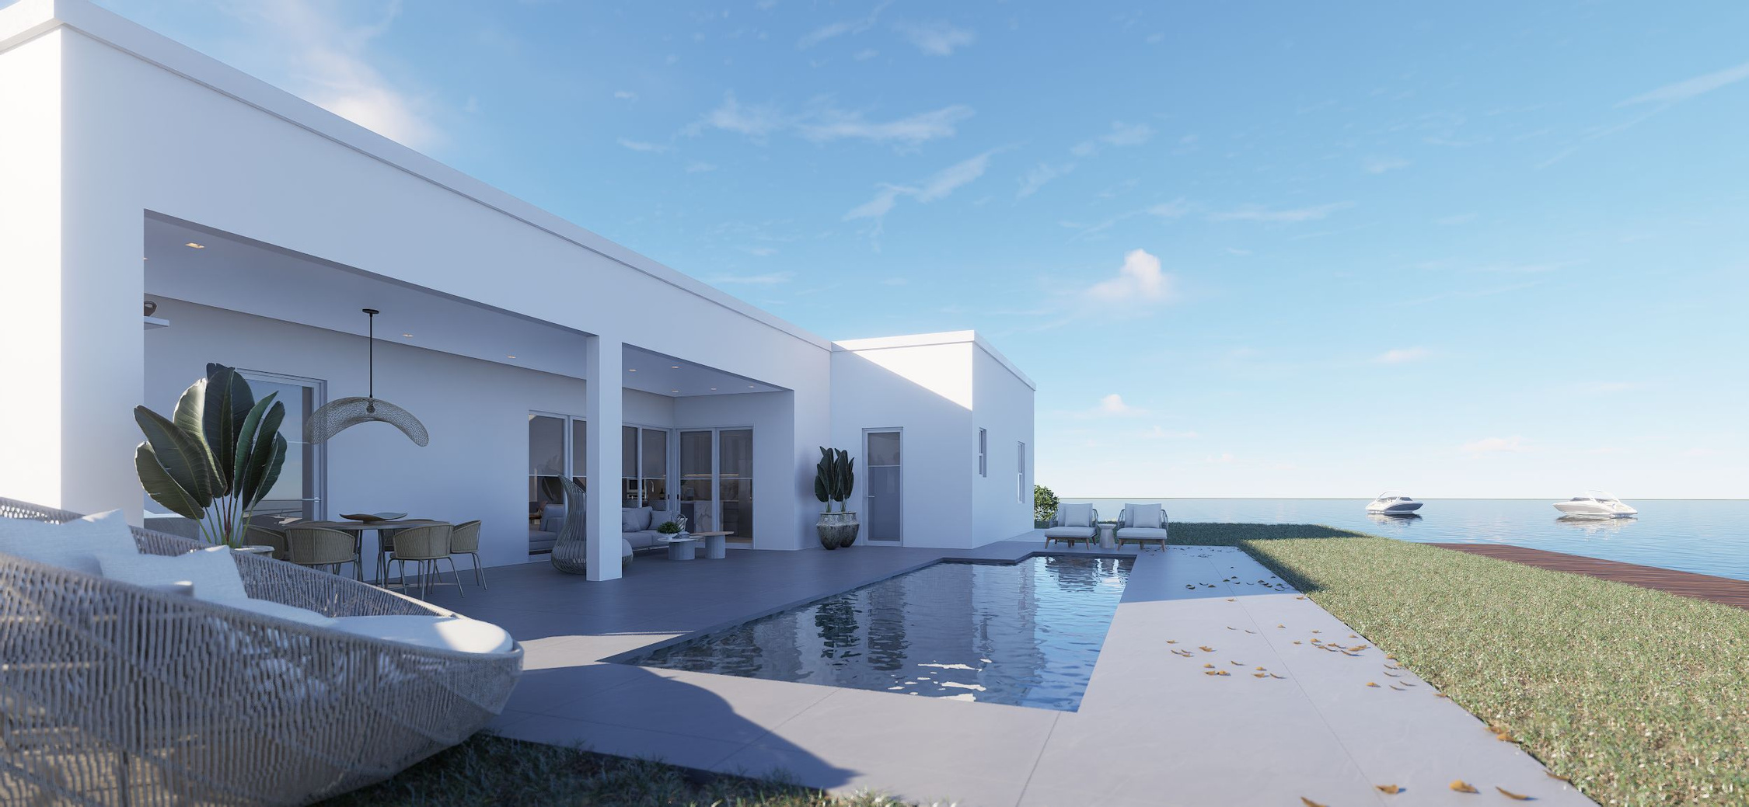

Slide 30
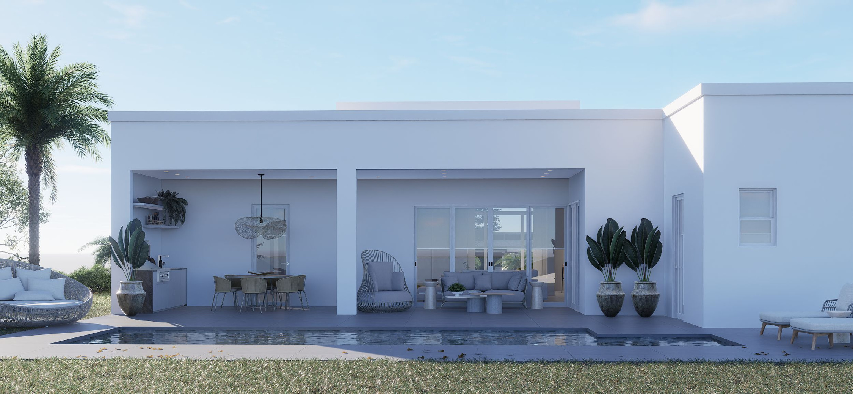

Slide 31
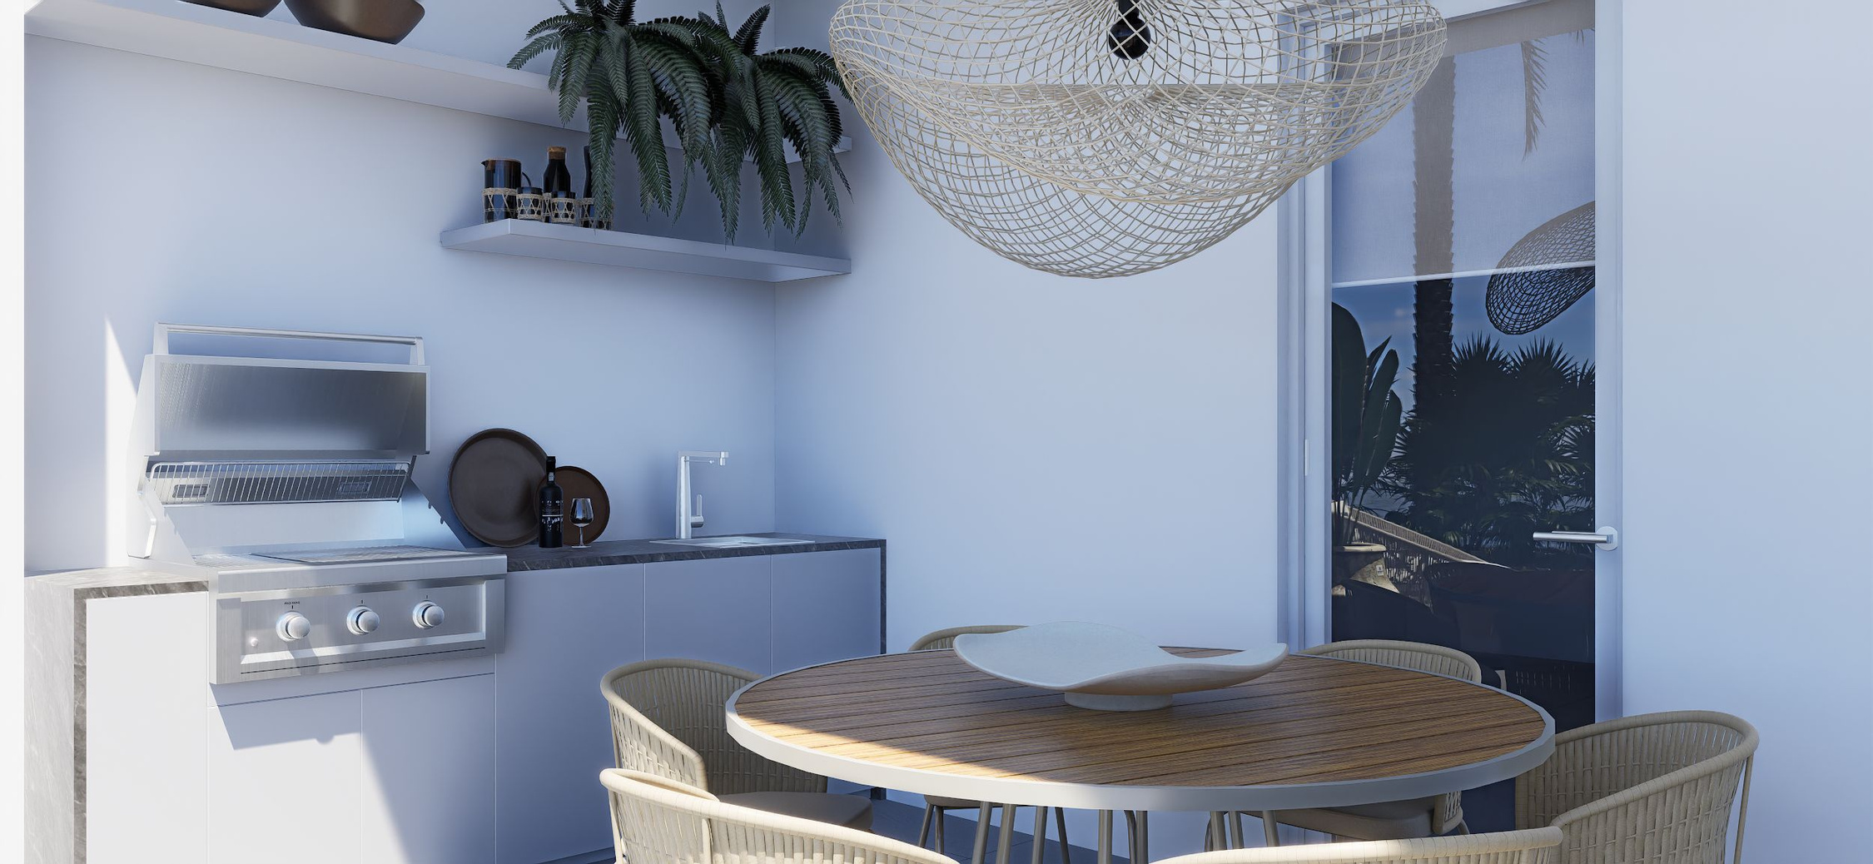

Slide 32
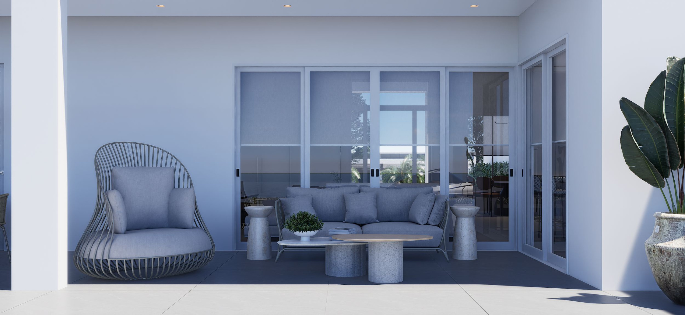

Slide 33
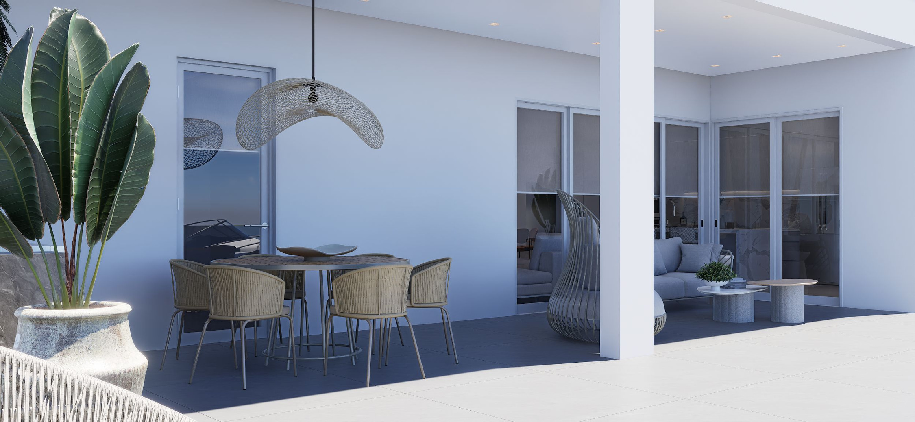

Slide 34
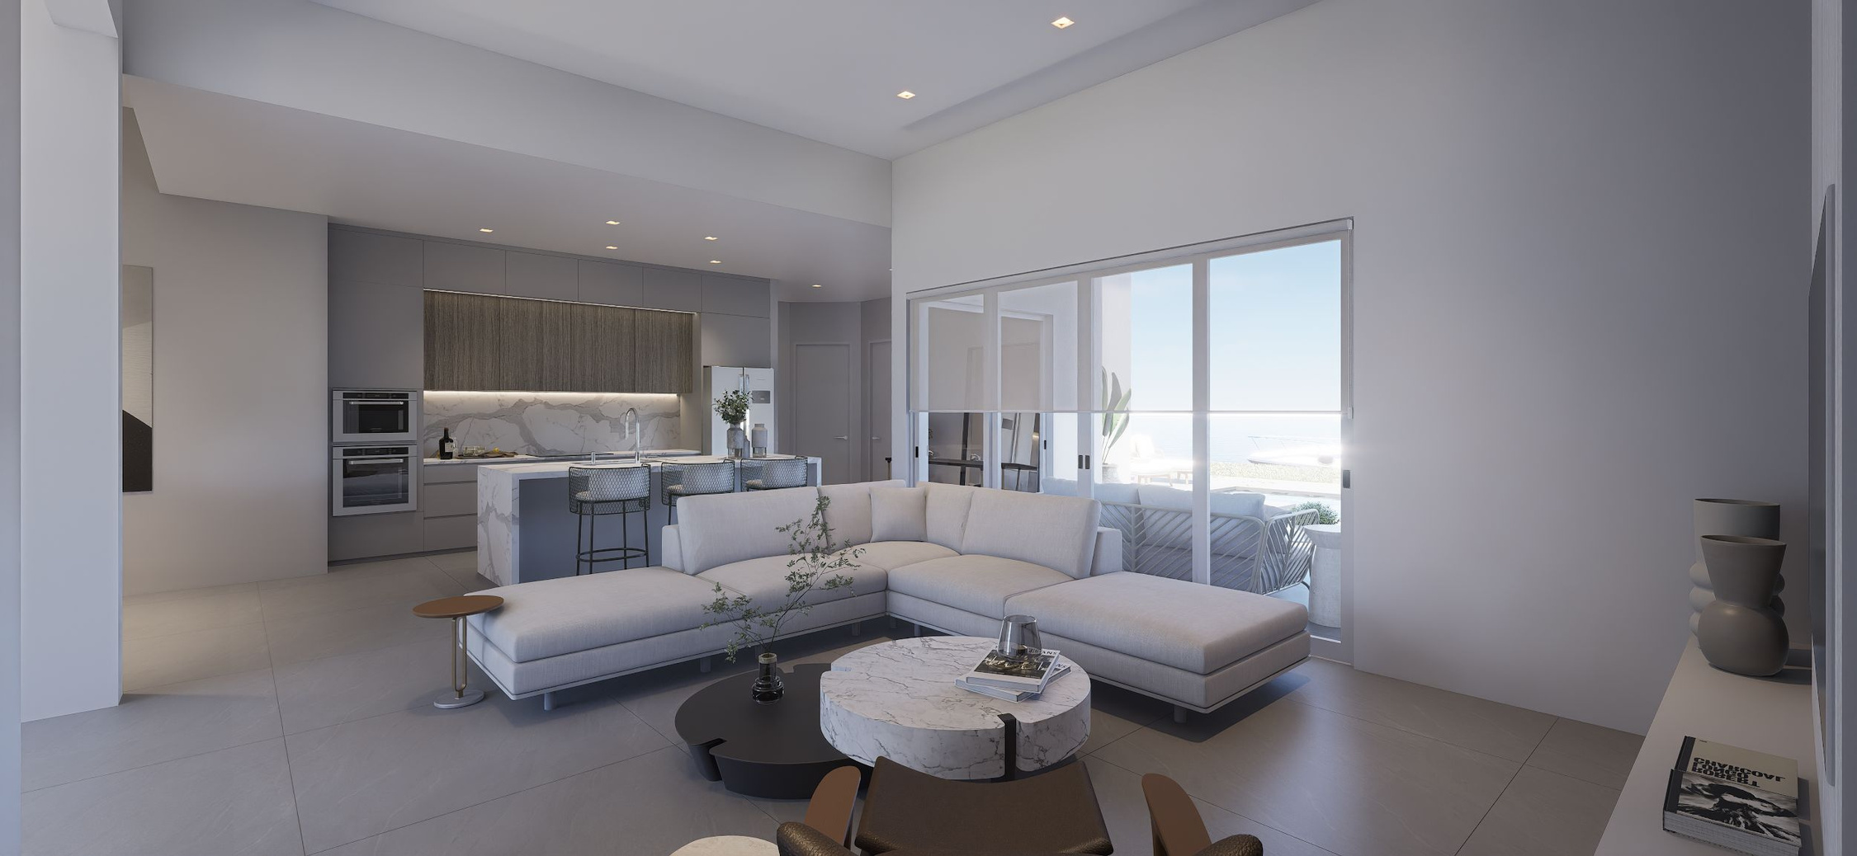

Slide 35
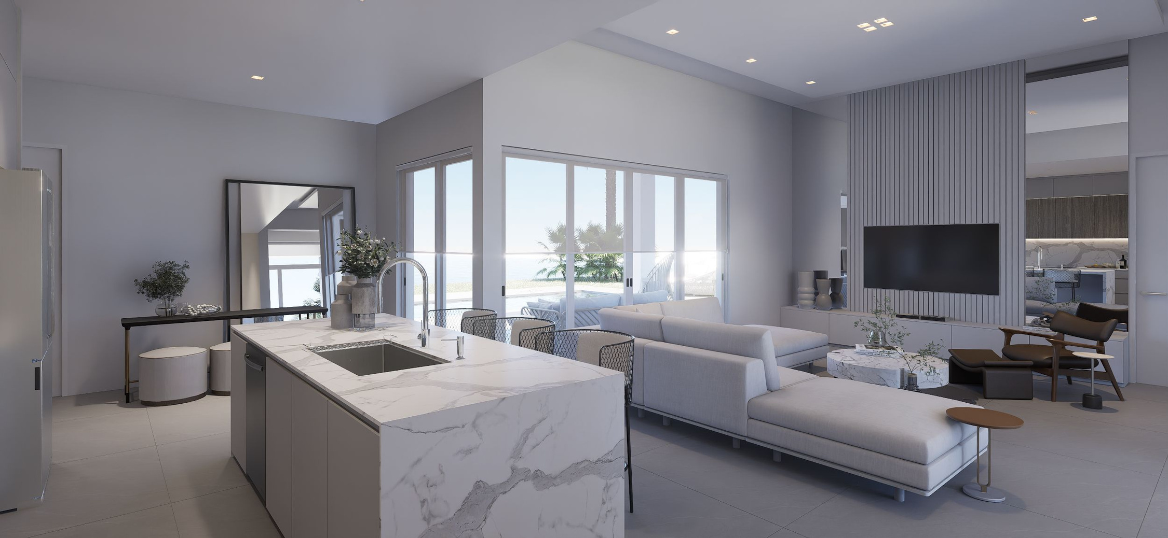

Slide 36
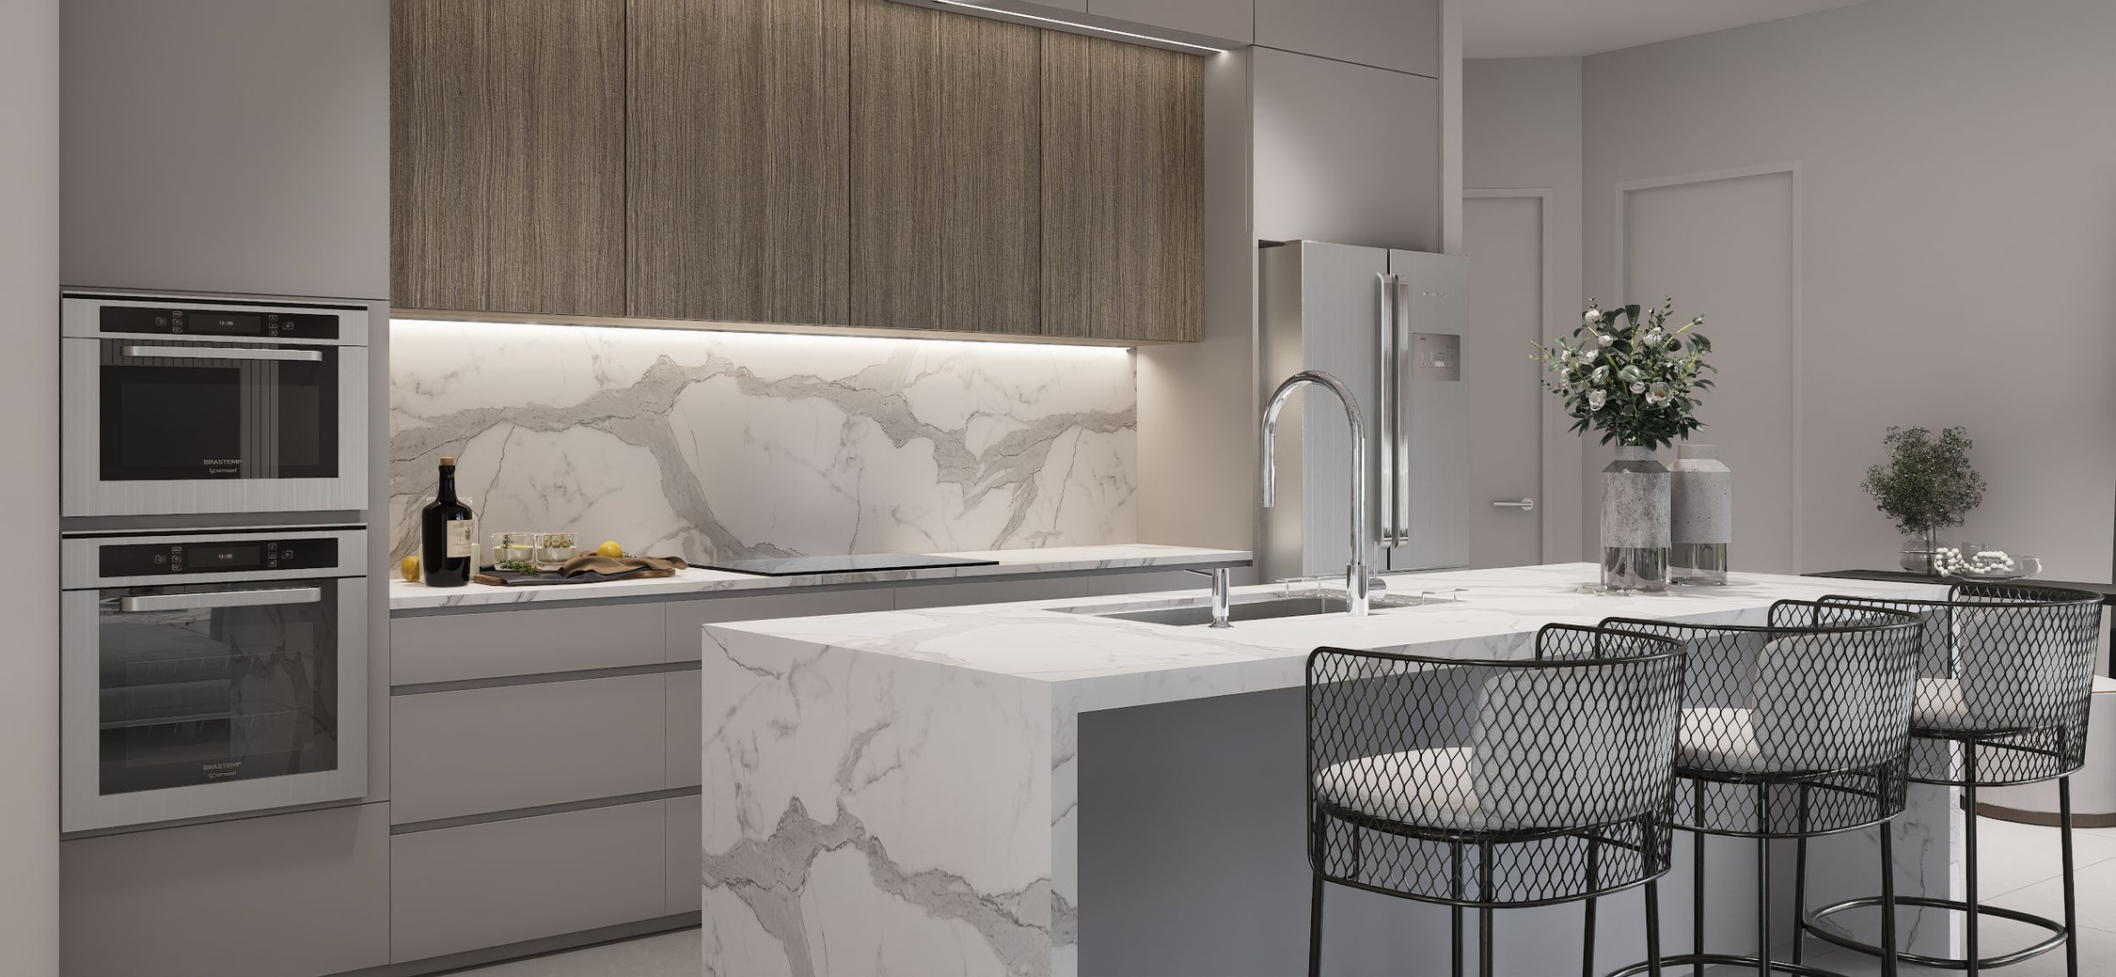

Slide 37
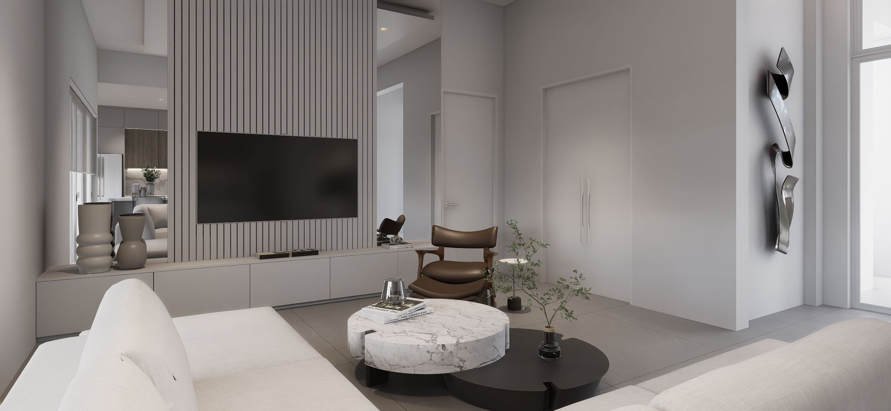

Slide 38

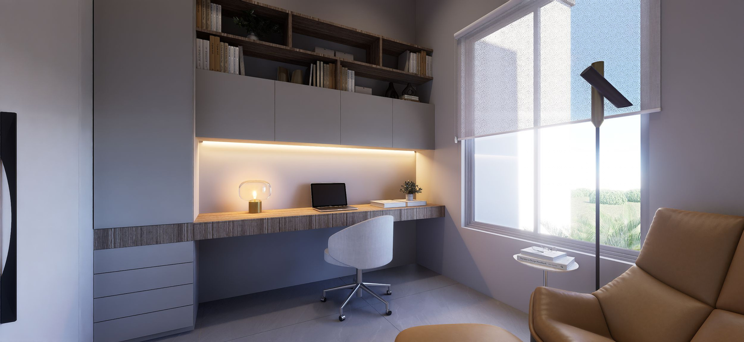

Slide 39
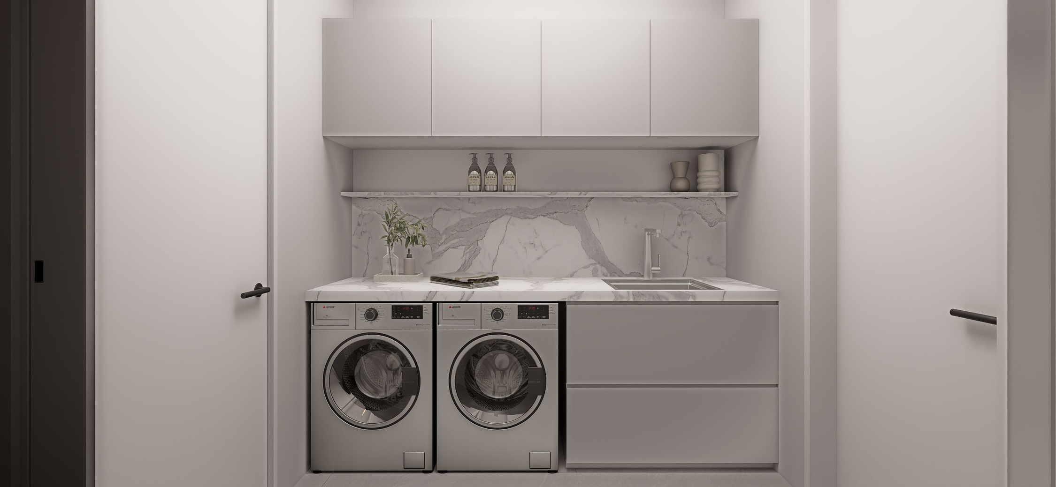

Slide 40
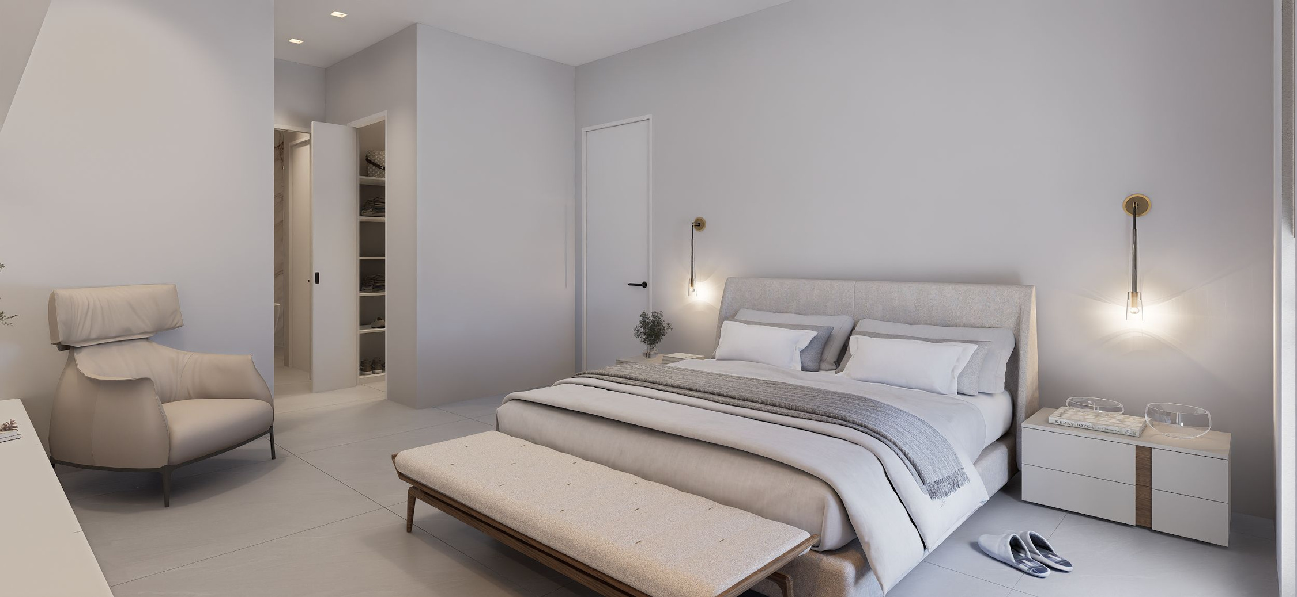

Slide 41
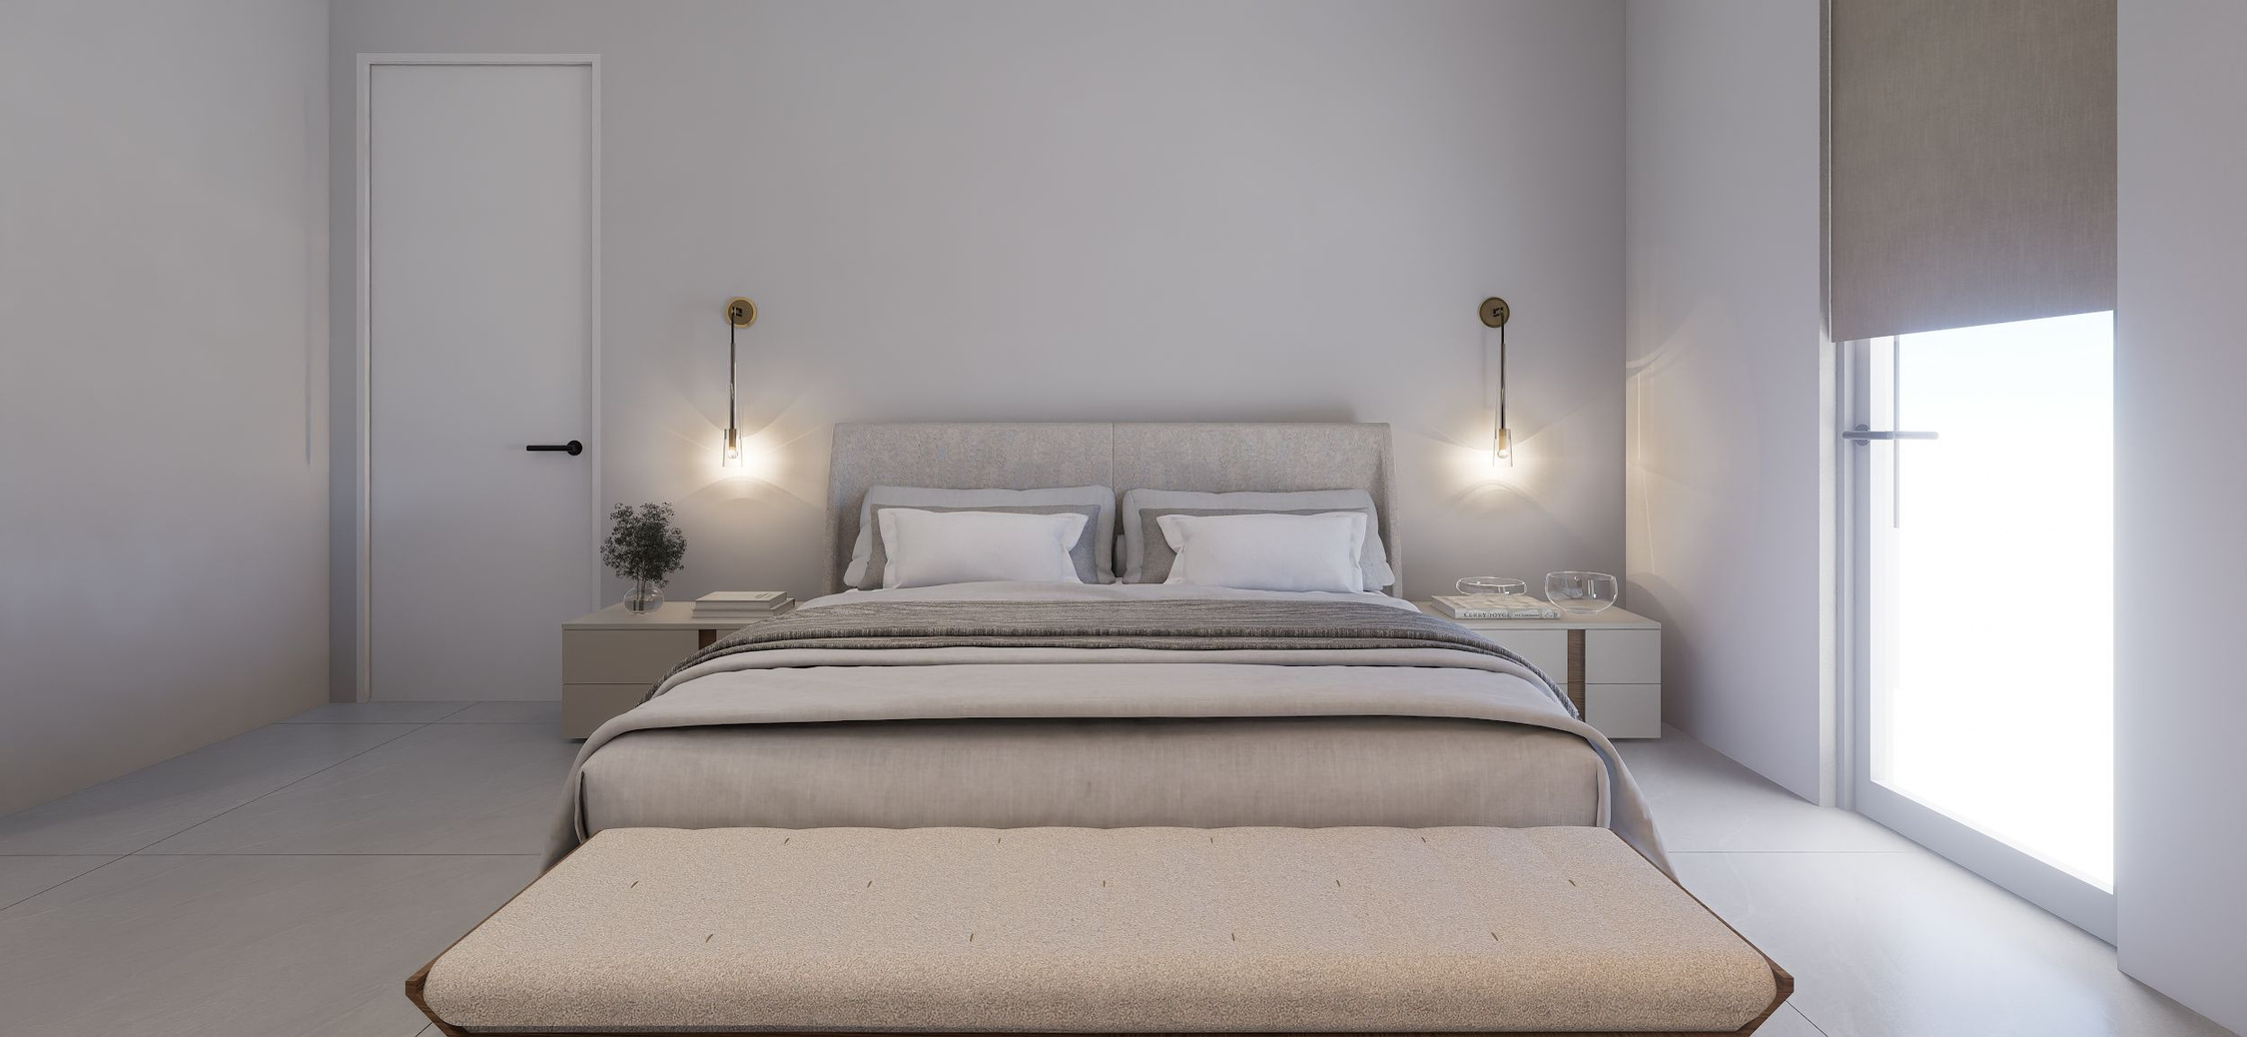

Slide 42
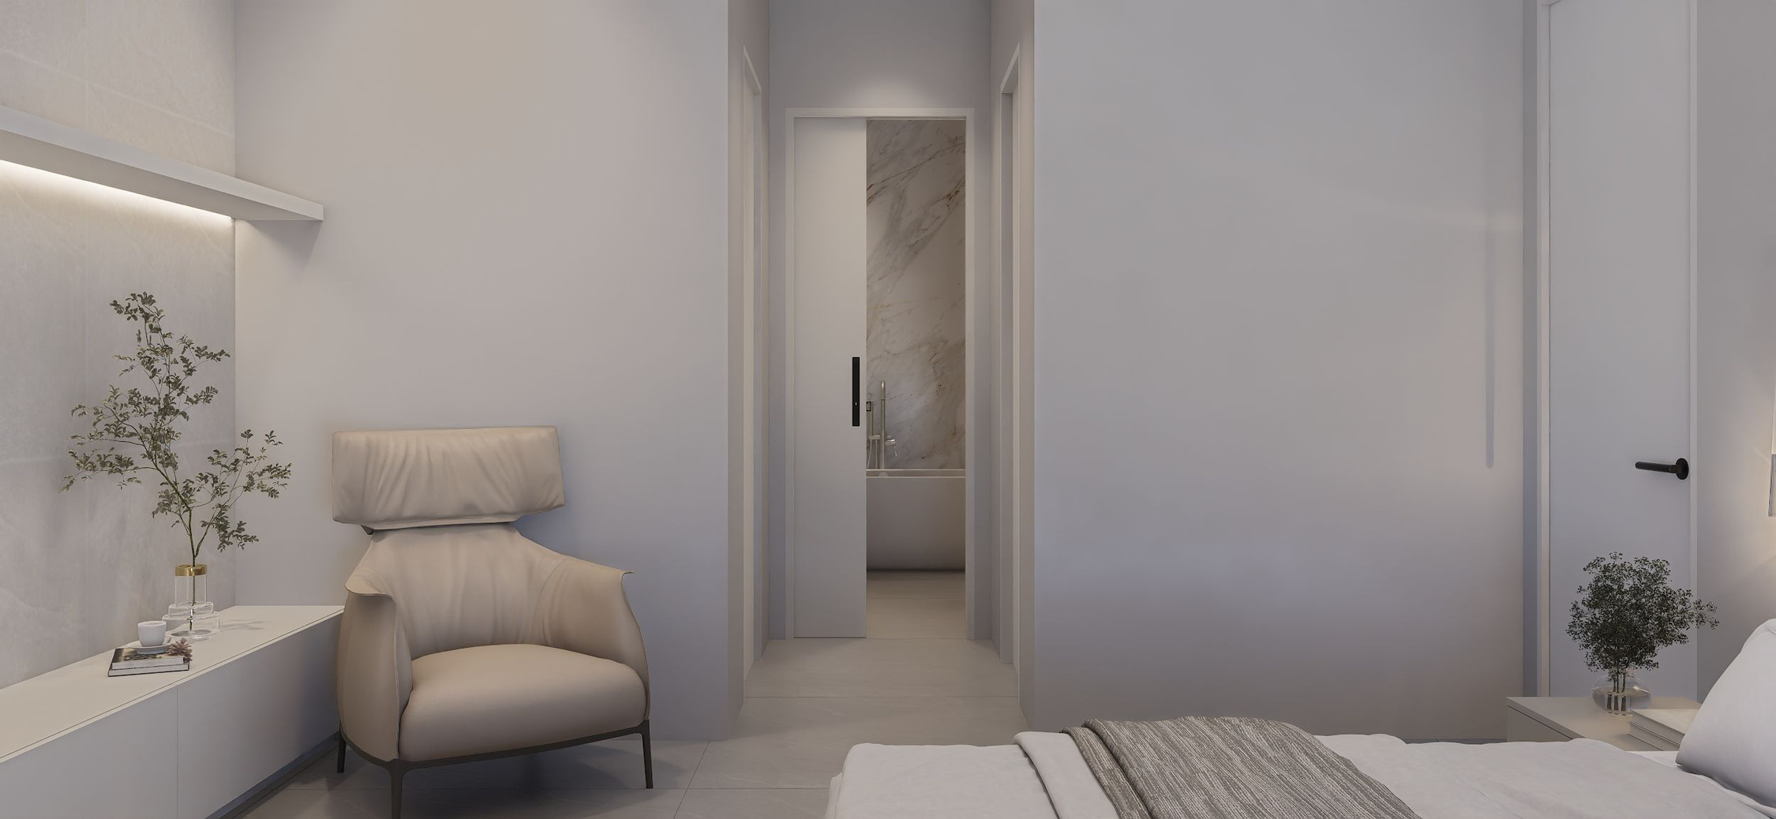

Slide 43
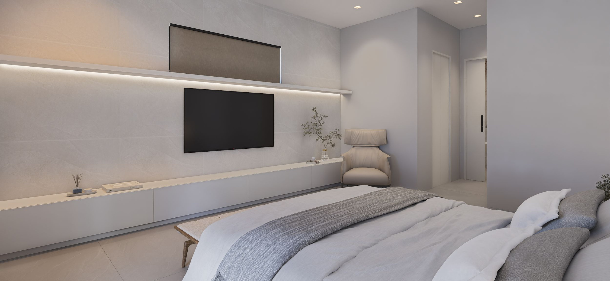

Slide 44
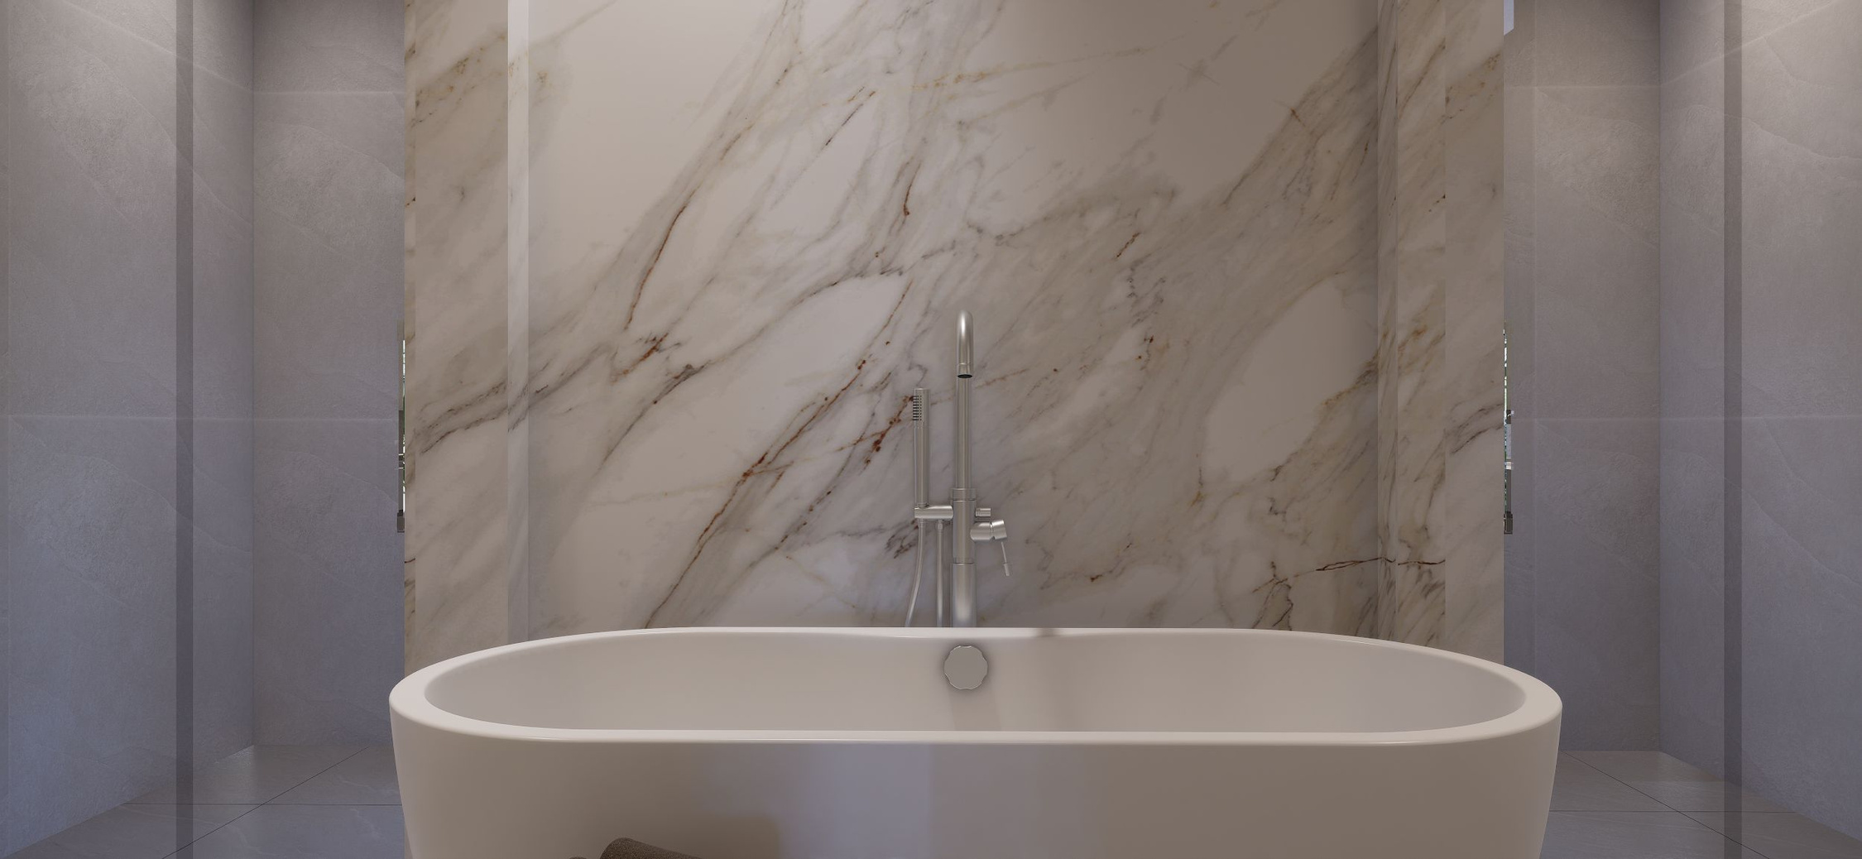

Slide 45
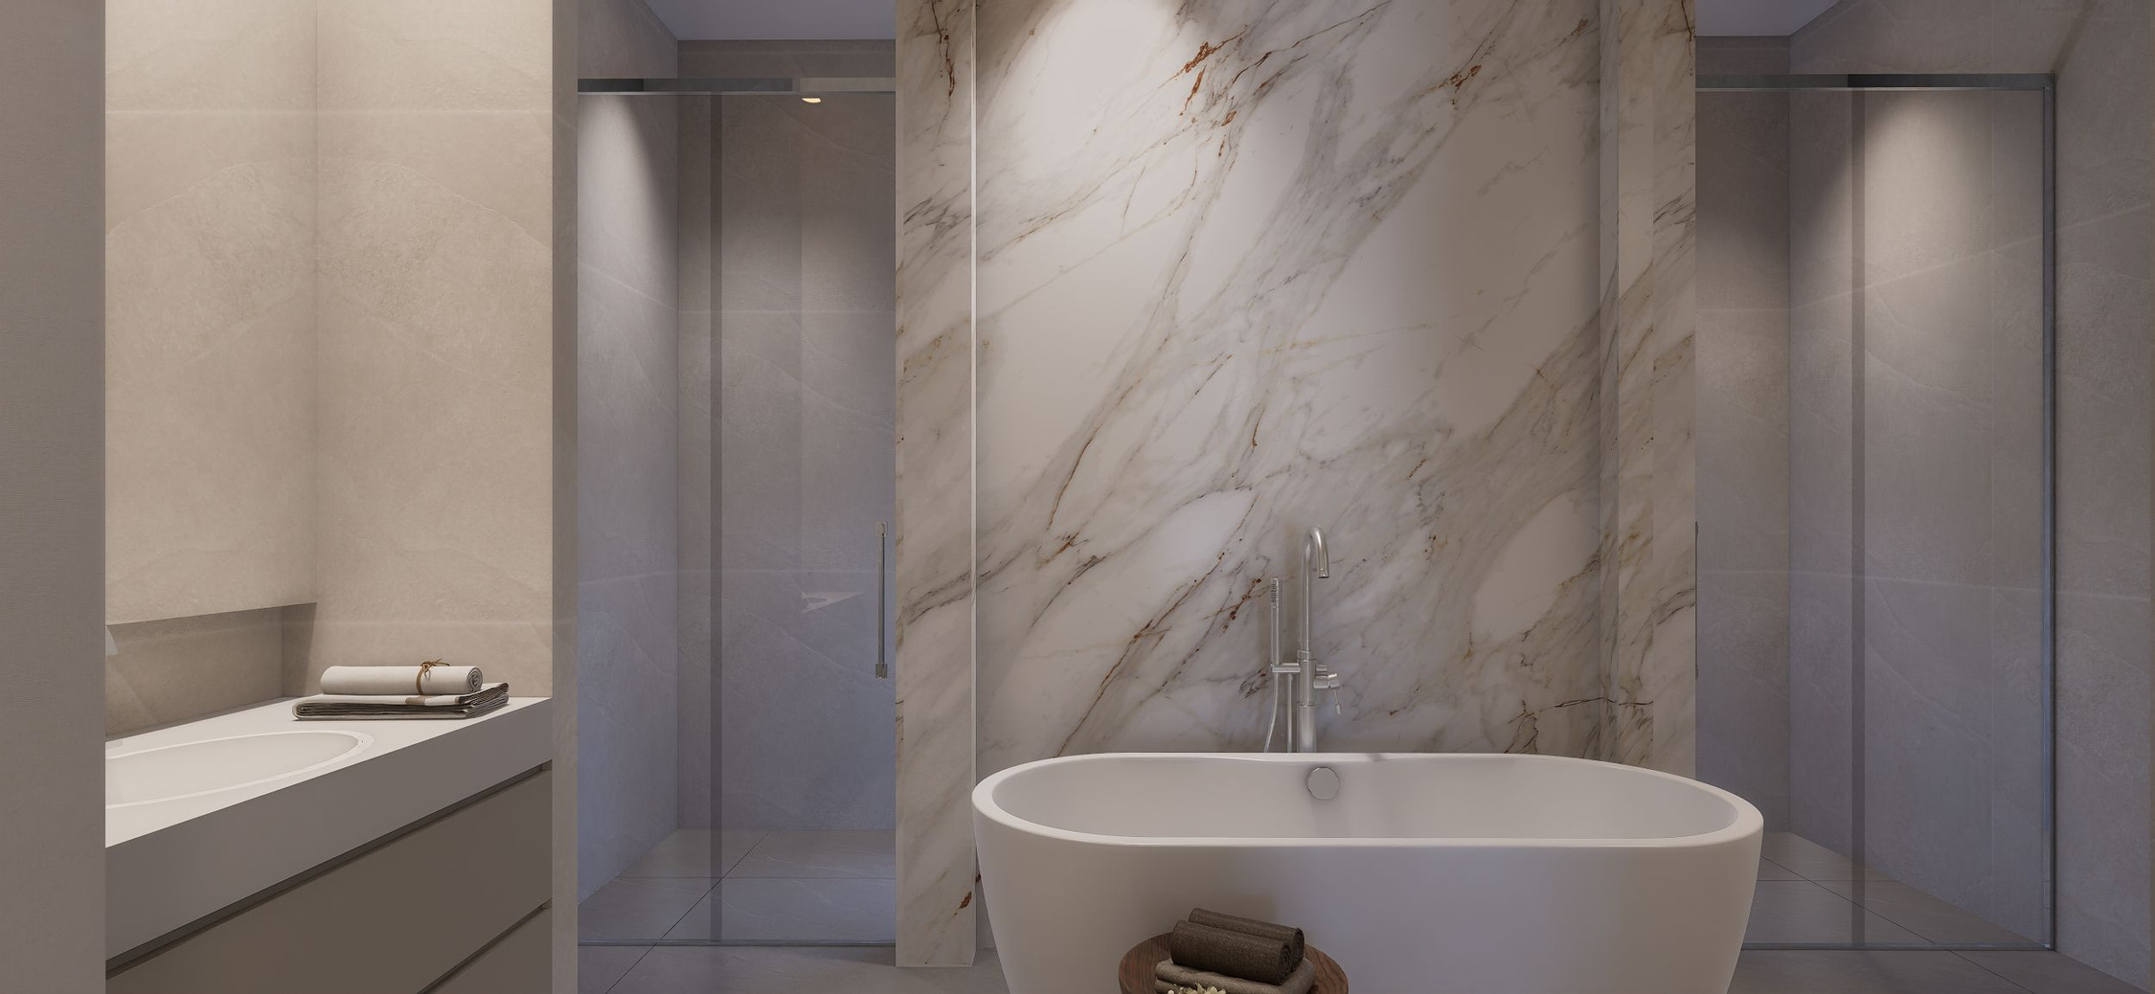

Slide 46
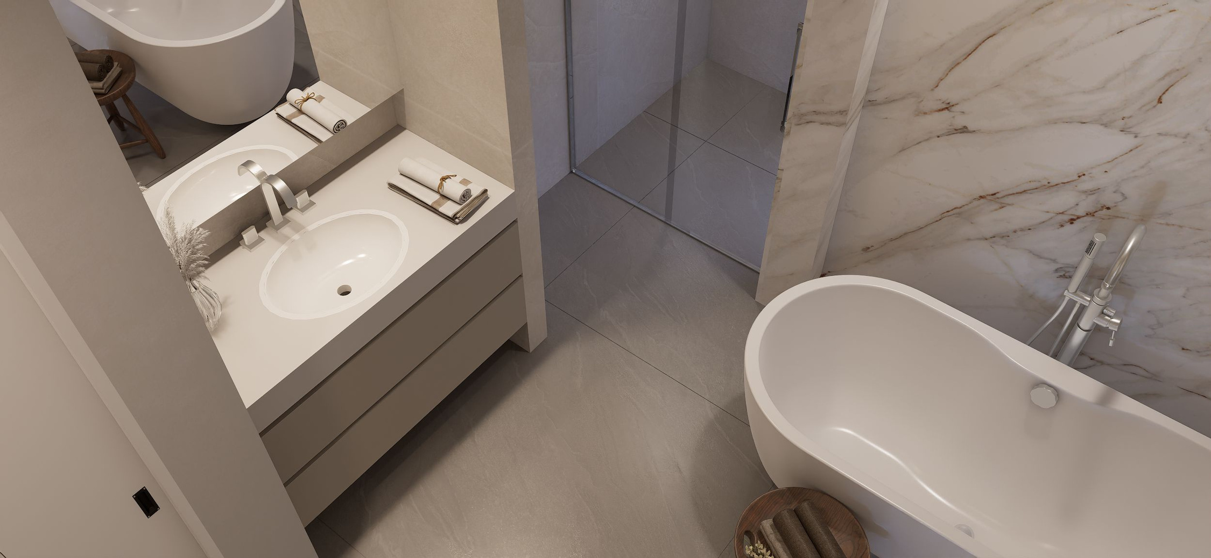

Slide 47
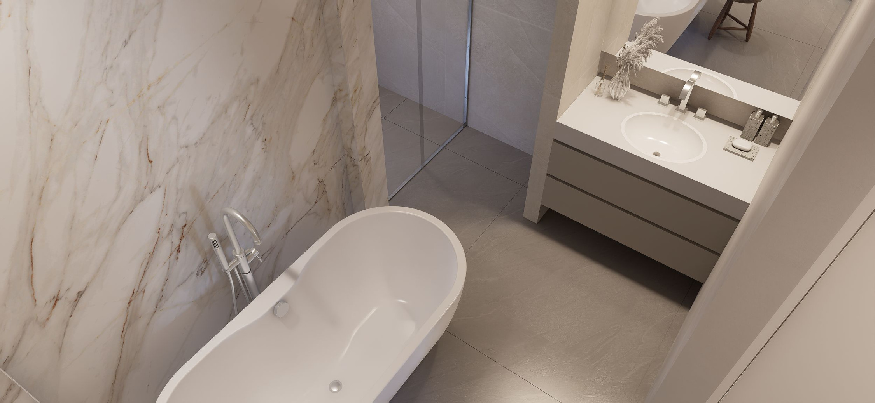

Slide 48
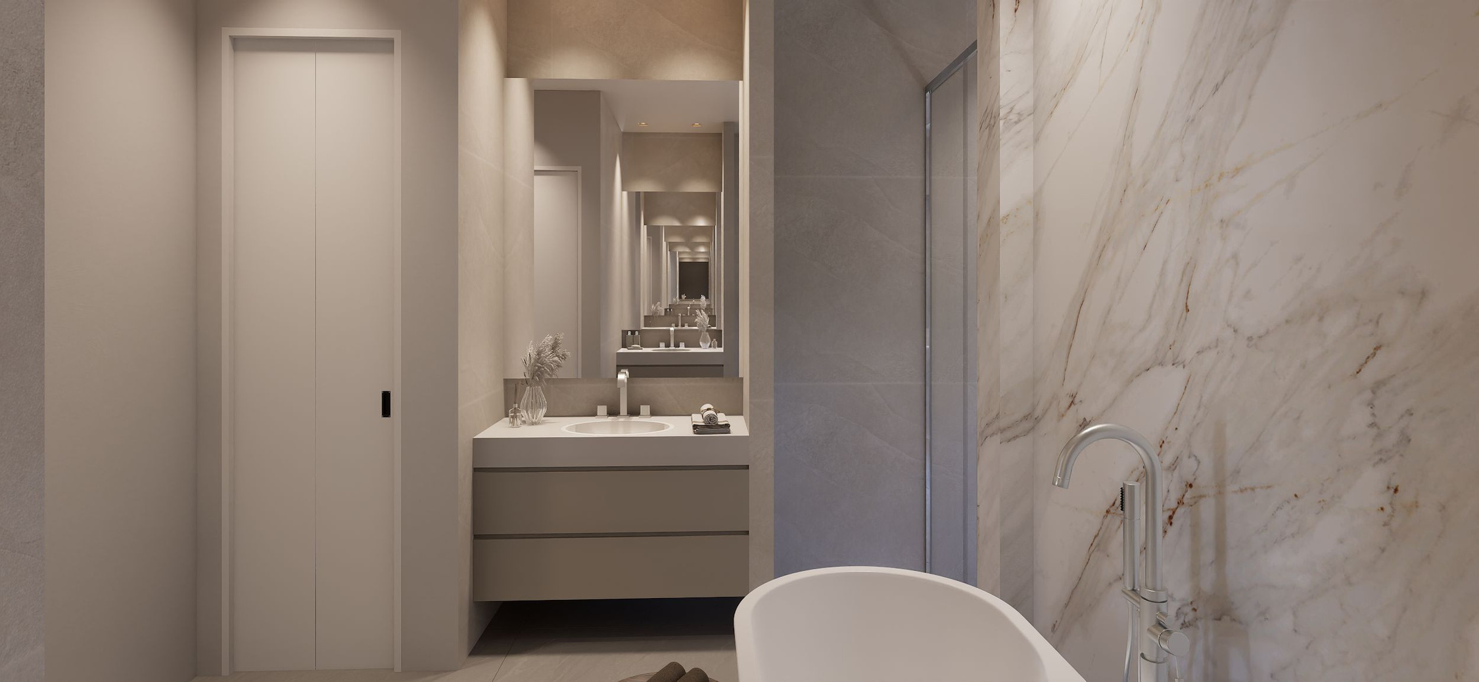

Slide 49

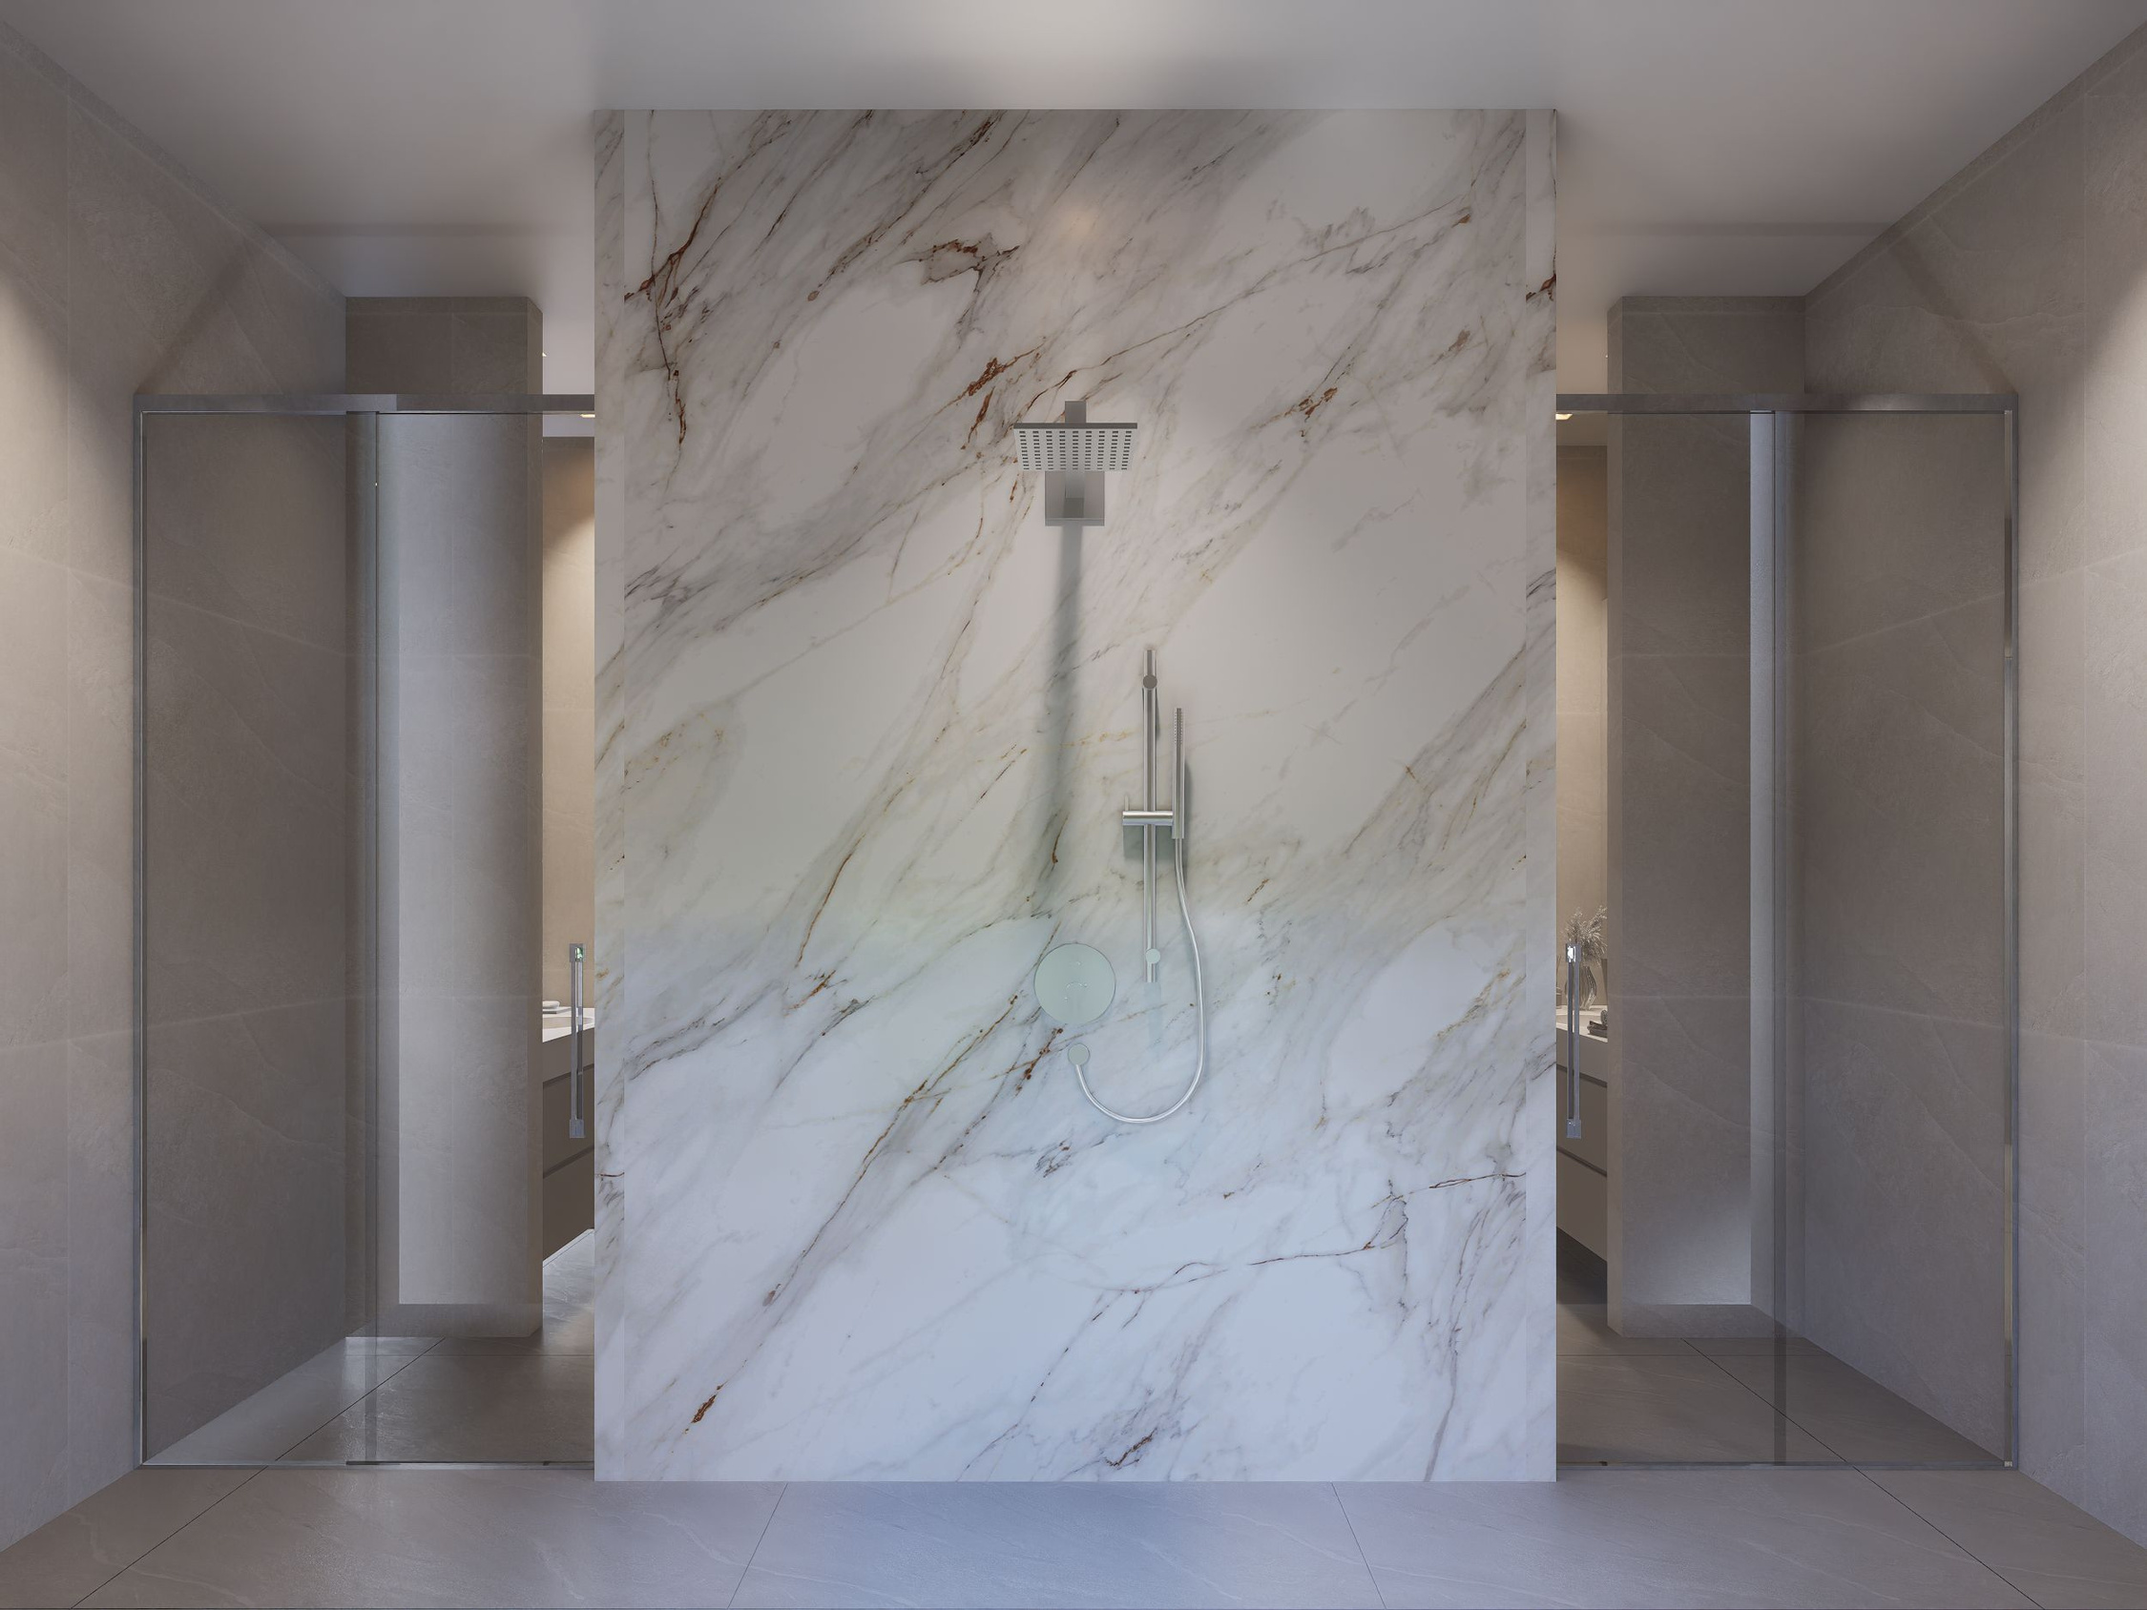

Slide 50
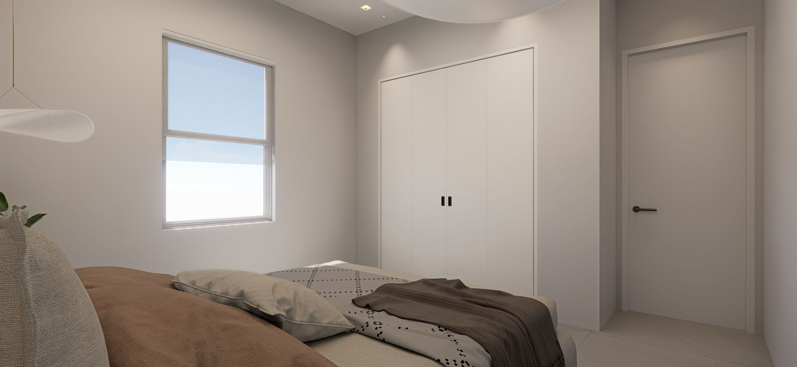

Slide 51
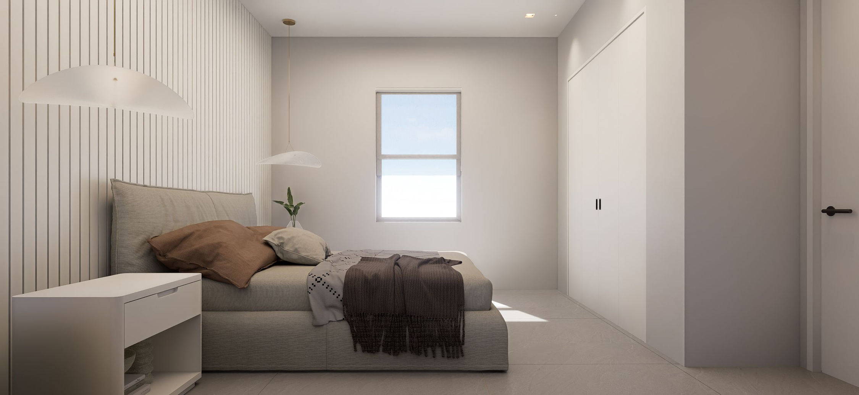

Slide 52
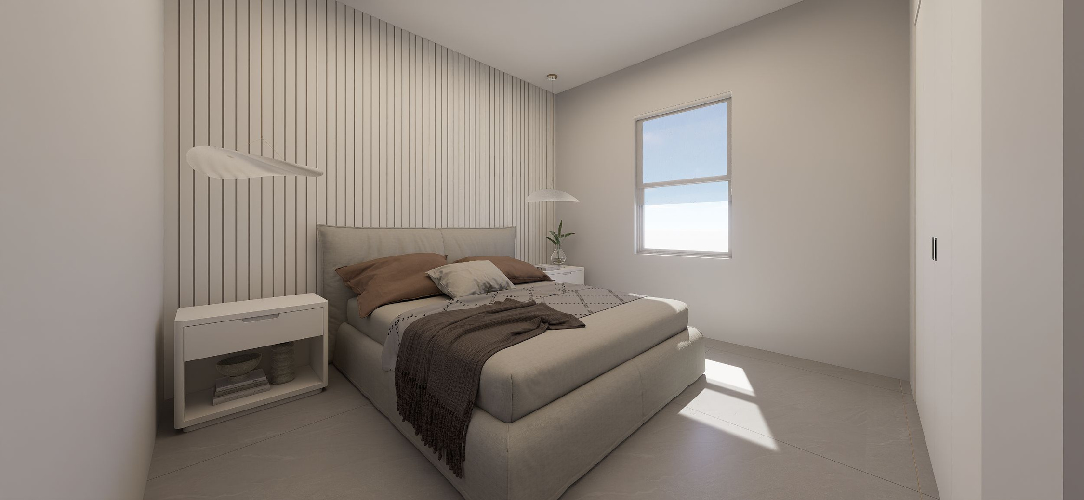

Slide 53
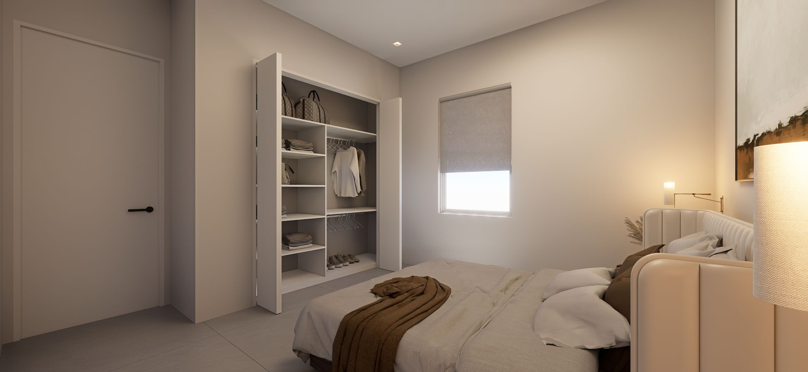

Slide 54
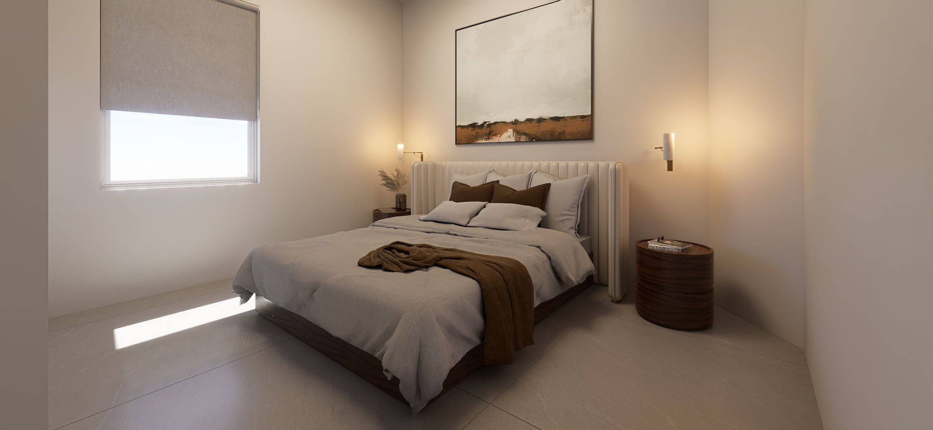

Slide 55
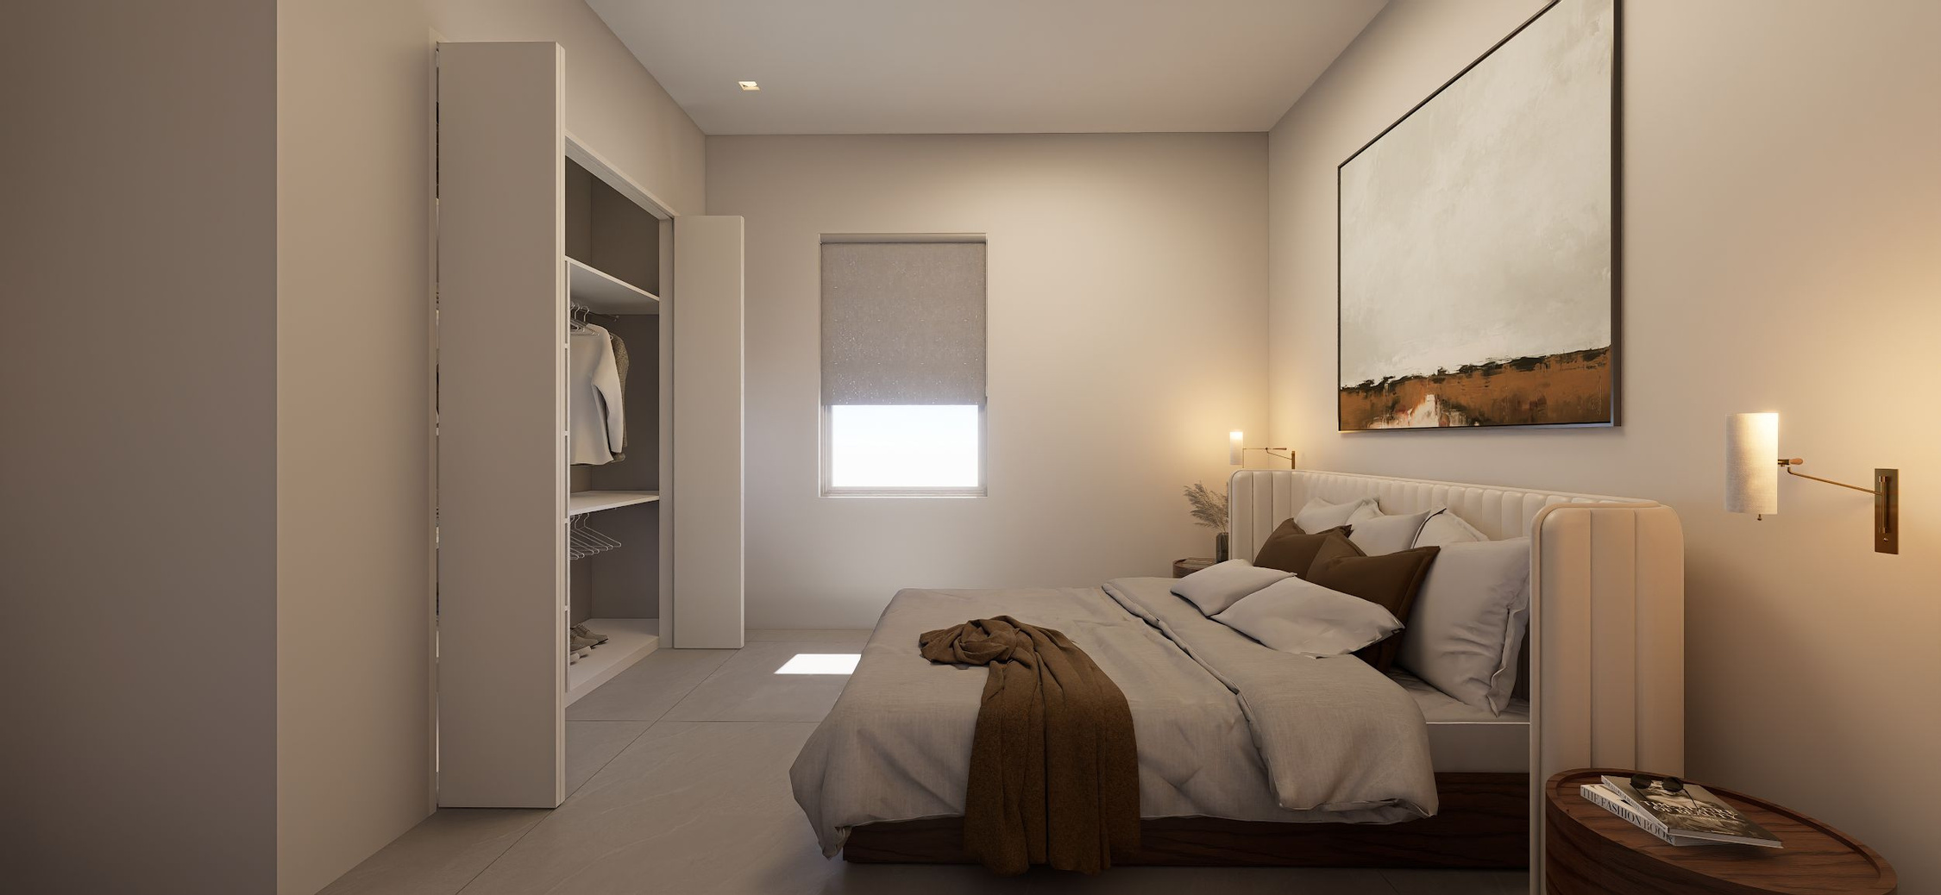

Slide 56
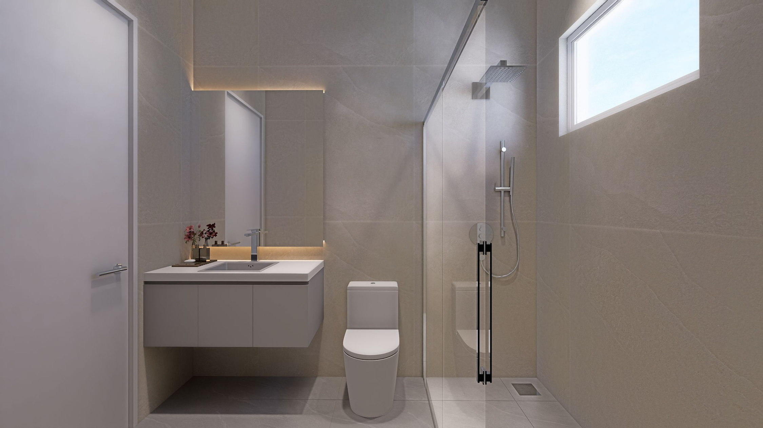

Slide 57

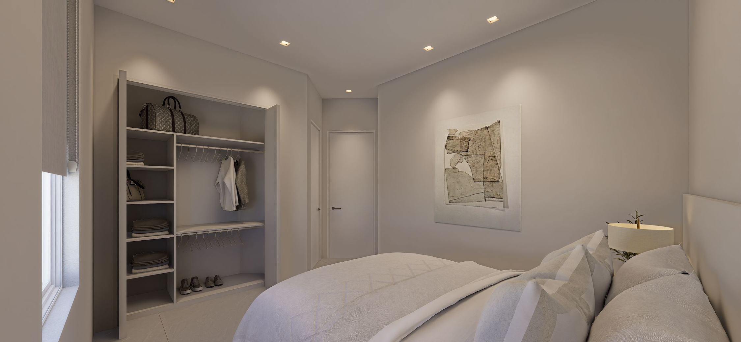

Slide 58


Slide 59



Slide 60


