Slide 1


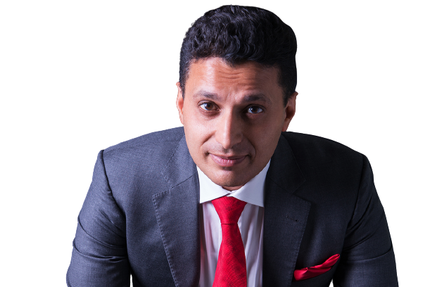

CAREER SPANNING OVER THREE DECADES
GUIDING LEADERS, SALES & TEAMS TO SPEAK LIKE A WISE CEO
Be A Speaking Genius In Conversations, Public Speaking, Rough & Tough Talks
POWER OF HIGH-STAKES COMMUNICATION
Your communication defines your leadership, sales, and team impact. Communication determines leadership effectiveness, sales impact, and team performance. In boardrooms, sales pitches, and high-pressure discussions, the ability to speak with clarity and influence separates those who lead from those who follow.
Rohit Bassi equips professionals with the tools to master high-stakes conversations. With 30+ years of experience across 21+ countries, he has helped leaders, sales and corporate teams sharpen their ability to persuade, lead, and collaborate with impact. His keynotes deliver real-world results that drive success.
Rohit has delivered sessions for brands like Honeywell, Oracle, World Bank, and many more guiding professionals in transforming communication into a strategic advantage. His approach is built on the 4Cs: Courage, Clarity, Conviction, and Compassion.
WATCH ROHIT
IN ACTION 2:30
WHY HIRE ROHIT BASSI?
30+ Years of Experience - educating leaders, sales and teams
Spoken in 21+ countries to 51+ nationalities
Featured on TED & is part of the National Academy of Best-Selling Authors®
Clients Have Achieved:
Closed deals worth millions in revenue
Improved influence and persuasion skills by over 80%
Strengthened resilience and adaptability under pressure
“He identified with his audience and communicated in their language.” Tim Forster, Head of UK Recruitment, PwC – UK
“He can move crowds so that the crowds can move mountains.” Marcelly Suhali, VP of Sales, Walton International – Singapore
“He is awesome. One of the very few legit individuals in the industry.” Talal Ghandour, Managing Director, Bank of America Merrill Lynch – UAE
THREE HIGH-IMPACT KEYNOTES FOR LEADERS, SALES & TEAMS
"Speak Like a Wise CEO"
High-Impact Leadership Communication for Teams
For: Leaders, managers, cross-functional teams
Key Takeaways:
Communicate with confidence, clarity, and authority
The CEO communication framework—speak like a leader
Manage rough and tough conversations to create alignment and collaboration
ROI: Improved team dynamics, stronger workplace communication, and reduced conflicts
"How to Sell a Brick for $1,000"
Sales Influence & Persuasion for High-Value Selling
For: Sales teams, business development, revenue leaders
Key Takeaways:
Shift from price-based selling to value-based persuasion
The art of making any product or service compelling
Handle objections, control conversations, and close high-value deals
ROI: Sales teams increase conversion rates and drive higher revenue
”The Leader Said I DO to W.E.D”
Commitment & Decision-Making for Leadership Success
For: Board members, C-Suite, executives, senior leadership teams
Key Takeaways:
The psychology of leadership commitment and decisive action
Inspire trust, loyalty, and engagement in teams
The W.E.D. Framework—a leadership decision-making model for long-term success
ROI: Stronger leadership, better decision-making, and enhanced team performance
BOOK ROHIT FOR YOUR NEXT EVENT roi@roitalks.com | www.rohitbassi.com | +971 (0)55 553 2275
"Secure a high-impact keynote that transforms leaders, sales, and teams. Book Rohit today."

