Slide 1

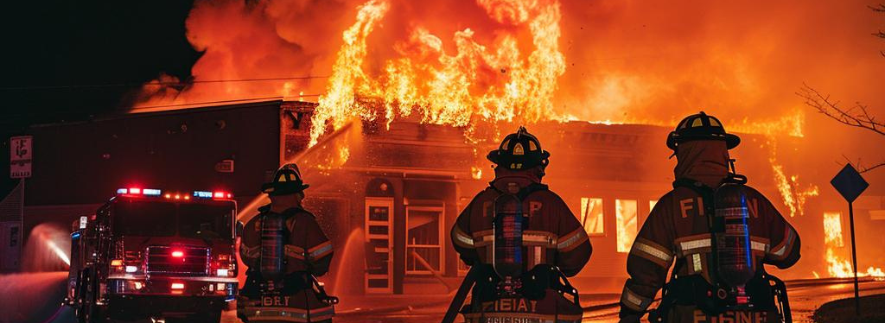
Course: Can you hear me now, When you need it?
DAS UNIVERSITY Summit - Live
Instructor: Rick Rausch

Slide 2
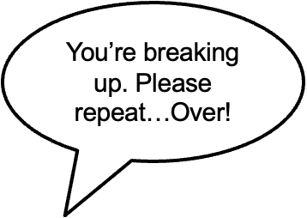
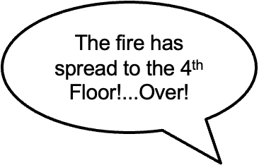
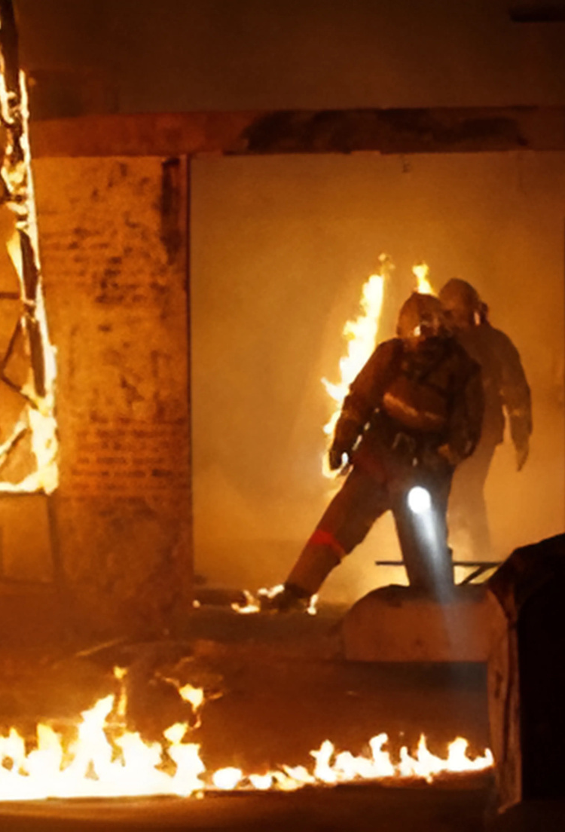
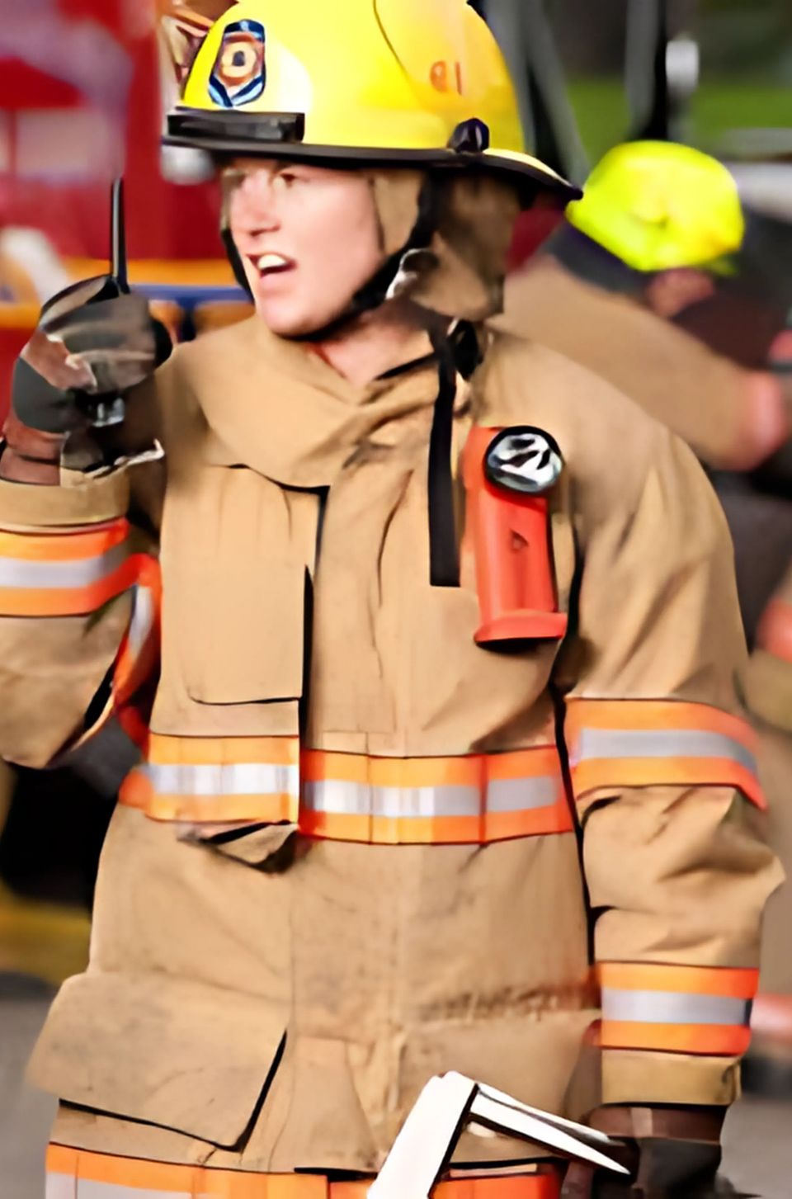

Failure to
COMMUNICATE
CAN YOU HEAR ME NOW WHEN YOU NEED IT?

Slide 3
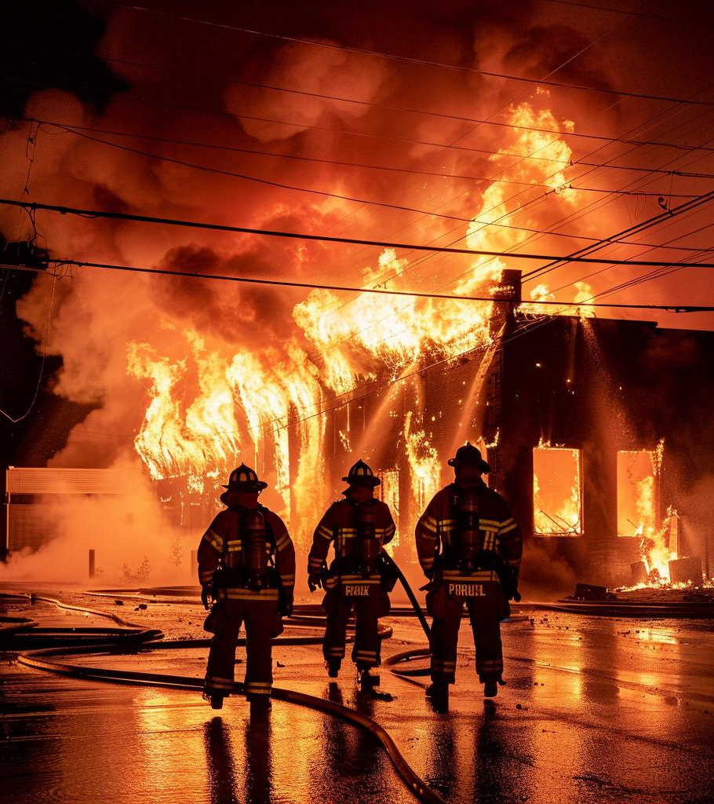

Incident
REPORT
NIOSH LODD REPORT RELEASED ON FIRE AND COLLAPSE IN COMMERCIAL STRUCTURE WHICH KILLED 2 CHICAGO FIREFIGHTERS
Key Recommendations Included:
• Provide all fire fighters with radios and train them on their proper use

Slide 4
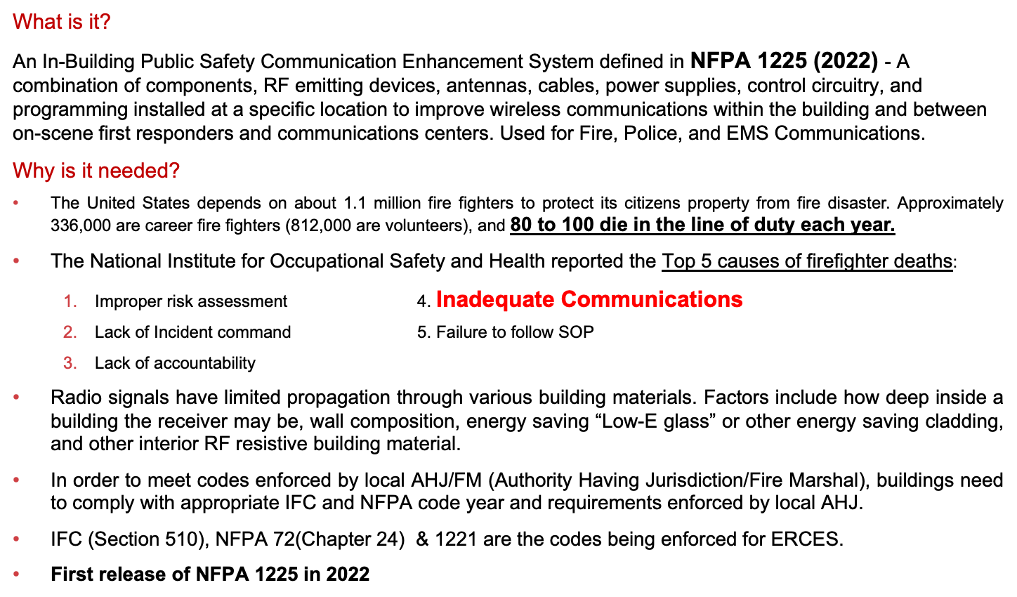


PUBLIC SAFETY INTRO - ERCES
COPYRIGHT 2025 DAS UNIVERSITY. ALL RIGHTS RESERVED | DASUNIVERSITY.ORG

Slide 5
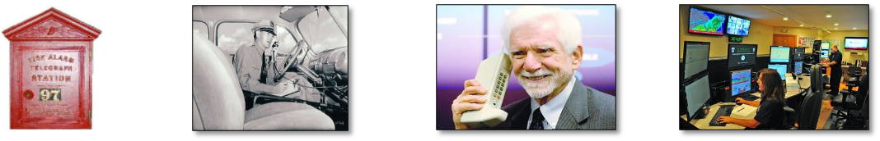
HISTORY OF FIRE COMMUNICATION
  1852: First fire box was installed using telegraph technology
  1896: National Fire Protection Association (NFPA)
  1923: First two-way radio developed in Australia
  1940s: Motorola two-way radio widely used in WWII
  1950s: Two-way radio market shifted to Fire, Police
    and EMS
  1973: First cellular phone call
  1997: International Building Code published
  1999: Wireless Communications and Public Safety Act
    passed
  2009: First Model Code Language for In-Building Public Safety Radio – NFPA 72.
  2018: First Standard for ERCES Actives = UL 2524
  2022: NFPA 1225 – Code focused on Public Safety Communications and ERCES details
COPYRIGHT 2025 DAS UNIVERSITY. ALL RIGHTS RESERVED | DASUNIVERSITY.ORG

Slide 6
Public Safety AND TELECOM ACRONYMS
• ERCES = Emergency Responder Communication Enhancement System (ERRCS and ERCS are different)
• NFPA = National Fire Protection Association
• IFC = International Fire Code
• FCC = Federal Communications Commission
• AHJ = Authority Having Jurisdiction
• RF = Radio Frequency
• DAS = Distributed Antenna System
• BDA = Bi-Directional Amplifier / Indoor Repeater
• LTE = Long Term Evolution
• NRTL = National Recognized Testing Laboratory
• TX/RX = Transmit/Receive
• UL/DL = Uplink/Downlink
• GROL = General Radiotelephone Operators License
• NICET = National Institute for Certification in Engineering Technologies
• dBm = dB per milliwatt is the measurement of RF power
• SINR = Signal-to-Noise Ratio
• BER = Bit Error Rate
• DAQ = Delivered Audio Quality
EPO = Emergency Power Off
COPYRIGHT 2025 DAS UNIVERSITY. ALL RIGHTS RESERVED | DASUNIVERSITY.ORG

Slide 7

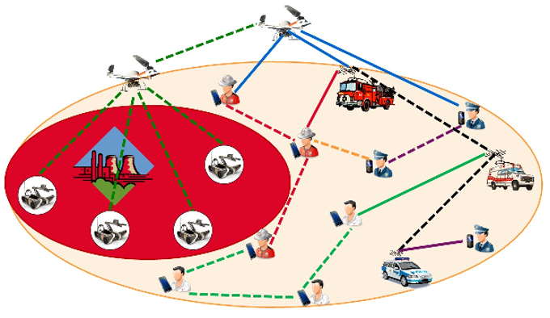
Public Safety FREQUENCIES
•Very High Frequency (VHF):
152 MHz to 174 MHz – long range, difficult to get and configure repeaters, Simplex or Duplex technology
•Ultra High Frequency (UHF):
450 MHz – 512 MHz – Medium range, made for repeater systems and commercial/industrial
•700 MHz: Mix of narrowband Public Safety voice channels, wideband data in FirstNet band 14
•800 MHz: Used extensively by Public Safety for wide area radio networks
WHAT BAND(S) DOES YOUR JURISDICTION USE?
COPYRIGHT 2025 DAS UNIVERSITY. ALL RIGHTS RESERVED | DASUNIVERSITY.ORG

Slide 8

•Interoperable communications for first responders
•Network and capacity to support broadband for data
•Expand LTE to more rural areas of US
•700 MHz (758-768 MHz and 788-798 MHz)
•ALL 50 STATES HAVE OPTED IN!!
•Leverages existing AT&T network utilizing all LTE bands
•AT&T aggressively rolled out this network since 2019 and completed Urban/Suburban areas by 2024.
• March 2022 – AT&T mandates FirstNet Notch Filters to be deployed on DAS/BDA Systems that retransmit Public Safety 700MHz
COPYRIGHT 2025 DAS UNIVERSITY. ALL RIGHTS RESERVED | DASUNIVERSITY.ORG
Notes:
Share Broward County 700MHz BDA interference issue

Slide 9
2019 FIRST RESPONDER SURVEY BY SAFER BUILDINGS COALITION
First Responder Communications inside building of incident location:
63% of communication made with Wireless Carrier personal devices
37% on assigned 2-way radio Public Safety Network
  Why is it that only 37% use 2-way Radios on site?
COPYRIGHT 2025 DAS UNIVERSITY. ALL RIGHTS RESERVED | DASUNIVERSITY.ORG

Slide 10
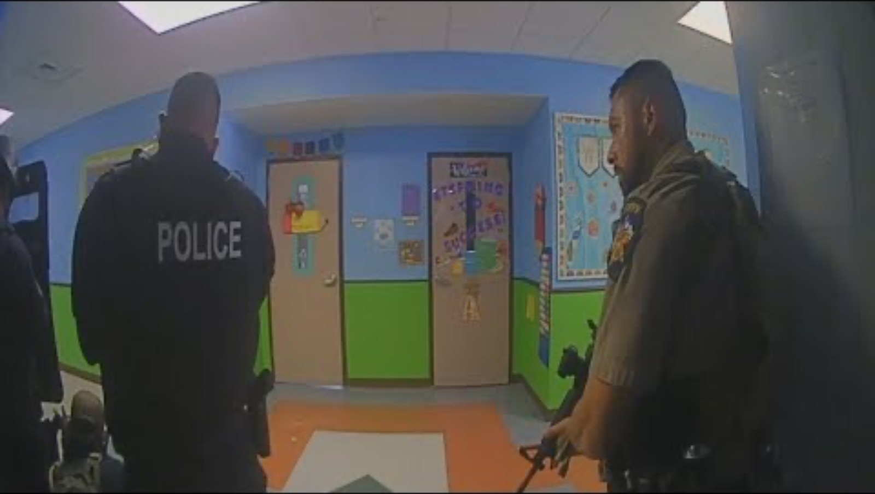
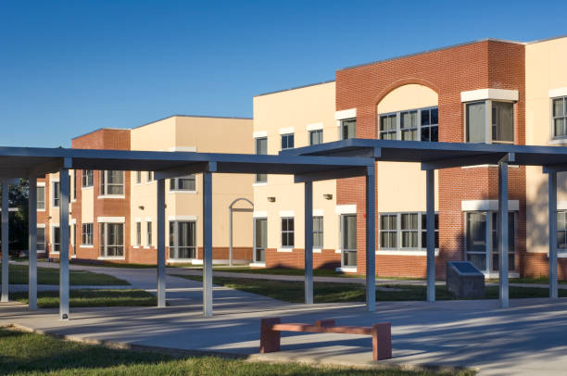
UVALDE TX – ROBB ELEMENTARY SCHOOL SHOOTING – NEWS REPORT ON RADIO COMMUNICATIONS
COPYRIGHT 2025 DAS UNIVERSITY. ALL RIGHTS RESERVED | DASUNIVERSITY.ORG
Notes:
Communications or radios didn’t work. Why??
No indoor RF coverage
PS Tower not close enough to provide indoor coverage
Weak outdoor coverage
Outdated 2-way radios

Slide 11
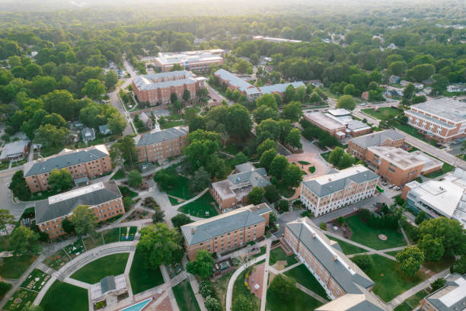
SCHOOL SAFETY SURVEY SAFER BUILDING COALITION / UNIVERSITY TEST RESULTS
Public School Building Radio Coverage Testing
Pass/Fail in the state of FL 2018-2022:
48% of floors of all buildings PASS
52% of floors of all buildings FAIL
-------------------------------------------------------------------
  University Tested 220 buildings:
  95 Passed = 43%
  125 Failed = 57%
COPYRIGHT 2025 DAS UNIVERSITY. ALL RIGHTS RESERVED | DASUNIVERSITY.ORG

Slide 12

RESPONSIBLE STAKE HOLDERS
• Local AHJ Enforcement: Fire, Radio Authority, Police, Public Schools/Universities
• OEMs (including Distributors): BDA/BBU, Fiber DAS, passives, antennas, coax cable
• System Integrators: RF Testing, Design, Installation, Maintaining
• Building owners – REIT, Developer, GC, PE/Architects, Schools
• FCC & License Holder = State/County/City Radio Authority
• Wireless Carriers
COPYRIGHT 2025 DAS UNIVERSITY. ALL RIGHTS RESERVED | DASUNIVERSITY.ORG

Slide 13
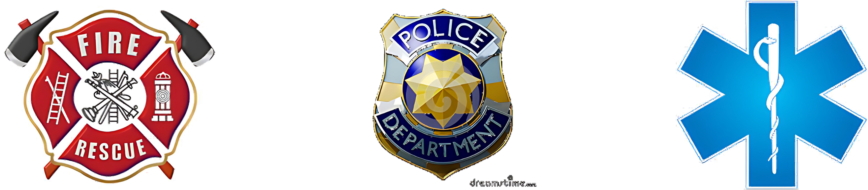
Why Do Public Safety In-building Regulations Fall Under
FIRE DEPARTMENT CODE ENFORCEMENT?????
• Responsible Services: Police, Fire, EMS,
Radio Authority=FCC License Holder)
• NFPA, IFC, State and local Codes
• Building Department / Electrical Department
• Only Public Safety Code Enforcement with Fire Safety
• Annual Inspections = FIRE
COPYRIGHT 2025 DAS UNIVERSITY. ALL RIGHTS RESERVED | DASUNIVERSITY.ORG

Slide 14
FCC LICENSE HOLDER
• Responsible for the 2-way radio macro network used for providing RF coverage for all First responders
• Handle Retransmission agreement forms for BDA/DAS approval and registration
• Provide Technical and RF guidance and requirements for ERCES
• Should collaborate with Fire Marshal Team to write local AHJ Documents for ERCES requirements
• Should test RF Network tower reception of BDA system UL RSSI levels and require UL gain decrease when excessive noise rise occurs
COPYRIGHT 2025 DAS UNIVERSITY. ALL RIGHTS RESERVED | DASUNIVERSITY.ORG
Notes:
Share Miami case

Slide 15
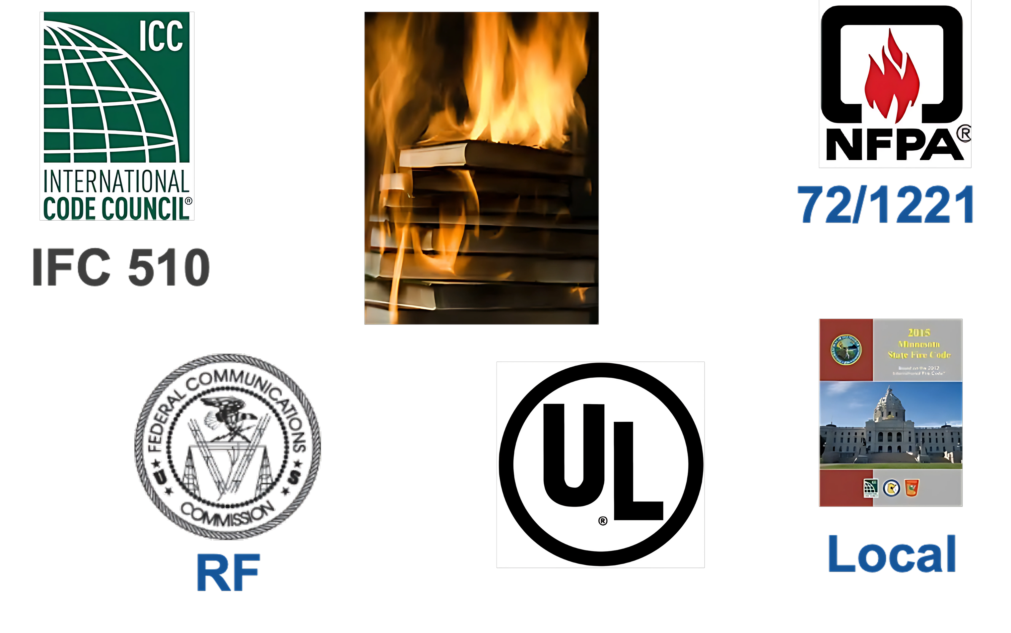
Codes & Standards
COPYRIGHT 2025 DAS UNIVERSITY. ALL RIGHTS RESERVED | DASUNIVERSITY.ORG

Slide 16

WHAT IS UL2524
UL 2524 STANDARD FOR SAFETY:
In-building 2-Way Emergency Radio Communication Enhancement Systems Includes:
•Minimum enclosure specs, NEMA4 testing
•Electrical safety of active components
•Meets minimum environmental conditions
•Durability, Strike tests
•Alarms operate as needed to comply with NFPA
•Only covers BDA, Battery Backup, Alarm Panel, other active (powered) devices
COPYRIGHT 2025 DAS UNIVERSITY. ALL RIGHTS RESERVED | DASUNIVERSITY.ORG

Slide 17
WHAT UL2524 IS NOT
Does NOT Include:
RF system performance or Specs
Passive components, cables, antennas
Grid Testing
Design
Installation
RF Coverage from the system
Operational performance within a building
COPYRIGHT 2025 DAS UNIVERSITY. ALL RIGHTS RESERVED | DASUNIVERSITY.ORG

Slide 18
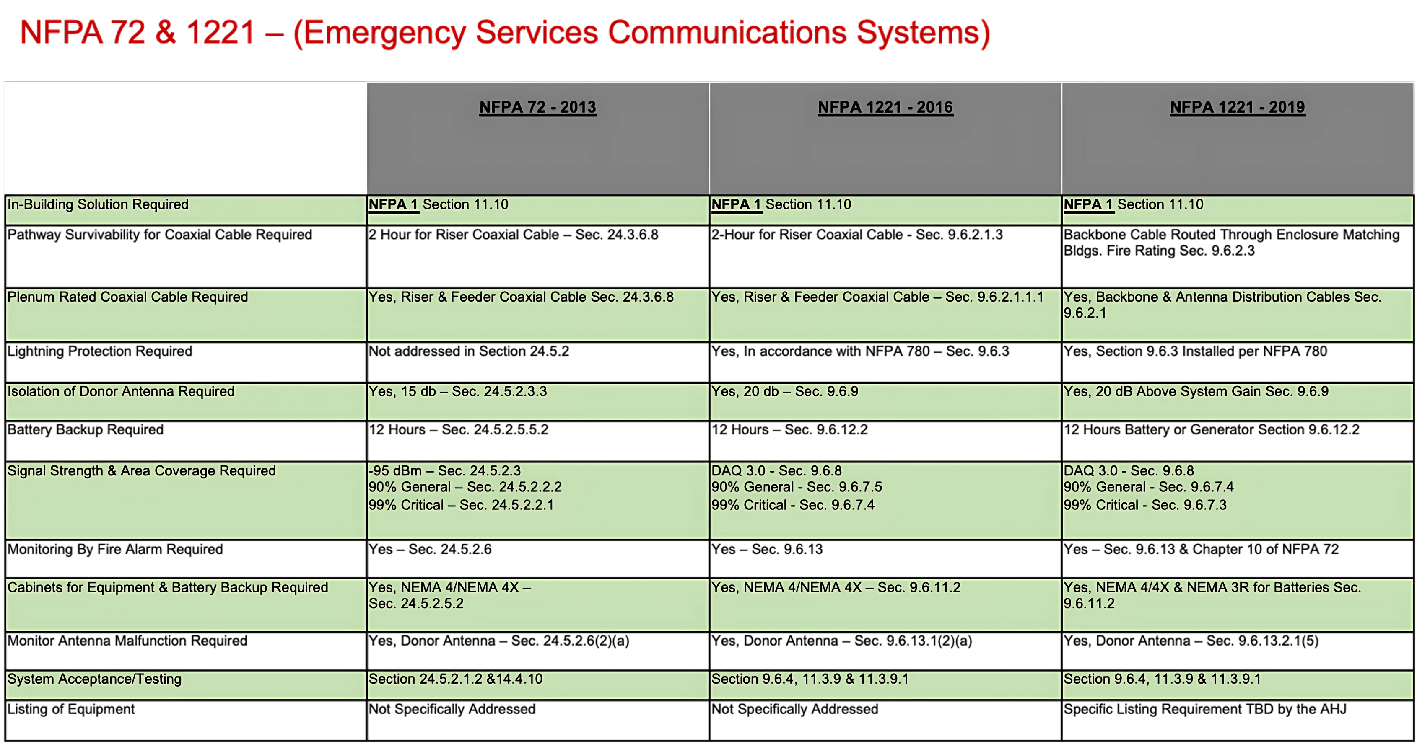
Code Comparison NFPA/1221 2013, 2016, 2019
COPYRIGHT 2025 DAS UNIVERSITY. ALL RIGHTS RESERVED | DASUNIVERSITY.ORG
Notes:
12 important PS DAS Topics and Criteria

Slide 19
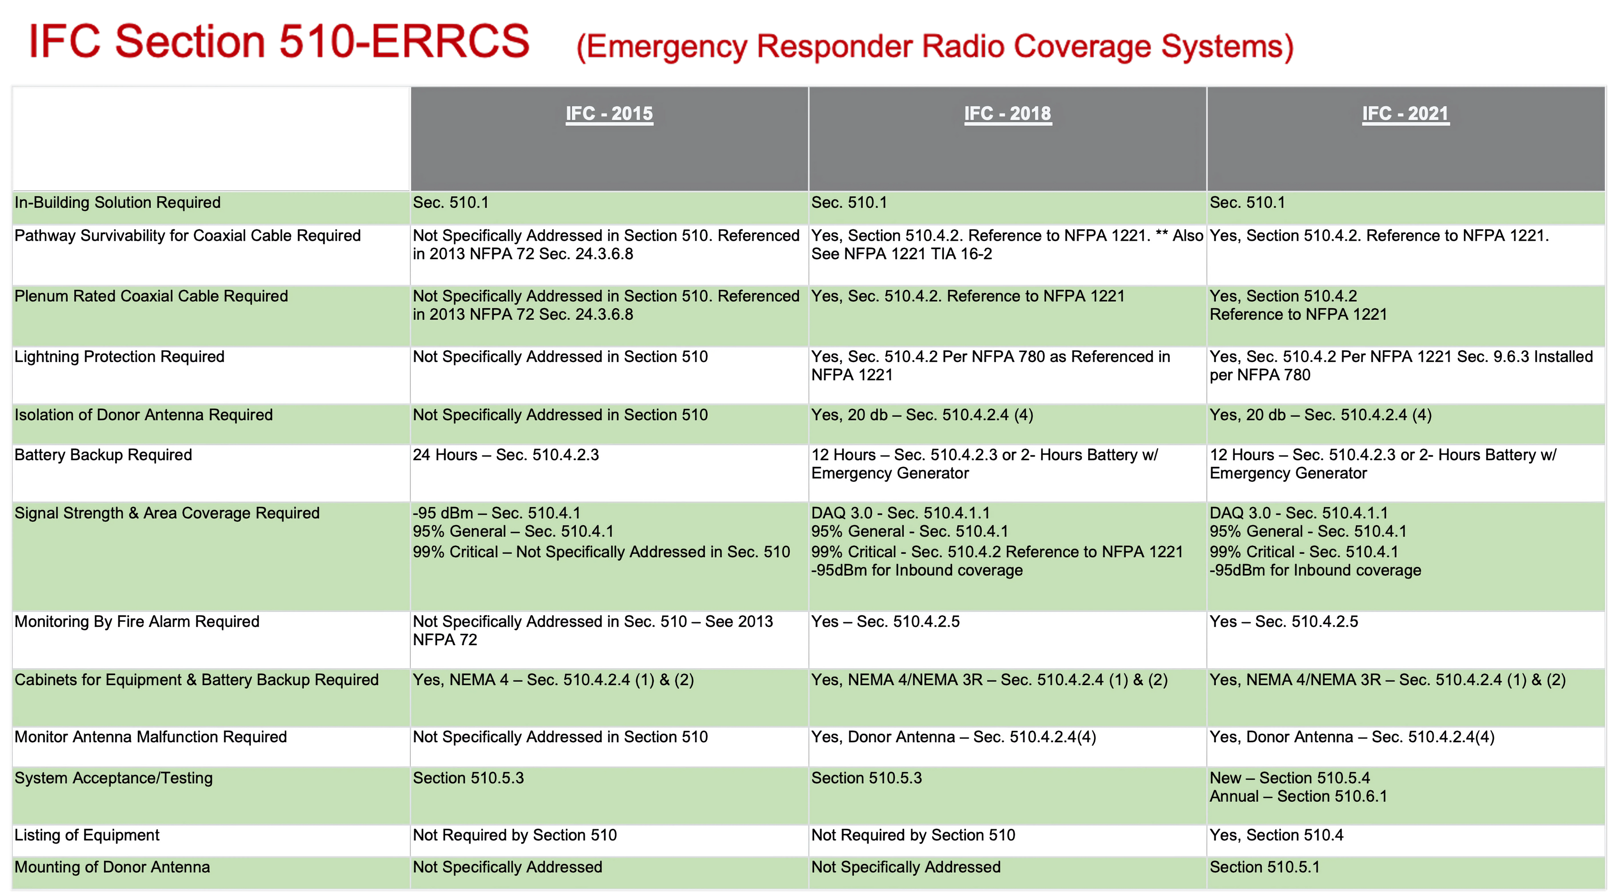
Code Comparison IFC 510 2015, 2018, 2021
COPYRIGHT 2025 DAS UNIVERSITY. ALL RIGHTS RESERVED | DASUNIVERSITY.ORG
Notes:
13 important PS DAS Topics and Criteria

Slide 20
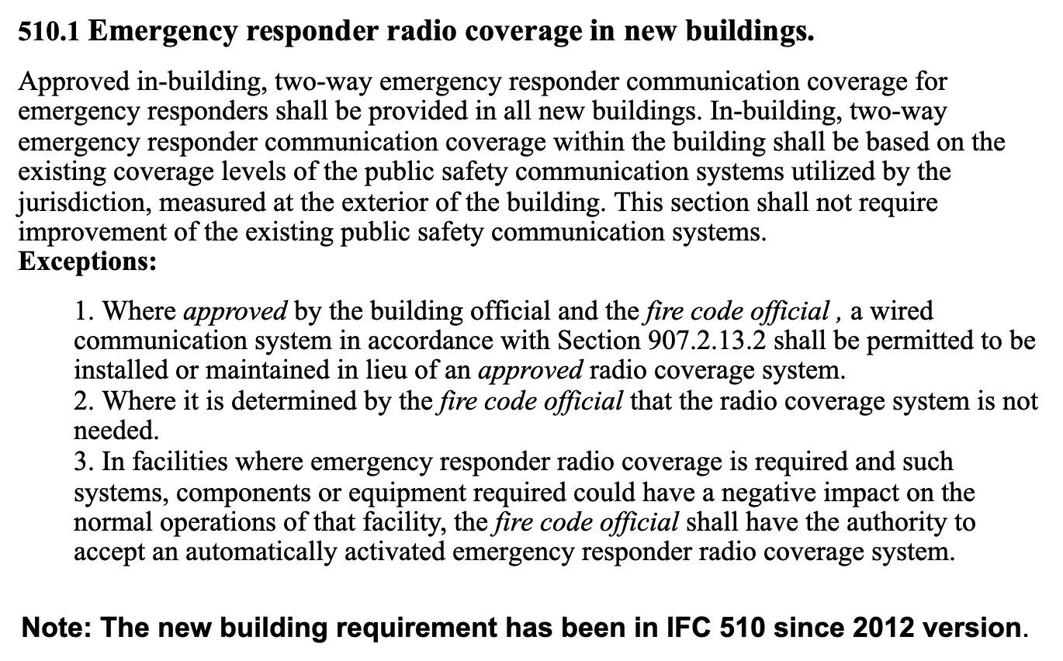
IFC 510 Ch. 11 (2021) NEW CONSTRUCTION REQUIREMENTS
COPYRIGHT 2025 DAS UNIVERSITY. ALL RIGHTS RESERVED | DASUNIVERSITY.ORG
Notes:
When is a PS DAS ERCES System required?? When the Grid Test for Coverage Fails

Slide 21
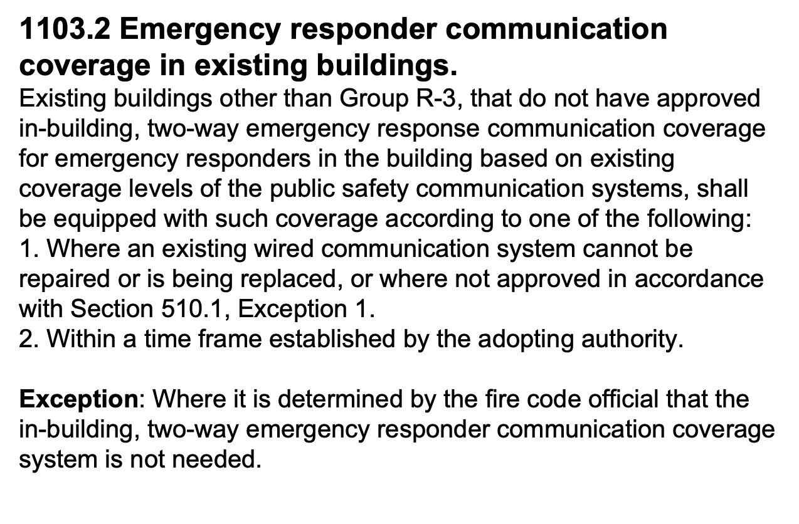
IFC 510 Ch. 11 (2021) EXISTING BUILDINGS
COPYRIGHT 2025 DAS UNIVERSITY. ALL RIGHTS RESERVED | DASUNIVERSITY.ORG

Slide 22
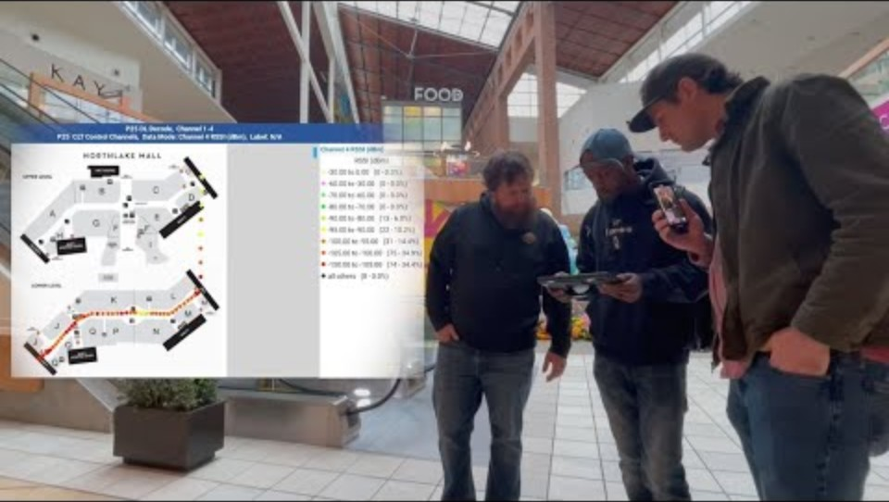
EMERGENCY RADIO FAILURES IN EXISTING BUILDINGS – CHARLOTTE, NC NEWS CAST JULY 2024
COPYRIGHT 2025 DAS UNIVERSITY. ALL RIGHTS RESERVED | DASUNIVERSITY.ORG

Slide 23
2024/2025 Update VERSION OF FL FIRE CODE 633.202 – PAR 18 ERCES
TWO-WAY RADIO COMMUNICATION ENHANCEMENT
(18)(a) The local authority having jurisdiction shall determine the minimum radio signal strength for fire department communications in all new and existing buildings. Two-way radio communication enhancement systems or equivalent systems may be used to comply with the minimum radio signal strength requirements. However, two-way radio communication enhancement systems or equivalent systems are not required in apartment buildings 75 feet or less in height that are constructed using wood framing, provided that the building has less than 150 dwelling units and that all dwelling units discharge to the exterior or to a corridor that leads directly to an exit as defined by the Florida Building Code. Evidence of wood frame construction shall be shown by the owner providing building permit documentation which identifies the construction type as wood frame. Existing high-rise buildings as defined by the Florida Building Code are not required to comply with minimum radio strength for fire department communications and two-way radio communication enhancement systems as required by the Florida Fire Prevention Code until January 1, 2025. However, by January 1, 2024, an existing high-rise building that is not in compliance with the requirements for minimum radio strength for fire department communications must apply for an appropriate permit for the required installation with the local government agency having jurisdiction and must demonstrate that the building will become compliant by January 1, 2025. Existing high-rise apartment buildings are not required to comply until January 1, 2025. However, existing high-rise apartment buildings are required to apply for the appropriate permit for the required communications installation by January 1, 2024.
(b) Except as provided in this subsection, all new and existing buildings must meet the minimum radio signal strength requirements for public safety agency communications as provided in the Florida Fire Prevention Code.
COPYRIGHT 2025 DAS UNIVERSITY. ALL RIGHTS RESERVED | DASUNIVERSITY.ORG

Slide 24
2024/2025 Update VERSION OF FL FIRE CODE 633.202 – PAR 18 ERCES
TWO-WAY RADIO COMMUNICATION ENHANCEMENT
(c) The local authority having jurisdiction as defined in the Florida Fire Prevention Code may require:
1. The installation of a two-way radio communication enhancement system in a new or existing building if the interior of the building does not meet the minimum radio signal strength as required in the Florida Fire Prevention Code.
2. An assessment of a new or existing building’s interior radio coverage and signal strength, for purposes of determining the need for a two-way radio communication enhancement system within the building, not more frequently than once every 3 years for an existing high-rise building and an existing building having more than 12,000 total gross square feet and once every 5 years for all other existing buildings, unless:
a. Such building undergoes Level III building alteration or rehabilitation as defined in the Florida Building Code;
b. Such building undergoes reconstruction as determined by the Florida Fire Prevention Code;
c. A public safety agency reports to the local authority having jurisdiction that the agency’s communication devices failed to function correctly inside a building due to poor signal coverage; or
d. A building is determined to be an imminent life safety threat to first responders.
(d) Any modification to an existing system or any installation of a new system must have the express consent of the frequency licenseholder of the frequencies for which the system is intended to amplify. The consent must be maintained in a recordable format that can be presented to a Federal Communications Commission representative or other relevant agency investigating radio interference.
COPYRIGHT 2025 DAS UNIVERSITY. ALL RIGHTS RESERVED | DASUNIVERSITY.ORG

Slide 25
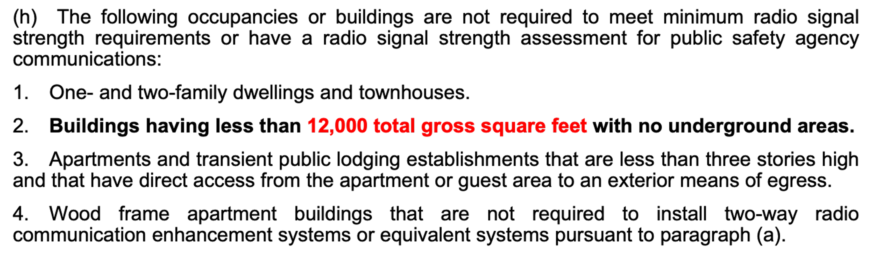
2024/2025 Update VERSION OF FL FIRE CODE 633.202 – PAR 18 ERCES
TWO-WAY RADIO COMMUNICATION ENHANCEMENT
COPYRIGHT 2025 DAS UNIVERSITY. ALL RIGHTS RESERVED | DASUNIVERSITY.ORG
Notes:
Where sis 12,000 feet come from? NFPA 1225 2022 & IFC 510 2024

Slide 26
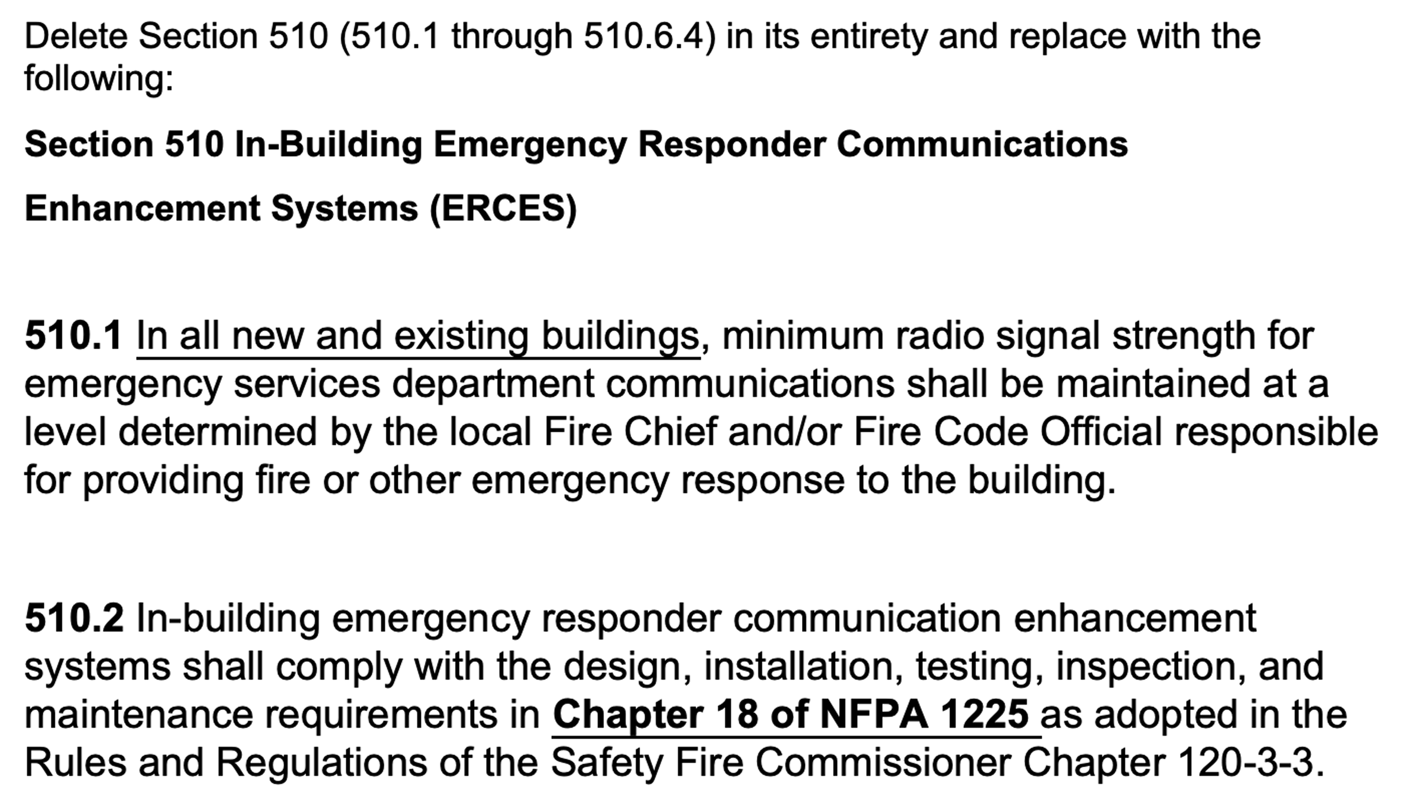
STATE OF GEORGIA EMERGENCY RESPONDER ERCES 2023
COPYRIGHT 2025 DAS UNIVERSITY. ALL RIGHTS RESERVED | DASUNIVERSITY.ORG

Slide 27
STATE OF NORTH CAROLINA FIRE CODE – B-5 2024
Section 510: EMERGENCY RESPONDER COMMUNICATION COVERAGE
510.1 Emergency responder communication coverage in new buildings. Approved in-building, two-way emergency
responder communication coverage for emergency responders shall be provided in all new buildings. In-building, two-way emergency responder communication coverage within the building shall be based on the existing coverage levels of the public safety communication systems utilized by the jurisdiction, measured at the exterior of the building. This section shall not require improvement of the existing public safety communication systems.
Exceptions:
1. Where approved by the building official and the fire code official, a wired communication system in accordance with
Section 907.2.13.2 shall be permitted to be installed or maintained instead of an approved radio communication coverage system.
2. Where it is determined by the fire code official that the radio communication coverage system is not needed.
3. In facilities where emergency responder radio communication coverage is required and such systems, components or equipment required could have a negative impact on the normal operations of that facility, the fire code official shall have the authority to accept an automatically activated emergency responder radio communication coverage system.
4. One-story buildings not exceeding 12,000 square feet with no below-ground area(s). (REVISED 2024 - REASON: This amendment is proposed to protect the NC VIPER ERRCS from increased noise and interference from BDA systems installed in buildings that the IFC 2024 has deemed undersized. This amendment will also provide relief to small business owners that are required to have these systems installed. )
4.1. This exception does not apply to windowless buildings, underground buildings or buildings with a basement.
COPYRIGHT 2025 DAS UNIVERSITY. ALL RIGHTS RESERVED | DASUNIVERSITY.ORG

Slide 28
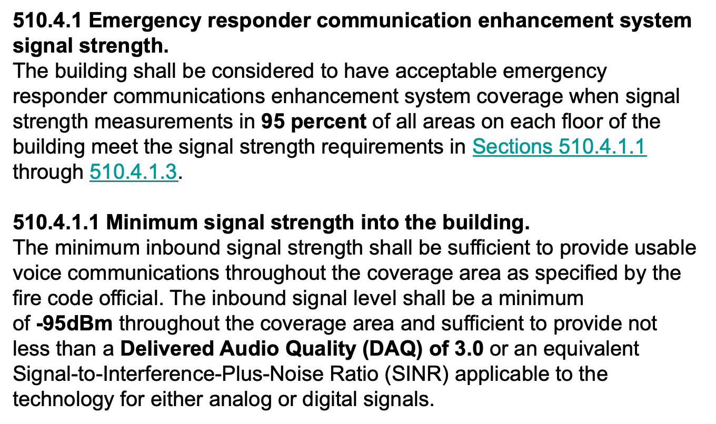
IFC 510 2021 SIGNAL REQUIREMENTS
COPYRIGHT 2025 DAS UNIVERSITY. ALL RIGHTS RESERVED | DASUNIVERSITY.ORG

Slide 29
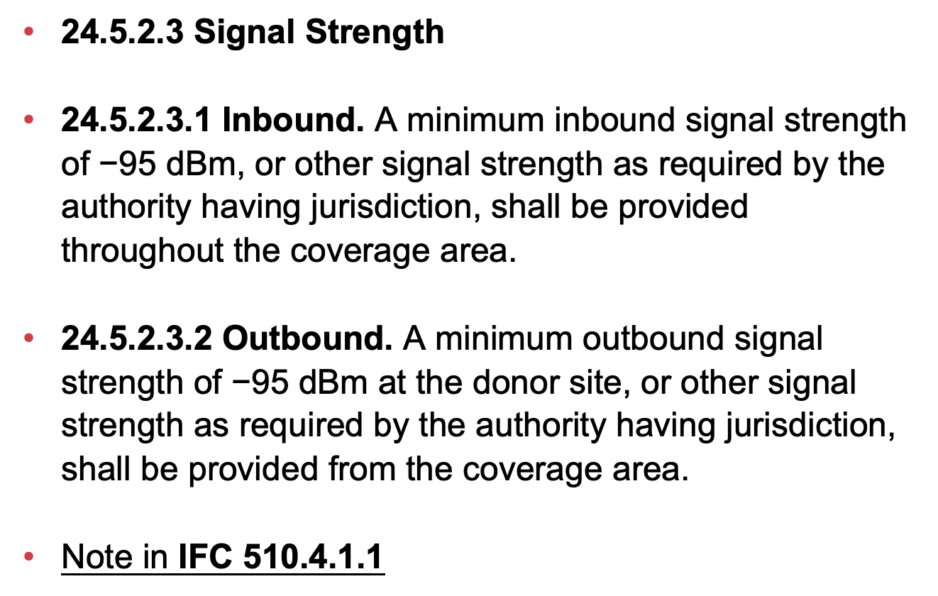
2016 NFPA 72 INBOUND / OUTBOUND SIGNAL REQUIREMENTS
COPYRIGHT 2025 DAS UNIVERSITY. ALL RIGHTS RESERVED | DASUNIVERSITY.ORG

Slide 30
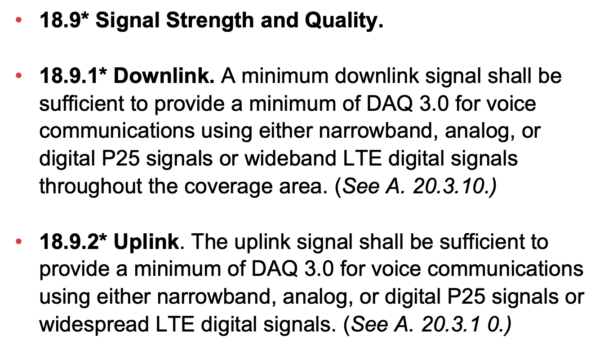
2022 NFPA 1225
DOWNLINK / UPLINK SIGNAL
COPYRIGHT 2025 DAS UNIVERSITY. ALL RIGHTS RESERVED | DASUNIVERSITY.ORG

Slide 31
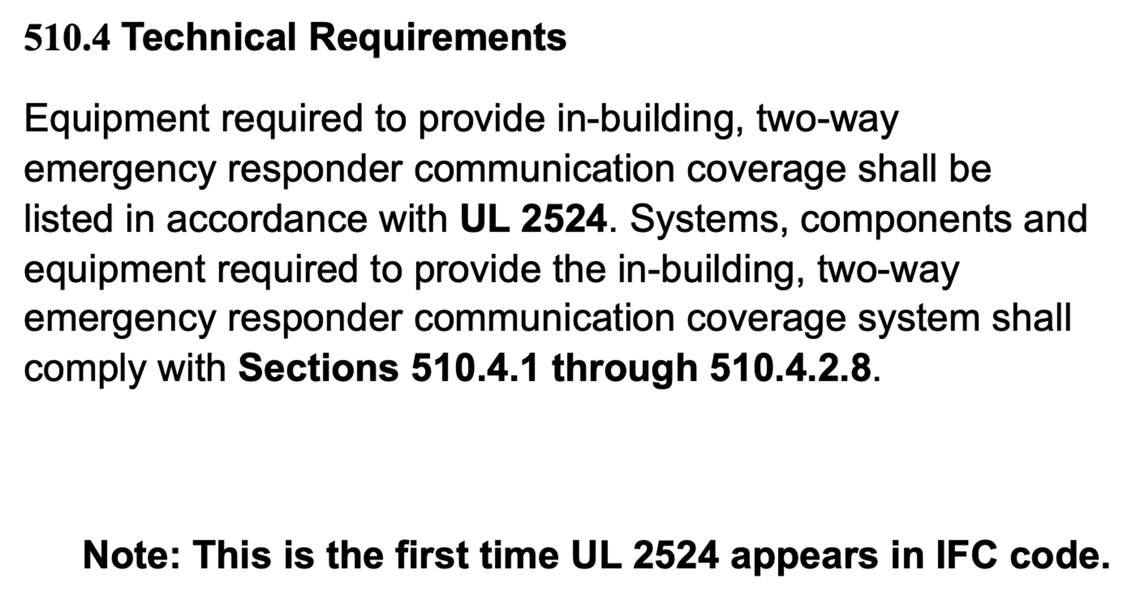
IFC 510 2021 CODE TECHNICAL CRITERIA
COPYRIGHT 2025 DAS UNIVERSITY. ALL RIGHTS RESERVED | DASUNIVERSITY.ORG

Slide 32
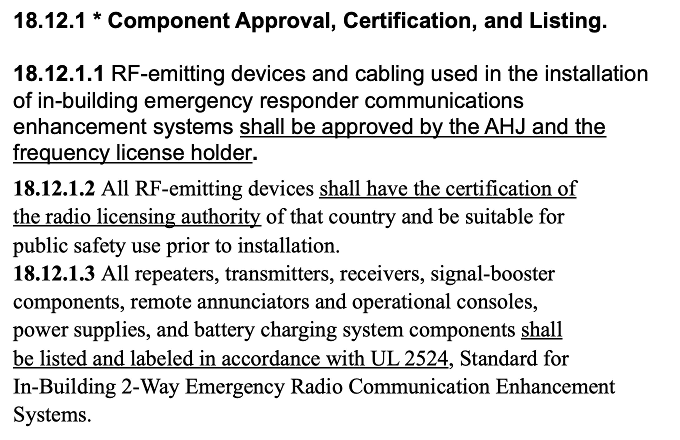
NFPA 1225 RF EMITTER EQUIPMENT TECHNICAL REQUIREMENTS
COPYRIGHT 2025 DAS UNIVERSITY. ALL RIGHTS RESERVED | DASUNIVERSITY.ORG

Slide 33
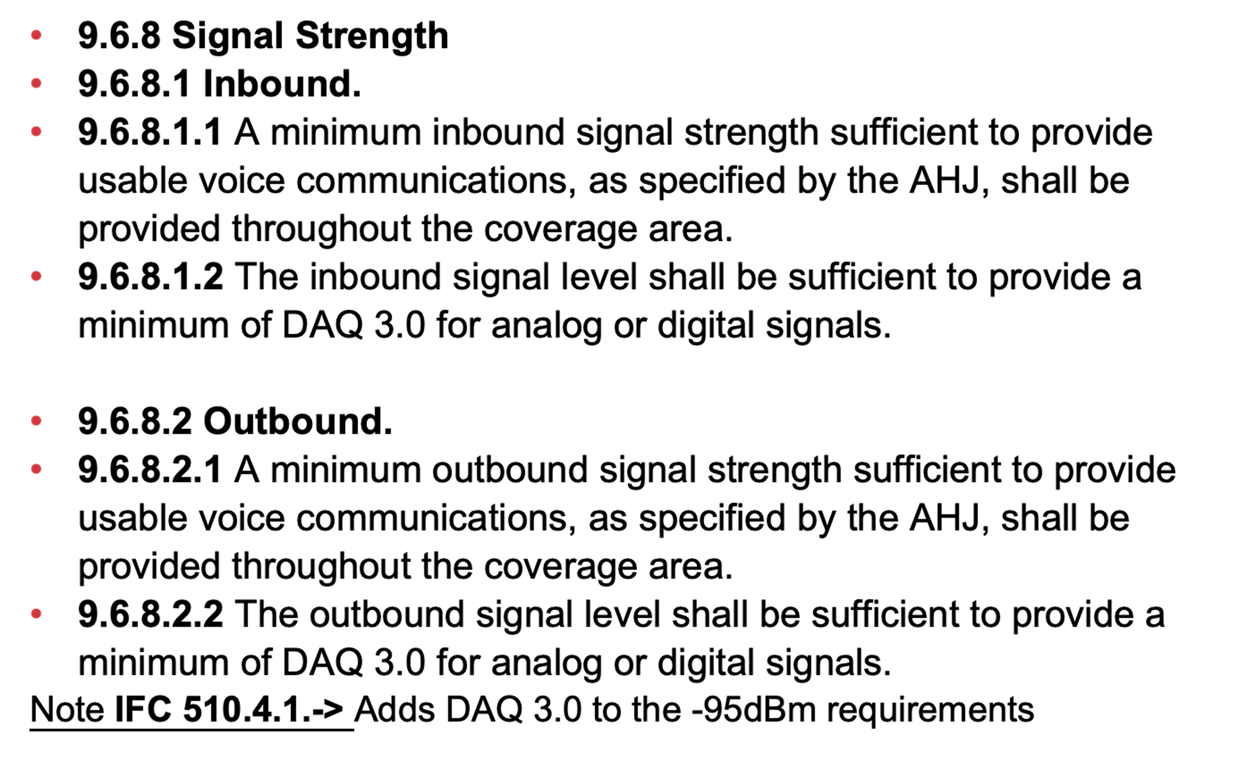
2021 IFC 510 AND 2019 NFPA 1221 INDOOR/ OUTDOOR SIGNAL REQUIRED
COPYRIGHT 2025 DAS UNIVERSITY. ALL RIGHTS RESERVED | DASUNIVERSITY.ORG

Slide 34
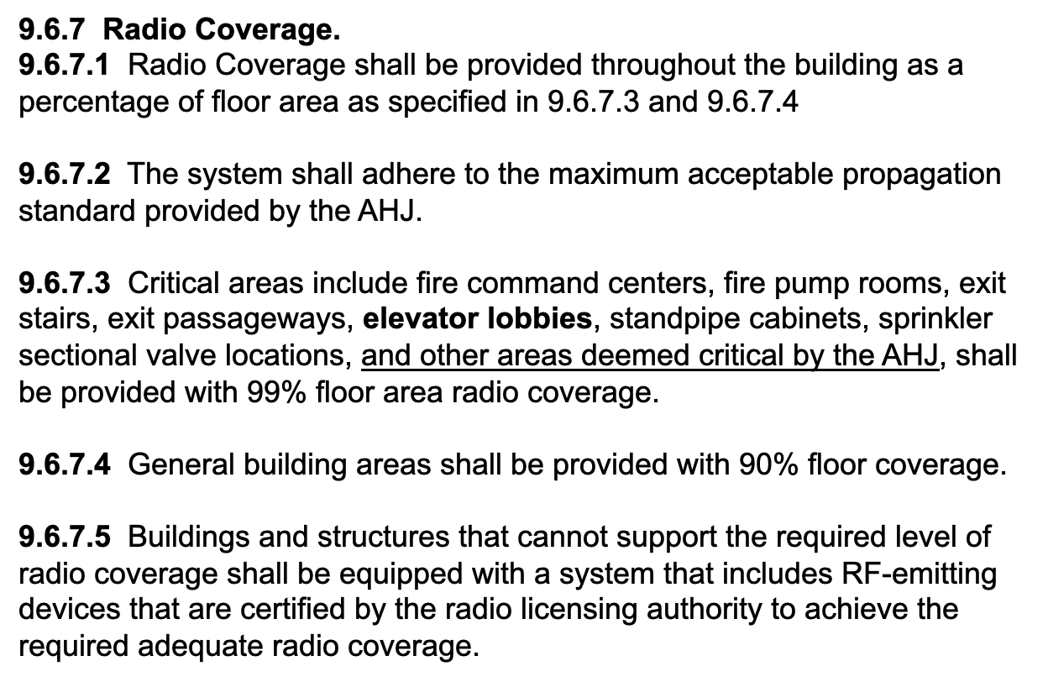
NFPA 1221 2019 COVERAGE ARE REQUIREMENTS
COPYRIGHT 2025 DAS UNIVERSITY. ALL RIGHTS RESERVED | DASUNIVERSITY.ORG

Slide 35
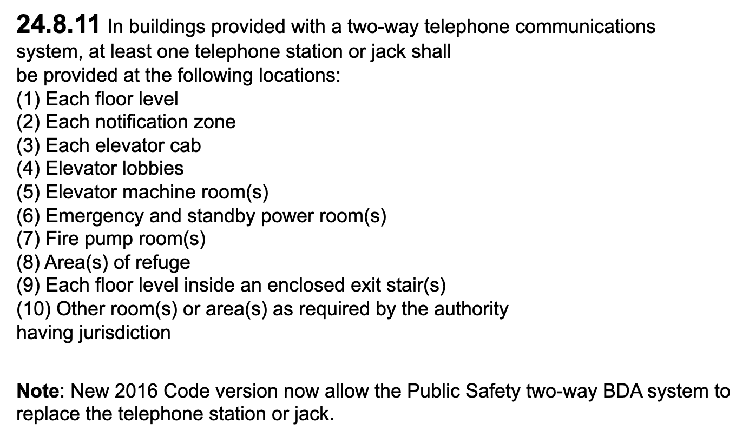
NFPA 72 CH. 24 2016 COVERAGE AREA COVERAGE
COPYRIGHT 2025 DAS UNIVERSITY. ALL RIGHTS RESERVED | DASUNIVERSITY.ORG

Slide 36
STATE OF NORTH CAROLINA FIRE CODE – B-5 2024
Section 510: EMERGENCY RESPONDER COMMUNICATION COVERAGE
510.5.4 Acceptance test procedure
Where an in-building, two-way emergency responder communication coverage system is required, and upon completion of installation, the building owner shall have the radio system tested to verify that two-way coverage on each floor of the building is not less than 95 percent. The test procedure shall be conducted as follows:
1. Each floor of the building shall be divided into a grid of 20 approximately equal test areas. Where a floor exceeds 128,000 ft2 (11,900 m2), which is the floor area that can be covered by the maximum grid dimension of 80 ft. (24.4m), the floor shall be subdivided into sectors each having an area less than or equal to 128,000 ft2 (11,900 m2), and each sector be tested individually with 20 grid cells in each sector. Signal strength measurements should be taken at the center of each grid and should be performed using standardized parameters as specified by NFPA 12215.
2. The test shall be conducted using a calibrated portable radio of the latest brand and model used by the agency talking through the agency’s radio communications system or equipment approved by the fire code official.
3. Failure of more than one test area shall result in failure of the test.
4. In the event that two of the test areas fail the test, in order to be more statistically accurate, the floor shall be permitted to be divided into 40 equal test areas. Failure of not more than two nonadjacent test areas shall not result in failure of the test. If the system fails the 40-area test, the system shall be altered to meet the 95-percent coverage requirement.
COPYRIGHT 2025 DAS UNIVERSITY. ALL RIGHTS RESERVED | DASUNIVERSITY.ORG
Notes:
Does this mean that 1 failed grid on a floor allows the floor to pass?? YES

Slide 37
STATE OF NORTH CAROLINA FIRE CODE – B-5 2024
Section 510: EMERGENCY RESPONDER COMMUNICATION COVERAGE
510.5.4 Acceptance test procedure (Continued)
5. A test location approximately in the center of each test area shall be selected for the test, with the radio enabled to
verify two-way communications to and from the outside of the building through the public agency’s radio communications system. Once the test location has been selected, that location shall represent the entire test area. Failure in the selected test location shall be considered to be a failure of that test area. Additional test locations shall not be permitted.
6. The gain values of all amplifiers shall be measured and the test measurement results shall be kept on file with the building owner so that the measurements can be verified during annual tests. In the event that the measurement results become lost, the building owner shall be required to rerun the acceptance test to reestablish the gain values.
7. As part of the installation, a spectrum analyzer or other suitable test equipment shall be utilized to ensure spurious oscillations are not being generated by the subject signal booster. This test shall be conducted at the time of installation and at subsequent annual inspections.
8. Systems shall be tested using two portable radios simultaneously conducting subjective voice quality checks. One portable radio shall be positioned not greater than 10 feet (3048 mm) from the indoor antenna. The second portable radio shall be positioned at a distance that represents the farthest distance from any indoor antenna. With both portable radios simultaneously keyed up on different frequencies within the same band, subjective audio testing shall be conducted and comply with DAQ levels as specified in Sections 510.4.1.1 and 510.4.1.2.
COPYRIGHT 2025 DAS UNIVERSITY. ALL RIGHTS RESERVED | DASUNIVERSITY.ORG
Notes:
Are Annual Inspections Required in NC?? YES
Is a Near-Far DAQ Test required? YES

Slide 38
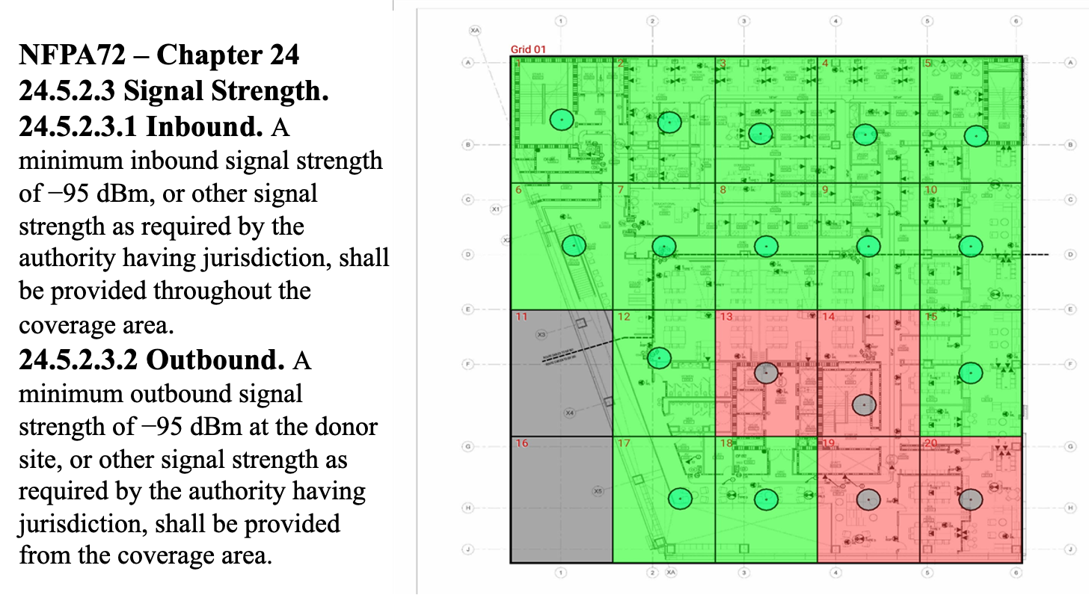
NFPA 72 CH. 24 2016 SIGNAL REQUIREMENTS
COPYRIGHT 2025 DAS UNIVERSITY. ALL RIGHTS RESERVED | DASUNIVERSITY.ORG

Slide 39
STATE OF NORTH CAROLINA HOUSE BILL 768v2– APRIL 2024
AMEND THE STATE BUILDING CODE AND STATE FIRE CODE TO CLARIFY EXEMPTIONS FROM
IN-BUILDING EMERGENCY RESPONDER COMMUNICATION COVERAGE REQUIREMENTS.
SECTION 1.(b) Exemptions Established. – Notwithstanding the emergency responder communication coverage requirements of the Code, the following buildings and structures, whether existing, newly constructed, or altered after the effective date of this act, are exempt from those requirements:
(1) Apartment buildings not exceeding 75 feet in height, constructed using wood framing, provided the building has fewer than 150 dwelling units, and all dwelling units discharge directly to the exterior or to an interior corridor providing required egress that leads directly to an exterior exit.
(2) Apartment buildings and transient public lodging establishments, including hotels and motels, not exceeding two stories above grade plane and that provide direct exterior egress from each dwelling unit or guest room.
(3) Buildings or structures subject to the North Carolina Residential Code.
(4) Buildings with a total gross floor area of less than 12,000 square feet and containing no story below grade plane or basement areas.
COPYRIGHT 2025 DAS UNIVERSITY. ALL RIGHTS RESERVED | DASUNIVERSITY.ORG
Notes:
If a system has already been installed with coax, antennas, etc. does that mean that it should be completely removed?

Slide 40
STATE OF NORTH CAROLINA HOUSE BILL 768v2– APRIL 2024 (Cont.)
SECTION 1.(c) Treatment of Existing Systems in Exempted Buildings. –
Notwithstanding Section 901.6 of the North Carolina Fire Code or any other provision of the
Code that might require the removal of nonrequired, obsolete, or abandoned systems, an
emergency responder communication coverage system installed prior to the effective date of this
act in a building or structure that meets the exemption criteria established in subsection (b) of
this section shall not be required to be removed. Such systems may be deactivated.
SECTION 1.(e) Interim Application of Exemptions. – Until the effective date of the permanent rules that the Council is required to adopt pursuant to subsection (d) of this section, the Council and local governments enforcing the Code shall not enforce the emergency responder communication coverage requirements against buildings and structures that meet the exemption criteria established in subsection (b) of this section and shall apply the provisions regarding existing systems established in subsection (c) of this section.
SECTION 1.(f) Sunset. – This section expires when permanent rules adopted as required by subsection (d) of this section become effective.
SECTION 2. Effective Date. – This act is effective when it becomes law. ENACTED July 2, 2025
COPYRIGHT 2025 DAS UNIVERSITY. ALL RIGHTS RESERVED | DASUNIVERSITY.ORG
Notes:
If a system has already been installed with coax, antennas, etc. does that mean that it should be completely removed?

Slide 41
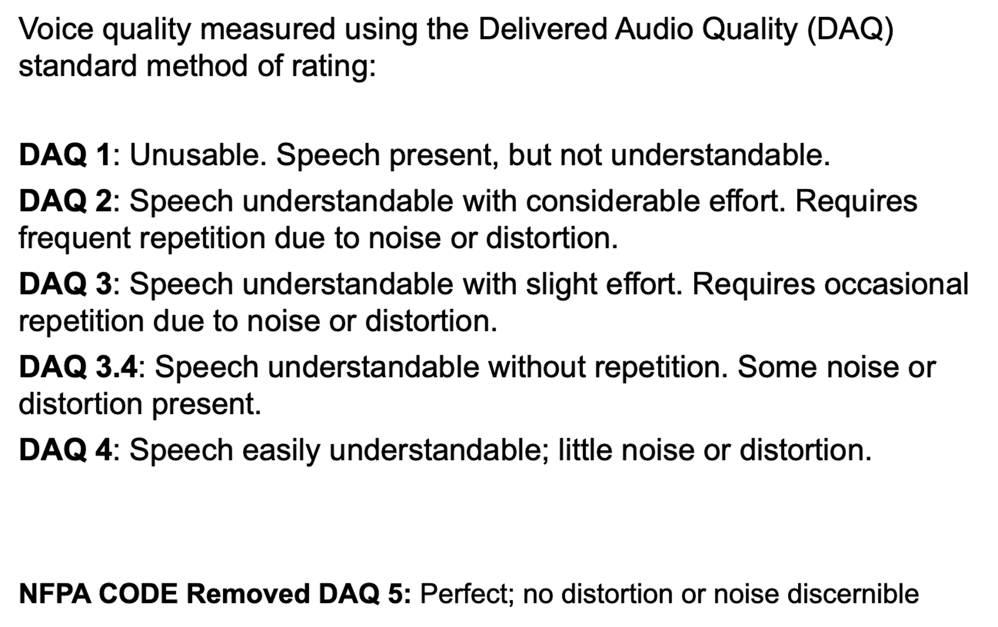
NFPA 1221 2016, 2019 DAQ DEFINED
COPYRIGHT 2025 DAS UNIVERSITY. ALL RIGHTS RESERVED | DASUNIVERSITY.ORG

Slide 42
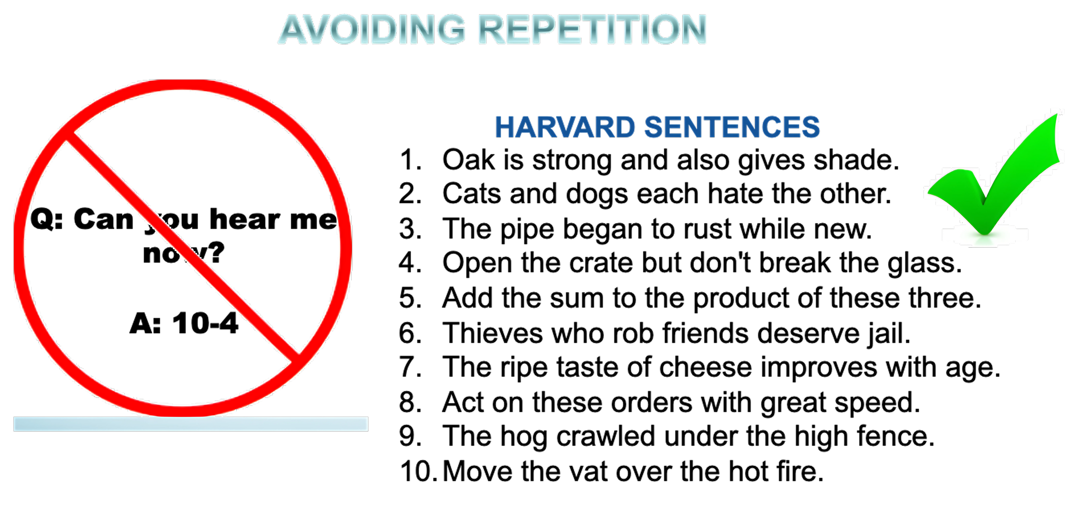
DAQ TESTING
COPYRIGHT 2025 DAS UNIVERSITY. ALL RIGHTS RESERVED | DASUNIVERSITY.ORG

Slide 43
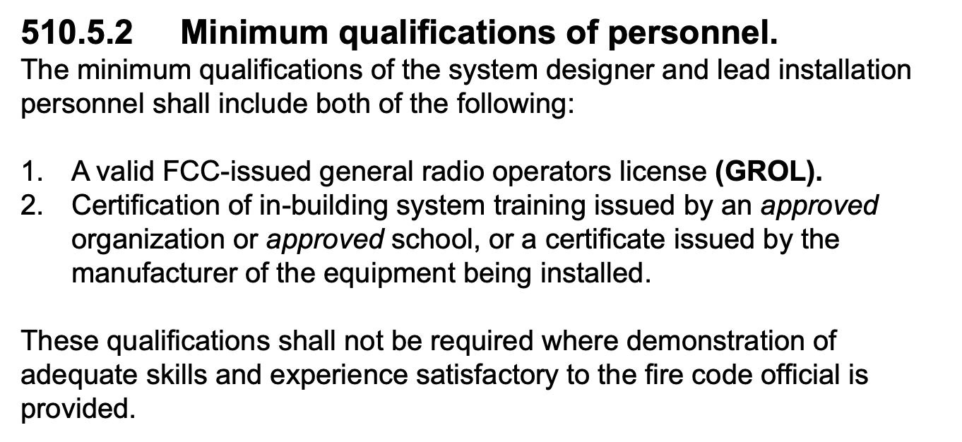
IFC 2015 /18/ 21 CODE MINIMUM QUALIFICATIONS
COPYRIGHT 2025 DAS UNIVERSITY. ALL RIGHTS RESERVED | DASUNIVERSITY.ORG

Slide 44
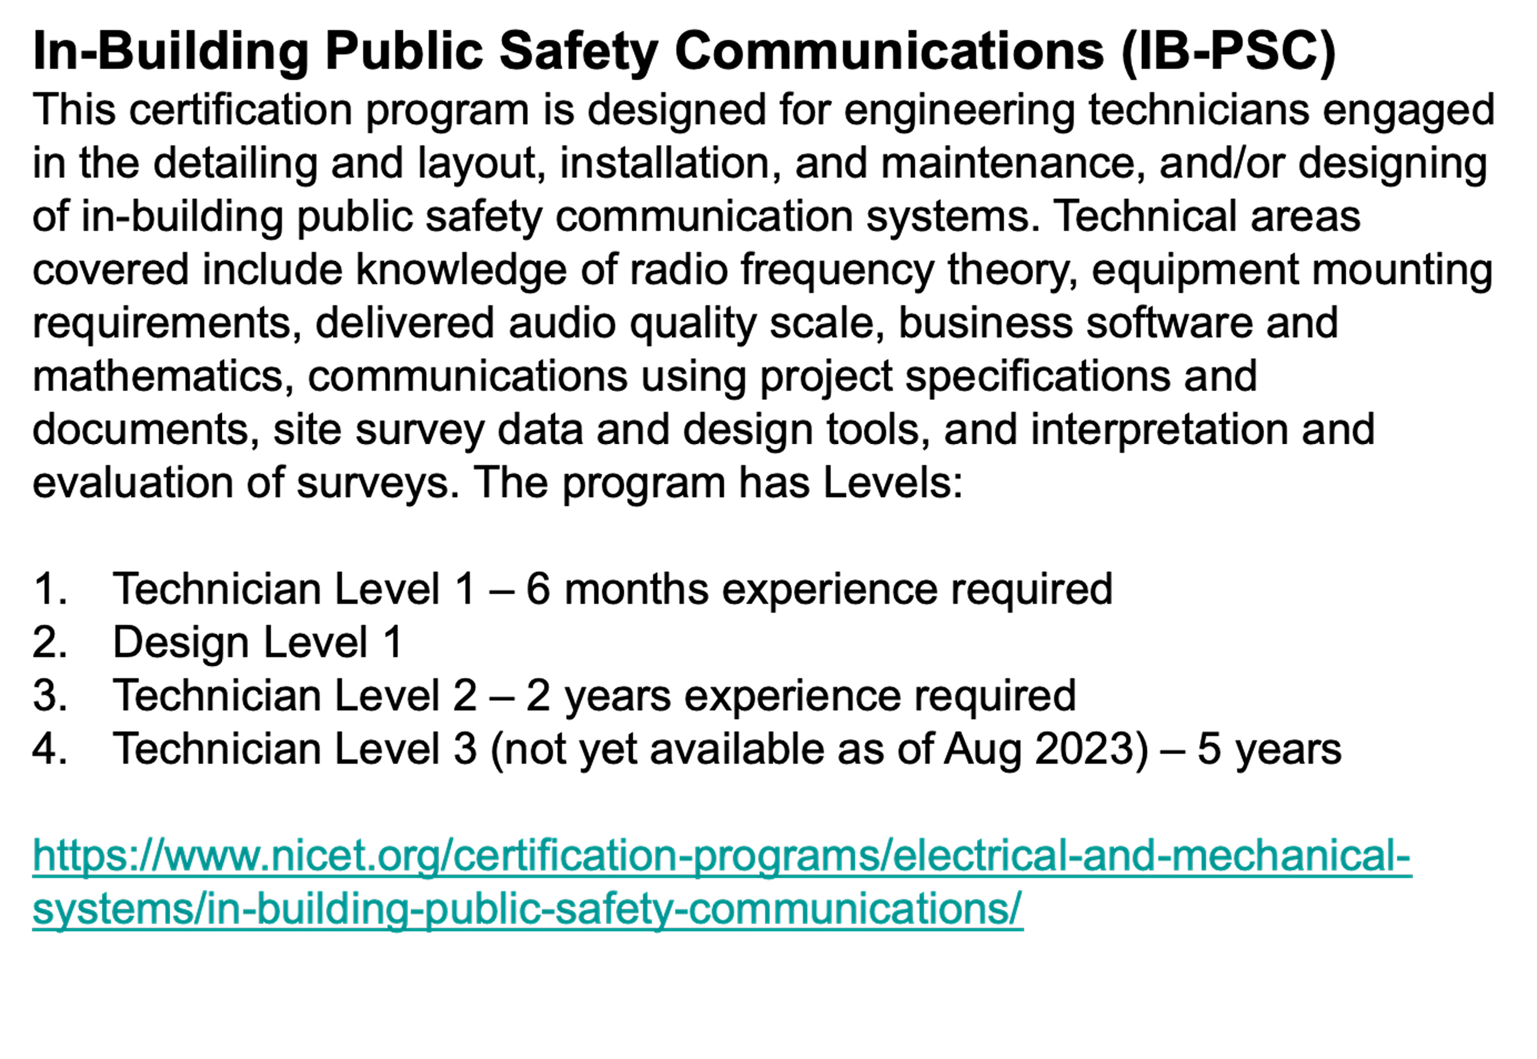
NICET TEST FOR ERCES QUALIFICATIONS (2022)
COPYRIGHT 2025 DAS UNIVERSITY. ALL RIGHTS RESERVED | DASUNIVERSITY.ORG

Slide 45
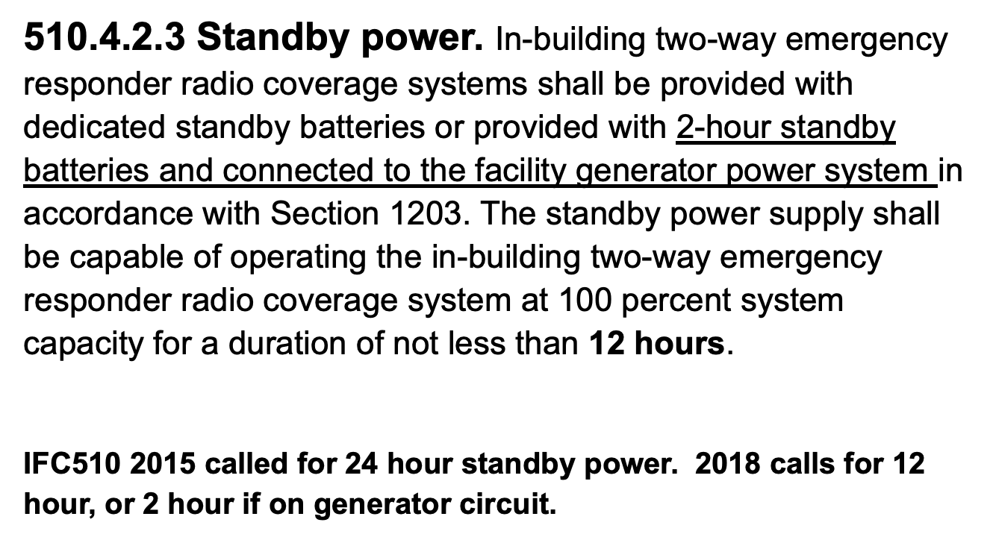
IFC 2021 CODE STANDBY POWER BATTERY BACKUP
COPYRIGHT 2025 DAS UNIVERSITY. ALL RIGHTS RESERVED | DASUNIVERSITY.ORG

Slide 46
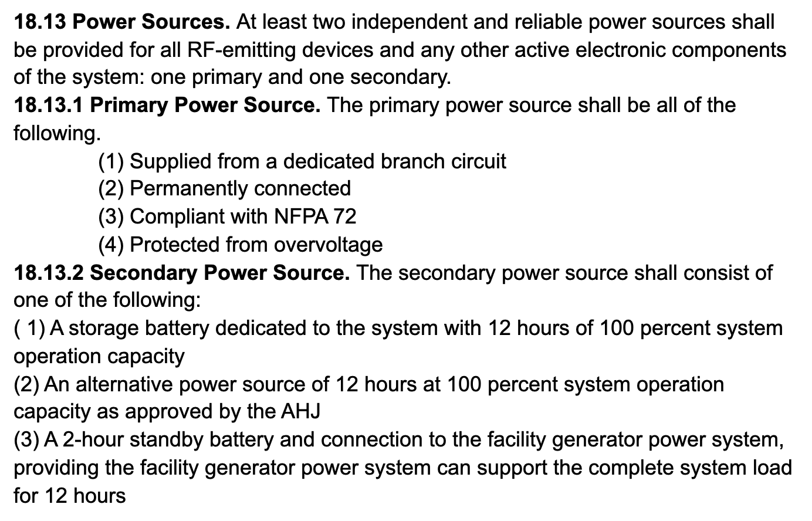
NFPA 1225 CODE POWER SOURCES AND BACKUP
COPYRIGHT 2025 DAS UNIVERSITY. ALL RIGHTS RESERVED | DASUNIVERSITY.ORG

Slide 47
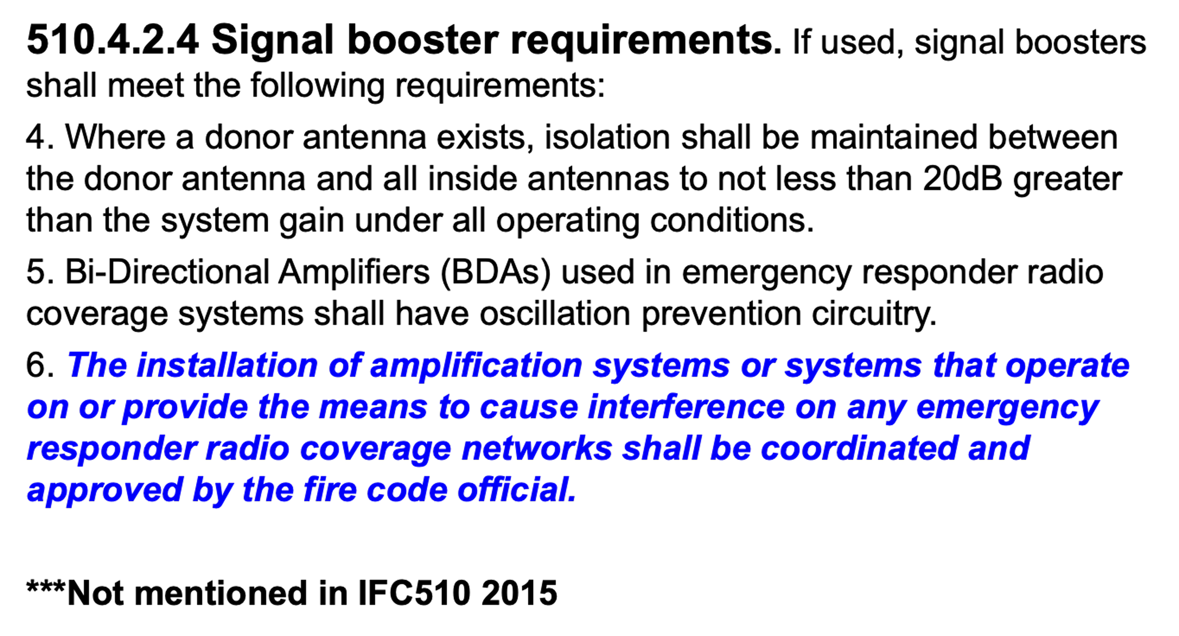
IFC 2018 CODE - MORE SIGNAL BOOSTER REQUIREMENTS
COPYRIGHT 2025 DAS UNIVERSITY. ALL RIGHTS RESERVED | DASUNIVERSITY.ORG

Slide 48
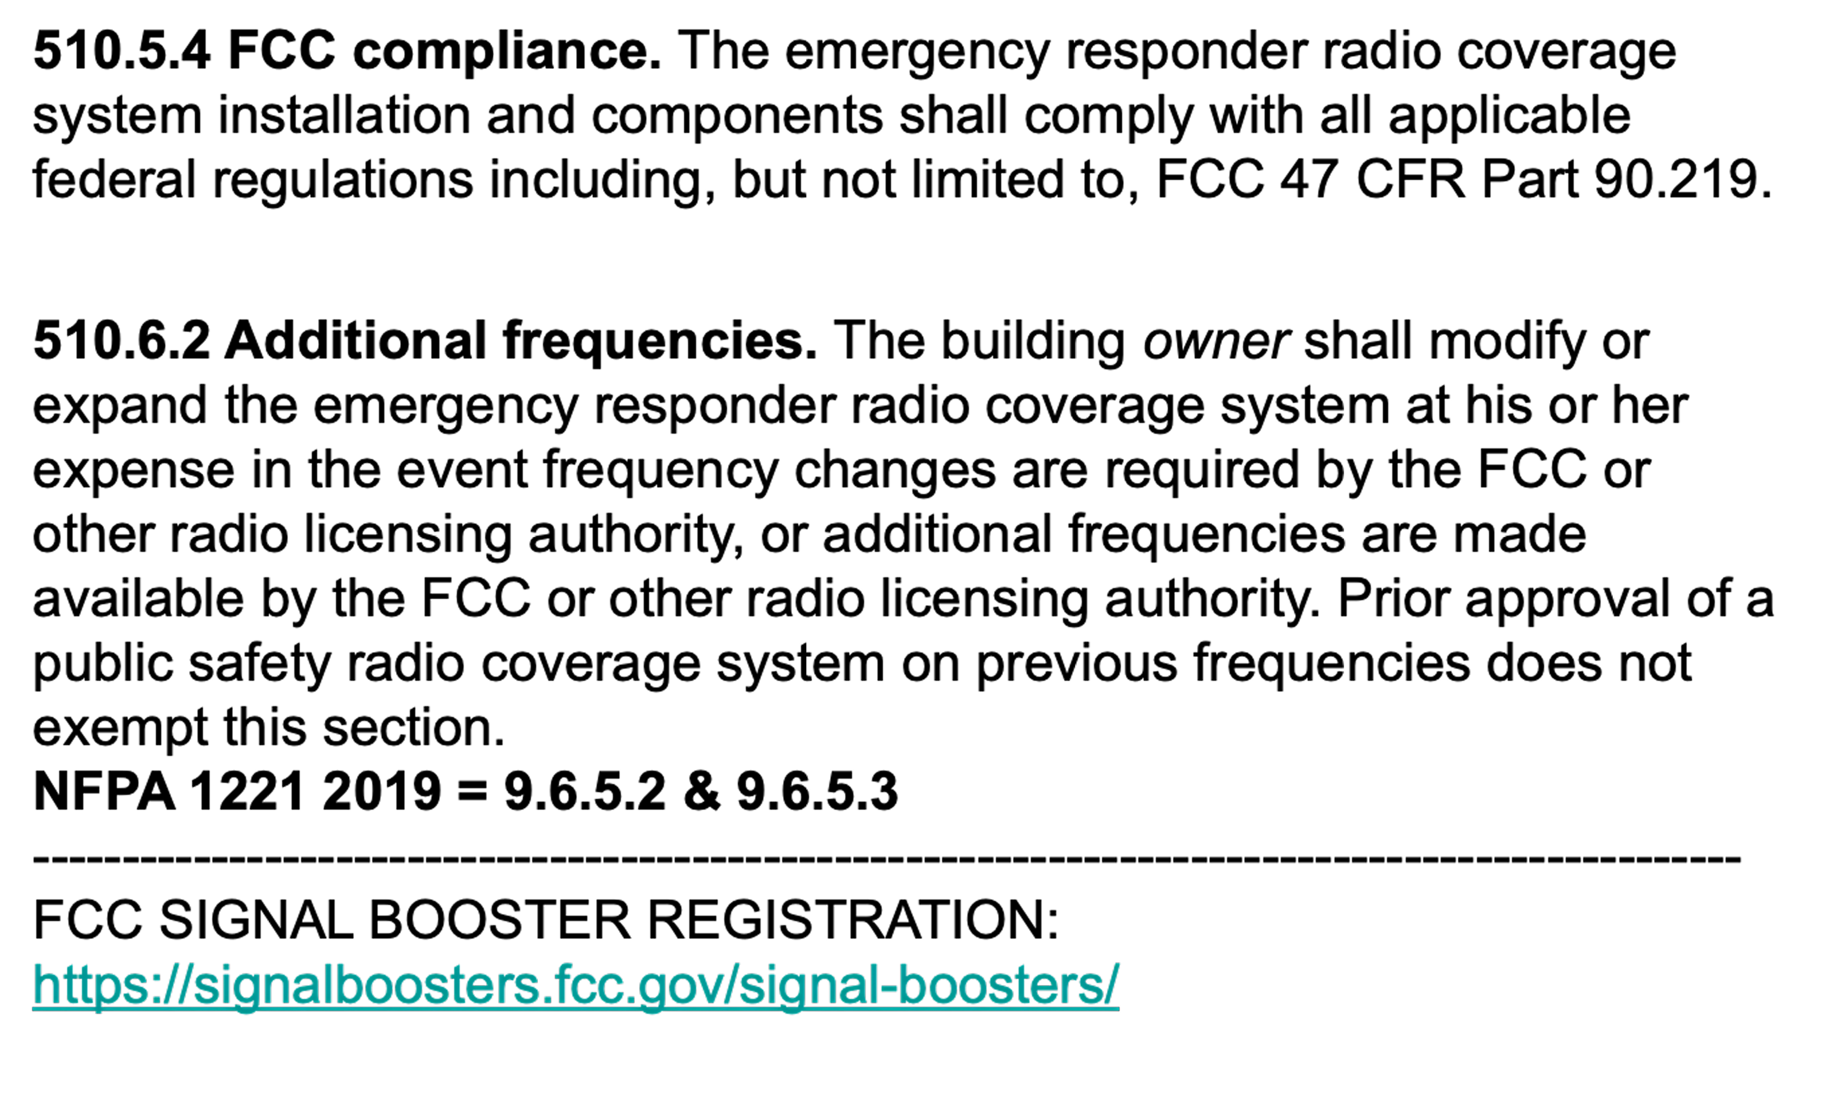
IFC 2018 CODE - NFPA 1221 2019 FCC REQUIREMENTS
COPYRIGHT 2025 DAS UNIVERSITY. ALL RIGHTS RESERVED | DASUNIVERSITY.ORG

Slide 49
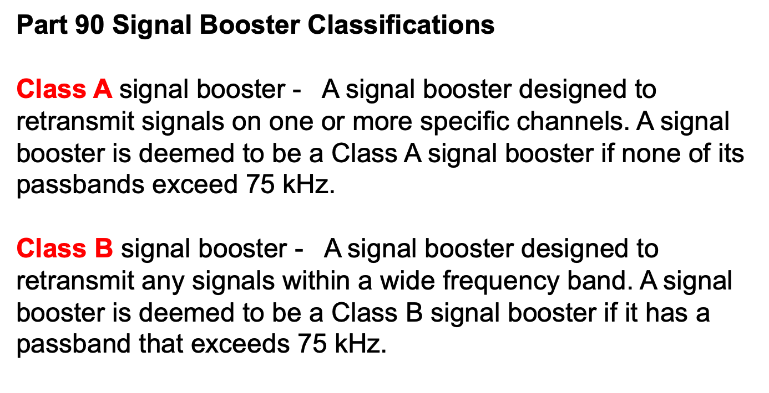
FCC - SIGNAL BOOSTER DEFINITIONS
COPYRIGHT 2025 DAS UNIVERSITY. ALL RIGHTS RESERVED | DASUNIVERSITY.ORG
Notes:
Which one is better?? It depends

Slide 50
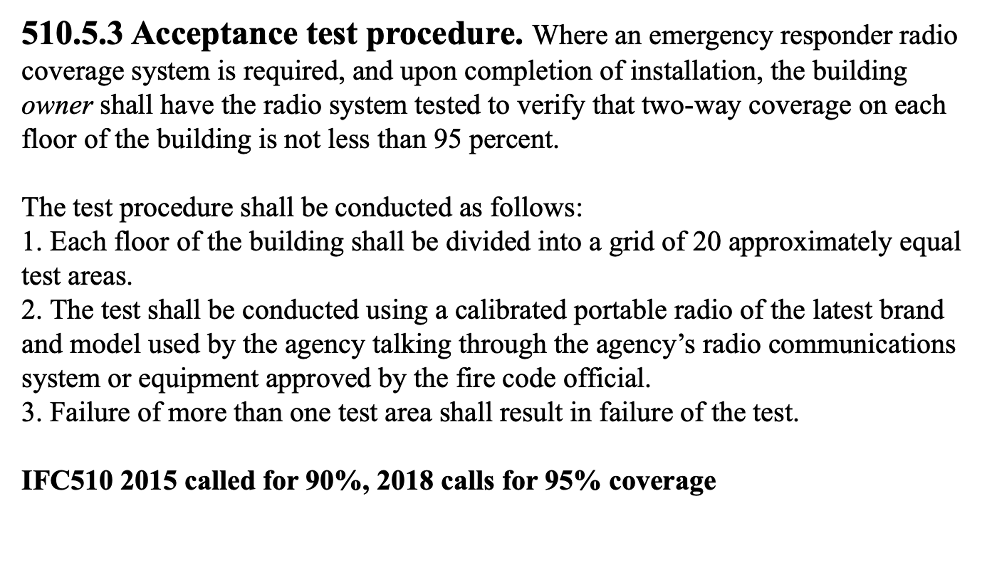
IFC 2018 CODE ACCEPTANCE TEST PROCEDURE
COPYRIGHT 2025 DAS UNIVERSITY. ALL RIGHTS RESERVED | DASUNIVERSITY.ORG

Slide 51
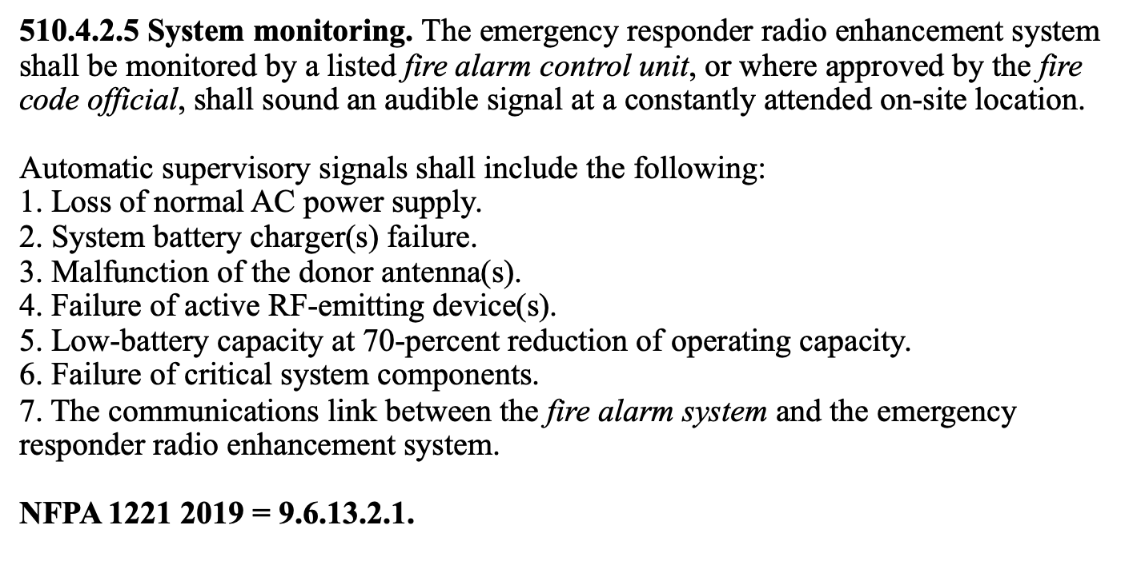
IFC 2018 CODE, NFPA 1221 2019 SYSTEM, MONITORING
COPYRIGHT 2025 DAS UNIVERSITY. ALL RIGHTS RESERVED | DASUNIVERSITY.ORG

Slide 52
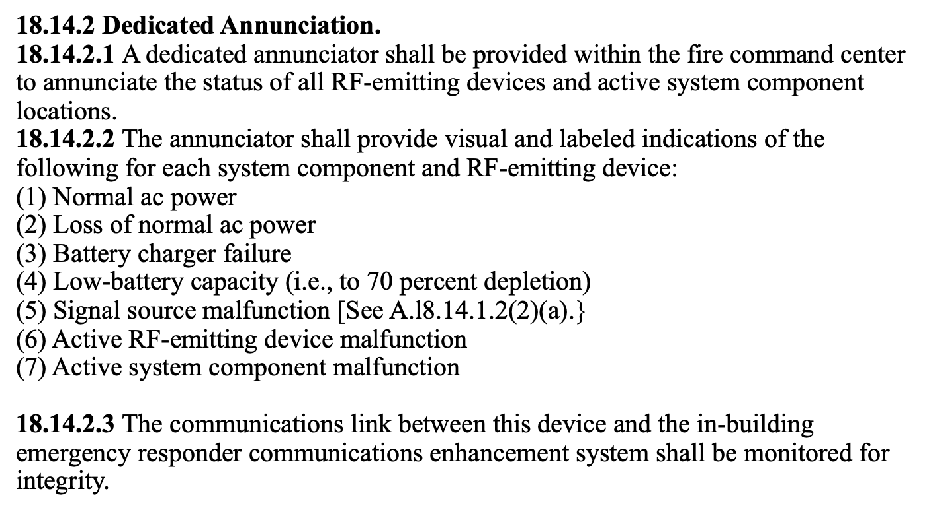
NFPA 1225 CODE SYSTEM, MONITORING
COPYRIGHT 2025 DAS UNIVERSITY. ALL RIGHTS RESERVED | DASUNIVERSITY.ORG
Notes:
How does the Link communication happen?? Small voltage level from alarm in BDA to Fire Panel.
Does the Fire Panel send voltage levels to the BDA? NO

Slide 53
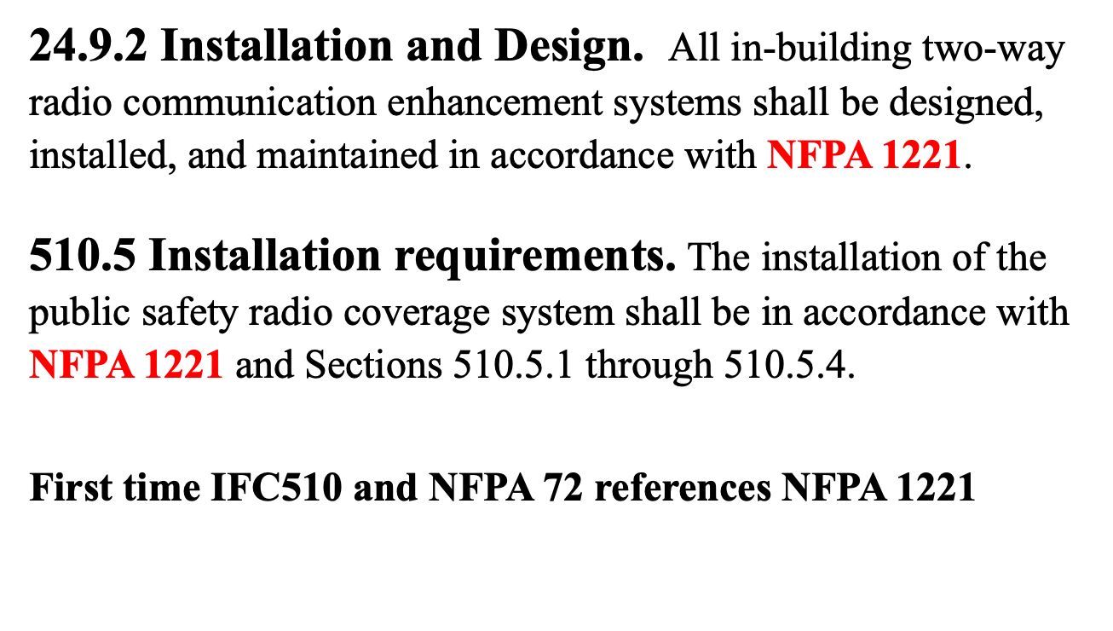
NFPA 72 2019, IFC 2018/2021 CODE INSTALLATION REQUIREMENTS
COPYRIGHT 2025 DAS UNIVERSITY. ALL RIGHTS RESERVED | DASUNIVERSITY.ORG

Slide 54
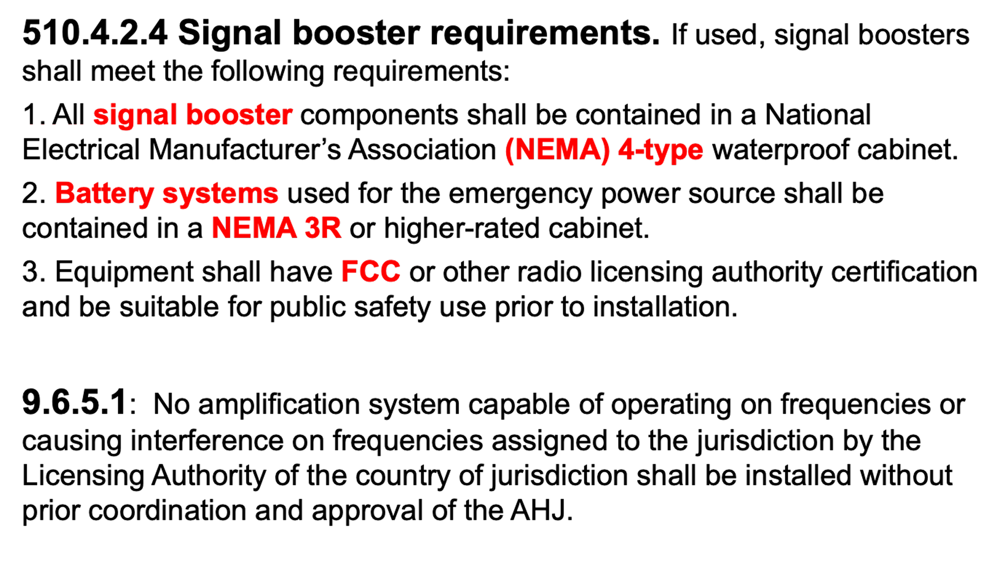
IFC 2018 / NFPA 1221 2019 SIGNAL BOOSTER COORDINATION
COPYRIGHT 2025 DAS UNIVERSITY. ALL RIGHTS RESERVED | DASUNIVERSITY.ORG

Slide 55
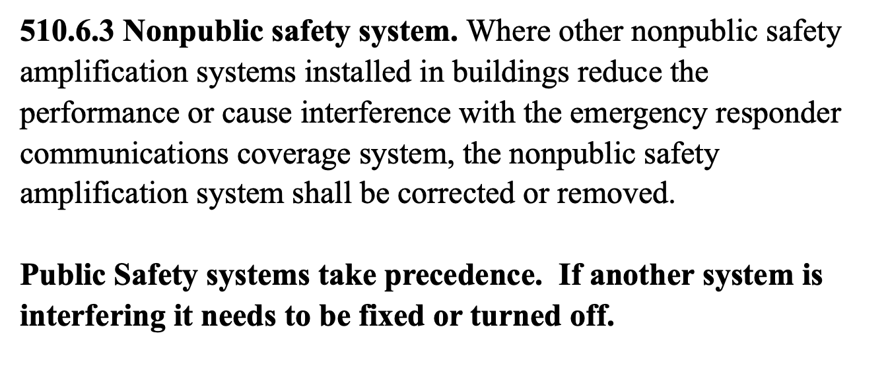
IFC 510 2018 & 2021 CODE NONPUBLIC SAFETY SYSTEM
COPYRIGHT 2025 DAS UNIVERSITY. ALL RIGHTS RESERVED | DASUNIVERSITY.ORG

Slide 56
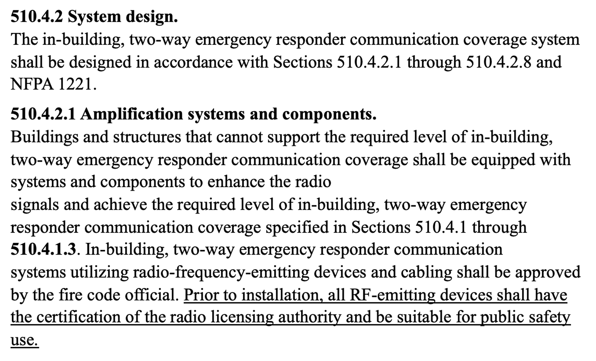
IFC 2021 CODE SYSTEM DESIGN
COPYRIGHT 2025 DAS UNIVERSITY. ALL RIGHTS RESERVED | DASUNIVERSITY.ORG

Slide 57
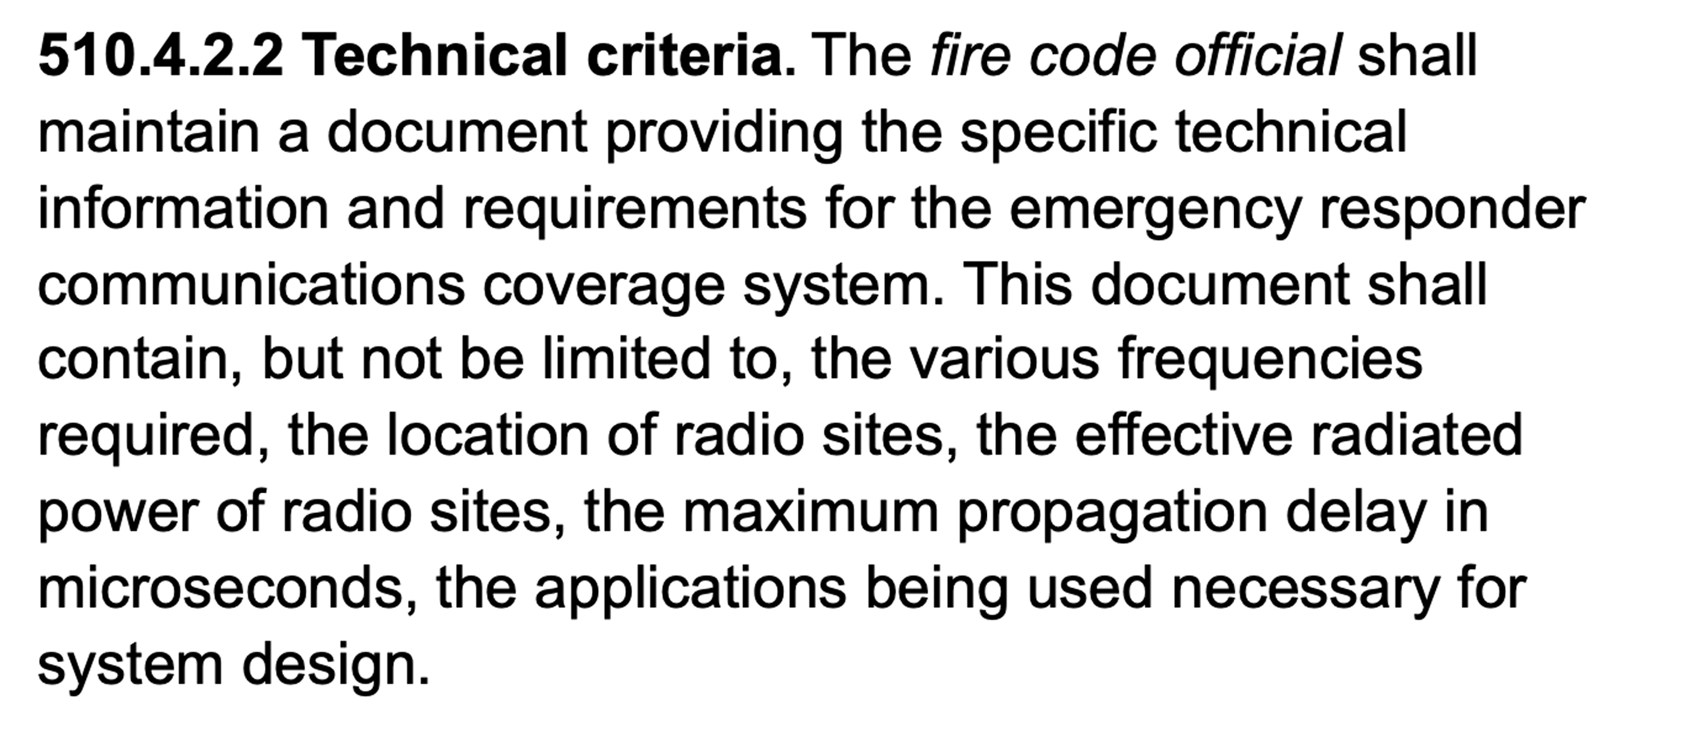
PERFORMANCE AND TECHNICAL CRITERIA IFC 2018 CODE
COPYRIGHT 2025 DAS UNIVERSITY. ALL RIGHTS RESERVED | DASUNIVERSITY.ORG

Slide 58
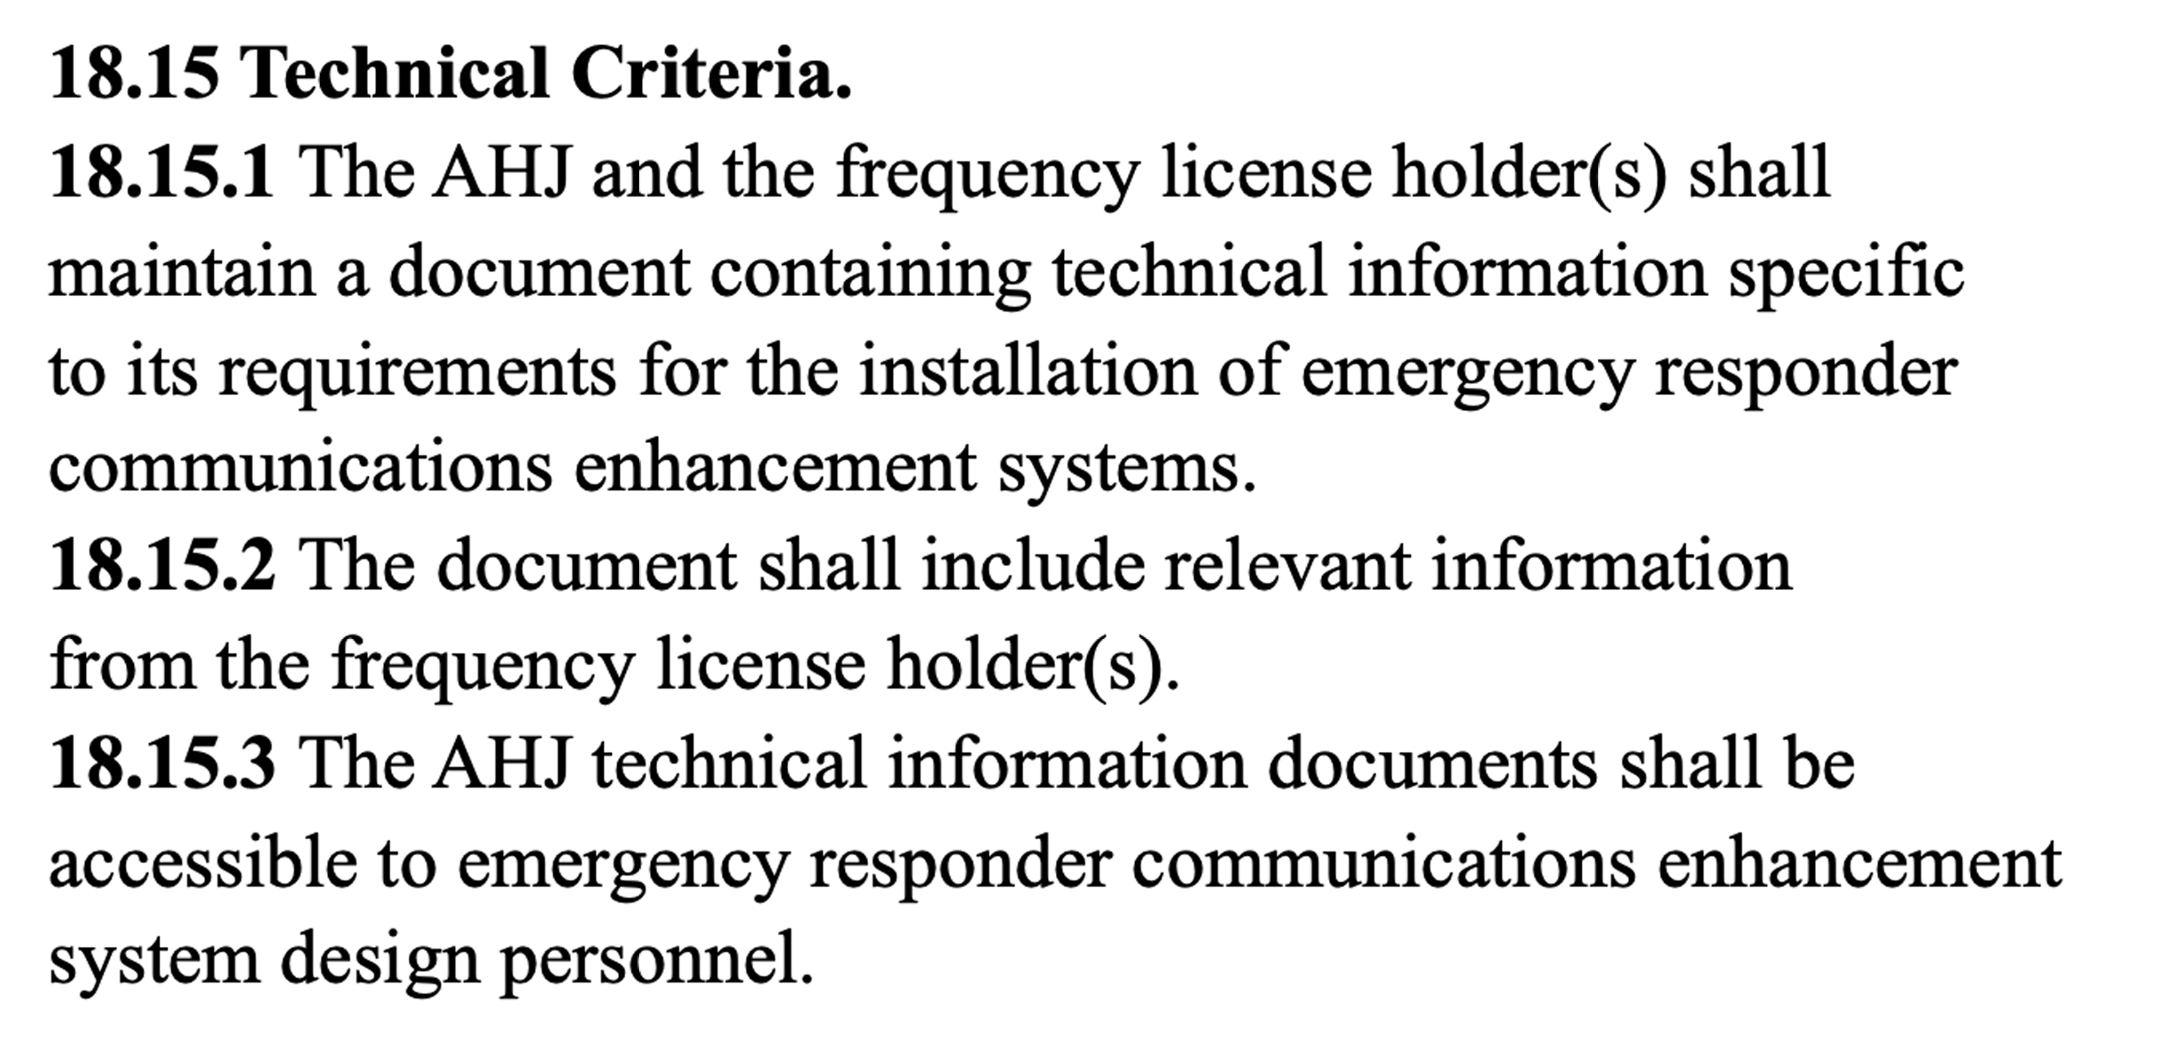
TECHNICAL CRITERIA & DESIGN DOCUMENTS NFPA 1225
COPYRIGHT 2025 DAS UNIVERSITY. ALL RIGHTS RESERVED | DASUNIVERSITY.ORG

Slide 59
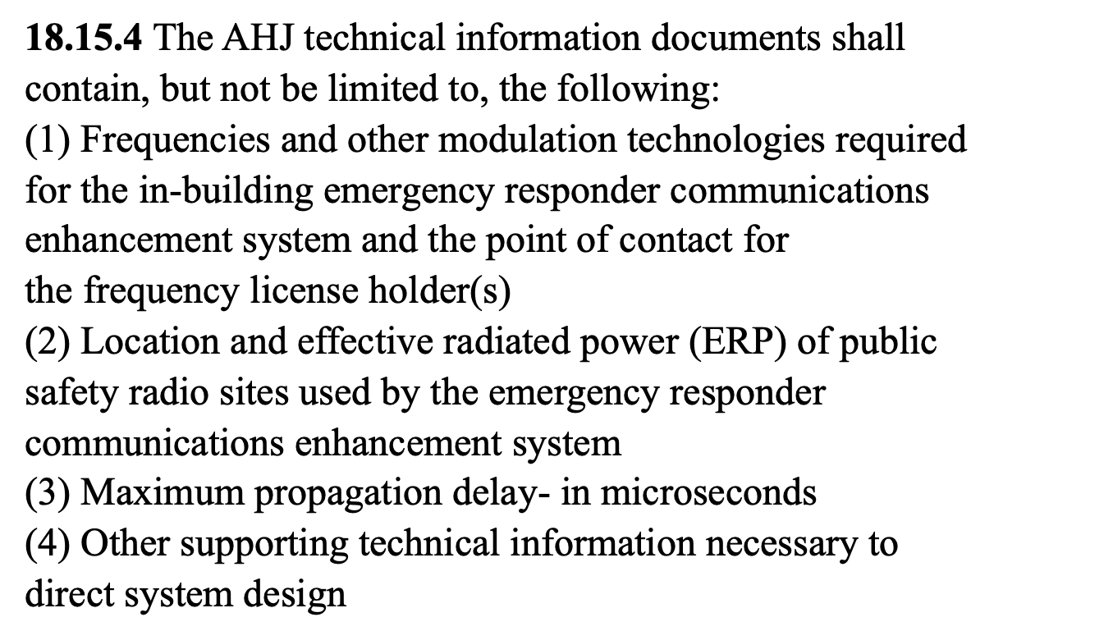
TECHNICAL CRITERIA & DESIGN DOCUMENTS NFPA 1225
COPYRIGHT 2025 DAS UNIVERSITY. ALL RIGHTS RESERVED | DASUNIVERSITY.ORG

Slide 60
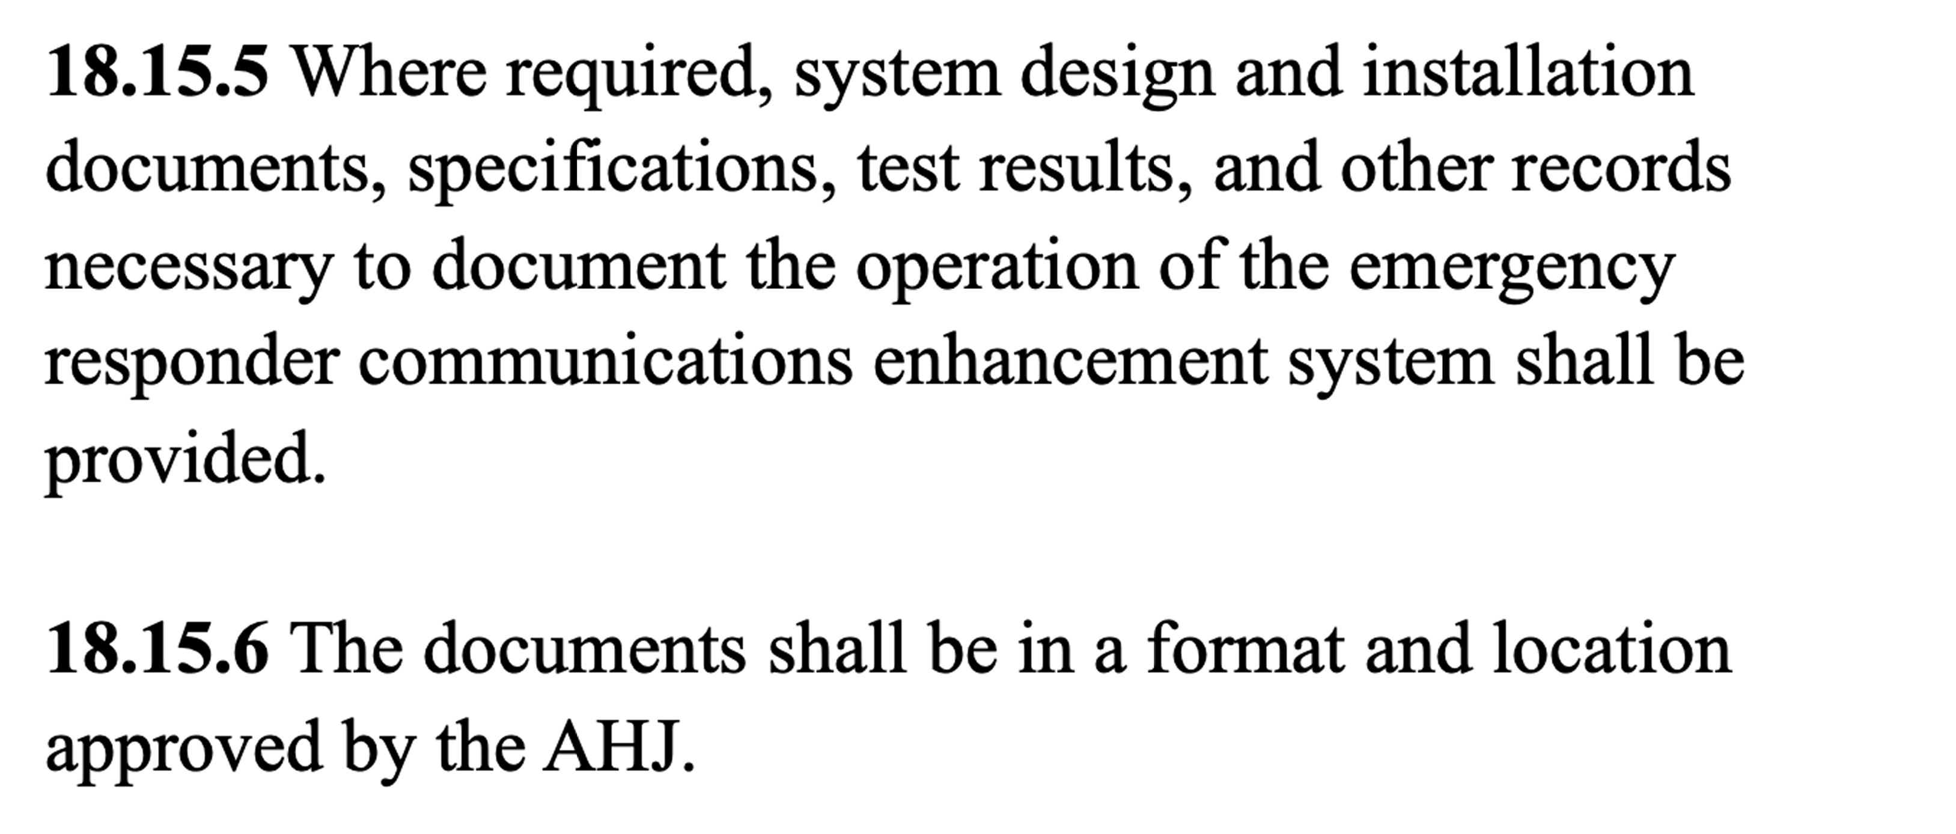
TECHNICAL CRITERIA & DESIGN DOCUMENTS NFPA 1225
COPYRIGHT 2025 DAS UNIVERSITY. ALL RIGHTS RESERVED | DASUNIVERSITY.ORG

Slide 61

IFC 2018 CODE ANTENNA DENSITY – NEAR FAR EFFECT
COPYRIGHT 2025 DAS UNIVERSITY. ALL RIGHTS RESERVED | DASUNIVERSITY.ORG

Slide 62

NFPA 1225 ANTENNA DENSITY
COPYRIGHT 2025 DAS UNIVERSITY. ALL RIGHTS RESERVED | DASUNIVERSITY.ORG

Slide 63
ACCEPTANCE TEST PROCEDURE FOR NEAR-FAR IFC 2018 CODE
510.5.3 Acceptance test procedure.
8. Systems incorporating Class B signal-booster devices or Class B broadband fiber remote devices shall be tested using two portable radios simultaneously conducting subjective voice quality checks. One portable radio shall be positioned not greater than 10 feet from the indoor antenna. The second portable radio shall be positioned at a distance that represents the farthest distance from any indoor antenna. With both portable radios simultaneously keyed up on different frequencies within the same band, subjective audio testing shall be conducted and comply with DAQ levels as specified in Sections 510.4.1.1 and 510.4.1.2.
COPYRIGHT 2025 DAS UNIVERSITY. ALL RIGHTS RESERVED | DASUNIVERSITY.ORG

Slide 64







ANIMATED NEAR-FAR EFFECT
RF out TX1 = Good
RF out TX2 = Very Poor
Radio transmits at 4 watts
2nd portable transmits from afar
Repeater/BDA
Battery Back-up
This signal comes in weak, but usable if the BDA were at full gain
Signal received at BDA loud and clear at -10dBm.
As long as 1st portable is still transmitting the 2nd portable signal too weak to talk out
COPYRIGHT 2025 DAS UNIVERSITY. ALL RIGHTS RESERVED | DASUNIVERSITY.ORG

Slide 65

TESTING AND PROOF OF COMPLIANCE IFC 2015/18 CODE (Annual Inspection)
COPYRIGHT 2025 DAS UNIVERSITY. ALL RIGHTS RESERVED | DASUNIVERSITY.ORG

Slide 66

NON-PUBLIC SAFETY SYSTEM DEGRADATION NFPA 1225 CODE
COPYRIGHT 2025 DAS UNIVERSITY. ALL RIGHTS RESERVED | DASUNIVERSITY.ORG

Slide 67
ERCES IN-BUILDING
SOLUTIONS
UNDERSTANDING RF AND
DAS BASICS
THE SOLUTION PROCESS
COPYRIGHT 2025 DAS UNIVERSITY. ALL RIGHTS RESERVED | DASUNIVERSITY.ORG

Slide 68

RF BEHAVIORS
COPYRIGHT 2025 DAS UNIVERSITY. ALL RIGHTS RESERVED | DASUNIVERSITY.ORG

Slide 69


WHAT IS RF?
COPYRIGHT 2025 DAS UNIVERSITY. ALL RIGHTS RESERVED | DASUNIVERSITY.ORG

Slide 70

RF BEHAVIORS
COPYRIGHT 2025 DAS UNIVERSITY. ALL RIGHTS RESERVED | DASUNIVERSITY.ORG

Slide 71



HOW RADIO FREQUENCY BEHAVES
Higher frequencies fade faster, don’t reflect and don’t penetrate
Lower frequencies travel farther, reflect and penetrate.
Note: The wavelength or frequency hasn’t changed but the amplitude or power has.
COPYRIGHT 2025 DAS UNIVERSITY. ALL RIGHTS RESERVED | DASUNIVERSITY.ORG

Slide 72




RF PATH LOSS
COPYRIGHT 2025 DAS UNIVERSITY. ALL RIGHTS RESERVED | DASUNIVERSITY.ORG

Slide 73

NFPA 1221 2019 PATHWAY SURVIVABILITY
COPYRIGHT 2025 DAS UNIVERSITY. ALL RIGHTS RESERVED | DASUNIVERSITY.ORG

Slide 74





COAX AND SURVIVABILITY
COPYRIGHT 2025 DAS UNIVERSITY. ALL RIGHTS RESERVED | DASUNIVERSITY.ORG

Slide 75




RF COAX PLENUM
COPYRIGHT 2025 DAS UNIVERSITY. ALL RIGHTS RESERVED | DASUNIVERSITY.ORG

Slide 76




RF COAX ALUMINUM
1/2" PLENUM IN METAL
COPYRIGHT 2025 DAS UNIVERSITY. ALL RIGHTS RESERVED | DASUNIVERSITY.ORG

Slide 77

RF COAX -
2 HOUR FIRE RATED
1/2" PLENUM
COPYRIGHT 2025 DAS UNIVERSITY. ALL RIGHTS RESERVED | DASUNIVERSITY.ORG

Slide 78
DAS
BASICS
DISTRIBUTIVE ANTENNA SYSTEM
SOLUTION ARCHITECTURES
COPYRIGHT 2025 DAS UNIVERSITY. ALL RIGHTS RESERVED | DASUNIVERSITY.ORG

Slide 79

DAS RF SYSTEM TOOL CHEST
COPYRIGHT 2025 DAS UNIVERSITY. ALL RIGHTS RESERVED | DASUNIVERSITY.ORG

Slide 80

CLASS B VS. CLASS A RF ENVIRONMENT
COPYRIGHT 2025 DAS UNIVERSITY. ALL RIGHTS RESERVED | DASUNIVERSITY.ORG

Slide 81

NEAR-FAR EFFECT
COPYRIGHT 2025 DAS UNIVERSITY. ALL RIGHTS RESERVED | DASUNIVERSITY.ORG

Slide 82







BASIC PASSIVE DAS CONFIGURATION
COPYRIGHT 2025 DAS UNIVERSITY. ALL RIGHTS RESERVED | DASUNIVERSITY.ORG

Slide 83

NFPA 1225 DONOR ANTENNAS
COPYRIGHT 2025 DAS UNIVERSITY. ALL RIGHTS RESERVED | DASUNIVERSITY.ORG

Slide 84

BEFORE AND AFTER DONOR ANTENNA INPUT RF READINGS
BAND 14 (FIRSTNET) NOTCH FILTER
COPYRIGHT 2025 DAS UNIVERSITY. ALL RIGHTS RESERVED | DASUNIVERSITY.ORG

Slide 85

TYPICAL VENUES FOR PASSIVE DAS
COPYRIGHT 2025 DAS UNIVERSITY. ALL RIGHTS RESERVED | DASUNIVERSITY.ORG

Slide 86

BASIC ACTIVE DAS CONFIGURATON
COPYRIGHT 2025 DAS UNIVERSITY. ALL RIGHTS RESERVED | DASUNIVERSITY.ORG

Slide 87





BASIC ACTIVE DAS CONFIGURATION
2 hour riser
Coaxial Cable
from donor
Coverage
Antennas
Remote Units
Coax w/Passives
Fiber
Repeater/BTS/Small Cell
POI/DAS Headend/Optical Dist
Battery Back-up
Active Equipment: Repeater/BTS, DAS HE & RUs
Ideal solution for larger venues/campuses
Capability for future growth or expansion
COPYRIGHT 2025 DAS UNIVERSITY. ALL RIGHTS RESERVED | DASUNIVERSITY.ORG

Slide 88






TYPICAL VENUES FOR ACTIVE DAS
Large Hospitals
Malls
College Campuses
High-Rise Buildings
Stadiums and Arenas
Casinos
COPYRIGHT 2025 DAS UNIVERSITY. ALL RIGHTS RESERVED | DASUNIVERSITY.ORG

Slide 89

THE SOLUTION
PROCESS
COPYRIGHT 2025 DAS UNIVERSITY. ALL RIGHTS RESERVED | DASUNIVERSITY.ORG

Slide 90



WHAT? WHERE? HOW? WHEN?
Developing and Understanding our real SCOPE.
CONCEPTUAL
PRELIMINARY
FINAL
Available information will determine accuracy of design, schedule and budget.
COPYRIGHT 2025 DAS UNIVERSITY. ALL RIGHTS RESERVED | DASUNIVERSITY.ORG

Slide 91


PUBLIC SAFETY DAS DEPLOYMENT PROCESS (New Construction)
Identify AHJ – Determine AHJ requirements/standards (NFPA72, NFPA 1221, IFC, ICC). FCC Licensee Holder Agreement
Pre-Design Survey - Initial survey of floor plans, equipment locations, outdoor signal
Conceptual / Preliminary Design - RF link budget, initial antenna/cable layouts, BOM
Statement of Work - Project installation requirements are clearly defined
RF Survey / CW testing - Perform interference & propagation measurements
Update design - Revise preliminary design & BOM based on results
Pre-DAS Installation Survey - Walk-thru to validate cable routes & equip. locations
Final Design - Revise based on changes to installation design if necessary
Order Equipment – Order Infrastructure and active equipment
Installation - Install and verify cables, antennas and active equipment
Commission/Optimize - Verify RF system performance; set Amplifier gains; test
System Acceptance – FCC Registration Certificate, FCC Licensee Consent Document, Post install walk through with AHJ Fire Inspector to demonstrate compliance. Customer obtains Certificate of Occupancy (CO) and permit closure
COPYRIGHT 2025 DAS UNIVERSITY. ALL RIGHTS RESERVED | DASUNIVERSITY.ORG

Slide 92

IT ALL STARTS WITH THE AHJ
COPYRIGHT 2025 DAS UNIVERSITY. ALL RIGHTS RESERVED | DASUNIVERSITY.ORG

Slide 93
DAS DESIGN
AND DOCUMENTS
COPYRIGHT 2025 DAS UNIVERSITY. ALL RIGHTS RESERVED | DASUNIVERSITY.ORG

Slide 94
GOALS OF THE DESIGN PHASE
Conveys a complete scope of work including all equipment, materials, installation codes & requirements.
Defines the commissioning process, turn-over documents and the acceptance testing requirements.
Equalizes the Procurement RFP Responses
Minimizes changes & cost overruns
Maintains Schedule
Provides consistent, successful results.
-> to provide ALL STAKEHOLDERS with ALL of the information needed to build, operate and maintain the PS DAS system.
COPYRIGHT 2025 DAS UNIVERSITY. ALL RIGHTS RESERVED | DASUNIVERSITY.ORG

Slide 95

IFC 2018/21 CODE DESIGN DOCUMENTS
COPYRIGHT 2025 DAS UNIVERSITY. ALL RIGHTS RESERVED | DASUNIVERSITY.ORG

Slide 96

INFORMATION NEEDED FROM THE AHJ
Listing of First Responder Frequencies
Tower Location(s)
Different towers for different frequencies?
Voted Receive tower locations?
EiRP of Transmit Tower(s)
Code Enforcement
NFPA? IFC? Year? Local Document?
Local Interpretations?
Maximum allowable delay?
Permitting Review and Approval Process
Radios provided – or – approved testing contractor?
Final Approval Documentation from Licensee
COPYRIGHT 2025 DAS UNIVERSITY. ALL RIGHTS RESERVED | DASUNIVERSITY.ORG

Slide 97

INFORMATION NEEDED FROM BUILDING OWNER/GC
Address/Location
Floor Plans including parking garages
Construction Materials/Finishes
Walls, Ceilings, Floors, Exterior
Permitting Review and Approval Process
First Responder RSSI at proposed donor antenna location
Vertical and Horizontal Pathways
Equipment Locations
Existing Building/Room Fire Rating
COPYRIGHT 2025 DAS UNIVERSITY. ALL RIGHTS RESERVED | DASUNIVERSITY.ORG

Slide 98

SIGNAL TO NOISE RATIO AND DAQ
COPYRIGHT 2025 DAS UNIVERSITY. ALL RIGHTS RESERVED | DASUNIVERSITY.ORG

Slide 99

DETERMINING THE NEED RF SURVEY
RSSI readings use ONLY CONTROL CHANNELS to measure each floor Pass/Fail levels
COPYRIGHT 2025 DAS UNIVERSITY. ALL RIGHTS RESERVED | DASUNIVERSITY.ORG

Slide 100

RF SURVEY REPORT
Building Grid Test Results RSSI/DAQ
By floor, By Zone
RSSI & DAQ Reading
Color Coded
Visual “Pass/Fail” confirmation
Done for both initial building survey AND post completion validation.
AHJ Pass/Fail Decision = If 1 Passes then is the grid Passing or are both be required to Pass?
COPYRIGHT 2025 DAS UNIVERSITY. ALL RIGHTS RESERVED | DASUNIVERSITY.ORG

Slide 101

NFPA 1225 OSCILLATION DETECTION AND CONTROL
COPYRIGHT 2025 DAS UNIVERSITY. ALL RIGHTS RESERVED | DASUNIVERSITY.ORG

Slide 102


OSCILLATION EXPLAINED
COPYRIGHT 2025 DAS UNIVERSITY. ALL RIGHTS RESERVED | DASUNIVERSITY.ORG

Slide 103

OSCILLATION TESTING
New NFPA 1221 CODE Requires that BDA Systems do not Oscillate
Isolation – RF Separation between Donor Antenna and Serving Antennas. If the RF uplink signal from a Serving antenna feeds back into the donor antenna within 20 dB of its gain value calculated power, it will oscillate. BDA Gain + 20dB = Isolation
COPYRIGHT 2025 DAS UNIVERSITY. ALL RIGHTS RESERVED | DASUNIVERSITY.ORG

Slide 104





DONOR ANTENNA – DIRECTIONAL PANEL VS. YAGI
What are Donor Directional Antennas?
  Directional antennas focus energy in a particular direction. (i.e. isolate macro network donor tower)
  Utilize narrow Beamwidth (to reduce RF to other Macro Network Towers)
  Higher Gain Panel or YAGI models achieve more input from weak donor signal
  Some are HURRICANE RATED!
Types of Directional Donor Antennas
Panel Antenna
Yagi Antenna
COPYRIGHT 2025 DAS UNIVERSITY. ALL RIGHTS RESERVED | DASUNIVERSITY.ORG

Slide 105

DONOR ANTENNAS
COPYRIGHT 2025 DAS UNIVERSITY. ALL RIGHTS RESERVED | DASUNIVERSITY.ORG

Slide 106

PASSIVE COMPONENTS
COPYRIGHT 2025 DAS UNIVERSITY. ALL RIGHTS RESERVED | DASUNIVERSITY.ORG

Slide 107

SERVING ANTENNAS
COPYRIGHT 2025 DAS UNIVERSITY. ALL RIGHTS RESERVED | DASUNIVERSITY.ORG

Slide 108

INSPECTION AND TESTING WALL PENETRATIONS
COPYRIGHT 2025 DAS UNIVERSITY. ALL RIGHTS RESERVED | DASUNIVERSITY.ORG

Slide 109

INSPECTION AND TESTING RATINGS/LISTINGS
COPYRIGHT 2025 DAS UNIVERSITY. ALL RIGHTS RESERVED | DASUNIVERSITY.ORG

Slide 110

INSPECTION AND TESTING WALL PENETRATION SEAL
COPYRIGHT 2025 DAS UNIVERSITY. ALL RIGHTS RESERVED | DASUNIVERSITY.ORG

Slide 111


INSPECTION AND TESTING COAX/PASSIVE INSTALLATIONS
Improper Passive devices and connector type - Not allowing closure of box
Kinked Coax
COPYRIGHT 2025 DAS UNIVERSITY. ALL RIGHTS RESERVED | DASUNIVERSITY.ORG

Slide 112

INSPECTION SUMMARY
COPYRIGHT 2025 DAS UNIVERSITY. ALL RIGHTS RESERVED | DASUNIVERSITY.ORG

Slide 113


PUBLIC SAFETY CODE RESOURCES
National Fire Protection Association: http://www.nfpa.org/
International Fire Code / International Code Council (IFC/ICC): http://www.iccsafe.org/codes-tech-support/codes/2015-i-codes/ifc/
HTTP://AHJDOCS.COM = State and Local AHJ Requirements Document repository
COPYRIGHT 2025 DAS UNIVERSITY. ALL RIGHTS RESERVED | DASUNIVERSITY.ORG

Slide 114


PUBLIC SAFETY DAS EDUCATION
DAS University
Revolutionizing Learning, Empowering Futures
Our mission: to break down barriers to learning and provide high-quality courses that equip learners with the skills and knowledge needed to thrive in today’s dynamic world. Whether you're advancing your career, exploring a new field, or pursuing personal growth, DAS University offers an enriching educational experience designed to support your unique goals.
What We Offer:
✅ Comprehensive Courses: Carefully designed modules that simplify complex concepts, ensuring an easy-to-follow, engaging learning experience.
✅ Practical Skills: From theory to application, our focus is on real-world outcomes that make a tangible difference in your journey.
✅ Interactive Learning: Quizzes, projects, and opportunities to connect with a global community of learners and experts.
✅ Accessibility and Inclusivity: Education for all—anytime, anywhere, tailored to fit your needs and learning style.
COPYRIGHT 2025 DAS UNIVERSITY. ALL RIGHTS RESERVED | DASUNIVERSITY.ORG

Slide 115


Gamma DASTalk Podcast
www.dastalk.com
The Podcast for the ERCES and DAS and Public Safety DAS industry
CEU Credit
COPYRIGHT 2025 DAS UNIVERSITY. ALL RIGHTS RESERVED | DASUNIVERSITY.ORG

