Slide 1

From Theory to Action: Harnessing Bowtie Analysis for Real Results
Christian Young

Slide 2
Use the chat function
Where are you watching from?
On a scale of 1-10 how would you rate your knowledge of Bowtie Analysis?
1 – Nonexistent, 10 - Expert

Slide 3
From Theory to Action: Harnessing Bowtie Analysis for Real Results
Christian Young

Slide 4
3 Gets
Get your tools
Get rid of distractions
Get in state
Notes:
Get your tools – pen, paper, get a drink
Get rid of all distractions – mute your phone, shut down facebook, fire up video to attend
Get in state – get yourself ready for a learning experience, If there was one emotional state that you would like to be in for this learning experience, what would it be?
By the way I’m standing up to get myself into state

Slide 5
Causes
Preventative Controls
Vehicle Interaction
Mitigating Controls
Consequences
Drug & Alcohol testing
Autonomous Braking
Driver unfit to drive
Autonomous Braking
Injury or Fatality to driver
Lane detection system
Vehicle Maintenance
Crumple Zones
Seatbelts
Speedometer
License test
Speeding
Damage to vehicle
Loss of control of vehicle
Speed Limits
Speed Cameras
Autonomous Braking
Crumple Zones
Road Barriers
Autonomous Braking
Pedestrian Strike
Driver Distraction
Lane detection system
Police Enforcement
Crumple Zones
Pedestrian zones
Road Inspections
Speed Limits
Traffic Delay
Water on road
Roadworthy Tyre checks
Road Drainage
Road monitoring cameras
Minimum Road shoulder width
Notes:
To ensure that we are all on the same page, here is an example Bowtie
Explain bowtie left to right

Slide 6
Where are with Bowtie Analysis?
What’s The Problem?
How do we know this to be true?
My Promise
Notes:
The problem – We’re not getting our bowties to the level they need to be.
How do we know this to be true – Every time we review bowties we see lots of issues, during incident investigation reviews we see that causes, consequences, or control failure modes were not identified.
My promise – I will share with you 3 critical elements of Bowtie Analysis that if you put in place will enhance it.

Slide 7
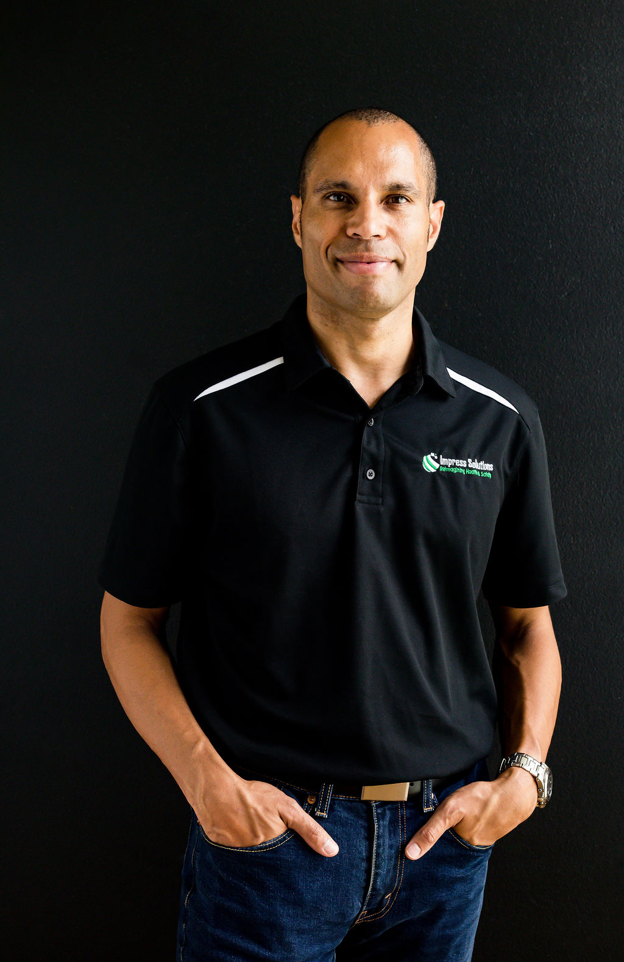

I help you save lives at Work
Notes:
Who am I?
My name is Christian Young I help safety professionals in the mining industry gain control of their H&S systems and activities to help save lives at work.
Here are some of the clients I have helped with their critical risk management process

Slide 8
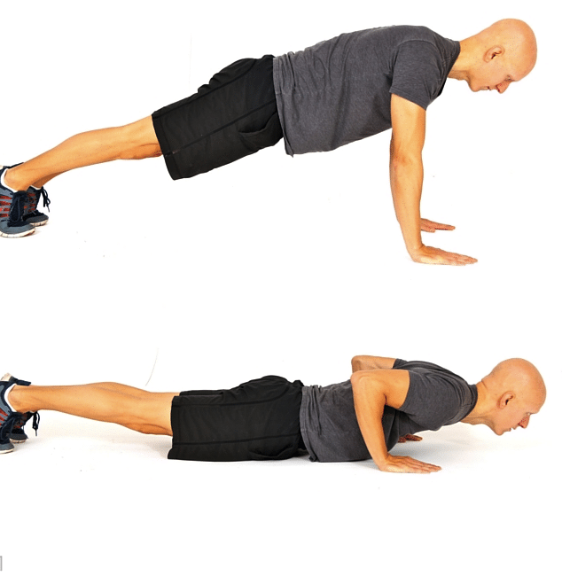
My style
UMM!!!!
We’ll move fast
I need you
Notes:
Let me tell you a bit about the style of the webinar today
When I have a pause or I’m thinking UM slips out. I’m working on it, and have a bet with my daughter about how many times I say it, as it will be 5 pushups per UM.
I’m going to move quickly so that we can get through everything and have plenty of time for questions
I want to make it interactive, as the more I understand on what you need the more I can tailor the content to you. Therefore If I ask a question, please type your response in the chat box. In fact, right now, could you please go to the chat box and type sounds cool or similar that would be great.

Slide 9
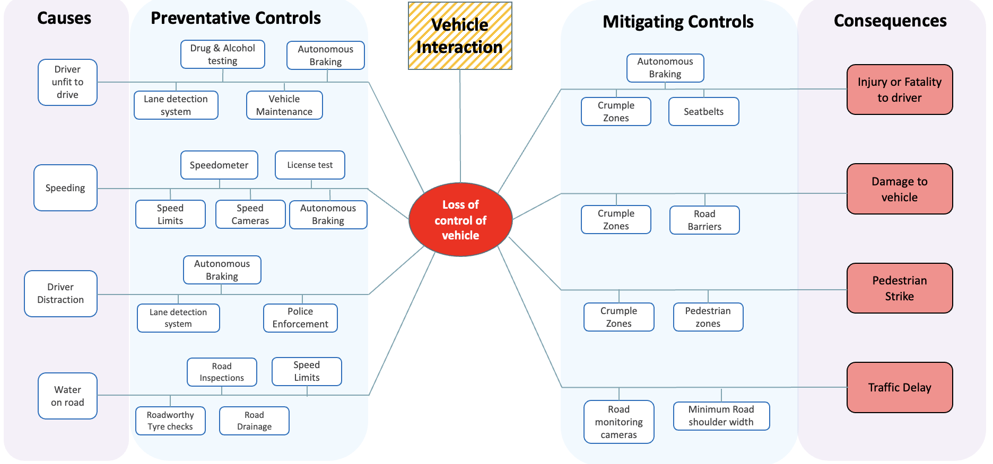
Content
3 Strategies
Q&A
My all won’t be enough
Notes:
Let me tell you about how today’s webinar is going to work.
I’m going to discuss each of the 3 strategies one by one –
Spend time on Q&A as long as you need
Bowtie Analysis takes time to get right, and and a 45 minute discussion won’t even touch the surface,
I’m going to give you everything I can in the time we’ve got and at the end I’ll show you where to go to get more help if you want it. Is that ok?

Slide 10
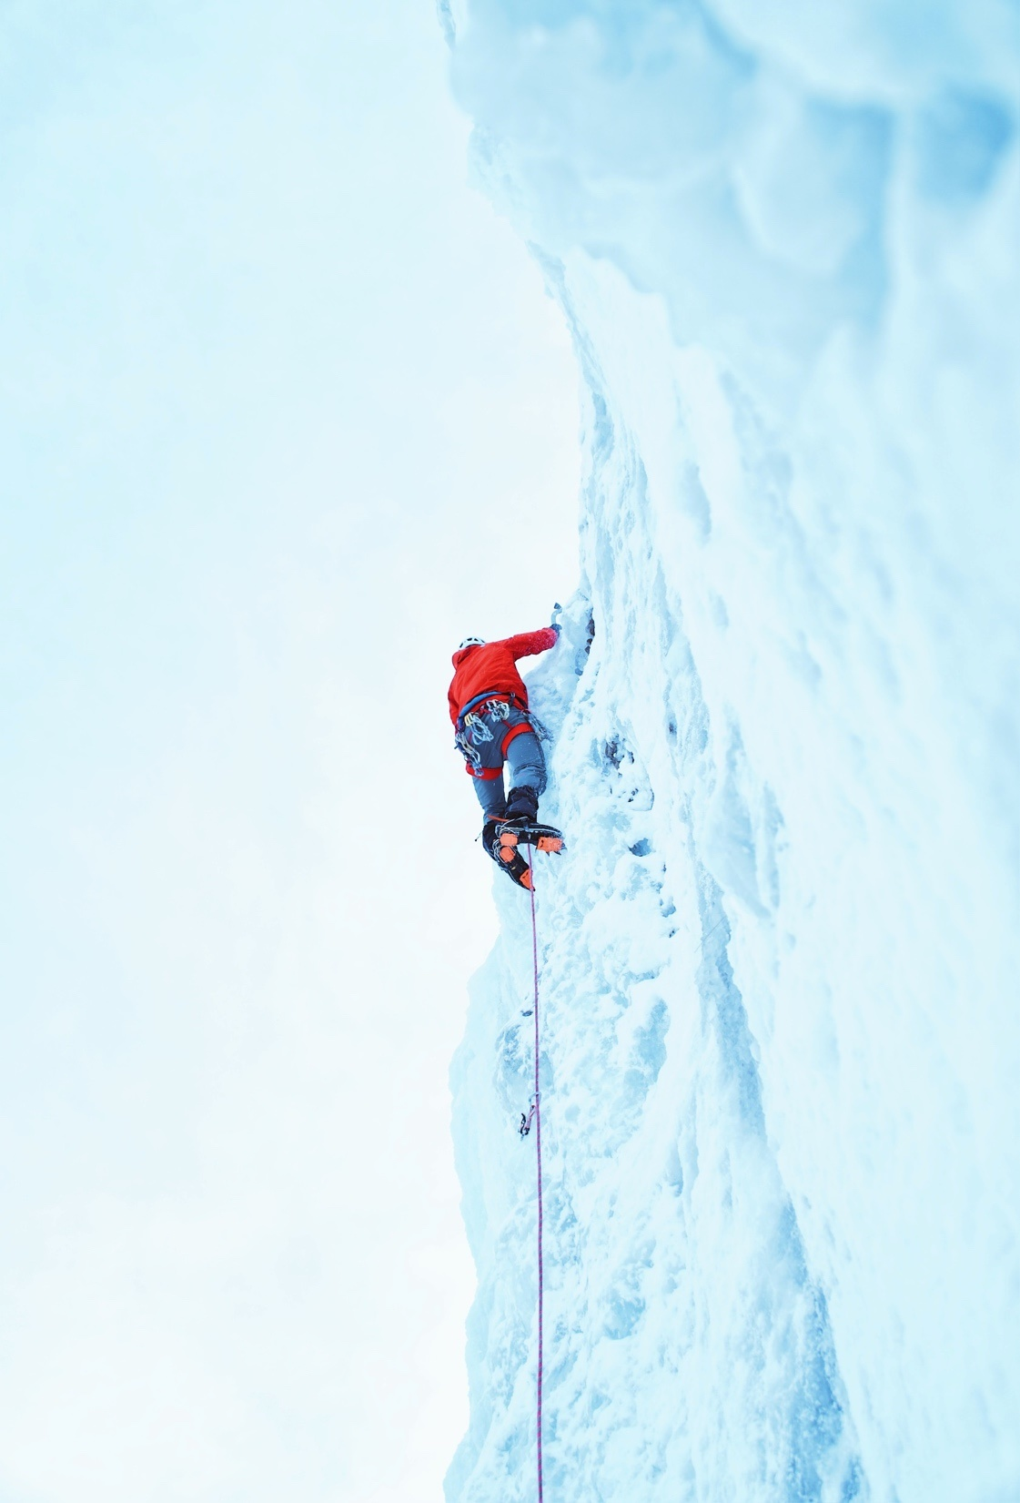
Stick around
Slides
This Recoding
Notes:
Stick around until the end and I will tell you what to do to get a copy of the slides, a recording of this presentation,

Slide 11
Question
What’s the hardest part about getting Bowtie Analysis right in your business or from your experience?
Notes:
Ask questions and answer – 3 minutes
Thanks everyone for their contribution, we all agree there are some challenges, now let’s move onto the content to see what we can do to alleviate some of these pain points.

Slide 12
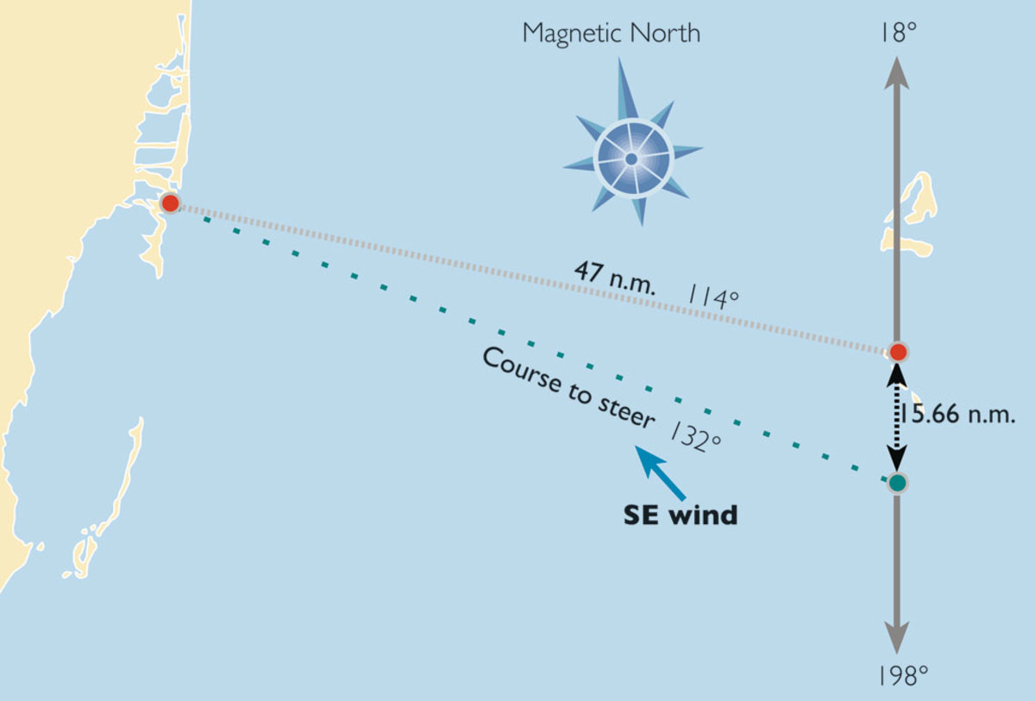
1. Know your destination
Be clear on the Unwanted Event

Slide 13
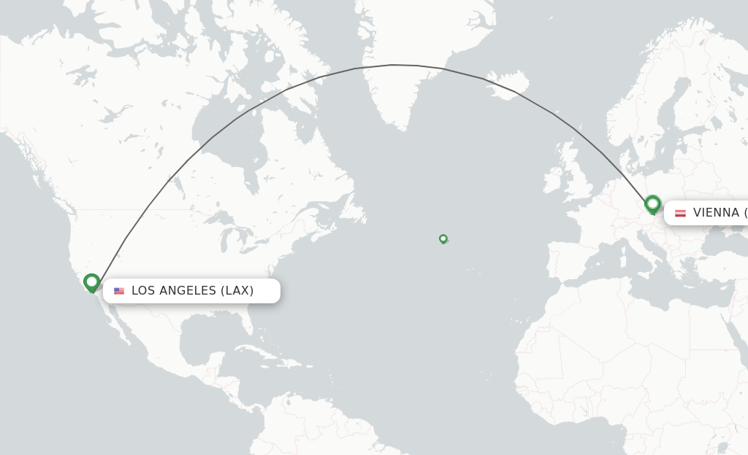
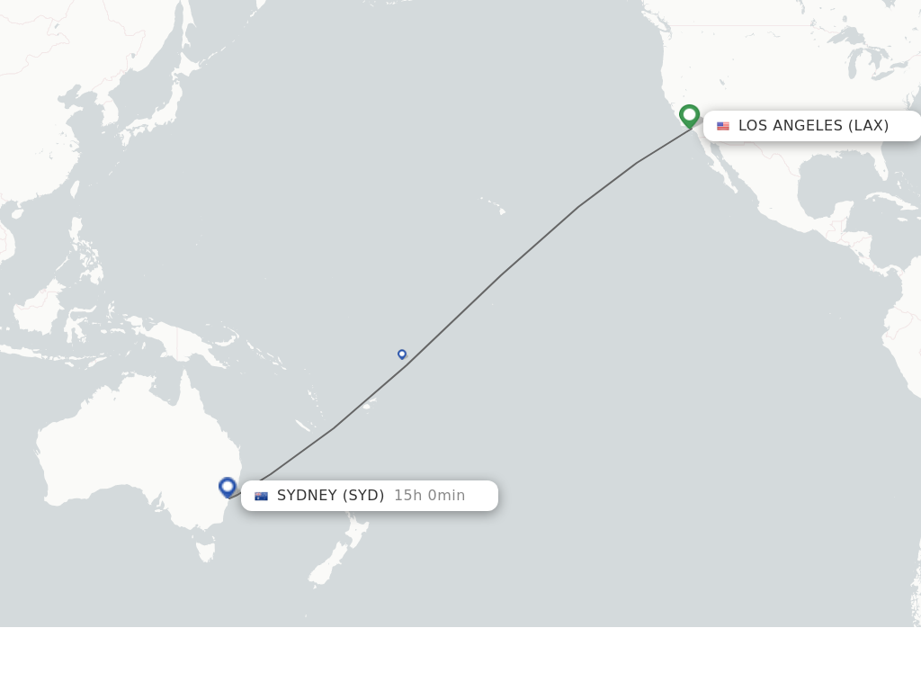
Imagine if
Notes:
Imagine if you were in Los Angeles and wanted to fly to Austria. However, the booking people got the wording wrong, and you ended up in Australia. How would you feel about this? It was only a simple mistake in the wording, yet it had a profound impact on the outcome.
The same can happen with the centre of the knot of a bowtie analysis, get the wording wrong and you can end up with causes, impacts, and the right controls being completely missed – having critical risks of high likelihood of being realised.

Slide 14
Does this sound familiar?
The unwanted event (centre of the bowtie is;
  a ‘failure of a control e.g. failure of emergency response
  An impact e.g. Vehicle Collision
Critical Controls not relevant to the unwanted event
Incident Investigations identifying gaps in the bowtie
Notes:
In these types of scenarios we would often see this signs and symptoms
Please use the chat function to write which of these applies to your business

Slide 15
Wouldn’t it be nice if
You have absolutely clarity on the unwanted event to be analysed is
Your Bowtie Analysis descriptions aligned to the Broad-Brush Risk Assessment Events

Slide 16
The Unwanted Event
The description of the unwanted event should describe the point at which the system has gone from in control to out of control.

Slide 17
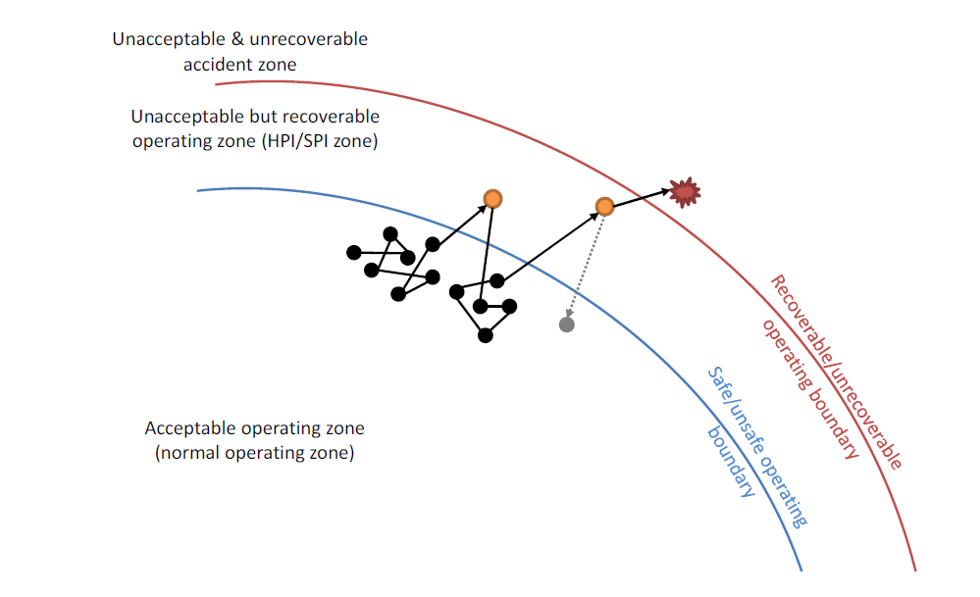
Source: M. Hassall, J. Joy, C. Doran and M. Punch, Selection and Optimisation of Risk Controls. ACARP report no C23007, 2015.
Notes:
Describe this model here

Slide 18
Working at Heights
Vehicle Interactions
Notes:
For these activities, what might be the centre of the knot description for the bowtie that describes this as a loss of control event?

Slide 19
Causes
Preventative Controls
Vehicle Interaction
Mitigating Controls
Consequences
Drug & Alcohol testing
Autonomous Braking
Driver unfit to drive
Autonomous Braking
Injury or Fatality to driver
Lane detection system
Vehicle Maintenance
Crumple Zones
Seatbelts
Speedometer
License test
Speeding
Damage to vehicle
LV Vehicle Collision
Speed Limits
Speed Cameras
Autonomous Braking
Crumple Zones
Road Barriers
Pedestrian Strike, infrastructure damage, HV collision, vehicle rollover, vehicle over open edge, vehicle into body of water / liquid
Autonomous Braking
Driver Distraction
Lane detection system
Police Enforcement
Crumple Zones
Pedestrian zones
Road Inspections
Speed Limits
Traffic Delay
Water on road
Roadworthy Tyre checks
Road Drainage
Road monitoring cameras
Minimum Road shoulder width
Notes:
Imagine if we reworded the centre of the knot of our previous example
Highlighted in the green box are potential consequences that we would not identify.

Slide 20
Good Examples | Poor Examples
Ignition of fire in a processing plant | Conveyor burnt down (This is a consequence)
Uncontrolled release of gas from storage vessel | Gas explosion (This is a consequence)
Diesel particulate emissions in workspace above acceptable limit | Diesel particulate emission over exposure (This is a consequence)
Unplanned movement or contact made by vehicle | Human error (Poorly defined generalised comment)
Falling person or object in working at heights situation | Fall arrest not used (This is an ineffective use of a control)
Exposure to uncontrolled electrical energy | Incorrect isolation (This is a poorly executed control)
Inrush event | Flooded mine (This is a consequence)
Loss of control of strata | Cave in or wall slump (These are consequences)
Misfire of explosives | Contaminated explosives (This could be a cause)

Slide 21

Notes:
Before Christmas we were working with a client who asked us to review their critical risk management documentation as part of our advisory service.
They had 30 bowties, and can anyone guess what we found when we reviewed their unwanted event descriptions?
14 of the bowties (almost half) had issues with the wording of their unwanted event. They are currently working on reviewing and updating their bowties to remove this issue. Which is a bit of work.

Slide 22
What you need to do
Review your current bowties and ensure all the unwanted events are described as the point of loss of control.
If you find bowtie deficiencies, you need to fix them to give you the best chance of saving lives.

Slide 23

Notes:
We’ve talked about;
the impacts of not getting the centre of the bowtie right
The process of defining the unwanted event as the point at which the system has lost control
A client who almost half of their bowties were incorrectly worded.
What type of impact would it make to your Bowtie Analysis process if you have absolute certainty on on your unwanted events?
So now you know there is a process for obtaining certainty on your unwanted events, you have a decision to make. You can keep doing Bowtie Analysis the old old way where you continue to get lazy on defining the unwanted event meaning the bowties end up with completely different outcomes than intended, or, you can be disciplined on defining the unwanted event and obtain absolute certainty you have identified the right ones.
What’s it going to be, the old way, or the new way, type your response in the chat box.

Slide 24
Defining the unwanted event as a Loss of control event is a key strategy in mastering bowtie analysis.

Slide 25
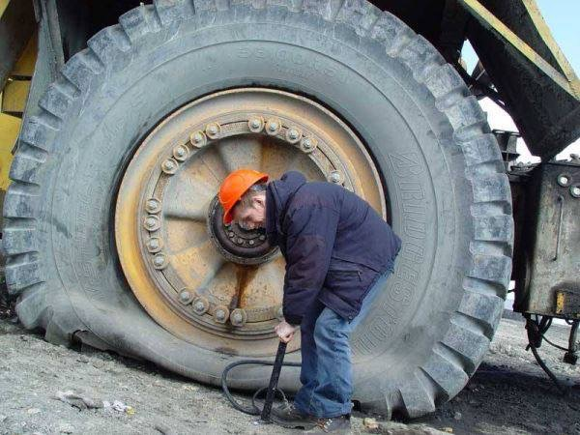
2. Wrong tool for the job
Use Bowtie Analysis at the wrong times.

Slide 26
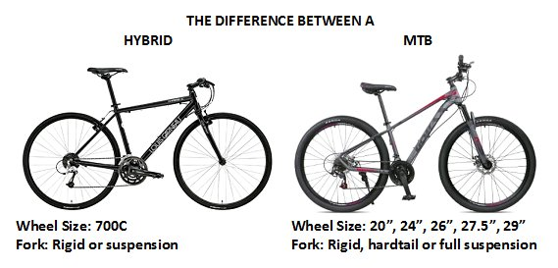
Imagine If
Notes:
Imagine if you were a professional mountain bike and road race cyclist, and at your next mountain bike race you used your road bike which has skinny tyres and no suspension?
What would be the result?
You could certainly make it work by tapping into your skills and experience, but unlikely you would win because the equipment is not designed for that type of race.
The same can happen if we use bowtie in the wrong circumstances – we can make it work with skills and experience, however it’s likely there will be missing risks, and controls.

Slide 27
Sound familiar?
Uncertainty on when to use Bowtie Analysis
Bowtie Analysis have been modified to add likelihood scores
Bowties are used for process step risk assessments.
Bowties are used to assess complex systems
Notes:
In these types of scenarios, we would often see this signs and symptoms of confusion on when to use Bowtie Analysis

Slide 28
Wouldn’t it be nice if
We knew when to use a bowtie and when not to.
Notes:
How would it feel if you….
We’re going to cover 3 strategies you can perform to identify and review controls.

Slide 29
When to Use
Bowtie Analysis are designed to analyse 1 x loss of control event (hazard) at a time.
Contact with Live Electrical Conductors, Falling from Height, Loss of Control of Vehicle, Failure of Strata
They are not designed to analyse a scope with multiple hazards.
12 step Isolation process, Blasting Management Process, Confined Space Management
They are not designed to analyse failure modes of complex systems
Gas monitoring system, Electrical Protection System,

Slide 30
Electrical Energy
Risk Analysis of Isolation Process
Workplace Risk Assessment and Control (WRAC)
Critical Risk Analysis of ‘Contact with Live Electrical Conductors’
Bowtie Analysis
Assessment of Electrical Protection Infrastructure
Hazard Operability Study (HAZOP), Failure Modes Effects Analysis (FEMA)

Slide 31
What you need to do
Review each bowtie and ensure it has been used for a loss of control unwanted event only.
If you find examples of incorrect use, you need to implement the right tool to give you the best chance of saving lives.

Slide 32
Notes:
We’ve talked about;
the impacts of only not using bowtie analysis for what it’s intended to do
Criteria that can be applied to help you know when it should be used and when it shouldn’t
What type of impact would it make to your Critical Risk Management Process if you had bowties in place for what they are designed to do?
The question I have for you is knowing what you now know, if you have examples of bowties used for the wrong purpose, will you take action to fix this, or just lave it as is?
Are you going to do look outside or continuing to look inside? Type you answer in the box?

Slide 33

Ensuring that Bowie Analysis is only used for the analysis of single Loss of Control Events is a key strategy in mastering bowtie analysis.

Slide 34
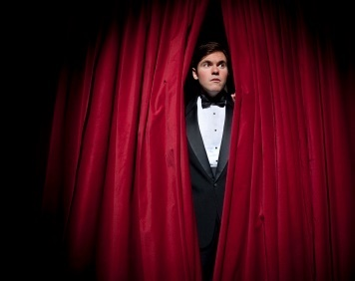
3. Are your Controlling Risk?
Are your controls really controls?

Slide 35
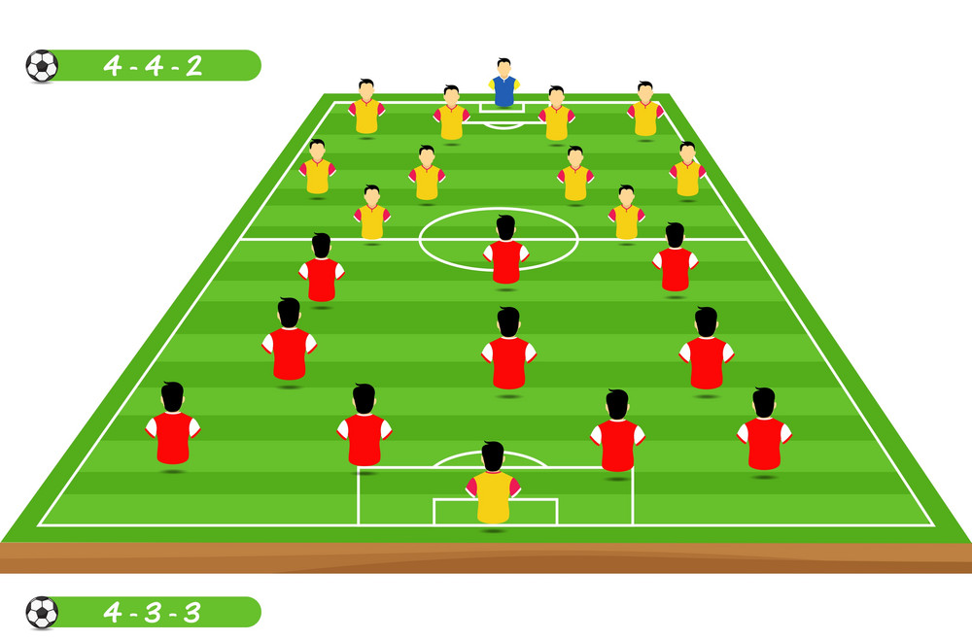
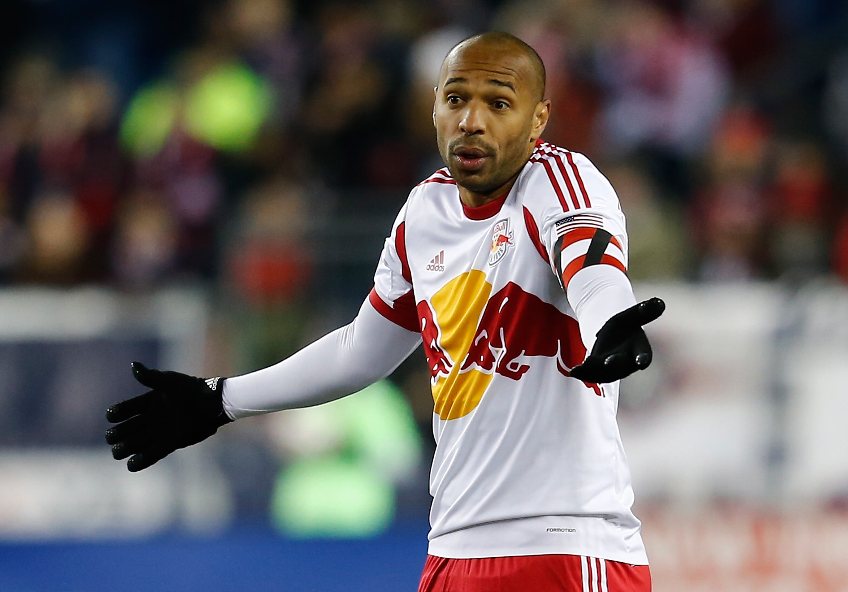
Imagine if
Notes:
Imagine if you were the coach of a soccer team and the only instructions you gave your players was you 3 attack, you 3 play in the middle and you 4 stay at the back and defend.
What would be the result?
Would the players know what their specific role was?
How would you know if they were doing their role well or not?
The same can happen if we use controls in our bowties that are not specific, measurable or auditable.
We haven’t been specific in what we want them to do, and therefore we don’t know if the control is working or not?

Slide 36
Sound Familiar?
Controls are broad statements
Controls are copied over risk assessment after risk assessment.
Controls are not validated with SHMS documentation
The control (as described) cannot be audited.
Unable to perform Control effectiveness assessments of controls as they are no specific
Notes:
In these types of scenarios we would often see this signs and symptoms of Controls not well defined

Slide 37
Imagine
Controls are specific
Key controls have control effectiveness performed on them
Notes:
Imagine….
We’re going to cover a key strategy to prevent your Critical Controls from failing

Slide 38

Why is it important that we ensure our controls are specific, measurable and auditable?

Slide 39

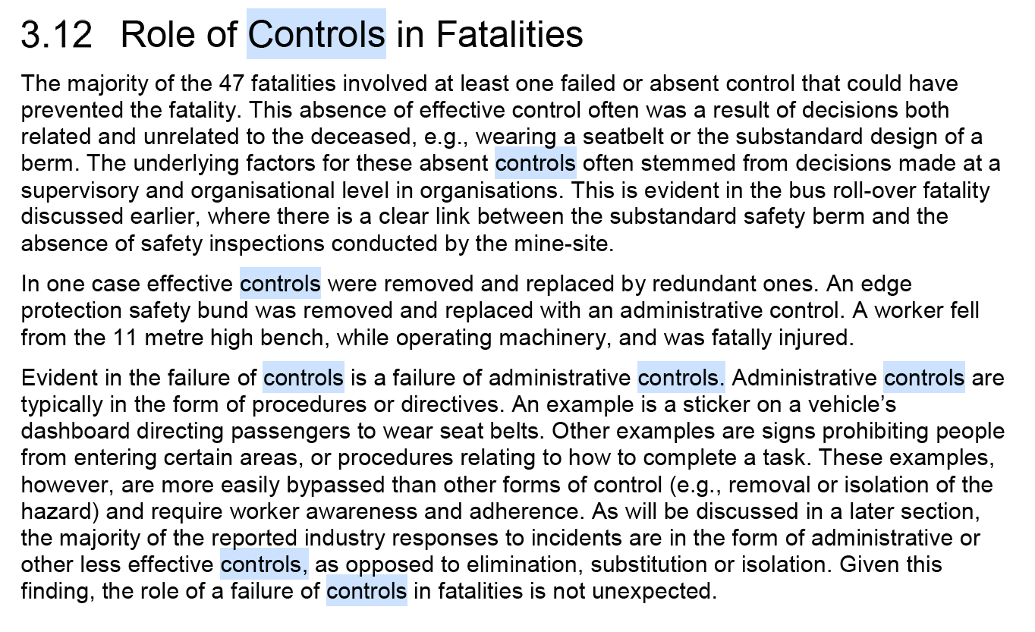
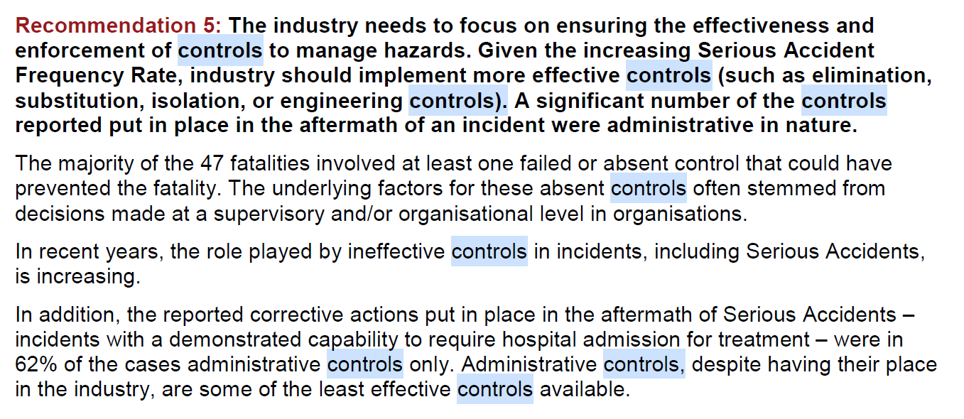
Controls Fail

Slide 40
A Control
Is;
  An act, or,
  An object or,
  A technological system.
  Must be;
  Intended to arrest or mitigate an unwanted event.
  Specifiable, measurable and auditable
  Mapped to the management system (Impress)
Adapted from: Rasmussen & Svedung, 2000; Leveson, 2004.
Provide a rating out of 10 for your organisation

Slide 41
Act
A human ‘act’, which of itself, arrests or mitigates an unwanted event.

Slide 42
Question?
Is “Isolation Procedure” an ‘act’ type control for the hazard of “Incorrect isolation” ?
No
  The “Isolation Procedure” does not define the ‘act’
  More appropriate Control Description
  Look inside the procedure for the specific ‘act’ which controls this hazard
    e.g.. “Test the system is de-energised prior to commencing work”
  List this as the control

Slide 43
Object
A physical, ‘engineered’ or designed ‘object’, which of itself, would arrest or mitigate an unwanted event.

Slide 44
Question?
Which of the following are object type controls?
  Seatbelts
  Flashing lights at rail crossings
  Fire sensors and alarm
Answer
  Fire sensors and alarm
  The other two require ‘acts’ to enable their success

Slide 45
System
A combination - an object control that requires human acts to actuate, operate or respond.

Slide 46
Specific, Measurable, Auditable
Specificity:
  How would you describe the control to someone else such that they would know what to look for
  E.g.. all drivers must drive a maximum 40km/hr through a school zone
Measurability:
  How can you measure if it’s working or not
  E.g.. GPS tracking,
Auditability:
  How could you audit its effectiveness
  E.g.. Review GPS logs, in field observations with radar gun

Slide 47
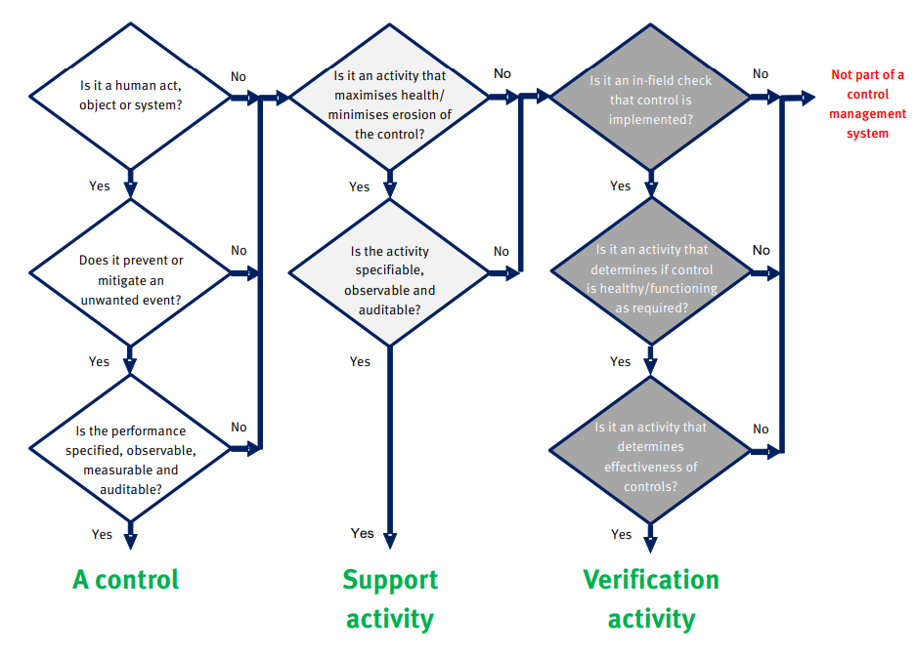
Source: The State of Queensland (Mining Safety and Health Advisory Committee) Risk assessment education resource.

Slide 48

Notes:
Of the client we worked with before Christmas.
Out of the 30 bowties we reviewed, what do you think we found in relation to their controls in their bowties?
How many of the 30 bowties do you think had issues with their controls?
Correct all 30
So 100% of their bowties for their critical risks had weak or poorly defined critical controls.
Is it any wander that we still having significant incidents of worse

Slide 49
Another Decision
Notes:
We’ve talked about;
the impacts of not articulating the defining controls adequately
The key criteria for defining controls
A case study from Mitchell Services where they applied the Performance Standard Process within their business
What type of impact would it make to your Critical Risk Management Process if each for each Control was specific, measurable and auditable?
I will make it a rhetorical question this time, you know how a choice, when it comes to managing Critical Controls will you stop at identification of the Control with some monitoring activities, or will you ensure all of the performance requirements are defined?

Slide 50

Ensuring controls are clearly defined is a key strategy in a key strategy in mastering bowtie analysis.
Notes:
Looking out and up is an activity embedded within world class CRM processes

Slide 51

What is your key takeaway so far?

Slide 52

Notes:
I don’t know why you showed up today it could be because:
There is not a lot of knowledge or experience in using Bowtie Analysis?
You think the bowties in your organisation can be improved.
The bowties are a big light on detail

Slide 53
Poorly defined unwanted events lead to deficient bowties. The criteria of “loss of control of system” should be applied.
Notes:
Know you know that – list them off above

Slide 54
Bowtie Analysis should only be used to assess a single loss of control event at a time.

Slide 55
Controls need to be specific, measurable and auditable to enable us to determine if we have controlled the risk.

Slide 56

The obvious question
How do I do it?
Notes:
This then brings up the obvious question doesn’t it, how do I do it?

Slide 57
Slow or Fast
Trial and Error Vs system
Notes:
You could perform trial and error with some of the content that you have learned on the webinar today and go it alone. Which will take time.
We all know that trial and error is the slowest way to get things done, and the quickest way is to follow a recipe of someone who has done this a bunch of times.

Slide 58
Help is here – If you don’t know how big the gap is
Free Critical Risk Triage Call
It’s not for everyone
Notes:
I promised you earlier that I would let you know where to go to get some more help and the help I want to offer you is exclusive access to our Critical Control Accelerator Workshop where in 40 minutes or less I give you everything you need to implement a Critical Control Management Program
I want to let you know upfront that it’s not for everyone.
If you you are comfortable with your CRM Process and documentation, then this is not for you,
If you;
Are willing to grow your CRM skills and knowledge,
Know that your CRM program can be improved to help save lives
Then this is for you

Slide 59
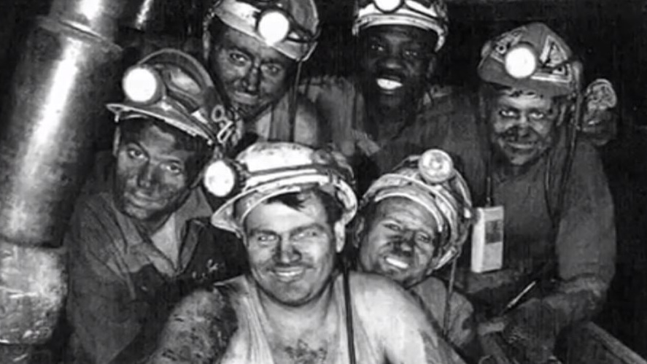
Save lives at work
Notes:
So why am I doing this, to help save lives at work.
To help you save lives at work and get started now, I’ve finally been able to get all of our content online

Slide 60
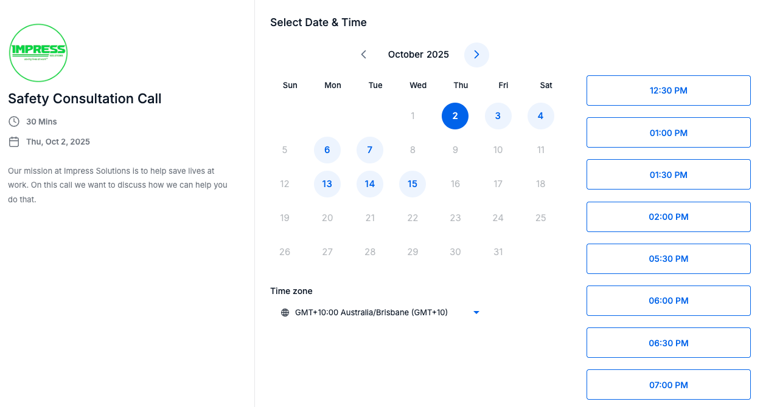
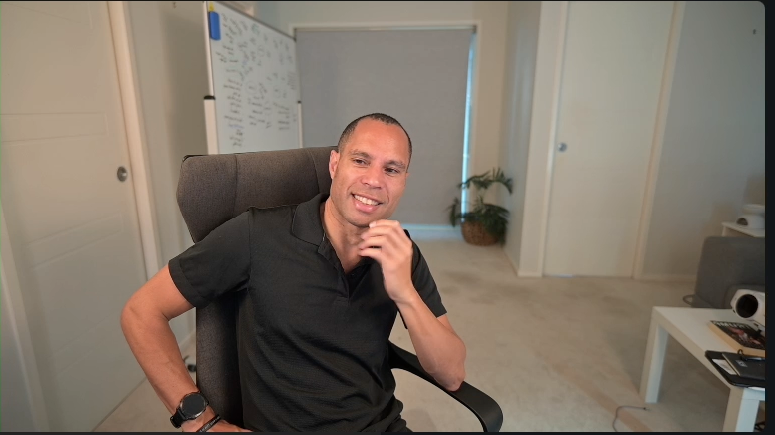
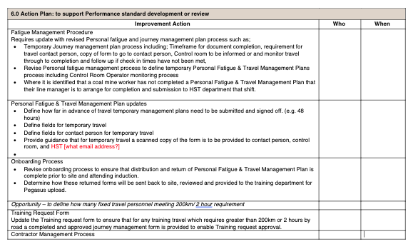
Book a time and date
15-minute call with Christian
You have a plan

Slide 61




Benefits
You know exactly where you are and what to do in 30 minutes, not 5 years.
Don’t pay $100K to Consultants for a review
Use our 25 years of CRM skills and experience to improve your process.
Identify low hanging fruit that can make meaningful change.

Slide 62

Only taking submissions for the next 2 weeks only.

Slide 63
Help is here
Attend our next Virtual Bowtie Masterclass
It’s not for everyone.
Notes:
I promised you earlier that I would let you know where to go to get some more help and the help I want to offer you is a spot at our next Virtual Bowtie Analysis Masterclass
I want to let you know upfront that it’s not for everyone.
If you you are comfortable with your Bowtie Analysis knowledge and documentation, then this is not for you,
If you;
Are willing to grow your Bowtie Analysis skills and knowledge,
Know that your Bowtie Analysis process can be improved to help save lives
Then this is for you

Slide 64
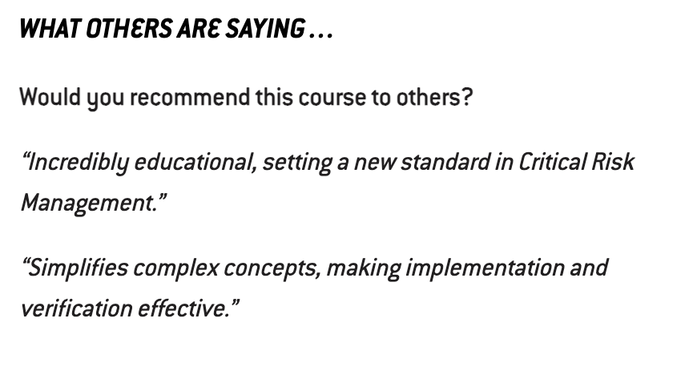
Virtual Bowtie Analysis Masterclass
Details
  Wednesday 14th of January 2026
What You Will Learn:
  Comprehensive Bowtie Analysis Techniques.
  A deep understanding of the do’s and don’ts in Bowtie Analysis.
  Skills to identify critical controls and assess control effectiveness.
  Techniques for facilitating a successful Bowtie Analysis workshop.
What you will receive;
  Course workbook
  Editable Templates to use within your business
  Flowcharts for selecting and evaluating Critical Controls
  Additional 30 minute Q&A session
  1 year of complimentary support
Total investment $439

Slide 65

Satisfaction Guarantee
We’re so confident in the transformative power of our Bowtie Analysis Master Class that we offer an unmatched satisfaction guarantee.
If you’ve fully participated in the Masterclass, completed all coursework, and still feel that it hasn’t delivered exceptional value, we will not only provide you with a full refund but also allow you to keep all course resources.
Our commitment is to your absolute satisfaction and empowerment in mining safety – without any risk to you.

Slide 66
Questions / Comments
Notes:
While people are submitting their documents or checking out the CRM Courses, we have time for questions on the content or the free audit process.

Slide 67
Resources
Email admin@impresssolutions.com.au
Slides + Audio
Once recording is edited, we will send through materials

Slide 68
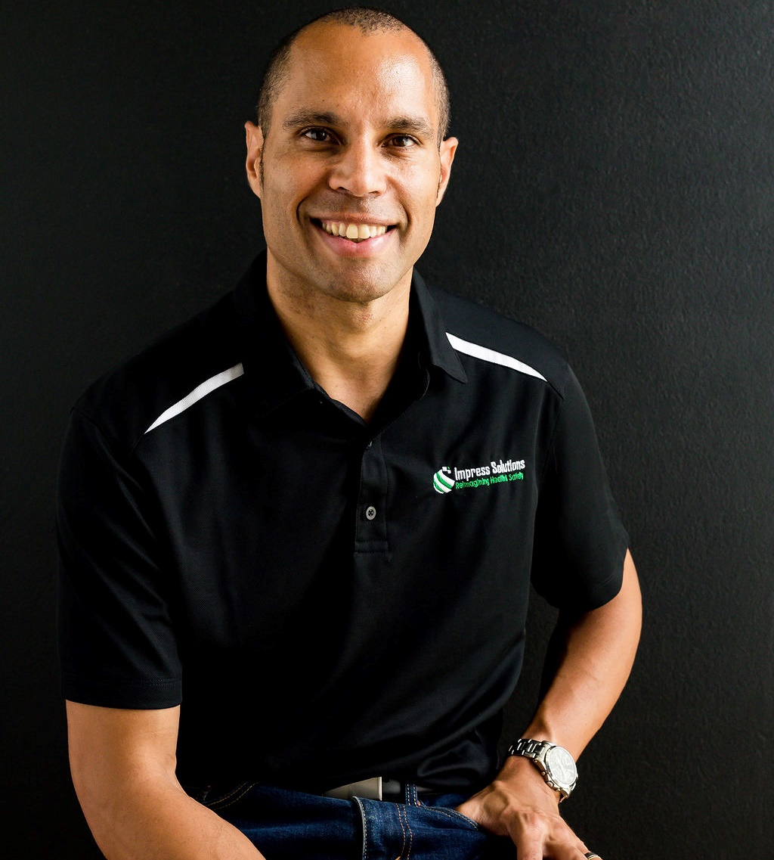

Christian Young
FOUNDER
0473 497 838
Christian.Young@impresssolutions.com.au
www.impresssolutions.com.au

Slide 69
Thank you
Notes:
Thankyou for your time, especially during a week day.
I hope this was of value, if it was please share your thoughts using the chat function.
That’s the end of the formal proceedings, but I am more than happy to stay on the line to answer any other questions or discuss anything else. Depending on the numbers we might open up audio as well.

