Slide 1
MEMBERSHIP promotions supplier guide

Slide 2
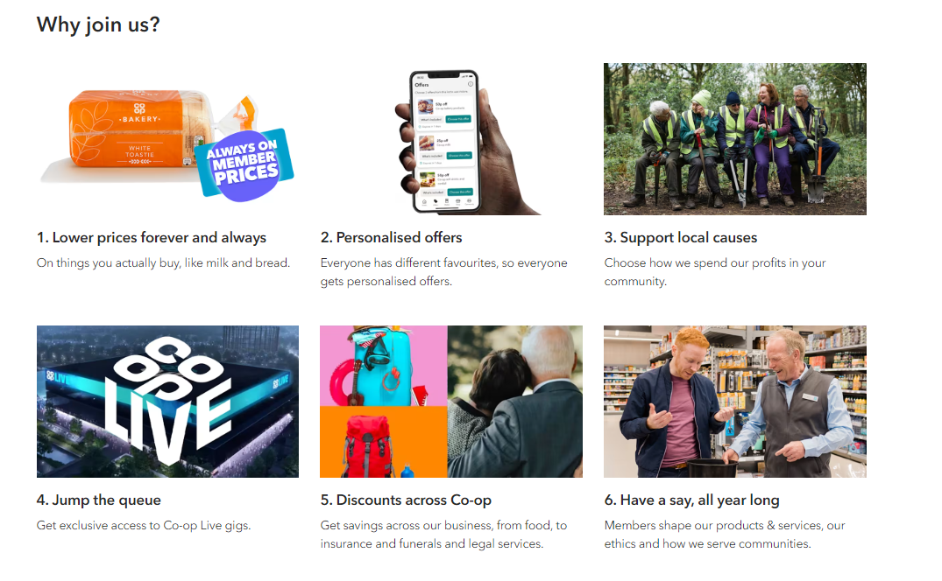
Why become a coop member?

Slide 3
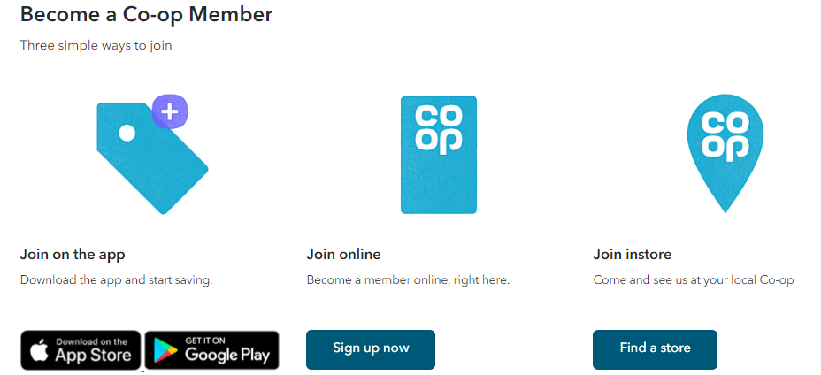
How to become a coop member?

Slide 4
Membership in 2024
Member sales worth £3.1bn, an increase in spend of +20% YOY
97% of total Co-op member spend is spent in Food
6.19m Active Members
Trading across Co-op in the L52wks
Member Penetration has increased from 37.4% to 40.5%
3.72m members shopping in a Co-op Food store in the last 4 weeks- up 22.9% YOY

Slide 5
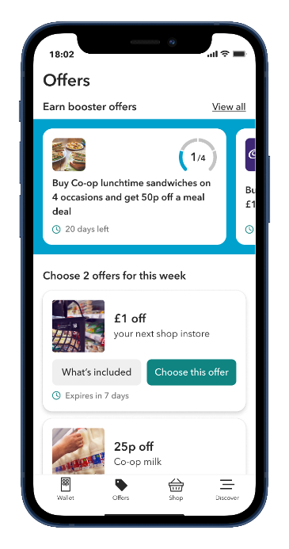



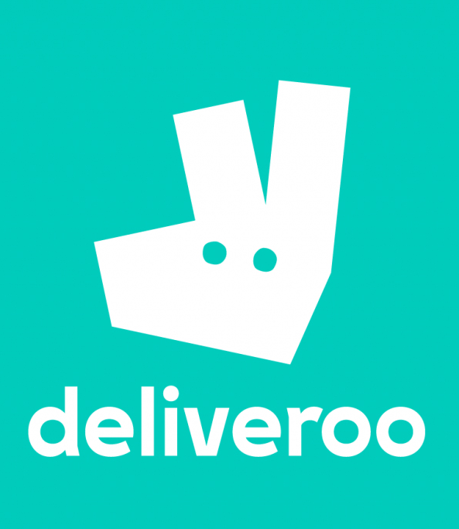
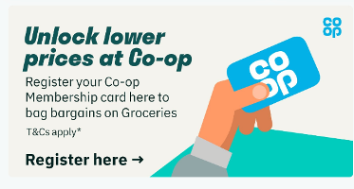
Membership News
Launched our Member Swipe Report in Hive giving the ability for users to see the member penetration at line level every week. This is a great tool to help determine how members react to our member promotional activity in store.
Member Prices are now live on Deliveroo, in Co-op Live and in our EG on the Move Franchises, allowing members to access member prices however they choose to shop and engage with Co-op.
We’ve scaled our App proposition through trialling Booster Offers with our most engaged members- driving uplift in trips to store and driving an increase in spend when they do shop more often.

Slide 6
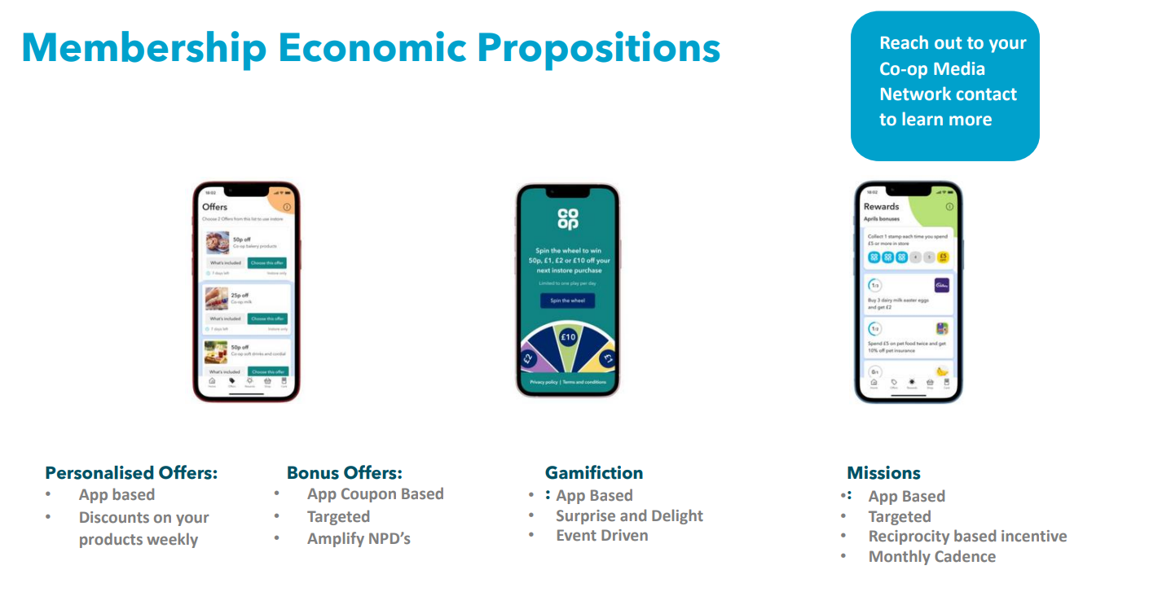

Slide 7
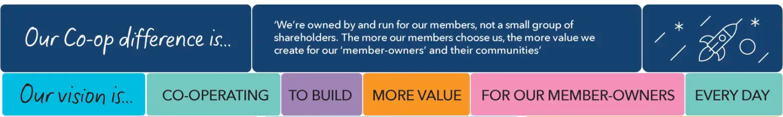
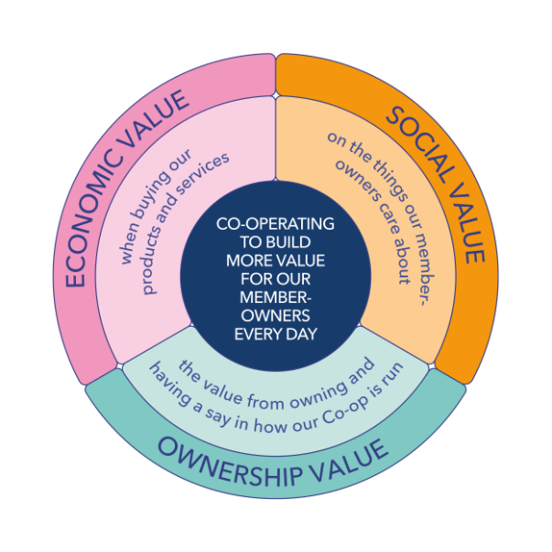


2025 sees us continue to showcase member value across all our channels, continuing to highlight this through our Owned By You Right by You brand platform, as we aim to get to 8m active members by 2030.
8m Active Members by 2030

Slide 8

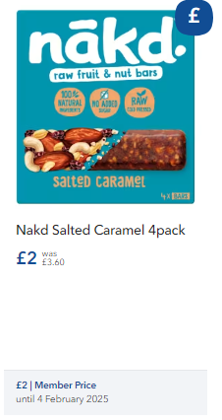
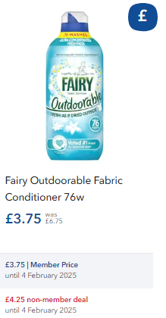
Types of member promotions
Member Enhanced
Promotion
Member Only Promotion
This is where we offer a promotional price which is only accessible to customers who scan their member card.
Non-members pay full price (AYR base price).
This is where we offer a market matching price for all customers and then a market leading promotional price which is only accessible to customers who scan their member card.

Slide 9
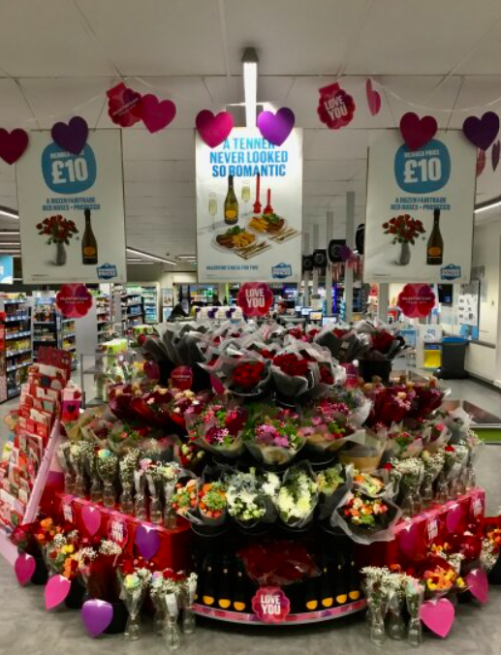

EDLP, WIGIG & Seasonal
Member only promotions can still be run on EDLP, WIGIG and Seasonal lines.
Base price for all customers is competitive vs the market.
Member price offers a deal that is more competitive that the base price.
Lines will not show a member saving/cross out due to price establishment rules (same ruling as current).
Lines can be run as a price promotion, multi buy or link save (as the 2025 Prosecco/Roses Valentines' example)
For specific line level queries on EDLP/WIGIGs or Seasonal, please reach out to your buyer for support to talk through options.

Slide 10
Step 1 : identify the deal member only space in tcg
The following off shelf sites are dedicated to featuring Member Only promotional activity;
Grocery End 3
Grocery End 4
Chilled End 1
Freezer Door 1
Bakery Stand
BWS End 2
Wine Tower 2
Unless specifically agreed as part of the promotional planning process, there shouldn’t be any deals in this space without a Member Only offer

Slide 11
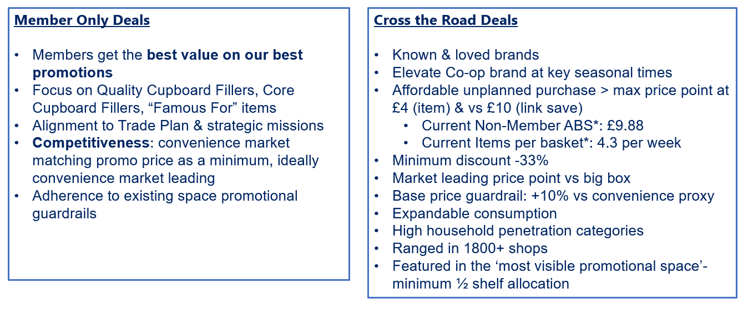
Step 1 : identify the deal
membership guardrails
Contact your category buyer with any questions ​

Slide 12
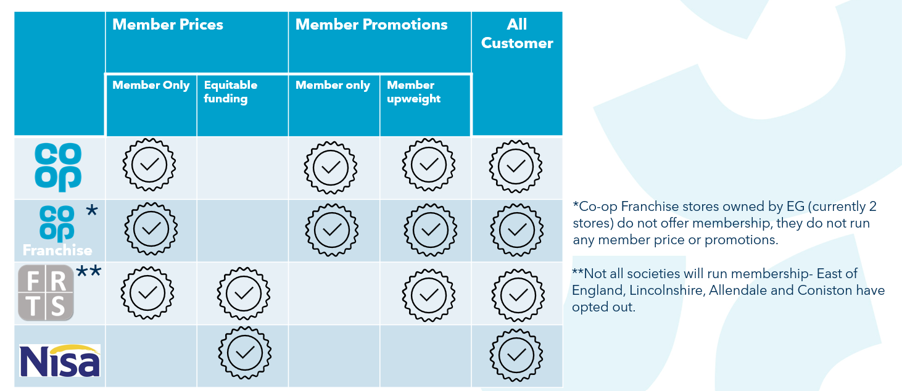
Step 1 : identify the deal
other channels

Slide 13
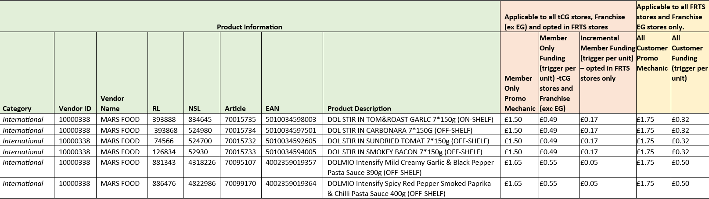
Step 3 : fund the deal
member only
For Member Only, the “Incremental Member Funding” (FRTS opt in) +
“All-Customer Funding” (Standard offer) = “Member Only Funding” (Total TCG offer)
E.g. below… £0.17 + £0.32 = £0.49

Slide 14
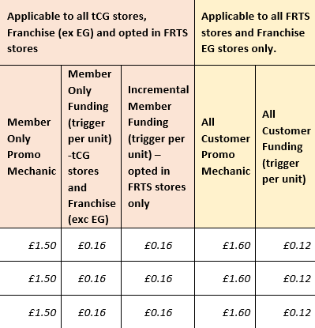
Step 3 : fund the deal
member enhanced
For Member Enhanced, the “Member Only Funding” (Total TCG offer) and “Incremental Member Funding” (FRTS opt in) should be the same
E.g. below… £0.16 is the same as £0.16

Slide 15
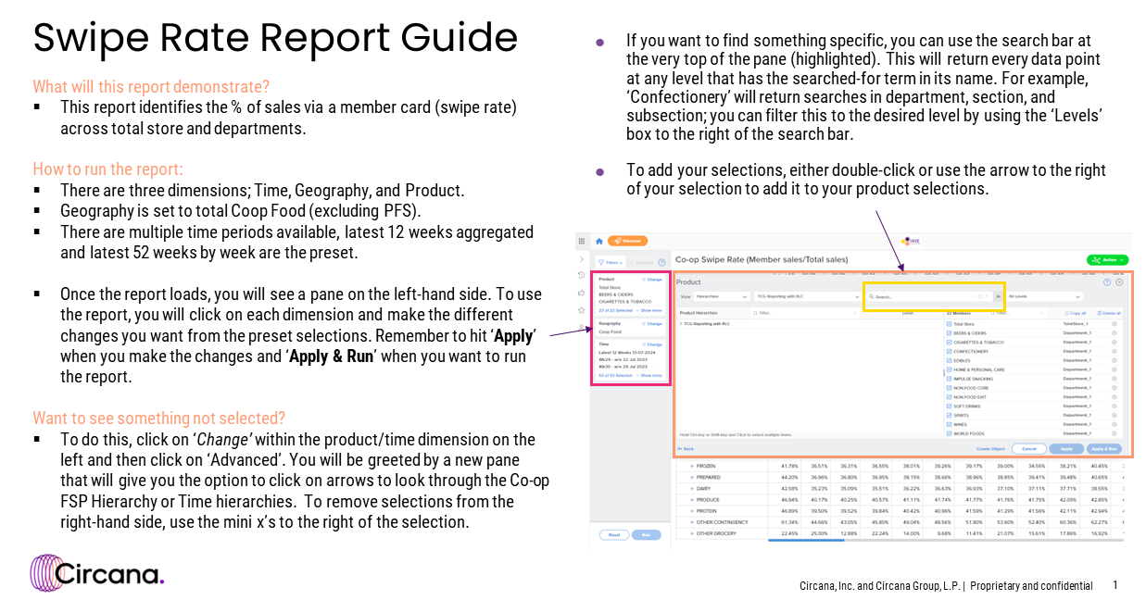
hive: member volume sales report
Use the following link for more info on Hive https://www.coopsupplierhub.com/hive
For sign up queries, the below
Coop-CS@circana.com
There are reports available through Hive to understand the performance of your Membership deals. Please refer to the following guides or the links on the right for more information.

Slide 16
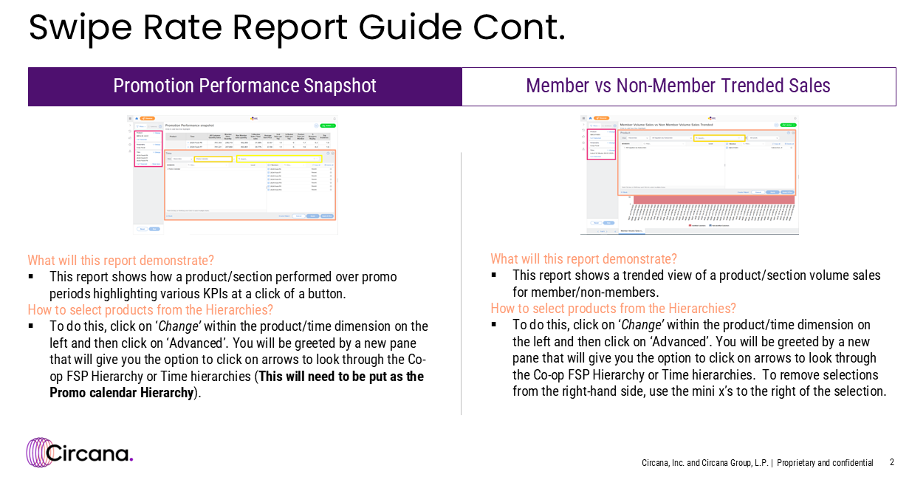
hive: member volume sales report
Use the following link for more info on Hive https://www.coopsupplierhub.com/hive
For sign up queries, the below
Coop-CS@circana.com

