Slide 1



2025 Benefit Account Offerings
Health Savings Accounts

Slide 2



THE NUESYNERGY DIFFERENCE
Providing full-service administration since 1996
Award-winning live, U.S.-based customer service:
Calls answered in under 30 seconds
98.5% first call resolution
Electronic claims processed within 24 hours
Smart debit card convenience
Easy-to-use smart mobile app and participant web portal

Slide 3

HEALTH SAVINGS ACCOUNT
Tax-advantaged savings for qualified medical expenses
Must be paired with an HSA compliant high deductible health plan (HDHP)
Consumer owned, tax-favored account
Contributions are tax-free
Funds used to pay for current and future medical expenses for employees, spouses and dependents
Tool for saving and investing tax-free dollars to cover health care expenses into retirement
Health Savings
Accounts
FREEDOM & ACCESSIBILITY

Slide 4
2025 CONTRIBUTION LIMITS
 | 2025 | 2026
MAXIMUM CONTRIBUTION
INDIVIDUAL | $4,300 | $4,400
FAMILY | $8,550 | $8,750
CATCH-UP CONTRIBUTIONS (AGE 55 & OLDER) | $1,000 | $1,000
HDHP MINIMUM DEDUCTIBLES
INDIVIDUAL | $1,650 | $1,700
FAMILY | $3,300 | $3,400
OUT-OF-POCKET MAXIMUM
INDIVIDUAL OUT-OF-POCKET MAXIMUM | $8,300 | $8,500
FAMILY OUT-OF-POCKET MAXIMUM | $16,600 | $17,000
SOURCE: IRS

Slide 5
HOW AN HSA WORKS
Employer and/or Employee Contributions
High Deductible Health Plan (HDHP)
Health Savings
Account
HDHP Insurance Carrier
Helps Pay Deductible
Large Medical Claims Protection
Tax Advantage: Pre-Tax Contributions
Tax Advantage: Tax-Free Interest Income
Tax Advantage: Tax-Free Medical Expenses

Slide 6
Benefits of the HSA
Health Savings Account (HSA)
Health Savings Accounts can help reign in rising health care costs
Reduced premiums
Provide Incentives to get Involved with health care decisions
Increased Plan Satisfaction
Percentage Very/Somewhat Satisfied
SOURCE: Fidelity

Slide 7

Benefits of the HSA
Health Savings Account (HSA)
Portable: HSA account holder can take the HSA balance with them when they change jobs or retire
Triple tax savings: Pre-tax contributions, tax-deferred investments growth, tax-free dollars to cover health care expenses
Unused balances carry over each year without limitations
HSA balance (including any employer contributions) belongs exclusively to the account holder.

Slide 8

Benefits of the HSA
HSAs have many advantages and can work well regardless of how they are used.
Low Utilizer: Can keep the money rather than give it to the insurance company and either roll it over from year to year or use it on other qualified expenses.
Medium Utilizer: In most cases, the money saved on premiums and the tax break received from contributions offsets the initial out-of-pocket deductible costs. This saves money over a traditional copay plan, although it is important for each individual accountholder to do the math for themselves.
High Utilizer: More likely to hit their out-of-pocket maximum, and then the insurance company pays 100% of the cost – even for prescriptions.

Slide 9

ADDED BENEFITS OF AN HSA
You can use the money in your HSA for other qualified medical expenses that may or may not be covered by your health plan – things like dental, vision, orthodontia, and visits to the chiropractor.
HSA money can also be used for your spouse and dependent child(ren)’s eligible expenses – whether they’re covered under your health plan or not.

Slide 10
HSAs and Retirement
The HSA can be a great resource for retirement, helping you pay for medical expenses and even Medicare Part A, B, and D premiums.
When you enroll in Medicare, you must pro-rate your contributions for the number of months you had HSA-qualified coverage, prior to the month your Medicare enrollment is effective.
When you turn 65, the 20% tax penalty for using the HSA on non-qualified medical expenses is waived and is subject only to normal income tax.
Additional qualified expenses:
Out-of-pocket healthcare expenses while enrolled in Medicare (including Medicare premiums, deductibles, co-insurance and co-pays, but not “Medigap”)
Employee share of health insurance premiums for employer-based coverage (for employees over 65 only)
Premiums for COBRA continuation health insurance coverage
Premiums for qualified long-term care insurance coverage
8. Each spouse age 55 or older can contribute an additional $1,000 “catch-up” on top of the annual maximum contribution for that tax year. If you did not have HDHP coverage for the full year, you must pro-rate your “catch-up” contribution for the number of full months you were “eligible”, i.e., had HDHP coverage. If you had HSA-qualified HDHP coverage for the entire year, you can deposit the entire “catch-up” amount starting with the year you turn 55, regardless of when you turn 55 during the year. If both spouses want to make “catch-up” contributions, each spouse must have a separate HSA.
9. In the year you enroll in Medicare, you must prorate your “catch-up” contribution for the number of months you had HSA-qualified HDHP coverage, prior to the month your Medicare enrollment is effective. You can delay enrollment in Medicare Part A only if you delay taking Social Security. You can delay taking Social Security up until age 70 and one half years old.
10. Once enrolled in Medicare, you can no longer contribute any funds, including “catch-up” amounts, to your HSA. If you are not enrolled in Medicare, you can contribute to your HSA and continue to make “catch-up” contributions.

Slide 11
HSA TAX BENEFITS
Reduces federal income taxes by reducing adjusted gross income
Reduces state income taxes (in most states)
HSA contributions earn interest tax-free and do not need to be itemized for taxes
COVERAGE TYPE | TAX BRACKET | SALARY RANGE | ANNUAL TAX SAVINGS BY CONTRIBUTION |  | CONSUMERS
Single Filing with Single Coverage |  |  | $3,000 | $2,000 | $1,200
Single Filing with Single Coverage | 15% | $8,026 - $32,550 | $450 | $300 | $180
 | 25% | $32,551 - $78,850 | $750 | $500 | $300
 | 28% | $78,851 - $164,550 | $840 | $560 | $336
 | 33% | $164,551 - $357,700 | $990 | $660 | $396
Single Filing with Family Coverage |  |  | $5,950 | $4,000 | $2,000
 | 15% | $8,026 - $32,550 | $893 | $600 | $300
 | 25% | $32,551 - $78,850 | $1,488 | $1,000 | $500
 | 28% | $78,851 - $164,550 | $1,666 | $1,120 | $560
 | 33% | $164,551 - $357,700 | $1,964 | $1,320 | $660
Married Filing with Single Coverage |  |  | $3,000 | $2,000 | $1,200
 | 15% | $16,051 - $65,100 | $450 | $300 | $180
 | 25% | $65,101- $131,450 | $750 | $500 | $300
 | 28% | $131,451 - $200,300 | $840 | $560 | $336
 | 33% | $200,301 - $357,700 | $990 | $660 | $396
Married Filing with Family Coverage |  |  | $5,950 | $4,000 | $2,000
 | 15% | $16,051 - $65,100 | $893 | $600 | $300
 | 25% | $65,101- $131,450 | $1,488 | $1,000 | $500
 | 28% | $131,451 - $200,300 | $1,666 | $1,120 | $560
 | 33% | $200,301 - $357,700 | $1,964 | $1,320 | $660

Slide 12


Customer Focused & Technology Driven

Slide 13
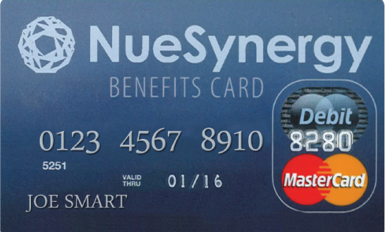
SMART DEBIT CARD SOLUTION
One Card for All Consumer Directed Benefit Accounts
Easy, immediate, thought-free access to funds with one benefits debit card
Use to pay for eligible Health Care FSA and Dependent Care FSA expenses
Linked to the NueSynergy mobile app and online account for real-time account balance information
Dependent Care FSA
Health Care FSA

Slide 14
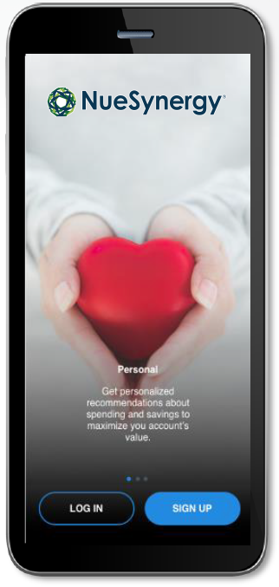
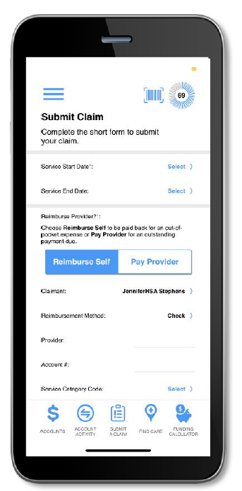
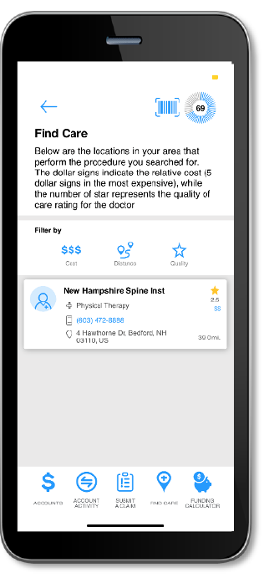
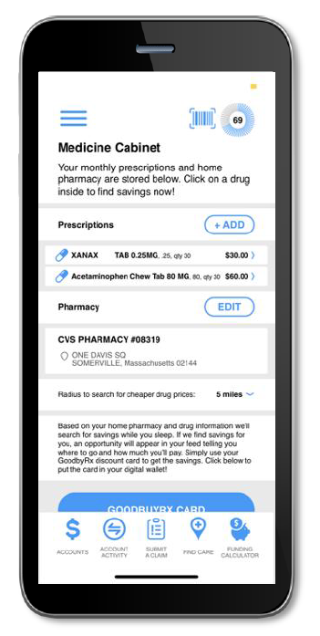
SMART MOBILE APP FEATURES
New and innovative technology makes the experience more convenient while providing more of the important information needed to make health care decisions
Account tracking allows up-to-date viewing of balance, claims status, and contributions
Prescription storing and cost savings opportunities
Transparency tools to evaluate providers and shop for procedures
Geotracking to find nearby providers
Reporting tools to help maximize benefits and potential savings

Slide 15

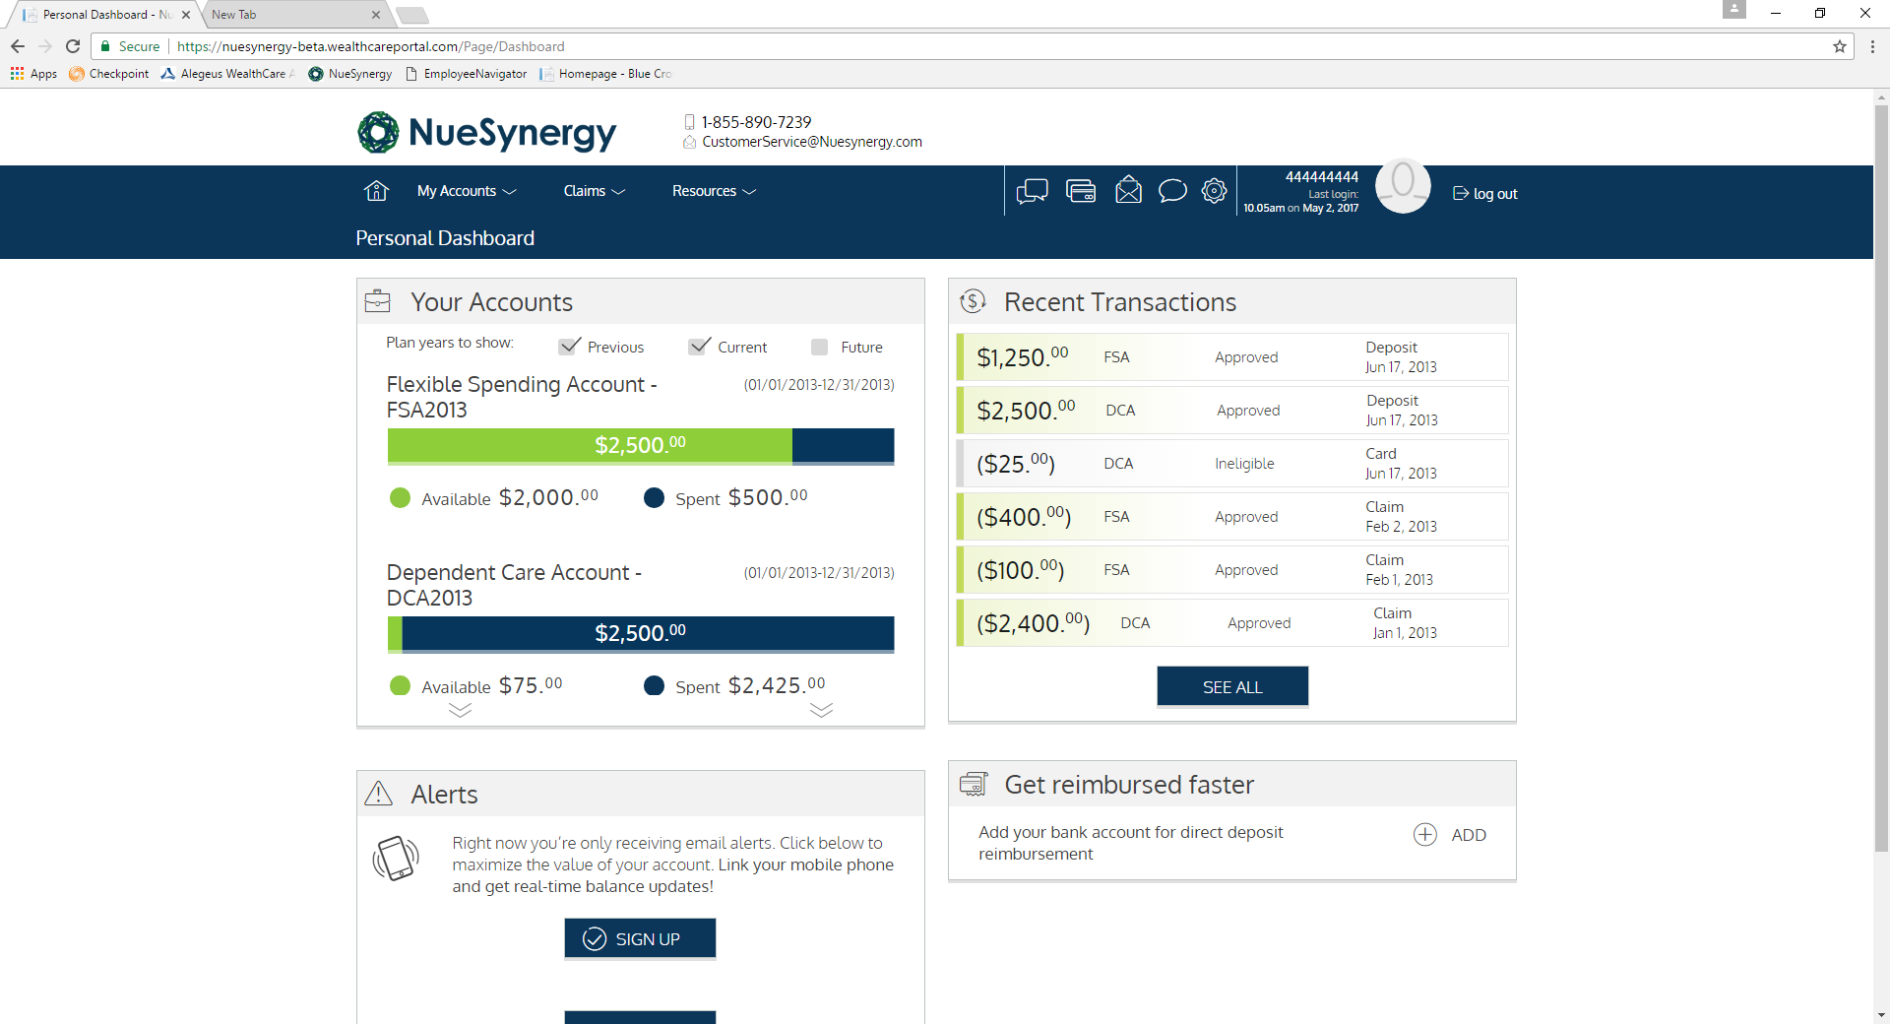
MEMBER PORTAL
Allows members convenient and secure access 24/7/365
Real-time, year-to-date benefit account tracking
Claims filing and status
Secure communications
Meaningful insights to better guide healthcare spending
Educational videos and planning calculators

Slide 16
NueSynergy, Inc.
(855) 890-7239 CustomerService@NueSynergy.com
www.NueSynergy.com

