Slide 1

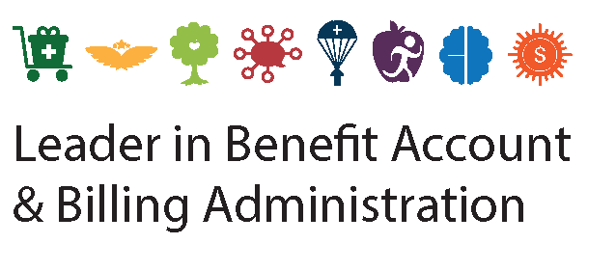

2025 Benefit Account Offerings
Health Care FSA

Slide 2



THE NUESYNERGY DIFFERENCE
Providing full-service administration since 1996
Award-winning live, U.S.-based customer service:
Calls answered in under 30 seconds
98.5% first call resolution
Electronic claims processed within 24 hours
Smart debit card convenience
Easy-to-use smart mobile app and participant web portal

Slide 3

HEALTH CARE FSA
Savings on many of the expenses you already pay for
Allows you to set aside pre-tax dollars for eligible medical, dental, and vision expenses for you and your dependents, even if they aren’t covered under your primary health plan
Choose an annual election amount; up to $3,300
At the beginning of the plan year, account is pre-funded and full contribution is immediately available for use
Election amount is deducted from paychecks in equal installments throughout the year
Example: $3,300 contribution over 24 pay periods = $137.53
Money contributed is free from federal and state taxes and remains tax-free when spent on eligible expenses
Flexible Spending
Account
HEALTH CARE
FSA

Slide 4

ELIGIBLE EXPENSES
Health Care FSA
Your Health Care FSA can cover costs for hundreds of eligible medical, dental, and vision expenses for you and your dependents, like:
Feminine care products and over the counter medications
Copays, deductible payments, coinsurance
Doctor office visits, exams, lab work, x-rays
Hospital charges and prescription drugs
Dental exams, x-rays, fillings, crowns
Orthodontia, including braces
Vision exams, frames, contact lenses/solution
Laser vision correction
Physical therapy/chiropractic care
Medical supplies and first aid kits

Slide 5
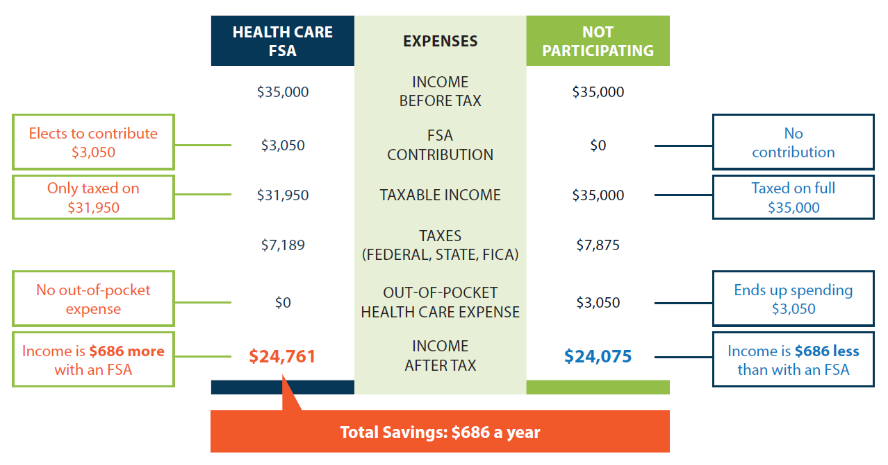
HOW DO YOU SAVE?
Health Care FSA

Slide 6


Customer Focused & Technology Driven

Slide 7
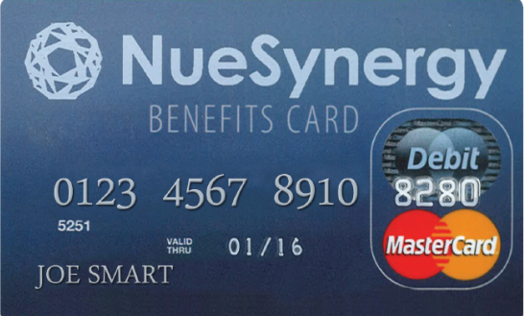
SMART DEBIT CARD SOLUTION
One Card for All Consumer Directed Benefit Accounts
Easy, immediate, thought-free access to funds with one benefits debit card
Use to pay for eligible Health Care FSA and Dependent Care FSA expenses
Linked to the NueSynergy mobile app and online account for real-time account balance information
Dependent Care FSA
Health Care FSA

Slide 8
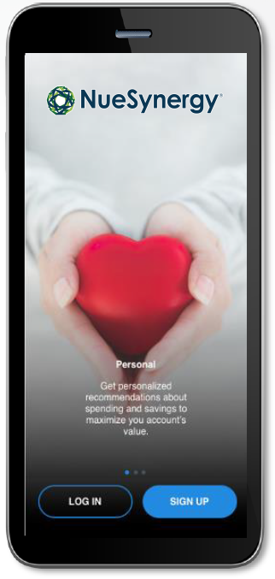
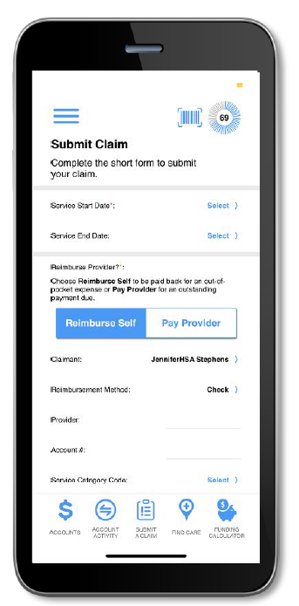
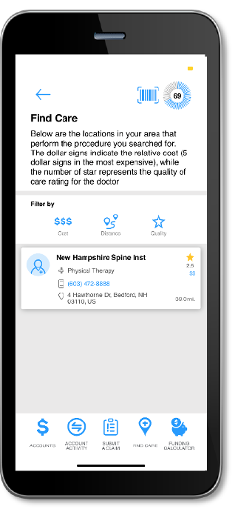
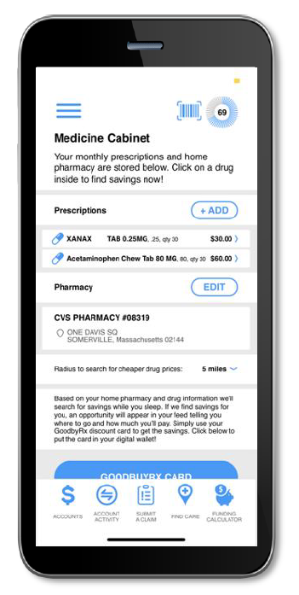
SMART MOBILE APP FEATURES
New and innovative technology makes the experience more convenient while providing more of the important information needed to make health care decisions
Account tracking allows up-to-date viewing of balance, claims status, and contributions
Prescription storing and cost savings opportunities
Transparency tools to evaluate providers and shop for procedures
Geotracking to find nearby providers
Reporting tools to help maximize benefits and potential savings

Slide 9

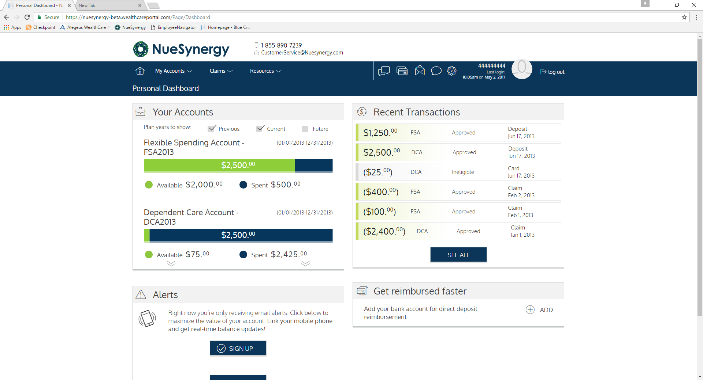
MEMBER PORTAL
Allows members convenient and secure access 24/7/365
Real-time, year-to-date benefit account tracking
Claims filing and status
Secure communications
Meaningful insights to better guide healthcare spending
Educational videos and planning calculators

Slide 10
NueSynergy, Inc.
(855) 890-7239 CustomerService@NueSynergy.com
www.NueSynergy.com

