Slide 1



SERVICE & INNOVATION
Full Service, Customer-Focused Administration

Slide 2



The NueSynergy Difference
Based in Leawood, Kansas
Nationwide, full-service administration since 1996
Flexible solutions, continuous innovation, and collaborative partnership model
Security, reliability, stability and proven financial solutions
Innovative benefit funding and payments platform, providing essential spending, saving and investing capabilities
Notes:
Length of service
Quality of Team
Overall Support Model

Slide 3

The NueSynergy Difference
Multiple awards for growth, effective solutions, innovation, and operations efficiency
Recognized as an industry thought leader and solution provider
Award winning, live customer service:
Employees average 10+ years of benefit administration experience
Proprietary monitoring system ensures service team quality
Calls answered in under 30 seconds
98.5% first call resolution
Data-driven insights and innovative AI technology to deliver truly personalized guidance
Notes:
Valued Alegeus partner
Success and overall growth over the years

Slide 4
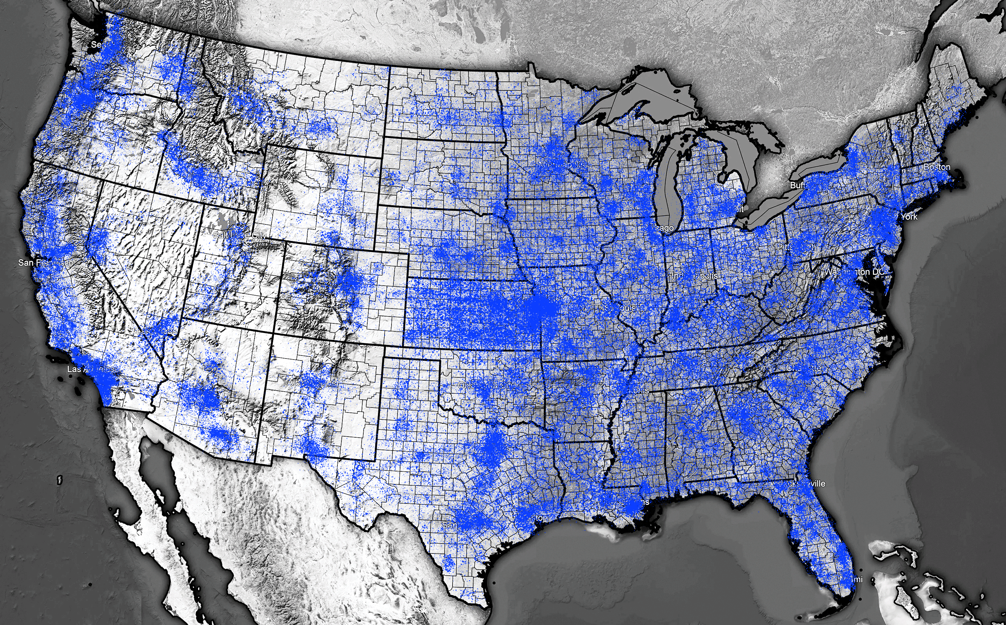
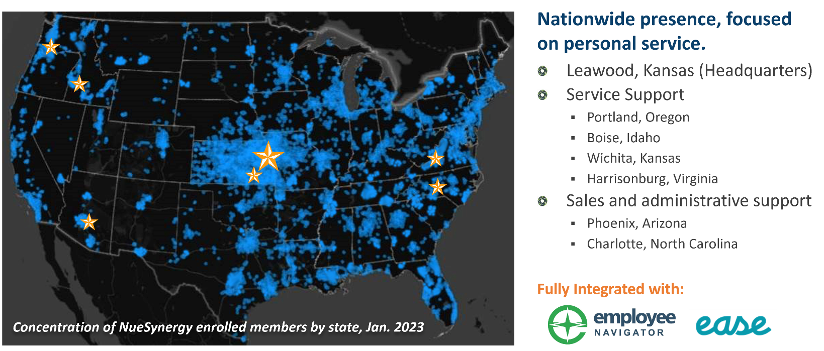
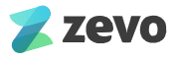
NueSynergy Presence
Nationwide presence, focused on personal service.
Sales and administrative support
Leawood, Kansas (Headquarters)
Portland, Oregon
Boise, Idaho
Phoenix, Arizona
Wichita, Kansas
Fayetteville, Arkansas
Philadelphia, Pennsylvania
Harrisonburg, Virginia
Charlotte, North Carolina
Ocala, Florida
Enrolled Members by State

Slide 5








Administrative Plan Offerings
Services offered by NueSynergy
Health Reimbursement Arrangement (HRA)
Flexible Spending Account (FSA)
Health Savings Account (HSA)
Lifestyle Spending Account (LSA)
SpouseSaver Incentive Account
Billing Solutions & Reconciliation Services
COBRAcare+ Administration
Additional NueSynergy Specialty Solutions
Health Care, Dependent Care, Limited Purpose, Commuter
Student Loan Payback, Memberships, Entry Fees, Apparel & Equipment
Combined Billing, Invoice Consolidation & Direct Billing
Compliance Services & Communications Module

Slide 6

COBRAcare+ Administration
Employer-centric, high-touch COBRA solution
A complimentary COBRA advisory service that engages and assists qualified beneficiaries in understanding not only their COBRA options, but those plans available in the individual market.
NueSynergy takes the extra step to check available health coverage and compare it to the employer’s COBRA benefits
If the COBRA-eligible selects:
An individual coverage option, we’ll help them get set up – and the employer no longer has an obligation to fulfill
COBRA, NueSynergy will help get them set up and will provide required communications and payment options
COBRAcare+
Administration
Dependable & Helpful

Slide 7
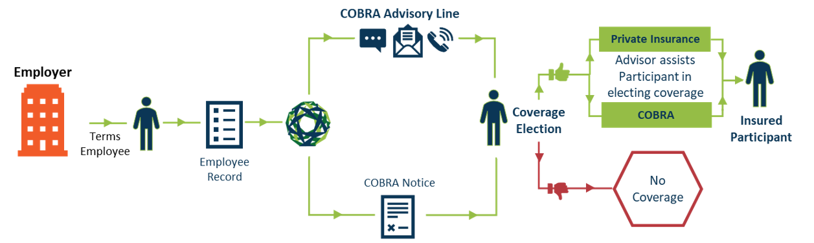
COBRAcare+ Administration
How it works

Slide 8
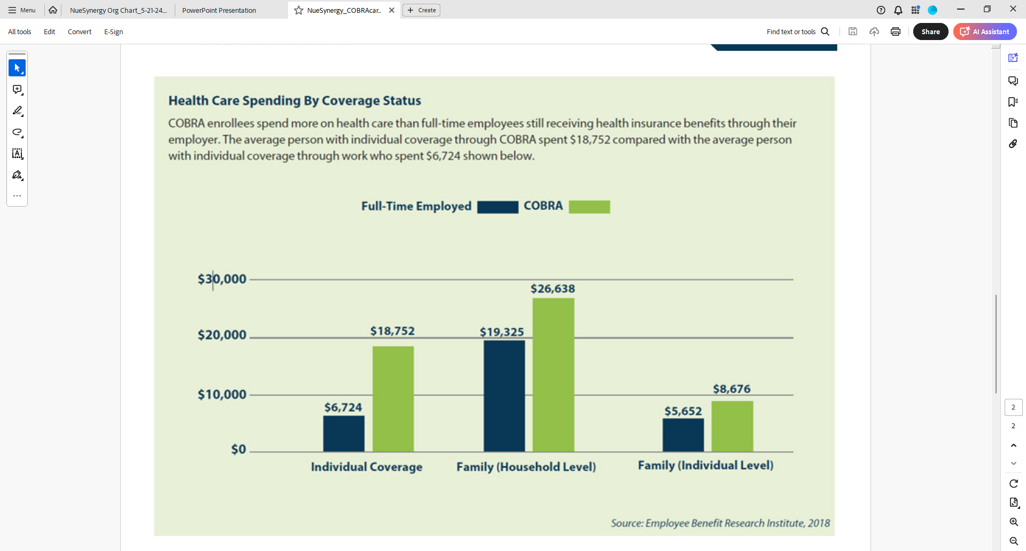
Health Care Spending
How it works
COBRA enrollees spend more on health care than full-time employees still receiving health insurance benefits through their employer.
Average spend for a person with COBRA coverage: $18,752
Average spend for a person with individual coverage through their employer: $6,724
Source: Employee Benefit Research Institute, 2018

Slide 9
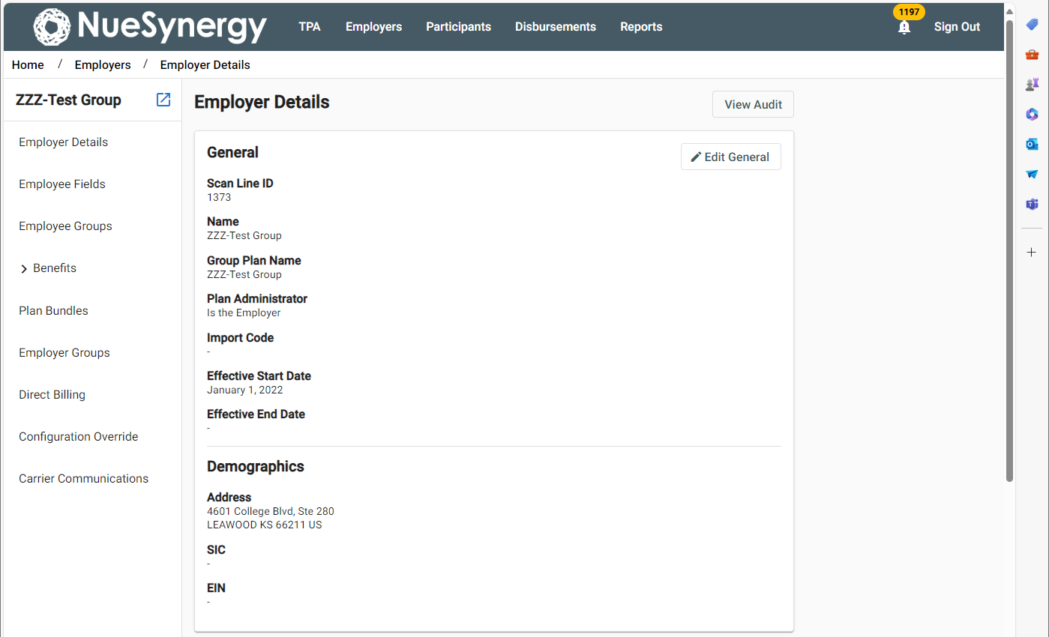
COBRAcare+ Administration
Employer Details
View

Slide 10
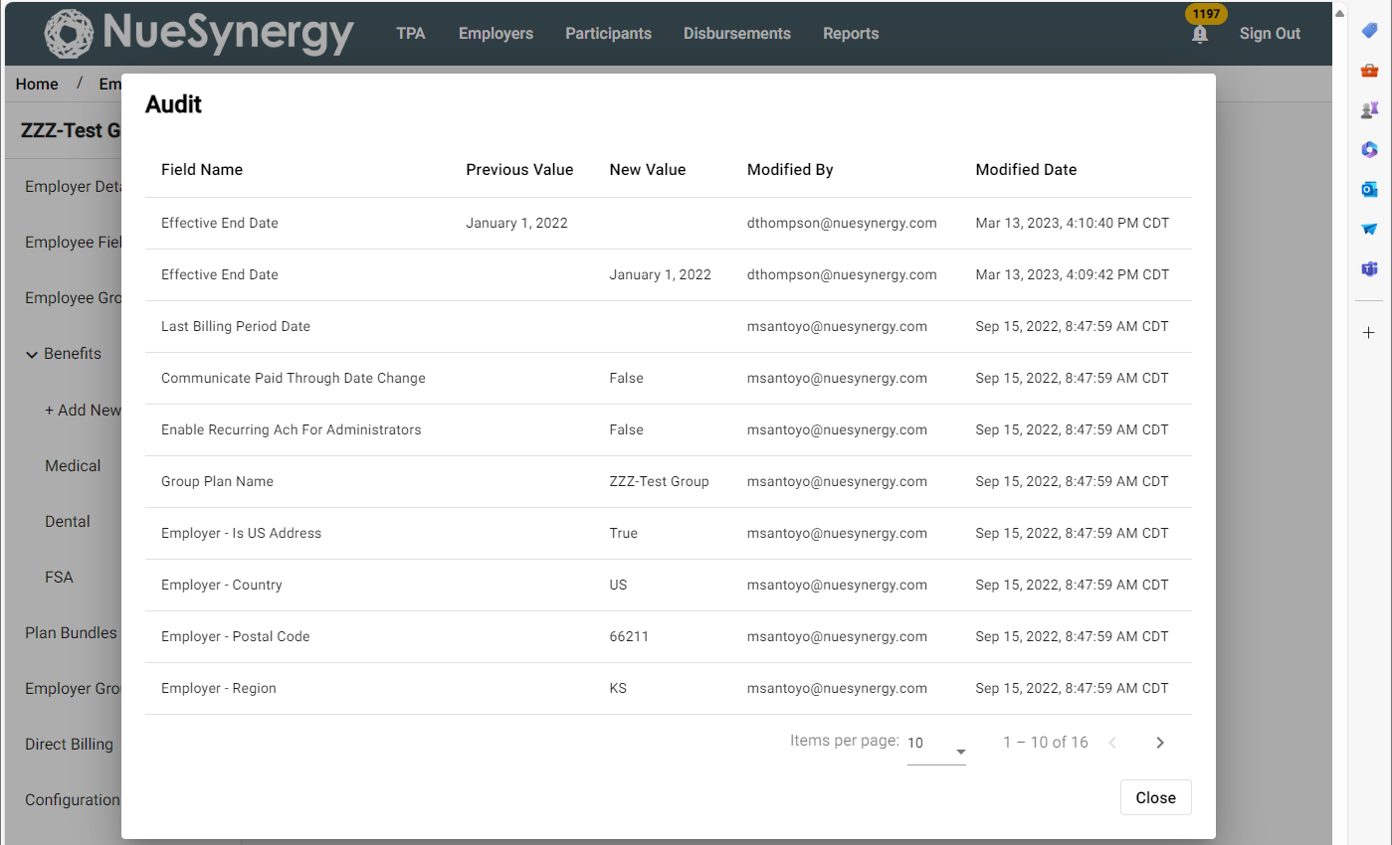
COBRAcare+ Administration
Employer Details
Audit View

Slide 11
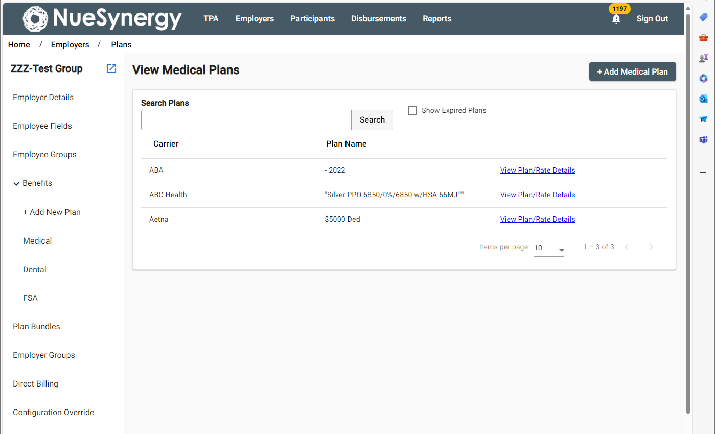
COBRAcare+ Administration
Itemized Medical Plan View

Slide 12
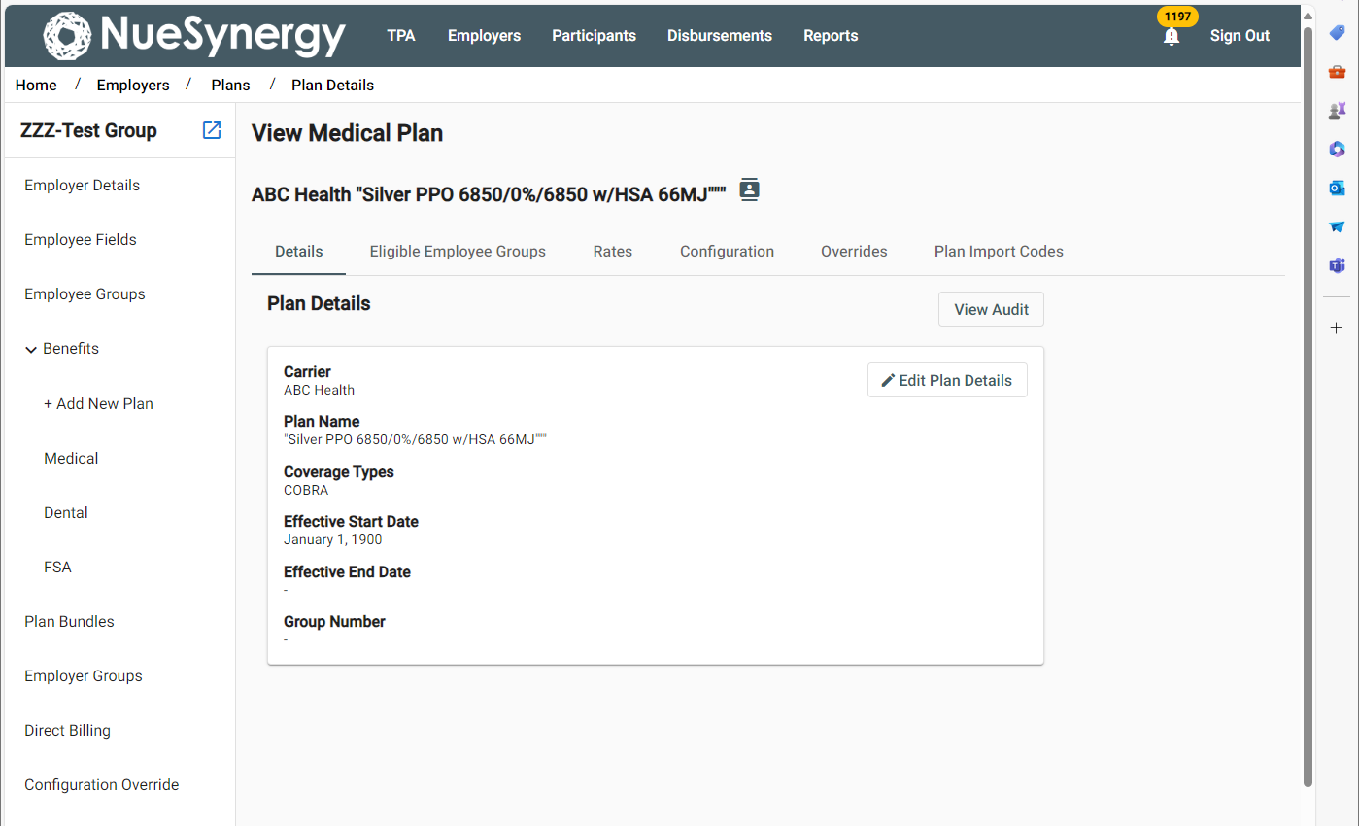
COBRAcare+ Administration
Specific Medical Plans Info View

Slide 13



5/24

