Slide 1

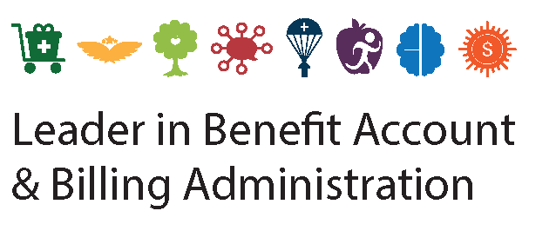

2025 Benefit Account Offerings
Dependent Care FSA

Slide 2



THE NUESYNERGY DIFFERENCE
Providing full-service administration since 1996
Award-winning live, U.S.-based customer service:
  Calls answered in under 30 seconds
  98.5% first call resolution
Electronic claims processed within 24 hours
Smart debit card convenience
Easy-to-use smart mobile app and participant web portal

Slide 3


DEPENDENT CARE FSA
Savings on many of the expenses you already pay for
An FSA that allows you to set aside pre-tax dollars
for dependent care expenses, such as daycare
Choose an annual election amount; up to $5,000
per family
  Money is placed in account via payroll deduction, in equal installments then used to pay for eligible dependent care expenses incurred during the plan year
  Example: $5,000 contribution over 24 pay periods = $208.33
Money contributed to a dependent care account is free from federal and state taxes and remains tax-free when it is spent on eligible expenses
Dependent Care
Account
DEPENDENT CARE
FSA

Slide 4

ELIGIBLE EXPENSES
Dependent Care FSA
Your Dependent Care FSA can cover costs for many different types of providers, such as:
Before/after school care for children 12 and younger
Child care at a day camp, nursery school, or by a private sitter
Custodial care for dependent adults
Licensed day care centers, nursery schools, or preschools
Nanny/Au Pair
Placement fees for a dependent care provider, such as
an au pair
Late pick-up fees
Summer or holiday day camps

Slide 5
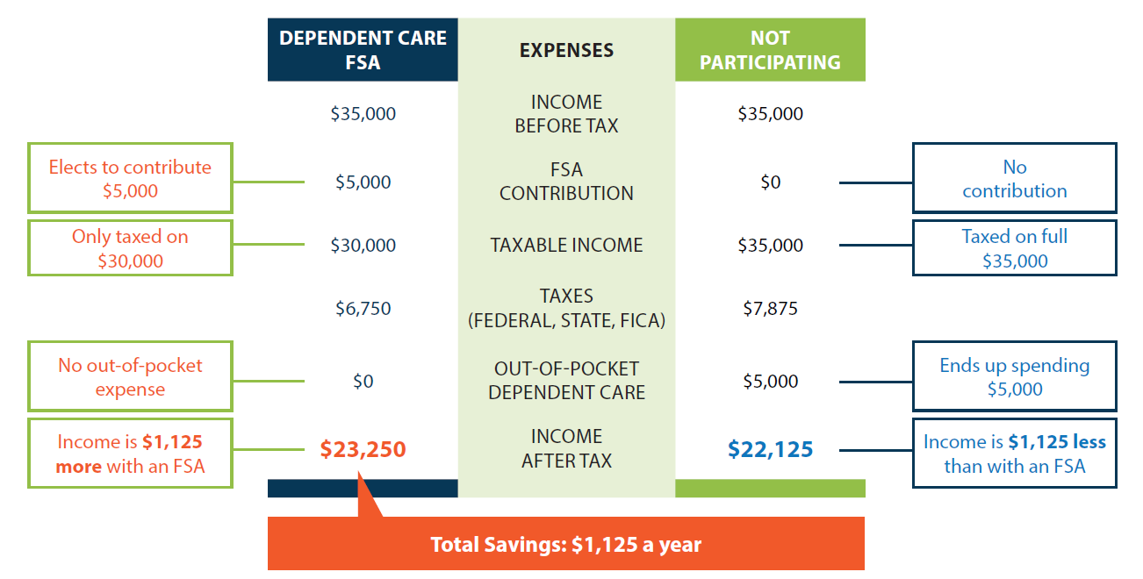
HOW DO YOU SAVE?
Dependent Care FSA

Slide 6


Customer Focused &
Technology Driven

Slide 7
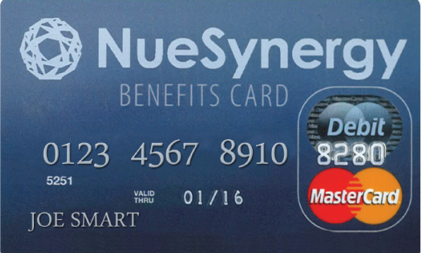
SMART DEBIT CARD SOLUTION
One Card for All Consumer Directed Benefit Accounts
Easy, immediate, thought-free access to funds with one benefits debit card
Use to pay for eligible Health Care FSA and Dependent Care FSA expenses
Linked to the NueSynergy mobile app and online account for real-time account balance information
Dependent Care FSA
Health Care
FSA

Slide 8
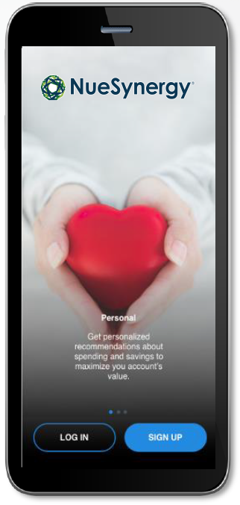
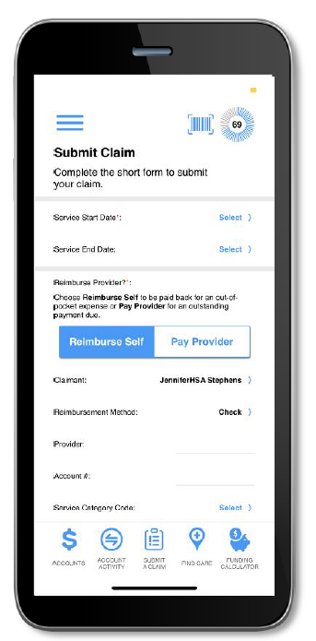
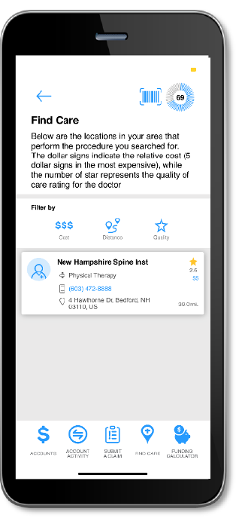
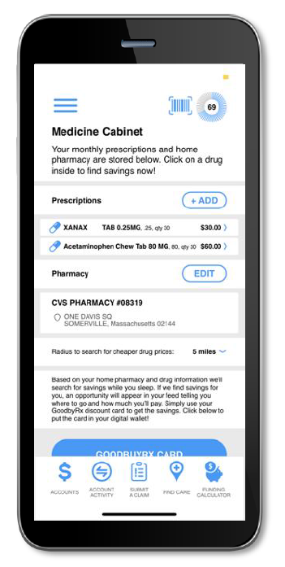
SMART MOBILE APP FEATURES
New and innovative technology makes the experience more convenient while providing more of the important information needed to make health care decisions
Account tracking allows up-to-date viewing of balance, claims status, and contributions
Prescription storing and cost savings opportunities
Transparency tools to evaluate providers and shop
for procedures
Geotracking to find nearby providers
Reporting tools to help maximize benefits and potential savings

Slide 9

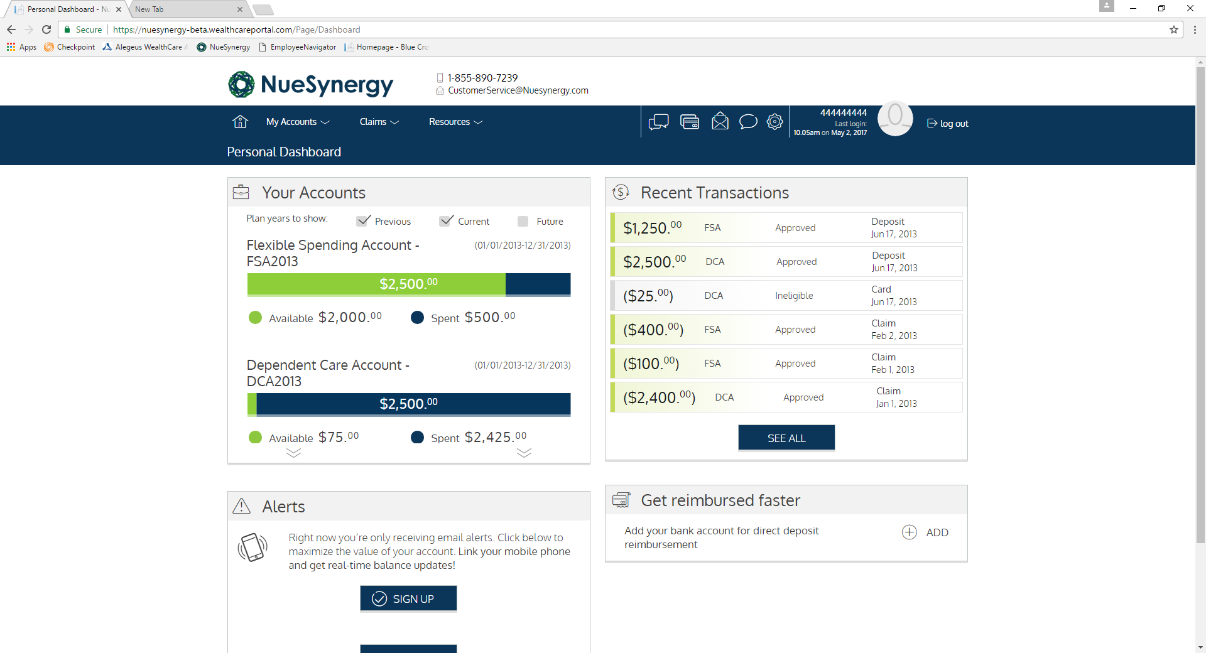
MEMBER PORTAL
Allows members convenient and secure access 24/7/365
Real-time, year-to-date benefit account tracking
Claims filing and status
Secure communications
Meaningful insights to better guide healthcare spending
Educational videos and planning calculators

Slide 10
NueSynergy, Inc.
(855) 890-7239 CustomerService@NueSynergy.com
www.NueSynergy.com

