Slide 1
Social Media Templates

Slide 2
Instructions
Download the TM Brand Manual
Install brand preferred fonts Gotham

Slide 3
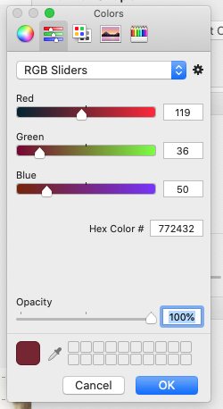
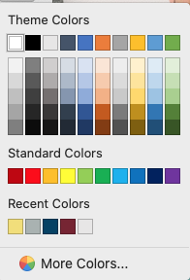
Toastmaster Brand Colors
Show Me:
How to change a shape color to match brand?
Digital Use: RGB= Red, Green, Blue
True Maroon
Loyal Blue
1. Create a shape, select format shape (or right click), select more colors.
2. Enter the RGB equivalents for the color you want to use, click OK.
R= 119
G=36
B=50
R= 0
G=65
B=101
Cool Gray
Happy Yellow*
R= 169
G=178
B=177
R= 242
G=223
B=116
* Happy Yellow is for accent color only
Read more at Brand Portal https://www.toastmasters.org/resources/brand-portal
The Toastmaster Brand as a series of primary colors, on this side is the RGB color values for Power point. In the Brand Manual does gives the hex values and 4 color , CMYK and HEX options.

Slide 4
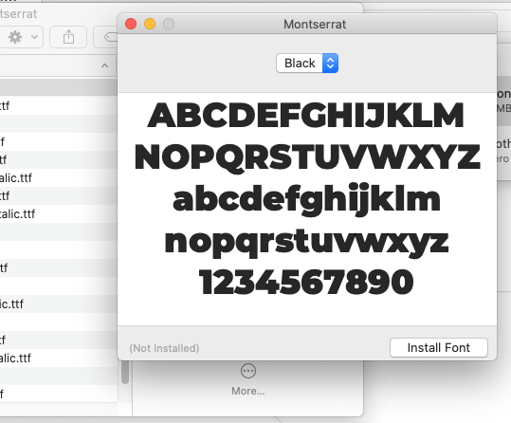
Fonts
Show Me: How to download and install fonts
Enter “Free Fonts” in your search engine, example: https://freefontsfamily.com/gotham-font-family/
Download the font
Font | When to use
Gotham | Headlines and subheads
Alternate: Montserrat | Headlines and subheads
PC
On the Start menu, click Control Panel. In Control Panel, double-click Fonts.
On the File menu, click Install New Font.
Locate the downloaded or unzipped font, and then in the List of Fonts box, click the font that you want to add.
Mac
Click on the download folder and select the font choice (bold, italicized) and click on install.
Font | When to use
Myriad Pro | Body copy for collateral
Alternate: Source Sans Pro | Body copy for collateral
Arial is a tertiary font for body copy that comes standard on most computers.
Read more at Brand Portal https://www.toastmasters.org/resources/brand-portal
The new font may be available right away, if not, try to close and start the program or reboot, depending on computer.
Notes:
The strength of the brand is how we use it.

Slide 5
Instagram
If you want to create your own ads.
1080px by 1080 square
1080px by 608 Landscape
1080px by 1350 Portrait
Twitter
1200px by 628
Facebook
1200px by 675px
*** Each platform will compress to their specs.

Slide 6
Messaging
Sample copy
I work collaboratively
I acquired new skills
I learned to plan
I just delivered my first presentation
I know how to write a speech
I can’t believe I used to be shy
I improved my self confidence
I know how to build a team
I became a better team leader
I am confident for my next presentation
I learned to lead
Investing in myself if paying off
One of the best decisions I’ve ever made
How I got there:
Thanks to Toastmasters

Slide 7
Sample template
The next slides have premade ads you can use, or create your own, they do work on Twitter, Instagram, Facebook, etc
How to build and ad: follow the guides, create your ads, select, group, save as jpeg to your desktop and post your social, don’t forget hashtags!
There may be some notes to the right of the ad for guidance.
The ads are in a group, if you like them as they are, just click on the ad, right click to save as picture, (jpeg or png).
Want to change out the graphics? We will show you how. Check our step by step guide.

Slide 8
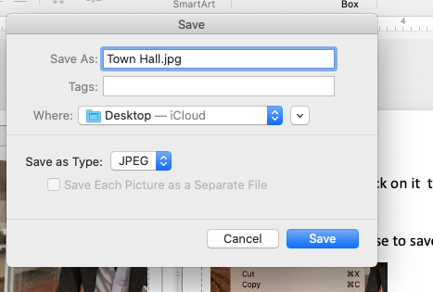
How to Save the image to your desktop
I became a better leader
If you like the ad- as is- click on it to select it, (all the elements are grouped.) You can tell if there is a bounding box around it.
Right click with your mouse to save a picture.
Open House October 5, 2021
Open your social media page share the ad.
Discover how:
toastmasters.org/find-a-club

Slide 9
Want to Make a text Change?
I became a better leader
Note: Do not scale down the image, keep it in the guides as shown.
How to change the text
Click on the area you want to change. If you want to change the text, just click in the area and type your new text.
Open House October 5, 2021
Discover how:
TalkandThrive@kp.org

Slide 10
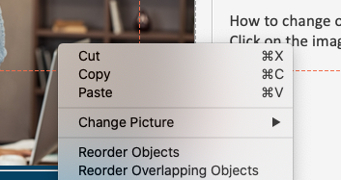
Want to change the image?
I became a better leader
Note: Do not scale down the image, keep it in the guides as shown.
How to change out an image.
Click on the image, right click, select change picture.
Open House October 5, 2021
Discover how:
toastmasters.org/find-a-club
See next slide

Slide 11
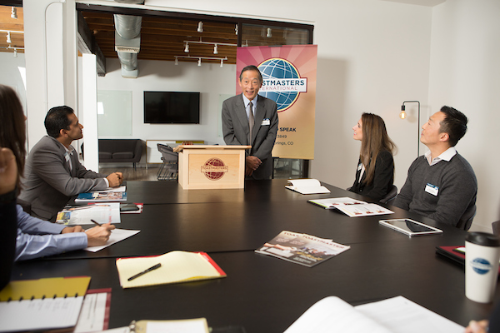
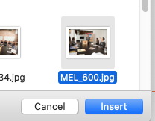
Want to Make a Photo Change- part II
I became a better leader
Find the file and click on insert.
Find the file and click on insert.
Save the image.
If you need to re-group the ad, ( image, logo, text) drag a box around the ad, right click and group
Open House October 5, 2021
Discover how:
toastmasters.org/find-a-club

Slide 12
I became a better leader
Make sure all of the elements are grouped.
See how on the next slide.
Open House October 5, 2021
Discover how:
toastmasters.org/find-a-club

Slide 13
How to Group your elements.
If you need to re-group the ad,
( image, logo, text) drag a box around the ad, right click and select group.
Now, select the image, and click on save as picture.
Note you are only selecting the image and saving this section.

Slide 14
Topic Career
Call to action find a club
I nailed my interview and got the job!
Thank you Toastmasters!
Discover how:
toastmasters.org/find-a-club

Slide 15
I became a better leader
Topic Career
Call to action find a club
Thank you Toastmasters!
Discover how:
toastmasters.org/find-a-club

Slide 16
Topic Career
Call to action – promo club
You can replace the text with your club name.
Group, save as jpeg.
Open House
Learn How To Find Your Voice and Make a Difference!

Slide 17
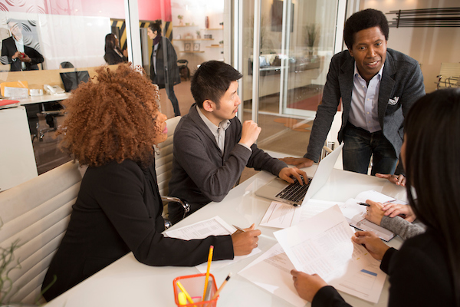
Topic Career
Call to action – promo club
I became a better team player
Thank you Toastmasters!
Discover how:
toastmasters.org/find-a-club

Slide 18
Topic Career/presenter
Call to action – promo club
I became a better presenter
Thank you Toastmasters!
Discover how:
toastmasters.org/find-a-club

Slide 19
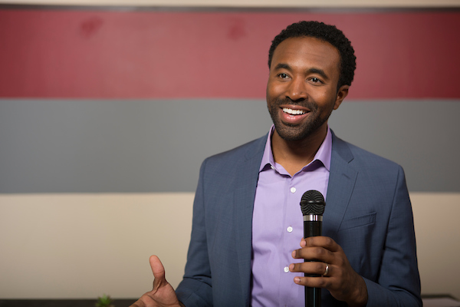
Instagram
Topic Career/influence
Call to action – promo club
I learned how to influence and inspire
Thank you Toastmasters!
Discover how:
toastmasters.org/find-a-club

Slide 20
My mentor makes the difference
Instagram
Topic Career/Mentor
Call to action – promo club
Thank you Toastmasters!
Discover how:
toastmasters.org/find-a-club

Slide 21
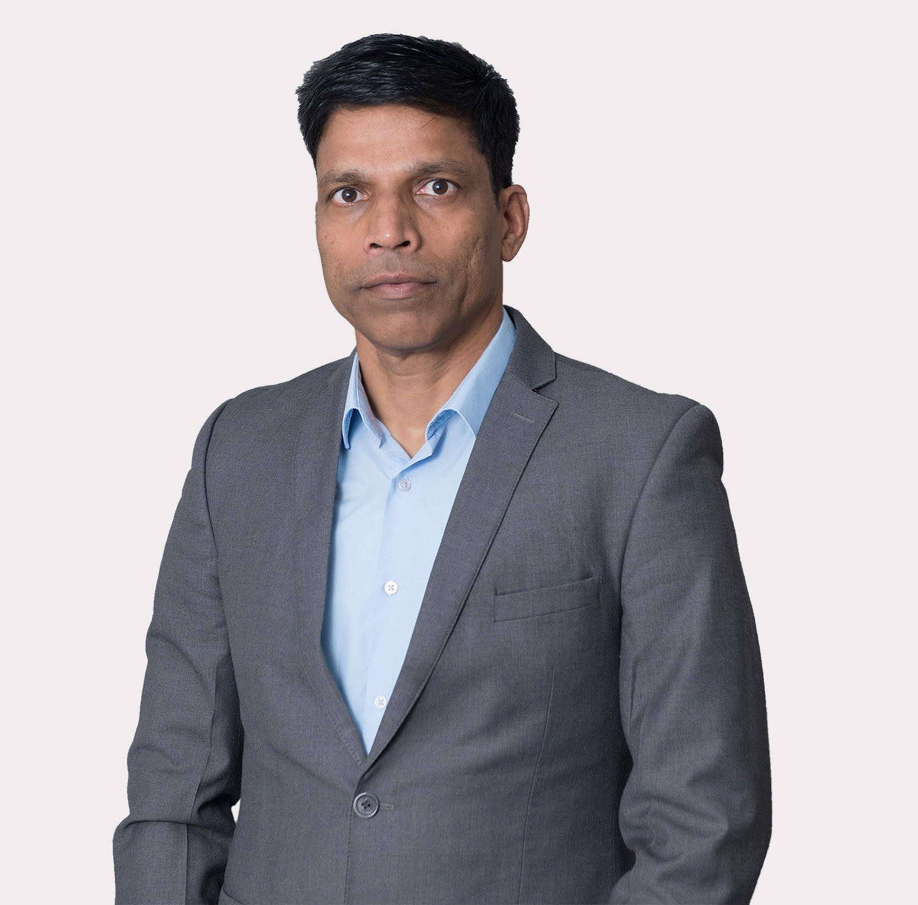
Instagram
Design Event,
Register here
https://www.eventbrite.com/e/branding-creating-brand-communication-with-canva-tickets-174814273197
Special Guest:
Cajetan Barretto, DTM
Creating Brand Communication with CANVA
October 23, 2021, 9-11AM pst

