Slide 1
Basic Zoom Set Up for Your Club

Slide 2
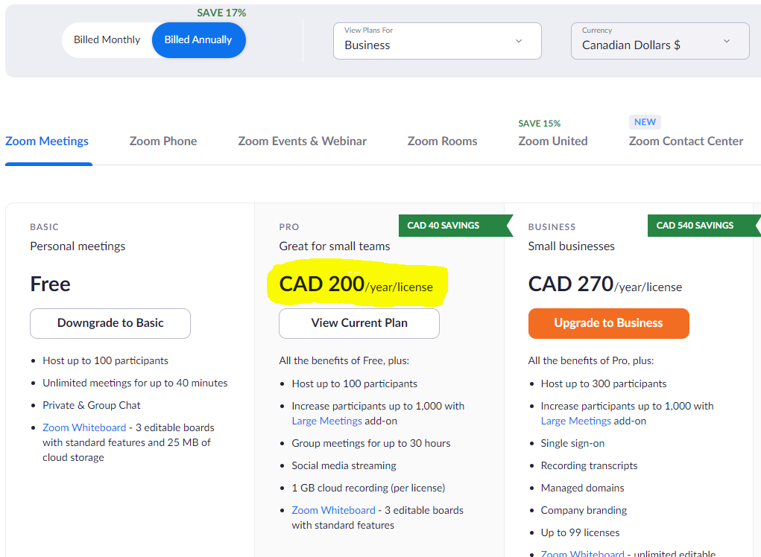
Zoom Account
www.zoom.us - purchase an account for your club
Best value is yearly subscription (note this is showing in Canadian dollars for this example)
Notes:
If your club is going to be meeting online or hybrid, you will need to have access to an online meeting platform. Zoom is one option and most members are familiar with using it. Your club can purchase a Zoom account specifically for your club use. You will need to determine an email address to use for the account and purchase with a credit card. The best value is to pay for the Zoom account on a yearly basis. This gives you the ability to host up to 100 participants with meetings up to 30 hours. You also have a cloud to record meetings or special events to and can live stream to your Facebook page if that is something you want to try! Zoom is constantly adding new features and updates, so be sure to check out the email they send around with details on updates. There is the “FREE” Zoom account but please note, if you have more than 2 people in your meeting, it will time out after 40 minutes and you will have to start the meeting again. This is NOT recommended for club meetings!
As executive officers, it will be up to you to decide who purchases the account and will act as the main host manager of the account. Remember, your credit card will be attached to the account.

Slide 3
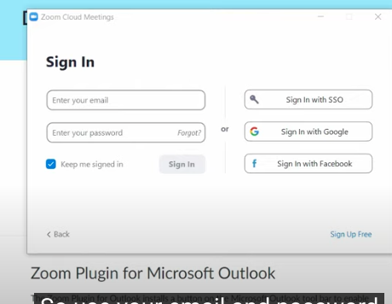
Sign In
Notes:
Once you have your account purchased, you can access it to set up meetings by signing in. Remember to use the email address and password you provided during the set up of your Zoom account.

Slide 4
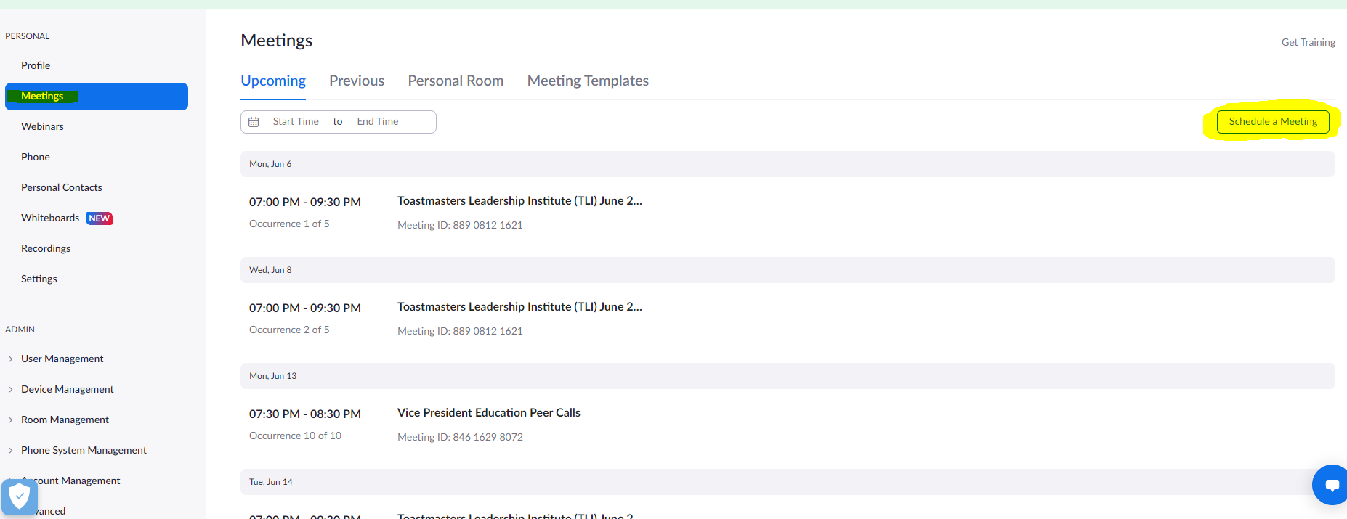
Meetings Page
Notes:
Once you log in, there is a menu on the left hand side - choose Meetings. You will see a list of any meetings you already have scheduled - for example, you see in this picture that the TLI sessions are scheduled and there is also a VPE Peer Call on Monday June 13th. To schedule a new meeting, click on the schedule a meeting, highlighted in yellow on the right hand side. This will bring you to a new page and you can set up your meeting as desired.

Slide 5
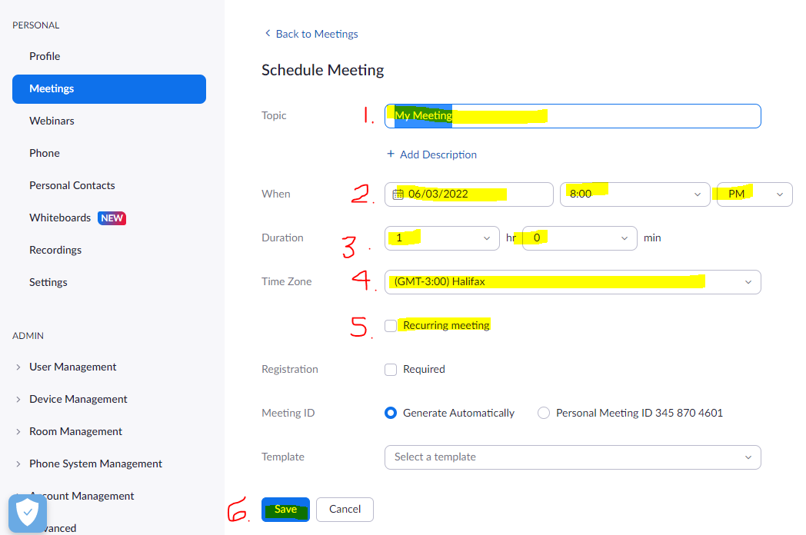
Setting Up Your Meeting(s)
Notes:
This is the screen where you will input all the details to set up your meeting
Name of Meeting - “Club Name” Meeting
Select dated and start time (remember to select the correct time - AM or PM)
Duration - how long is your meeting to be held?
Time Zone - this is important. Ensure you select the time zone your club is in.
If you are setting up a meeting that is happening every week, biweekly or monthly at the same time/day, you should click recurring meeting. This means that each session will use the same Zoom link and will be set up according to the details you added during set up. When you click recurring meeting, a new window shows, which we will discuss on the next slide.
Once you have edited the details, remember to click save.

Slide 6
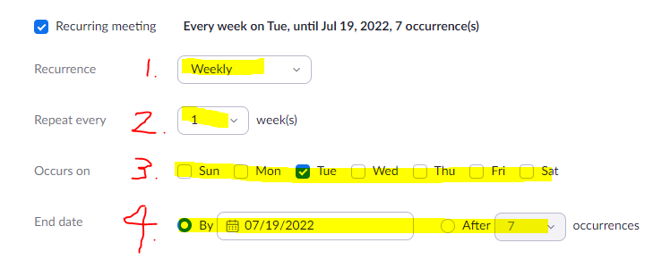
Recurring Meetings
Notes:
Once you click the recurring meeting box from the previous slide, the menu expands and gives you options to edit. Your club meetings will be recurring, so this helps so you do not have to set up each meeting individually.
You can choose between daily, weekly, monthly or no fixed time.
You can choose how often you want the meeting to repeat, ranging from 1-12 weeks
You choose which day(s) you want the recurring meetings to take place - click the box to add the checkmark
This option allows you to determine how far ahead you want the recurring meetings to be scheduled - choose a date on the calendar or after X amount of occurrences.
Remember to press save once you have finalized all the details for setting up your meeting.

Slide 7
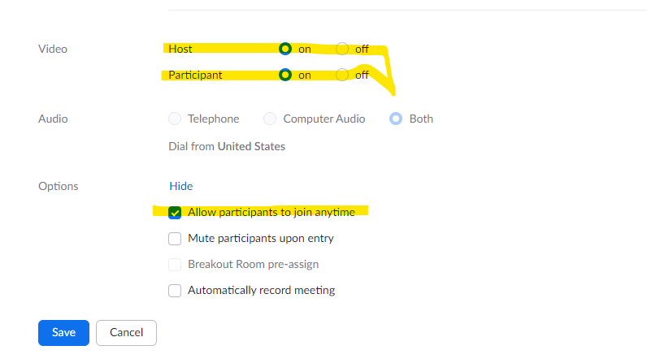
Notes:
Once you set up meeting time and frequency there are a couple of other options you can choose. You will have to ask for these to be shown. Determine who can come in with video on. Unless it’s a speech contest, there is no reason to not allow everyone to come in with video on.

Slide 8
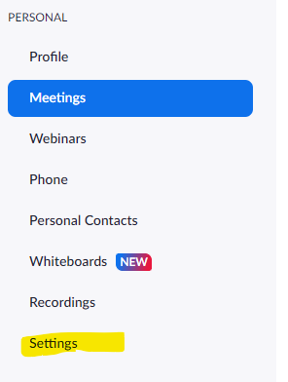
Notes:
There are more settings to consider when setting up a meeting. You get to these settings by clicking Settings in the menu on the left side of your screen. We will touch on some of the more common ones. As a club executive, you should determine which settings you want.

Slide 9
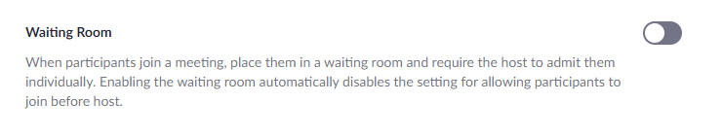
Notes:
You can have a waiting room. Usually there is no need for this unless it’s a speech contest. You create more work for yourself by always having a waiting room.

Slide 10
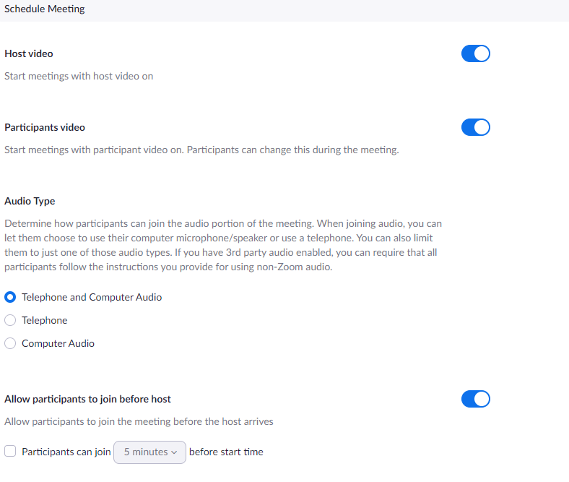
Notes:
These are ones that were also on the first set-up page except for how long before start time that members can join. I would suggest that you usually allow participants to join before host. If you set a time, I suggest at least 15 minutes before so members have the chance to socialize. If this is turned off, you would not be able to have your meeting if, for some reason, the host can’t make the meeting. The one time you might want to have this off is if you’re having a meeting before hand such as an executive meeting and you don’t want others to come into your meeting. You could, however, start the meeting and put the executive in a breakout room so others can come into the main room.

Slide 11
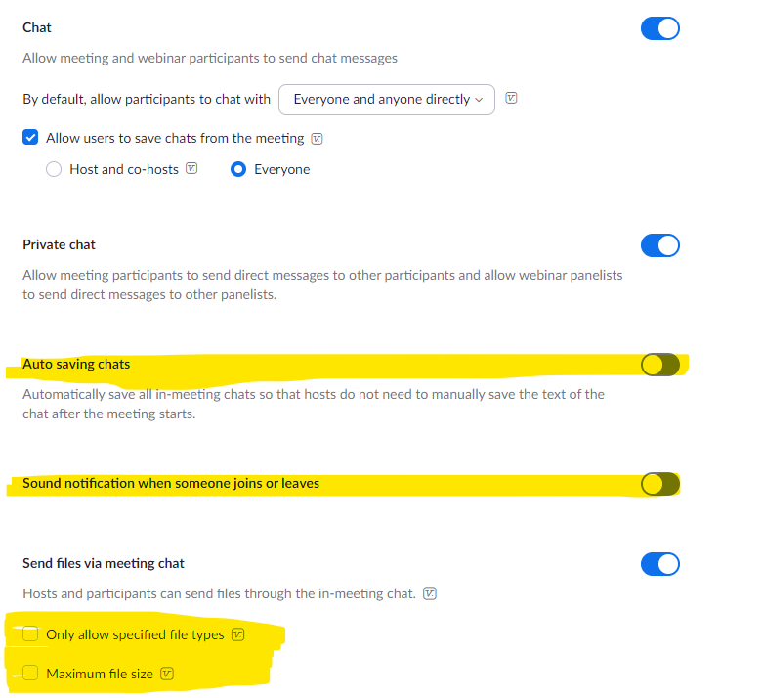
Notes:
We are probably all used to chat. You have options of determining who can chat to whom. If you think you may want to save the chat you can set up auto saving chats so you don’t have to remember to do so. Here you can see that the sound notification is turned off. If you leave it on, you will hear each person coming into the meeting or leaving the meeting. Note that you can also send files via meeting chat. This is a great way to ensure all members have the current agenda.

Slide 12
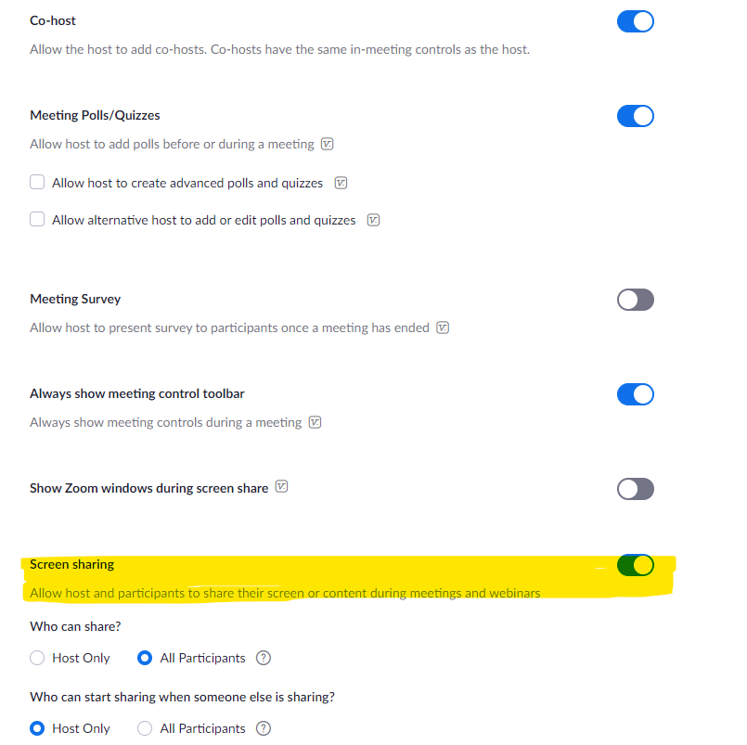
Notes:
You should allow a co-host (or more) and allow polls. We will not discuss how to do polls here but it’s easy to find instructions on setting them up. The somewhat controversial control here is screen sharing. Some think it should only be the host and a member needs to be given permission. This can be an issue if the host is not present. Unless members are abusing the right to share their screens or unless you start getting Zoom bombed, I would recommend all screen sharing for all. (Just a note to never put the link on Twitter.)

Slide 13
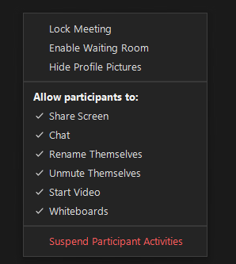
Other functions
  Breakout room
  Virtual backgrounds
  Allow live streaming
  What to do when meeting cancelled
Notes:
There are a number of other functions that you should have a look at which are listed on the left side of the slide. You should also know that you cannot change settings while in a meeting. If you do, they will not be effective until your next meeting so make sure any changes are made before the meeting starts. The exceptions are those list on the right side of the slide. You find these by clicking on the security shield on the control bar. A check mark shows those functions are enabled. If you want to disable one, click on the function. If it’s not clicked, it means it is not enable so to do so, again just click on the function.

Slide 14
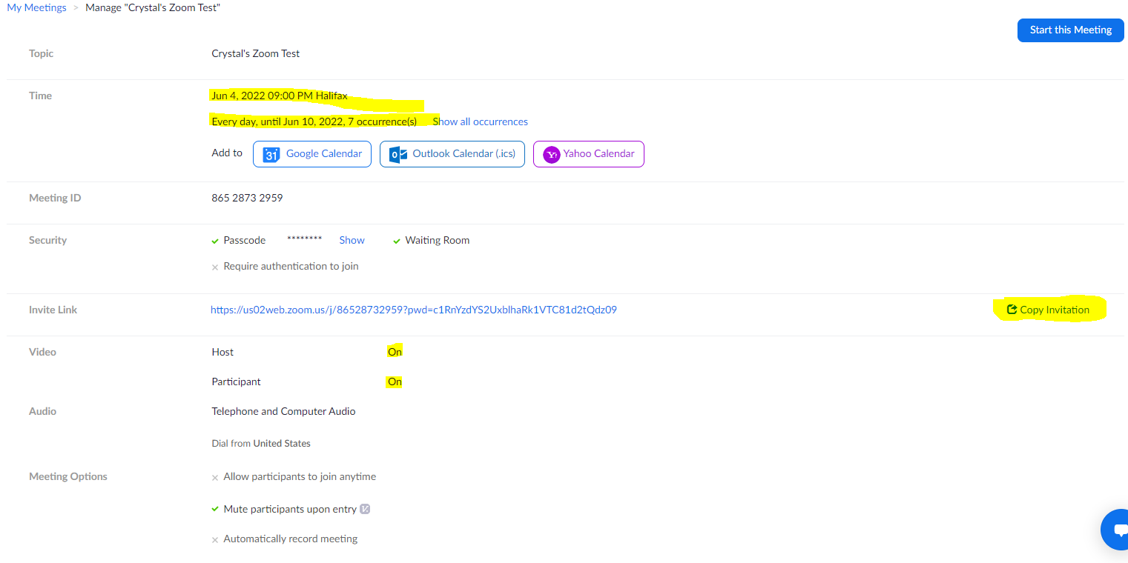
Invite People to Your Meeting
Notes:
You now have your meeting set up, you’ve clicked save and this is the screen that appears. Check over the details to ensure you have entered the date, time, occurrence, etc correctly. Once you have verified the information is correct, it’s time to share the meeting invite with your members and guests. You can click the “COPY INVITATION” button highlighted in yellow on the right hand side of the screen. This bring ups a new window with the invitation to copy and send off to people.

Slide 15
Copying Invitation
Crystal Cobb is inviting you to a scheduled Zoom meeting.
Topic: Crystal's Zoom Test
Time: Jun 4, 2022 09:00 PM Halifax
Join Zoom Meeting
https://us02web.zoom.us/j/86528732959?pwd=c1RnYzdYS2UxblhaRk1VTC81d2tQdz09
Meeting ID: 865 2873 2959
Passcode: 621483
Find your local number: https://us02web.zoom.us/u/kwkvXskI9
It is important to edit the invitation before sending it so that it is clear and concise.
Always include the Meeting ID & Password
Find Your Local Number for phone connections
Notes:
When you copy the invitation and paste it into an email or calendar, it gives A LOT of information. To make the invitation clear and concise, we recommend you edit the invitation before sending. Be sure to include highlighted info: Topic/Meeting Name, Date, Time, the Zoom link to join, the meeting ID and password as well as the “find your local number” link. This is an edited version that is ready to be sent to your members and guests.
We include the meeting ID and password with the invitation because sometimes the link to join the Zoom meeting gives people an error, so with the meeting ID and password, you can easily join a meeting. The link to find your local number is important to include so that if people need to join audio by phone, they can search the number for their area.
Once you have your invitation edited and ready to go, you can send it by message, email, and/or a calendar invite. Anyone that receives your invite will be able to access your meeting, so be careful when sharing with the world. There is a chance it could get into the wrong hands and you could experience Zoom bombing during your meeting. It is best NOT share the password for your meeting on social media.

Slide 16
Next Steps
Buy your account
Go through all the settings to see what’s available
Set it up as you think appropriate
Need help?
  See if a member has experience setting up Zoom
  Check with your Area Director
  Check with your Division Director
  And, if you still need help, check with Program Quality Director
Notes:
At the end of showing what’s on the slide, say something like Happy Zooming. Use Zoom in whatever way will best make your club successful.

