Slide 1
Pre-Meeting Check
Rename yourself as follows:
OFFICER ROLE then NAME
i.e. Div A - Jane Doe
i.e. AD 6 - John Doe
Please Remain Muted During Presentations
Category or Menu Item Placeholder

Slide 2
TI Online Disclaimer
By attending this event, you agree to the privacy policy of Toastmasters International as well as the unassociated remote hosting service. Some of your personal information, such as name, image, and any shared messages may be shared with other meeting participants and will be recorded by Toastmasters International who may use the recording in the future as it sees fit. Your remote attendance hereby discharges Toastmasters International from all claims, demands, rights, promises, damages and liabilities arising out of or in connection with the use or distribution of said video recordings, including but not limited to any claims for invasion of privacy, appropriation of likeness or defamation.

Slide 3
District 45 Council Meeting
Zoom Host please begin recording
The purpose of the recording this meeting is for administration purposes only
Once meeting minutes are completed, the recording will be deleted
Category or Menu Item Placeholder

Slide 4
District 45 Annual
Council Business Meeting
May 3, 2025

Slide 5
Call to Order
District 45 Administration Manager
Claudette Joseph

Slide 6
Welcome!
District 45 Director
Sharon Joseph, DTM

Slide 7
District 45 Mission
We build new clubs and
support all clubs in achieving excellence
Category or Menu Item Placeholder

Slide 8
District Standing Rules
District 45 Parliamentarian
Erin McMenemy, DTM

Slide 9
District 45 Standing Rules
For District Executive and District Council meetings (hence forth referred to as DEC and DC)
Assignment of the floor. To seek regular recognition by the chair, a voting member shall raise their hand by use of the ‘raise hand’ feature of the virtual meeting platform or by physically raising their hand at an in-person meeting. The voting member wishing to speak will wait until recognized by the chair. Once recognized by the chair the voting member will state their name and leadership position. The voting member will then state for what purpose they wish to speak. The speaking order will be determined by the order in which electronic hands were raised. At an in-person meeting the member will state their position on a matter and the speaking order will be on an alternating basis (pro/con) for reasons of fairness.
Non-voting members seeking the floor: non-voting members are only present in DEC and DC meetings at the invitation of the chair. Non-voting members may not seek the floor unless invited to do so by the chair. The exception to this rule is the district parliamentarian.
Debate or discussion on any item on the agenda shall be limited to a maximum of ten minutes. No voting member shall speak more than once on the same question or longer than one minute. Debate may be extended at the discretion of the Chair to allow additional discussion, if fairness so requires. This limitation does not apply to points of order.
The Chair shall call for discussion on pros and cons of interested parties who will speak on an alternative basis. Members must state their name, role and position for or against the motion before speaking and are limited to times indicated.
Category or Menu Item Placeholder

Slide 10
District 45 Standing Rules (cont.d)
For District Executive and District Council meetings (hence forth referred to as DEC and DC)
Voting is conducted through the use of the ‘raise hand’ feature in the virtual voting platform. The chair will declare the result. The counting of the hands, if necessary, will be done by the Administration manager. Hands shall remain raised until instructed to be lowered by the chair. The administration manager will provide the chair with a count of only the voting members in favour of and opposed to the item being voted upon. The chair will openly state the results and declare the motion carried or defeated.
The Administration Manager shall maintain a set of minutes, which shall be approved by DEC/DC at the next DEC/DC meeting and posted on the district webpage.
Technical requirements and malfunctions. Each attendee is responsible for their electronic connection; no action shall be invalidated on the grounds that the loss, or poor quality, of an attendee’s individual connection prevented him or her from participating in the meeting or training.
Forced disconnections. The chair may cause or direct the disconnection or muting of an attendee’s connection if it is causing undue interference with the meeting. At in-person meetings the chair may instruct the SAA to remove disruptive individuals who have been warned of their improper behaviour.
Recordings. Attendees shall not record any session or workshop.
Category or Menu Item Placeholder

Slide 11
Credentials Report
Credentials Committee Chair
Angela Stoddart

Slide 12
District 45 Council Credentials Report
Active Club Presidents & VPEs 126
Quorum (⅓ club votes) 42
# of Club Ballots Issued 69
# of District Ballots Issued 14
Total Ballots Issued 83
Simple Majority on Motion (will be based on ballots returned (50% + 1))
⅔ Majority on Motion will be based on ballots returned
Category or Menu Item Placeholder

Slide 13
District 45 Council Credentials Report
Quorum is established we may conduct business
Category or Menu Item Placeholder

Slide 14
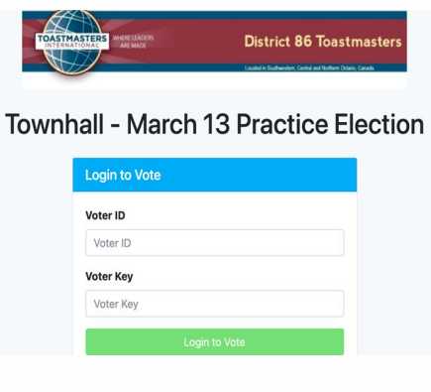
Features of Election Buddy
Ballot received through email
20 minutes to cast your vote
Each voter has a unique login
Weighted votes enabled
assigned to those eligible
split votes not permitted
You can only vote once - cannot be shared
Antifraud platform
Results are private and accurate
Category or Menu Item Placeholder

Slide 15
District 45 Council Meeting Agenda
District 45 Director
Sharon Joseph, DTM

Slide 16
Annual Council Business Minutes
from Sep 14, 2024
District 45 Director
Sharon Joseph, DTM

Slide 17
DISTRICT
LEADERSHIP
COMMITTEE
REPORT
DISTRICT 45
Empowering tomorrow’s Leaders
MARCH 2025

Slide 18
DISTRICT 45
MESSAGE FROM OUR CHAIR
As we delve into the DLC Report, I want to express my gratitude for the unwavering commitment the members show toward advancing sustainable leadership development. Our collective efforts go beyond meeting goals; they stand as a testament to our shared responsibility in shaping a better D45 future.
Angela Chute, DTM IPDD
DLC Chair
District Leadership Committee Report 2025

Slide 19
District Leadership Committee Report 2025
DISTRICT 45
DLC
TEAM
Division A
Division B
Division C
Division D
Nita Patel, DTM
DJ Turchon, DTM
Marion Taylor, DTM
Chris Solarski
Reese Eskrige, DTM
Melissa Miller
Paula Tozer
Jane Osemwegie, DTM

Slide 20
DLC Report 2025
The 2025 District Leadership Committee is proud to present and recommend this Senior Leadership slate of Candidates for your VOTE at D45 Annual District Election.
DLC NOMINATED
CANDIDATES
District Director | Program Quality Director | Club Growth Director
Sherry MacDonald, DTM | Thomas Macisso, DTM | Joe Reid
 |  | Madhu Kanji, DTM
DISTRICT 45

Slide 21
A
B
C
D
Division A
Director
Division B
Director
Division C
Director
Division D
Director
OPEN LEADERSHIP OPPORTUNITIES

Slide 22
DLC Report 2025
DISTRICT 45
VALID
CONCLUSION
Our D45 DLC Report is VALID.
Our DLC Team met every qualifier, DLC composition and deadlines.
In summary, our progress in advancing sustainable Leadership Development is evident through our strategic collaborations and innovative approaches. Additional membership involvement needs to be encouraged.
Incomplete
Our D45 DLC Report is incomplete.
In spite of committee efforts, key positions of Division Directors remain OPEN for Division A, B, C, D
Continued Commitment
While celebrating achievements, we recognize ongoing challenges and reiterate our enduring commitment to shaping sustainable Leadership Development.

Slide 23
MARCH 2025
DISTRICT 45
THANK
YOU

Slide 24
District 45 Leadership Committee Report
educationprogram@toastmasters.org
I move to accept the District 45
Leadership Committee Report as presented
Category or Menu Item Placeholder

Slide 25
District Alignment Committee
District Alignment Committee Chair
Crystal Cobb, DTM, PDD
Category or Menu Item Placeholder

Slide 26
District 45 Alignment Committee Report
educationprogram@toastmasters.org
I move to accept the District 45
Alignment Committee Report as presented
Category or Menu Item Placeholder

Slide 27
District Leader Elections
District Director
Sharon Joseph, DTM

Slide 28
District Director
We have one DLC nominee for the position of District Director:
Sherry MacDonald, DTM
We have one floor candidate for this position:
Paul Coddington, DTM
Do we have any other floor candidates for this position?
Category or Menu Item Placeholder

Slide 29
Voting for District Director
educationprogram@toastmasters.org
Vote is LAUNCHED
SILENCE PLEASE
Check your email
Check your junk mail
Refresh your browser
Category or Menu Item Placeholder

Slide 30
Voting for District Director
educationprogram@toastmasters.org
Voting is CLOSED
SILENCE PLEASE
Results being tabulated
Category or Menu Item Placeholder

Slide 31
District 45 Tellers Report
Number of votes cast 82
Majority 82 / 2 + 1 = 42
Vote Distribution
Paul Coddington, DTM 33 (40.24%)
Sherry MacDonald, DTM 49 (59.76%)
Category or Menu Item Placeholder

Slide 32
District Director
Congratulations District Director Elect
Sherry MacDonald, DTM
Category or Menu Item Placeholder

Slide 33
Program Quality Director
We have one DLC nominee for the position of Program Quality Director:
Tom Macisso, DTM
Do we have any other floor candidates for this position?
Category or Menu Item Placeholder

Slide 34
Program Quality Director
Congratulations Program Quality Director Elect
Tom Macisso, DTM
Category or Menu Item Placeholder

Slide 35
Club Growth Director
We have one DLC nominee for the position of Club Growth Director:
Madhu Kanji, DTM
Do we have any other floor candidates for this position?
Category or Menu Item Placeholder

Slide 36
Club Growth Director
Congratulations Club Growth Director Elect
Madhu Kanji, DTM
Category or Menu Item Placeholder

Slide 37
Division A Director
We have no DLC nominees for the position of Division A Director
Do we have any other floor candidates for this position?
Category or Menu Item Placeholder

Slide 38
Division C Director
We have no DLC nominees for the position of Division C Director
Do we have any other floor candidates for this position?
Category or Menu Item Placeholder

Slide 39
Division D Director
We have no DLC nominees for the position of Division D Director
Do we have any other floor candidates for this position?
Category or Menu Item Placeholder

Slide 40
BREAK!
Category or Menu Item Placeholder

Slide 41
Audit Committee
Audit Committee Chair: Louise Bernier, DTM
Monica White, DTM
Manoj Kaushalya Rathnayake

Slide 42
District 45 Mid-Year Audit Report Motion
educationprogram@toastmasters.org
I move to accept the District 45 Mid-Year Audit report as presented
Category or Menu Item Placeholder

Slide 43
TI District Realignment
District 45 Representative
Angela Chute, DTM, IPDD
Category or Menu Item Placeholder

Slide 44
District Realignment
Plan
Realignment Committee Group 12
By Angela Chute DTM (3) IPDD

Slide 45
Why Realignment?
Districts below 100 Clubs are experiencing challenges filling leaders at ALL levels.
Districts below 100 Clubs have smaller budgets and limited resources for conducting District activities.
2023-2024 TI finished with approximately the same number of clubs they had in 2012.
2012 TI had 86 Districts.
January 2025 TI has 131 Districts.

Slide 46
The Process
1.
Districts were assembled into realignment working groups
D45 assigned to Group 12, with 8 districts of “old Region 9”
Considering Geography, Marketing opportunities, logistics, club performance and Leadership, Culture, Socioeconomic
2.
GOAL:
120 - 180 Clubs per District
Consolidate 8 Districts into 5 Districts

Slide 47
D45 PLAN
Effective 07/01/2026
D45 will merge with D31,
EXCEPT VT
VT will merge with combined D65/53

Slide 48
New Map

Slide 49
What’s Next?
PROCESS AND IMPLEMENTATION
Toastmasters Board of Directors APPROVAL is expected by August 2025
District Realignments become effective July 1, 2026
Transition will be led by WHQ

Slide 50
Committee Members
Chair: Elaine Rogers, D46 PDG, PRA
D31 - Carly Cox, IPDD
D45 - Patricia MacNevin, PDG/ Angela Chute, IPDD
D46 - Evelyn Morrerro, PDD
D53 - Andrew Watt, PDD
D61 - Michel St. Germain, IPDD
D65 - Bill Kirby
D83 - Anne Gilson, PDD, PRA
D119 - Jennifer Chan, PDD

Slide 51
District 45 TI Realignment Committee Report
educationprogram@toastmasters.org
I move to accept the TI Realignment Committee Report as presented
Category or Menu Item Placeholder

Slide 52
Leadership Team Reports

Slide 53
Division A Report
Joe Reid

Slide 54
Division A Report
The Leaders
Lorri Menard is leading Area 7
Warren Coolidge is leading Area 8
Adam Burch is leading Area 12
David Dougher led Area 15 through March
Reese Eskridge is leading Area 16
Category or Menu Item Placeholder

Slide 55
Division A Report
Club Update
Club Status – 21 paid clubs with a base of 24
20 clubs have successfully achieved at least membership payments for April
Likely to achieve membership payments with the remaining clubs
Five Distinguished Clubs
Four Distinguished
One Select Distinguished
Category or Menu Item Placeholder

Slide 56
Division A Report
Speech Contests – A success!
Will be sending at least one contest to the District for each speech
Good turnout at the Area and Division Contests
Summer Officer Training:
Date: June, likely Saturday the 28th
Location: TBD, likely Dartmouth Hitchcock Medical Center
Possible Topics Include:
Club Success Plan
Building and Leading Effective Teams
Marketing
Delegation and Empowerment Strategies
Category or Menu Item Placeholder

Slide 57
Division B Report
Patricia Saucier, DTM

Slide 58
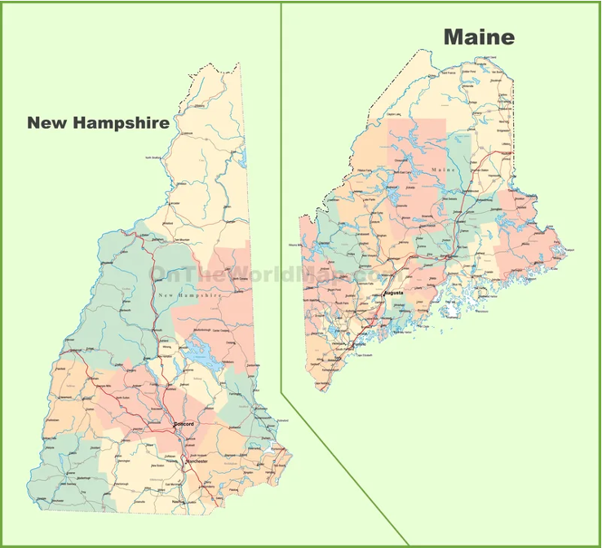
Division B Report
Maine and Part of New Hampshire
16 Base
10 Paid Clubs
4 Areas
8 Population Centers
Portsmouth, NH
Windham, NH
Exeter, NH
Portland, ME
Augusta, ME
Brunswick, ME
Bar Harbor, ME
Bangor, ME
Central locations for Division events
Auburn Library Auburn, ME
Category or Menu Item Placeholder

Slide 59
Division B Report
The clubs meet online, Hybrid, or in Person.
7 clubs have less than 10 members.
9 clubs have between 10 and 15.
There are 6 clubs out of the 7 that have less than 8 members
2 Clubs of the 7 are Suspended
Category or Menu Item Placeholder

Slide 60
Division B Report
Area 5 – 3 Officers
Area 6 – 7 Officers
Area 10 – 3 Officers
Area 14 – 16 Officers
Category or Menu Item Placeholder

Slide 61
Division B Report
Rishabh Keskar is Area 5 Director
Donna Tasker is Area 6 Director
Aanchal Gupta is Area 10 Director
Carol Niles is Area 14 Director
Category or Menu Item Placeholder

Slide 62
Division C Report
Veerendra Nagalla

Slide 63
Division C Report
Congratulations to our Clubs!
A2 TrueBlue Toastmasters – Select Distinguished
A13 Fredericton Toastmasters – Select Distinguished
A17 Memorial Toastmasters – President’s Distinguished
Club Visits Update
Special thanks to Stephen Clark – Completed all club visits for Area 4
Programs in Action
Youth Leadership and Speechcraft initiatives underway
Planning for June TLI – Member notifications coming in 2 weeks
Category or Menu Item Placeholder

Slide 64
Division C Report
Clubs Not Renewing
Support is available for impacted members
Thank You! To all members, club executives, Area Directors, and the Division & District Leadership Team – Your hard work, commitment, and leadership are driving our success.
Let’s finish the year strong!
Category or Menu Item Placeholder

Slide 65
Division D Report
Aaleyah Evans

Slide 66
Division D Report
Division D is made up entirely of clubs located in Nova Scotia.
The division is structured into four Areas: Area 1, Area 9, Area 11, and Area 18.
Each Area is actively engaged and contributing to the success of the division.
Area 1 consists of five clubs, including a newly chartered club that brings fresh energy and growth to the division.
Area 9 also includes five well-established clubs.
Area 11 and Area 18 each have four clubs, all of which are maintaining solid performance.
Category or Menu Item Placeholder

Slide 67
Division D Report
The Area Directors leading these teams are Stanley Orajiaka (Area 1), Tamara Elwood (Area 9), Joyce Ding (Area 11), and Pranit Shrestha (Area 18).
Their leadership continues to positively shape the experience of members in their respective Areas.
All of the clubs in Division D are doing well overall. While there are one or two clubs with lower membership numbers in each area, they remain active, committed, and continue to hold impactful meetings.
Between February and March, all Area Contests and the Division Contest were successfully completed. These contests showcased the talent, preparation, and enthusiasm of members across the division.
Category or Menu Item Placeholder

Slide 68
Division D Report
Area Directors are now in the process of visiting clubs to complete their Area Director Reports. These reports are a vital part of the Toastmasters year and are expected to be submitted by the end of May.
I want to sincerely thank all of my Area Directors for their outstanding work, dedication, and support throughout this year.
Category or Menu Item Placeholder

Slide 69
Administration Report
Carol Coolidge

Slide 70
Administration Manager Report
Carol Coolidge, EC5 thanks the leadership and members of District 45 for the opportunity to serve. Carol learns as she forges forward through all the new territory that this role has to offer. She sincerely thanks all who assist her journey.
Carol supports the streamlined transition of District 45 workbook as it incorporates a smooth succession of new leadership from one generation to the next by identifying activity dates, expected dates of activity completion and publication of supplemental activities described in the District Handbook.
Questions or suggestions can be forwarded to Carol at cdmvt47@yahoo.com.
Category or Menu Item Placeholder

Slide 71
Public Relations Report
Lawrence Kelly

Slide 72
Public Relations Manager Report
Next quarterly newsletter is June
Appreciate submissions by May 15th (please consider submitting for “District Buzz”)
VPPR Peer Meetings - Alternating 4th Mon / Tue
Next meeting, Tue May 27th
Reminders
D45 calendar events
D45 Meetup is free for all clubs
Category or Menu Item Placeholder

Slide 73
Public Relations Manager Report
Growing D45 LinkedIn page was the primary goal for 2024 - 2025
Category or Menu Item Placeholder

Slide 74
Club Growth Report
Tom Macisso, DTM

Slide 75
Club Growth Director Report
New Club Leads
Club Coaches
Sponsors & Mentors
Club Retention Chair
Category or Menu Item Placeholder

Slide 76
Program Quality Report
Sherry MacDonald, DTM

Slide 77
Program Quality Director Report
Contests
VPE Peer meetings
Webinars
Conference - May 23-25 2025
Summer TLI
Celebrate Your Success!
Category or Menu Item Placeholder

Slide 78
District Report
District 45 Director
Sharon Joseph, DTM

Slide 79
District Director Report
District 45 Trail Blazer Recognition Program: 77 recipients with more to come!
District 45 Executive Committee Meeting - Thurs Sep 4th, 2025
Thank you to our incredible leaders
Category or Menu Item Placeholder

Slide 80
Next District 45 Council Meeting
educationprogram@toastmasters.org
I move that the next District 45 Council Meeting be held on Saturday September 13th, 2025 online using zoom starting at 9 am Eastern / 10 am Atlantic / 10:30 am Newfoundland time
Category or Menu Item Placeholder

Slide 81
Spring Conference Update
May 23 - 25, 2025
Erin McMenemy, DTM
Lorelei Grecian

Slide 82
International Updates
District 45 Director
Sharon Joseph, DTM

Slide 83
New Business
District 45 Director
Sharon Joseph, DTM

Slide 84
District 45 Leadership Committee Report
educationprogram@toastmasters.org
I move District 45 Leadership Reports as presented
Category or Menu Item Placeholder

Slide 85
Meeting Adjournment
educationprogram@toastmasters.org
At this time, I will entertain a motion to adjourn the meeting
District Director Elect Sherry MacDonald DTM
please do the honours!
Category or Menu Item Placeholder

Slide 86
Thank you!

