Slide 1


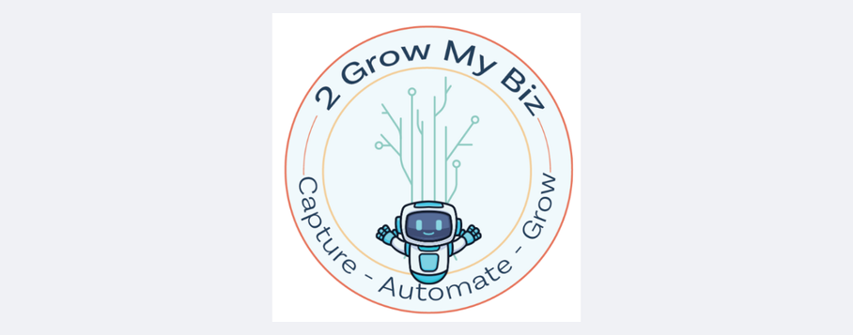

AI Content Repurposing Workshop
Maximize the value from a single video
Bill Quigley

Slide 2

Lesson Objective
Repurposing content is a highly effective strategy for maximizing the value of your efforts while minimizing the time and resources needed to create entirely new materials.
We will Repurpose a video to create other marketing materials

Slide 3

WHY?
1
Save Time and Resources - Creating new content from scratch can be time-intensive and costly. Repurposing allows you to leverage the effort already invested
2
Boost Engagement and Conversion Rates - Repurposing allows you to reinforce your message across multiple touchpoints, increasing the likelihood of engagement
3
Maintain Consistency in Brand Messaging - This ensures consistency in your brand voice and messaging across platforms
4
Maximize Return on Investment (ROI) - Repurposing ensures that this investment pays off by multiplying the ways in which you can use and distribute the content

Slide 4
Our Tasks
1
Transcribe Video Content
2
Turn Transcripts into Blog Posts
3
Creating a Newsletter
4
Writing Nurturing Emails

Slide 5


Video
Transcribing Video Content
  vizard.ai - Free for 60 minutes ($14.50/mon)
  otter.ai - Free for 300 minutes ($8.33/mon)
Getting Started with Transcription
  Upload Video
  Review Transcript
  Edit Transcript
  Save Transcript (to Google Docs)

Slide 6


Blogs
Turning Transcripts into Blog Posts
  ChatGPT - Free ($20/month )
  Copy.ai - Free ($49/mon ) ++ Workflow
Type Title of Your Story Here
  Use the Chat options
  PROMPT - You are an established blog writer. Based on this uploaded transcript, create a 1,000-word blog post summarizing the key points
  Upload transcript or paste the transcript into the Chat
My preference is ChatGPT as it is faster and will upload files. Copy AI may require a plan to upload files.

Slide 7


Newsletters
Creating a Newsletter
ChatGPT - Free ($20/month )
Copy.ai - Free ($49/mon ) ++ Workflow
Type Title of Your Story Here
  Use the Chat options
  PROMPT - You are an established newsletter writer. Summarize this uploaded transcript into a 1000-word newsletter with a call-to-action
  Add transcript or paste the transcript into the Chat

Slide 8


Emails
Writing Nurturing Emails
ChatGPT - Free ($20/month )
Copy.ai - Free ($49/mon ) ++ Workflow
Type Title of Your Story Here
  Use the Chat options
  PROMPT - You are an established email writer. create 5 different emails to leads that will inform them of this topic. Add a call to action at the end of the emails. Add transcript or paste the transcript into the Chat

Slide 9


Resources Used
What prompt did you use to generate your image?
Type answer here
Resources Used in the Workshop
  Transcribe Video - Otter AI & Vizard AI
  Create Blog - ChatGPT, Claude & Copy AI
  Create Newsletter - ChatGPT, Claude & Copy AI
  Create 5 Emails - ChatGPT, Claude & Copy AI

Slide 10

OFFER
Act now to take advantage of these exclusive discounts!
OFFER
Offer 1: Detailed Customer Avatar Prompt
Unlock the power of AI to create your ideal Customer Avatar with our proven prompt.
🎯 Special Price: $27 (Reg. $47)
Offer 2: Biz Strategy Documents + 1-Hour Session
Get our comprehensive Business Strategy documents and a 1-hour personalized strategy session to help you apply them effectively.
📈 Special Price: $147 (Reg. $197)
Offer 3: Register for Our Automation Class
Master automation and streamline your business processes in our upcoming live 'Automation Class'.
🚀 Special Price: $47 (Reg. $97)
AI-generated image

Slide 11


customer avatar offer
WHAT
YOUR GET
Avatar Prompt
Instructions
30 minute Zoom
LOADS of Information on Your Perfect Customer
ONLY
$27
Normally $47
Demographics
Social Media Groups
Publications Read
Associations In
Brands Use
& More
2growmybiz.com/ai-avatar
2GrowMyBiz.com

Slide 12

Biz Strategy offer
WHAT
YOUR GET
  Marketing Foundation
  Actionable Insights to Drive Smarter Decisions
  Ideas Brainstorming to Unlock Your Business’s Potential
  Marketing Funnel
$147
SAVE $50
Business Strategy Plan gives you the clarity, insights, and actionable steps to scale your business and stand out
Over 40+ pages
https://2growmybiz.com/ai-biz-strategy
2GrowMyBiz.com

Slide 13

Automation Class offer
WHAT
YOUR GET
Avatar Prompt
Instructions
30 minute Zoom
LOADS of Information on Your Perfect Customer
$47
SAVE $50
Learn about Automation and how it will help you to automate many of the processes in your Biz
2GrowMyBiz.com/?????
2GrowMyBiz.com

