Slide 1


5 Marketing Gaps Nearly Every Business Has And How To Fix Them

Slide 2


DFA Marketing
Paul thompson
Marketing Expert
Notes:
Hi everyone, my name is [your name] and I'm excited to speak with you all today about some modern growth capabilities that most local businesses are currently overlooking, which results in money left on the table.
As a proud citizen of [Town/County Name], I'm on a mission to help the local businesses in our area thrive and prosper.
*Optional*
To give you a little background about myself...
Over time, the roadmap to online success for a local business has become pretty clear.

Slide 3

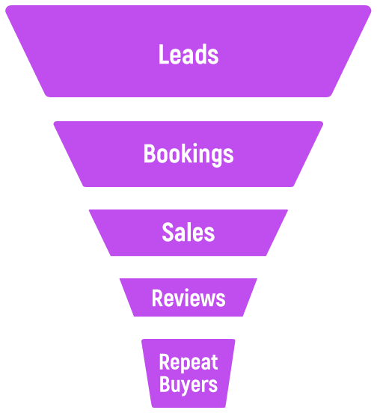
How Businesses Succeed Online In 2023
Consistently generate Leads
Consistently nurture leads into Bookings
Consistently turn bookings into Sales
Consistently turn sales into Reviews
Consistently turn sales into Repeat Buyers
Notes:
Businesses that successfully leverage online marketing are:
1. Consistently generating new Leads
2. Consistently nurturing those leads via conversations and automated messaging into Bookings
3. Consistently turning conversations into Sales
4. Consistently turning new sales into new online reviews
5. Consistently reactivating existing customers into repeat buyers
Sounds easy enough right? But most businesses are not consistently hitting the mark in each of these layers of the pipeline.
So let's dive into each and talk about some specific ways to ensure your business is consistently capitalizing on each of these stages.

Slide 4

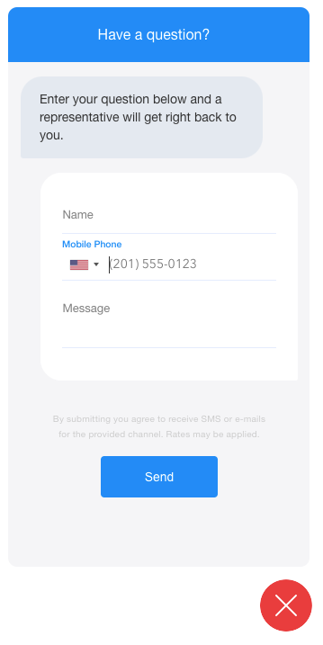
Most Businesses Are Leaving Leads On The Table
Most local businesses still don't have SMS capability
SMS is the most preferred method of communication
Average SMS open rates are 98% compared to email (16%)
Notes:
When it comes to consistently generating more leads, most of us immediately think of ads as the solve.
Now don't get me wrong, paid ads can be highly effective and if you have the budget, you should definitely be running ads, but there are some other tactics and tools we can put in place to generate leads without having to spend on ads.
The first way to easily start generating more leads is to text-enable your business.
SMS is the most preferred method of communication by a long shot and when someone receives an SMS, it's almost guaranteed to be opened.
By adding a simple message widget to your website, you can enable visitors to initiate a text-message conversation that you can manage in a mobile app or on a computer without having to use your real mobile number.
It's great because up until recently, these widgets have been live chat, which have frustrated users because there's never anyone available on the other end and they don't want to have to sit around forever on a website waiting for a reply.
With an SMS chat widget, the user is free to leave the site after they send the initial message because the conversation will continue on their phone.
Businesses are typically amazed by the amount of conversations that are generated as soon as they put this on their site.

Slide 5
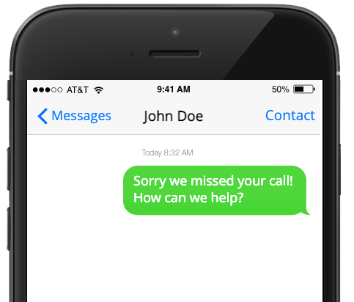
Most Businesses Are Leaving Leads On The Table
Most local businesses don't have a Missed-Call Text-Back in place
64% of inbound calls to SMBs go unanswered every day!
Notes:
Once your business is SMS capable, you'll be ready to fix an issue that is likely costing you a small fortune, which are missed calls.
Statistically, the average local business misses about 64% of all their inbound calls!
Now some of you might be thinking "There's no way we miss 64% of our calls" - fair enough.
Let's assume you're only missing 20% and that equates to 10 missed calls per day and that 1 of those 10 would have been a sale but the caller went on to dial a competitor - do the math on how much that's costing you every day, every week, and every month.
The good news is that modern technology enables us to actually automate back a text message saying "Sorry we missed your call - how can we help" to anyone who calls in but doesn't get an answer.
Imagine how much money in lost revenue this one tactic would bring back!

Slide 6
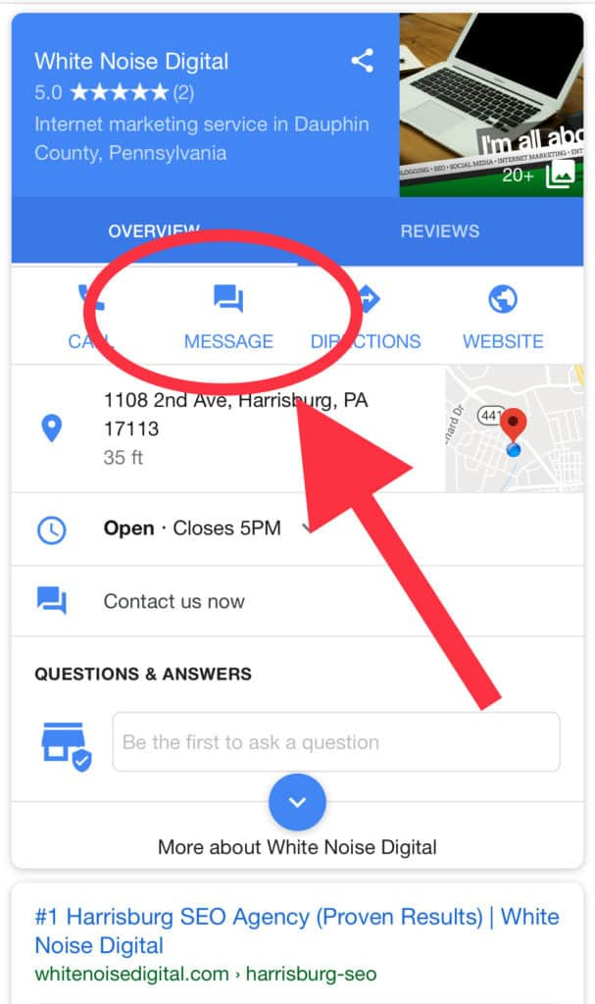
Most Businesses Are Leaving Leads On The Table
Most local businesses don't have Google Chat activated
The average business receives over 1000 visits per month to their Google Business Profile
Notes:
The next easy win to generate more leads with no ad spend is to activate Google Chat.
This is a feature from Google that most businesses don't even know exists but when you turn it on, Google ads a new message icon to your Google Business Profile that shows up in mobile search results and in the Google Maps app allowing users to shoot you a message right from your Google Business Profile.
As we talked about already with SMS, people don't want to have to call so as soon as they see there's a chat option, they jump on it.
Now I hate to be the bearer of bad news, but if you haven't figured it out yet, Google doesn't actually want anyone leaving the search results to actually go to a website, so they're going to start pushing this feature hard. Best to get ahead of your competitors while they're still in the dark about this one.

Slide 7
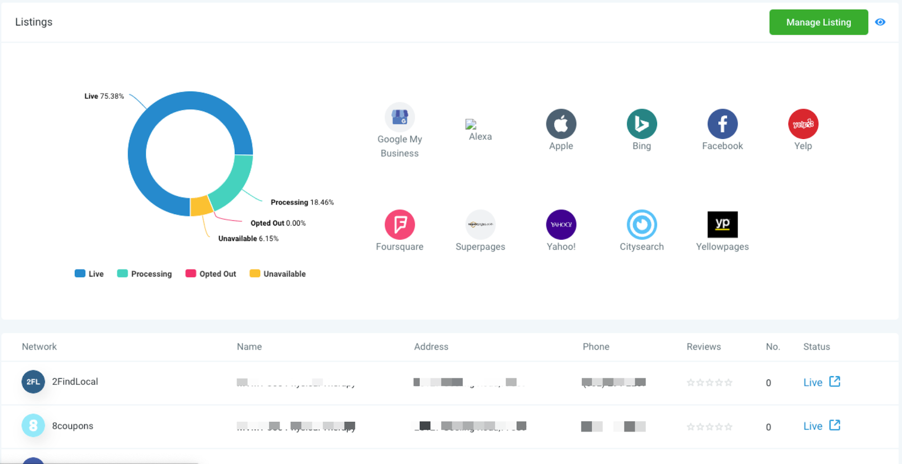
Most Businesses Are Leaving Leads On The Table
Top-ranking local businesses have approximately 81 citations from top-level domains on average
Google loves to see consistent data
Notes:
One last way to generate leads without paid ads is with online listings.
Now this one does have a recurring cost but it can be pretty powerful because having your business listed correctly across the top directories around the internet correlates pretty strongly with business that tend to rank well in search results.
And that makes sense because Google loves to see consistency so it has to choose between a business whose phone number and hours are different across only three directories and a business whose info is the same across a hundred directories, which do you think it will recommend?
With Listings, you can input all your business's important info like name, address, phone number, etc. and have that info automatically published across all the top directories around the web - nearly 100 in total.
Listings then locks that data, so no third party can change it, which is pretty common and leads to inconsistencies over time.
It's hard to get someone to claim your lead offer if they don't even know you exist, and Listings can be a great way to get yourself in front of a lot more people online.

Slide 8

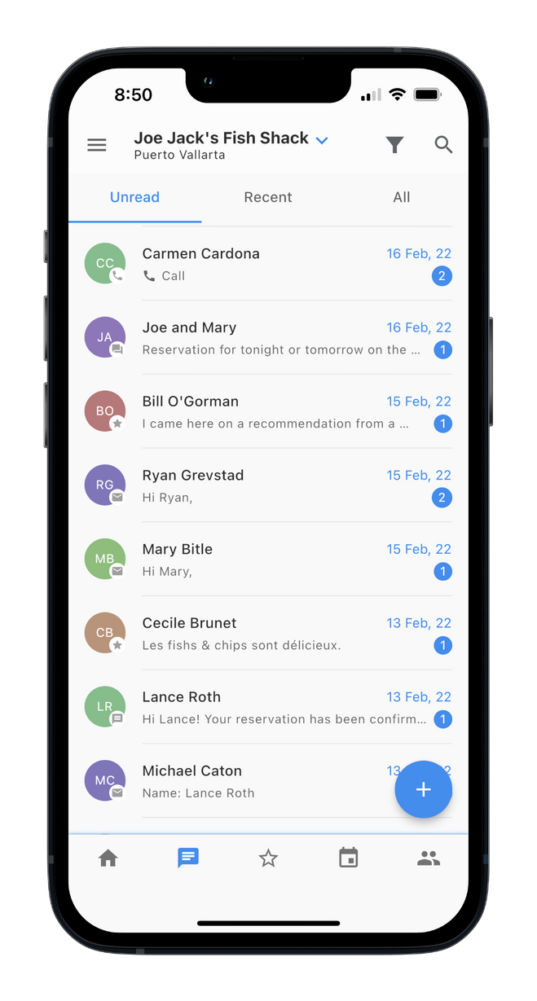
Most Businesses Aren't Set Up To Nurture Well
Most local businesses don't reply fast enough
The odds of a business connecting with a lead within five minutes of the lead being generated are about 100 times more likely than waiting 30 minutes
Notes:
When it comes to nurturing leads into sales, the number one issue local businesses face is speed.
Studies show that there's basically a five-minute shot clock. If you can get a new lead to engage within 5 minutes, the odds of closing that lead skyrocket.
The problem is, most small businesses are too busy with their day-to-day operations to reply that quickly.
One thing that helps with this is having your lead channels funnel into a consolidated mobile app, so you can quickly reply to everything in one place whenever your pocket buzzes.
With a consolidated mobile communication stream, it's not just one person who's receiving the new leads as you can have team members all working out of the same inbox, but you can also leverage some really handy features, which we'll cover in the next two slides.

Slide 9
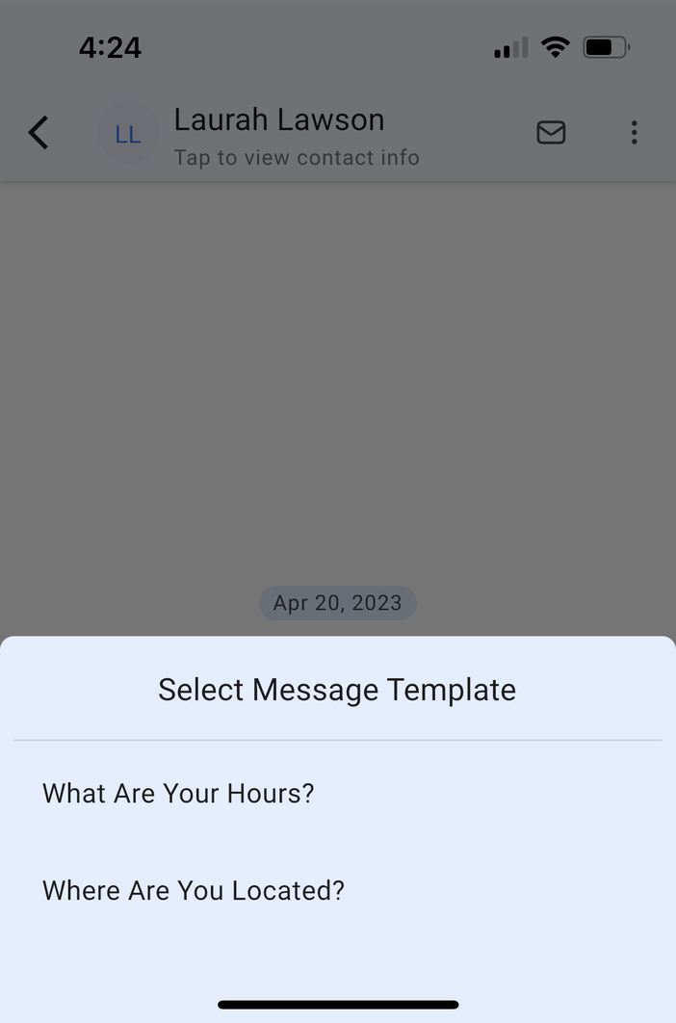
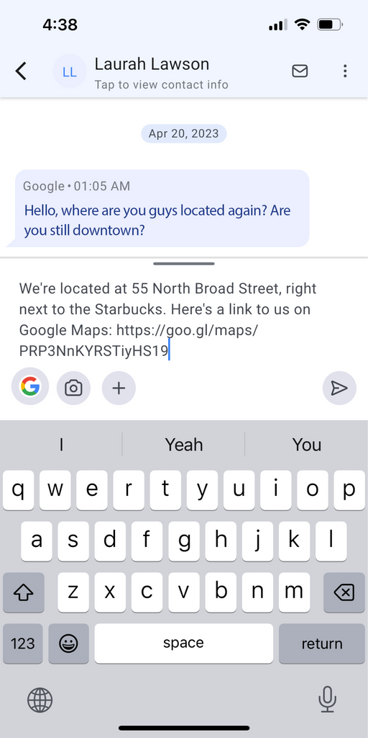
Most Businesses Aren't Set Up To Nurture Well
Most businesses don't reply quick enough
Businesses waste time answering the same questions every day
Most businesses don't reply consistently
Notes:
The first tool is called Snippets.
Snippets allow you to create pre-defined messages and save them so that anyone on your team can quickly drop a curated response into a conversation.
They save a ton of time as you and your staff no longer have to type out the same answers to questions you get asked over and over again, and they ensure that everyone on your team is giving the same exact response that you want delivered.

Slide 10
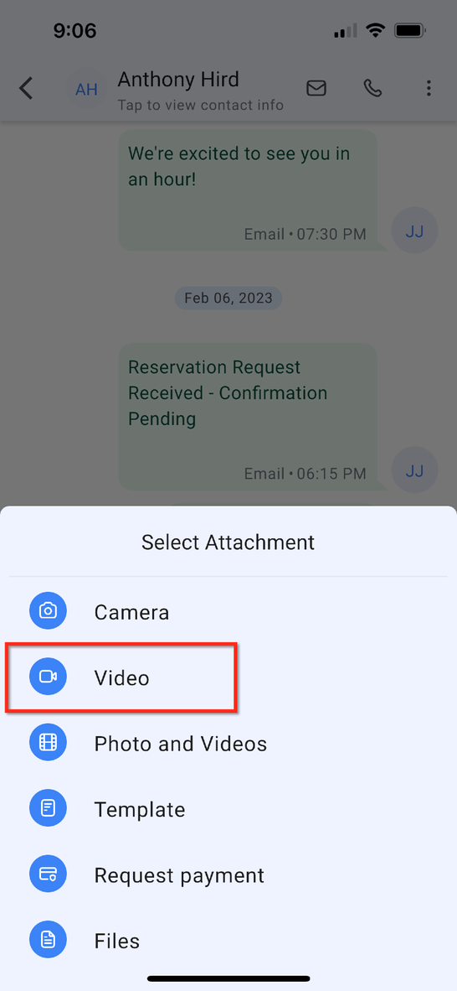
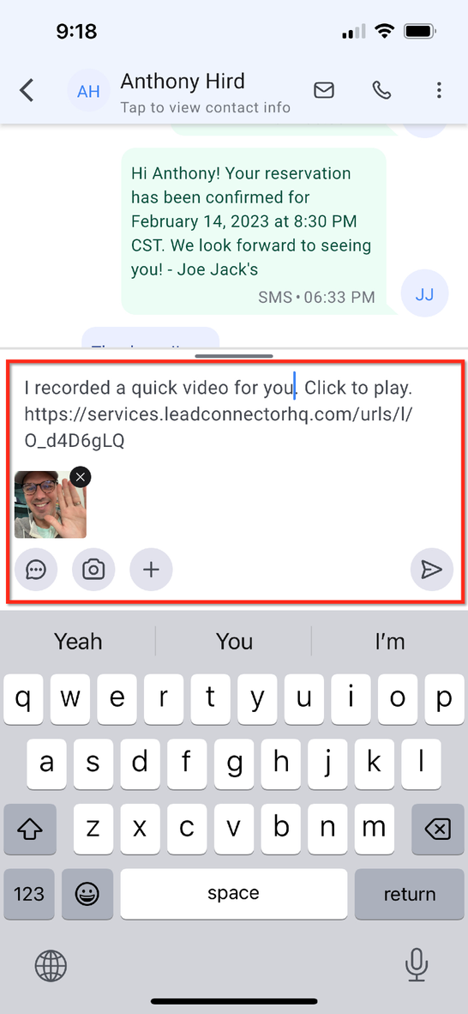
Most Businesses Aren't Set Up To Nurture Well
Most businesses don't leverage personal video
93% of companies who send personalized videos see an increase in conversion rates
Notes:
Another incredibly powerful nurture tool that most small businesses are not leveraging is video messaging.
Video messages allow you to quickly record a video, the video gets uploaded into the cloud, and then a link to the video plus a preview gets dropped into the conversation ready to be sent.
Imagine how much more business you would close if you and your staff were sending personalized hello videos to new leads!

Slide 11

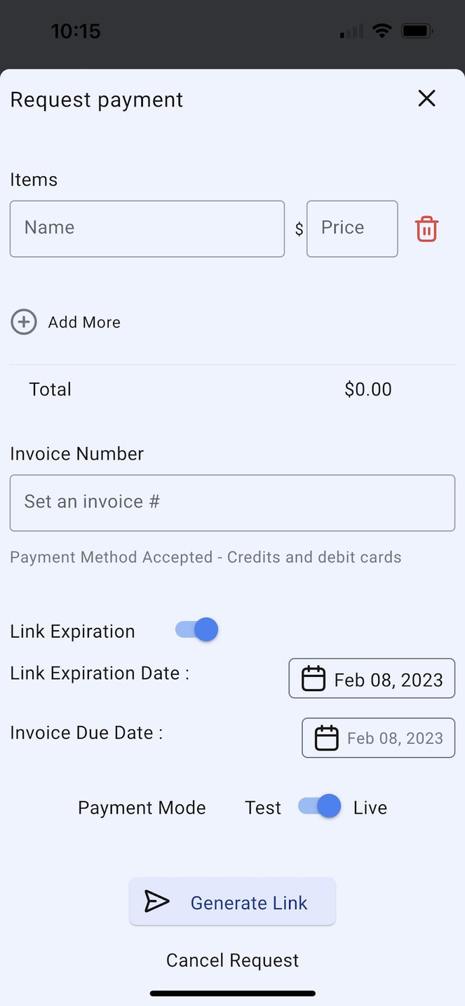
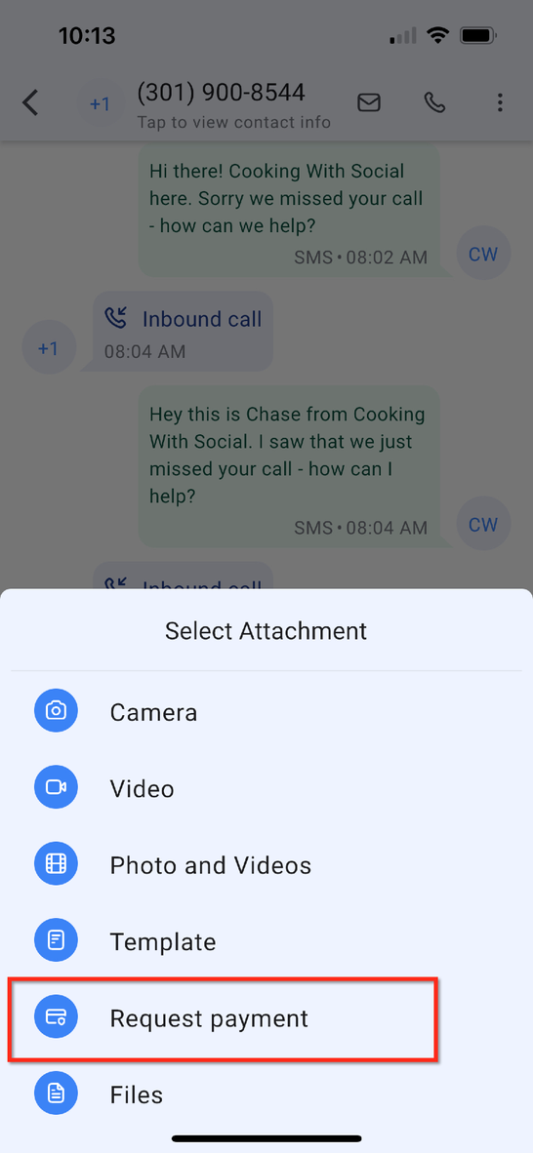
Most Businesses Aren't Ready To Quickly Collect Payment
Most businesses don't have a way to create and text someone an invoice
Notes:
Speaking of closing leads, most small businesses are not set up to quickly and easily collect payment on the fly.
Have you ever been out of the office or out on a job and needed a way to quickly collect money from someone?
A technology called Text-2-Pay enables you, right from within the mobile app, to quickly create an invoice and a link to the invoice gets dropped into the conversation.
And with Google & Apple pay included, the person receiving the text can just click the link, scan their face, and the invoice is paid!

Slide 12
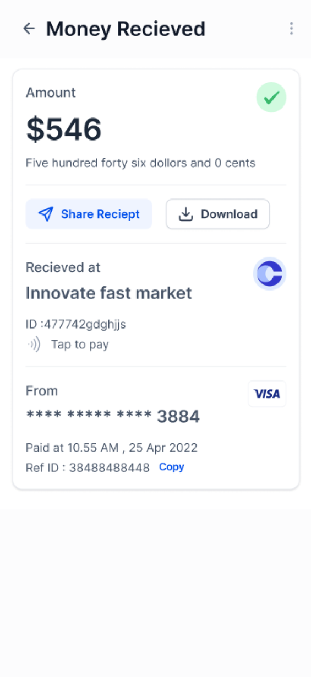
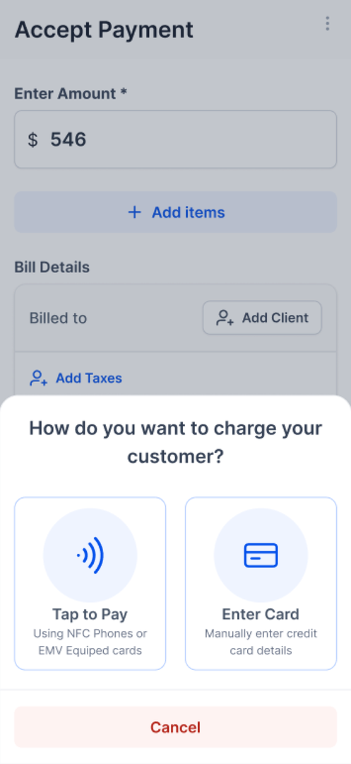
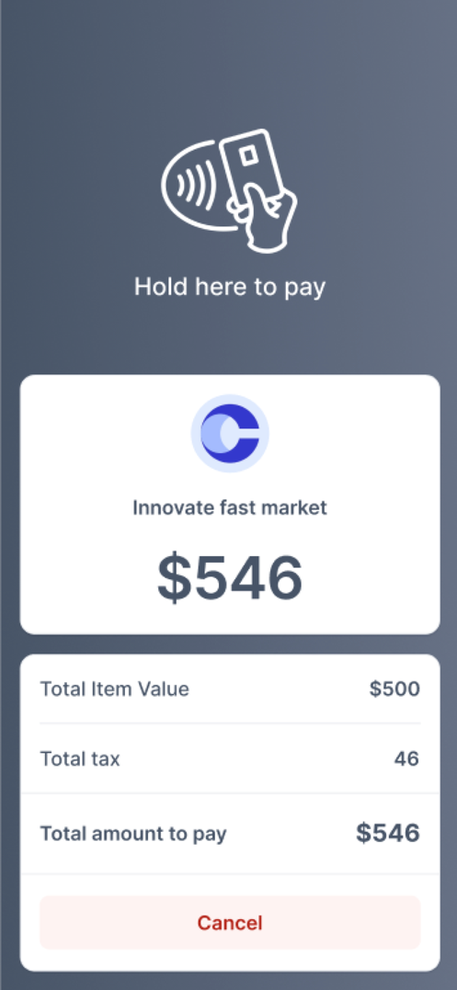
Most Businesses Aren't Ready To Quickly Collect Payment
Most businesses can't collect credit card payments outside off premise
Notes:
In addition to Text-2-Pay, there's also Tap-2-Pay which turns any modern mobile phone into a credit card terminal.
So if you're off-premise, you need to collect a payment that doesn't require an invoice, you can just punch in the amount, have the buyer tab their credit card to your phone to make payment, and then you can hit email to send their receipt!
Collecting money has literally never been easier.

Slide 13
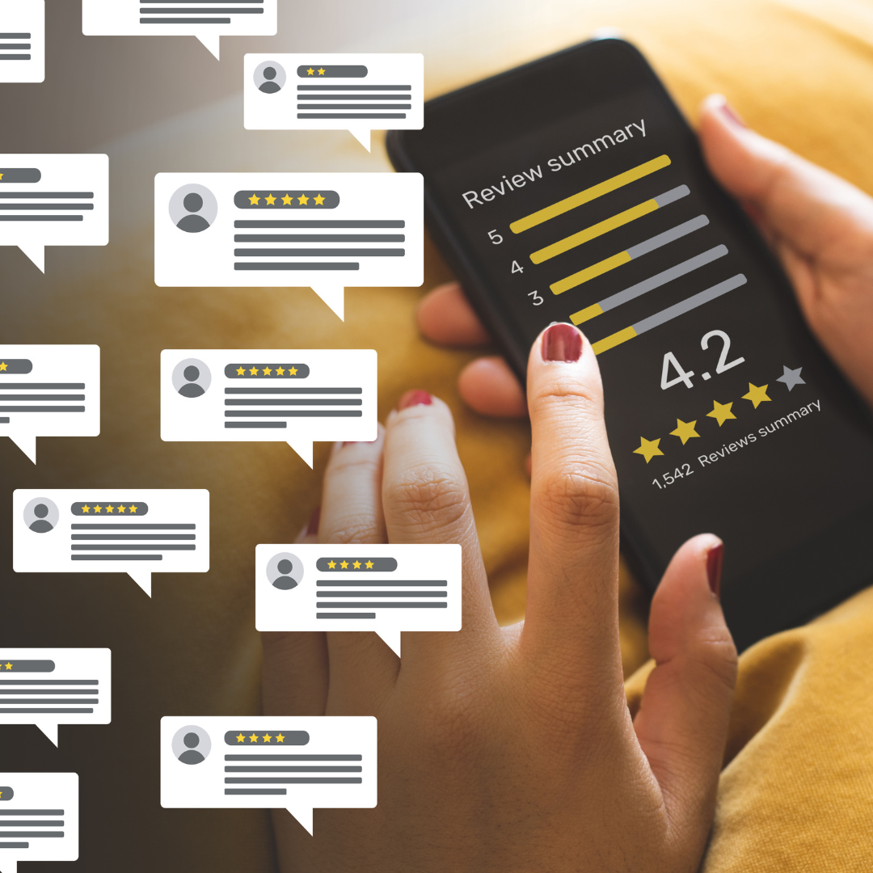
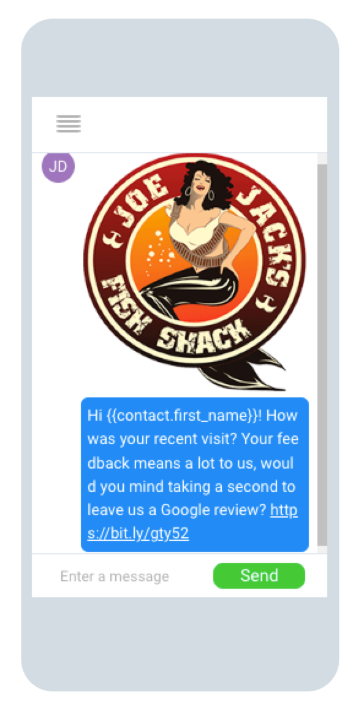
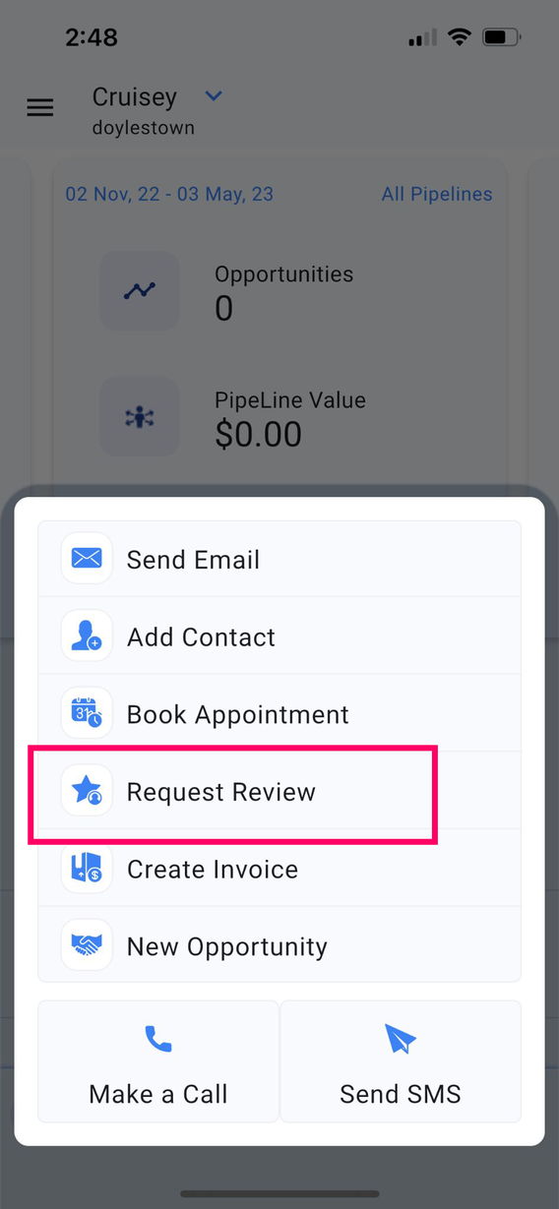
Most Businesses Don't Consistently Generate Reviews
Most local businesses don't have a way to quickly request a Google Review
A steady increase in reviews has been shown to correlate with an increase in BGP phone calls
88% of consumers worldwide consult reviews when discovering a local business
60% of consumers feel the number of reviews a business has is critical when deciding whether to use its services.
Notes:
Now that we've talked about a few ways to quickly take payment, let's talk about what should happen after payment has been made.
Most businesses focus all their attention on getting that sale, and they don't have a system or process in place to take the next step, which is turning that customer into a review.
Generating a consistent flow of new reviews is crucial to a businesses growth for several reasons.
A steady stream of positive reviews correlates very strongly with better rankings in local search results, and the large majority of consumers look at reviews before making a decision about who to do business with.
So the more reviews you generate, the more visibility you get from Google and on top of that, you start converting more of that traffic from Google because people like your reviews, so it creates a flywheel effect where you just gain more and more momentum.
The problem is most businesses don't have a system in place to easily generate reviews consistently.
With a feature called Review Requests, though, we can pre-program a message requesting a review that links directly to the review panel in Google that can be shot out with just a few taps.
In a lot of cases, this can even be automated to fire off a purchase or an appointment.

Slide 14
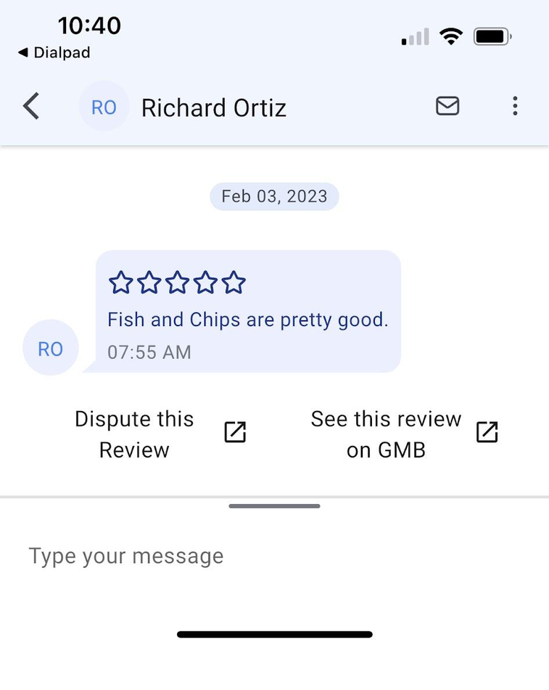
Most Businesses Don't Consistently Generate Reviews
Most businesses don't reply to reviews
89% of consumers say they’re likely to choose a local business that responds to reviews.
People who receive a response feel connected to the company and others are more likely to leave a review if they see the business responds.
Notes:
Another big opportunity that's typically missed by local businesses when it comes to reviews is the act of simply replying.
As you can see, the stats are around review replies are crazy, but the truth is we like to see how a business interacts with its customers - especially when they business gets a bad review.
And as crazy as it might sound, there's actually a bond that's created between a business and customer when the business takes the time to reply to a review, so it creates loyalty.
Whether you do this manually in your Google Business Profile or you use an app like ours where you can do it right in the conversation stream, it's critical that you 1) consistently request review and 2) reply to every review as they come in.

Slide 15
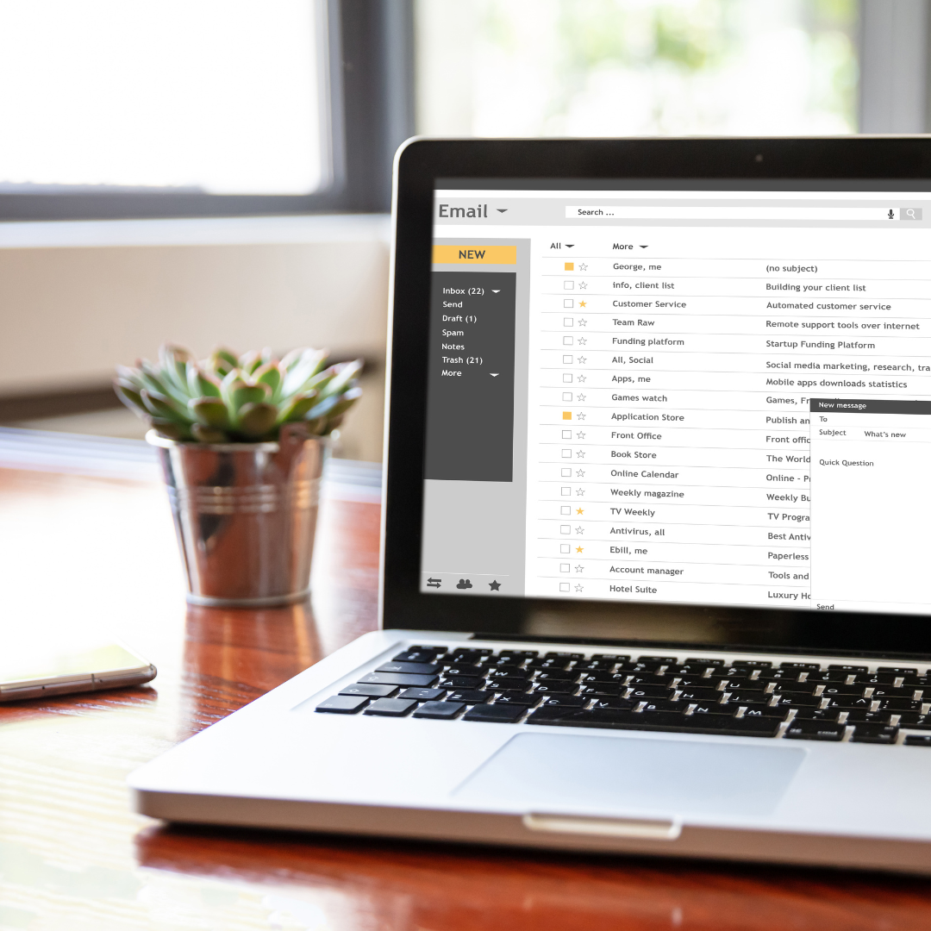
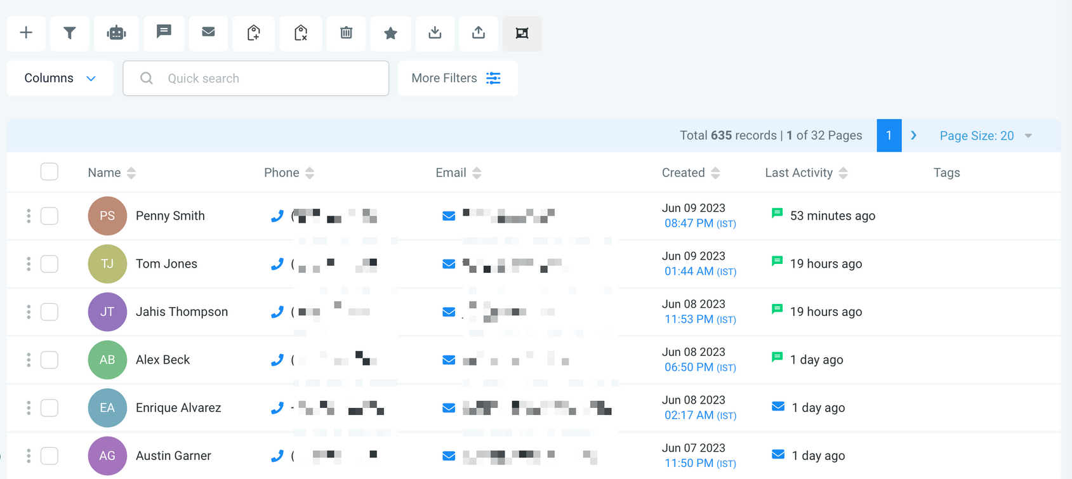
Most Businesses Don't Reactivate Their Database
Most businesses don't have a database to reactivate
Notes:
Ok, so let's talk about what we call Database Reactivations.
This is a huge miss for most local businesses, because it's dramatically easier and drastically cheaper to turn an existing customer into a repeat buyer than it is to acquire a new customer.
But to do that, you first need a database (also known as a CRM), which is a place to house the contact information of your leads and customers as they come in.

Slide 16
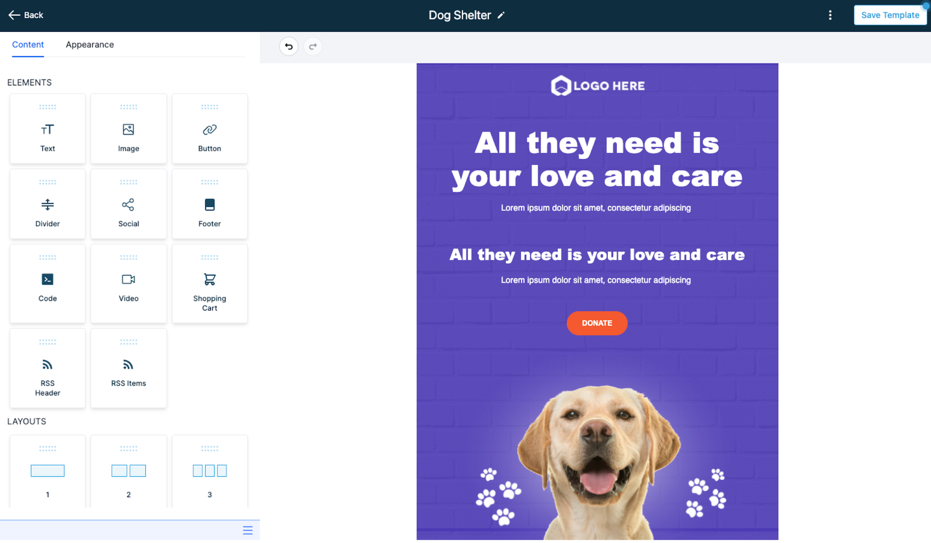
Most Businesses Don't Reactivate Their Database
Most businesses don't have a way to do bulk email (especially in a way that looks professional)
Notes:
Once you have a database in place, you then need a way to broadcast messages, stories, promotions, etc.
Ideally, you have a nice visual email builder as well like the one on the screen where you can easily drag and drop elements to design really visually appealing emails.
How many of you have ever tried Groupon?
It probably didn't go so well right? It's not fun to have to give a 50% discount and then give another 25% to Groupon.
But when you consistently build your own database and you have the tools to activate it, you essentially have the power of Groupon but you're keeping all the revenue!

Slide 17
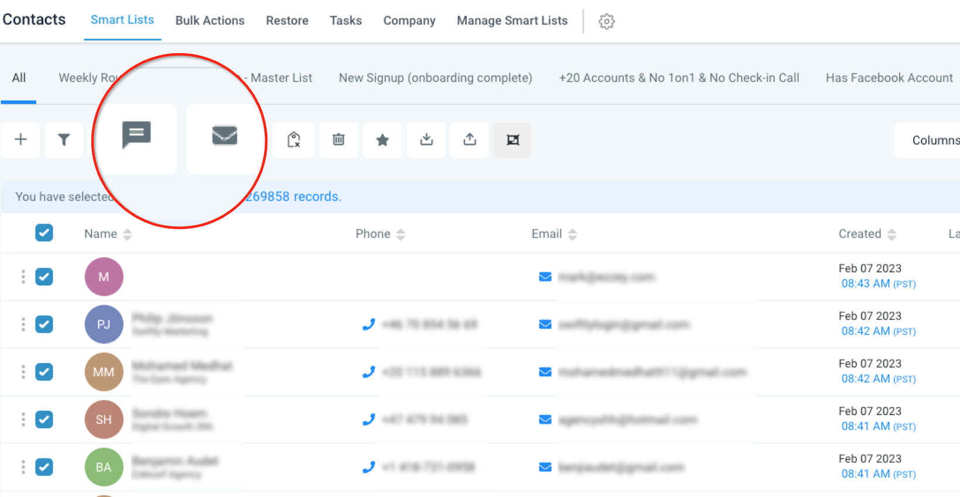
Most Businesses Don't Reactivate Their Database
Most businesses don't have a way to bulk SMS
Notes:
When you have a tool like ours, you can even do reactivation campaigns with text-messages.
That chat icon there on the screen is what we call a Bulk Action that allows you to shoot a text message to a whole list of people at once or drip a message out over time.
We talked about the open rates of text messages earlier so as you can imagine, SMS reactivation campaigns are incredibly effective - you just have to make sure that your registered correctly with the carriers and that everyone on text list has opted in, but we have a whole Trust Center that makes that process easy.

Slide 18
How Businesses Succeed Online In 2023
Consistently generate Leads
Consistently nurture leads into Bookings
Consistently turn bookings into Sales
Consistently turn sales into Reviews
Consistently turn sales into Repeat Buyers
Notes:
Businesses that successfully leverage online marketing are:
1. Consistently generating new Leads
2. Consistently nurturing those leads via conversations and automated messaging into Bookings
3. Consistently turning conversations into Sales
4. Consistently turning new sales into new online reviews
5. Consistently reactivating existing customers into repeat buyers
Sounds easy enough right? But most businesses are not consistently hitting the mark in each of these layers of the pipeline.
So let's dive into each and talk about some specific ways to ensure your business is consistently capitalizing on each of these stages.

Slide 19


Your Checklist For Success
Notes:
So to help you go back and and make sure you've got these bases covered for your own businesses, I've put together a checklist that we actually use as an initial audit when we take on a new client.
Take this back to your team and hopefully it serves as a guide to help you plug some of the common gaps that we talked about today.

Slide 20
THANK YOU!
dfasales@dfamarketing.com
Notes:
Thanks so much for your time!

