Slide 1


Slide 2

Being an
“Encourager of the Fellowship”
Steve Holt
Church Services
TBMB

Slide 3
A Church at a Crossroads
Acts 6:1-7
What was the “presenting issue?”
How did the Twelve address the situation?
What was the real reason for calling the Seven?

Slide 4
How to be a “Hur” to your pastors
Verbally support them
Pray for them and with them regularly
Encourage your family to support their families
Mentor or befriend their children
Lead the church to support him financially
Be consistently positive
  In your attendance
  In your faithful giving
  In service to the church
  Seek to be a blessing, not a curse

Slide 5
What Does a Healthy Deacon Body Look Like?
    Organized as a Team and not as a Committee
    Unified and Defined Purpose
    Task Clarity
    Accountability

Slide 6
Deacon ministries converge from...
Statement of
Deacon Purpose
Needs of church
and community
Passion/
Calling
Ministries
Spiritual Gifts

Slide 7
What is the Purpose of Your
Deacon Ministry?
Why does it exist?
Does it fit the model we see in Acts 6?
Could it be improved?
How could your deacon ministry be more effective in meeting the fellowship needs of your church?

Slide 8

Definition of “Community”
A Place Where People . . .
Know and are Known . . .
Serve and are Served . . .
Love and are Loved and . . .
Celebrate and Mourn together

Slide 9
Six Metaphors for the Church
Flock
Vine
Bride
Body
Kingdom
Building

Slide 10
The Church is a Living Organism
Living things need to be nurtured, tended, and/or cultivated
The care needs to be consistent
When growth stops, the dying process begins

Slide 11
Kingdom Growth Principle
“All by itself” Growth (Mark 4:26-29)
If left to itself, the Kingdom of God will grow.
If God’s Kingdom is not growing it is most likely being artificially hindered.

Slide 12
Healthy Things Reproduce
The goal of every living thing is to recreate itself—often many times over
Thriving organisms MULTIPLY!!!!

Slide 14


Funding for this presentation provided by your faithful contributions to the Cooperative Program.

Slide 15
Who Am I?
I was a Levite from Cyprus
60% of the books in the N.T. are directly linked to my influence
I was the key leader of the Church at Antioch-Where disciples were first called Christians
Luke refers to me as an apostle
The modern concept of missionaries and missions started with my example
My name is BARNABAS

Slide 16

The Impact of Barnabas
Epaphroditus
Antioch Church
Timothy
Silas
Priscilla & Acquilla
Titus
25.6%
of NT
Paul
60%
Barnabas
Luke
34.4%
of NT
John-Mark
Matthew

Slide 17
The Premier Example
Joseph of Cyprus
He was a man who was willing to share his resources with others (Acts 4:36)
Barnabas was a man whose life was characterized by the activity of encouragement (Acts 11:23)
He was a man who expressed confidence in others (Acts 11:25-26)

Slide 18
The Premier Example
Joseph of Cyprus
Barnabas was a man who stood by Saul/Paul in good times and in bad times (Acts 13:2; 13:50)
He was a man who demonstrated the fullness of the Spirit and faith in his life (Acts 11:24)
Barnabas was an advocate for Saul when Saul had no credibility to advocate for himself (Acts 9:27)

Slide 19
The Premier Example
Joseph of Cyprus
He saw potential in Paul and in others (Acts 9:26-28)
Barnabas viewed his role as preparing others (Acts 13:6-13)
He challenged, and even disagreed (Acts 15:36-40)

Slide 20
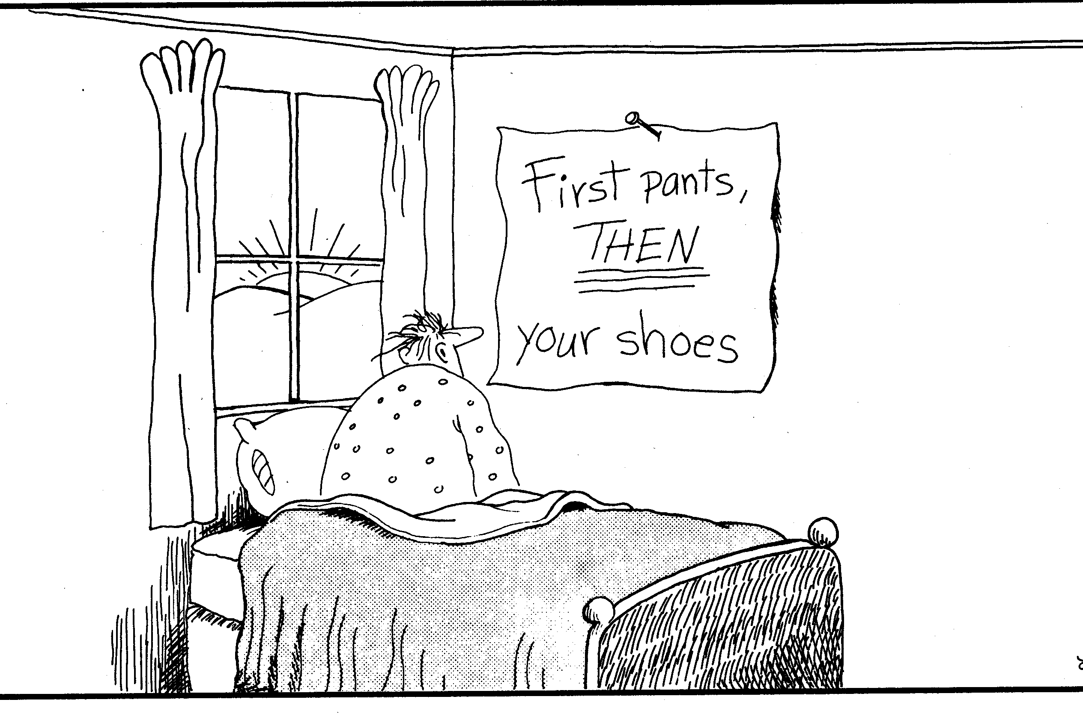

Slide 21
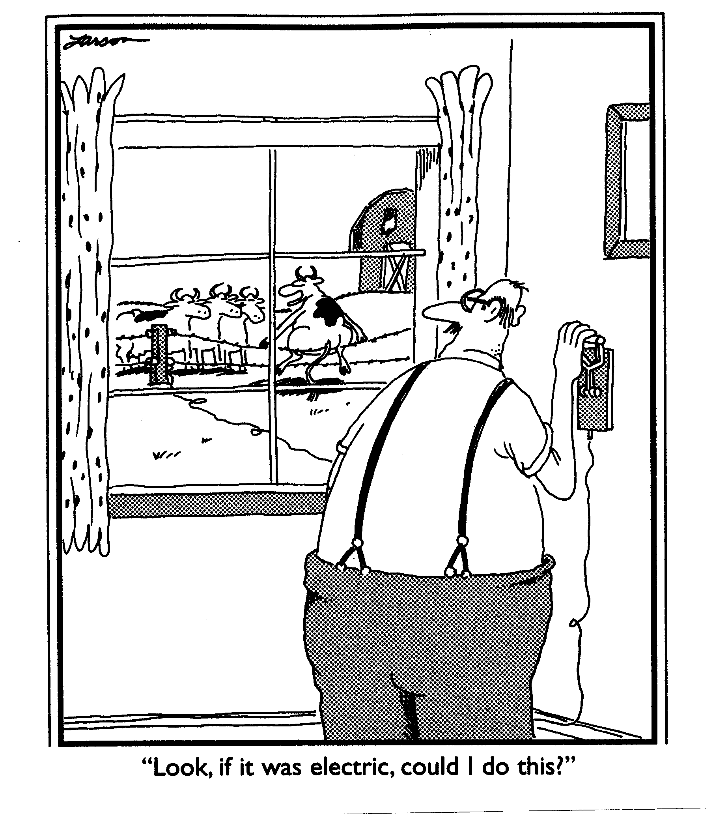

Slide 22
