Slide 1

Revitalizing the 35 Participant Church: Principles & Practices!
By Dr. Tom Cheyney
RenovateConference.org
A Breaking the 35 Barrier in Renewal Resource

Slide 2
Revitalizing the 35 Participant Church: Principles & Practices!
2 Timothy 1:7
“For God has not given us a spirit of fearfulness, but one of power, love, and sound judgment.”

Slide 3
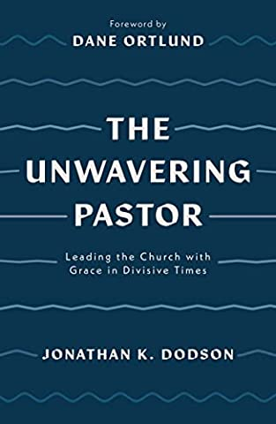
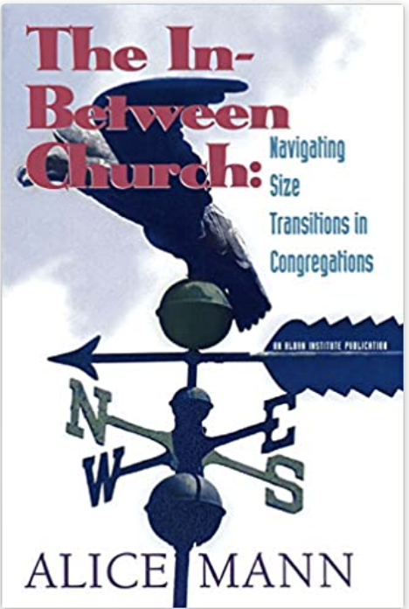


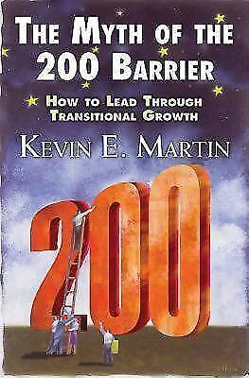
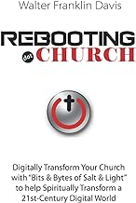


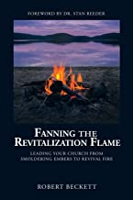
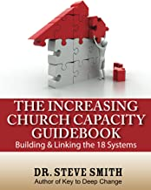

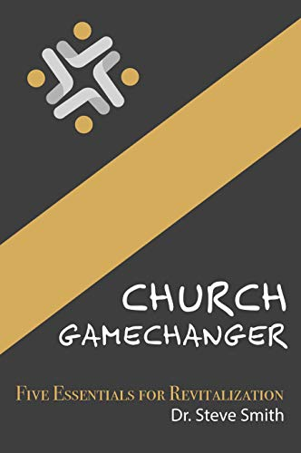

Slide 4
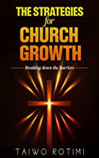
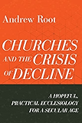
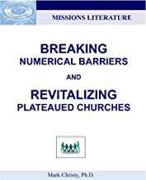
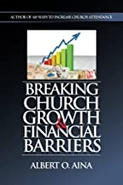
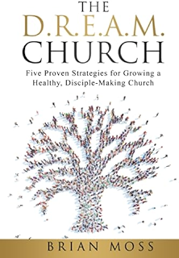
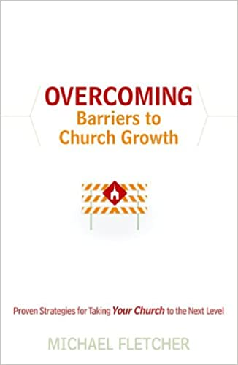

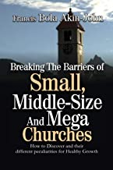
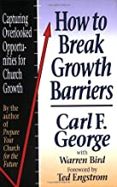
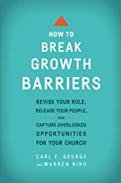

Slide 5

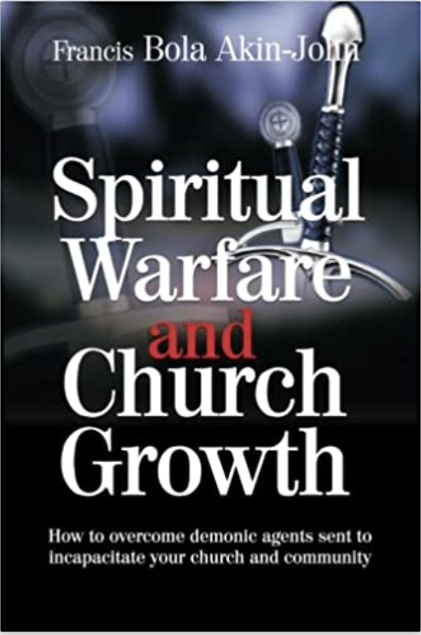
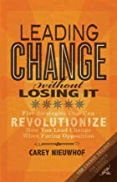


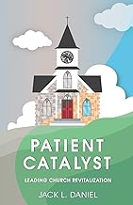





Slide 6
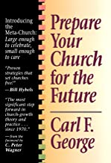

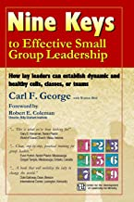

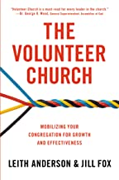
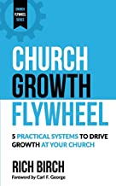



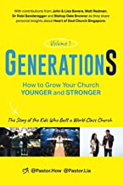

Slide 7
Revitalizing the 35 Participant Church: Principles & Practices!
The small church is the beginning of our early American Religious Heritage. We started our religious foundation with the creation of small churches. Even during the early days of the pilgrims at Plymouth Rock, the small church was in existence. Many things can be said about the small church. The small church is unique from all other sized churches. Paul Madsen says it so well, "The small church has no different mission than any other church of the land, regardless of size. It may use different methods to achieve that mission, but the mission of proclamation, fellowship, ministry, and service is the same for all.”

Slide 8
Revitalizing the 35 Participant Church: Principles & Practices!
It is astounding to realize that 90 percent of all churches today are not growing, and that churches with 101-200 total members 50 percent of them have plateaued.
Another 19 percent have declined, leaving only 31 percent of these churches that are growing.

Slide 9
Statistical Realities Concerning Church Revitalization
Did you know that:
•There are 344,000 protestant evangelical churches from the eight mainline denominations in the western hemisphere, which are in plateau and decline.
•95% of all churches in North America average 100 or less.

Slide 10
Statistical Realities Concerning Church Revitalization
Did you know that:
•Over 82% of American Churches are in decline or on a plateau.
•Each year 3,500 to 4,000 churches die in North America (900 last year within our Denomination alone).

Slide 11
Statistical Realities Concerning Church Revitalization
Did you know that:
•Studies have shown that churches typically plateau in attendance by their fifteenth year, and by year 35 they begin having trouble replacing the members they lose.
•They have the inability to regain the critical mass necessary to regrow the church utilizing the tools and techniques they are presently employing.

Slide 12
Statistical Realities Concerning Church Revitalization
Did you know that:
•50 – 60 churches in North America close their door every week.

Slide 13
Statistical Realities Concerning Church Revitalization
Did you know that:
•A more recent series of studies (The State of the Church) was conducted by Bill Day; Associate Director of the Leavell Center for Evangelism and Church Health, who serves the New Orleans Baptist Theological Seminary as the Gurney Professor of Evangelism and Church Health in his sequential studies on church health and growth of 2003, 2007, and 2010 where he reports that currently there are less than seven percent (6.8) of our SBC churches which are healthy growing churches. That means 3,087 of our 45,727 SBC churches are healthy.

Slide 14
Revitalizing the 35 Participant Church: Principles & Practices!
Abraham Lincoln said about the small churches in America, "God must love the small church. He made so many of them.”
Notes:
Schaller, The Small Church Is Different, p. 15.

Slide 15
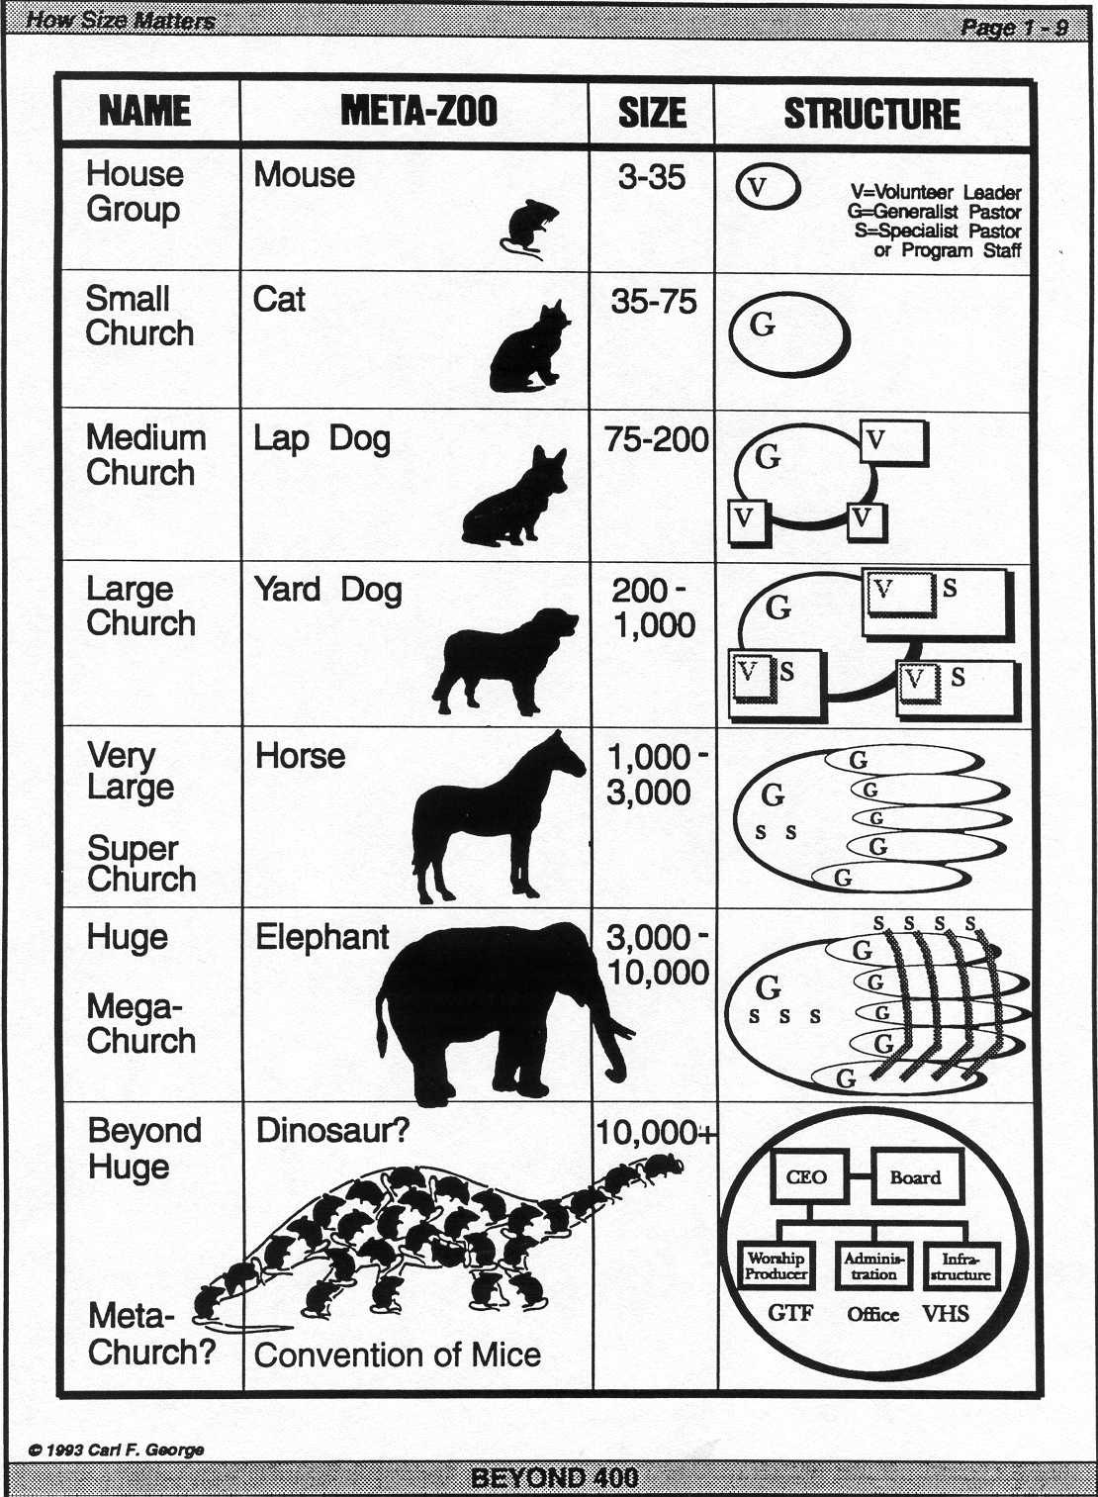

Slide 16
Revitalizing the 35 Participant Church: Principles & Practices!
Carl S. Dudley, professor of church and community at McCormick Theological Seminary, in Chicago, Illinois, states that the break-even number would be around 175 participants in the Sunday School structure of the church.
He does give us one careful delineation, he says that in the Mennonite denomination a congregation of 75 would be considered quite large.
Notes:
Dudley, p. 20.
Ibid.

Slide 17
Revitalization in the Small Church Defined!
1. Number of members now!
2. Worship attendance
3. A comparison with past days when the congregation was much larger
4. The image projected by the pastor's definition of comparative church size
5. The size of the building or buildings
6. The size of the budget as compared to the past
7. A full workload for the minister or ministers
8. An individual's previous experiences in other congregations
9. The quality of caring relationships among the members
10. The size, number, and variety of fellowship circles or primary face-to-face groups which together constitute that congregation

Slide 18
Church Revitalization in the Small Church!
Most definitions about the small church are misleading. In most main-line denominations, at least 60 percent of the congregations are included among the "small" churches.
One stunning report comes from James E. Lowery as he describes the Churches of his particular denomination where he states: "43 percent of the clergy are serving 18 percent of the people in 62 percent of the churches in a situation which is programmed for failure.“
Notes:
Carl S. Dudley, Making the Small Church Effective, Nashville, Abingdon Press, 1993, p. 9.
Ibid, p. 19.
James L. Lowery, Jr., Peers, Tents and Owls, New York, Morehouse-Barlow Publishers, 1973, p. 89.

Slide 19
Revitalizing the 35 Participant Church: Principles & Practices!
There are at least fifteen characteristics of the small church today. Regardless of denomination, these fifteen elements appear predominantly throughout the small church.
ONE CENTRAL FAMILY CHURCH SINGLE CELLED;
A CLOSE NICHED INWARDLAY FOCUSED CHURCH;
CASUAL IN ITS STRUCTURE AND GOVERNANCE;
DISPLAYS MARVELOUS DEVOTION AND COMPASSION;
OPEN TO NEW MEMBERS PARTICIPATION AND CONNECTION ON CHURCHES TERMS;
SIGNIFICANTLY RELIES ON VOLUNTEERS TO LEAD THE CHURCH;
KNOWS OF YOUR ABSENCE AND DRIFTING INSTANTLY;
PRACTICES CAREFUL FINANCING AND MANAGEMENT;

Slide 20
Revitalizing the 35 Participant Church: Principles & Practices!
There are at least fifteen characteristics of the small church today. Regardless of denomination, these fifteen elements appear predominantly throughout the small church.
IS INVOLVEMENT FOCUSED NOT QUALITY FOCUSED;
HAS FEW ENTRY POINTS INITIALLY;
PLACES THE CENTER OF ATTENTION ON A SINGLE EVENT AT A TIME;
PASTOR MAY OR MAY NOT HAVE IMPACT;
IS GUIDED BY A FEW COMMITTED PATRIARCHIAL LAY LEADERS;
GROWTH BLUEPRINT IS SMALL GROUP AND CLUSTER DESIGNED;
DRAWS PARTICIPANTS FOR A VARIETY OF REASONS.

Slide 21
THE SMALL CHURCH ATTRACTS MEMBERS FOR A VARIETY OF REASONS
Interviews with members of new churches reveals a variety of reasons for joining and becoming involved:
new work is exciting and rewarding
new work attracts new people
provides opportunity for involvement
allows small group involvement.

Slide 22
GROWTH IMPEDIMENTS FOR THE SMALLER CHURCH!
For the small house of worship there are various impediments to expansion that need to be defeated if it wishes to break the hurdle in church renewal. What is of significance, is that some of the small churches strengths can also be their weaknesses. I see at least eight growth impediments for those small churches desiring to break through in church renewal.

Slide 23
GROWTH IMPEDIMENTS FOR THE SMALLER CHURCH!
Here are the eight enlargement obstacles:
THE SMALL CHURCH PLANT HAS PARTIAL OR INCOMPLETE PROGRAMMING
THE SMALL CHURCH PLANT HAS VERY LITTLE OUTREACH OR EVANGELISM
THE SMALL CHURCH PLANT CAN REAR SMALLNESS IF IT DOES NOT KEEP A GROWTH MENTALITY CLEARLY BEFORE THE PEOPLE
THE SMALL CHURCH PLANT CAN EXHIBIT AFTER THE INITIAL FUNDS RUN OUT TO LAUNCH THE CHURCH, SWIFT AND STEADY PASTORAL TRANSITION.

Slide 24
GROWTH IMPEDIMENTS FOR THE SMALLER CHURCH!
Here are the eight enlargement obstacles:
THE SMALL CHURCH PLANT CAN BEGIN TO GROW A TOUGH CRUSTED LEADERSHIP TEAM
THE SMALL CHURCH PLANT DICTATES MERE EXSISTENCE FINANCAL PROCEDURES
THE SMALL CHURCH PLANT EXHABITS TO THEIR TARGET AREA INSUFFICIENT AMENITIES AND SERVICES
IN THE SMALL CHURCH PLANT FAMILIARITY OF SMALL GROUP BECOMES TOO FAMILURE

Slide 25
SO WHAT ARE THE STRENGTHS OF A SMALL CHURCH ?
Since one quarter of the Protestant churches in the United States and Canada average fewer than thirty-five at worship, what can we find are the strengths of these congregations?
I believe there are at least nine strengths.

Slide 26
SO WHAT ARE THE STRENGTHS OF A SMALL CHURCH ?
THE STRENGTH OF A HIGH DEGREE OF LAY OWNERSHIP
THE STRENGTH OF POSSESSING A VISION FOR REACHING THE COMMUNITY
THE STRENGTH OF HAVING A HARD WORKING AND DEDICATED PASTOR
THE STRENGTH OF A SUPPORTIVE PASTOR'S WIFE
THE STRENGTH OF DEDICATED LAY LEADERSHIP INVESTMENT
THE STRENGTH OF AMPLE FACILITY FOR THE PRESENT AND NEAR FUTURE
THE STRENGTH OF CORRECT METHODOLOGY
THE STRENGTH OF FELLOWSHIP
THE STRENGTH OF BAPTISM

Slide 27
Church Revitalization in the Small Church!
There are at least eight major factors that influence the capability of the small church to survive. The small church:
1. Is not a branch office
2. It reinforces community
3. It's subsidies increase vulnerability
4. It is a socialization factor
5. It displays the Importance of shared experiences
6. It shows distinctively the centrality of worship
7. It is a lay-dominated institution
8. The members institutional commitment is directed as a whole rather than toward any one component.

Slide 28
SEVEN INTENTIONAL ACTIONS For Church Revitalization in the Small Church!
For the small church aspiring to crack the barrier in church enlargement at least 7 intentional actions should be considered.
REQUIRES CHANGES IN PASTORAL LEADERSHIP PATTERNS
REQUIRES CHANGES IN ORGANIZATIONAL FORMATION
REQUIRES CHANGES IN HOW NEW MEMBERS ARE INCORPORATED INTO THE WORK
REQUIRES CHANGES IN THE NEW CHURCHES OUTREACH STRATEGIES
REQUIRES CHANGES IN THE BUDGET AND FINANCIAL POLICIES OF THE NEW CHURCH
REQUIRES CHANGES IN THE WAY THE NEW CHURCH FUNCTIONS IN REGARD TO BUSINESS PROCEDURES
REQUIRES CHANGES IN THE NEW CHURCHES LAY LEADERSHIP PATTERNS

Slide 29
Church Revitalization in the Small Church!
One important ingredient to learn while you are just starting out to renew your church:
Seek to Continually Build Momentum in Your Church
Notes:
You are waiting at the starting line for the starter’s horn to sound and the sailing race to begin! It’s going to be a while, that much you know, because most of the boats are still at a dead stop. With ten minutes to go before the start you hear and see a new wave of activity begin as the boats display life and begin to move towards the starting line. Some start fast and others start out ever so slowly. It seems to take the larger boats so long to get going! When younger I raced sailboats of all sizes. It was so easy to get a 14 foot Hobbie Cat moving as compared to the 69 foot Morgan deep hull. But once that larger sailboat began to move the wind within its sails had no problem maintaining hull sped and plowing through the water with great efficiency! It’s the principle of inertia at work: things at rest tend to want to stay at rest and things in motion tend to want to stay in motion. That is also true in beginning a new church:
Sometimes the greatest risk is in doing nothing.
The inertia that a moving object builds up is called momentum. It takes lots of energy to build up momentum but it takes far less energy to maintain it. Momentum is more than a principle of physics. It’s a principle we can apply to our personal lives and to the life of a new church plant as well.
The Muscle of Momentum
Two teams have a game together. The team the experts consider to be the underdog has previously played teams not as good as they are, so they’ve won all of their games; they’re undefeated. The better team has played teams ranked as better than themselves, so they’ve lost all their games. Who’s going to win? No one can know for certain, but a betting person would be smart to put money on the underdog team that’s undefeated. Momentum can be a big advantage!
John Maxwell, a nationally-known church leadership expert, has written a book called The 21 Irrefutable Laws of Leadership.(Thomas Nelson Publisher, Nashville, Tenn. © 1998, Maxwell Motivation, Inc.) One of the 21 laws is the law of momentum. Maxwell argues that a leader must create and sustain momentum among those he leads if he is to succeed. Someone has well said:
A minister doesn’t become truly effective as a leader until
after seven years at a church.
Even new churches can experience a lack of momentum when there is little measurable growth, either spiritually or numerically during the conception stage. We often refer to this in an older more established church as being on a plateau. This inertia of going nowhere doesn’t last long, however. Negative momentum (going backward faster and faster) begins.
Jesus Told a Story about Momentum
Momentum played a role in one of the stories Jesus told. The story is about a wealthy man who had to be away on business for an extended period of time. He called together his three associates and gave them his wealth to invest while he was gone. One was given five talents, another was given two, and the third was given one talent to oversee.
A talent was about what an ordinary worker could earn in 20 years. For comparison, let’s use $30,000 for a worker’s annual salary today. That means one worker was given $3 million, another $1.2 million, and the third $600,000.
After a long period of time the wealthy man returned and found that the first associate had invested the $3 million and doubled it to $6 million. The second associate had invested his as well, and also doubled it—to $2.4 million. The third, however, had simply hid his $600,000 in a mattress, a tin can in the backyard, or some place like that, and had the same $600,000 to give back to his boss.
The boss was very pleased with the first two men for doubling his money, but he was angry with the third man. He took the $600,000 he had given to that man and gave it to the one with $6 million. Jesus wants His followers to see the importance of using whatever God gives us in life. We’re to invest wisely what He’s given us in opportunities, finances, abilities, and time. Jesus indicates that when we attempt to do something with what we’ve been given, we’re going to end up with more, and this increase will increase even more. In Jesus’ story, the man who had acquired the ten talents was given an eleventh (the one taken from the man who did nothing) presumably to continue to multiply his boss’s wealth.
Jesus summarized the story by saying, “For everyone who has will be given more, and he will have an abundance. Whoever does not have, even what he has will be taken from him” (Matthew 25:29). That’s the principle of momentum at work. The one who works and takes risks to multiply what he has been given by God has even more, and the one who doesn’t do anything to gain more will lose what he has. Sometimes the greatest risk is in doing nothing.
Some things that Cause Us to Lose Momentum
There are many things that cause us to lose our momentum.
Discouragement
failure
a lack of focus
ungratefulness and
inattention
are some of the factors that can cause resistance to our forward momentum!
Positive experiences and memories of the past can either
hamper or build momentum.
I heard about one couple who ran out of gas while traveling. It happened at an exit ramp, at the top of which was a gas station. The husband figured he could push the car up the ramp to the station, so he told his wife to get behind the steering wheel. He leaned into the back bumper with his shoulder, and pushed and pushed. It was really hard work, but eventually he pushed the car up to the pump at the gas station.
“Wow! That hill was steeper than I thought,” he breathlessly told his wife.
“I know,” she replied. “It was so steep I thought we might roll backward and I’d run you over, so I kept the brakes on.” You can add fear to the list of things that keep us from building momentum!
Intentional Steps toward Building Momentum
There are several steps we can take to build momentum:
Understand it takes time and persistence to grow a new church!
Jesus said God’s kingdom grows in influence like yeast does in bread dough. Who wants to sit and watch bread rise? Get a life! Bread rises really slowly, but it does happen! Reversing negative momentum, or getting positive momentum going from a dead stop, takes time and persistence.
I’ve observed as a pastor how losing a mate is a life-wrenching event. The first year is often one in which the widow or widower makes little progress at rebuilding a life. Some remain immobilized for the remainder of their lives. There are those, however, who begin to join life again by little steps: starting back to church, visiting a friend in the hospital, or joining in the celebrations of the holidays and special family events once again.
New churches gain momentum slowly too. Our small group ministry, missions, lay leadership development, and other key areas of church life also seemed to take a long time before there was significant growth. Research has shown that a minister doesn’t become truly effective as a leader until after seven years at a church. New churches are not served well when there is a change of pastoral leadership every three or four years. Momentum in a new church takes time to build.
Just do something—almost anything.
Doing nothing won’t change anything; in fact, it usually makes things worse. In Jesus’ story of the three men given the talents, the criticism of the man with one talent was that he did nothing. We can begin by just doing a little something, being obedient to God in little ways. After all, most of life’s greatest achievements are made up of small things.
Building positive momentum in a new church involves identifying small and manageable goals that, with prayer and some effort, can be achieved. It requires moving beyond the momentum-killing idea that “We’ve never done it that way before.” For that matter in a new plant, “You’ve never done it before!”
Build on Your Successes
Focus on your latest forward progress. Many of the Psalms were written by people in trouble who reviewed in their psalms the ways God had helped them in the past. This gave them the confidence to move forward and seize the future, and their psalms usually end on that confident note. One word of warning! Even those positive experiences and memories can either hamper or build momentum. A nostalgic wishing list can hurt even a brand new church! Don’t get buried in such but remember, God is the giver of good gifts.
Remember the Muscle of Momentum.
It takes a great deal of energy to get a yacht moving across the water, but once it gets going its nearly unstoppable! That’s the muscle of momentum. The little play craft was able to get moving more quickly but the larger yacht is able to stand up to the rough seas while the smaller craft is thrown about by turbulence. Momentum helps you with assimilating new people into the life of a new work. Momentum allows you to grow past levels that might otherwise stall your new work. Momentum helps you create more momentum. Momentum is that little extra that allows a new church to keep its focus on what is worthy and right for this hour without sinking at the most crucial time just at the beginning of the race. Learn to harness the muscles of momentum and they will greatly assist your new work in moving across the starting line of growing a great church with God. Keep the wind in your Sails!

Slide 30
Prayer: the Often Overlooked Revitalization Tool!
It ought to go without saying but here is the first thing you need to do and it ought to be the last thing you hear from me today!
Pray and teach your people to pray.
Stop talking about it and start actually praying at prayer meetings.
Keep preaching about prayer and model prayer during your preaching.
Have a prayer list and pray through it.
Develop a ministry that prays for all other ministries.
Be a leader that models prayer.

Slide 31
Revitalizing the 35 Participant Church: Principles & Practices!
For most denominations a small participant church, though it is tenacious, does not have the willingness to break the barriers needed for church revitalization unless a church revitalizer is deployed.
Yes, they are vital to the American heartland.
Yes, they by and large will not die.
Yes, they do not experience great shifts in membership.
But they do not have the willingness to take the actions needed to break the barriers necessary for church revitalization. It will take a church revitalizer to turn around the church!

Slide 32
Revitalizing the 35 Participant Church: Principles & Practices!
There are at least nine characteristics of the church which is beginning to stall and face plateau or decline.

Slide 33
Revitalizing the 35 Participant Church: Principles & Practices!
ACHIEVING ORGINIAL GOALS
PEAKING ATTENDANCE & MEMBERSHIP
THE GOOD OLE DAYS
STAGNANT POPULATION
COMMUNITY IN TRANSITION

Slide 34
Revitalizing the 35 Participant Church: Principles & Practices!
NOT MAKING CORRECT TRANSITIONS
SENIOR INFLUENCE
BEFUDDLED BUILDING COMPLEX
NOT INVOLVING NEW MEMBERS
LACK OF PASTORAL DISCRETIONARY TIME

Slide 35
Revitalizing the 35 Participant Church: Principles & Practices!
DECLINING ATTENDANCE
COMFORT
TURNING INWARD
Notes:
These twelve obstacles are very real in the 75 participant church. You can find this type of church located anywhere in the United States. They are found in all denominations.

Slide 36
SEVEN INTENTIONAL ACTIONS TO BREAKING THE "35" BARRIER IN CHURCH REVITALIZATION
BREAKING THE GROWTH BARRIER OF "35" REQUIRES CHANGES IN PASTORAL LEADERSHIP PATTERNS
BREAKING THE GROWTH BARRIER OF "35" REQUIRES CHANGES IN ORGANIZATIONAL STRUCTURE

Slide 37
BREAKING THE GROWTH BARRIER OF "35" REQUIRES CHANGES IN HOW NEW MEMBERS ARE ASSIMILATED
BREAKING THE GROWTH BARRIER OF "35" REQUIRES CHANGES IN THE CHURCHES OUTREACH STRATEGIES
BREAKING THE GROWTH BARRIER OF "35" REQUIRES CHANGES IN THE BUDGET AND FINANCIAL POLICIES OF THE CHURCH

Slide 38
BREAKING THE GROWTH BARRIER OF "35" REQUIRES CHANGES IN THE WAY THE CHURCH FUNCTIONS IN REGARD TO BUSINESS PROCEDURES
BREAKING THE GROWTH BARRIER OF "35" REQUIRES CHANGES IN THE LAY LEADERSHIP PATTERNS

Slide 39
Church Revitalization Lesson!
Remember from “0-50”-ish, your people helped you grow to that level!
To get the next 50 people the pastor will have to get them and personal evangelism will be a key contribution to that cause!
Your people usually will not do it due to comfort restraints. As you get to 125 participants your people begin bringing people again!

Slide 40
Church Revitalization in the Small Church!
WHAT DOES 14 MILLION DOLLARS IN CHURCH REVITALIZATION RESEARCH GET YOU IN THE AREA OF DISCOVERY?
1991-2002
Let’s see:
Notes:
*Thanks to the Lutheran Research Project of 1991-2002

Slide 41
Church Revitalization in the Small Church!
Discovery #1: Growing and declining churches actually do the same things! (Discovery, there are no best procedures or programs.)

Slide 42
Church Revitalization in the Small Church!
Discovery #1: Growing and declining churches actually do the same things! (Discovery, there are no best procedures or programs.)
Discovery #2: Growing and declining communities did not statistically correlate with growing and shrinking congregations, except in very isolated rural areas where the population was fading away!

Slide 43
Church Revitalization in the Small Church!
Discovery #3: Growing churches have a clear sense that God is active within them and is using them to change lives. Declining congregations lack this sense of the divine calling and leading from God.
Often laity create a “it’s your fault pastor” because they are afraid of revealing that they are a large part of the challenge!

Slide 44
Church Revitalization in the Small Church!
Discovery #3: Growing churches have a clear sense that God is active within them and is using them to change lives. Declining congregations lack this sense of the divine calling and leading from God.
Discovery #4: In both growing and declining congregations the emphasizing of money and programming is a mistake!

Slide 45
Church Revitalization in the Small Church!
Discovery #5: Growing congregations that have turned things around have experienced a spiritual renewal.

Slide 46
Church Revitalization in the Small Church!
Discovery #5: Growing congregations that have turned things around have experienced a spiritual renewal.
Discovery #6: Learning from the churches who were spiritually renewed was the enlightenment that everything else then comes from that renewal of spirituality.

Slide 47
Church Revitalization in the Small Church!
Discovery #5: Growing congregations that have turned things around have experienced a spiritual renewal.
Discovery #6: Learning from the churches who were spiritually renewed was the enlightenment that everything else then comes from that renewal of spirituality.
Discovery #7: Nothing happens without that spiritual renewal first and foremost.

Slide 48
Church Revitalization in the Small Church!
A few additional things discovered from this study:
All renewed churches had a collective sense of what God wanted them to do!
All renewed churches were outer focused and other focused.
All renewed churches were willing to change! It was not lip service but real commitment.

Slide 49
Church Revitalization in the Small Church!
A few additional things discovered from this study:
All renewed churches had leadership both in staff and laity that were unified. They worked hand in hand to accomplish the mission.
The discovery from the report was that these factors were the distinctions between growing and declining congregations. It concluded that all of these must take place for revitalization and growth to happen.

Slide 50
Church Revitalization in the Small Church!
BY DOING ALL BUT ONE OR TWO AND REVITALIZATION AND GROWTH JUST WILL NOT HAPPEN!
These are powerful church revitalization truths learned and so should we.

Slide 51
Church Revitalization Small Church Principles!
Church Revitalization Is A Long-Term Many Year Process! (1000 day investment minimal)
Plan on investing a minimum of three or four years at the outset.
Do not allow ones self to become distracted in the process. (Singularly focused)
Remember you are called to do God’s thing not a good thing! It is amazing that by only adding one letter how easy it is to get distracted.

Slide 52
Church Revitalization Small Church Principles!
As pastor’s we easily get bored and that is why so many churches are constantly doing one thing after another. Our attention spans are quite small.
Like the “Book of the Month Club” there are churches whom practice and belong to the “Program of the Month Club!”

Slide 53
Church Revitalization Small Church Principles!
New ideas are often the very thing that can get a church in the process of renewal off track and out of focus! Some new things are needed, but if it is a new this or that every year, focus will suffer.
Be sure the new things you do match the main thing you are doing to revitalize your church. There are a lot of great ideas out there that sound good but might not be where God desires to lead your church.

Slide 54
Church Revitalization Small Church Principles!
Lastly, Prayer is the glue that holds everything together! So keep praying! It will be the very thing that hold the church together during difficult times.

Slide 55
Formula for Developing Critical Mass
Everyone wants to see some sort of growth come back to their dying church. Many a church revitalization effort has been hurt due to the leadership within the church, both lay and clergy, waiting too long before they addressed the issue of critical mass. Critical Mass is that size of any church where it has enough members actively working and participating in the weekly work of ministry growth. When a church has waited too long to address the issue of critical mass, it is almost sure the church will die even if for a moment it keeps it head above the water of closure. Here is a quick formula for developing and keeping critical mass in ones church:
• 1 % of the church membership is in pastoral leadership
• Plus 6% of the church membership is passion- ate about the future of the church
• Plus 14% of the churches leaders are in positions willingly and are advocating for the future renewal of the church
• Plus 42% of the church are actively participat- ing and willingly following future directions of the church
This simple formula equals a growing critical mass for growth and the eventual revitalization of the congregation.

Slide 56
Revitalizing the 35 Participant Church: Principles & Practices!
By Dr. Tom Cheyney
RenovateConference.org

