Slide 1

Revitalizing the 75 Participant Church: Principles & Practices
By Dr. Tom Cheyney
Tom@RenovateConference.org
RenovateConference.org
Notes:
Abraham Lincoln said about the small churches in America, "God must love the small church. He made so many of them."
Schaller, The Small Church Is Different, p. 15.
One third of all the Protestant churches in the United States have from 35 to 100 persons in the Sunday morning worship service. Interestingly, there are many lay men who believe the church with 75 participants is nothing more than two churches of 35 participants combined. This is an over simplification of the issue as we shall see.

Slide 2


Slide 3
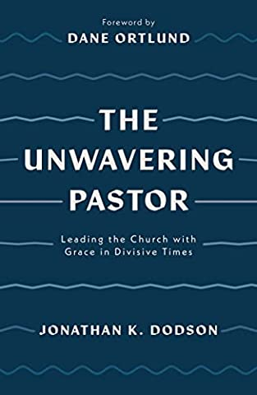
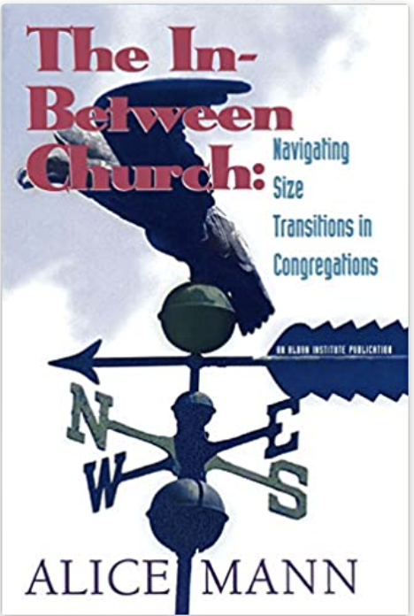


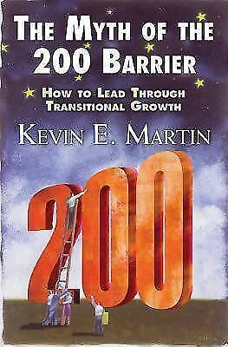
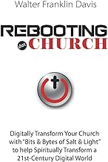


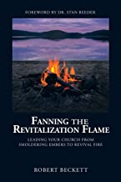
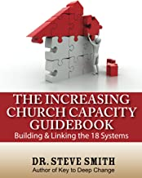
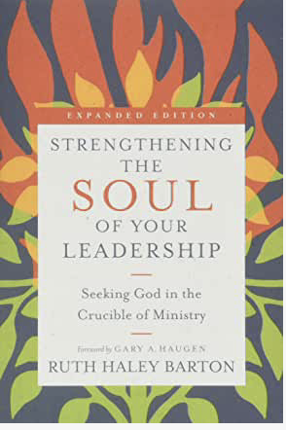


Slide 4
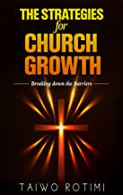
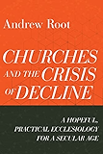
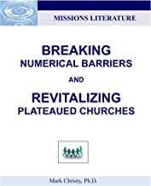
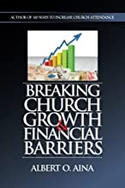
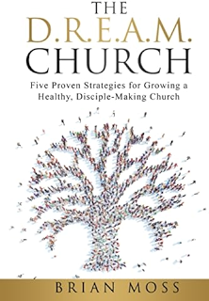
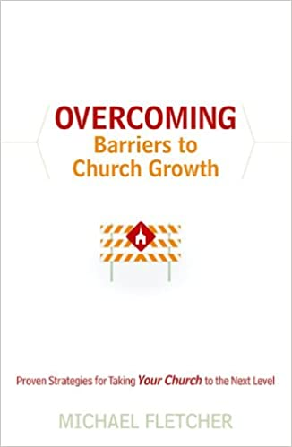

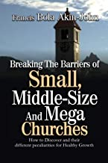
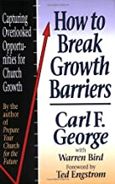
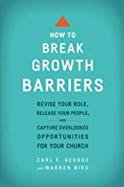

Slide 5

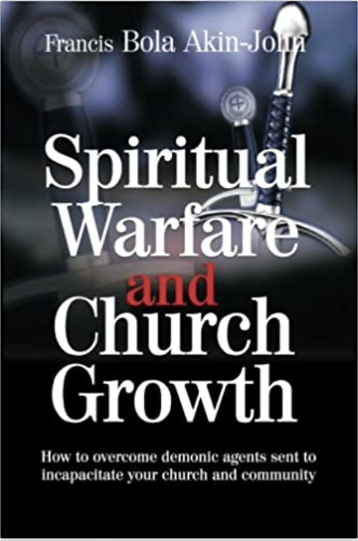
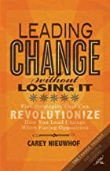


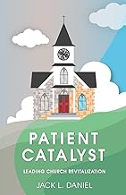
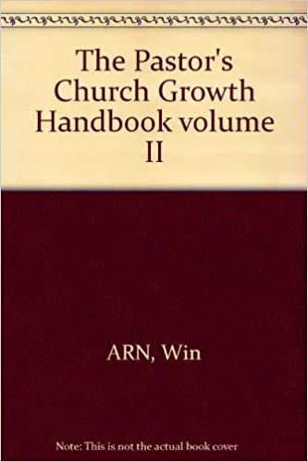

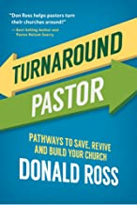


Slide 6
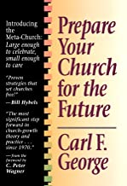
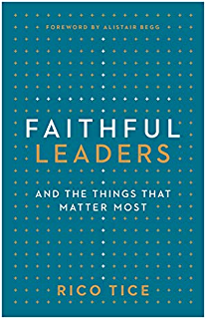
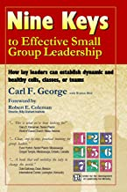

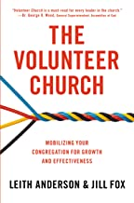
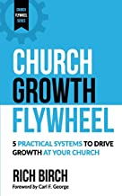

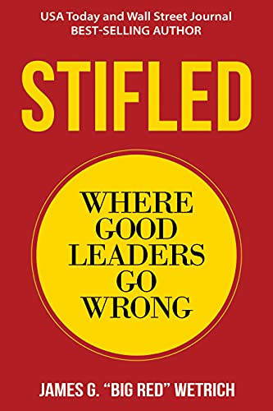
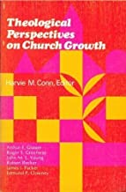
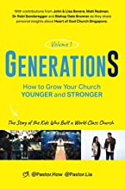

Slide 7
Revitalizing the 75 Participant Church: Principles & Practices
Abraham Lincoln said about the small churches in America, "God must love the small church. He made so many of them.”
One third of all the Protestant churches in the United States have from 35 to 100 persons in the Sunday morning worship service. Interestingly, there are many lay men who believe the church with 75 participants is nothing more than two churches of 35 participants combined. This is an over simplification of the issue as we shall see.
Notes:
Schaller, The Small Church Is Different, p. 15.

Slide 8
What is the size of U.S. churches?
The median church in the U.S. has 75 regular participants in worship on Sunday mornings, according to the National Congregations Study (NCS) http://www.soc.duke.edu/natcong/ .
Notice that researchers measured the median church size — the point at which half the churches are smaller and half the churches are larger — rather than the average (186 attenders reported by the USCLS survey http://www.uscongregations.org/charact-cong.htm ), which is larger due to the influence of very large churches. But while the United States has a large number of very small churches, most people attend larger churches.
The National Congregations Study estimated that the smaller churches draw only 11 percent of those who attend worship. Meanwhile, 50 percent of churchgoers attended the largest 10% of congregations (350 regular participants and up).

Slide 9
Want to know more?
Check the websites for the National Congregations Study (NCS) at http://www.soc.duke.edu/natcong/
The US Congregational Life Survey (USCLS) website has statistics about congregations by religious traditions at http://www.uscongregations.org/
The Faith Communities Today national study of churches www.faithcommunitiestoday.org 2010 study also contains size and other congregational findings.

Slide 10
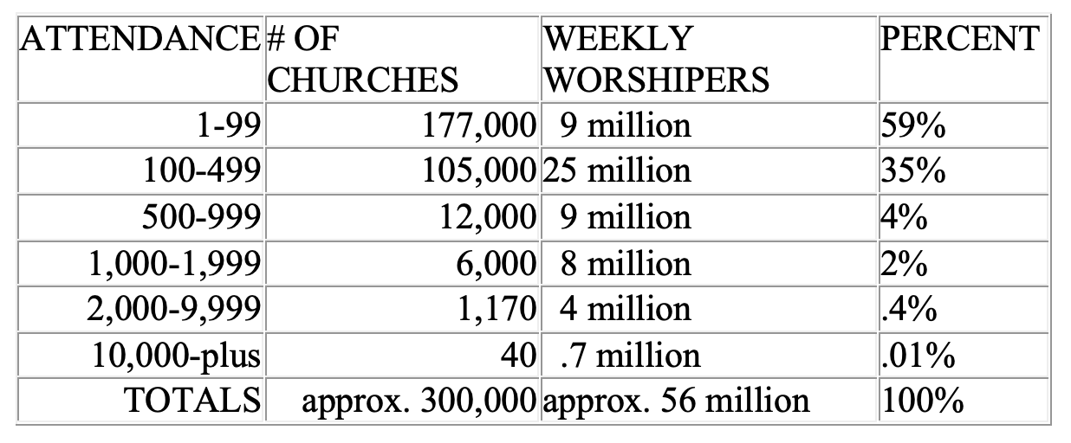
Approximate Distribution of U.S. Protestant and Other Christian Churches by size *based on NCS study (excluding Catholic/Orthodox)

Slide 11
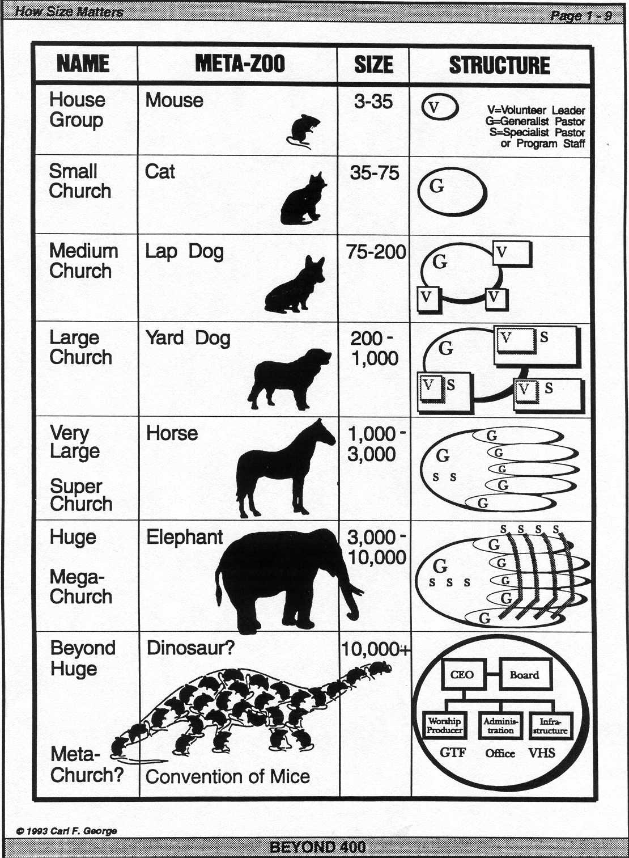

Slide 12
CHURCH SIZE : IS YOUR CHURCH A CAT OR A DOG?
In my initial years as a lead pastor, I would get excited when our church’s Sunday attendance would increase from an average of 75 to an average of 80 or 85 for a few weeks. Also I remember how discouraged I would become when it went back to its normal 75 as some of the prospects stopped attending and some of our regular members drifted into inactivity. You can imagine my confusion and frustration—it seemed 75 was our default number, and we just could not stretch past it. I desperately wanted to see our older, inwardly focused church reach out and be revitalized. I would wonder what was wrong with me as a pastor leader.

Slide 13
Thank You John!
John Maxwell helped me understand a profound truth. He said that a definition of insanity is: “doing the same thing over and over and expecting a different result.” At the time, I had never heard that saying. He helped me understand that if I wanted a different result, namely for my church to be renewed and grow, I would have to take a whole new approach to the work of ministry.
Andy Stanley puts it a bit differently; he says, “Every church is perfectly engineered to get the result it is getting.” My church was functioning exactly as the members had shaped it to function, and as they wanted it to function.

Slide 14
The Size Culture Today
The “size culture” of our church was what locked it in at 75 people. The very way we were “doing church” kept it small and ineffective. It was the strong relational bond among the existing members that effectively excluded newcomers and kept the church at the same size. My 75 member church was not going to become a healthy 200 member church simply because I prayed harder or worked harder. Clearly, we were going to have to do something new.

Slide 15
Revitalizing the 75 Participant Church: Principles & Practices
Kevin E. Martin’s book The Myth of The 200 Barrier helped me better understand how the size dynamics of a church can work for or against church revitalization. He proposes that there are essentially three different size churches:
The FAMILY size church, the most common, with an average Sunday attendance (Average Sunday Attendace) of 3 to 75 people
The PASTORAL size church, with an ASA of 76 to 140
The PROGRAM size church, which can further be divided into Small PROGRAM (ASA 200-400), Medium PROGRAM (ASA 400-600) and Large PROGRAM (ASA 600-900)
For practical purposes, Iwill this discussion to family and pastoral size churches since the vast majority of churches in America that are in need of revitalization fall into these two categories. These two church cultures are so different . . . well, they are different animals altogether.

Slide 16
Revitalizing the 75 Participant Church: Principles & Practices
CATS. A family size church (ASA up to 75) is like a pet cat: it is independent, and self-sufficient. A family size church can function without a settled pastor for months and even years because its identity is in relationships, traditions, and shared history, not in its pastor. The members bond to the church and to Christ through their church relationships, not through the pastor or program.
On the positive side, healthy family size churches have wonderful strengths. These include a deep sense of belonging, genuine care for one another, “all-hands-on-deck” member participation, and an ability to enfold a limited number of broken people. These churches highly value everyone knowing everyone else, people over program, financial solvency, faithful church attendance, cherished traditions, and maintaining church property. Healthy family size churches may be the purest form of Christian community. And they can frequently grow into larger churches because healthy organisms tend to grow. But, they must do something different to get there.

Slide 17
Revitalizing the 75 Participant Church: Principles & Practices
On the negative side, when family size churches are no longer healthy, they exhibit characteristics that make revitalization harder. First, small, ailing churches are often resistant to pastoral leadership because their pastors have typically had brief stays. They assume that the current pastor will be leaving soon and are reluctant to let him or her introduce changes, fearing they will be stuck with those changes when he or she leaves. Second, family size churches are often controlled by one or two families who resist yielding leadership to newcomers. This ensures that new people will not stay around long. Third, an unhealthy family church focuses on meeting the needs of the existing members, and the calendar and budget reflect this. There is no time, money, or energy left to fulfill the Great Commission in the wider community. And finally, since these churches function like extended families with everyone accepted “as is,” unskilled or poorly trained members are in leadership, and worship services and programs reflect a lack of quality, making them ineffective in reaching outsiders. Like a dysfunctional family, unhealthy family churches will often tolerate bad behavior on the part of some members, becoming even less appealing. In short, the close-knit family bond that holds them together and gives them their identity is what makes it difficult for them to attract and enfold outsiders.

Slide 18
Revitalizing the 75 Participant Church: Principles & Practices
However, if pastors can assure their people that they intend to stay and can patiently build trust by accepting the flock as they are, faithfully preaching the gospel, caring for their spiritual needs, and winning their support for a new approach to ministry, then unhealthy family churches can gain health and growth. It will take time; every good thing does. As one very effective family church pastor I know says, “Preach, Pray, Love, Stay.”

Slide 19
Revitalizing the 75 Participant Church: Principles & Practices
DOGS. If the family size church is like a pet cat, then a pastoral size church (ASA 76 to 140) is like a pet dog. Both the church and the dog are eager to spend time with their leader and are good at following commands, but unfortunately, both are very dependent on their master (pastor) for their care and feeding. The chief characteristic of a pastoral size church is that, unlike a family church, it is too big to lead itself. It must depend on pastoral leadership. In a pastoral size church, high value is placed on everyone knowing the pastor and having direct access to him or her. Also, the pastor is tasked with providing overall leadership and direction. Pastoral churches have a traditional understanding of the pastoral role and expect the pastor to be present at all functions and active in all visitation and care. Unlike family churches, pastoral churches become more anxious when they are without a pastor.

Slide 20
Revitalizing the 75 Participant Church: Principles & Practices
On the positive side, pastoral churches are able to support a full-time pastor and are more willing to follow the pastor’s lead, even in initiating change. They are big enough that they can allow newcomers to integrate somewhat easily, even into leadership. Further, they can often provide ministries to children and youth, making them more attractive to families who are seeking a healthy church.

Slide 21
Revitalizing the 75 Participant Church: Principles & Practices
On the negative side, a pastoral size church will rarely grow beyond ASA of 150 unless the pastor introduces a new style of leadership. This is because 150 is the approximate number of people that the average pastor can effectively relate to and lead. This number seems to be hard-wired into the psychosocial makeup of human beings. It is observable in other leadership-dependent social systems such as tribes, military units, and corporations.

Slide 22
Revitalizing the 75 Participant Church: Principles & Practices
In pastoral size churches, pastors are the gatekeepers, and people are drawn to the church through them because of their personality and friendship. People are also attracted because of their ministry skills, especially preaching. Individual members connect to the church because of and through the pastor. He or she is the glue that holds everyone together. Consequently, as the membership exceeds the pastor’s capacity to relate meaningfully to everyone, some members will start to disengage, feeling that the pastor does not have time for them anymore. A frequent complaint is that the pastor pays too much attention to newcomers. Furthermore, the pastor inadvertently becomes a bureaucratic bottleneck for the development of ministries. Because everyone defers to the pastor for leadership and approval, everything takes longer to happen.

Slide 23
Revitalizing the 75 Participant Church: Principles & Practices
What happens when a pastoral size church reaches its growth ceiling of around 150, and the pastor starts to hear complaints about spending too much time with newcomers (that is, not enough time with us)? The pastor’s natural tendency is to absorb the blame and devote more time to the old guard by visiting, counseling, and other pastoral care duties, which robs time from outreach to the wider community. This response pretty much guarantees that the church will plateau.

Slide 24
Revitalizing the 75 Participant Church: Principles & Practices
A better approach would be to teach the congregation that it is God who is “giving the increase,” that this is His blessing and an opportunity for everyone to discover, develop, and deploy their spiritual gifts. The pastor must shift from being a shepherd to the people and become a shepherd to the shepherds, those volunteers and paid leaders who are providing care to groups within the church. So instead of trying to be all things to all people, the pastor must focus on some people more than others, developing leaders and vesting them with authority so they can help shepherd the flock.

Slide 25
Revitalizing the 75 Participant Church: Principles & Practices
This is a very difficult shift to make, and the pastor-dependent flock will push back against it. In fact, some pastors will not be able to make this change because of their own co-dependency. They simply cannot bear the thought of not being the gatekeeper, all things to all people, and fully in control. However, if a pastor is persevering in teaching this truly biblical understanding of the pastor as the “equipper of the saints for the work of ministry” (Ephesians 4:12), a pastoral size church can be revitalized, become healthy, and grow.
Whether you serve a church that acts like a pet cat or a pet dog, God has called you to lead it to greater health.
Excerpted and adapted from Patient Catalyst: Leading Church Revitalization, by Jack L. Daniel, Overseed Press, 2018.

Slide 26
Formula for Developing Critical Mass
Everyone wants to see some sort of growth come back to their dying church. Many a church revitalization effort has been hurt due to the leadership within the church, both lay and clergy, waiting too long before they addressed the issue of critical mass. Critical Mass is that size of any church where it has enough members actively working and participating in the weekly work of ministry growth. When a church has waited too long to address the issue of critical mass, it is almost sure the church will die even if for a moment it keeps it head above the water of closure. Here is a quick formula for developing and keeping critical mass in ones church:
• 1 % of the church membership is in pastoral leadership
• Plus 6% of the church membership is passion- ate about the future of the church
• Plus 14% of the churches leaders are in positions willingly and are advocating for the future renewal of the church
• Plus 42% of the church are actively participating and willingly following future directions of the church
This simple formula equals a growing critical mass for growth and the eventual revitalization of the congregation.

Slide 27
Revitalizing the 75 Participant Church: Principles & Practices
Most definitions about the small church are misleading. This is due to an obscurity of the characteristics and growth dynamics in small churches.
In most main-line denominations, at least 60 percent of the congregations are included among the "small" churches.
One stunning report comes from James E. Lowrey as he describes the Churches of his particular denomination, "43 percent of the clergy are serving 18 percent of the people in 62 percent of the churches in a situation which is programmed for failure.”

Slide 28
Revitalizing the 75 Participant Church: Principles & Practices
Many feel that the 75 participant church is small enough for everyone to know everyone else, but big enough to offer a full-scale program. Some think this is the ideal size that our Heavenly Father planned for the New Testament church.

Slide 29
Revitalizing the 75 Participant Church: Principles & Practices
Carl S. Dudley, professor of church and community at McCormick Theological Seminary, in Chicago, Illinois, states that the break-even number would be around 175 participants in the Sunday School structure of the church.
He does give us one careful delineation, he says that in the Mennonite denomination a congregation of 75 would be considered quite large.

Slide 30
Revitalizing the 75 Participant Church: Principles & Practices
For most denominations a small 75 participant church, though it is tenacious, does not have the willingness to break the barriers needed for church revitalization growth.
Yes, they are vital to the American heartland. Yes, they by and large will not die. Yes, they do not experience great shifts in membership. But they do not have the willingness to take the actions needed to break the 75 barrier in church revitalization growth.

Slide 31
BREAKING THE 75 BARRICADE IN CHURCH REVITALIZATION!
This stage of church revitalization, church health and church advancement is the highest pressure point for pastors who are moving towards becoming full-time.

Slide 32
HOW IS THE SMALL CHURCH DEFINED
1. Number of members
2. Worship attendance
3. A comparison with past days when the congregation was much larger
4. The image projected by the pastor's definition of comparative church size
5. The size of the building
6. The size of the budget
7. A full workload for the minister
8. An individual's previous experiences in other congregations
9. The quality of caring relationships among the members
10. The size, number, and variety of fellowship circles or primary face-to-face groups which together constitute that congregation."

Slide 33
Revitalizing the 75 Participant Church: Principles & Practices
There are at least nine characteristics of the 75 participant church. Remember that the 35 participant church was single celled. It has a sense of family that is held on to.

Slide 34
One Thousand Small Churches Studied
In my research of 1000 small churches, there are at least nine characteristics of the 75 participant church.
The 35 participant church has also an Informal Environment. There is an atmosphere of Love and Caring that overflows these congregations.
A 35 participant church also allows for quicker involvement in the leadership structure. Volunteerism is the norm in a small church.
When you worship in a 35 participant church you are missed when you are not there. For this size church all finances are project oriented with very little money being wasted.

Slide 35
One Thousand Small Churches Studied
If you minister in a 35 participant church participation means more than performance.
The tenth characteristic of the 35 participant church is that is has limited entrance points.
Additionally, the church focuses on one event at a time and everyone's participation is needed to have it be successful. In this size church the pastor may not have a great impact.
Lay leaders are predominant and hold high influence in a 35 participant church.

Slide 36
One Thousand Small Churches Studied
In a church this size growth will be due to the small group involvement.
Lastly, those who participate in "New Work" conditions are attracted to reward of toughing it out.
So what makes a 75 participant church any different than a 35 participant church?
Let us see.

Slide 37
CHARACTERISITCS OF THE “75 PARTICIPANT” CHURCH
AGE
THE NEED FOR INTIMACY
THE PASTORAL STRUCTURE
THE DUTIES OF THE PASTOR
A STRUCTURAL SHIFT IN THE SUNDAY SCHOOL

Slide 38
CHARACTERISITCS OF THE “75 PARTICIPANT” CHURCH
THE STYLE OF WORSHIP SERVICE
CHURCH FELLOWSHIPS
AN EXTENDED LEADERSHIP GROUP
THE PROCESS OF DECISION MAKING

Slide 39
Revitalizing the 75 Participant Church: Principles & Practices
We have considered the characteristics of a 75 participant church.
Now let us begin to look at their strengths before we tackle these barriers toward growth.

Slide 40
THE STRENGTHS OF A 75 PARTICIPANT CHURCH
VISIBILITY
FACILITIES
LAY LEADERSHIP
GOOD COMMUNITY RELATIONS
PASTORAL LEADERSHIP

Slide 41
THE STRENGTHS OF A 75 PARTICIPANT CHURCH
GOOD BUT NOT GREAT FINANCIAL BASE
COOPERATIVE SPIRIT
ADEQUATE PARKING
ADEQUATE SPACE

Slide 42
THE STRENGTHS OF A 75 PARTICIPANT CHURCH
DISPLAYING TRUE LOVE
SIBLINGS JOINING
MEDIAN AGE
HARVEST FIELDS

Slide 43
Revitalizing the 75 Participant Church: Principles & Practices
While it may appear that the 75 participant church has a lot going for it, there are also obstacles to consider.
If these following obstacles are not faced or even dealt with, they will never be able to climb over the barrier of seventy five.

Slide 44
GROWTH OBSTACLES IN A 75 PARTICIPANT CHURCH
ACHIEVING ORGINIAL GOALS
PEAKING ATTENDANCE & MEMBERSHIP
THE GOOD OLE DAYS
STAGNANT POPULATION
COMMUNITY IN TRANSITION

Slide 45
GROWTH OBSTACLES IN A 75 PARTICIPANT CHURCH
NOT MAKING CORRECT TRANSITIONS
SENIOR INFLUENCE
BEFUDDLED BUILDING COMPLEX
NOT INVOLVING NEW MEMBERS
LACK OF PASTORAL DISCRETIONARY TIME

Slide 46
GROWTH OBSTACLES IN A 75 PARTICIPANT CHURCH
DECLINING ATTENDANCE
COMFORT
TURNING INWARD
These twelve obstacles are very real in the 75 participant church. You can find this type of church located anywhere in the United States. They are found in all denominations.

Slide 47
BREAKING THE 75
BARRIER IN CHURCH
GROWTH
SIX INTENTIONAL ACTION STEPS
If a local congregation desires growth beyond the 75 barrier, it will require at least six intentional actions.

Slide 48
SIX INTENTIONAL ACTION STEPS
A CHANGE IN THE PASTOR’S LEADERSHIP STYLE
Many church across this land remain small because that is all the pastor is competent to handle. There is an old adage: "We teach what we know, we reproduce what we are." Most pastors are comfortable leading about seventy five people.

Slide 49
SIX INTENTIONAL ACTION STEPS
A CHANGE IN LAY LEADERSHIP
If the 75 participant church really desires to grow, Laymen must realize that there is a high price to be paid for church growth. The core group has to make many a highly emotional adjustment. They will have to sacrifice some of the very things that make them a strong small church.

Slide 50
SIX INTENTIONAL ACTION STEPS
A CHANGE IN ORGANIZATIONAL STRUCTURE
When the church was small a simple structure within the organization worked well. But now that it is growing, structural expansion is needed.

Slide 51
SIX INTENTIONAL ACTION STEPS
A CHANGE IN THE NUMBER OF ENTRANCE POINTS
Additional entrance points are needed for meeting needs and attracting new members. Rapidly growing churches have at least eight entrance points and ministries that attract new members.

Slide 52
SIX INTENTIONAL ACTION STEPS
A CHANGE IN MINDSET
The 75 participant church must develop a mindset of growth. Church revitalization is a state of mind.

Slide 53
SIX INTENTIONAL ACTION STEPS
A CHANGE IN STRATEGY
Breaking the "75 barrier," requires the church to develop a Biblical growth strategy with necessary changes and intentional actions. That includes numerical, spiritual, and structural goals.

Slide 54
Remember: (Life Lesson)
Remember from “0-50”-ish, your people helped you grow to that level!
To get the next 50 people the pastor will have to get them!
Your people usually will not do it due to comfort restraints. As you get to 125 participants your people begin bringing people again!

Slide 55
Revitalizing the 75 Participant Church: Principles & Practices
The growth barrier of 75 can be broken! But if a church desires to break it they must learn church growth principles, learn the peculiarities of their church in regards to church growth and attain an understanding of the required actions for growth.

Slide 56
4 Ways to Break the Attendance Barrier
Ed Stetzer says: When it comes to church growth, some barriers or size plateaus prove to be difficult to overcome, churches feel stuck at a certain size. Many thinkers and strategists have written about these attendance barriers that burden today’s church.
For example, a lot of churches get stuck at 35 members. These kinds of churches are typically comprised of a family or two and some of their friends. Another barrier exists at 75 members. The church consists of a pastor, who may not be full time, and a congregation in which everybody knows each other. The 125-person barrier is one of the hardest for churches to break through because progress involves restructuring and thinking differently.
Even when churches do break through these barriers they often remain hindered because their thinking is still associated with their previous attendance level. A location suited for growth, effective outreach and a tremendous word-of-mouth campaign can help churches power through barriers without ever changing their thinking.
Eventually, though, stagnant thinking will catch up to the church. To continue their growth, churches must shift their thinking. There are four shifts that must take place to ensure continued growth past the traditional attendance barriers.

Slide 57
4 Ways to Break the Attendance Barrier
1. Pro-Growth Shift
First, church members and leadership must shift their mindset from anti-growth to pro-growth. I once received some pushback from an occasional attendee at our church. During an outreach emphasis, he asked why we were wasting our time emphasizing church growth. He said we were behaving like a business and that we should be happy with the people we already had.
Our church is unapologetically pro-growth for a very specific reason. It has nothing to do with salary, status or fame. We are pro-growth because there are people in our city without Christ. We believe we can reach more people than we are reaching currently. Growth is good because it means more people who are far from Christ will be brought near.
That doesn’t mean you idolize numerical growth as the complete picture of church success. It simply means you keep growth as a mindset—not as the only indicator of the success.

Slide 58
4 Ways to Break the Attendance Barrier
2. Relational Shift
The second key mindset shift must express itself in how church members relate to one another. In Transformational Church: Creating a New Scorecard for Congregations, Thom Rainer and I outline relational intentionality as one of seven elements common in churches that see the transformation of individuals, their congregation and their community. Many churches struggle to keep attendees because they fail to connect them in relationship with others.
Because proximity to other people does not automatically lead to community with other people, the shift must move people from sitting in rows to sitting in circles. Having a 30-second meet and greet on Sunday mornings will not help visitors connect, but helping them to make friends through small groups will. A small group environment provides opportunities for authentic community and connection to the church at large.

Slide 59
4 Ways to Break the Attendance Barrier
3. Staff Shift
In order to break attendance barriers, a church must experience a staff shift. It’s not necessarily that churches need to hire more staff members—though that could be the case—but rather they must help their staff undergo mindset shifts regarding the functions and purposes of their ministries. They must intentionally spend time with two specific groups of people—leaders and the lost.
Church staff members need to increasingly move into different roles. The pastors should be administrators, while the people serve as the ministers. Ephesians 4:11 says that pastors and teachers are to equip believers—the ordinary members of a church—for works of ministry and for the building up of the body of Christ.
The success of staff is not based on accomplishing tasks, but rather on meeting with, working with and providing leadership to lay leaders, who then carry out leadership in each ministry area. Church staff should shift from being shepherds who perform all the ministry tasks to being ranchers overseeing the shepherds in each ministry.

Slide 60
4 Ways to Break the Attendance Barrier
4. Ownership Shift
The fourth and final shift must take place in the lay leaders within the church. They must take responsibility for their respective ministries. They must own the goals, plans and strategies for implementing and improving their ministries.
This concept must spread to the church as a whole. Beyond merely those in a leadership position, every church member must see the church as his or her own. They should not think of it in terms of being the lead pastor’s church or the elders’ church. Every church member must take ownership and work toward the church’s growth and health.
Ultimately, both churches and church plants looking for revitalization must shift their mindsets. As members and leaders become pro-growth and seek to connect visitors and members in authentic relationships, transformation will occur. Then, as church staff works both to reach the lost and equip new leaders for ministry areas, staff and members will experience renewed ownership and responsibility for their roles within the body of Christ. Then the church can break any barrier they face.
Source: https://outreachmagazine.com/features/18394-break-the-attendance-barrier.html

Slide 61
Revitalizing the 75 Participant Church: Principles & Practices
By Dr. Tom Cheyney
Tom@RenovateConference.org
RenovateConference.org

