Slide 1

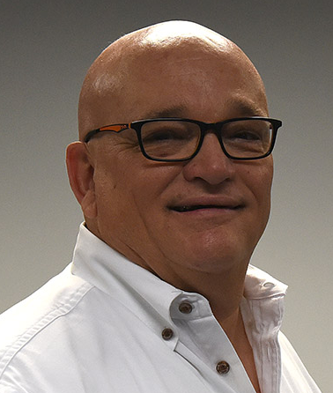
Revitalizing the 75 Participant Church: Principles & Practices
This three hour workshop is designed to help you reach your dreams for Church Revitalization and Renewal and grow past the 75 barrier. Nearly one third of all the Protestant churches in the United States have between 35 to 100 persons in the Sunday morning worship service. Interestingly, there are many lay leaders who believe the church with 75 participants is nothing more than two churches of 35 participants combined. This is an over simplification of the issue as we shall see.
By
Dr. Tom Cheyney
Founder & Directional Leader

Slide 2
Revitalizing the 75 Participant Church: Principles & Practices
What this 4 hour workshop includes:
Building Momentum for Church Revitalization And Renewal (Parts One & Two)
The Force of Momentum and Milestones
How the Church Revitalizer Should Make Decisions
The Church Skunking Which Stalls Momentum
Why You Must Accelerate Momentum in Church Renewal
The Muscle of Momentum
Things Which Cause Us to Loose Momentum in Renewal
Why You Must Build Your Church Revitalization Team
What Waiting Does to Hurt Renewal
Tradition the Deadly Killer of Momentum
The Percentage of Median Church in the United States
Is Your Church a Cat of a Dog?
Why You Are Getting the Results Your are Getting (Size Church Culture)
Why the Pastoral Size Church Stays at 75 Participants
The Formula for Developing Critical Mass
The Break Even Size for Sustainability (Full Time or Part Time)
The Characteristics of the 75 Participant Church
The Strengths of the 75 Participant Church
The Obstacles a 75 Participant Church Faces
Action Steps You Must Take to Move Past the 75 Barrier
The First & Second 50 Participants and the Differences
The Four Ways to Break Your Attendance Barrier

