Slide 1

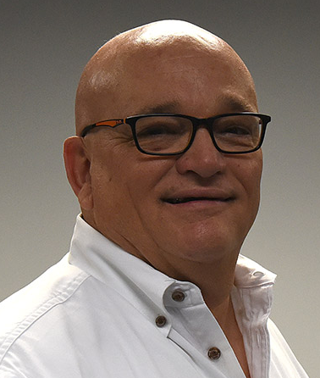
Revitalizing the 125 Participant Church: Where Pastors and Churches Go Wrong!
These Three Sessions, 4 1/2 Hour workshop is designed for the renewing church that is facing the move from a two cell church to becoming a multicell church. Most of the churches in North America are 125 or less and never understand where they went wrong and stopped growing. This workshop is designed to help you reach your dreams for Church Revitalization and Renewal and grow past the 125 barrier.
By
Dr. Tom Cheyney
Founder & Directional Leader

Slide 2
Revitalizing the 125 Participant Church: Where Pastors and Churches Go Wrong!
What this 4 1/2 hour workshop includes:
The Differences Between Heritage & Healthy Churches
Traits of Churches Remaining Small
The Tier Three Churches Necessary Changes to be Made
Actions Steps to Create Engagement
The 125 Participant Church Lifecycle
People Types in These Churches
Who Keeps the Small Church from Growing
The Common Stifling Effects that Create Ruts
Where Pastors and Churches Go Wrong
Four Barriers that Hinder Growth
Seven Ways Church Revitalizers Influence People
The Membership Functions that Keep the Church from Growing
Why Familiarity Breeds Contempt Towards Growth
The Satisfaction factor and Why It Works Against You
Can A Small Church Become Larger
The Strengths of a 125 Participant Church
The Obstacles the Leader Faces Towards Growth
The Issues the Leader Faces Towards Growth
Specific Actions to Turn It Around
Key Lessons for Revitalizing the 125 Participant Church

