Slide 1

Revitalizing the 125 Participant Church: Where Pastors and Churches Go Wrong!
(Part 1 of 3 Parts)
By
Dr. Tom Cheyney
Founder & Directional Leader
For Churches 125+

Slide 2
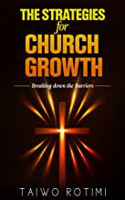
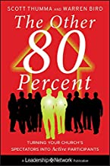
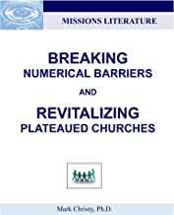
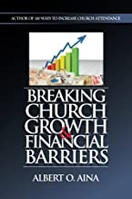
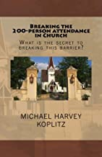
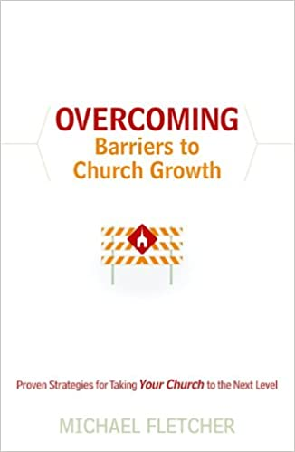

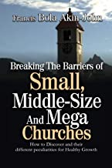
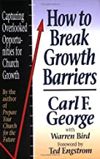
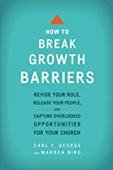

Slide 3

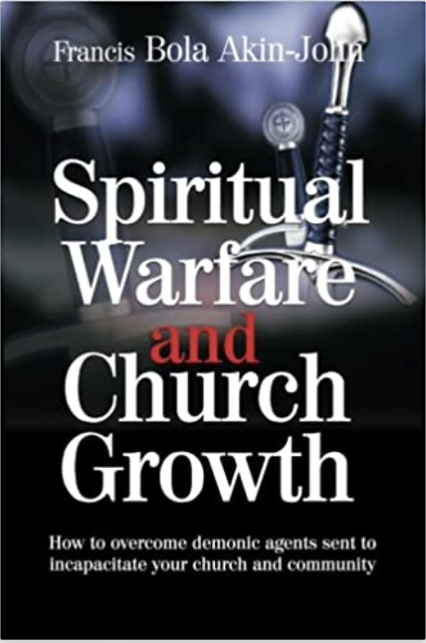
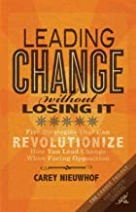
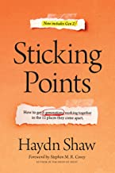

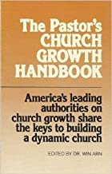
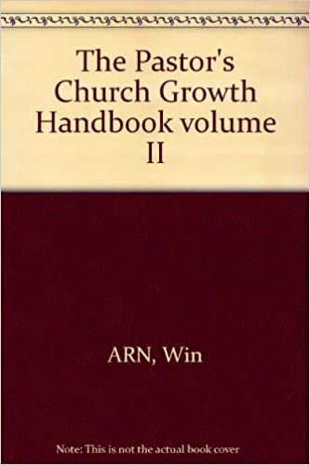
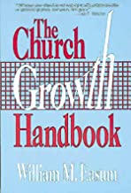



Slide 4
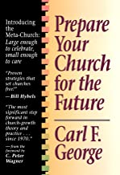

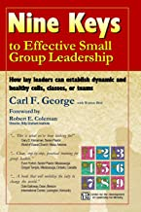

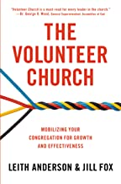
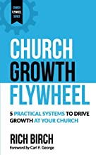

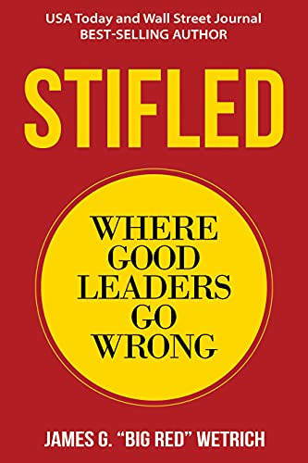
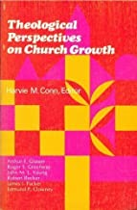
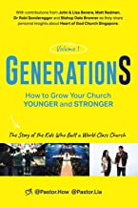

Slide 5
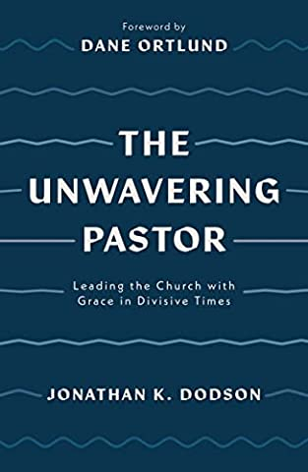
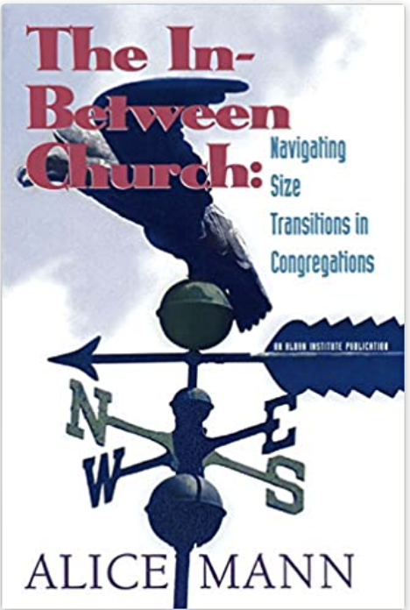






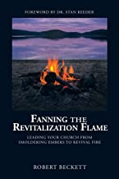
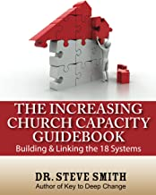



Slide 6
We will continue this in February as we begin a series on Revitalizing the 35, 75, 125, 200, 400, and 700 Participant Church!
35
75
200
125
700
400

Slide 7
(Jesus) “Do you think the work of harvesting will not begin until the summer ends four months from now? Look around you! Vast fields are ripening all around us and are ready now for the harvest. The harvesters are paid good wages, and the fruit they harvest is people brought to eternal life. What joy awaits both the planter and the harvester alike"
-- John 4:35-37.

Slide 8
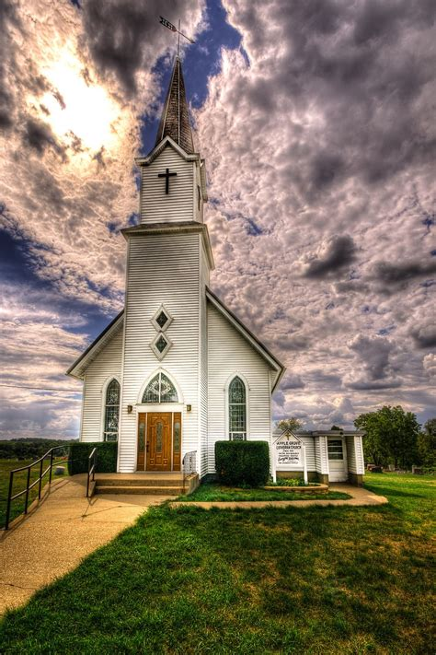
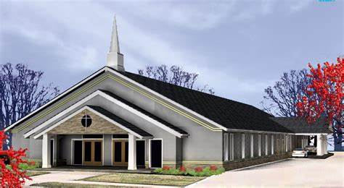
The Differences Between Heritage Churches & Healthy Churches

Slide 9
The Differences Between Heritage Churches & Healthy Churches
Heritage Churches
Maintain the institution
Make long-term commitment to the church
Manage committees/hold offices
Make decisions
Emphasize membership training

Slide 10
The Differences Between Heritage Churches & Healthy Churches
Heritage Churches
Emphasize raising money
Talk about church work
Discuss internal needs
Emphasize loyalty to the institution
Have information-oriented faith
Are concerned with perpetuating a heritage

Slide 11
The Differences Between Heritage Churches & Healthy Churches
Healthy Churches
Transform Lives
Have newfound commitment to Jesus Christ
Deploy members into missions/ministry
Make disciples
Emphasize lifetime learning/growing in grace

Slide 12
The Differences Between Heritage Churches & Healthy Churches
Healthy Churches
Emphasize raising people
Talk about fulfillment, mission, and ministry
Discuss unchurched community needs
Emphasize loyalty to the unchurched
Have experience-oriented faith
Are concerned with looking toward the future and building the Kingdom

Slide 13
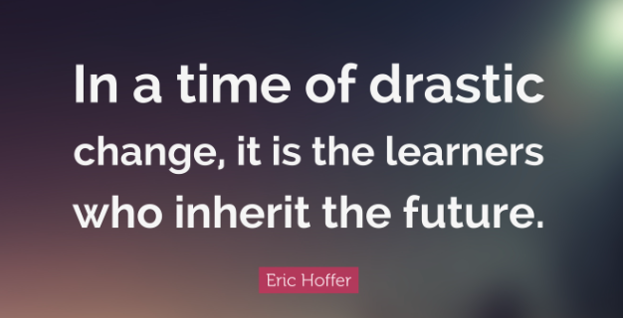
Revitalizing the 125 Participant Church
When your church reaches the point where it is approaching 125 regular participants, there are some drastic changes that will begin to take place. How they are confronted will depend to a great extent on the church being able to break through this numerical barrier. Carl S. Dudley has said, "In a big world, the small church has remained intimate. In a fast world, the small church has been steady. In an expensive world, the small church has remained plain. In a complex world, the small church has remained simple. In a rational world, the small church has kept feeling. In a mobile world, the small church has been an anchor. In an anonymous world, the small church calls us by name". That is a wonderful trait of a small church, but realistically it is also one of the reasons it stays small! It is astounding to realize that 90 percent of all churches today are not growing, and that churches with 101-200 total members 50 percent of them have plateaued. Another 19 percent have declined, leaving only 31 percent of these churches that are growing.
Dudley, Front Cover. "Facts and Trends," September, 1985; SBC Sunday School Board.

Slide 14
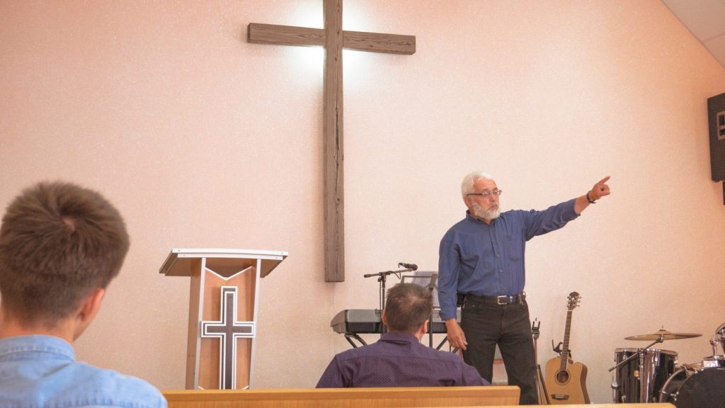
The 125 Participant Churches are often referred to as Tier #3 Churches!
These are those who have 76 to 125 participants @ Worship
Here are some early changes that must be made:
75 Barrier broken finally!
Pastors role shifts
Nearing 150 pastor must begin delegating heavily
Pastor now helps people arrive at consensus.

Slide 15
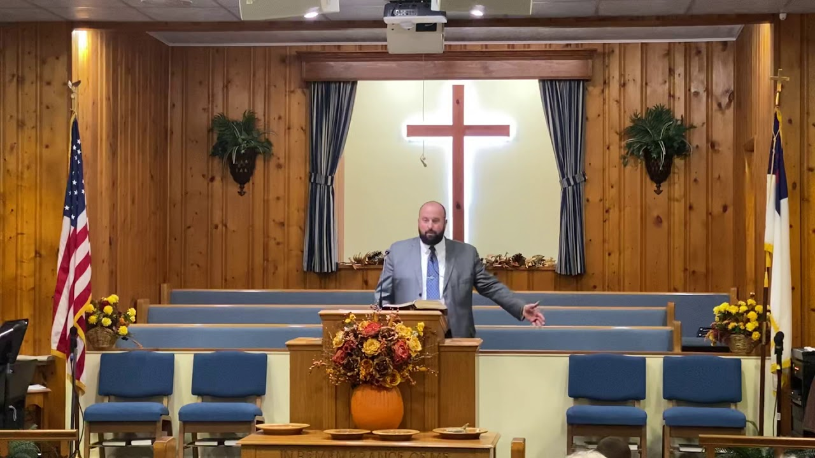
The 125 Participant Churches are often referred to as Tier #3 Churches!
These are those who have 76 to 125 participants @ Worship
Pastor is motivator and trust builder.
Multiple staff begins
Deacons act as board of directors.
Careful intentional care of visitors
Members and prospects kept track of

Slide 16
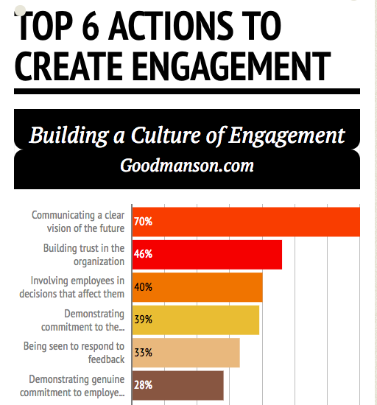
Revitalizing the 125 Participant Church

Slide 17
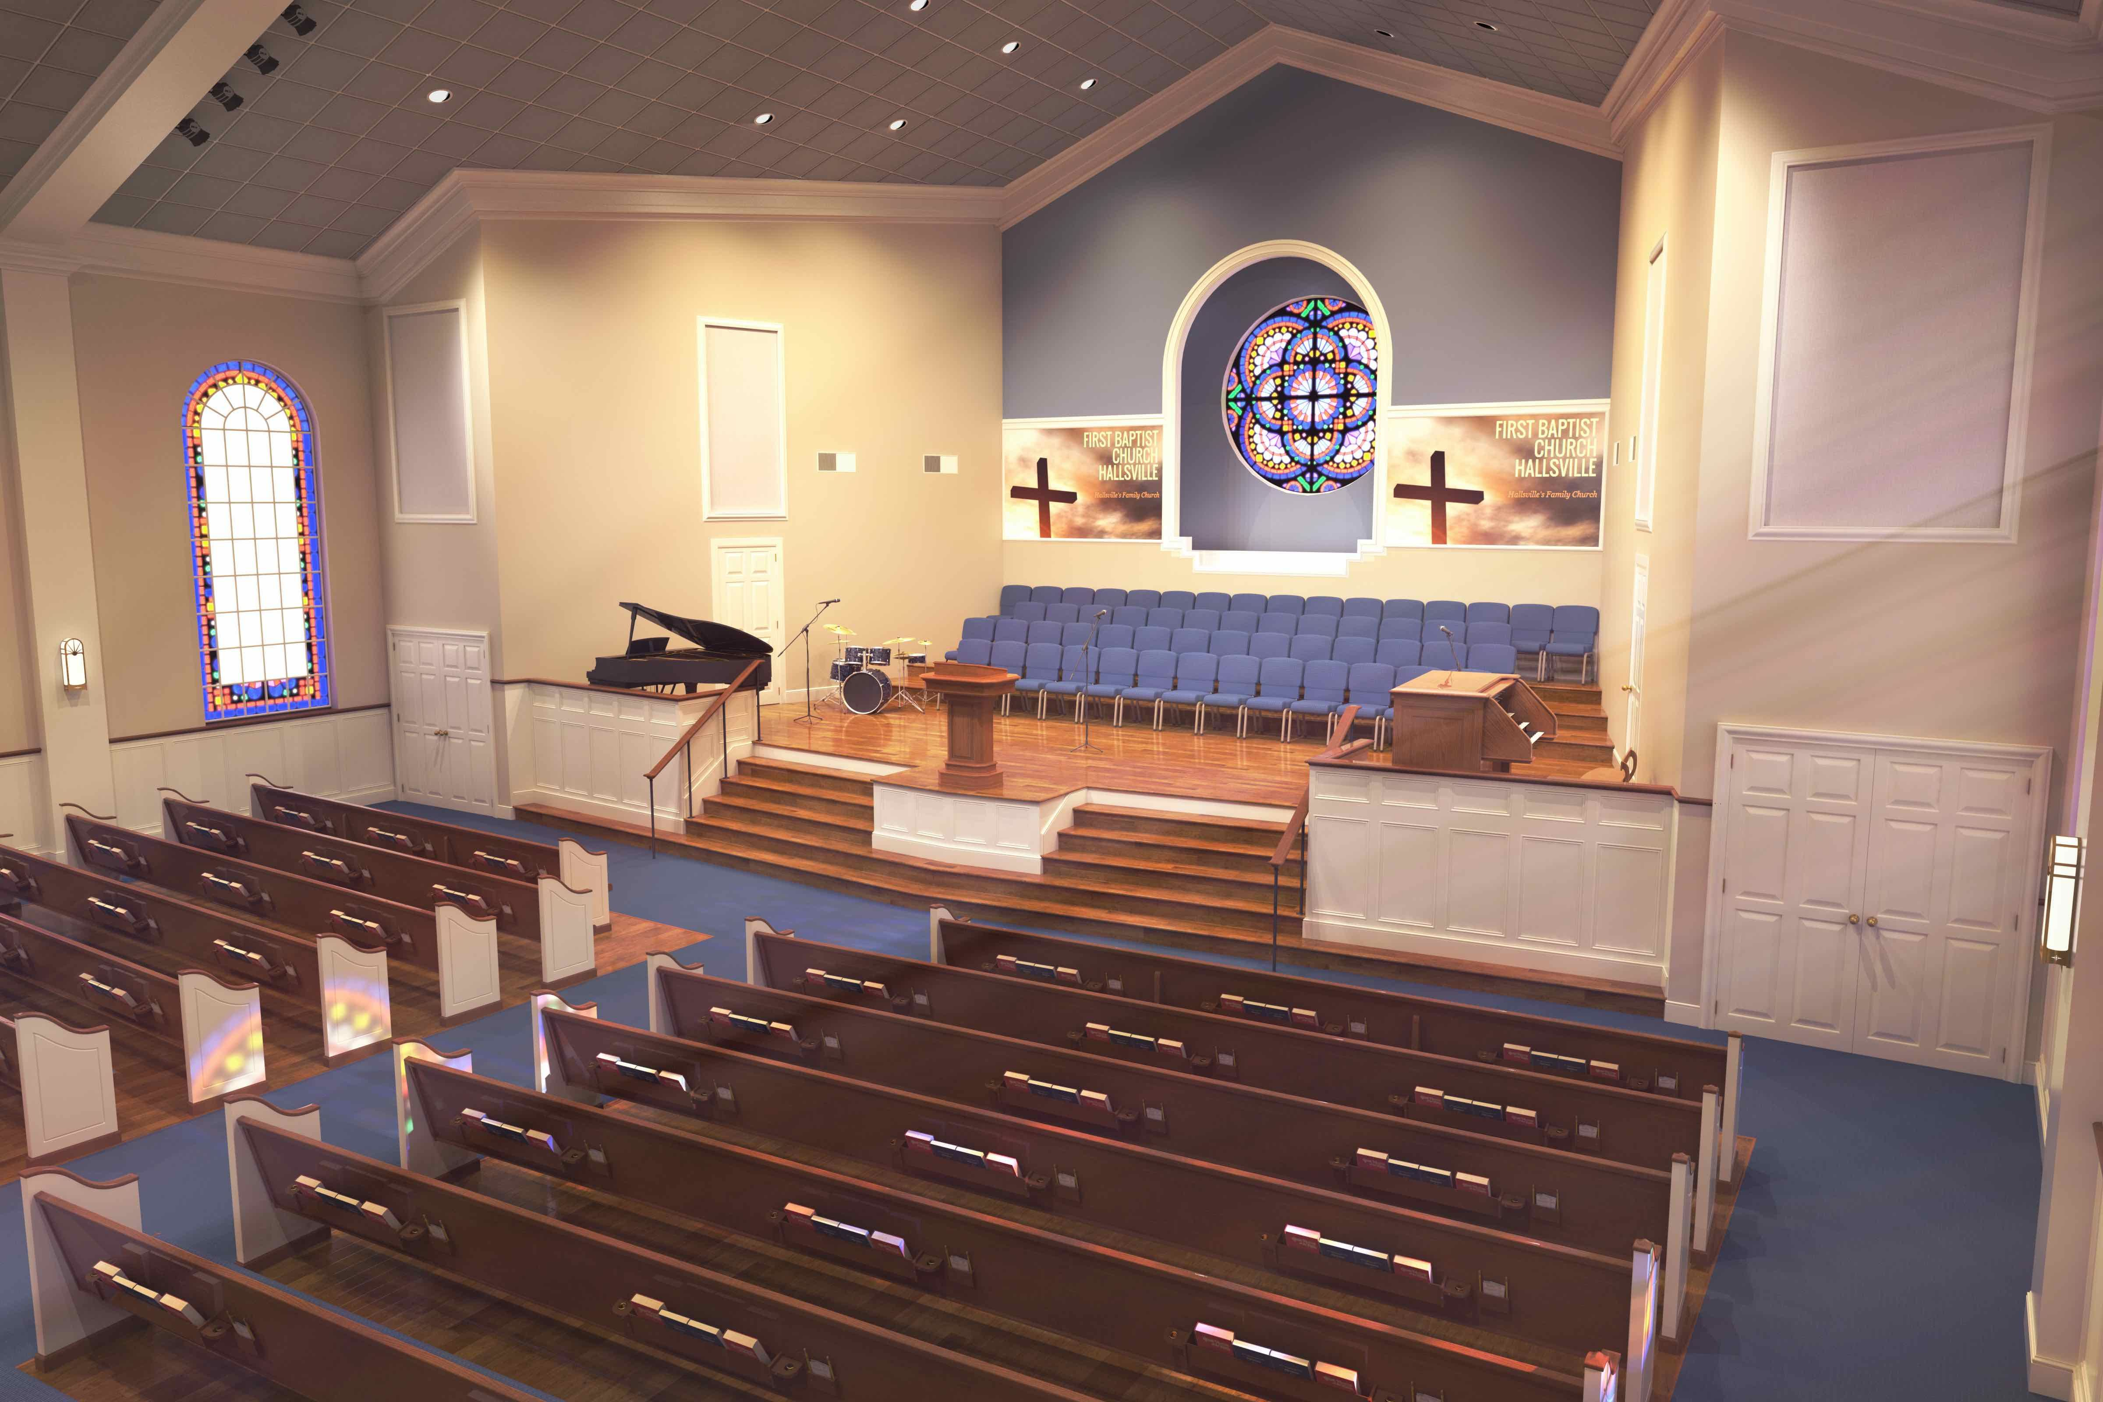
Revitalizing the 125 Participant Church
Leading church analysts such as Lyle Schaller, George Barna, and Mike Regele stress the alarming truth that over 80% of American Protestant churches are in plateau and decline. The church in America has lost its ability to reach its transitioning communities for Christ, turning ever inward in the service of itself as it abandons its zeal for evangelism. The time is now for the cycle of plateau and decline to be broken.

Slide 18
The 3 Phases of the 125 Participant Church Lifecycle
1. Incline: Future oriented, vision driven, community focused, $ is seen as an investor in the future, conversion is the goal.
2. Recline (plateau): Present oriented (wish they could ‘freeze time’), program driven, congregation focused, $ is a provider for the cost of programs, growth is from transfer as people seek better programs.
3. Decline: Past oriented, structure driven (“it’s the way we’ve always done things), core group focused (a subset of the congregation that are the old-timers from the good old days), $ is to be preserved to survive.)
Recommended Reading: Historical Drift: Must My Church Die? by Arnold Cook

Slide 19

Revitalizing the 125 Participant Church
There are four types of people in every church:
1. Theorists
2. Realists
3. Pragmatists
4. Preservationists
The Big Lifters in a Church

Slide 20
The “Why” of Churches Staying Small
Wanting to stay small, they reject new ideas and freeze out new visitors.
A quick turnover of preachers not taking the time to become their pastor.
Domination by a few strong members who want to be the church boss.
Not trusting the leaders to lead the church daily.
An Inferiority complex which keeps them from achieving greatness.
They have small plans or no plan at all.
Bad health in that they are sitters not doers.
Lousy fellowship with perpetual ignoring & resenting of new members.
A state of neglect permeates the church (building issues).

Slide 21
Changing Up the Vison of the 125 Participant Church
The church initially needs to identify community need and reach out to the community around them. This can be both outward ministry and changing the way ministry functions (worship styles, etc.).
To begin change you build a team of theorists who identify a vision and begin to execute. As progress is made, the realists are brought in and begin to see the vision. After change starts to show results, the pragmatists jump on board. Often as this vision is cast and executed, people from outside the church catch the vision and join in.

Slide 22
So how can a small church grow into a big church?
This question lies at the center of the small church problem. The answer is found in three apparent contradictions, yet for most small churches, the same four answers should be given regardless of their apparent discrepancies. This small church has grown. This small church can't grow. This church could give up its smallness and change into a larger congregation.

Slide 23

Fifteen Common Barriers in the
125 Participant Church
Remember, we should not ask, “What will make our church grow?” Rather, we should ask, “What is keeping our church from growing.” God brings growth automatically when living things are healthy. He just waits on us to remove the barriers. The task of leadership is to find the barriers and then remove them.
1. Members don’t bring friends to church. You can’t grow until you have visitors. But members think that visitors looking for us will find us through other means. Members are instinctively embarrassed that the services are not designed for their seeking friends. They feel that the church is designed to meet their needs but not their neighbor’s needs; so they don’t bring them. We must design something that the members can’t wait to bring their friends to. Evaluate every Sunday service on a weekly basis – viewing it through the eyes of a visitor.

Slide 24
Fifteen Common Barriers in the
125 Participant Church
2. People fear that growth will ruin their fellowship; they won’t know everyone. If that’s the case, we will never grow beyond 200 because after that, it’s impossible to know everyone. Since the average person knows 67 people, then it is imperative to get them involved in a ministry with others of like calling and get them involved in a small group. Churches that grow must first decide to grow – it really begins with desire. Get committed to growth.
3. Being driven by tradition. Traditions are not necessarily bad; we make things repetitive because they work. We don’t automatically throw it out because it’s not new, we just don’t automatically accept it either. It’s dangerous when we make methods sacred. It’s also dangerous when we forget WHY we do things. When the horse is dead, dismount. Let dead programs die. Life support systems are very expensive. Business as usual is just not working. We’re getting behind and must change. There are more live births each year than spiritual births. We’re losing ground on the Great Commission. We must not be afraid of change! Moses lost his right to lead when he refused to change. The first time his people needed water in the wilderness, God said to strike the rock. But the next time they needed water, God changed and said to only speak to the rock. Moses couldn’t flow with the change, and lost out. He said, “We’ve never done it that way before.” Confronting the barrier of traditionalism was Jesus’ greatest challenge. We must always ask, “Is this fulfilling its purpose?” Once a year, review each program and do one of three things: re-affirm, refine, or replace. The hardest thing to change is what’s working. But if we want more maximized results, we have to change it before it stops working. (Like pruning rose bushes; pruning takes place before all the roses have died.) We cannot use yesterday’s tools in today’s ministry to meet tomorrow’s challenge.

Slide 25
Fifteen Common Barriers in the
125 Participant Church
4. Trying to appeal to everybody. We must define our target, then accept the fact that not everyone in the community will connect to our church. McDonald’s knows they won’t appeal to those wanting Chinese food.
5. Being program-oriented rather than process-oriented. We have a growth process much like a tree – getting people rooted in their faith, developing the disciplines for spiritual maturity, and discovering their purpose for fruit productivity. Programs become outdated, expensive to run, ineffective, exhausting to volunteers, and unfamiliar to guests.
6. Emphasizing meetings rather than ministry. You know that you are askew when your #1 measurement for health is attendance – counting noses instead of the lives being transformed. Meeting-orientation makes people passive spectators and leaves no time for ministry. We don’t need more meetings; we have to meet more needs.

Slide 26
Fifteen Common Barriers in the
125 Participant Church
7. Teaching without application. Preaching that merely informs but does not transform will stifle a church. The antidote is behavioral preaching – preaching that focuses on obedience. Be doers, not just hearers only. Acts 2 gave us the perfect outline: At the beginning, people said, “What does this mean?” and at the end, the people said, “What must we do?”
8. People don’t trust their leaders. Build credibility and earn the right to lead. Gather honest advisors around you because there is wisdom in a multitude of counselors.

Slide 27
Fifteen Common Barriers in the
125 Participant Church
9.Legalism. Many churches are more interested in keeping rules than winning people to Christ. We must build a climate of acceptance. Start where people are and engage them on their slow journey of faith.
10. Structured for control rather than for growth. Too many churches are over-structured. Keep the structure simple. Empower others to make decisions regarding their area of ministry. The pastor must deliberately change his role from being the sole source of ministry to releasing others to minister and make decisions; otherwise, he becomes the bottleneck. There is a limit to how many people can be shepherded by one individual.
11. One Service. By starting multiple services, even before another one is really needed, we give more people opportunities to connect and get involved. It’s like putting more hooks in the water. Secret: Only pastors really like large church services!

Slide 28
Fifteen Common Barriers in the
125 Participant Church
12. Small Staff. Good staff members pay for themselves. If we wait until we can afford them, we might wait a long time. If they join us, those additional folks with whom they connect will support them with their giving. Always be prepared to hire another staff member to take you to the next attendance level. Continue to acquire those who can specialize in one particular area very well – worship, children, hospitality, administration, etc.
13. Failure to Capitalize on Big Days. We must deliberately break attendance barriers on days when it is more likely others will come. Plan a big event on a special day and the numbers will go up. Perhaps the numbers will go back down afterwards, but not to the place prior to the event. Big holidays are an obvious time to concentrate on events.

Slide 29
Fifteen Common Barriers in the
125 Participant Church
14. No small groups. People with real needs tend to fall between the cracks and drift away from church when the source of care is centralized around the pastor’s office. Failure to feel cared for is a common complaint among churches that do not encourage small group participation. By intentionally training new leaders and encouraging everyone’s participation, creating a climate of cell multiplication, the body will become self-responsive – people ministering to one another’s needs out of relationship rather than being assigned by the church office.
15. Remaining within the same facility. Project what your needs would be if God allowed you to reach the next level of attendance, then plan for it and move that direction. An over-crowded, or even a comfortably full, facility will plateau a church. But be sure the facility is multi-purpose.

Slide 30
Where Pastors and Churches Go Wrong!
Many churches and pastors once they reach the 125 participant level become stifled and slowly decline into a rut of non-advancement. This is due largely to the rate of change taking place in growing churches and for the declining church the pace is challenging because of sedimentary lifestyle has set in at the church. Pastors who are leading a stifled church must become incredible inspirers, recruiters of volunteers, and display a willingness to engage members to become participants of the ministry. Pastors who cannot get out of the way is one reason that churches never break the 125 participant level. Successful Church Revitalizer’s recognize a members potential to lead, but great ones help develop that individuals potential to lead.

Slide 31
Where Pastors and Churches Go Wrong!
Climbing over the 125 participant level in a church necessitates that Church Revitalizer’s understand that leading a church over the 125 level and towards the 200 level requires ones leadership and administration of the church to be morphed, intensified, and multiplied. That only can be accomplished by adding more volunteers and leaders of teams. These churches must embrace the millennials and zoomer’s while ramping up the rate of change happening in the church. This rate is why many churches never can grow past the 125 participant level.

Slide 32
Where Pastors and Churches Go Wrong!
Pastors often begin to coast at the 125 participant level because they have not learned how to keep going without getting all tensed up. They arrive and then rest which is not helpful to the breaking of any barrier. What happens next is that they begin to hide or pass off their mistakes. Failure to learn from our failures and admit them can cripple a church in renewal. Mistakes happen and should not be viewed as a punishable offense. One of the thongs that often surprises me is when a church reaches this level, there begin to be created and put into place a series of bureaucracies which lock them to right where they are. A few examples are: hypocritical leadership, negativity in lay leadership, and stifling bureaucracies that keep the church from moving forward.

Slide 33
Where Pastors and Churches Go Wrong!
I worked for a strong servant leader who knew how to get the best out of his team. He lived servant leadership and practiced it daily. All of us trusted him in leading us towards the goal and with our ministry careers. The next guy came in as the leader and was very judgmental towards everyone who was there before him. Because he was not a servant, conflict often arose as most of the talent left the organization. One leader inspired trust while the second one was looking for a bunch of people who helped make him look good notadvance the organization. One could admit his mistakes and get back in the game. The other will probably never admit he has made a mistake. I know that the tiniest of mistakes usually have the most significant consequences. They often trip us up.

Slide 34
Where Pastors and Churches Go Wrong!
Here is where these churches usually go wrong and lock themselves in as a church with less than 125 participants:
They are unclear in their direction towards growth and wing it.
Their strategy and values adapt more towards remaining the same as compared to growth.
Conflict arises as to weather the church remains small of grows.
The staff and laity do not seek to work as a team.
The membership is not committed to the new direction and changes required to grow pass 125 participants.
Their behavior as a church acts like a small church with no vision for growth.
There is a lack of coordination with various ministries because everyone is doing their own thing.

Slide 35
Where Pastors and Churches Go Wrong!
Here is where these churches usually go wrong and lock themselves in as a church with less than 125 participants:
The leadership grossly overestimate their individual abilities as they lead out as a solo leader not a leader of the team.
The tiniest things and details of a ministry plan fen will trip us up if we are not willing to give attention to the whole strategy plan.
When there is poor leadership exemplified in routine lying, going back on ones word, and poor stewardship of the churches resources, the consequences can become fatal.
Understand that most members do not see divisions in the leadership, they see the church as a whole. Staffs actions have consequences beyond each staff members sphere of influence.
Most volunteers quit because they have a bad leader directly over them.

Slide 36
Where Pastors and Churches Go Wrong!
Most plateaued churches perform what has been labeled a postmortem, which is fittingly titled because a postmortem is the examination of a dead congregation.
The majority of pastors take feedback as a personal criticism. They do not like it at all. They mistakenly think if they don’t get it right the first time they are marked as a failing leader. Not true.

Slide 37
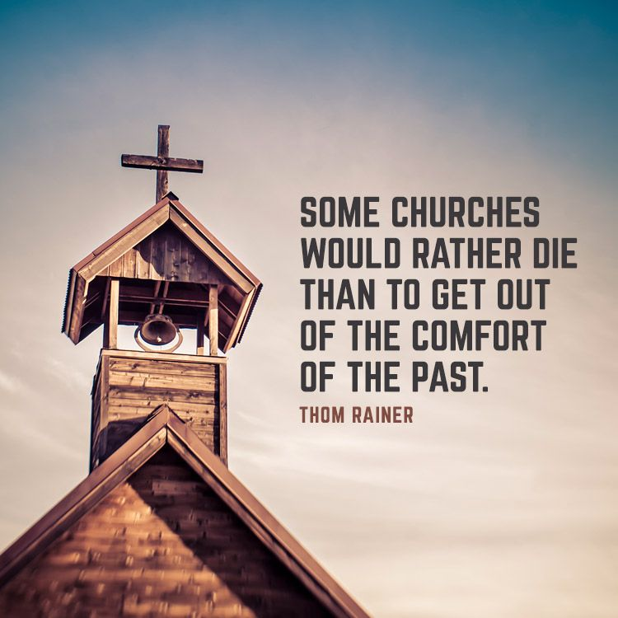
Where Pastors and Churches Go Wrong!
Here are some pastoral leadership competencies that help you be an effective leader:
Flexible and Adaptable
Agreeable
Culturally sensitive
Inquisitive
Open to new Experiences
Optimistic
Resilience
Tenacity
Integrity & Character

Slide 38

Where Pastors and Churches Go Wrong!
Trust is the foundation for a successful church of any size, and trust is difficult to build and too easy to lose.

Slide 39
Where Pastors and Churches Go Wrong!
The difference between the actively engaged and those not engaged within a church:
  Usually around fifteen percent of any declining church are actively disengaged.
  In these churches fifty-four percent are not engaged at all.
Those engaged are highly involved, enthusiastic about the mission, and committed to the ministry in which they are apart. An actively disengaged member is often miserable and spreads their misery around the church. They are skunkers. These members are the congregations cancer carriers. They fester churchwide cancer. In these churches often well over half are not engaged. They are unattached, contribute minimum effort and are looking for a better church to infect. Their misery loves company and seeks to damage the church.

Slide 40
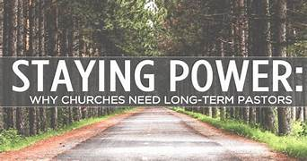
Where Pastors and Churches Go Wrong!
The difference between the actively engaged and those not engaged within a church:
A church ember which is satisfied and engaged are the empowers within the church. They inspire others.

Slide 41
Where Pastors and Churches Go Wrong!
When a 125 participant church looses its growth mindset:
It can be easy to loose one’s growth mindset at 125 participants because some think it is big enough.
Many do not want to make changes.
Leaders must practice the power of belief that the church can still grow.
A growth mindset face the challenges head on.
They are seen as opportunities not threats.
A churches peer pressure has little significance upon them.
They are goals oriented. They persevere.
They work hard and engage new experiences.

Slide 42
Where Pastors and Churches Go Wrong!
Church Bureaucracy
Churches which become bureaucratic have essentially stated that they are all about making the possible become impossible.
An example of such is when a church with excessive bureaucracy focuses more on the rules and structure rather than embrace something new which could lead to growth.
At 125 participants in a church it is easy to begin to put into place a new employees dedicated to bureaucracy management. That stifles the churches chance for growth.
Churches reaching past the 125 participant barrier must change the many rules and regulations that have come into being in the church.
There are people in the church which use bureaucracy as a means to slow growth down and keep it from advancing.

Slide 43
Where Pastors and Churches Go Wrong!
What the pandemic has taught us is that all our churches have changed. While for some it was a devastating experience, for others who were open to change, it was an opportunity to see the new things and good things it brought. We learned how to be mobile. We learned how to become an online church. We became churches with a leaner staff and overhead. Laity have taken on new opportunities and began new ministries. I know some churches have closed or will close in the near future because they are unable to embrace the new realities. That is painful to me even though I have tried to get them to understand. Do not let go of the good which has come from the horrible challenges of the pandemic. Keep pressing on.

Slide 44
Revitalizing the 125 Participant Church: Where Pastors and Churches Go Wrong!
(Part 2 of 3 Parts)
By
Dr. Tom Cheyney
Founder & Directional Leader
For Churches 125+

Slide 45
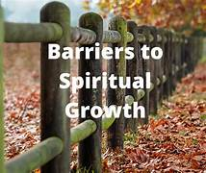
Four Barriers that Hinder Growth

Slide 46
Four Barriers that Hinder Growth
Internal Barriers –
Stained Glass Barriers –
Cultural & Class Barriers –
Language Barriers -

Slide 47
1. The Necessity of the Cross Cultural Evangelistic Church
E-O INTERNAL BARRIER
Overcoming the barriers of those unsaved in the church, i.e., spiritual blindness, hardness to the Gospel, ignorance of the Gospel, etc.

Slide 48
E-1 STAIN GLASS BARRIER
Overcoming the barriers of people in the church’s neighborhood, i.e., poor location, comfort in the building, cleanliness, type of building, wrong type of denomination, etc.

Slide 49
E-2 CULTURAL AND CLASS BARRIER
Witnessing to people of a different ethnic, race, or socio-economic background.
E-3 LINGUISTIC BARRIER
Witnessing to people who speak a different dialect or language.

Slide 50
2. Focus on Receptive Groups
“Reach the Reachable
Win the Winnable
Train the Trainable
Use the Usable”
- Elmer Towns

Slide 51
3. Types of Church Growth
a. Internal growth (spiritual factors of growth in grace, the Word, conformity to Christ, attitude, etc.).
b. External growth (Natural factors of growth in attendance, offering, membership, baptisms, enrollment, numerical growth, etc.)
c. Transfer growth.

Slide 52
d. Biological growth.
e. Conversion growth.
f. Extension growth (beginning another similar type church in a similar type neighborhood).
g. Expansion growth or bridge growth (beginning another church in a different culture, i.e. cross-cultural evangelism).

Slide 53
4. The Homogeneous Principle
(People Movement)
Everyone knows everyone, everyone relates to everyone, and everyone waits on everyone before anyone will do anything.

Slide 54

Seven Ways Leaders
Influence People
For Churches 125+

Slide 55

Ministry leadership is about influence, which can be positive or negative. Here are seven ways ministry leaders influence people.

Slide 56

Seven Ways Pastors Influence Laity
Negative Influence #1
  Coercion. This is the gun in your face style of pastoral tyrant. While this forceful method can achieve short term results, it produces a long term drop in morale and high turnover.

Slide 57

Seven Ways Pastors Influence Laity
Negative Influence #2
  Intimidation. “You will do this or you are out of here!” This is a trademark of the pastor dictator. Only weak and insecure people will tolerate this style of pastoral leadership. Eventually there will be no respect for the pastor leader and the laity become resentful.

Slide 58

Seven Ways Pastors Influence Laity
Negative Influence #3
  Manipulation. This is the one-sided style of the pastor controller. The pastor/leader wins and everyone else loses. The net result: distrust and suspicion rise.

Slide 59

Seven Ways Pastors Influence Laity
Neutral Influence #1
  Negotiation. “Give and take” is probably the most common form of influence in churched America.

Slide 60
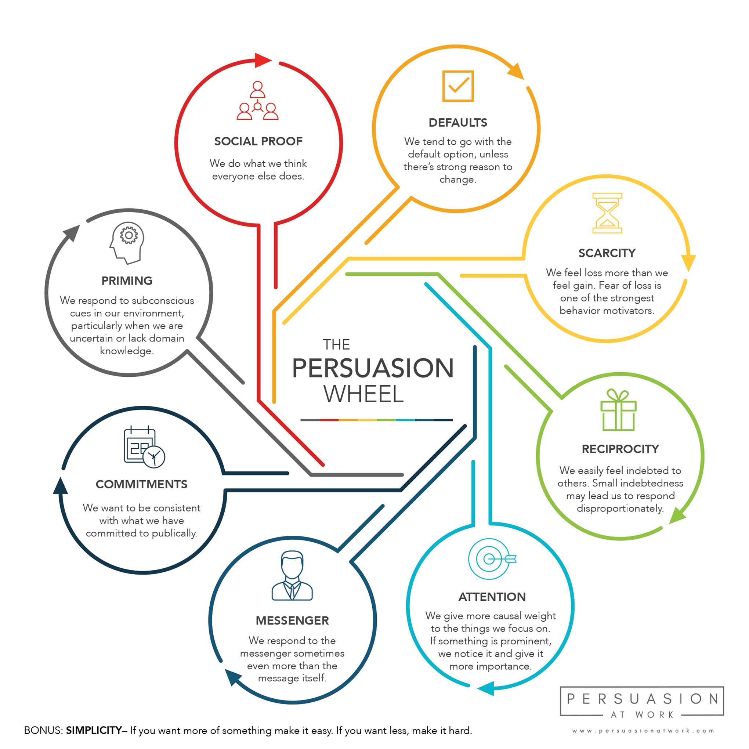
Seven Ways Pastors Influence Laity
Positive Influence #1
  Persuasion. The gifted speaker knows how to stir hearts by appealing to emotions. This style of influence is powerful because the leader’s God given goals get carried out by the laity because they believe it is in their best interests.

Slide 61

Seven Ways Pastors Influence Laity
Positive Influence #2
  Education. The good pastor leader influences people with logic. Laity do what the leader wants because it simply makes sense as part of the full ministry plan. The key to this style is adequate preparation.

Slide 62

Seven Ways Pastors Influence Laity
Positive Influence #3
    Inspiration. This is the highest form of pastoral influence because the leader is a master of spiritual, emotional and logical techniques. The greater the quality of inspiration provided by the leader, the greater the quantity of self-motivation that’s displayed by the followers. The encourager understands that words and ways must be congruent.

Slide 63

It is astounding to realize that 90 percent of all churches today are not growing, and that churches with 101-200 total members 50 percent of them have plateaued.
Another 19 percent have declined, leaving only 31 percent of these churches that are growing.

Slide 64
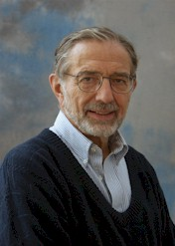
In smaller congregations, several functions are important in helping new members become part of the congregation.
These functions have been referred to by Kurt Lewin and Carl S. Dudley as:
  the gatekeeper,
  the patriarch, and
  the matriarch.

Slide 65
Some Particular Personalities Found in the Gatekeepers, Matriarchs, and Patriarchs.

Slide 66
The Gatekeepers
The gatekeepers linger around the edge of the church meetings and congregational worship. They are often older, often male. Although they usually do not have positions of leadership, they enjoy greeting everyone, especially visitors. They like to know everyone and everything, but they avoid being at the center of events. One pastor reports that "During the sermon they go outside, just to talk." They may not agree with what the church is doing, but they enjoy explaining it to others. Gatekeepers will be found near the "gates" of the group. More likely, they will find you. Gatekeepers are often seen as busybodies because they want to know everything but take so little initiative in personal leadership.

Slide 67
The Gatekeepers
In the process of adoption, the functions of gatekeepers and patriarchs/matriarchs are essential. Gatekeepers are the matchmakers at the door, or keep a watchful eye from the choir loft. They may not embody the values of the church or carry the weight of leadership. But they are gifted with the pleasure of communication--gab. They like to talk to anyone, especially visitors. The gatekeepers interpret the church to prospective members, sometimes with a glad hand; but at other times they lock the doors. If the gatekeepers like the match of church and visitor, often being welcomed fully into the church is realized.

Slide 68
The Patriarchs and Matriarchs
The patriarchs and matriarchs are at the center of the church. They sit in the center of the sanctuary, and they feel in the center of the congregation. They may have wealth and be involved in many activities, or they may have passed their prime. They may be friendly or aloof. One pastor describes a matriarch as "gruff on the outside, but a very caring person." They may no longer sit on the official boards of the church. But they have lived through the historical moments of the church. They remember when things were different, and "how we got to where we are."

Slide 69
The Patriarchs and Matriarchs
Matriarchs and patriarchs are often difficult to work with, especially in the introduction of new programs. They are the informal officers who accept the new members into the family. They complete the process of adoption by sharing the church history with the new members. New members know they are accepted when they have heard the stories from the elders of the church family. New members do not really belong until they have appreciated the stories and accepted the "old folks" who shared them.

Slide 70
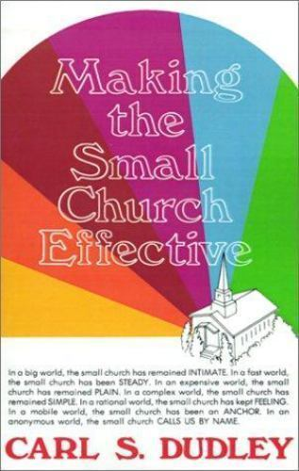
Revitalizing the 125 Participant Church
In Carl S. Dudley's book Making the Small Church Effective, he writes about particular personalities found in the Gatekeepers, matriarchs, and patriarchs. I share them simply for observation.

Slide 71
EIGHT PERSONALITIES FOUND IN ANY CHURCH

Slide 72
THE STORYTELLER
He is the living historian who may embellish for the pleasure of the listeners.

Slide 73
THE FIRST SERGEANT OF THE LORD
This individual makes it clear that he is not really in charge, but the one who is in charge is "not immediately available." And that he is only making decisions "according to policy."

Slide 74
THE MR. EXECUTIVE ORDER
He functions just a little lower than God or the pastor, depending how much "authority" he requires to get what he desires.

Slide 75
THE EARLY BIRD
This person is always early and one of the chief cheerleaders for the church.

Slide 76
THE SCOREKEEPER
He has been called the referee in some congregations, but his job is to see who is winning.

Slide 77
THE SPARKPLUG
This person usually carries two buckets with him. One is water to put out the potentially destructive fires for his comrades. The other is kerosene to make his opposition burn into destruction.

Slide 78
THE PEACEMAKER
This is a quality that needs to be promoted in the church. It is the unifying quality that keeps things together.

Slide 79
THE BELLRINGER
Some call him the clock watcher. This is the one who reminds the pastor that it is time to quit and that there is no such thing as a bad short sermon.

Slide 80
Revitalizing the 125 Participant Church
Breaking some innate long held beliefs about why churches exist will be one of the first barriers that will need to be confronted when it comes to church growth in a 125 participant fellowship. Many an individual believes that the small church has already grown bigger then God ever intended for it to be. If the church is defined by the number of people who know and care about one another, by name, then the small church has already grown. For those who combine the classes of gatekeepers, patriarch, or matriarchs, they see the real strength of the small church as the ability to know, or know about everyone else who participates. In a small church everyone has a particular place. They have an exact place to sit, and an exact place in the social fabric of the congregational structure.

Slide 81
Revitalizing the 125 Participant Church
In larger congregations this social fabric begins to change somewhat or even break down. This usually beings to appear in the church approaching the 125 participant barrier. In larger congregations, the subgroups are considerably smaller than the whole congregation of a small church: a fellowship group may have thirty or forty members; a committee or a study group may have fifteen or twenty participants; a prayer cell or a sharing group may not tolerate more than eight or ten people. In larger congregations, members may know persons in one or more other groups. In the small church, everyone knows, or knows about, one another.

Slide 82
Revitalizing the 125 Participant Church
It is interesting that most church members usually claim that they really desire that their church grow. Outsiders, and some insiders, whisper uncomplimentary reasons why they believe that small churches can't grow. They say that they are lazy, and small in vision. They note the lack of a "full church program," and urge the addition of particular activities to attract new members. Sometimes they identify the problem with a style of leadership, or the motives of particular people: the officers are afraid of losing their position, or the congregation is "allergic" to new faces.

Slide 83
Revitalizing the 125 Participant Church
In their classic study, Small Town in Mass Society, Arthur Vidich and Joseph Bensman point out the limited prospects for membership growth in a relatively stable community. They designate two sorts of adults who are not church members (the majority of the community): the first are the people "who look like good prospects, but don't respond," and the others are people whose life-style does not attract the invitation to join. In short, they are the intransigents and the untouchables, which is not a very promising choice.
Arthur Vidich and Joseph Bensman, Small Town in Mass Society, Princeton, Princeton University Press, 1968, pp. 251-252.

Slide 84
Revitalizing the 125 Participant Church
Still the basic obstacle to growth lies in the satisfaction factor of the present church membership. Intimacy in a small church is not by accident, it is by intent. The essential character of the small church is this capacity to care about people personally. The small church cannot grow in membership size without giving up its most precious appeal, its intimacy. Many members of small churches unconsciously feel that they can't absorb new faces without redesigning the fabric of the group.

Slide 85
Revitalizing the 125 Participant Church
Lyle Schaller states the small church is already much larger than similar kinds of caring groups. One of my church members who is a chemist, uses the phrase "supersaturated" to describe a solution in which the concentration of the solid dissolved in that liquid is abnormally high! The same can be said about the small church. It is a super-saturated body with more participants than regular face-to-face encounter groups can hold. The result is that members often feel the strain. They feel that they cannot receive new members without losing touch with those whom they already know. They cannot make a radical change in the size of the church without losing their motivation for belonging. In the number of people who they can embrace in Christian care, the members feel, often they can embrace in Christian care, the members feel, often unconsciously, that they have reached their limit. They cannot grow because, in a word, they feel "stuffed.”
Schaller, "Looking at the Small Church," p. 7.

Slide 86
Revitalizing the 125 Participant Church
Members in some small churches effectively counteract anything the pastor does to make them grow. If a member leaves the church due to a job transferal, replacements can come in, but growth is almost impossible. The point to consider at this stage is the small church willing to change its style of caring (small group structured) for the goal of financial stability? No small church can grow while it remains "our church." It is a choice often made in the unconscious.

Slide 87
Revitalizing the 125 Participant Church: Where Pastors and Churches Go Wrong!
(Part 3 of 3 Parts)
By
Dr. Tom Cheyney
Founder & Directional Leader
For Churches 125+

Slide 88

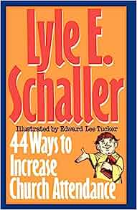
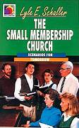
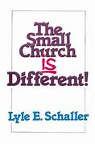
CAN A SMALL CHURCH
BECOME A LARGER CHURCH?

Slide 89
Revitalizing the 125 Participant Church
The answer to this question is yes. A resounding yes! Rapid membership growth is possible for many small churches. A substantial minority of small churches could double their membership in the next few years. Rapid membership growth depends less on community potential, more on the values and attitudes of church members. Members of the congregation must want to grow so much that they are willing to give up the satisfactions of knowing, or knowing about, everyone else in the congregation. They must sacrifice the satisfactions of being a small church.
Thad Hamilton, Evangelism Strategies Workshop, Summersville, West Virginia December 11-12, 1991, West Virginia Convention of Southern Baptist.

Slide 90
Revitalizing the 125 Participant Church
The difference is very clear. Members of larger, multicelled churches cannot know each person in the congregation. They do not expect to know everyone. Larger churches attract and assimilate members through several small units that are "hungry" for members to share the common task. New members do not join the whole church, but become attached to their group. When a group attracts so many members that it becomes unwieldy, the group subdivides to provide space for more new members. Like cells of the human body, the church body has grown by division of large cells into two or more smaller cells.

Slide 91
Revitalizing the 125 Participant Church
Most membership growth programs have been designed for large congregations with different groups and diverse interests. These programs have been particularly effective in suburban communities where the population is management oriented and highly mobile. Congregations have taken great pride in a full church program, from preschool care to programs for the elderly. This program demands a vast variety of social cells, each receptive to new members to fill the necessary functions. The more cells, the more members: the congregation grows by dividing.

Slide 92
Revitalizing the 125 Participant Church
Dividing is one activity that the single-cell church refuses to do. A church program with something for everyone is unnecessary when everyone shares in whatever happens. Members are either present or are immediately informed by the grapevine. Additional church activities are either exhausting or divisive. Growth by division is subversive to the essential satisfactions of belonging to the whole church.

Slide 93
Revitalizing the 125 Participant Church
Advocates of the Church Growth movement have stated quite boldly that it is an imperative to grow numerically. C. Peter Wagner writes: "I wish to disassociate myself from the big-church-small-church debate...The optimum size of each church depends primarily on its philosophy of ministry. Churches, much like people, have personalities that set them apart from another." That sounds affirmative, but Wagner continues: "But whether a church is large or small, it should be a growing church...Healthy large churches and healthy small churches are evangelistically effective." He goes on to note the implications: "If smaller churches are growing they eventually will become large churches. Just as every river was once a stream, every large church was once a small church. When this happens, new small churches will continually be needed."
Wagner, Your Church Can Grow, Glendale, Kegal, 1976, pp. 85, 92.

Slide 94
Revitalizing the 125 Participant Church
Wagner describes the growing church, with levels of participation. Everyone shares in the large celebration, where anonymity is not bad at all. A smaller group can be gathered into the congregation, as a fellowship circle of about two hundred worshipers. Last, there is the Christian cell, which is so close to a family situation that it can be called a "kinship circle" to contract it from the membership circle and the fellowship circle.
That's the logic of church growth, and it works. But the small church must be "converted" to believe that the change is worth the cost. One pastor at a conference on methods of evangelism observed that "any of these methods, if used conscientiously, would turn the small church into a large church, and that's the one thing most small congregations don't want to see happen." Members of the small church know the alternatives.
Ibid., p. 92.

Slide 95
Revitalizing the 125 Participant Church
Members who joined large and small churches were compared and interviewed in a careful study by Allan Wicker. Both groups of new members agreed that large churches have better church schools, more formal worship, more efficient committee organization, and so forth. But they also both agreed that in the small congregation, the members spend more time at church, work harder, know the pastor better, and seem to care more. Each group separately seemed more satisfied with the choice that they had made in the church that they had joined.
In a small church, membership growth means a loss of contact with the whole body of the congregation. The members must give up knowing everyone, for the sake of sharing with many more people whom they can never know. Even when members have agreed to try to get their church to grow, they often find that the heart resists.
Allan W. Wicker, "Assimilation of New Members in a Large and a Small Church," Journal of Applied Psychology, Vol. 55, No. 3, pp. 151-56.

Slide 96
Revitalizing the 125 Participant Church
When the community has growth potential, any congregation can grow--if the members are willing to let go of their satisfactions in being close to one another. A few of the small churches are changed into larger churches, with full programs and ministries for everyone. But keep clearly set in your mind they are not acting like small churches anymore!

Slide 97
Revitalizing the 125 Participant Church
In order for churches to break the 125 participant barrier there are some perspectives that need to be considered. The strength is the first perspective to be observed. What are the strengths, then, of a 125 participant church? There is some generalization, but many, if not most small churches fit into the majority of these categories.
The Strength of …

Slide 98
ELEVEN STRENGTHS OF CHURCHES APPROACHING 125 PARTICIPANTS
A WELL RESPECTED PASTOR
A WELL LOCATED FACILITY
A STABLE & CAPABLE LAY LEADERSHIP
A PHYSICAL CAMPUS WITH EXPANDABLE ROOM

Slide 99
ELEVEN STRENGTHS OF CHURCHES APPROACHING 125 PARTICIPANTS
A HIGH VISITOR FLOW RATIO
A SOLID FINANCIAL PLATFORM
A STRONG SOCIAL MIX
AN INTACT SUNDAY SCHOOL ORGANIZATION

Slide 100
ELEVEN STRENGTHS OF CHURCHES APPROACHING 125 PARTICIPANTS
ADDITIONAL PROPERTY AVAILABLE FOR FUTURE EXPANSION
THREE ENTRANCE POINTS OR MORE
A MINDSET AMONG LAITY FOR GROWTH

Slide 101

OBSTACLES FOR CHURCHES APPROACHING 125 PARTICIPANTS

Slide 102
O.B.S.T.A.C.L.E.S. ARE…
OPPORTUNITIES to
BUILD
STRATEGIES and
TECHNIQUES that
ADVANCE your
CAPABILITIES and
LEAD you into
EFFECTIVE
SOLUTIONS

Slide 103
SIX OBSTACLES OF CHURCHES APPROACHING 125 PARTICIPANTS
THE OBSTACLE OF AGE
THE OBSTACLE OF ONE PROFESSIONAL STAFF MEMBER
THE OBSTACLE OF COMPLETELY FILLED BUILDINGS

Slide 104
SIX OBSTACLES OF CHURCHES APPROACHING 125 PARTICIPANTS
THE OBSTACLE OF NON-FUNCTIONAL CHILDREN’S AND YOUTH PROGRAMS
THE OBSTACLE OF TWO ENTRANCE POINTS
THE OBSTACLE OF ORGANIZATIONAL STRUCTURE

Slide 105
Revitalizing the 125 Participant Church
ISSUES TO CONFRONT AT THE 125 BARRIER
The 125 barrier has a different set of issues than the 35 and the 75 barriers. With minor adjustments, attendance can grow from 35 to 75. Growing beyond the 125 barrier requires major adjustments in eleven areas:
Fowler.

Slide 106
ISSUES TO CONFRONT AT THE 125 BARRIER
PROGRAMMING
ENTRANCE POINTS

Slide 107
Revitalizing the 125 Participant Church
Programming –
Prior to reaching 125, occasional youth and children activities seemed sufficient to satisfy the fellowship needs. Growing churches provide ministries that meet needs. At this point, the church must offer quality youth and children's ministry to attract new members in the 25-40 age bracket. Single parents look for programs that fill the void created by a missing parent.

Slide 108
Revitalizing the 125 Participant Church
Entrance Points –
Multiple entrance points are required for growing beyond the 125 barrier. An entrance point is a class, group, ministry, or person by which new persons enter the church. To discover existing entrance points, ask the question, "what attracts a first time visitor to the church?"

Slide 109
Revitalizing the 125 Participant Church
Most new members join small churches through two basic entrance points: the worship service and the pastor. Most first time visitors attend the worship service because of contact with the pastor. Later, they may attend Sunday School. The choir is the most closed group in the church.
A church with four entrance points has a better opportunity to attract new members than the church with one or two entrance points. Multiple entrance points meet multiple needs and attract a variety of people.

Slide 110
BREAKING THE 125 BARRIER REQUIRES HAVING AT LEAST FOUR ENTRANCE POINTS

Slide 111
ENTRANCE POINTS
CHURCH STAFF DEVELOPMENT
CHURCH FELLOWSHIP
PASTOR LEADERSHIP STYLE SHIFT (2 Shifts Required)

Slide 112
PASTOR LEADERSHIP STYLE SHIFT (2 Shifts Required)
SHIFT NUMBER ONE
The pastor must shift from establishing deep one-to-one relationships to establishing group relationships with the members. This does not mean the pastor will lose concern for his people nor quit visiting them. It does mean that he will have less time per family. The pastor and his family may have two or three couples with whom they visit on a regular basis. Sometimes church members become very jealous and accuse the pastor of showing partiality. While it is impossible to love everyone alike and have the same feelings for everyone, the pastor does need friends. Pain with discomfort plus a lack of close friends, is often great. As the church grows, group relationships increase and personal relationships decrease.

Slide 113
PASTOR LEADERSHIP STYLE SHIFT (2 Shifts Required)
SHIFT NUMBER TWO
The pastor must shift from being a foreman to being a supervisor. An effective supervisor delegates responsibility to his foremen. Many preachers have said, "I had rather do something myself than delegate to someone else." Growing past the 125 barrier requires a shift from "doing it all yourself" to "getting others involved."

Slide 114
ENTRANCE POINTS
CONGREGATION GOALS
FACILITIES AND SPACE
NEW MEMBER ASSIMILATION
STRUCTURE
LAY LEADERSHIP
MINISTRY FOCUS

Slide 115
Revitalizing the 125 Participant Church
CONGREGATION GOALS
Churches fifteen years and younger are occupied with tangible goals: erecting the first building; constituting; paying off the mortgage; paving the parking lot; raising money for missions; paying the pastor's salary; providing housing for the minister, etc. Tangible goals produce a high level of enthusiasm as they are easily measurable. Intangible goals do not generate the same enthusiasm and support.
Blue collar persons are more comfortable with tangible goals as they think concretely. White collar persons think abstractly. Ministry goals, new programming, creating new entrance points, and staff relationships require abstract thinking. Intangibles such as attitudes, progress, and effectiveness are more difficult to measure than meeting a financial goal, painting a foyer, or paving the parking lot.

Slide 116
Revitalizing the 125 Participant Church
FACILITIES AND SPACE
Space is a big church growth factor. New churches often outgrow the facilities before the debt is paid, which makes it impossible to build the second unit. Space limits the church growth. A quart container holds a quart of liquid. All excess water spills and is wasted. Attendance does the same.
Mobile units provide a temporary solution. Enthusiasm and excitement leads the young church to build too soon. Knowing when to build and what to build is quite a decision. Some geographical areas equate a building with credibility; therefore, the need for a building is critical.

Slide 117
Revitalizing the 125 Participant Church
NEW MEMBER ASSIMILATION
As the church grows beyond the 125 barrier, a strategy shift for assimilating new members is required. Up to now, most new members join because of the pastor's ministry. As the church grows, lay persons must develop relationships with new members. This can best be done in groups of fifteen or less persons. The first six months is crucial as new members must make new friends and develop a sense of belonging. New members attracted to the church because of the pastor, must become involved in a group to develop an "our church mentality."

Slide 118
Revitalizing the 125 Participant Church
STRUCTURE
Several organizational structural shifts are required to grow beyond the 125 barrier. Departmentalizing the Sunday School is a big step. Two adult departments are needed.
Additionally, three functional group sizes are required for breaking the 125 barrier:
small groups of 12-15 persons: these include Sunday School classes, committees, choirs, mission groups, etc.
mid-size groups of 35-75 persons: these include Sunday School departments, larger classes, several families fellowshipping on a monthly basis.
large groups of everyone: healthy churches have regular church wide fellowship opportunities.
Growing past the 125 barrier requires establishing all three levels of group involvement. Because of their sizes, the 35 and the 75 in attendance church cannot offer these levels.

Slide 119
Revitalizing the 125 Participant Church
LAY LEADERSHIP
Breaking the 125 barrier requires more sacrifice for the lay leadership, than the two previous barriers. As the church grows, the importance of one diminishes. Long-time members seem to develop an ownership of the church that causes newcomers to feel unwelcomed. Conflicts and power struggles arise in the fellowship. A common conflict is the homesteaders verse pioneers. In a growing church, new members will outnumber the older members in about the third or fourth year of the pastor's ministry. The pioneers feel threatened and often rebel against the pastor's leadership. Sparks fly and soon the pastor leaves for another field of service. New members have their feelings hurt and leave the church with the pastor. After this happens several times, the church becomes resistant to growth.
Lay leaders must allow new members to become a part of the church and become involved in the leadership structure. How long has the newest deacon been a church member? The answer may provide some insights into this issue.

Slide 120
Revitalizing the 125 Participant Church
MINISTRY FOCUS
An absolute is a balanced ministry focus between maintenance activities and growth activities. The 125 participant church does an excellent job in maintenance ministries: looking after their members, keeping tabs on the sick, and acknowledging needs, birthdays, anniversaries, and other special occasions. This focus seems to take place naturally if the members are loving and caring people.
The most difficult focus to develop is the growth ministry. Specific intentional actions are required to discover prospects, cultivate relationships, and meet community needs. An inward focused church becomes nothing more than a social club.

Slide 121
Revitalizing the 125 Participant Church
TEN SPECIFIC ACTIONS
According to Harry H. Fowler, there are ten specific areas that need correction in breaking the 125 barrier to church growth.

Slide 122
TEN SPECIFIC ACTIONS
PROGRAMMING
ENTRANCE POINTS
CHURCH STAFF DEVELOPMENT
CHURCH FELLOWSHIP
PASTORAL LEADERSHIP
CONGREGATIONAL GOALS
FACILITIES & SPACE
NEW MEMBER ASSIMILATION
STRUCTURE
MINISTRY FOCUS

Slide 123
Revitalizing the 125 Participant Church
PROGRAMMING:
Begin developing a youth and children's program.
Discover the needs of young adults ages 18-40.
Plan specific events that meet needs of young adults such as retreats, fellowships, etc.
Begin broadening the program to include other groups you are not currently reaching.
Keep regular communications channels functioning.

Slide 124
Revitalizing the 125 Participant Church
ENTRANCE POINTS:
Focus on the church's strengths and the community needs to determine needed ministries.
Add the fourth and fifth entrance points based on number one.
Strengthen the first three entrance points.

Slide 125
Revitalizing the 125 Participant Church
CHURCH STAFF DEVELOPMENT:
Determine existing staff needs.
Choose staff that complements the pastor's ministry and existing programs.
Use proper channels - committee, deacons, business meeting, etc., to get approval and affirmation.
Add to the existing staff.

Slide 126
Revitalizing the 125 Participant Church
CHURCH FELLOWSHIP:
Develop a group ratio of 1:15 - one group for every 15 persons.
Promote large group activities for everyone.
Promote small group activities for 12 to 15 persons.
Promote mid-size group activities for 35 to 75 persons.
Create opportunities for new members to interact with older members.

Slide 127
Revitalizing the 125 Participant Church
PASTORAL LEADERSHIP:
Make a gradual shift to relating to groups.
Make a shift from foreman to supervisor.
Involve more lay persons to ministry.

Slide 128
Revitalizing the 125 Participant Church
CONGREGATIONAL GOALS:
Develop tangible goals.
Develop intangible goals.
Develop short and long range ministry goals.

Slide 129
Revitalizing the 125 Participant Church
FACILITIES AND SPACE:
Provide adequate facilities for 250.
Consider all possibilities.

Slide 130
Revitalizing the 125 Participant Church
NEW MEMBER ASSIMILATION:
Make conscious efforts to involve new members in groups.
Provide new groups for new people.
Monitor new member involvement.

Slide 131
Revitalizing the 125 Participant Church
STRUCTURE:
Departmentalize the Sunday School.
Develop classes for all ages and needs.

Slide 132
Revitalizing the 125 Participant Church
MINISTRY FOCUS:
Develop a 4:1 inreach/outreach ratio.
Involve members in church community ministries.
Develop an effective outreach.

Slide 133
Revitalizing the 125 Participant Church
Growing beyond the 125 barrier requires crucial shifts in structure, leadership style and ministry focus. A church can grow numerically providing the pastor and lay leadership desire the church to grow; the church community has sufficient population that will support growth; knowledge and practice of church growth principles; and the presence of power of the Holy Spirit!
Churches located in sparsely populated rural areas, as well as churches in changing urban communities will find it difficult to grow. As a church growth consultant, I have come to realize that some churches just will not pay the price for growth. May we never use our lack of commitment and misplaced priorities to rationalize our non-growth patterns.

Slide 134
Revitalizing the 125 Participant Church
The hard fact of breaking 125
The hard fact is that in breaking the 125 barrier, it is going to require you to make some changes on yourself and on your church. When you think about the hard fact in breaking the 125 barrier, you are going to have to do some analysis of who you are as a leader, where your church is in its life stage. And you are going to have to confront the brutal facts. Rick Warren has said in his book The Purpose Driven Church, the wrong question to ask when it comes to church growth is “How can I grow my church?” Instead the right question to ask is, “What is keeping my church from growing?” That’s going to require some introspection. That’s a little bit of bad news.
My experience has taught me, sadly, that some churches are just not going to do that. You may not be able to do it. Some churches have systems that are designed to keep it small. Some pastors are unable to make the leap from the family church mentality to the healthy growing church mentality that is required to break the 125 barrier.

Slide 135
Key Lessons for Revitalizing the 125
Participant Church
If your church has been stuck at 35, 50, or 75 level for more than three years and God has laid it on your heart to reach lost people in your community, you have two choices that lay before you. They are:
Take massive action or
Find another means for employment
There is no third option.
Trying to break the 125 barrier is more akin to making it through Navy Seals basic training than any other ministry assignment there is. The odds are stacked against you that you will make it to the end, but for those who do, there’s unparalleled satisfaction and kingdom impact that awaits. You must take massive action. You must push all your chips to the center of the table and gamble your ministry, your ego, your reputation, and the entire future of the church you serve on the critical lessons I am about to share with you!

Slide 136

Key Lessons for Revitalizing the 125
Participant Church
Here’s a little secret about the 125 barrier: it is entirely up to you.
Nobody is going to grow your church for you.
Nobody is going to develop a strategy for growth besides you.
Nobody is going to come alongside you and make it easier for you.
You are in a battle for your church and your ministry.
And you can win if you are willing to work hard.

Slide 137
Key Lessons for Revitalizing the 125
Participant Church
1. Commit To Staying At That Church 5 More Years (Break the Cycle)
Most Senior Pastors stop listening right here, at least the ones who are on the “stepping stone to somewhere bigger and better” ministry blueprint. Listen, you can’t even begin to think about turning that church around without a long-term commitment. Ten years is more realistic, especially if you want to take it beyond 125 to break 200 and possibly even 400.

Slide 138
The starting point of revitalizing a church in decline is the realization that no other church is coming to your rescue. Everything that your church is right now and everything your church will be is entirely up to you and your members willingness to completely follow the Lord’s leading and not mans!

Slide 139
Key Lessons for Revitalizing the 125
Participant Church
2. Commit To Working at least 50 Hours A Week
Chances are that in the absence of a staff team and a healthy governing board of leaders, you’ve grown slack. This is always a serious temptation for many pastors at this size. Make the commitment. Do the work.

Slide 140
Key Lessons for Revitalizing the 125
Participant Church
3. Place Your Top 5 Gifted Leaders Over Kids, Students, Adults, Worship and Finance
This is your staff. You will meet with them once a week. You hire them first with a title, then $50 a week, then gradually moving them towards full-time pay as the church grows. The order in which you pay them is simple: Worship, then children, then finance, then youth, then adults.

Slide 141
Key Lessons for Revitalizing the 125
Participant Church
4. Schedule 10 meetings A Week With The 100+ Most Influential People In Your Community
Your job, besides preaching, will be to network, lead to Christ and then deploy the most influential leaders in your community. When I was at this size I had 5 breakfasts and 5 lunches a week, every week, without fail, until we grew to 600. Gut it out and make it happen.

Slide 142
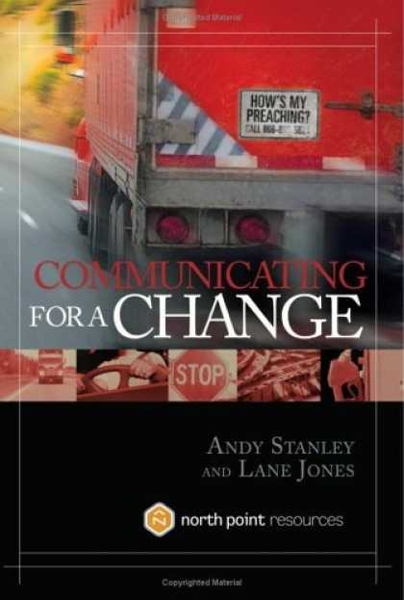
Key Lessons for Revitalizing the 125
Participant Church
5. Preach Amazing, 25 minute Sermons. Every. Single. Sunday.
The best way to improve is to preach no more than 25 minutes each Sunday. Then get coaching. Then make an appointment with yourself to watch yourself on video every single week. Prop up your iPhone and hit record before you preach. No excuses. Also, read Andy Stanley’s Communicating For Change. Make it your goal to become the best preacher you can possibly be.

Slide 143
Key Lessons for Revitalizing the 125
Participant Church
6. Get Into The Best Shape Of Your Life
I’ve met more depressed Senior Pastors at this stage of growth than all other stages of growth combined. You owe it to yourself to invest in yourself. You need the energy and stamina to work long, hard, thankless hours to lead this church past 125. As your health goes, so goes the rest of the church. So hire a trainer. Go see a licensed dietician. Overhaul your eating. Carve out the best possible times of the day to invest in yourself. No-one else is going to make you do it. Trust me.

Slide 144
Key Lessons for Revitalizing the 125
Participant Church
7. Share A Life-Change Story Every Sunday And Give New People Invite Cards To Share With Friends
As I’ve shared elsewhere, if you want to grow above 125 people, you need to get how many people to visit your church over the next year? The answer is 1000 new people! To make that happen you must focus on sharing stories in your preaching about life-change, especially how God is using your services to facilitate it.
But that’s not enough. You must ask your new people to bring new people EVERY WEEK and make it as easy as possible to help them do that. Give them Invite Cards for each new series. Create “special days” on Sunday that will intrigue new people and cause them to bring their friends. Non-churched new visitors will bring their friends at 10x’s the rate that your existing people will, so leverage their influence.

Slide 149
Revitalizing the 125 Participant Church: Where Pastors and Churches Go Wrong!
(Part 1 of 3 Parts)
By
Dr. Tom Cheyney
Founder & Directional Leader
For Churches 125+

Slide 150
Revitalizing the 125 Participant Church

