Slide 1

Revitalizing the 200 Participant Church: Why Your Church Struggles & What to Do About It! (Part 4 & 5 of 6 hour seminar)
By
Dr. Tom Cheyney
Founder & Directional Leader

Slide 2
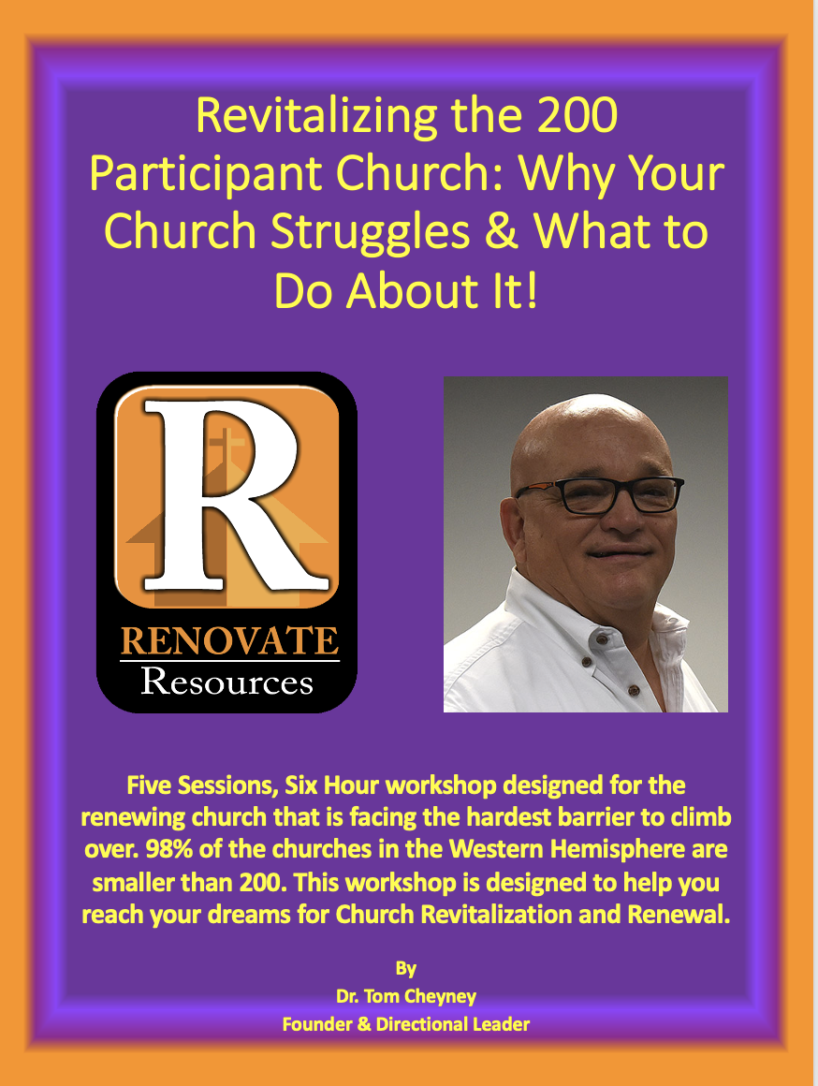

Slide 3
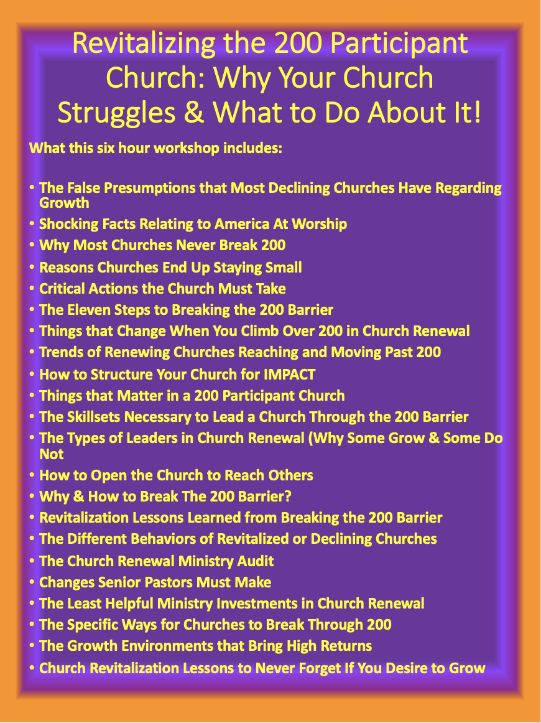

Slide 4

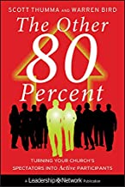
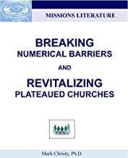
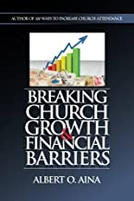

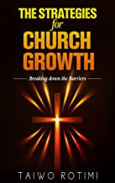

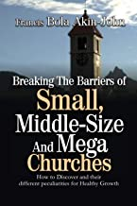

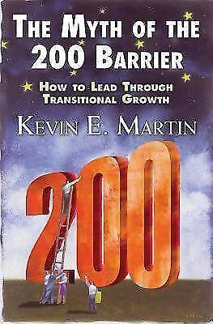

Slide 5
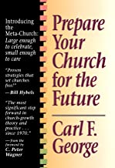


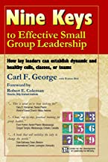

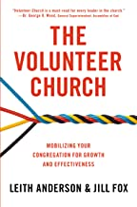


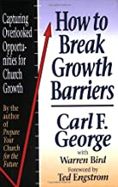
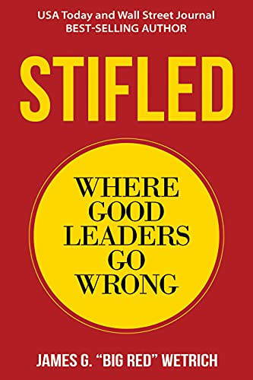

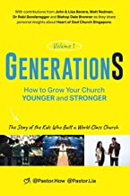
Twenty-Two Useful Resources to Help You Turn Around Your Church!

Slide 6
We will continue this in February as we begin a series on Revitalizing the 35, 75, 125, 200, 400, and 700 Participant Church!
35
75
200
125
700
400

Slide 7
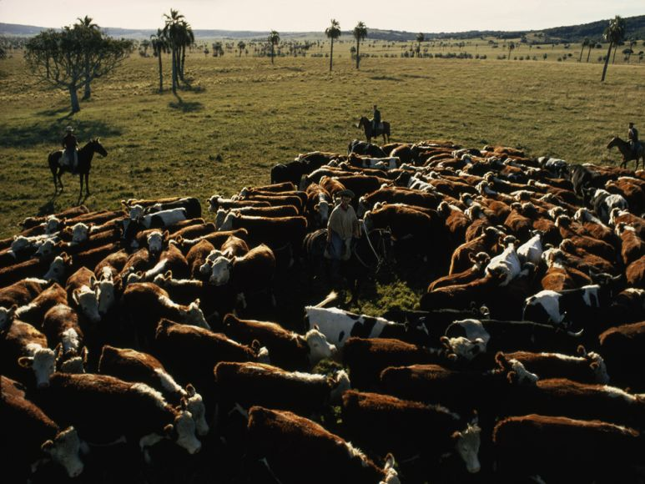
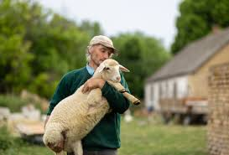
ARE YOU A HERDER OR A RANCHER?
WHICH ARE YOU?

Slide 8
The Five Behaviors of Sheep Herding Pastors
They personally do all the pastoral care.
They attempt to meet all of the expectations.
They work to their limit pf both time and energy.
They keep the work close to themselves and protect it.
They base their perspective on present conditions not future possibilities.

Slide 9
The Five Behaviors of Cattle Ranching Pastors
He is concerned for high quality pastoral care.
He sets expectations.
He perceives the church organizationally.
He delegates and involves others.
He seeks to develop leadership and management skills.

Slide 10
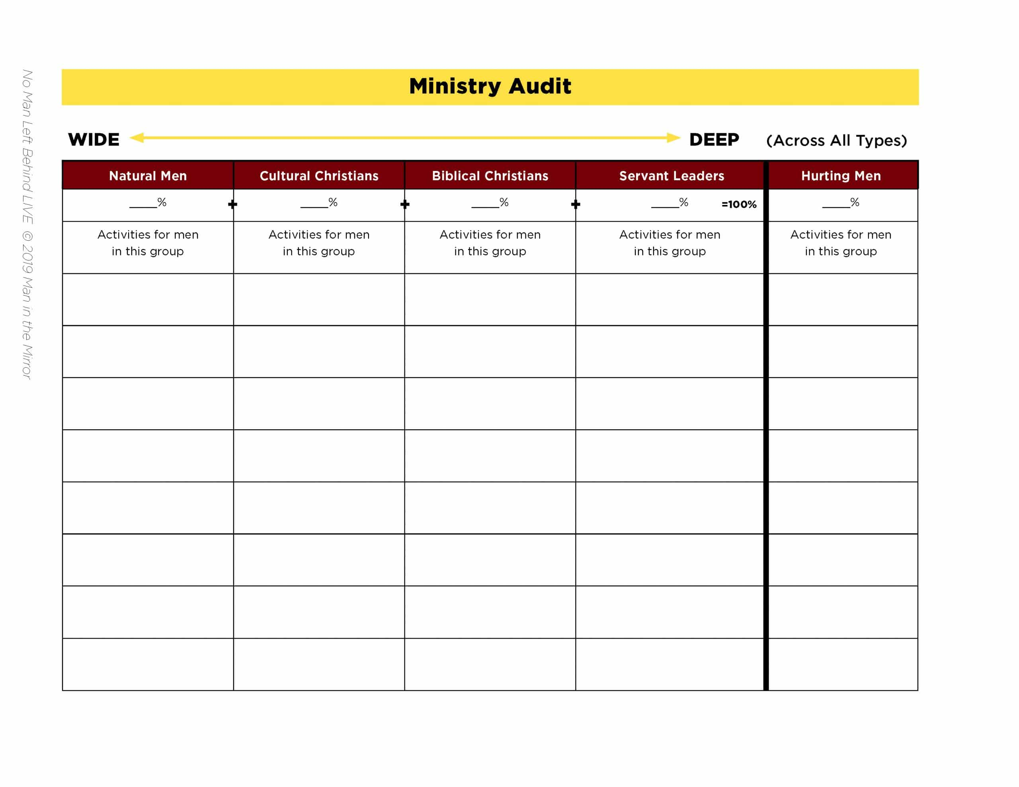
The Church Renewal Ministry Audit

Slide 11
Church Renewal Principles
Renewal is not concerned with numbers only, but ultimately with meeting the needs of people.
Renewal growth occurs when people are given a wide variety of choices.
Renewal growth occurs when people are matched with their skills.

Slide 12
Church Renewal Principles
Renewal growth does not dictate that more people will become inactive.
Renewal growth provides a wider outreach to people in need.
Renewal growth need not be hampered by participation in the public arena.

Slide 13
Church Renewal Principles
Renewal growth will occur when worship is intentionally emphasized.
Renewal growth usually occurs with the addition of each new morning worship service.
Renewal growth is directly related to the leadership strength of the planter.

Slide 14
Church Renewal Principles
Renewal growth is directly related to the attitude of the staff.
Renewal growth is directly related to the unpaid staff’s perception of the new church’s size and ability, rather than the reality.
Renewal growth stalls when 80% of any space in use, is full. It is time to make plans for more space.

Slide 15
Church Renewal Principles
Renewal growth is encouraged when parking is adequate.
Renewal growth can occur even though a work cannot afford to build.
Renewal growth can occur without merely transferring members from one church to another church.

Slide 16
Church Renewal Principles
Renewal growth almost always occurs if the congregation is friendly toward new visitors.
Renewal growth is related to you encouraging your people to give financially.
Renewal growth needs a solid foundation.

Slide 17
Church Renewal Principles
Renewal growth that is healthy comes from regular strategic planning.
Renewal growth takes more effort to implement change than to maintain the status quo.

Slide 18
The Changes Senior Pastors Must Make To Break The 200 Barrier
If your church is under 200 in attendance every weekend, you are in good company. Every study out there suggests that more than half of the 384,000 churches in the United States are in the same boat.
The bad news is that the 200 barrier is where congregational and pastoral dreams for evangelistic impact come to die. The challenges that stand before you are extraordinary, but they’re not insurmountable. You must believe your church can grow, and you must believe you are the person to do it, because both are true.

Slide 19
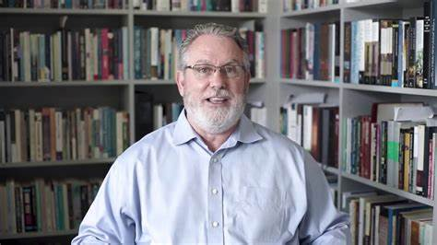
The Changes Senior Pastors Must Make To Break The 200 Barrier
Here are the personal changes needed for a Senior Pastor to lead a congregation through the 200 barrier.

Slide 20
The Changes Senior Pastors Must Make To Break The 200 Barrier
1. Commit To Staying At Your Church For Five Years Minimum
It’s going to take a five-year tour of duty for you to spark the momentum needed and make the changes necessary to incorporate 100+ new converts into your church. That’s because, unless you’re a church planter, your people have seen a number of bright-eyed Senior Pastors just like you who had great ideas for change, but didn’t stay long enough to see them through.
It takes time to build credibility and to lead a congregation through change. We’re talking about serving people, not starting a company with venture capital that we know we’ll sell off later and move on. It’s about them, not us as Senior Pastors, which means everything we do has to be done in their best interest, not ours.

Slide 21
The Changes Senior Pastors Must Make To Break The 200 Barrier
1. Commit To Staying At Your Church For Five Years Minimum -Cont.
The other reason you need a longer horizon is because more than likely you’re a one-man band. There is a massive amount of work that lies before you, and it can’t be done in a couple years. Working 55 hours a week is expected, 75 hours is not. When you boil it down, breaking the 200 barrier is a 13,475 hour job. That’s 55 hours a week + 5 full years – 3 weeks of vacation per year = 13,475 hours.
At about 5,000 hours you’ll notice a credibility tipping point with your church, which, not coincidentally, is just about the time most pastors leave. I ask every staff member that comes on my team to make a five-year commitment. That’s because years 1-2 are all about learning what you have, and years 3-5 are all about hitting your sweet spot.

Slide 22
The Changes Senior Pastors Must Make To Break The 200 Barrier
2. Commit To Growing Your Church Through Conversion Growth Only
This is a decision that you need to make up front. Are you going to pay the price needed to reach truly non-Christian people in your area? Or are you going to lower the bar and attract transfer Christians? The formula for reaching transfers is simple: preach long sermons, sing endless worship songs, and get on the radio and TV. Like pigs coming to slop, you’ll see the underbelly of the Christian subculture gravitate towards your church posthaste.
Resist this tendency and focus instead on identifying and creatively engaging truly non-Christian people in your region. Yes, that means you’ll grow slower and the giving won’t be as strong, but you’ll be setting into motion the kinds of ministries and systems it will take to break the 400 and 600 barrier.

Slide 23
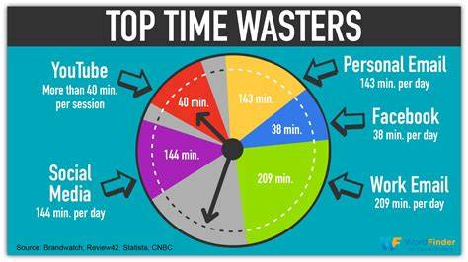
The Changes Senior Pastors Must Make To Break The 200 Barrier
3. Eliminate Time Wasters
Most Senior Pastors leading churches under 200 have either inherited bad systems that waste precious time, or bad theology that places them as the focal point of care and support in the congregation. You’ll need to change both. Concerning the bad systems, here are a few (6) important changes you’ll need to address:

Slide 24
The Changes Senior Pastors Must Make To Break The 200 Barrier
• Write your sermons in one day. Senior Pastors who brag about spending endless amounts of time on their sermons are braggers. Your sermons won’t be any better with twenty hours of sermon prep instead of eight. Preach to get the job done, not to impress. And by all means, if needed, preach other pastor’s sermons in a pinch.
• Don’t do “drive-by” weddings. Only agree to marry couples where one of them is an active member of the church. Reject every wedding inquiry of people who found you in the phone book. Pastors think weddings are great outreach events, when they’re usually not. Also, require all couples to do six sessions of pre-marital counseling with a paid licensed counselor instead of with you.

Slide 25
The Changes Senior Pastors Must Make To Break The 200 Barrier
• Make it known that you don’t do counseling. You’re not a counselor, so stop pretending to be one and partner with a counseling center in your area. Limit all counseling to professionals and push care to your groups. As I heard Steve Sjogren once say, “Many light touches, few deep touches.”
• Keep email replies to 3 sentences. When someone emails you wanting a 10,000-word answer, respond in no more than 3 sentences and tell them to see you Sunday between services to talk further. 95% of the people who had a life and death urgent question that had to be answered on Tuesday will forget they even emailed when Sunday rolls around. Another thing that helps is to craft 2-3 page policy papers that answer the top 10 questions you get on a regular basis. Having those ready to send will save a ton of time and energy.

Slide 26
The Changes Senior Pastors Must Make To Break The 200 Barrier
Change your cell phone number.
One of the counter-intuitive things I tell Senior Pastors I coach is that they are too accessible. No more than ten people should have your cell phone number. Change it, get caller ID block and don’t hand out the new one. Give out your email instead. “Email is the best way to get in touch with me,” is the phrase church people should hear when they ask what is the best way to get in touch with you. Doing this will create boundaries and reinforce the fact that you’re a leader, not a chaplain on call.

Slide 27
The Changes Senior Pastors Must Make To Break The 200 Barrier
Stop hosting church events at your house. Since you are the most committed person to the vision, it’s so easy for you to host events at your house. That’s what I did at your size. Then one day I strategically stopped. Putting an end to meetings at your house not only kills the idea that you’re the church’s chaplain, but it creates boundaries and saves you time cleaning up. Put an end to this and you’ll thank me later.

Slide 28
The Changes Senior Pastors Must Make To Break The 200 Barrier
As Peter Drucker writes in his book The Effective Executive:
Effective executives, in my observation, do not start with their tasks. They start with their time. And they do not start out with planning. They start by finding out where their time actually goes. Then they attempt to manage their time and to consolidate their “discretionary” time into the largest possible continuing units.

Slide 29
The Changes Senior Pastors Must Make To Break The 200 Barrier
4. Get In The Best Shape Of Your Life
You need to get in the best shape of your life if you are going to break the 200 barrier. The time demands, pressures, and stress of leading the change that needs to take place will add 30 pounds if you don’t. Trust me. Here are four things you need to do before you embark on leading your church through the 200 barrier:
• Go to your doctor. Get complete blood and cholesterol work done. You want a good handle on where you are right now. Have him/her help you set health goals. If you are at your goal weight, fantastic. • Go to a licensed dietician. Purge yourself from the collected eating wisdom you’ve accumulated from people, books, TV, and magazines. Get a handle on how to eat well based on science. My dietician has been fantastic. • Get a gym membership. Find a workout partner or hire a trainer if you can. An active brain trapped inside an inactive body leads to depression. • Take two full days off a week. I suggest Fridays and Saturdays. Many pastors take Mondays off, which is not wise. You’re tired on Mondays. Reserve that for administrative work. Take your days off when you’re most refreshed.

Slide 30
The Changes Senior Pastors Must Make To Break The 200 Barrier
The best gift you can give to your congregation is a healthy, refreshed, growing, and passionate you. As Peter Drucker says:
“Your first and foremost job as a leader is to take charge of your own energy.”

Slide 31
The Least Helpful Ministry Investments for Small-Church Growth
It may be expected that the pastors who participated in the survey had some difficulty ranking the growth produced by some of the less prominent ministries offered by their churches. Clearly, however, there were three areas of ministry, which were not very helpful in fostering the growth of their small churches. The ratings given to these ministry areas in the CGP survey are worthy of notice.

Slide 32
The Least Helpful Ministry Investments for Small-Church Growth
The Ineffectiveness of Stewardship Campaigns
Only a few (7 total) of the successful ministries reflected in the CGP survey even ranked stewardship campaigns in the top ten most valuable ministry efforts. Exactly half of the CGP respondents gave it the lowest possible ranking in their priorities.
If this statistic astounds the U.S. clergyman, it probably will not astound lay people. Research indicates that unchurched people have a very negative view of ecclesiastical fund raising efforts. Moreover, the case may be made that even the faithful Christians are weary of the guilt motivated stewardship drives so prevalent today. In light of the CGP results, however, it seems incredible that so much emphasis on stewardship and capital fund raising campaigns is found in church growth circles.

Slide 33
The Least Helpful Ministry Investments for Small-Church Growth
The Ineffectiveness of Singles Ministry
Next to the bottom of the list of helpful ministry investments, was the area of singles ministry. The general feeling among pastors who led their congregations through the two hundred barrier seems to be that single individuals contributed very little to the growth of their churches. For this reason singles ministries must be regarded as "pure" ministries-- efforts for which minimal growth benefits to the local church will be realized. This, undoubtedly, may be attributed to the transitional nature of "singlehood" in America.
The typical full time college student has little social standing, little compelling reason to stay in his present location after graduation, little financial ability, little time, no winsome spouse and no lively children from which a church might derive benefit. On the other hand, the student has great financial, social and academic pressures which few small churches can absorb.

Slide 34
The Least Helpful Ministry Investments for Small-Church Growth
The situation only grows worse, in the case of men, if a single individual decides not to pursue college or some other skill enhancing education. Taking a few classes at the local junior college, or long term working at jobs which do not require job skills and which offer no future often puts the young single in roughly the same position as an adolescent.
Add to these disadvantages the problems that come from a growing number of divorced singles, singles who lack the maturity for marriage, etc., and the challenges of singles ministry become clear. Campus churches and churches which target military singles have, it seems, wonderful evangelistic potential, but very limited church growth potential.

Slide 35
The Least Helpful Ministry Investments for Small-Church Growth
The Ineffectiveness of Senior Adult Ministry
Removed from the next highest priority area of ministry investment by a wide margin, senior adult ministry was certainly not regarded as a key to the growth of the churches surveyed. It is often said that senior adults, as a class, are the most difficult to evangelize. The oft repeated testimony is that they are also generally the most resistant age group to change, growth and the role of servanthood in Christianity. Spending a lifetime ministering to the needs and demands of the elderly may be very noble and worthwhile--another pure form of ministry--but, according to the CGF figures, it is not generally a good outreach strategy.

Slide 36
Why Your Church Struggles to Break Two Hundred
In breaking 200 you must realize that you and your church will not glide through it, will not charge through it and you will not slide through it. Without a daily focus, the goal of 200 will become elusive. To break the 200 barrier requires extreme hard work which is why many pastors are not up to it.

Slide 37
7 Ways For Churches To Break Through The 200 Attendees Barrier
1. Enlarge your volunteer base by 25%.
2. Stop asking for volunteers from the platform.
(Do it Personally!)
3. Simplify what you do in ministry.
4. Re-think your sermon approach. (Shorter is better)
5. Treat your strangers like Royalty.
6. Think of creative ways to reach out. (Remember Side Door Evangelism)
7. Don’t pressure people to commit. Stop guilting people.

Slide 38
What Church Revitalizers Should Know About Assimilation
“Assimilation” sounds like a big, scary word. But it’s a vital part of any healthy church that’s thriving in ministry. Do assimilation well, and you’ll have the people and money you need to continue to move your church forward. Do assimilation poorly, and you’ll lose people and ministry funding — and you won’t even realize it. To achieve ministry success, you’re responsible for supporting many areas of your church, including your church’s assimilation process.

Slide 39
What Church Revitalizers Should Know About Assimilation
While you might not be directly responsible for day-to-day assimilation work, it’s important for you to have a solid understanding about the processes your church has in place to move people from first-time guests to fully engaged members.
Do you need to rethink your church’s assimilation process?

Slide 40
What Church Revitalizers Should Know About Assimilation
You might need to rethink your assimilation process if:
You don’t know what assimilation is.
You can’t explain your assimilation approach or strategy.
No one on your organizational chart is assigned that responsibility.
You judge growth by your ability to slightly outpace your rate of attrition.
You have no idea why someone who seemed to be connecting suddenly disappeared.
People participate in your new members’ class, but then are never seen or heard from again.
You look to place volunteers regardless of their passions, interests, experience, or abilities.
You think collecting personal contact information is intrusive.

Slide 41
What Church Revitalizers Should Know About Assimilation
The Reason for Assimilation
Before we can improve your church’s strategy for moving people through the engagement process, we need to step back and see why it’s important.
Reason #1: Assimilation leads to healthy church growth.
Assimilation is a core component of church growth, but it’s often overshadowed by outreach. Most staff members assume that growth is primarily the outreach pastor’s responsibility, and most church leaders are satisfied as long as new visitors outnumber those slipping out the back door. The problem is that this assumes a steady influx of new visitors and ignores the potential of people who want to go deeper but can’t figure out how. A well-designed assimilation process can make a huge impact on helping people engage — and stay that way.

Slide 42
What Church Revitalizers Should Know About Assimilation
Reason #2: Assimilation is essential for life change.
We can’t stand in the pulpit preaching to people and simply expect transformation to take place. There’s a reason some churches are full of spectators. Profound teaching has the potential to challenge the way people think, but it takes much more to empower sustainable life change.
Consider the common strategies for supporting teaching and discipleship. Small groups, volunteer development, missions and outreach, stewardship and giving, events, leadership development — these can be very powerful drivers of life change. What do they all have in common? They’re all key milestones in a church’s assimilation process.

Slide 43
What Church Revitalizers Should Know About Assimilation
Reason #3: Assimilation keeps people the priority. Many church leaders think that focusing on a process means you’re taking away from the emphasis of building relationships with people. But an effective assimilation process is essential to truly learning about people and helping them serve in places that align with who God created them to be. Too often, we send an implicit message of, “Thanks for coming … now go figure it out.” When we invest in our assimilation process, we’re showing interest in people, making them feel valued, included, and special. This often leads to more committed, engaged, and passionate church communities — and investing in people like this is our responsibility as church leaders.

Slide 44
What Church Revitalizers Should Know About Assimilation
The Function of Effective Assimilation
Let’s go ahead and clear this up now: assimilation is a process, not an event.
It transforms our programs, services, and events into connection points to foster authentic community. It uncovers members’ interests, passions, and personalities, and teaches members about the leadership, community life, and vision of the church. Done well, it can exponentially advance the church’s mission through members’ passions, interests, and skills. Done poorly, it can burn new members out in record time and create the epic ‘revolving door’ we often refer to in church life.
The assimilation process begins when a person first visits the church and ends when that person connects with the people, ministries, and programs that drive its mission. Only after people get engaged in the community of the church can they grow, be discipled, and start on the path to real life transformation. Assimilation is where it all begins.

Slide 45
What Church Revitalizers Should Know About Assimilation
Assimilation Is an Engine
In the same way an engine is composed of multiple parts all working together to move a vehicle in one direction, effective assimilation is a system that involves many different areas working together to move people from first-time visitors to fully engaged members. And just like you inspect and care for your car’s engine, it’s important to regularly inspect the parts of your church’s ‘assimilation engine’ that matter most in getting you where you want to go. How you do that is what we’ll cover next.

Slide 46
What Church Revitalizers Should Know About Assimilation
The Process of Effective Assimilation
Each church is unique; therefore, each church’s assimilation process will be different. Instead of providing you with a step-by-step guide for improving your church’s assimilation process, it’s more beneficial to understand the fundamental principles needed to improve your church’s assimilation process.
No matter how large or small your church, these are three keys for improving your assimilation process — and, ultimately, your ability to minister effectively:

Slide 47
What Church Revitalizers Should Know About Assimilation
Embrace the importance of evaluating your current process.
Sometimes it’s all you can do to maintain the status quo each week. You feel constantly behind in your daily tasks, while your ‘someday’ list keeps growing. It might be hard to imagine having time to stop, strategize, and learn a new system.
Still, taking time to think through your church assimilation process might be the single most effective choice you can make in ministry. We can’t afford to ignore the importance of defining and systematizing assimilation. Without a systematic approach, it’s nearly impossible to be confident that someone hasn’t been overlooked or fallen away. The only way to know whether or not your church’s assimilation process is providing the most opportunity for life change and ministry impact it can is to take a step back and evaluate it objectively.

Slide 48
What Church Revitalizers Should Know About Assimilation
2. Identify the primary areas that need inspection.
What parts of your church’s assimilation engine need a tune-up? How does each play a role in keeping your church’s growth running strong?
While each church’s assimilation process is unique, there are certainly elements included in every process. After working with hundreds of churches to improve their assimilation processes, here are the four primary parts or processes that need inspection:
Hospitality
There are two elements to successful hospitality — passive and active. Passive hospitality includes directional signs and maps that make navigating the campus easier. Active hospitality involves real people watching for ways to assist anyone entering the facility. Can your volunteers answer a visitor’s question with confidence, or do they fumble around and look clueless? First-time visitors need to feel confident that you and your people know what you’re doing.

Slide 49
What Church Revitalizers Should Know About Assimilation
Information Gathering
Hospitality is hard to measure. We can’t say, “We had a 23 percent improvement in hospitality.” Capturing information, however, is easier. When churches intentionally gather information from visitors, they often discover there’s a bigger discrepancy than they expected between their headcount and the actual number of visitors. So it’s important to gather information and then provide a few ways for first-time visitors to connect. Make sure you provide just one or two next steps and don’t overwhelm them; you can ramp up people’s commitment levels slowly.
10

Slide 50
What Church Revitalizers Should Know About Assimilation
Follow-Up Follow-up doesn’t require a lot of creativity — just remember your visitors and say hello — but it’s important to evaluate. A simple thank-you card could suffice, but you can make a bigger impression if you include a small gift (a Starbucks card, a bus ticket, etc.). Make sure the note is personally signed by someone — photocopies don’t build relational connections.
Connection This step is the end of assimilation and the beginning of discipleship. There should be a smooth handoff to someone who can guide people to go deeper in their relationship with God and their connection to the church. The discipleship ministry of the church will only be as strong as the assimilation process. If you aren’t assimilating people, you’re only increasing the number of spectators.
Every church has an assimilation engine that includes these four parts. What makes one successful is how well these parts are working individually and collectively.

Slide 51
What Church Revitalizers Should Know About Assimilation
The Process of Effective Assimilation - Cont.
3. Develop a strategy for improving your church’s assimilation process.
Your church’s assimilation process isn’t going to improve by simply praying about it. You need to take time to intentionally invest in a plan that’s going to improve your church’s overall health and growth. A process is something that can be measured and monitored; the same should be true of your assimilation strategy.

Slide 52
What Church Revitalizers Should Know About Assimilation
Here are some ways we’ve seen churches benefit from greater intentionality around assimilation:
1. They end up mapping out how a new visitor is integrated into their community. This helps them remember the new visitor experience.
2. They develop a process that can be replicated and reproduced. These are critical to the success of your ministry, and should regularly be assessed and tweaked.
3. They’re able to measure what’s working and what isn’t. You can’t manage what you don’t measure.
4. They place a higher percentage of attenders into small groups. Active small group participants are more likely to be faithful givers, volunteers, and lay leaders.
5. They have greater success connecting people with volunteer opportunities that match their passions and abilities. Just filling slots leads to burn out; matching people to positions leads to breakthrough.
6. Their churches are producing active leaders instead of ‘frozen chosen’. They make it more comfortable for people to get involved than to just sit and consume.
7. They discover ministry opportunities they didn’t know existed. God has given your members unique gifts and a purpose that He wants to fulfill through your church. That purpose might be something you hadn’t considered before.

Slide 53
What Church Revitalizers Should Know About Assimilation
4. Leverage technology to measure the results of your process.
Technology will help you make assimilation more efficient and effective. In addition to helping you distribute workloads, it can also provide a place for recording and measuring the effectiveness of your process. A church that combines the right technology with a solid understanding of its process can see return on investment (ROI) in ways such as:
• Better matching between interests of the member and opportunities for ministry • Increased satisfaction in volunteer placement • Greater assessment of the leadership potential of new members • Insight into new ministry opportunities based on members’ unique gifts • A much higher rate of generosity with respect to time, talent and treasure
The larger your church becomes, the more you and your staff will need to rely on robust technology designed to accelerate the rate your people grow, serve, and commit to being part of the long-term vision and development of your church.

Slide 54
What Church Revitalizers Should Know About Assimilation
The Impact of Assimilation
You probably have a list of things you’d like to do to help your church reach more people. However, you can’t keep doing the same things you’ve been doing and expect different results. A weak assimilation process is probably at the root of your issues. Discipleship suffers without a process to move people into a deeper relationship with Christ; community withers because people feel disconnected; generosity isn’t cultivated like it could be; and overall church health decays because there’s no plan in place to help people keep growing.

Slide 55
What Church Revitalizers Should Know About Assimilation
Consider taking these next steps:
1. Outline your church’s assimilation process. It will take time, but there are few things you can do in local church ministry that will result in a greater ROI. It starts by carefully documenting your process as it exists today.
2. Assess the effectiveness of your process. How are you doing in the areas of hospitality, information-gathering, follow-up, and connection? These are all key parts in turning first-time guests into fully engaged members, and should be evaluated regularly.

Slide 56
What Church Revitalizers Should Know About Assimilation
Consider taking these next steps:
3. Put necessary changes in motion. Be intentional. That means putting action to your words and doing something new and different. You can’t expect better results if you continue to do the same things week in and week out.
You might need to adapt your current assimilation process, or even create a new one, but the effort pays off. Not only will you engage more people in ministry, but you’ll feel the impact in every area of your church: volunteers, giving, serving, and participation.
The assimilation engine powers your church. The more powerful your assimilation process, the more powerful your church. Assimilation doesn’t create growth, but it does multiply it. If you want to keep your church moving forward, take a second look at how effective assimilation can multiply your ministry efforts and maximize your Kingdom impact.

Slide 57
What Church Revitalizers Should Know About Assimilation
Every church has an assimilation process intended to drive the overall growth and health of the church. Just like you inspect and care for your car’s engine, it’s important to regularly inspect the parts of your church’s ‘assimilation engine’ that matter most in getting from where you are to where you want to go.

Slide 58
What Church Revitalizers Should Know About Assimilation
Without a systematic approach to assimilation, it’s nearly impossible to feel confident that someone hasn’t been overlooked and fallen away. Technology can play a key role in helping your church define and support this process. In this case study, individual church leaders reflect on the impact technology has had on their ministry by supporting and systematizing their assimilation process. In every situation, the improvements to each church’s assimilation process led to deeper, more personal relationships with potential and existing membership. (After our Break we will look at the Six Growth Assimilation Zones!)

Slide 59


Slide 60
Growth Assimilation Zones

Slide 61
“We all have different gifts, according to the grace given us” Romans 12:6.

Slide 62
The Role of Prayer Is The Beginning of Assimilation!
Prayer must blanket a new move towards assimilation into the new church.
Usually it is harder to begin such assimilation after the core has hung around together for more than a year together.

Slide 63
Zone Identification (Six Zones)
Purple Zone
Red Zone
Orange Zone
Yellow Zone
Green Zone
Blue Zone

Slide 64
Zone Identification (Clarity First)
Purple Zone
Governance
Celebration
New Church Starts
Missions
Bridge Events
Nurture Groups Ministry Teams
Pastoral Care
Red Zone
Orange Zone
Yellow Zone
Green Zone
Blue Zone

Slide 65
Assimilation Zones
This is a major ministry shift for many renewal work pastors. It is so enormous that it will take you into productivity gains of two and three times what you are now achieving!

Slide 66
Red Zone Amplification
Purple Zone
Governance
Celebration
New Church Starts
Missions
Bridge Events
Nurture Groups Ministry Teams
Pastoral Care
Red Zone
Orange Zone
Yellow Zone
Green Zone
Blue Zone

Slide 67
The Red Assimilation Zone
It is the zone of celebration where larger events act as a moment in the renewal work where we are the strongest (200+). The Key is to get there as often as possible. Small gatherings come together in large celebration gatherings.

Slide 68
The Red Assimilation Zone
Remember that the red zone relates to everything that is tied to celebration and worship. If you have a revival, it is in the red zone of assimilation.
Teams that use the large group areas are also red zone assimilators. Examples: Large worship services, city-wide outreach events, praise team practices, ushers and parking lot greeters, etc.

Slide 69
The Red Assimilation Zone
Responsive Scripture reading
Silence
Group Prayer
Choir Singing
Garden of Prayer
Musical ensembles
Instrumental praise
Testimonials
Incense
Drama presentations
Short illustrative skits
Reader’s theatre
Banners & visuals
Congregational singing
Processionals & Costuming’s
Set Builders
Sound crew
Music Lessons Acting Classes

Slide 70
Red Zone Amplification
If the sermons regularly illustrate clergy performance and laypeople’s dependence on clergy ministry, a small group system of many co-ministers will never fully fly.

Slide 71
Yellow Zone Amplification (Bridge Events)
Purple Zone
Governance
Celebration
New Church Starts
Missions
Bridge Events
Nurture Groups Ministry Teams
Pastoral Care
Red Zone
Orange Zone
Yellow Zone
Green Zone
Blue Zone

Slide 72
Yellow Zone Amplification
Middle size islands represent medium sized events such as seminars, and groups around 25 to 125 (congregations), such as adult bible study or larger adult Bible fellowship classes.

Slide 73
Yellow Zone Amplification
Bridge events are those medium size events that serve as a means for attracting outsiders into the work of the church.
These groups represent anything larger than a cell, and that contains an intentional acquaintance making dimension.

Slide 74
Yellow Zone Amplification
Probable Examples: High Visibility outreach seminars, Walk thru the Bible seminar, More than Graham Crackers seminar, program of backyard Bar-B-Que’s, golf tournaments, children’s school musical performance, Home Schooling Recreation times, scout meetings, painting classes, reunions of cell groups, large youth events etc.

Slide 75
People come to a revitalizing church for many reasons, but they stay if they find a “real” friend!

Slide 76
Green Zone Amplification
Purple Zone
Governance
Celebration
New Church Starts
Missions
Bridge Events
Nurture Groups Ministry Teams
Pastoral Care
Red Zone
Orange Zone
Yellow Zone
Green Zone
Blue Zone

Slide 77
Our Leadership…
Meet Monthly!
V – Vision (Pastor Shares Vision 30 Min.)
H – Huddle (Leaders meet to teams)
Plan
Pray
Prepare
S – Skill Training (Build the Team)
A church’s success, over the long run, will be determined by its skill in organizing VHS activities.

Slide 78
STATEMENT
(Purpose)
STRUCTURE
Deacons, Elders
Lay-Pastors
SHARED
(Vision, Values)
PRAYER
SPIRIT
(Context)
SERVICES
(What can we do)
SEGMENTS
(Psycho-graphics
Demographics)
The DNA of Multiplication
STAFF
(Who will do)
STRATEGY
(How to do)

Slide 79
Green Zone Amplification
Small islands represent small groups (cells) of approximately ten to twenty people. These could be a small body such as a deacon body, small worship team, a small-group Bible study, a service group, a task force, a Step group, or a support group.

Slide 80
Green Zone Amplification
Remember, the green assimilation zone indicates nurture groups and ministry teams.
Probable examples include: Small once a week bible studies, home groups, Sunday School classes, a meals-on-wheels task force, to even sports teams.

Slide 81
Today (early 2020’s) most of our churches consist of Red Zones and a little bit of Green Zones! Great churches of the future will be two thirds Green and one third Red!

Slide 82
Church Revitalization Lesson: You will loose more people through the cracks if you don’t sponsor small group systems than you would loose through neglecting people!

Slide 83
Blue Zone Amplification (The Pastoral Care Zone!)
Purple Zone
Governance
Celebration
New Church Starts
Missions
Bridge Events
Nurture Groups Ministry Teams
Pastoral Care
Red Zone
Orange Zone
Yellow Zone
Green Zone
Blue Zone

Slide 84
The blue zone is not a permanent place for participants to stay. Rather, it is somewhere to grow through and grow out of!

Slide 85
Blue Zone Amplification
This zone is usually carried out by those who have the gift and necessary credentials to conduct the psychologically intensive ministries.
The Intercessory Prayer team is one of these such groups.
Another would be staff counseling and pastoral care ministries.

Slide 86
Blue Zone Amplification
Here are some other examples: Support groups, recovery groups, 12 Step Groups, Tele-care Teams, Crisis Response Teams, Deacon Groups (if they help provide pastoral care), lay counseling ministries, and other prayer teams.

Slide 87
Orange Zone Amplification
Purple Zone
Governance
Celebration
New Church Starts
Missions
Bridge Events
Nurture Groups Ministry Teams
Pastoral Care
Red Zone
Orange Zone
Yellow Zone
Green Zone
Blue Zone

Slide 88
Orange Zone Amplification
This zone is for groups that do not necessarily directly contribute to the numerical assimilation growth of your local church, but contribute to the expansion of the kingdom through mission endeavors.
Orange zone assimilation is a kingdom assimilation mindset through starting new works, ministering to the needy, etc.

Slide 89
Orange Zone Amplification
Additionally, some in-house ministries such as podcast ministries, Bible courses, bookstores, Radio or Television ministries, church sponsored day cares or Christian schools are all part of this assimilation zone.

Slide 90
Orange Zone Amplification
No single church can reach everybody. Therefore a need exists to multiply the number of available launch units.
Goals: If a lay led ministry becomes centered more than ten miles beyond the church’s meeting place (Smaller in Highly urban areas) it should hive off to become a new work.

Slide 91
Orange Zone Amplification
If a particular ministry takes on a personality different from that of the people leading the present work it should seek to hive it off into a new work if at all possible.
If a ministry constantly develops new volunteer leaders and encourages them to take responsibility for an evangelistic harvest then begin a new church start with these volunteer leaders.

Slide 92
Orange Zone Amplification
If a particular ministry reaches a group of people who could not readily join the original church due to differences in language or culture then begin a new church start with these new converts.
It is a harvest based mentality that expands the Christian movement through the deploying of more laborers.
10

Slide 93
Orange Zone Amplification
My church planting experience has shown me why Jesus never asked his disciples to pray for a harvest, but rather for harvest workers to go into the field.
When he looked out over the crowds, his heart broke. So confused and aimless they were, like sheep with no shepherd. “What a huge harvest!” he said to his disciples. “How few workers! On your knees and pray for harvest hands!”
Eugene H. Peterson, The Message: The Bible in Contemporary Language (Colorado Springs, CO: NavPress, 2005), Mt 9:36–38.

Slide 94
Purple Zone Amplification
Purple Zone
Governance
Celebration
New Church Starts
Missions
Bridge Events
Nurture Groups Ministry Teams
Pastoral Care
Red Zone
Orange Zone
Yellow Zone
Green Zone
Blue Zone

Slide 95
Purple Zone Amplification (The Governance Zone)
This zone represents church staff as they develop volunteer leaders through apprenticeship, training, supervision, mentoring, and coaching.
This zone ought to permeate and assist all other zones.
This is also the governance zone.

Slide 96
Purple Zone Amplification
Governance is not a title, it is more of the description that defines the function.
It is not an elite group of somebody’s.
Their job is to make decisions, set policy and develop consensus for actions, appoint group leaders, approve budget.
Most churches have example of these with titles such as: Staff, Board, body, elders, committees, and others.

Slide 97
Purple Zone Amplification
You and your team members are no longer looking for those who will do ministry, but those who will produce ministers!

Slide 98
Purple Zone Amplification
When you practice the work of assimilation zones, the work and ministry of the professional staff is to create volunteer ministers who are capable of being leaders of groups or teams.

Slide 99
Remember to give extra strokes during times of growth. It will make a big difference to those who have sacrificed earlier to feel they are still important to the work. This is the difference between people feeling the church has changed and those that still fell cared for.

Slide 100
A Final Thought: Some people absolutely have to be in on the planning or they will scuttle the whole idea! It does you no good to exclude them.

Slide 101
“These things you heard me say in the presence of many witnesses entrust to reliable men who will also be qualified to teach others” 2 Timothy 2:2.

Slide 103
Twenty-Two Useful Resources to Help You Turn Around Your Church!

Slide 104
Revitalizing the 200 Participant Church: Why Your Church Struggles & What to Do About It! (Part 4 & 5 of 6 hour seminar)
By
Dr. Tom Cheyney
Founder & Directional Leader

