Slide 1

Why Your Church Struggles to Break Two Hundred
(Part 2 of 6 hour seminar)
By
Dr. Tom Cheyney
Founder & Directional Leader

Slide 2


Slide 3
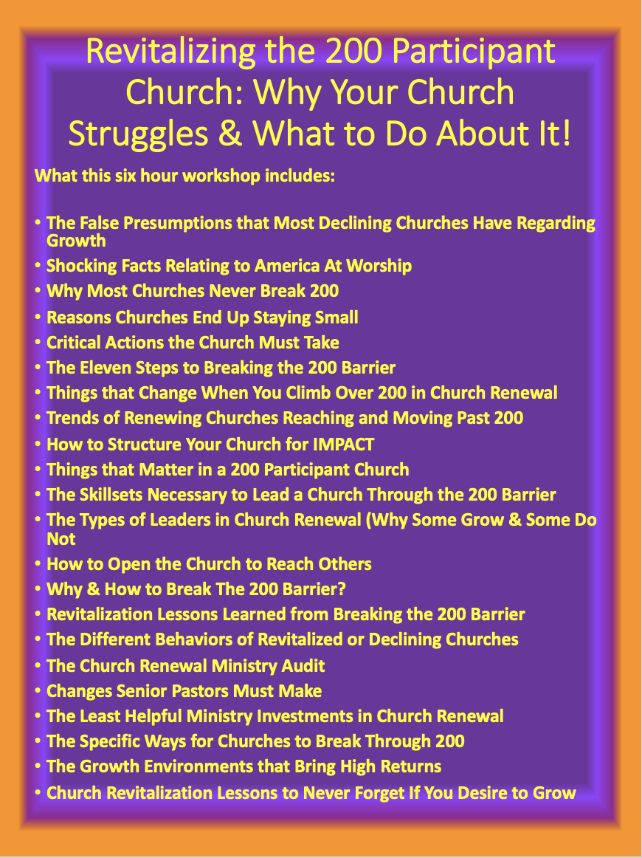

Slide 4

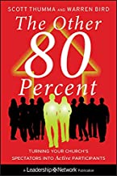
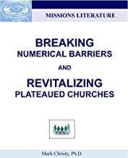
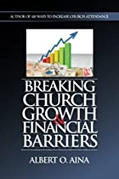

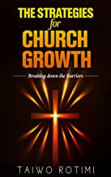

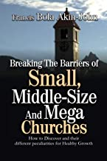

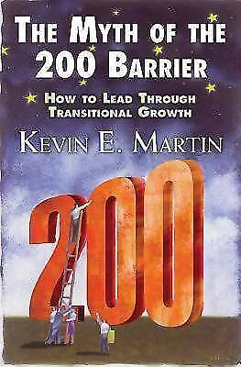

Slide 5
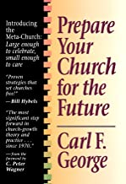

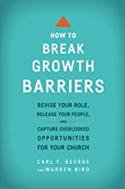
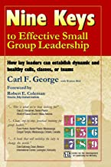

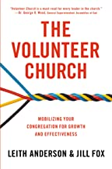


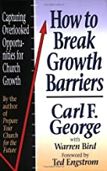

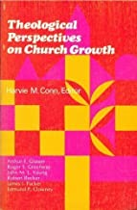
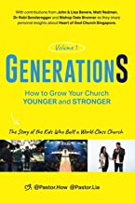

Slide 6
We will continue this in February as we begin a series on Revitalizing the 35, 75, 125, 200, 400, and 700 Participant Church!
35
75
200
125
700
400

Slide 7
Why Your Church Struggles to Break Two Hundred Part 2
Eleven Steps to Breaking the 200 Barrier (We will look at these today)
Check Your Motives
Amplify the Prayer Network in Your Church
Practice and Display Faith
Your Goal Needs to Be Larger than 200
Discover, Develop and Deploy your Strategic Plan
Develop a few Activities which will spearhead your growth effort
Create Urgency and Excitement
Utilize: Hight Attendance Days, Bible Study Groups, Church Outreach, and any new entry point to draw new people
Get out of the office and lead people to Jesus
The Church Revitalizer Must Become the Change Agent
Plant a New Church!

Slide 8
10 Reasons Churches Stop Growing at the 200 Barrier (Chuck Lawless)
It’s common for churches to hover around 200 in attendance, bouncing slightly below and slightly above that number recurrently, but not moving beyond that level. Here are some reasons that plateau happens:
Pastoral leadership style – Pastors who must be involved in every member’s life and who don’t delegate ministry usually cannot shepherd a congregation larger than 200. Many pastors simply don’t know how to change this leadership style.
Building space – Many churches build first or second buildings that will hold about 200 worshippers. If space is unavailable for future growth, that growth won’t happen.
Church expectations – Some congregations simply don’t want to be larger than about 200. They don’t want so many members they can’t know everybody, so outreach slows as the church approaches the 200 barrier.
Church history – In many cases, a church has a history of hitting 200, bouncing backward for a while, and then growing again up to 200. That’s been their history, so 200 has become the height of “the good old days.”
Man-sized vision – That is, the church leaders have no vision beyond the 200 barrier. They know they can get to this point, and that becomes their target. Nobody’s thinking about God’s doing something larger than that point.

Slide 9
10 Reasons Churches Stop Growing at the 200 Barrier (Chuck Lawless)
Poor preparation – Some leaders don’t think about addressing the 200 barrier until the church is at that level – which means they’ve made no preparation to push through the barrier. Their reactive leadership halts the church’s growth.
Ecclesiological choice – For those pastors who believe they must know every member of their congregation well, maxing attendance at about 200 is intentional. Others are church planting pastors who’ve determined that anything beyond 200 is a call to send out laborers to start another congregation. In the latter case, growth is still occurring—it just looks different.
Burdening bureaucracy – Churches that have numerous meetings, multiple committees, and slow processes often get stuck around 200. They’re not prepared structurally to cross that barrier.
Pastoral tenure – If pastors don’t stay at their church beyond 3-4 years, it’s hard for the church to move past 200. Pastoral transitions tend to slow down church growth for a while.
Poor discipleship – Moving beyond 200 requires a church to have trained lay leaders to carry on the work of ministry. Churches that don’t intentionally make disciples don’t often have these workers.

Slide 10
Why Your Church Struggles to Break Two Hundred
Part 2
The 200 Hundred Barrier is the difficulty churches experience in attempting to change from an association of friends to an organization of worshippers as they grow from under 200 to above 350 in worship attendance.
Bill Sullivan

Slide 11

What Changes When Your Attendance Breaks 200?
Many pastors, and church leaders wonder what missteps prevent churches from successfully breaking the 200 barrier—that is, surpassing 200 attendees in their weekly attendance.

Slide 12
What Changes When Your Attendance Breaks 200?
It’s important to remember that 200 is not some magical number. What it represents is a sociological shift and a cultural challenge. A church has to lead well (and differently) in order to function well once they pass 200 in attendance. The point is not that the number 200 has some sort of scriptural significance, but that there really is a substantive change when a church arrives at a congregation that large. Put simply, the church size changes the nature of the relationship between those who attend. How you lead a church of 75 is, in many important ways, different from how you lead a church of 250.

Slide 13
What Changes When Your Attendance Breaks 200?
For churches looking to grow, it’s important to note that without a shift in the way that you do ministry in a church of 100, you can’t properly manage a church of 300; the congregation simply wouldn’t get the appropriate shepherding and pastoral care. Of course, you could just choose to not grow over 100 and that settles the issue. However, since many churches desire to grow, it is best to do so in discerning ways that provide pastoral care, effective systems and fruitful ministry as the church does grow larger than 200. As always, success will require some advanced preparation and careful forethought. Let me share three pieces of advice that come to mind.

Slide 14
What Changes When Your Attendance Breaks 200?
First, don’t underestimate interpersonal challenges.
The interpersonal challenge here is that when you’re in a long-established church of 100 people or so, everybody knows each other. And more than that, if you’re the pastor, everybody also knows you. You’re like the middle of the wheel where all the spokes attach. Now, nothing about that is wrong—commonality can be a beautiful thing. Often, people who attend these close-knit smaller churches will say: “Man, I love the relationships we have in our church.”

Slide 15
What Changes When Your Attendance Breaks 200?
First, don’t underestimate interpersonal challenges. – cont.
But here’s the challenge you’re going to have to meet: When your church goes from 100 to 220 attendees, people aren’t going to so easily say, “I love the relationships in the church” anymore, unless you have a plan and a system to help them stay connected through smaller groups. The relationships will be different for both church leaders and congregants as a church grows. I recall the challenges I faced leading a growing church when it was no longer possible for people to come to me with every decision, every discussion and every issue that I used to have my hands in. Sometimes church growth is hard on congregations and church staff because they feel they’ve lost their close relationship with their leader.
For churches to succeed and make it through these interpersonal challenges, the creation of a baton-like handoff system to keep people connected and delegate tasks is really crucial.

Slide 16
What Changes When Your Attendance Breaks 200?
Second, develop leadership skills.
It’s going to take a new level of leadership to structure a church of 200+ people, and if you, the pastor, are not developing your skills as a leader, the transition will prove all the more challenging. Pastors leading growing churches need to ask themselves, “What are some skills that I’ll need to develop?” Well, there are many, but they include delegation, leadership development, knowing how to create systems and more. I would say that reading some basic leadership books is always a good place to start. To this some pastors might comment, “Well, I don’t want to just read some secular leadership book.” To start, I’d focus on books that explain how to delegate well, and how to work on developing new leaders.

Slide 17
What Changes When Your Attendance Breaks 200?
Third, don’t underestimate the power of the pulpit.
One of the other things that does change between smaller churches and larger churches is that leadership from the pulpit becomes more and more essential. Part of that is excellent preaching—sharing the word of God with clarity and power. However, your communication at other times from the pulpit can also matter. How you cast vision, explain transitions and handle missteps are all essential. Sometimes that will be in a sermon when it is appropriate for the text, but don’t be afraid to, at the beginning of the message or during announcement times, cast a vision for these things as well.

Slide 18
What Changes When Your Attendance Breaks 200?
Talking about breaking the 200 barrier seems to trigger some people.
Why should we care?
What’s wrong with 199?
Can’t churches just be small?
Well, in answer to the last question, yes. It’s fine for a church to be small, for the right reasons. It’s also fine for a church to aspire to grow. As the title of a recent Karl Vaters article aptly expresses, “Breaking The 200 Barrier Is Good—Feeling Guilty If You Don’t Break It, Isn’t.” He’s right.

Slide 19
The 150-250 Participant Church
According to the 2020 American Fact Study from Lifeway Resources: these churches declined, on average, at a greater percentage than the overall average. While they open their buildings to outside organizations that did not translate, on average, to a strong support of community service activities or active involvement in the area compared to larger churches.
Congregations larger than 250 was discovered that: those involved in large churches have a greater willingness to change, a clearer sense of mission and purpose, and a greater sense of spiritual vitality.

Slide 20

Recognizable Trends of Churches That Break the 200 Participant Barrier
Theologically Conservative (Not Against Everything)
Holds Scripture Highly
Reaching others a paramount priority
Strong Pastoral Leadership
Belief that God is doing something unique here
Church displays radical obedience to Jesus!

Slide 21
Recognizable Trends of Churches That Break the 200 Participant Barrier
Offers Exciting Celebrations of Worship!
Worship is participatory
Laity is used not watching
Prayer is Paramount
Pastor models deeper prayer life!
Prayer is an action not activity!
The Holy Spirit is felt and display the importance
Strong Belief that Everyone Can Be Saved

Slide 22
Recognizable Trends of Churches That Break the 200 Participant Barrier
Giving in all forms is expected!
Tithing is not an option but a biblical mandate.
Biblical Tithing is taught regularly.
The laity respond to this cheerfully.

Slide 23
Recognizable Trends of Churches That Break the 200 Participant Barrier
Laity are challenged to serve.
Gift development is the norm.
Members serve through their gifts.
Preaching is expository, practical, and applicative.
They participate in Missions consistently.

Slide 24
Why Your Church Struggles to Break Two Hundred
Part 2
Revitalization Lesson: Transfer Growth does not figure significantly in climbing over the 200 barrier. It is true in Extreme Urban, Urban, and Suburban areas. Successful churches which climb above 200 do so in less than five years. Rapid expansion is usually the only way. Few Churches achieve this mark after the five year period of the new renewal effort.

Slide 25
Structuring the Church for IMPACT

Slide 26

One of the least appealing activities for many ministry leaders is creating from and structure within the church they lead.
Once the church is becoming renewed, it seems that letting go of control is the major hurdle for most pastors.

Slide 27
Secrets to Achieving Universal Ministry Participation
Minimizing Paid Staff
  Six factors to involve laity and reduce staff overhead:
  - Raise the standard of expectations for ministry.
  - Opportunities for laziness and dependence must be removed.
  Adequate training is provided for volunteers.
  Control of the ministry is released to the laity.
  Efforts of lay ministers are reinforced.
  Skills and resources of paid staff are used very judiciously.

Slide 28
Secrets to Achieving Universal Ministry Participation
Structure to meet ministries changing needs:
  -Develop flexibility in changing ministry policies.
  -Flexibility in changing staff.
  -Flexibility in ending or restructuring a ministry.

Slide 29
Secrets to Achieving Universal Ministry Participation
Practice planned growth that is reasonable.
Practice and demand accountability.

Slide 30
Participation Matters in the
200 Attendee Church!

Slide 31
Ministry Is not a Spectator Sport!
Highly effective churches agree that ministry is not the domain of spectators.
Ministry must be populated by activists.
Leaders at great churches do not settle on people watching the staff perform, but make it clear that you cannot be part of the real church unless you get involved in ministry.

Slide 32
Ministry Is not a Spectator Sport!
Newcomer’s learn that spectator sports are not part of the churces program.
To avoid scaring away new believers, non believers or those who are more cautious about commitments these churches develop ways to soften their immediate involvement.

Slide 33
Ministry Is not a Spectator Sport!
The core expectation is clear though: get involved or find another place to worship!
Control in these type of churches focuses around the laity, not the pastor.
The result is the minimizing of paid staff and congregational dependence on them.

Slide 34
How do you minimize staff and have maximum ministry?
(Six Factors)
The standard of expectations is raised.
Opportunities for laziness and dependence are removed.
Adequate training is provided for volunteers.

Slide 35
Why Your Church Struggles to Break Two Hundred
By
Dr. Tom Cheyney
Founder & Directional Leader

