Slide 1

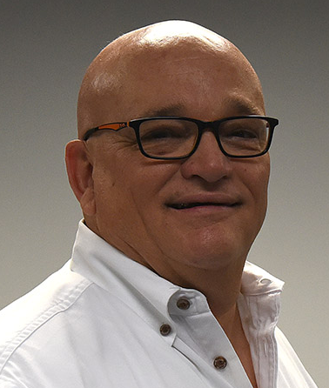
Revitalizing the 200 Participant Church: Why Your Church Struggles & What to Do About It!
These Five Sessions, Six Hours workshop is designed for the renewing church that is facing the hardest barrier to climb over. 98% of the churches in the Western Hemisphere are smaller than 200. This workshop is designed to help you reach your dreams for Church Revitalization and Renewal.
By
Dr. Tom Cheyney
Founder & Directional Leader

Slide 2
Revitalizing the 200 Participant Church: Why Your Church Struggles & What to Do About It!
What this six hour workshop includes:
The False Presumptions that Most Declining Churches Have Regarding Growth
Shocking Facts Relating to America At Worship
Why Most Churches Never Break 200
Reasons Churches End Up Staying Small
Critical Actions the Church Must Take
The Eleven Steps to Breaking the 200 Barrier
Things that Change When You Climb Over 200 in Church Renewal
Trends of Renewing Churches Reaching and Moving Past 200
How to Structure Your Church for IMPACT
Things that Matter in a 200 Participant Church
The Skillsets Necessary to Lead a Church Through the 200 Barrier
The Types of Leaders in Church Renewal (Why Some Grow & Some Do Not
How to Open the Church to Reach Others
Why & How to Break The 200 Barrier?
Revitalization Lessons Learned from Breaking the 200 Barrier
The Different Behaviors of Revitalized or Declining Churches
The Church Renewal Ministry Audit
Changes Senior Pastors Must Make
The Least Helpful Ministry Investments in Church Renewal
The Specific Ways for Churches to Break Through 200
The Growth Environments that Bring High Returns
Church Revitalization Lessons to Never Forget If You Desire to Grow

