Slide 1

Why Your Church Struggles to Break Two Hundred
(Part 1 of 6 hour seminar)
By
Dr. Tom Cheyney
Founder & Directional Leader

Slide 2


Slide 3
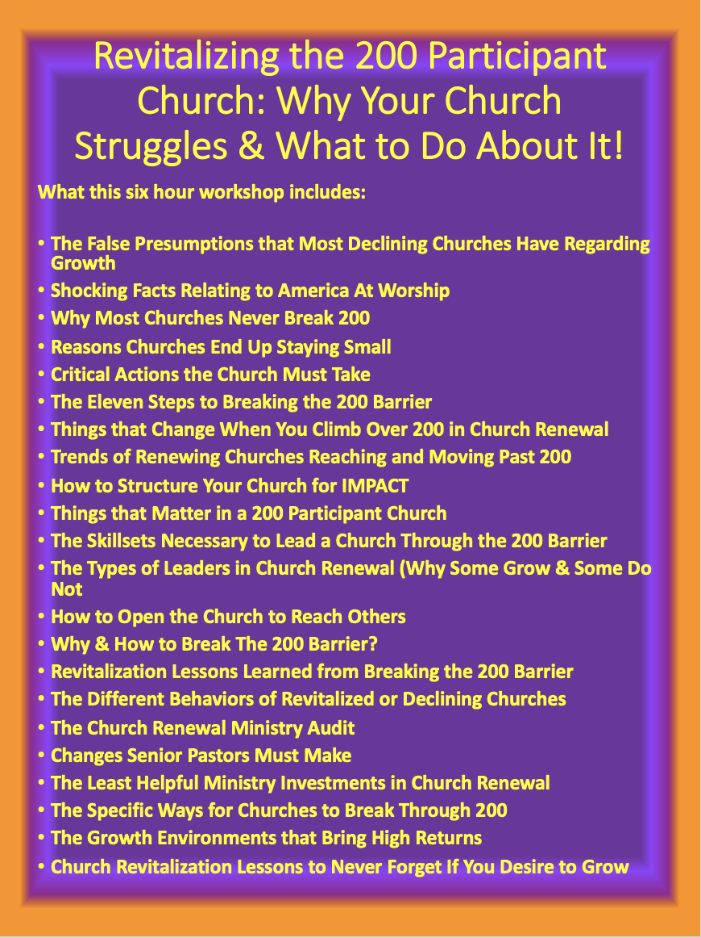

Slide 4
Why Your Church Struggles to Break Two Hundred
When a church begins to approach the 200 barrier there are several presumptions that need to be reviewed and articulated. The first presumption that most of Christendom has regarding growth, is that all churches desire to grow! This means they are willing to take steps that will help them grow. The second presumption is that the churches leadership has both a vision to grow and a commitment to grow. Many churches across America have never been taught about vision and thus have never been committed to such a vision.

Slide 5
Why Your Church Struggles to Break Two Hundred
This is why there are so many churches that plateau after the five to seven year mark after a significant step towards renewal. Church members tend to get comfortable much more quickly than leaders realize and begin to drag their heels towards the work that must be done to keep revitalizing the church.
This material is adapted from Dr. Cheyney’s first Doctoral Dissertation: Breaking Church Numerical Barriers from Zero to One Thousand.

Slide 6
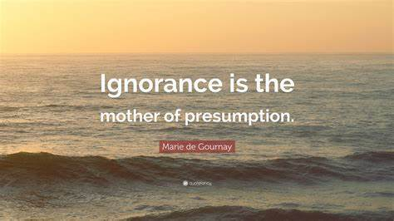
Why Your Church Struggles to Break Two Hundred
Presumption has been defined by Webster's Dictionary of the American Language as "the taking of something specific for granted; a reasoning that presumes; evidence that points to the probability of something, based on the proved existence of other facts."

Slide 7

Why Your Church Struggles to Break Two Hundred
For the church desiring to break the 200 participant barrier the acronym that could be used is "Less of Me” (the single staff pastor) and “more of we” (the multi-staffed team and laity volunteer).

Slide 8

Once a church reaches or climbs over the 200 barrier, they will have more in common with other churches of their own size, than their denomination affiliation, church traditions, location, age, or any other isolatable factor.
Why Your Church Struggles to Break Two Hundred
"Beyond 200" Church Growth Seminar, St. Louis, Missouri, Fuller Evangelistic Association.

Slide 9
Lyle E. Schaller also makes the same observation as he points to the new peer group these churches and pastors will have. This new peer group consists of other pastor's and churches that have had to face the cruel question, "Are we going to remain the same or are we going to adjust our leadership style so that we can still reach others?"
Schaller, Activating the Passive Church: Diagnosis and Treatment, Nashville, Abingdon, pp. 25-26.

Slide 10
Why Your Church Struggles to Break Two Hundred
While social media, and even traditional media, are still preoccupied with mega-churches and multisite churches, the reality is that most churches in North America are quite small. The Barna Group pegs the average Protestant church size in America at 89 adults. Sixty percent of protestant churches have less than 100 adults in attendance. Only 2 percent have over 1,000 adults attending.
It is astounding to realize that 90 percent of all churches today are not growing, and that churches with 101-200 total members 50 percent of them have plateaued.
Another 19 percent have declined, leaving only 31 percent of these churches that are growing.

Slide 11
In the United States the Nine Mainline Protestant Denominations Report:
that 85 Percent have an attendance on Sunday Morning of 200 or less!

Slide 12
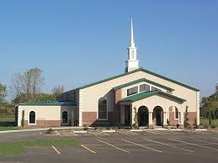
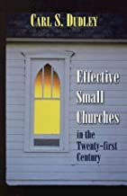
Small-church members unconsciously feel that they cannot absorb new members without changing the fabric of the group. Most member’s cannot make a radical change in the size of the church without loosing their motivation for belonging!
- Carl Dudley

Slide 13
Why Your Church Struggles to Break Two Hundred
I get that the mission of the church is to become more effective in reaching one more person with the hope that is in Christ.

Slide 14
Recognizing Growth Barriers
Lyle Schaller - “Multiple Staff & the Larger Church”
SIZE (Average Worship Attendance) TYPE
35 Fellowship
75 Small
140 Middle-sized
200 Awkward-size
350 Large
600 Huge
750 Mini-denomination

Slide 15
Mega Churches in North America
In the U.S. there are a little over 1,500 megachurches according to the Hartford Institute for Religious Research which they define as having more than 2,000 or more weekend attenders.
That is a very small number when you think about the total number of protestant churches being over 384,000 according to the National Congregational Study Survey.

Slide 16
What is a growth Barrier ?
“The invisible barrier that exists for churches (greatest at up to 200 in attendance) which is recognized (by church growth leaders) due to the vast majority of churches which stop growing at this point (85% around the world).”

Slide 17
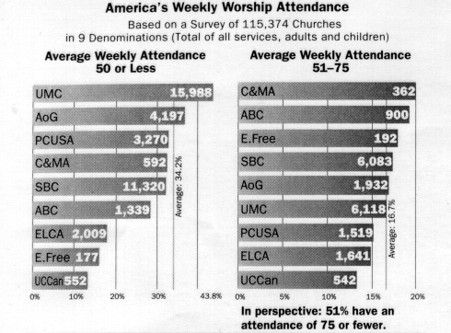
America at Worship

Slide 18
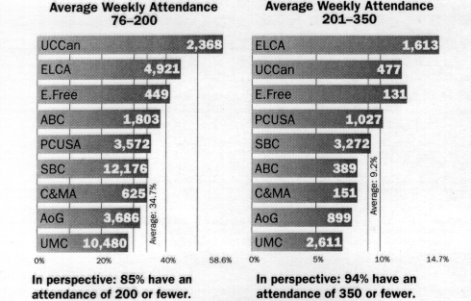
America at Worship

Slide 19
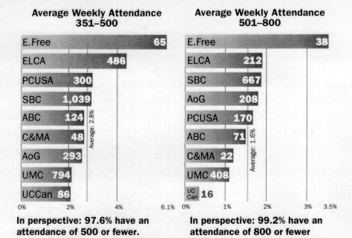
America at Worship

Slide 20
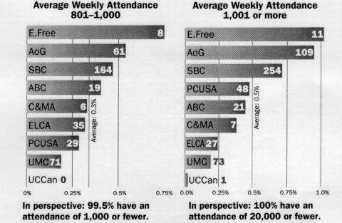
America at Worship

Slide 21
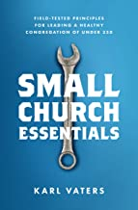

Why Your Church Struggles to Break Two Hundred
Please understand, there’s nothing wrong with being a small church. I just know that almost every small church leader I speak to wants his or her church to grow.

Slide 22
Why Your Church Struggles to Break Two Hundred
So, why is it that most churches never break the 200 attendance mark? It’s not:
Desire. Most leaders I know want their church to reach more people.
A lack of prayer. Many small church leaders are incredibly faithful in prayer.
Love. Some of the people in smaller churches love people as authentically as anyone I know.
Facility. Growth can start in the most unlikely places.

Slide 23
Why Your Church Struggles to Break Two Hundred
Let’s just assume you have a solid mission, theology and heart to reach people. You know why most churches still don’t push past the 200 mark in attendance?
Are You ready?

Slide 24
Why Your Church Struggles to Break Two Hundred
They organize, behave, lead and manage like a small organization.
Think about it. There’s a world of difference between how you organize a corner store and how you organize a larger supermarket. In a corner store, Mom and Pop run everything. Want to talk to the CEO? She’s stocking shelves. Want to see the director of marketing? He’s at the cash register. Mom and Pop do everything, and they organize their business to stay small. Which is fine if you’re Mom and Pop and don’t want to grow.

Slide 25

Why Your Church Struggles to Break Two Hundred
But you can’t run a supermarket that way. You organize differently. You govern differently. There’s a produce manager and people who only stock shelves. There’s a floor manager, shift manager, general manager and so much more.
So what’s the translation to church world?
Here are a bakers dozen of reasons churches who want to grow end up staying small:

Slide 26
Why Your Church Struggles to Break Two Hundred
1. The pastor is the primary caregiver.
Honestly, if you just push past this one issue, you will have made a ton of progress. When the pastor has to visit every sick person, do every wedding and funeral, and make regular house calls, he or she becomes incapable of doing other things. That model just doesn’t scale. If you’re good at it, you’ll grow the church to 200 people and then disappoint people when you can’t get to every event any more. Or you’ll just burn out. It creates false expectations and so many people get hurt in the process. The answer, by the way, is to teach people to care for each other in groups.

Slide 27
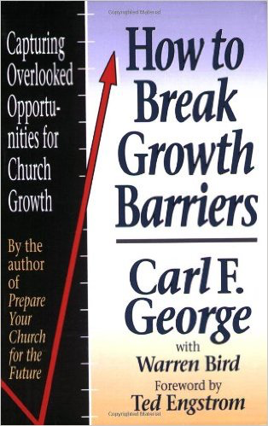
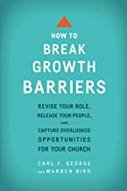
Why Your Church Struggles to Break Two Hundred
How to Break Growth Barriers: Capturing Overlooked Opportunities for Church Growth
Although it’s 20 years old, this is still the best book I know on the subject. The answer, by the way, is to teach people to care for each
other in groups.
Mar 1, 1993
There are 10 additional book recommendations at the end of this presentation
Apr 4, 2017

Slide 28
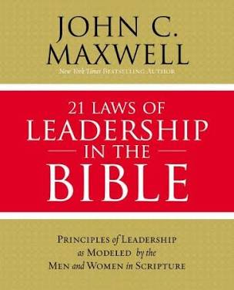
2. The Law of the Lid
The Law of the Lid states that leadership ability is the lid that determines a person’s level of effectiveness. In other words, whatever the capabilities are of an individual in a leadership position will determine the lid on their potential to lead. Let’s think about this for a minute. If you know someone who is in a leadership position and is not very successful at leading, they probably have a low lid or lessor ability to lead. If they are leading well they most likely have a high lid and greater ability to lead. To simplify this concept, simply ask yourself “How much influence do they have on those they are leading?”

Slide 29

The Law of the Lid
John Maxwell has said that simply put “Leadership is Influence” and the greater the impact we want to make as leaders will be determined by our influence on those around us. If we are not competent leaders, we will struggle to influence others. If we are unable to influence others, than we are probably not leading anyway. Consider these thoughts:

Slide 30
The Law of the Lid
Consider these thoughts…
People generally will not follow those that have a lower lid than they do.
People are drawn to leaders that have a higher lid than they do.
Based on those comments, consider the following…
What is your leadership lid?
What is the leadership lid of the person who is leading you?
I would suggest that if you truly want to raise your Lid as a Leader, you should consider the level of the people you are spending the most time with and the educational or intellectual value of the books you are reading. The only way to raise your lid is the raise your competence as a leader.

Slide 31
Why Your Church Struggles to Break Two Hundred
3. The leaders lack a strategy.
Many churches today are clear on mission and vision. What most lack is a widely shared and an agreed upon strategy. Your vision and mission answers the why and what of your organization. Your strategy answers how. And how is critical. Spend time working through your strategy. Be clear on how you will accomplish your mission and don’t rest until the mission, vision and strategy reside in every single volunteer and leader.

Slide 32
Why Your Church Struggles to Break Two Hundred
4. The true leaders aren’t leading.
In every church, there are people who hold the position of leadership and then there are people who are truly leaders (who may not hold any position in your church). Release people who hold titles but aren’t advancing the mission, and hand the job over to real leaders. Look for people who have a track record of handling responsibility in other areas of life and give them the job of leading the church into the future with you. If you actually have leaders leading, it will make a huge difference.

Slide 33
Why Your Church Struggles to Break Two Hundred
5. The volunteers are un-empowered.
Sure, small churches may not have the budget to hire other staff, but you have people. Once you have identified true leaders, and once you are clear on your mission, vision and strategy, you need to release people to accomplish them.
Try to do it all yourself and you will burn out, leave or simply be ineffective. Empower volunteers around an aligned strategy and you will likely begin to see progress.

Slide 34
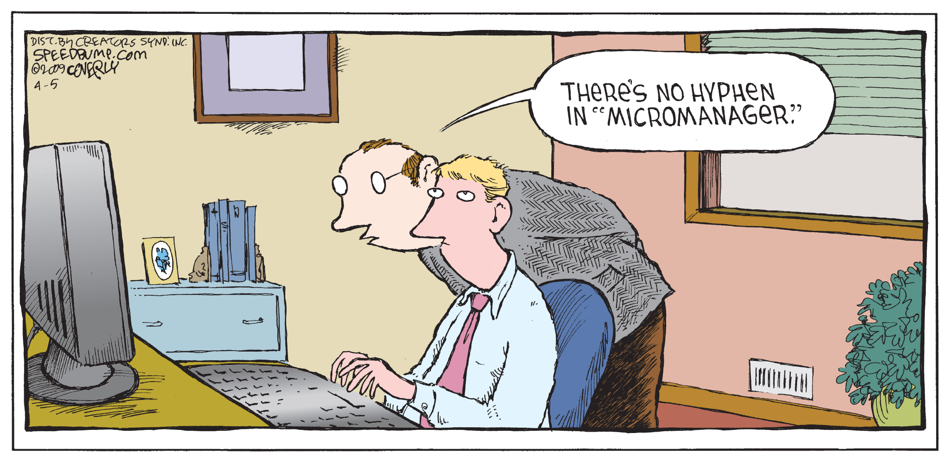
Why Your Church Struggles to Break Two Hundred
6. The governance team micromanages.
If you need permission every time you need to buy paper towels or repaint an office, you have a governance team issue. Most boards who micromanage do so because that’s where most people simply default. You need a board that guards the mission and vision and empowers the team to accomplish it and then gets out of the way.

Slide 35
Why Your Church Struggles to Break Two Hundred
7. The Congregation micromanages decisions.
If you need permission from the entire congregation every time you need to buy paper towels or repaint an office, you have a congregational organizational structure issue. Most congregations who micromanage do so because that’s where most people simply default. You need a leadership team and staff, that guards the mission and vision and empowers the ministry teams as well as pastors, to accomplish it and then gets out of the way.

Slide 36

Tip: If everyone who comes to your church gets onboard, your vision isn’t defined enough.

Slide 37
5 Essentials Every Church Constitution Needs In The Future
The scriptures have some clear guidelines around leadership/governance that you should pay attention to. Here are some characteristics of a healthy constitution and governance system that will take you into the future.

Slide 38
5 Essentials Every Church Constitution Needs In The Future
1. Keep Accountability Clean and Clear
Checks and balances are based on quality of people, not quantity of people.
There’s a misguided school of thought out there that says, “the more people you are accountable to, the more accountable you are.” The reality is that if you are accountable to 100 people, you aren’t really accountable to anyone. Keep the organizational accountability group (board or team) small and focus on making sure the circle includes high quality leaders who get your vision and mission at their very core.

Slide 39
5 Essentials Every Church Constitution Needs In The Future
2. Give Invested People Input
The most invested people should have the most input.
Leaders need valuable input from their community. Unfortunately, many churches are structured so that anyone who holds a member’s card and a pulse can influence the whole church. When setting up venues to get input from your community, things should be structured so that people who are most invested in the church’s mission with their time and finances have the most input.

Slide 40
5 Essentials Every Church Constitution Needs In The Future
3. Keep Decision-Making Nimble
If you can’t take advantage of opportunities within 24hrs, you are too slow. Slow decision-making means missed opportunities. Be sure that if the key leaders in your church see an opportunity that can move your mission forward, that they can make the decision quickly. If your circle of leaders can’t make a major financial decision in less than 24hrs, you need to rethink your decision-making model. I’ve seen incredible opportunities missed by churches because of this one structural flaw alone.

Slide 41
5 Essentials Every Church Constitution Needs In The Future
4. Have Minimal Congregational Involvement
Involving everyone in leadership decisions is irresponsible.
Large scale decisions (building purchases, major hires, etc.) can be emotional rollercoasters. People change their minds, finances fall through, and a “sure thing” can become a “mirage” very quickly. Always be transparent with finances and inquiries from people, but to take your entire congregation on every twist and turn along the way is irresponsible. You want to keep your congregation informed, but keep it to a minimum until plans are firm. Don’t take them on the rollercoaster along the way. If your structure demands that you have to over-inform your people, change it.

Slide 42
5 Essentials Every Church Constitution Needs In The Future
5. Vision and mission must be crystal clear and laser focused.
It’s obvious, but must be stated, a great constitution and governance system only works if your vision and mission are crystal clear. Clear enough that people can tell quickly whether they are onboard with you or not.
20

Slide 43
Why Your Church Struggles to Break Two Hundred
8. Too many meetings.
I led a church in the Northeast early in my ministry with a grand total of 50 people in attendance. We had 10 lay overseers. Overall, the church was in evening meetings two to three times a week. Why on earth would a church that small need to meet that often? I eventually repurposed most of those meetings to become meetings about vision and reorganization. Although I grew much bigger churches later in my ministry, I was out one or two nights a week (and then, mostly for small group). If you’re going to meet, meet on purpose for the future. Free up your time so you and your team can accomplish something significant.

Slide 44
Why Your Church Struggles to Break Two Hundred
9. Unrealistic Expectations of a Pastors Time for Extra Events.
Many small churches take unrealistic advantage of the pastors time and his families time with events which have no purpose other than fellowship for a specific few. The pastor does not need to be out at functions that drain him of the energies he needs to do the work of ministry. Attending your groups covered dish on Friday night regularly does not equal time well spent for the spiritual leader.

Slide 45
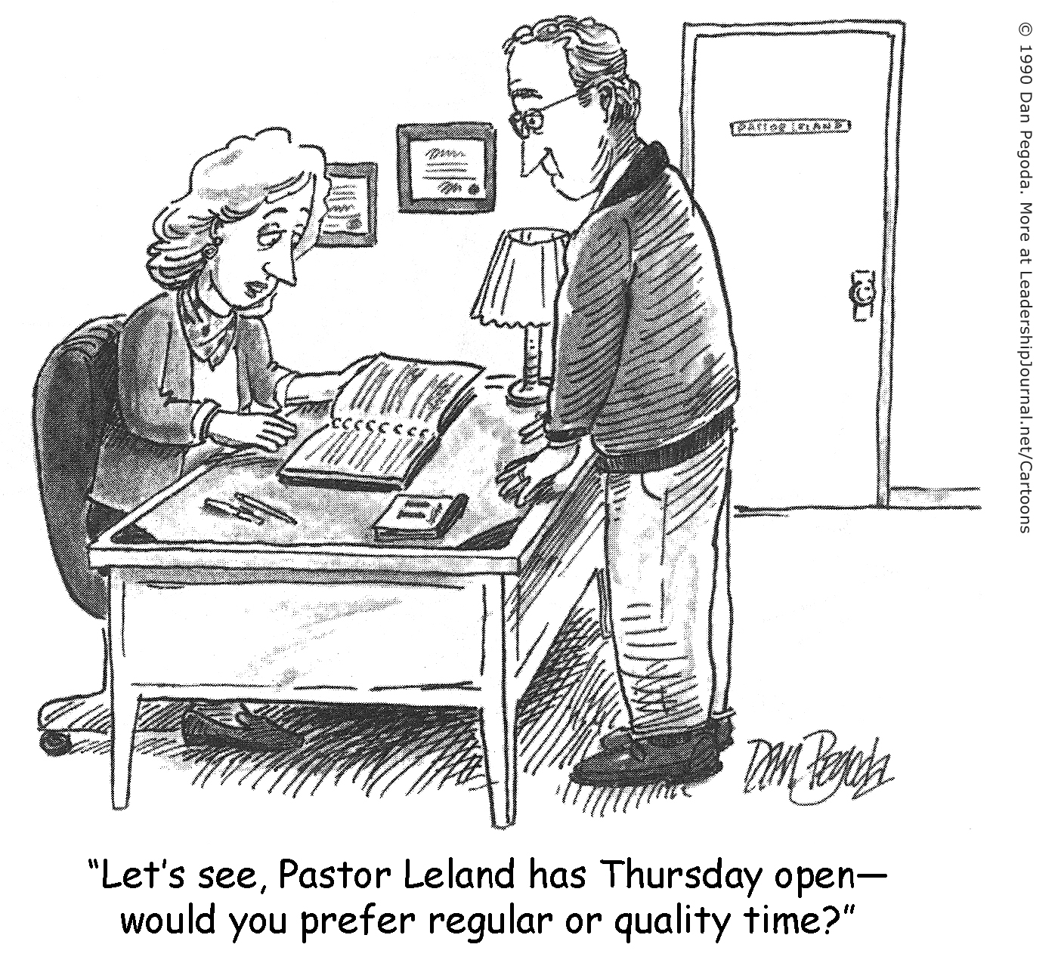

Slide 46
Why Your Church Struggles to Break Two Hundred
10. Too many events and programs that lead nowhere.
Activity does not equal accomplishment. Just because you’re busy doesn’t mean you’re being effective. If you check into most small churches, there are a lot of programs that accomplish little and lead nowhere. Stop them. Yes, some of your people will be mad. Even have the courage to cut some good programs. Good is the enemy of great. Then go out and do a few great things.

Slide 47

Why Your Church Struggles to Break Two Hundred
11. The pastor suffers from a desire to please everybody.
Many pastors I know are people-pleasers by nature. Go see a counselor. Get on your knees. Do whatever you need to do to get over the fear of disappointing people. Courageous leadership is like courageous parenting. Don’t do what your kids want you to do; do what you believe is best for them in the end. Eventually, many of them will thank you. And the rest? Honestly, they’ll probably go to another church that isn’t reaching many people either. I realize the diagnosis can sound a little harsh, but we have a pretty deep problem on our hands. And radical problems demand radical solutions.

Slide 48

Why Your Church Struggles to Break Two Hundred
12. Whom You Have Is Who You Will Attract!
Many small churches are small because of the thinking that most members of these churches hold. It is what keeps them small. Small church thinking hurts most chances of growing a larger church. Especially in revitalization efforts. The longer this mentality exists the harder to bring about the necessary change required.

Slide 49
Why Your Church Struggles to Break Two Hundred
13. NOW THE BAKERS DOZEN! There are Saboteurs Amongst the Brethren When It Comes to Opportunities for Growth.
There are individuals who really are happy with a small struggling church where they can reign forever. When an opportunity comes for revitalization and growth, often they will sabotage any efforts for a new future. Focus on opportunities not problems.

Slide 50
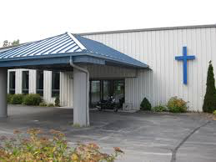
In smaller congregations, several functions are important in helping new members become part of the congregation. These functions have been referred to by Kurt Lewin and Carl S. Dudley as:
  the gatekeeper,
  the patriarch, and
  the matriarch.

Slide 51

Some Particular Personalities Found in the Gatekeepers, Matriarchs, and Patriarchs.
The Storyteller: He is the living historian who may embellish for the pleasure of the listeners.
The First Sergeant of the Lord: This individual makes it clear that he is not really in charge, but the one who is in charge is "not immediately available." And that he is only making decisions "according to policy."

Slide 52

  The Mr. Executive Order: He functions just a little lower than God or the pastor, depending how much "authority" he requires to get what he desires.
  The Early Bird: This person is always early and one of the chief cheerleaders for the church.
  The Scorekeeper: He has been called the referee in some congregations, but his job is to see who is winning.
10

Slide 53
  The Sparkplug: This person usually carries two buckets with him. One is water to put out the potentially destructive fires for his comrades. The other is kerosene to make his opposition burn into destruction.
  The Peacemaker: This is a quality that needs to be promoted in the church. It is the unifying quality that keeps things together.
  The Bell Ringer: Some call him the clock watcher. This is the one who reminds the pastor that it is time to quit and that there is no such thing as a bad short sermon.

Slide 54
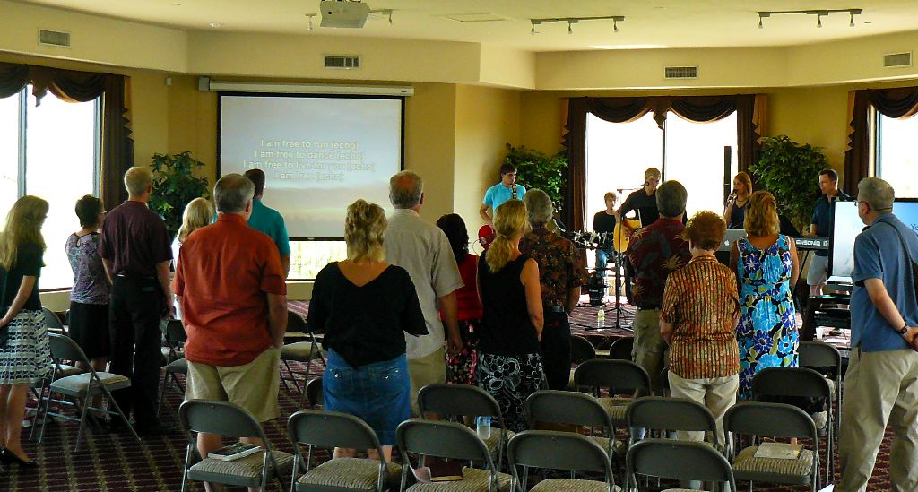
Five Chief Institutional Factors Keeping a Church Under 200
Desire to preserve social intimacy
Desire to maintain control
Desire to conserve memories
Desire to protect turf
Desire to remain comfortable

Slide 55

Some Congregations are Allergic to New Faces!
How do you get allergy relief?
GET NEW FACES!

Slide 56
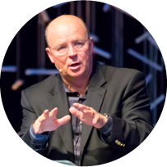
Three Specific Actions for the Pastor
Move from Provider to Equipper!
Just can’t meet every need personally
Must train others!
Become willing to trust others with the ministry!

Slide 57
Three Specific Actions for the Pastor
Move from Entertainer to Mobilizer!
Allow others to discover their gifts spiritually!
Learn to say no to good things in order to do best things!
Give away the ministry as others are trained to do them!

Slide 58
Three Specific Actions for the Pastor
Move from Soloists to Multiplier!
Start seeing the bigger picture
Set goals and work toward them based on the vision!
Work yourself out of as many jobs as possible!

Slide 59
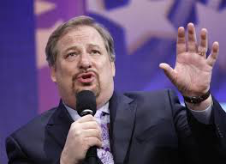
Three Marks of a Pastor Who Can
Grow a Church
Obedience to the Father.
Pragmatism towards the work.
Optimism towards the future.

Slide 60
