Slide 1

Why Your Church Struggles to Break Two Hundred (Part 3 of 6 hour seminar)
By
Dr. Tom Cheyney
Founder & Directional Leader

Slide 2


Slide 3
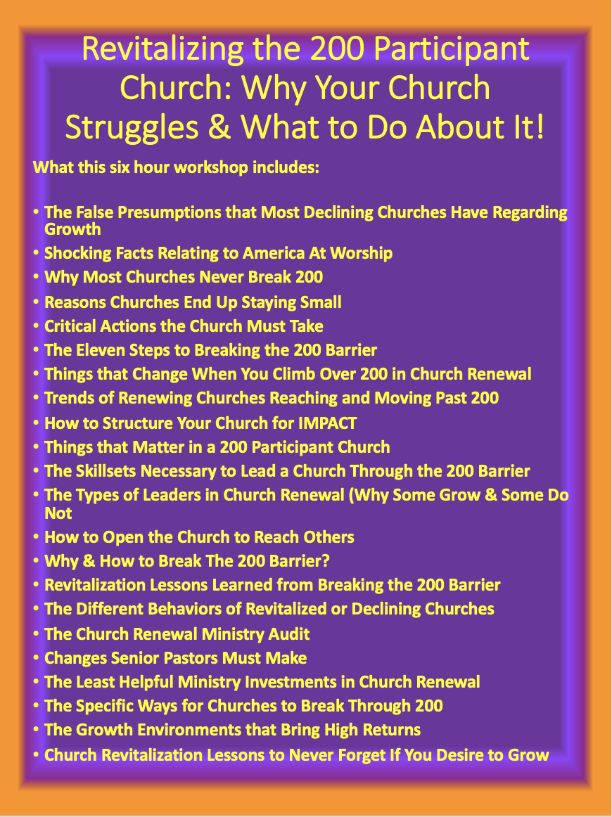

Slide 4

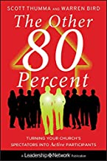

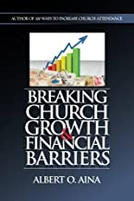

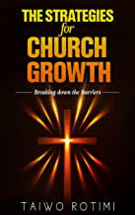

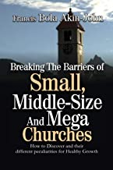

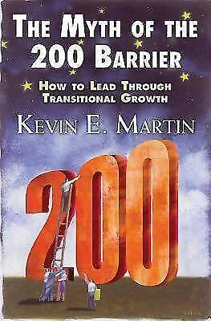

Slide 5
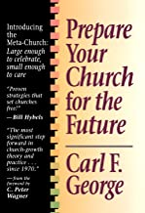

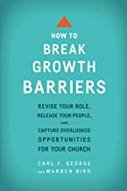
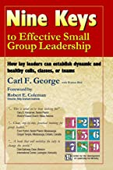




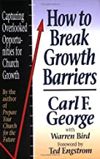




Slide 6



Slide 7
We will continue this in February as we begin a series on Revitalizing the 35, 75, 125, 200, 400, and 700 Participant Church!
35
75
200
125
700
400

Slide 8
Improve and expand these 3 skills to break the 200 barrier
Breaking the 200-person barrier looks like the typical pastor’s nemesis.
It’s probably most challenging because it’s different from growing a church of 40 to 125. Doubling or tripling the attendance of the “family church” takes hard work, but breaking that barrier is all about the pastor doing more of the same: more evangelism, more outreach, more visitation, more follow-up, more leadership.
Breaking the magic 200-barrier is qualitatively different. Doing more of the same won’t get the job done. And in most cases, it’s not possible because the pastor is already maxed out—or close to it.
A fundamental shift in how everyone thinks about what it means to “be a pastor” is in order. In smaller churches the pastor is the hired hand; he’s the paid religious functionary. If anything is going to get done, the pastor has to do it. This has to be replaced with another model: the pastor leads people who do the work.
The pastor has to stop being the hired laborer and start acting like the crew chief.

Slide 9
Improve and expand these 3 skills to break the 200 barrier
It takes a different set of skills to lead a church through the 200-barrier.
Learning, mastering, and polishing these new skills can lead to an existential crisis because the pastor will have to lay aside things that he loves doing and learn new ways of showing up as a pastor that may feel uncomfortable.

Slide 10
What Type of Leader Are You?
The Inherited Leader
The Positional Leader
The Demonstrated Leader
The Embraced Leader

Slide 11
Improve and expand these 3 skills to break the 200 barrier
1. Keep the destination in mind
The first and most important skill pastors must polish to move past this intractable barrier is to cast relentless focus on the church’s mission, vision, and long-term strategy.
Easum and Tenney-Brittian put it plainly: “There is no skill more important than having the ability to perceive and effectively communicate a church’s vision.”
If a pastor cannot show a congregation the future and motivate them to move in that direction, nothing else the pastor does will make much difference. But when a pastor can and does show a church what the destination looks like, several things happen.
The pastor leads ministry alignment: everything the church does advances mission and vision. The pastor holds volunteer staff accountable for ensuring that their ministry contributes to the mission. The pastor recruits leaders to replace managers as ministry heads. They become visionary leaders capable of recruiting, training, and motivating people to serve in their ministries. The pastor insists on After Action Review to ensure that precious resources and ministry activity lead to fulfillment of the mission and vision.

Slide 12
Improve and expand these 3 skills to break the 200 barrier
2. Cull your “friends” list
Hearing that a pastor must become a leader is like fingernails on a chalkboard. You’re tired of hearing it.
That is the response of pastors with inordinately high social service interest scores. Most pastors have a higher interest in providing care than the general population. However, some pastors, for various personal reasons, have an exceptionally high interest in hands-on care. This prevents them from leading through the 200-barrier.

Slide 13
Improve and expand these 3 skills to break the 200 barrier
2. Cull your “friends” list – cont.
Learning to live with the pain of distant relationships with church members is a crucial skill. This allows them to take steps to clear that 200-barrier:
Refocus their relationship from the whole church to an inner circle of people who will help carry the mission forward.
Training others to do hospital visitation, counseling, benevolence and provide care for the emotional and spiritual needs of others.
Manage their schedules so that they can focus on the things that will result in reaching more people with the gospel, discipling new believers and training Christians how to serve more effectively.

Slide 14
Improve and expand these 3 skills to break the 200 barrier
3. Broadcast information to the right people, at the right time, in the right way
Yes, the grapevine works in a small church. When the right people know, everyone else who should know will. However, communications for a church of 50 is ineffective for a church that wants to grow through the 200-barrier. What that strategy looks like will vary from church to church, and it is heavily dependent upon the local culture.

Slide 15
Improve and expand these 3 skills to break the 200 barrier
3. Broadcast information to the right people, at the right time, in the right way – cont.
But an effective communications strategy should at least include:
What gets put in the printed program or announced from the platform
When and where platform announcements will be made—if at all
How far in advance requests for inclusion in the program are required
A strategy to leverage the use of social media to communicate with the congregation
Training people to be responsible for staying informed
How requests for facilities, scheduling, finances, personnel and other resources will be submitted
Remedial training for volunteer ministry leaders who go off the path or cut across someone else’s territory

Slide 16
Key Factors in Breaking the Two Hundred Barrier
Understanding Your Identity as a Church – Who are you now? What did you se to be?
Answer the Question: Are we in a leadership crisis?
Are you and your members open to adding a new service?
Does your staff reflect a programing model?
Does your staff reflect a leadership model? Pastor as leader not manager.
Have you aligned the churches resources to match your vision?
How have you restructured the church to allow for future growth and success?

Slide 17
Front Doors are Closing So Look for Side Doors
The front doors of most churches are closing because there are fewer visitors showing up.
Fewer coming and fewer staying.
Most churches back doors are streaming prospects and members out the door.
Churches (200 or less) which rely on visitors as their primary source of growth will be dead in the next ten years.

Slide 18
What Does the term “Side Doors” Mean?
This is not a new idea. Side Door Evangelism has been happening for a long time.
Side Doors are a powerful way to harness the passion and energy in a church and to channel it into effective outreach.
Side Doors have the potential to help churches connect with, and reach, many new people in a community for Jesus Christ.

Slide 19
What Does the term “Side Doors” Mean?
Side Doors are a church sponsored program, group, or activity in which a nonmember can become comfortably involved with the church on a regular basis. It is a group that provides an ongoing opportunity for a nonmember to develop meaningful and valued relationships with people in the congregation. The goal of an effective side door is to provide a place in which participants (members and nonmembers) can develop friendships around important things that they share in common.

Slide 20

Some Sample Side Door Connections
Single Mothers
Softball
Expecting Mothers
Empty Nesters
Single Dads
Motorcycles
Newlyweds
Widowers
Raising Grand-Children
Kids with learning disabilities
Hearing Impaired
Mountain Biking
Cancer Patients & Families
Financial Management
Scrapbooking
Military Children
Reading Club
Bed-ridden parent

Slide 21
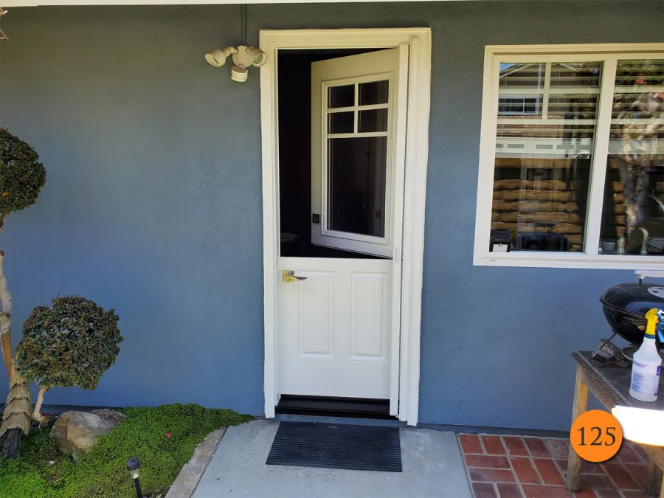
Why Side Doors?
More people will be reached.
More Kinds of people will be reached (affinity and sub-affinity groups).
More members will be involved.
More members will be involved in outreach.
More groups will be started.
More members will invite friends.
More new members will stay.
Your Church’s visibility will increase.
Dependency on your facility will decrease.
You will become a multi-celled church.
Your church will np longer be dependent on walk in visitors.

Slide 22
How do you minimize staff and have maximum ministry?
Control of the ministry is released to the Laity.
Efforts of Lay ministers are reinforced.
Skills and resources of paid staff are used very judiciously.

Slide 23
Highly Effective Churches:
Highly effective churches strive to grow at a rate of growth of no more than 15%!
Growing by more than 15% yearly creates significant assimilation problems.

Slide 24
Methods used in Assimilation for healthy growth:
Periodically preaching a series of “hard truths” messages.
Set higher goals and standards of quality in ministry.
Limit program involvement to the maximum level at which the church can provide excellence.
Modify marketing efforts based upon growth projections.
Work to help newcomers find churches that fit their need if yours does not.
Demand Accountability

Slide 25
Why Break The 200 Barrier?
1) The Lord demands it - (Matthew 28: 18-20)
Jesus, undeterred, went right ahead and gave his charge: “God authorized and commanded me to commission you: Go out and train everyone you meet, far and near, in this way of life, marking them by baptism in the threefold name: Father, Son, and Holy Spirit. Then instruct them in the practice of all I have commanded you. I’ll be with you as you do this, day after day after day, right up to the end of the age.”
Eugene H. Peterson, The Message: The Bible in Contemporary Language (Colorado Springs, CO: NavPress, 2005), Mt 28:18–20.

Slide 26
Why Break The 200 Barrier?
1) The Lord demands it - (Matthew 28: 18-20)
2) The Bible teaches it - (Acts 2: 41-47)
3) The Lost depend on it - (Romans 10:14)

Slide 27

How To Break The 200 Barrier
A. First Steps to Breaking the 200 Barrier
1) Make a decision
a) About Your Call:
(1) “Did God call you to Pastor?”
“Did God call you to this church?”
“Did God call you to GROW this church?”

Slide 28

How To Break The 200 Barrier
b) About Your Commitment:
(1) “Am I willing to give myself to the time necessary?”
(2) “Am I willing to give myself to the love necessary?”
(3) “Am I willing to give myself to the best things of the ministry?”

Slide 29
How To Break The 200 Barrier
2) Make A Discovery
a) Concerning God’s Vision
(1) “Vision comes from God” (prayer)
(2) “Vision is seeing a future condition (faith)
(3) “Vision is transferred to the people (communication)

Slide 30
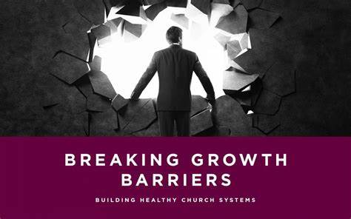
How To Break The 200 Barrier
b) Concerning a Kingdom Purpose
(1) “This is God’s Church”
(2) “We are here to do God’s will”
(3) “There is nothing we cannot do with God’s Power and Resources”

Slide 31
How To Break The 200 Barrier
B. Next Steps to Breaking the 200 Barrier (9 Things)
1) Prayer - “The one key element in turnaround churches” “George Barna”
a) The Pastor models prayer
b) The People are led to participate in prayer
c) The Prayer is not “rhetorical” but “active”

Slide 32
How To Break The 200 Barrier
2) Faith - “Lord, increase our faith…” (Luke 17:5)
a) Reacquaint yourself with the “people of faith”
b) Be willing to trust God
c) Recognize that faith leads to risk-taking

Slide 33
How To Break The 200 Barrier
3) Set Goals -
a) Based on your understanding of God’s vision
b) That are realistic and reachable
c) That demand God’s help to achieve
4) Plan Well -
a) Don’t over plan
b) The plan is effective
c) Involve key leaders in the plan

Slide 34
How To Break The 200 Barrier
5) Prioritize -
a) Determine what produces growth
b) Do less, better
c) Return to the “Basics”
6) Get Excited - (Proverbs 23:7)
Enthusiasm is Godly (Entheos)
Accentuate the positive/eliminate the negative
c) Celebrate victories

Slide 35
How To Break The 200 Barrier
7) Do Something -
a) High Attendance days
b) Sunday School renewal
c) Visitation/outreach revived

Slide 36
How To Break The 200 Barrier
8) Evangelism First -
a) Raise the priority of evangelism before the church
b) Enlist and equip people in multiple ways of being involved in evangelism
c) Get out into the community and meet the people

Slide 37
How To Break The 200 Barrier
9) Be the Leader
a) Lead the church to understand that change is worth the cost
b) Recognize that change is painful
c) Stay committed to the task…don’t be detoured

Slide 38

How To Break The 200 Barrier
C. 9 Recognizable Trends of Churches that Break the 200 Barrier
1) Conservative Theology (Not dogmatic elitism)
a) Believe that Jesus can make a difference between heaven and hell
b) Reaching people for Christ is a priority
c) High view of Scriptures

Slide 39
How To Break The 200 Barrier
2) Strong Pastoral Leadership
a) Accepts the responsibility of leadership
b) Optimistic, belief that God wants to do something here
c) Models a radical obedience to Jesus Christ

Slide 40
How To Break The 200 Barrier
3) Exciting Worship
a) Worship is participatory vs. performance based
b) Updated music is used
c) Majority of time is given to worship

Slide 41
How To Break The 200 Barrier
4) Powerful Prayer
a) Pastor models it
b) People are involved in it
c) Action prayer as opposed to activity prayer

Slide 42
How To Break The 200 Barrier
5 Importance of the Holy Spirit
a) He is recognized as a prominent member of the Trinity
b) These churches understand the importance of His work
c) Churches invite, not afraid, of His work

Slide 43
How To Break The 200 Barrier
6) Giving is Expected
a) Every member is challenged and assumed to be a tither
b) Tithing is taught and caught
c) God’s blessing of a “Cheerful giver” are recognized

Slide 44
How To Break The 200 Barrier
7) Lay Ministry
a) Christians are challenged to serve
b) Spiritual gifts discovery normal
c) Members are allowed to serve based on their gifts and passions

Slide 45
How To Break The 200 Barrier
8) Bible Teaching/Preaching
a)Expository, the message is taken from the scripture
b) Practical, simple to be used today
c) Application is based on needs of congregation

Slide 46
How To Break The 200 Barrier
9) Mission Involvement
a) These churches see themselves as having a “world vision”
b) Support Missions consistently
c) Send their on missionaries regularly

Slide 47

How To Break The 200 Barrier
D. Final Steps to Breaking the 200 Barrier
1) Opportunities
a) Demographics
b) Windshield Survey
c) Talk to people
10

Slide 48

How To Break The 200 Barrier
2) Organization
a) Enlarge the organization for growth
b) Eliminate back door problems

Slide 49

How To Break The 200 Barrier
3) Staffing
a) Enlist and train workers properly and regularly
b) Hold workers accountable
c) Prepare and plan for future staffing (Lay & Professional)

Slide 50

How To Break The 200 Barrier
4) Barriers
a) Space
b) Attitude
c) Community Awareness

Slide 51

How To Break The 200 Barrier
5) Work Hard
a) At God’s Vision
b) At Equipping People
c) At Building the Kingdom

Slide 52
Revitalization Lessons Learned from Tom Brady and His Retirement (Joe Casey)
Your Level of Determination Will Either Make You or Break You!
Hard Work & Humility are a Combination for Success
Your gratitude beats your attitude every time
He loves what he does and your should also
Change is going to happen so get ready for it
Know when it is time to hand it off to another It s better to hand it off when you are winning not loosing
Build your future before you retire not afterwards
Your Family is more important than your Job (Don’t learn it too late)

Slide 53
Revitalization Lessons Learned from Tom Brady and His Retirement
Be the Bigger person on the way out
Don’t burn your bridges or lock the door so you couldn’t come back.
Hold your head up high for the work you have done
You have to have a heart for what you are doing or you will burn out
Lead from a place of strength not weakness
Count the cost of being the goat
Have a succession plan if you are going to leave
Create a winning playbook. Educate yourself in your field.

Slide 54
Why Your Church Struggles to Break Two Hundred (Part 3 of 4)
By
Dr. Tom Cheyney
Founder & Directional Leader

